Slide 1
Navigating Freight Data in the FAST ACT Era
AMPO Conference
Fort Worth, TX
October 26, 2016
Paul Hershkowitz
Caliper Corporation

Slide 2
Acknowledgements
José Holguín-Veras, Ph.D., P.E., F.ASCE
Rensselaer Polytechnic Institute
Director, VREF Center of Excellence for Sustainable Urban Freight Systems
Derek Cutler
Economic Analyst
Economic Development Research Group, Inc.
Vince Bernardin, Jr., PhD
Director of Travel Forecasting
Resource Systems Group, Inc.

Slide 3
Presentation Overview
FAST ACT/FASTLANE
Challenges of understanding freight transportation patterns & movements
Freight data sources and challenges
Conclusions/Observations

Slide 4
FAST ACT/FASTLANE
Promotes projects that improve safety
Holds the greatest promise to eliminate freight bottlenecks
Targets improvement of critical freight movements.

Slide 5
Freight Transportation Patterns
Both intra-regional and inter-regional matter
Logistical arrangements dictate inter-regional mode choice and local distribution
For MPOs, the focus will be on freight and service activities that are associated with the deliveries to freight-intensive sectors
The traffic of large trucks is only about 10% of the total
Small/midsize trucks and delivery vans make 80-90% of the total freight traffic
Service-related traffic (e.g. HVAC technicians) use a more than proportional share of curbside space

Slide 6
Industry Sectors in Metro/Micropolitan Statistical Areas
45% of commercial establishments and 50% of employment; they produce 80-90% of freight traffic
2.8% of commercial establishments and 3.6% of employment

Slide 7
Understanding Regional Truck Movements
There are no good comprehensive sources of data
Reaching out to major shippers, receivers, and carriers can be essential
Both for-hire and private trucking should be considered

Slide 8
Understanding Regional Truck Movements (2)
Detailed mapping of key facilities is helpful
Identification of truck-intensive facilities and establishment locations (e.g. truck terminals, warehouses, etc.) is important
Selected supplemental truck counts can only help
Modeling freight generation is useful since it can help fill data gaps

Slide 9
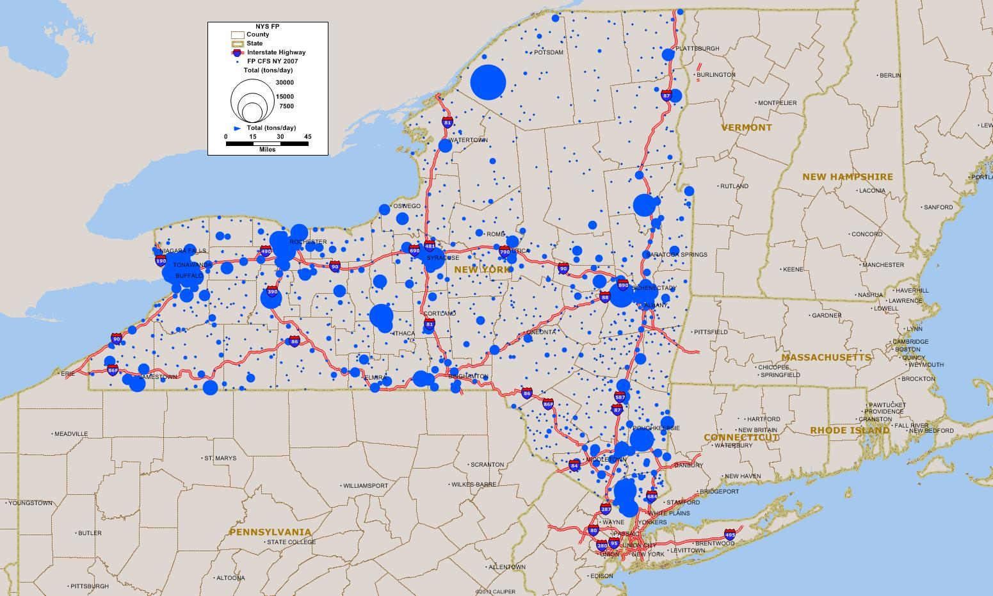
Freight Production by ZIP Code 2007

Slide 10
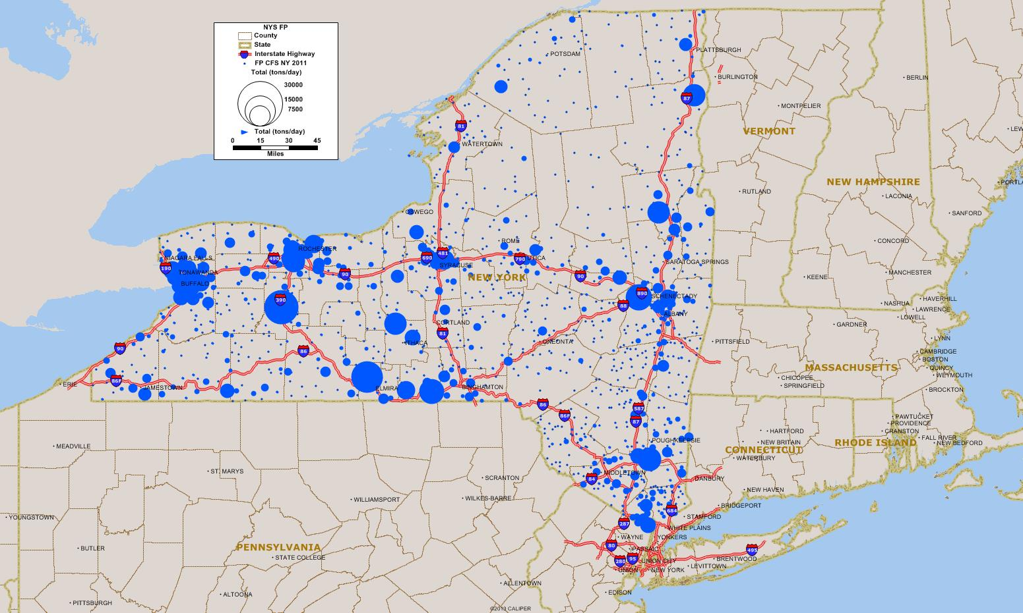
Freight Production by ZIP Code 2011
Freight Generation models help capture the changes in local economies and thus the freight traffic that is generated

Slide 11
Identifying network bottlenecks
Commercial speed data from HERE or INRIX can be used (GPS vehicle probe data - “Big Data”)
For Big Data, truck speeds are often provided in addition to auto speeds
Surveillance and counts at key locations such as bridges and tunnels, ports, intermodal terminals, etc.

Slide 12
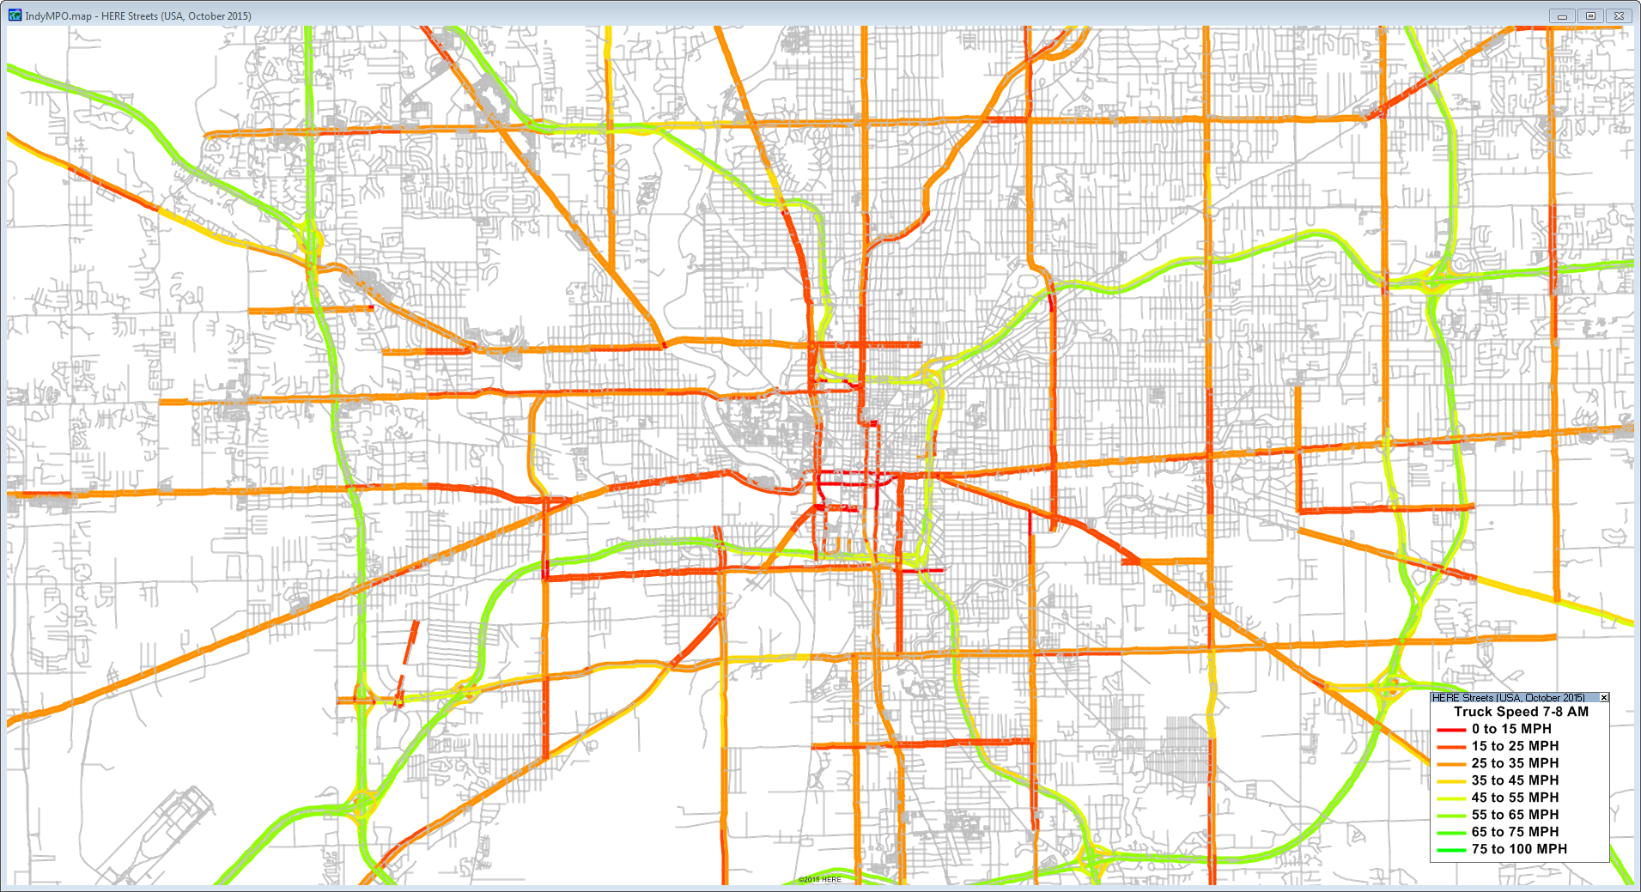
HERE map of truck speeds, Indianapolis, IN

Slide 13
Navigating freight data
Data-driven world. Myriad of choices, but none are perfect
Samples can be biased or too small to be reliable
Traffic flows by truck do not correspond directly to commodity flows in terms of origins, destinations, routes
LTL (Less-than-truckload) carriers haul FAK (Freight All Kind), further breaking correlations between commodity flows & truck movements

Slide 14
Navigating freight data (2)
Truck movements are based on aggregating shipments, often to multiple destinations in tours
Private and for-hire trucking firms are operated differently but neither is transparent
Multi-layer data collection strategies are the key...
…and better data = better results = better decisions (hopefully!)

Slide 15
Freight data sources Freight Analysis Framework (FAF4)
Nationwide coverage, but large regions (132)
Down-allocation process is key
Sample sizes may be optimistic
Nevertheless, a basic reference, good starting point
Easily accessible from HEPGIS (a GIS website developed by Caliper for FHWA) or the FHWA website

Slide 16
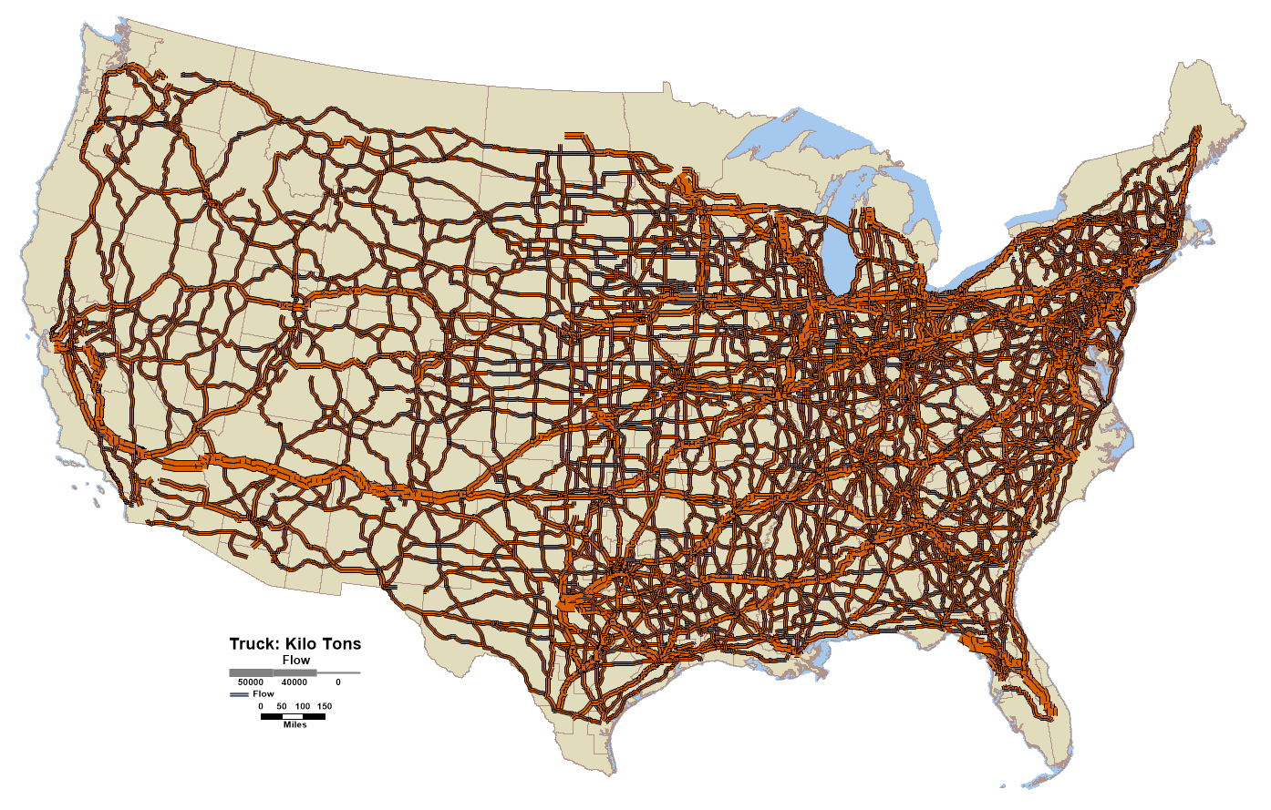
FAF4 Data: Commodity Tonnage Flow (2015)
Primary Mode: Truck

Slide 17
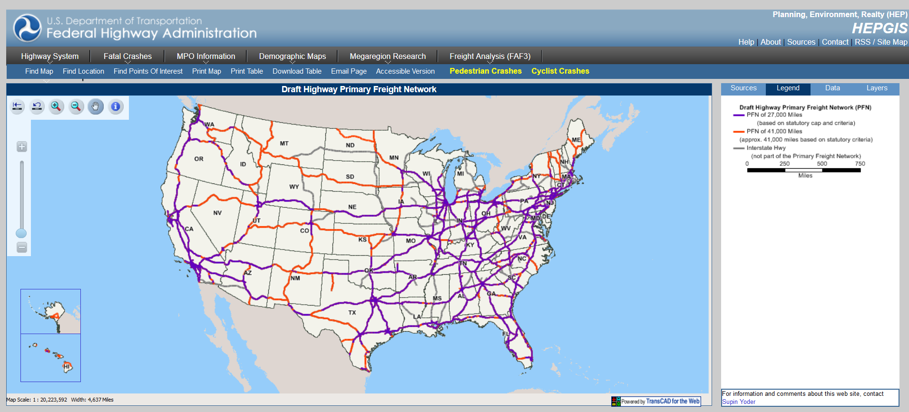
HEPGIS Primary Freight Network

Slide 18
Freight data sources (2)
Transearch
Privately maintained, for purchase freight flow database
172 BEA zones/3,000+ counties for US, state-level detail for Mexico, province/municipal data for Canada. Canada and Mexico cross-border flows w/ US
Outbound, inbound, intra and through shipments by geography.
Tonnage, value and units of shipments. Truck, rail, waterborne, and air. 340+ commodities
Data often needs “cleaning”
Solid down-allocation process is essential (County-TAZ)

Slide 19
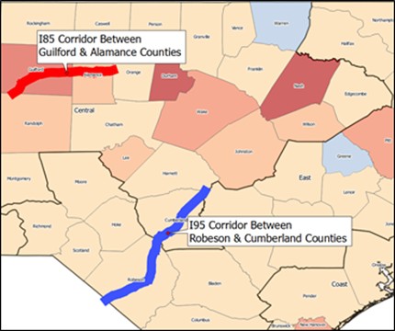
Transearch Commodity flows in two NC corridors

Slide 20
Freight data sources (3)
Truck GPS Trace Data (Big Data): ATRI, HERE, INRIX, Streetlight, etc.
ATRI: Truck flows, truck speeds & travel times.
Collects ~1 billion truck position reads every 1-2 weeks (2013). For purchase data
Can help improve truck model validation
FHWA’s Quick Response Freight Manual II
Helps users locate available data and freight-related forecasts compiled by others
Freight forecasting for specific facilities or freight plans
Provides simple techniques and transferable parameters to develop freight vehicle trip tables

Slide 21
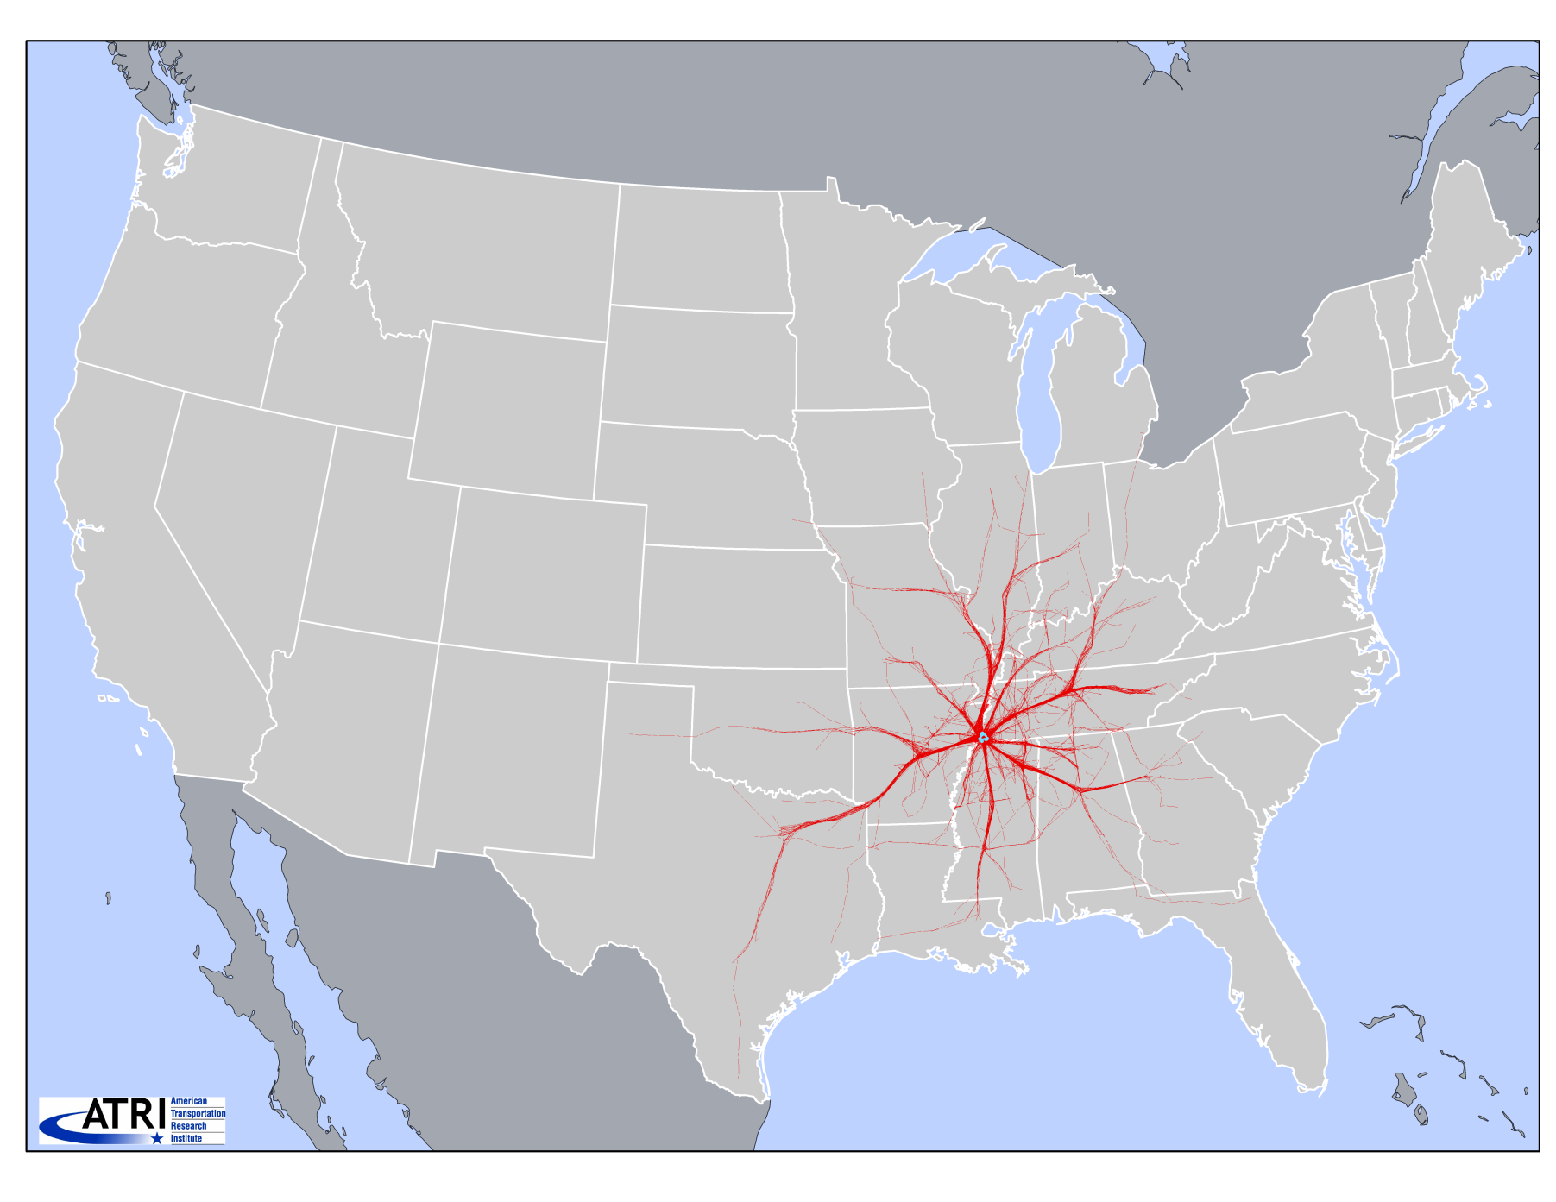
Memphis, TN: 1,000 Trucks After 24 hours

Slide 22
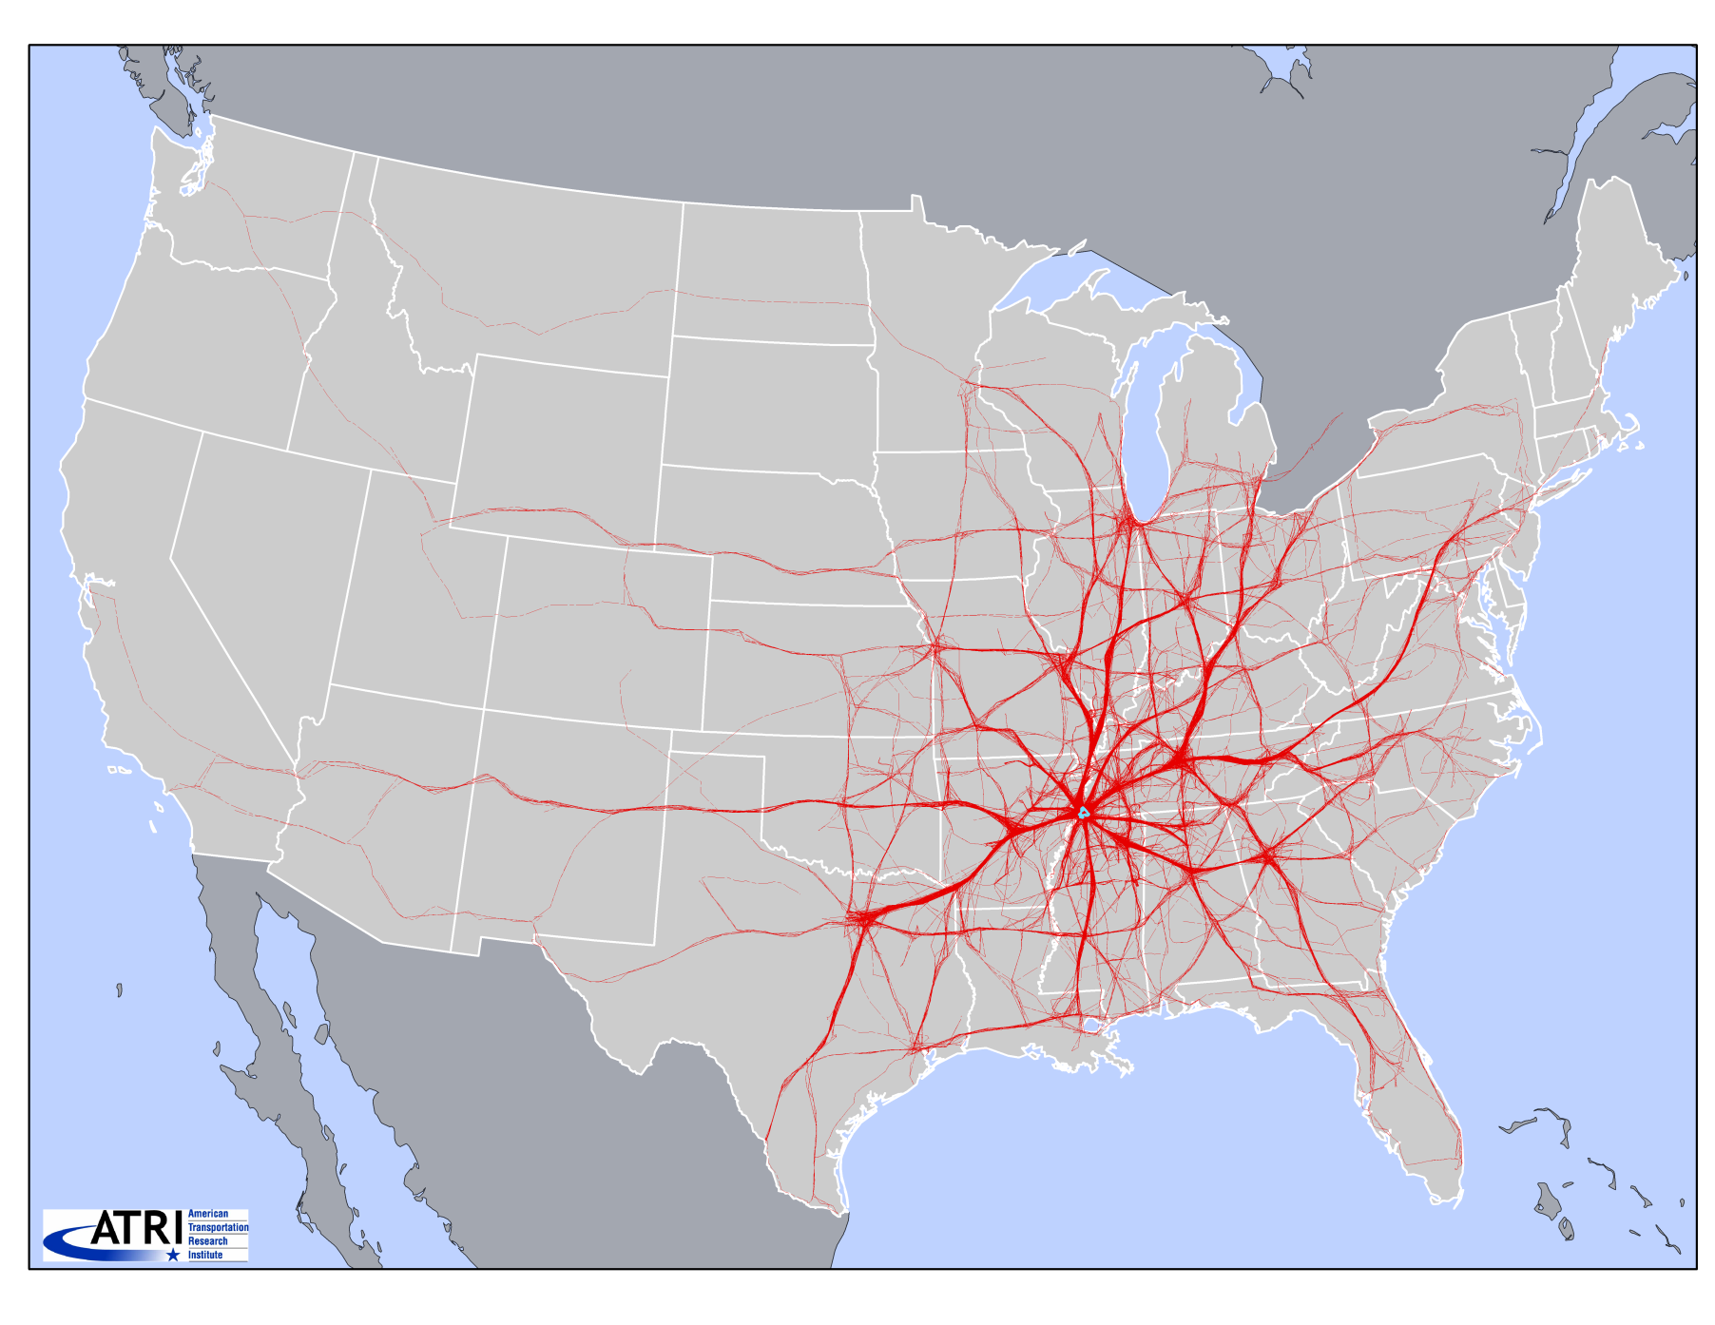
Same 1,000 Trucks After 72 hours

Slide 23
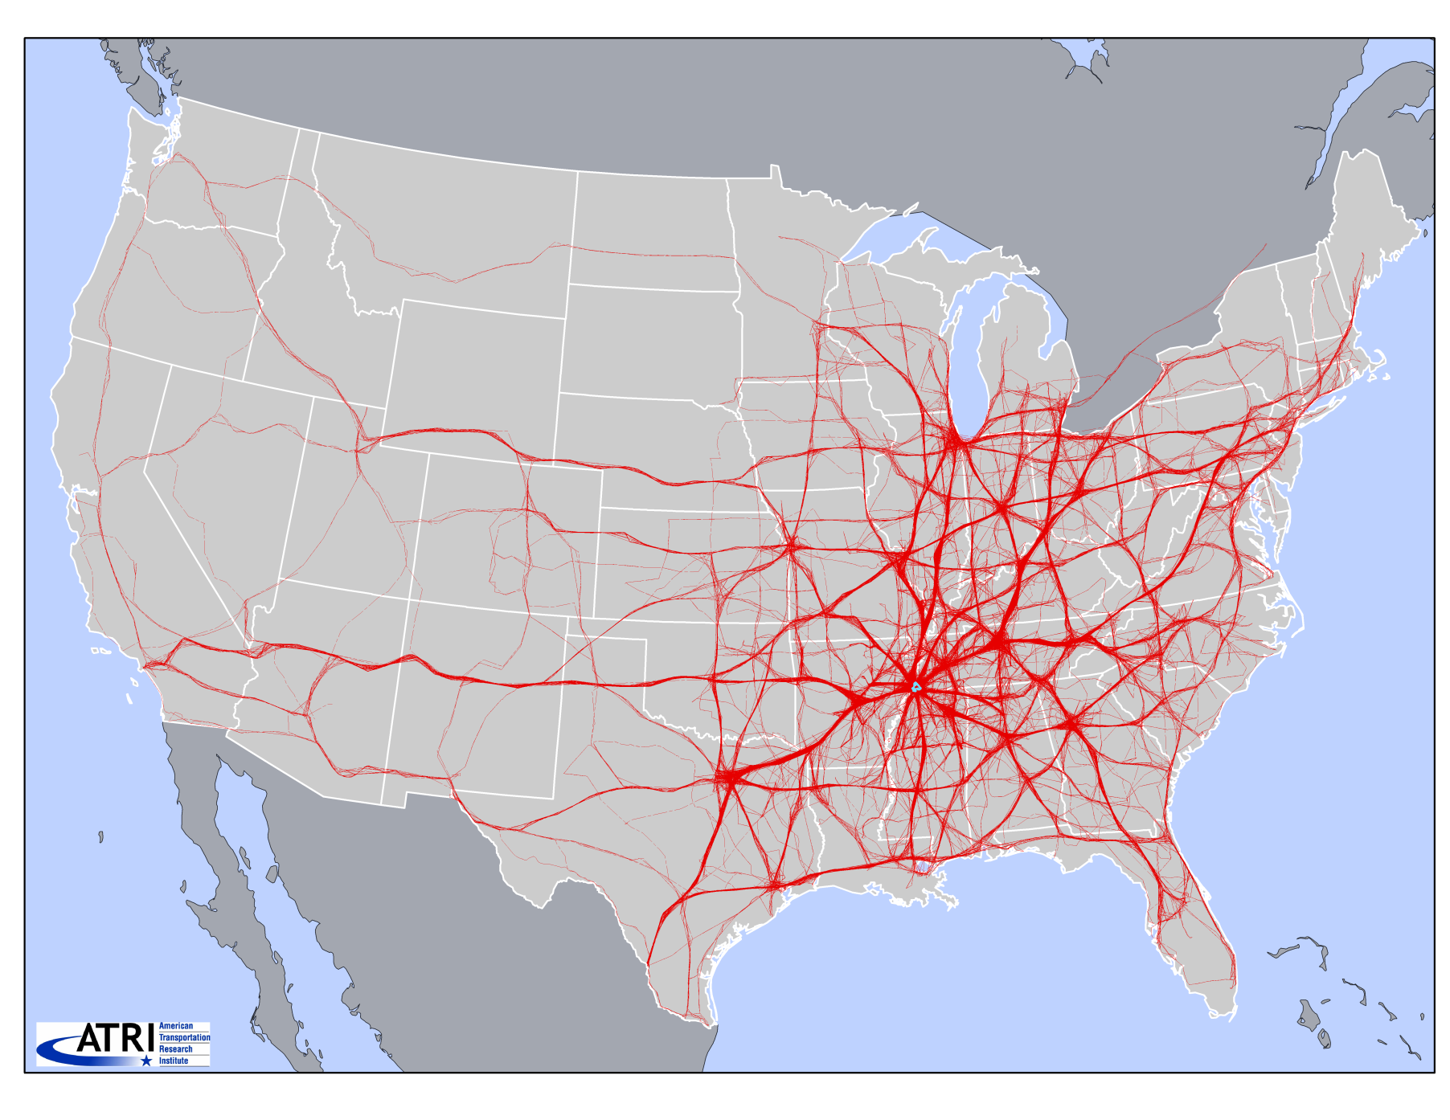
Same 1,000 Trucks After 7 Days

Slide 24
Freight data sources (4)
BTS TransBorder freight data
The purpose of the database is to provide transportation freight flow information on North American trade flows.
Contains freight flow data by commodity type and by mode (rail, truck, pipeline, air, vessel, and other) for U.S. exports to and imports from Canada and Mexico.
The database includes two sets of tables (one by commodities, one by geography)

Slide 25
Freight data sources (5)
RPI research on freight generation (amount of cargo), freight trip generation (all-vehicles), and service trip generation (service trips)
National road and rail networks along with network based travel times (Caliper)
Economic Census Data on establishments by industry and size group by zip code
1% Railroad Waybill sample (STB)

Slide 26
Freight data sources (6)
North American Industry Classification System (NAICS).
BLS data on county employment by industry. Nine Freight-Intensive Sectors (FIS).
FIS - 45% of commercial establishments and 50% of employment; they produce 80-90% of the freight traffic
vFreight
NCFRP and NCHRP - research on freight data

Slide 27
Conclusions/Observations
Understanding regional freight patterns is challenging
Data-driven world. Myriad of choices, but none are comprehensive/perfect
Some new data sources can help identify congestion points

Slide 28
Conclusions/Observations (2)
Evolving logistical arrangements will require monitoring
Freight data is inherently static. Trends today do not equate to future occurrences
But using forecasted freight data in tandem with other sources (travel demand models, economic models, etc.) can predict how freight patterns evolve over time

Slide 29
Conclusions/Observations (3)
MPO staff resources/turnover: Often many hats to wear, pulled in different directions, may not know what freight data is out there
The right source for the right job: Finding freight data that works under your set of operating constraints by prioritizing your data needs, the data budget & costs, and your staff resources
Multi-layer data collection strategies are the key...
…and better data = better results = better decisions (hopefully!)

Slide 30
Questions?

