Slide 1
Using NPMRDS Data for System Performance
Chris Upchurch
Wichita Area Metropolitan
Planning Organization

Slide 2
MAP-21 System Performance Measures
Level of Travel Time Reliability
Peak Hour Travel Time Ratio
Truck Travel Time Reliability
Average Truck Speed
Notes:
Earlier this year FHWA released a proposed rule for the System Performance measures.
You'll notice the CMAQ measures aren't listed.
The Wichita region is not a non-attainment area, so I haven't really delved into those.

Slide 3
MAP-21 System Performance Measures
How many of you plan to calculate these yourselves?

Slide 4
MAP-21 System Performance Measures
How many of you plan to calculate these yourselves?
How many plan to hire a consultant or buy off-the-shelf software?

Slide 5
MAP-21 System Performance Measures
How many of you plan to calculate these yourselves?
How many plan to hire a consultant or buy off-the-shelf software?
How many haven’t made a decision?
Notes:
I'm hoping that what I have to say will be useful to all three groups.

Slide 6
What is NPMRDS?
National
Performance
Management
Research
Data
Set
Notes:
All of these measures rely on the National Performance Management Research Data Set or NPMRDS

Slide 7
What is NPMRDS?
Travel time data for road segments
5 minute time increments (epochs)
Covers the National Highway System
Travel time data
All vehicles
Trucks

Slide 8
How many have downloaded NPMRDS data and looked at it?

Slide 9
How many of you have done something with NPMRDS data?

Slide 10
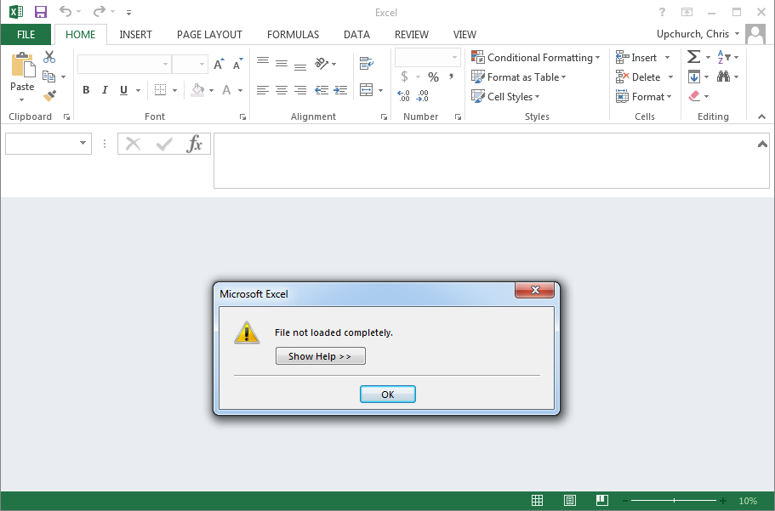
Tools for NPMRDS
Notes:
This is what it looks like when Excel breaks down and cries.
The file is too big for Excel to open.
For Kansas each month's file is about a gigabyte
Excel will show you the first few thousand rows.

Slide 11
Tools for NPMRDS
Statistical Tools
Databases
Custom software
Notes:
So you need some sort of specialized tool.

Slide 12
Mismatches between the NHS and NPMRDS
Notes:
The first potential pitfall:
NPMRDS claims to be the National Highway System
At least in Wichita, it's not.

Slide 13
Level of Travel Time Reliability
Divide:
80th Percentile Speed
50th Percentile speed
If a segment has a ratio of <1.5 it is considered reliable
Measure: Percentage of reliable mileage

Slide 14
Level of Travel Time Reliability:
Handling Missing Data
For epochs with missing data, use the posted speed limit for that segment
Speed limits often change within a travel segment
Notes:
For epochs with no travel time data, use the posted speed limit.
At WAMPO we found we did not have good speed limit data
Google street view
For many segments, the speed limit changes in the middle of the segment
The proposed rule does not specify how to handle this.
Submitted a comment
We've assigned the higher speed limit to the entire NPMRDS segment
Probably not the best way but it is the simplest for testing purposes

Slide 15
Level of Travel Time Reliability:
When to look at
Weekdays:
6 am to 10 am
10 am to 4 pm
4 pm to 8 pm
Weekends:
6 am to 8 pm
Calculate each time period separately
All four time periods must be reliable for the segment to be considered reliable
Notes:
Each time period is calculated separately.
Look at 6-10am every weekday for the entire year.
Look at 10am-4pm every weekday for the entire year.
Look at 4-8pm every weekday for the entire year.
Look at 6am-8pm every weekend for the entire year.
Each of these four time periods must be reliable for a segment to be reliable

Slide 16
Level of Travel Time Reliability:
Geography
Interstates within the MPO boundary
Non-Interstate NHS within the MPO boundary

Slide 17
Peak Hour Travel Time Ratio
Define a desired travel time for each segment
Divide:
Desired travel time
Actual travel time
If a segment has a ratio of <1.5 it is meets expectations
Measure: Percentage of mileage that meets expectations

Slide 18
Level of Travel Time Reliability:
Handling missing data
Ignore epochs with no data

Slide 19
Level of Travel Time Reliability:
Outliers
Remove epochs with travel speeds:
Below 2 mph
Over 100 mph

Slide 20
Peak Hour Travel Time Ratio:
When to look at
Weekdays only
Exclude federal holidays
Six 1-hour segments
6-7am, 7-8am, 8-9am, 4-5pm, 5-6pm, 6-7pm
Calculate the ratio between desired and actual for each hour
Select the hour with the highest average

Slide 21
Level of Travel Time Reliability:
Geography
Only urbanized areas with a population over 1 million
Interstates within the Urbanized Area Boundary
Non-Interstate NHS within the Urbanized Area Boundary
Notes:
Only urbanized areas with a population over 1 million
In the proposed rule, FHWA asked for feedback on lowering this threshold

Slide 22
Truck Travel Time Reliability
Divide:
95th percentile travel time
50th percentile travel time
If a segment has a ratio of <1.5 it is considered reliable
Measure: Percentage of reliable mileage

Slide 23
Truck Travel Time Reliability:
Handling missing data
For epochs with missing data:
Use "all vehicle" travel times if available
If not, use the posted speed limit for that segment

Slide 24
Truck Travel Time Reliability:
When to look at
24/7/365

Slide 25
Travel Time Reliability:
When to look at
Interstate System within the MPO Boundary

Slide 26
Average Truck Speed
Calculate the average struck speed over the year
If the average speed is over 50mph the segment is uncongested
Measure: the percentage of the system uncongested

Slide 27
Average Truck Speed:
Handling missing data
For epochs with missing data:
Use "all vehicle" travel times if available
If not, use the posted speed limit for that segment

Slide 28
Average Truck Speed:
When to look at
24/7/365

Slide 29
Average Truck Speed:
Geography
Interstate System within the MPO Boundary

Slide 30
Missing Data
Level of Travel Time Reliability | Use posted speed limits
Peak Hour Travel Time Ratio | Ignore epochs with no data
Truck Travel Time Reliability | Substitute "all vehicles" time Otherwise, use posted speed limit
Average Truck Speed | Substitute "all vehicles" time Otherwise, use posted speed limit

Slide 31
Outliers
Level of Travel Time Reliability
Peak Hour Travel Time Ratio | Remove time periods <2mph or >100mph
Truck Travel Time Reliability
Average Truck Speed

Slide 32
When to look at
Level of Travel Time Reliability | 6-10am, 10am-4pm, 4-8pm, Weekends 6am-8pm All must be reliable
Peak Hour Travel Time Ratio | 6-7am, 7-8am, 8-9am, 4-5pm, 5-6pm, 6-7pm Look at the hour with the highest average
Truck Travel Time Reliability | 24/7/365
Average Truck Speed | 24/7/365

Slide 33
Geography
Level of Travel Time Reliability | Interstates within the MPO boundary Non-Interstate NHS within the MPO boundary
Peak Hour Travel Time Ratio | Interstates within the Urbanized Area Boundary > 1 million Non-Interstate NHS within the Urbanized Area Boundary > 1 million
Truck Travel Time Reliability | Interstates within the MPO boundary
Average Truck Speed

Slide 34
Thank You

Slide 35
Questions?

