Slide 1
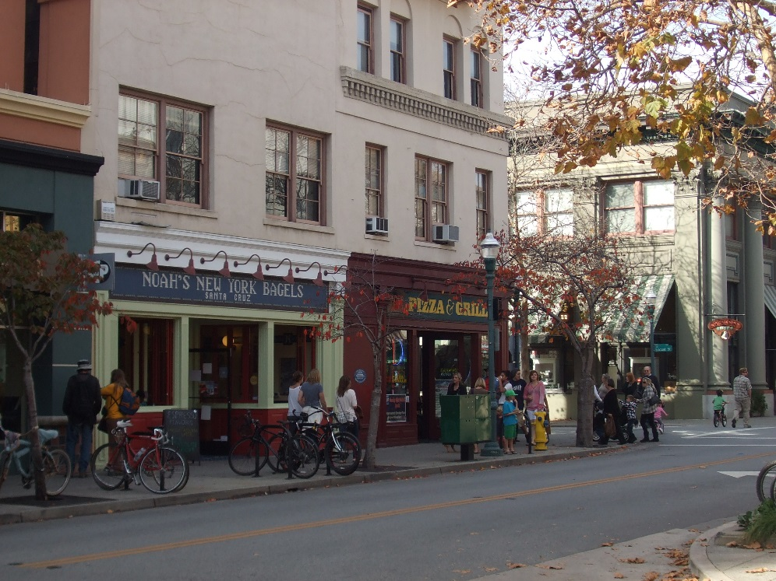
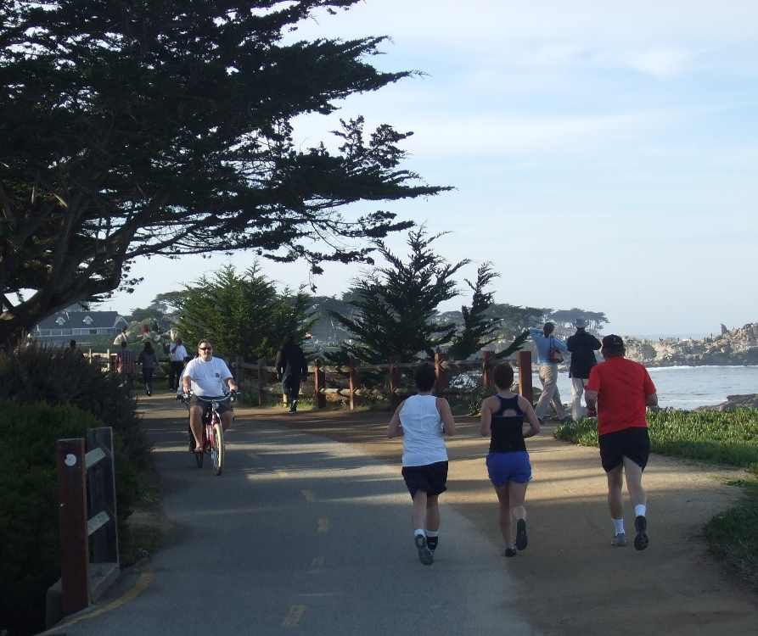
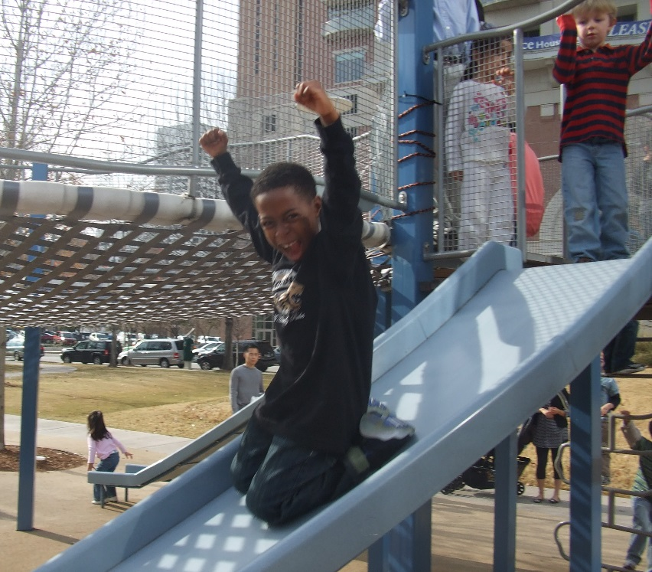



Healthy Regions in The Sunbelt
Association of Metropolitan Planning Organizations
2016 Annual Conference – Fort Worth
Wednesday, August 26, 2016
Austin/Capital Area MPO – Kelly Porter, AICP
San Diego/SANDAG – Carolina Ilic, AICP
Nashville MPO – Rochelle Carpenter

Slide 2
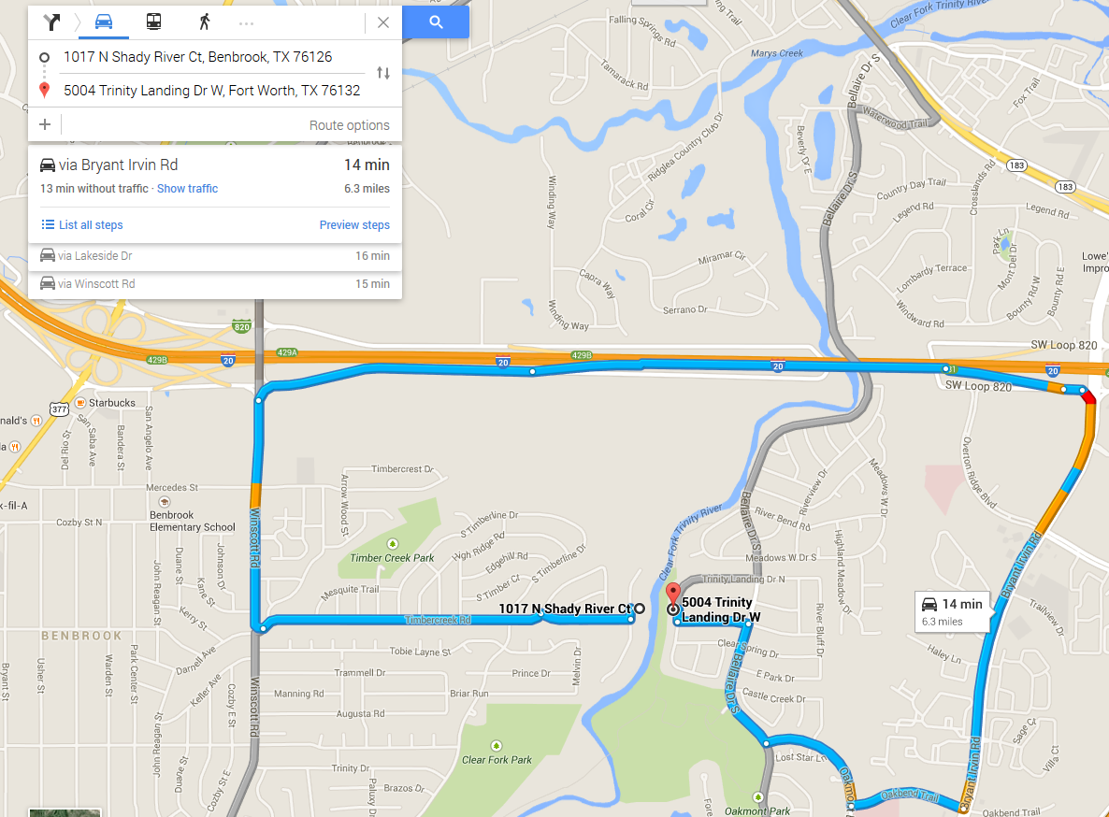
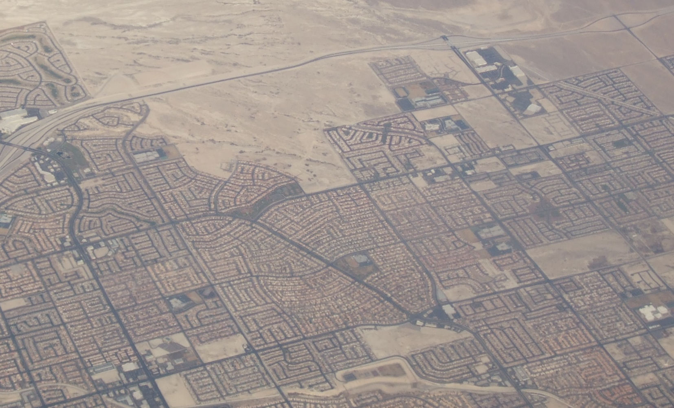
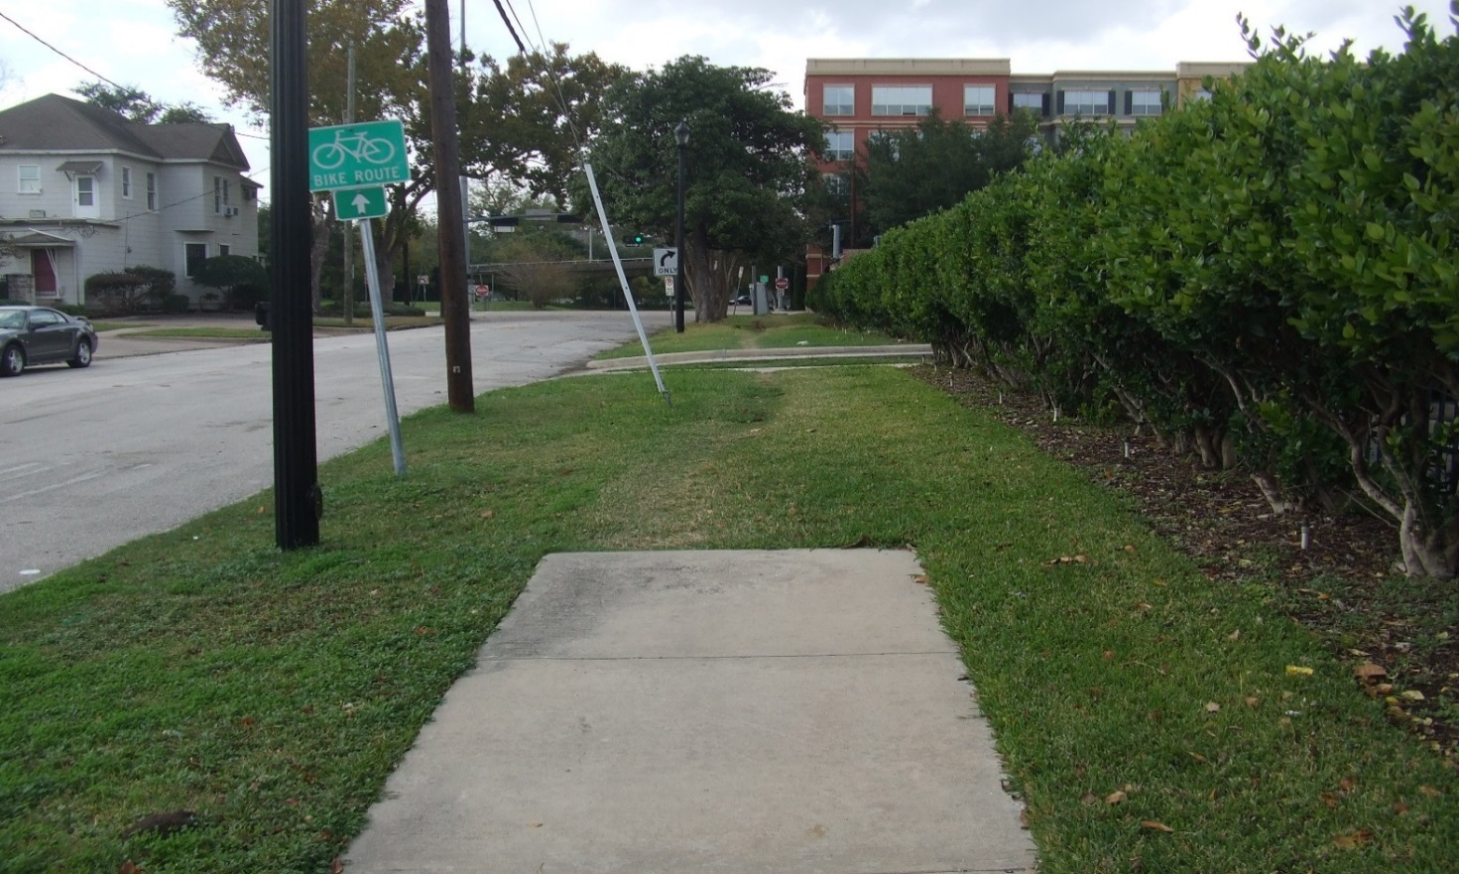
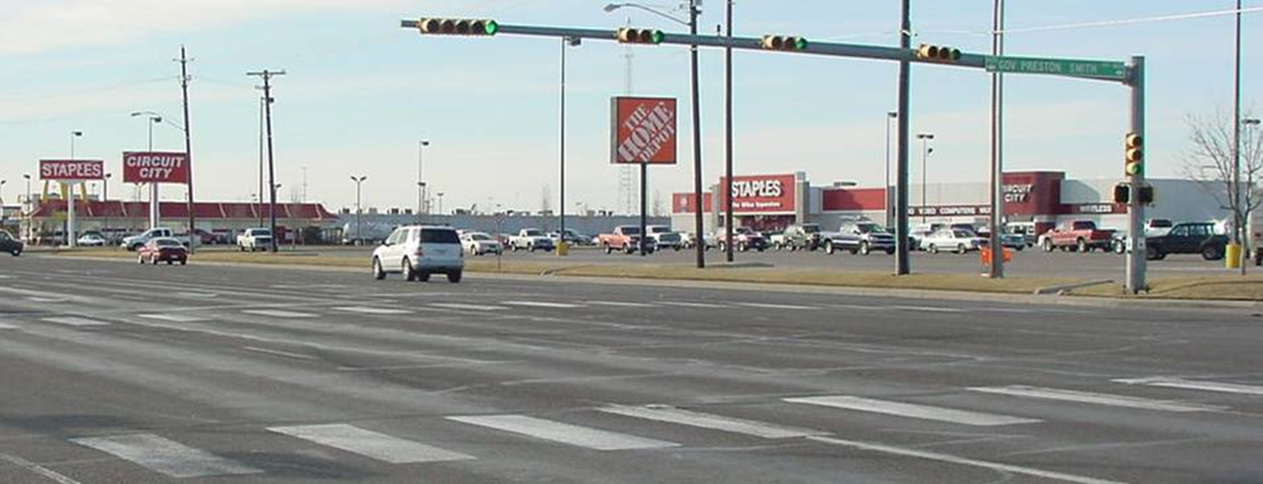

Slide 3
Planning and Public Health
Where you live matters
  Zip Code relates to health outcomes
Access to public transit, sidewalks and trails matter
  Physical inactivity includes higher risk of:
    High blood pressure
    Heart disease
    Anxiety and Depression
    Cancer
    Obesity
Notes:
http://www.hopkinsmedicine.org/healthlibrary/conditions/cardiovascular_diseases/risks_of_physical_inactivity_85,p00218/

Slide 4
Planning and Public Health
Non-Hispanic white adults are more likely to engage in physical activity than Hispanic and African American adults
Health disparities between Non-Hispanic white adults and Hispanic and African American adults are highest for wealthier Americans
Low-income American adults have higher rates of:
  Heart disease
  Stroke
  Diabetes
Notes:
http://www.heart.org/HEARTORG/Conditions/More/MyHeartandStrokeNews/African-Americans-and-Heart-Disease-Stroke_UCM_444863_Article.jsp#.WAfz2I8rKig
http://www.urban.org/sites/default/files/alfresco/publication-pdfs/2000178-How-are-Income-and-Wealth-Linked-to-Health-and-Longevity.pdf
http://kff.org/other/state-indicator/poverty-rate-by-raceethnicity/?dataView=0&currentTimeframe=0&sortModel=%7B%22colId%22:%22Location%22,%22sort%22:%22asc%22%7D
https://www.russellsage.org/sites/all/files/u4/Mullahy,%20Wenzlow,%20%26%20Wolfe.pdf
https://consumer.healthday.com/senior-citizen-information-31/misc-aging-news-10/lifespan-after-heart-attack-shorter-for-rich-blacks-too-703245.html

Slide 5
Healthy Planning Framework
Identify
  Understand your community’s issues
  Develop well-documented data
Organize
  Develop opportunities to organize stakeholders
Institutionalize
  Consider and include outcomes in projects, policies and plans
Notes:
http://www.heart.org/HEARTORG/Conditions/More/MyHeartandStrokeNews/African-Americans-and-Heart-Disease-Stroke_UCM_444863_Article.jsp#.WAfz2I8rKig
http://www.urban.org/sites/default/files/alfresco/publication-pdfs/2000178-How-are-Income-and-Wealth-Linked-to-Health-and-Longevity.pdf
http://kff.org/other/state-indicator/poverty-rate-by-raceethnicity/?dataView=0&currentTimeframe=0&sortModel=%7B%22colId%22:%22Location%22,%22sort%22:%22asc%22%7D
https://www.russellsage.org/sites/all/files/u4/Mullahy,%20Wenzlow,%20%26%20Wolfe.pdf
https://consumer.healthday.com/senior-citizen-information-31/misc-aging-news-10/lifespan-after-heart-attack-shorter-for-rich-blacks-too-703245.html

Slide 6
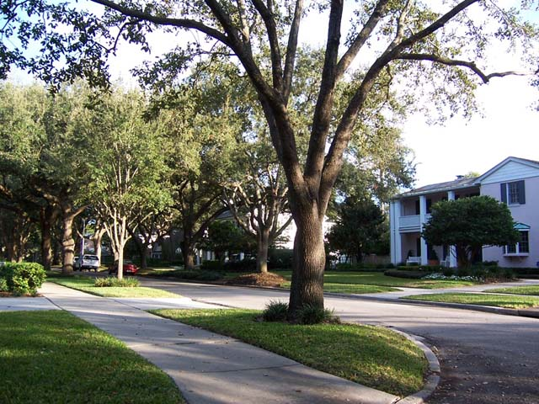
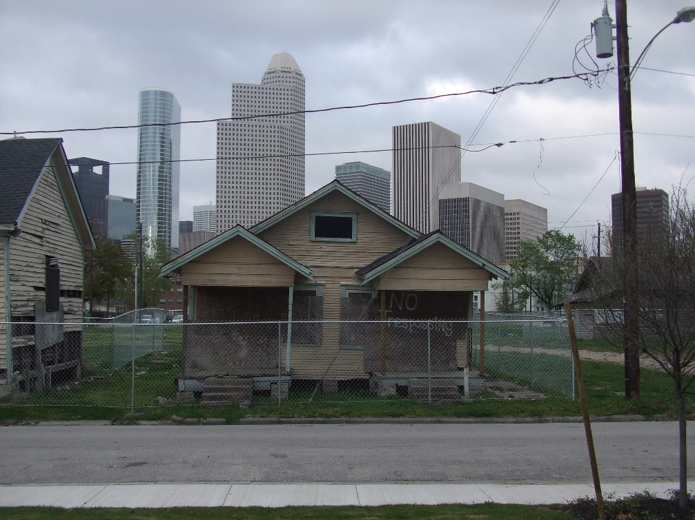
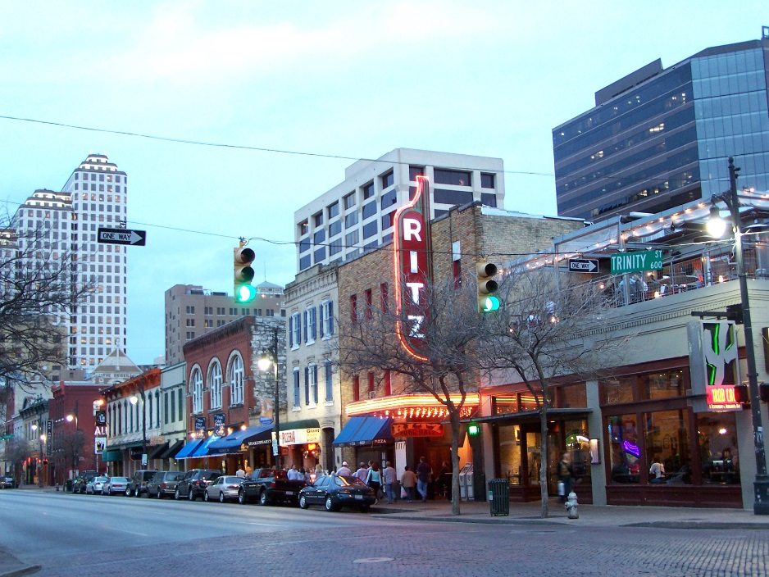
Disparities in Place

Slide 7
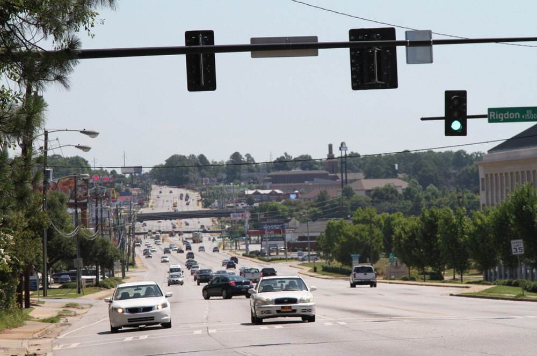
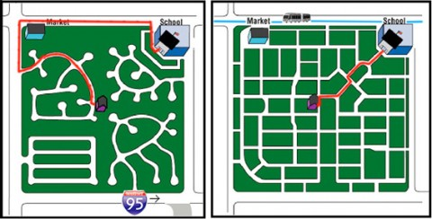
Disparities in Place

Slide 8
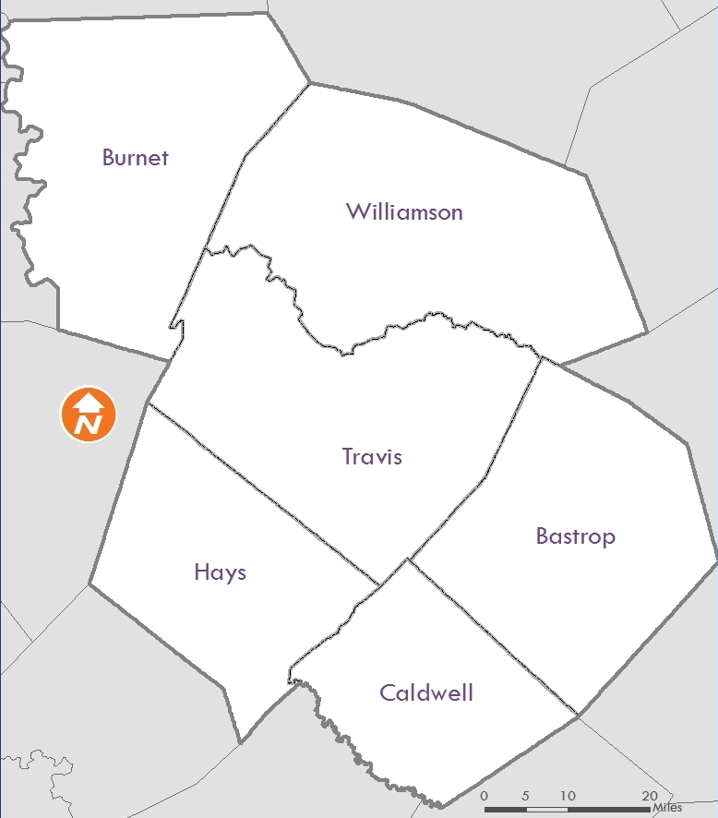
CAMPO Region
Six counties
5,302 square miles
2 million people
4th Largest in Texas
11th Largest in the Nation
Notes:
Six counties encompassing 5,302 square miles
2 million people
12,420 lane miles of roadway
41.8 million miles traveled by vehicles every day
31.2 million transit boarding each year
Boundary determined by economic ties

Slide 9
CAMPO REGION
 | CAMPO | Texas | United States
Poverty | 15.0 | 17.7 | 15.6
Uninsured | 20.4 | 21.9 | 14.2
Obesity | 24.0 | 28.4 | 31.2
Diabetes | 7.1 | 11.0 | 10.9
Median Household Income | 56,130 | 52,576 | 53,482

Slide 10
Current Regional Planning Efforts
Walkability Action Institute
2045 Regional Active Transportation Plan
  Online Project Viewer
  Near Northwest Corridor Case Study
15 percent STP-MM Funding Target
Platinum Planning – Georgetown Williams Drive

Slide 11

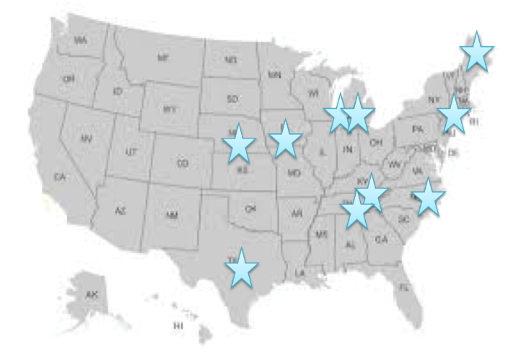



Walkability Action Institute
Notes:
Surgeon General Call to Action
Walkability Institute request for applications
CAMPO teams up with TMF, and Cities of Georgetown and Pflugerville
Application approved as one of 10 teams from the nation

Slide 12
Action Plan Elements
Regional Active Transportation Plan – Summer 2017
Multimodal Corridor Plan – May 2017
Online Project Viewer and Data Warehouse – December 2016
Health Outcome Performance Measures – March 2017
Public Health Representative on Technical Standing Committee – July 2017

Slide 13
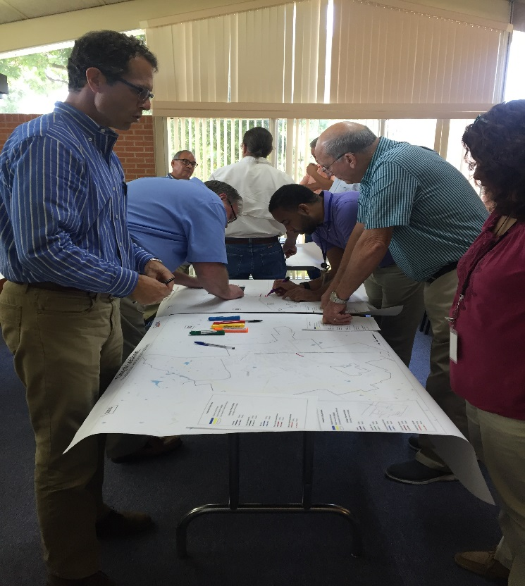


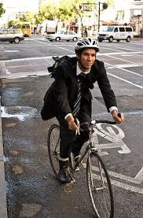
2045 Regional Active Transportation Plan
Notes:
Develop action plans to create RATP for region
Gather data on existing and planned bike/ped infrastructure in region
Conduct robust outreach with jurisdictions and general public to identify needs
Develop locally-driven approach to regional planning, i.e. identify different bike/ped infrastructure for each community’s needs

Slide 14
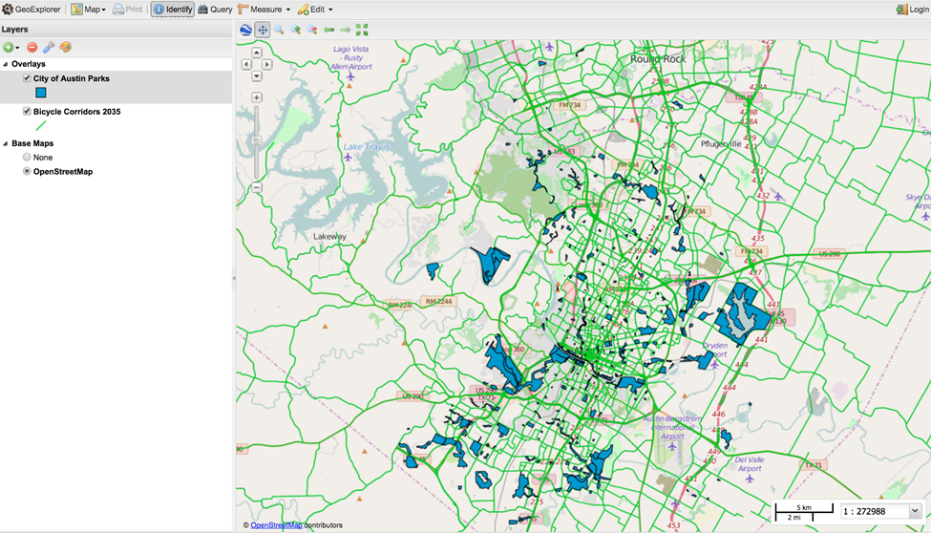
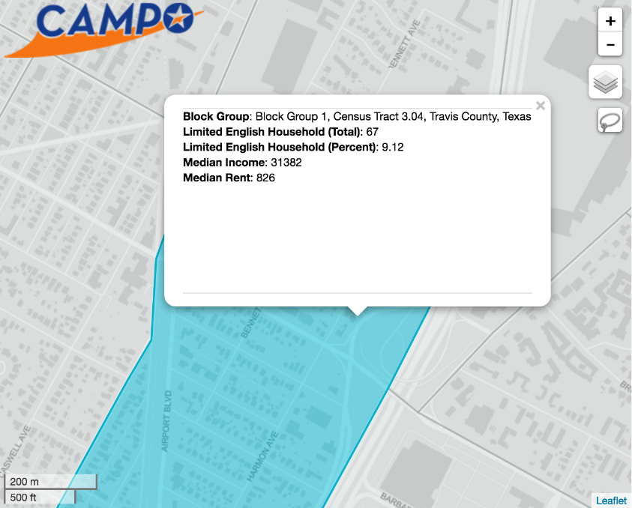
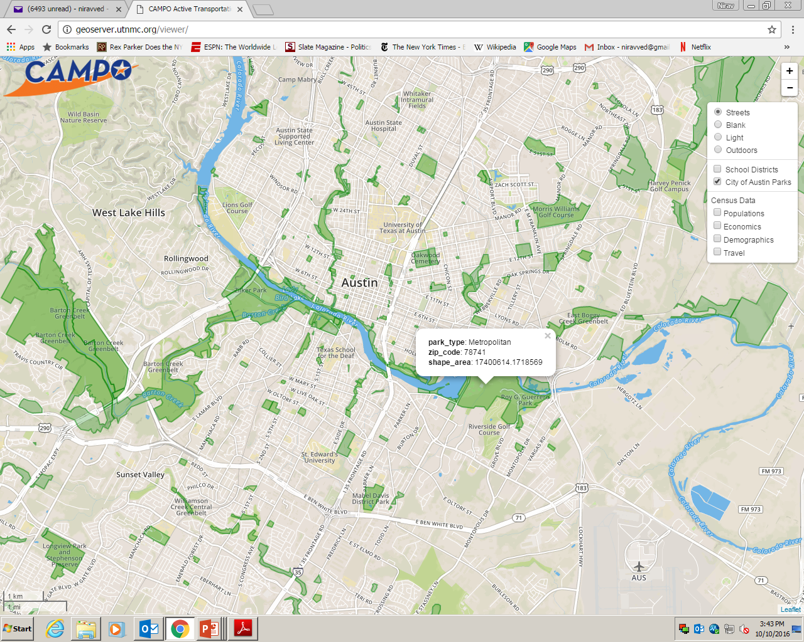
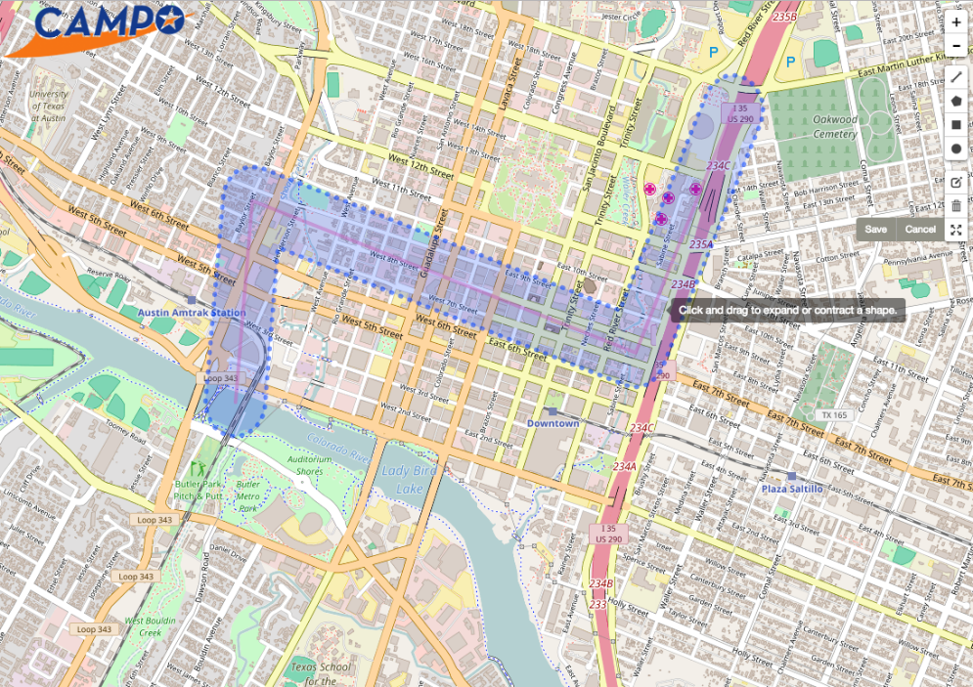
Project Viewer
Notes:
CAMPO conducts all manner of public engagement
Local government engagement
Open houses
Development of an online, publicly-accessible viewer

Slide 15
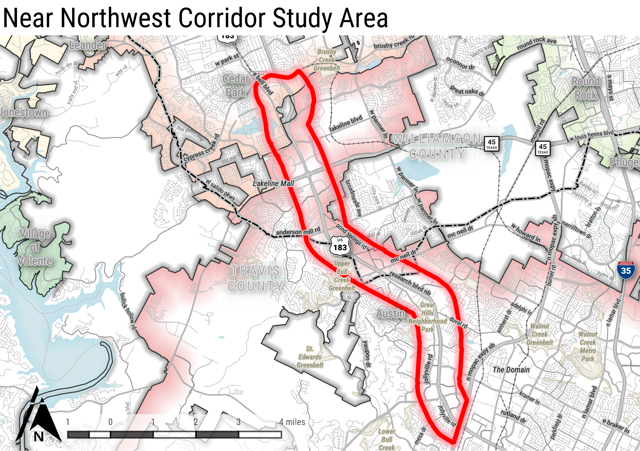

Slide 16
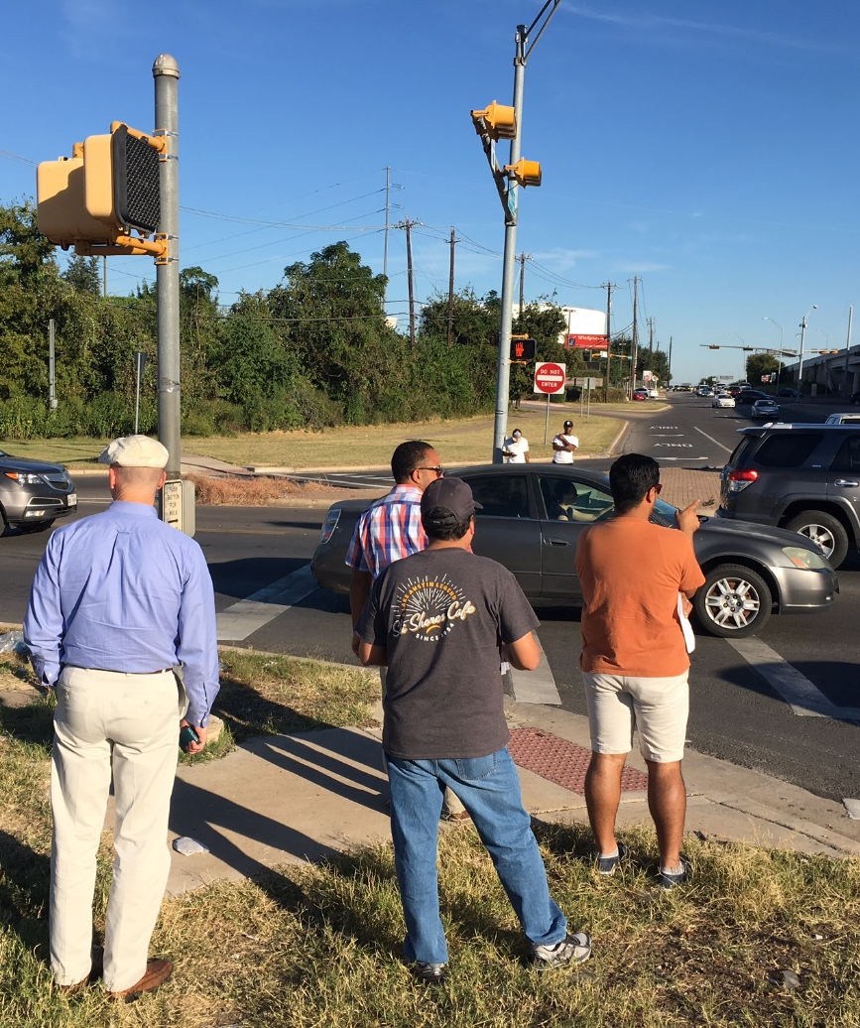
Purpose of the Near Northwest Corridor Connections Case Study
Recommendations on:
Connectivity
Facility design
Policy
Implementation plan with project and policy priorities:
Near-term
Short-term
Medium-term
Long-term
Vision
Address:
Pedestrian and bicycle connectivity
Last-mile connections
Access management
Multi-modal transportation elements
Safety and operational improvements
Private realm built-form supporting active transportation
Notes:
The purpose of the Near Northwest Corridor Connections Case Study is to develop recommendations on connectivity, facility design and policy; and an implementation plan with project and policy priorities for the near-, short-, medium-, and long-terms.
This case study seeks to develop a context-sensitive corridor plan for several miles, along and adjacent to the Near Northwest Corridor, to address pedestrian and bicycle connectivity, last-mile connections, access management, multi-modal transportation elements, safety and operational improvements, and recommendations for a private realm built-form that is conducive to active transportation.

Slide 17
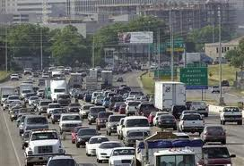
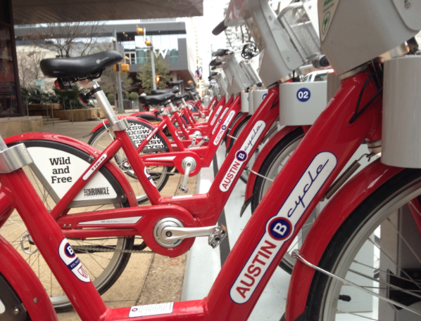
STP-MM Funding Target
Notes:
Previously all STP-MM funding went to roads and highways
CAMPO set a target of 15 percent of STP-MM for bike/ped facilities
This goal aided in the introduction of Austin B-Cycle program

Slide 18








Platinum Planning
Locally-driven approach for CAMPO’s Long-Range Planning work
Regional Special Studies
Sub-regions
Corridors
Centers
HOUSING – ENVIRONMENT – ECONOMIC DEVELOPMENT – EQUITY – MIXED USE – MULTI-MODAL –
PLATINUM
PLANNING

Slide 19
Notes:
Conducting corridor study of Williams Drive in Georgetown, TX
Part of Platinum Planning Process’ holistic approach to planning – housing; environment, economic development and equity
Williams Drive in present state (first picture)
Housing – mostly single family
Open space in the corridor
Economic trends in the corridor
Rental trends, employment and other equity factors

Slide 25
Takeaways
Grant and programs opportunities
Incorporate health outcomes in projects
Gather data where possible
Develop sound performance measures
Use a locally-driven and inclusive approach

Slide 26
Questions?
Kelly Porter, Regional Planning Manager
(512) 974 2084
kelly.porter@campotexas.org
www.campotexas.org

Slide 27
Integrating Public Health into Regional Planning
AMPO Conference, Carolina Ilic, AICP, SANDAG October 26, 2016

Slide 28
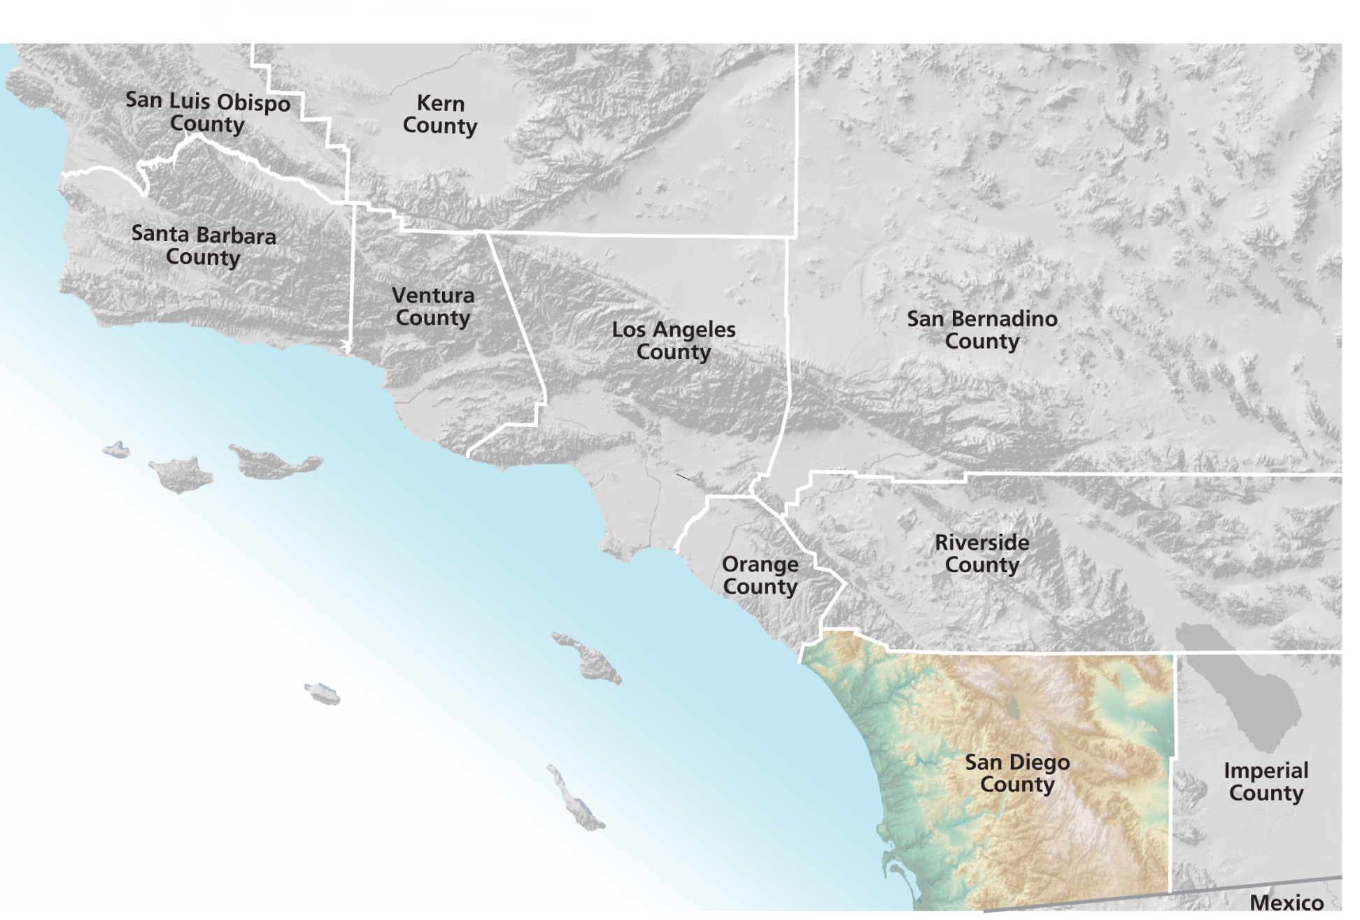
The San Diego Region
Notes:
The San Diego region is 4,230 square miles (about the size of the state of Connecticut) home to 3.1 million people
We are bound by mountains and desert to the east, the US Mexican Border to the South, the Pacific Ocean to the west, the US Marines to the north (protect us from LA).
Also home to 17 Native American Tribes- more than any other region in the nation.

Slide 29
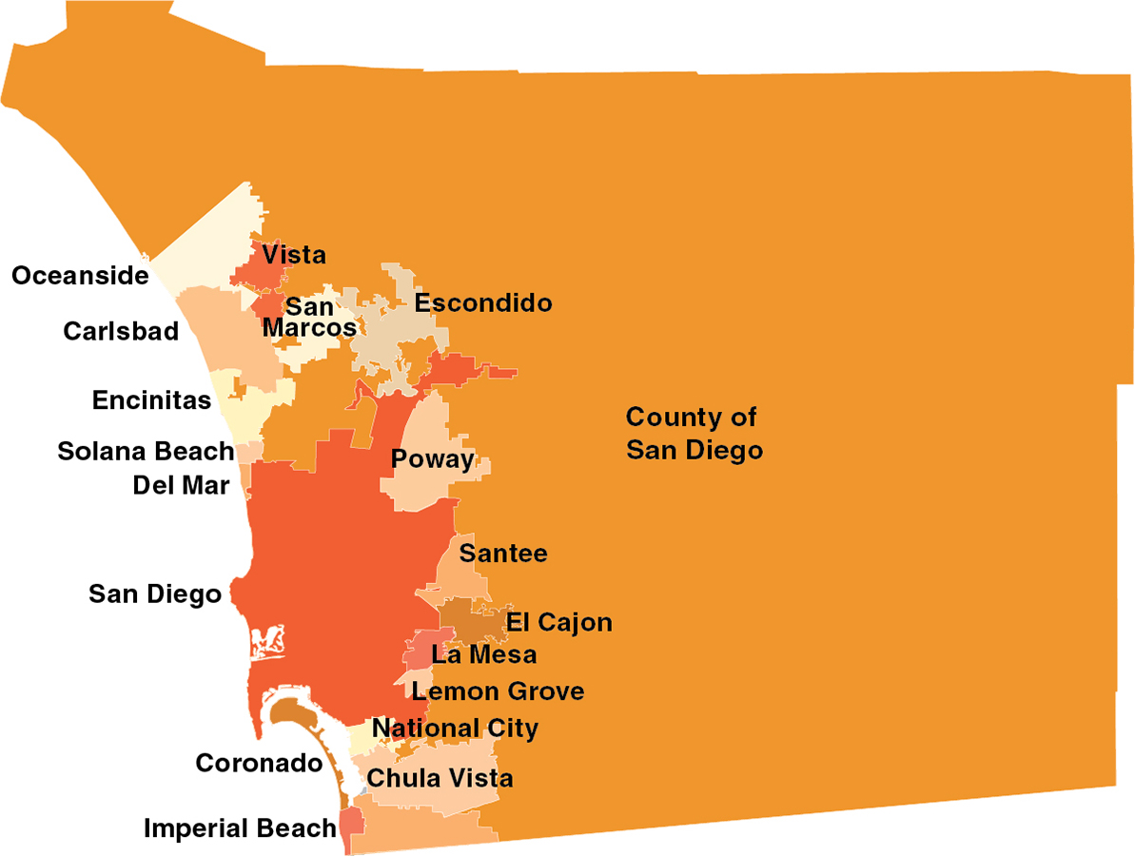
SANDAG Jurisdictions
Notes:
We are one County, one region- which does facilitate regional planning and collaboration.
18 cities and County make up our board
We have two transit agencies
One water authority

Slide 30
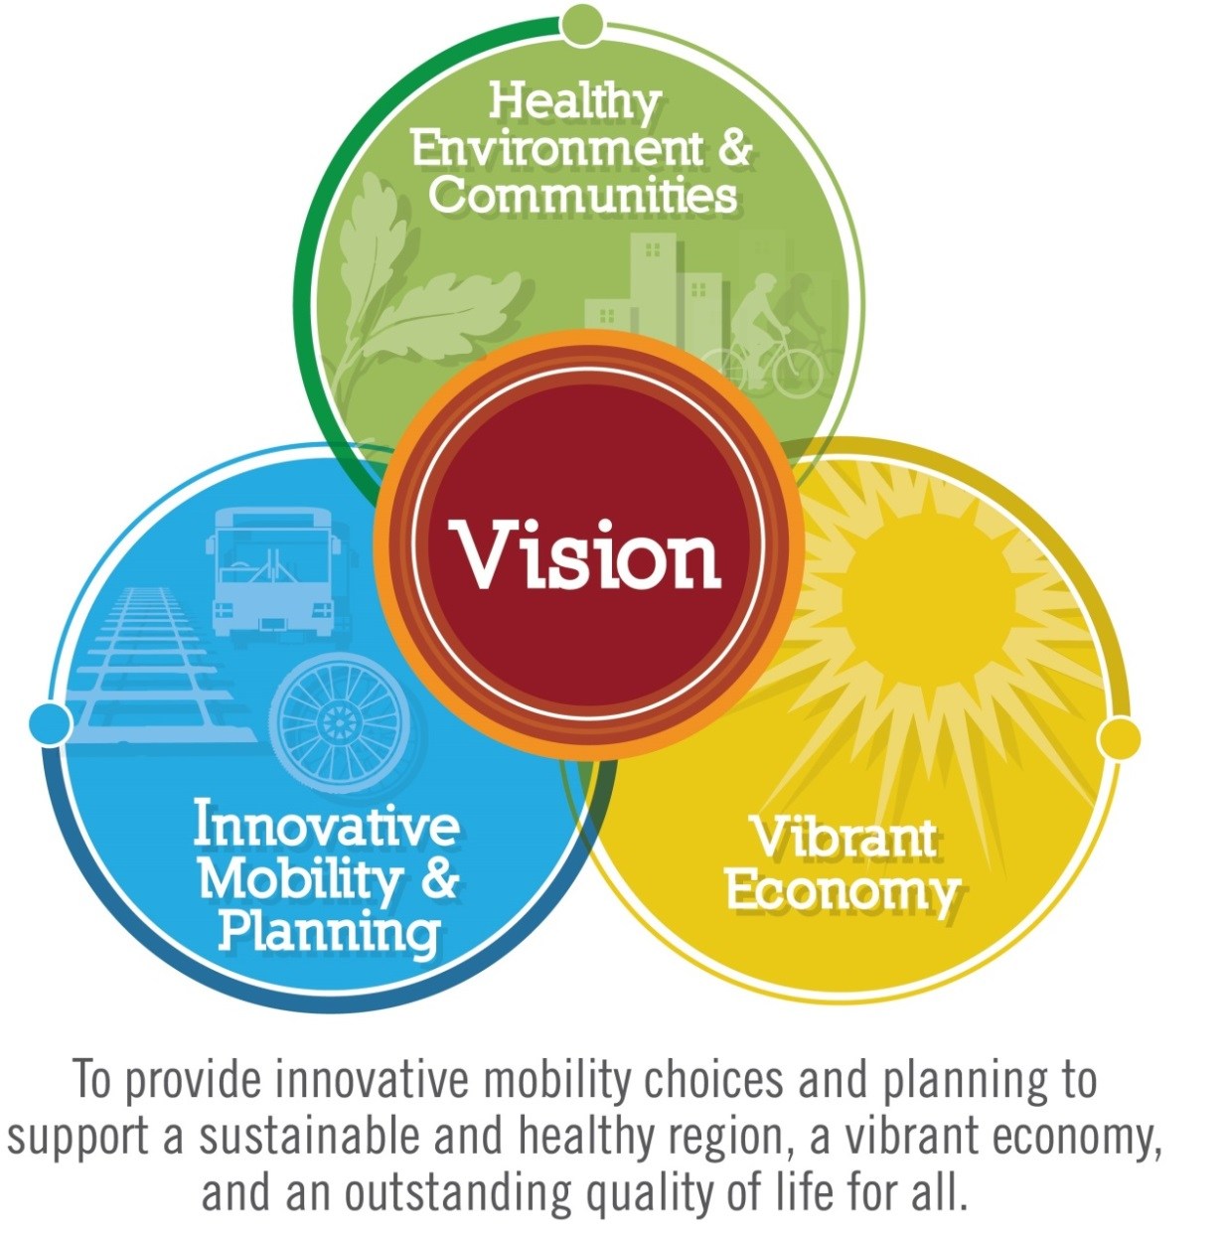
San Diego Forward: The Regional Plan
Notes:
San Diego Forward is being developed to provide a future that works for all groups and all communities.
The vision developed for the Plan is: “To provide innovative mobility choices and planning to support a sustainable and healthy region, a vibrant economy, and an outstanding quality of life for all.”
It is a long-range plan with equally important and interdependent goals:
Creating a HEALTHY ENVIRONMENT & COMMUNITIES
Providing INNOVATIVE MOBILITY & PLANNING and
Promoting a VIBRANT ECONOMY
These goals are supported by six policy objectives including regional economic prosperity, partnerships and collaboration, mobility choices, complete communities, habitat and open space preservation, and environmental stewardship.
The vision, goals, and policy objectives shape all elements of San Diego Forward.

Slide 31

Why Public Health Matters
3
Behaviors
4
Diseases
50+
Percent
Tobacco use
Poor diet
No exercise
Heart Disease
Type 2 diabetes
Lung Disease
Cancer
Percent
of deaths
Notes:
Adopted by the County of SD led by County Supervisors Ron Roberts
Chronic Diseases Asthma, Diabetes, Cancer,
Over 50 %
Basically, 3-4-50 was adopted for the Public Health Services, Chronic Disease Agenda which came a few years after the Obesity Initiative and a couple years before Live Well was adopted.

Slide 32



Partnership
Notes:
Through Healthy Works, the County initiated a unique and groundbreaking partnership between SANDAG and HHSA. This partnership is the first of its kind in the country and has been recognized by the CDC as a national model for inter-agency collaboration. CPPW/Healthy Works is a sub-effort of Live Well. Many CPPW and CTG activities are reflected in the Live Well strategy.

Slide 33
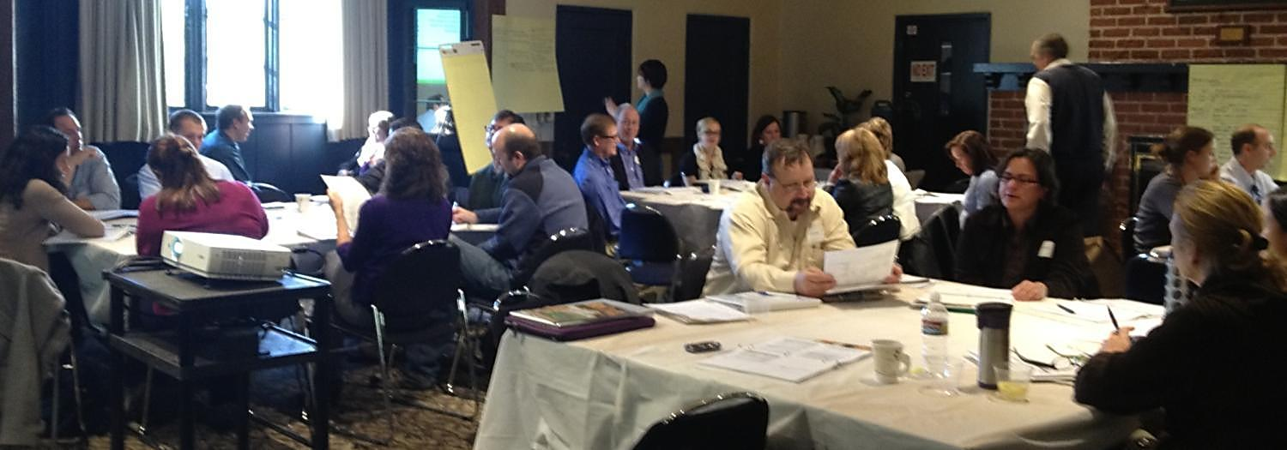
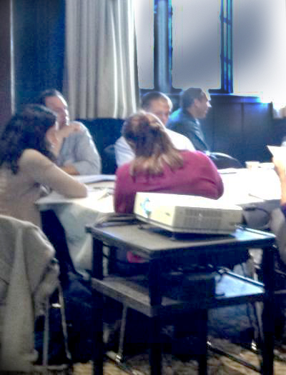
Public Health Stakeholders Group
Promote consideration of health co-benefits in SANDAG proposed policies, projects, and programs
Notes:
PHSG Charter approved by RPC for Healthy Works II-November 2012
Mike Strong who is co-chair of the PHSG will be speaking further on the groups at the end of my presentation.

Slide 34

How Transportation & Land Use Patterns Impact Health
Transportation
Options
Land Use Patterns
Travel Behavior
Health
Costs
From http://www.apha.org/advocacy/reports/reports/
Source: The Hidden Health Costs of Transportation.” A report prepared by Urban Design 4 Health, Inc. and the American Public Health Association, February 2010., pp: 2-3.
Notes:
City Study “The Effect of Light Rail Transit on Body Mass Index and Physical Activity” Charlotte, North Carolina LRT System
Background: The built environment can constrain or facilitate physical activity.
Conclusions: The results of this study suggest that improving neighborhood environments and increasing the public’s use of LRT systems could provide improvements in health outcomes for millions of individuals.
The health benefits of moderate and vigorous physical activity are clear, Less vigorous forms of physical activity are more likely to be sustained over time, making it easier to meet exercise goals through the promotion of walking as a basic change in one’s daily routine. Increasing the availability of public transit systems is one among a number of modifications to the built environment that offers some promise in increasing opportunities for physical activity and reducing the prevalence of obesity.
Poor health outcomes can have a significant cost burden on society. The CDC estimates that in 2008, obesity-related medical care costs were estimated to be as high as $147 billion. In 2006, obese people spent $1,400 more in medical care costs compared to people of normal weight. The California Center for Public Health Advocacy estimated that in 2006, the total annual cost to California from an overweight, obese, and physically inactive population was $41.2 billion. The estimated cost for the San Diego region was $3 billion.

Slide 35
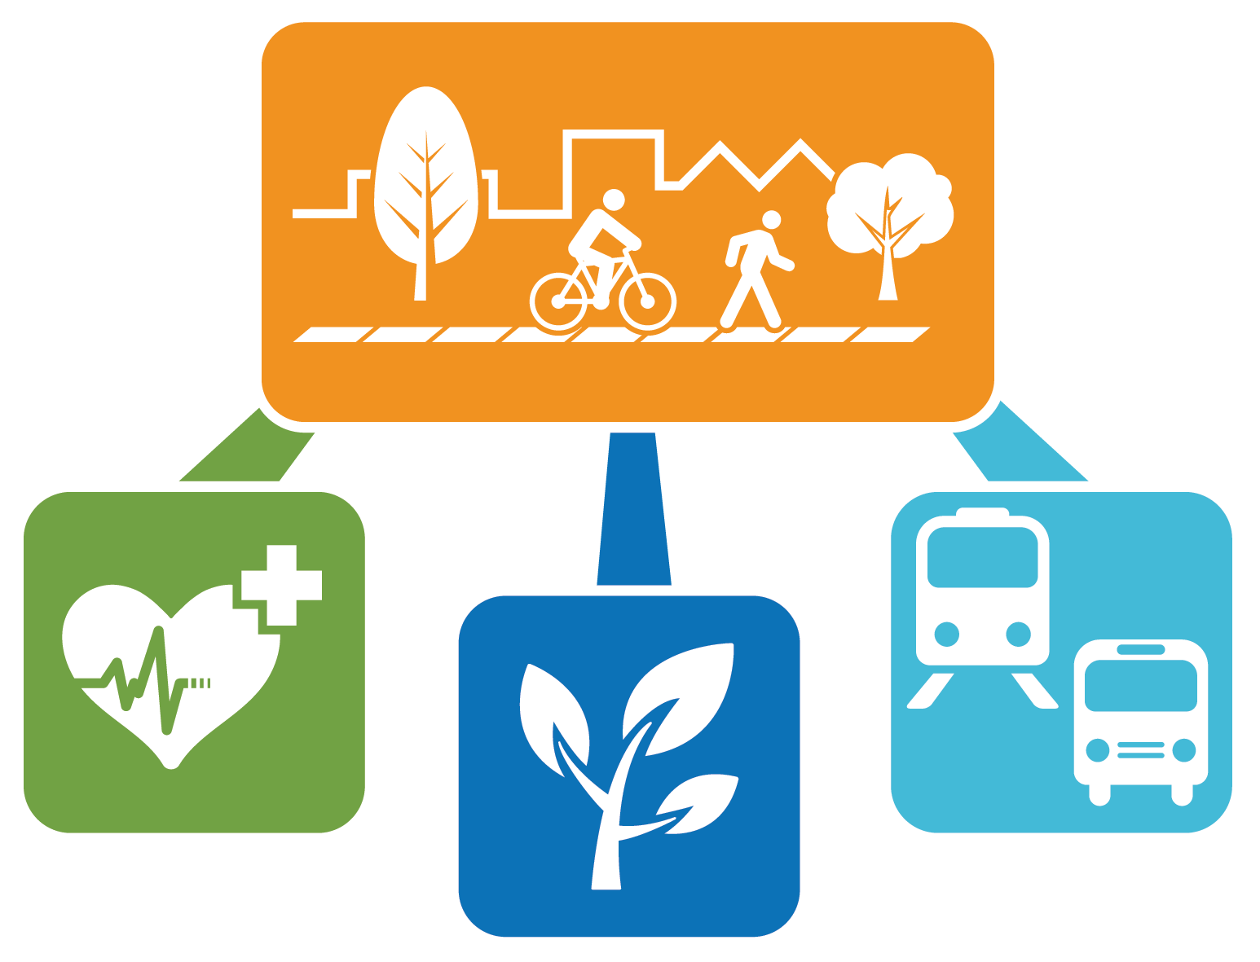
Walkable and Bikable Communties – A Triple Win
From http://www.apha.org/advocacy/reports/reports/
Source: The Hidden Health Costs of Transportation.” A report prepared by Urban Design 4 Health, Inc. and the American Public Health Association, February 2010., pp: 2-3.
Notes:
SD Forward: RP Survey 53% of respondents make it easier and safer to walk to places of interest.

Slide 36
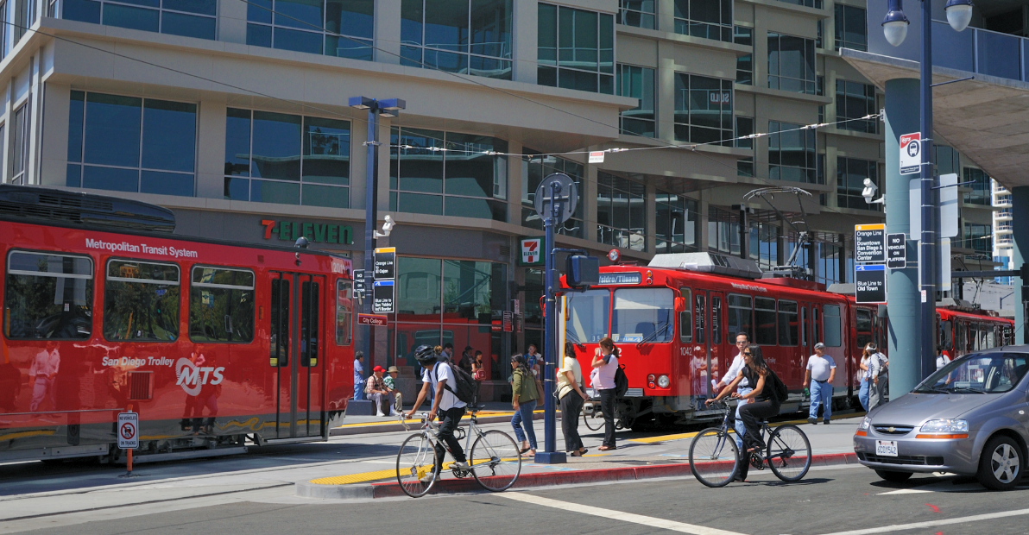
Healthy Communities:
Invest in transportation infrastructure that maximizes public health benefits, social interaction, and community cohesion
Notes:
These policy considerations were presented at the Pubic Workshops and have received excellent feedback from a very engaged public.
Active Transportation
Complete Neighborhoods include healthy, walkable, bikable, and vibrant communities with a variety of housing choices, access to goods, services, recreation and jobs. Good for Economic Growth!
Transp. Project Evaluation Criteria: Transit Services/Highway Corridor
Serves RCP Smart Growth Area
Critical Linkage
GHG Emissions
Access to Jobs
Performance Metrics:
Grocery store anchored neighborhood or community retail centers or districts within 30 minutes by transit, 20 mins by car, 15 min by bicycle and 10 by walking.

Slide 37

Access to Healthy Foods
Improve access to healthy, affordable,
and culturally appropriate food
and nutrition
Access includes transportation
Notes:
Farmer’s Markets
Food Deserts: Obesity is 20% higher in the least healthy food environments
30 million in US
1 million in CA
1 mile-Urban
10 miles-rural

Slide 38
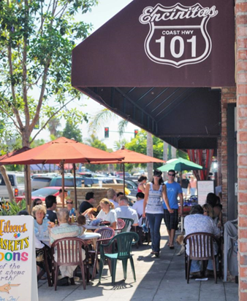
Public Safety
Encourage active uses in streets and public space to promote public safety
Notes:
Jane Jacobs “The Death and Life of Great American Cities” Street is activated there are more “Eyes on the Street”

Slide 39

San Diego Forward: The Regional Plan

Slide 40
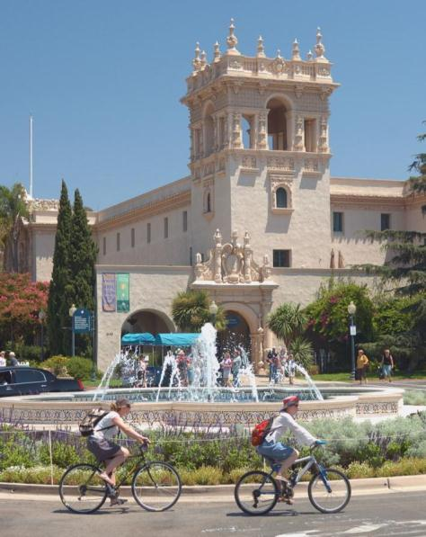
Integration of Health into San Diego Forward
Multi-modal transportation network
Health-based project evaluation criteria
Health-based performance metrics
Active Transportation enhancements to the travel forecasting model
Integrated Transportation Health Impact Model
Notes:
Farmer’s Markets
Food Deserts: Obesity is 20% higher in the least healthy food environments
30 million in US
1 million in CA
1 mile-Urban
10 miles-rural

Slide 41
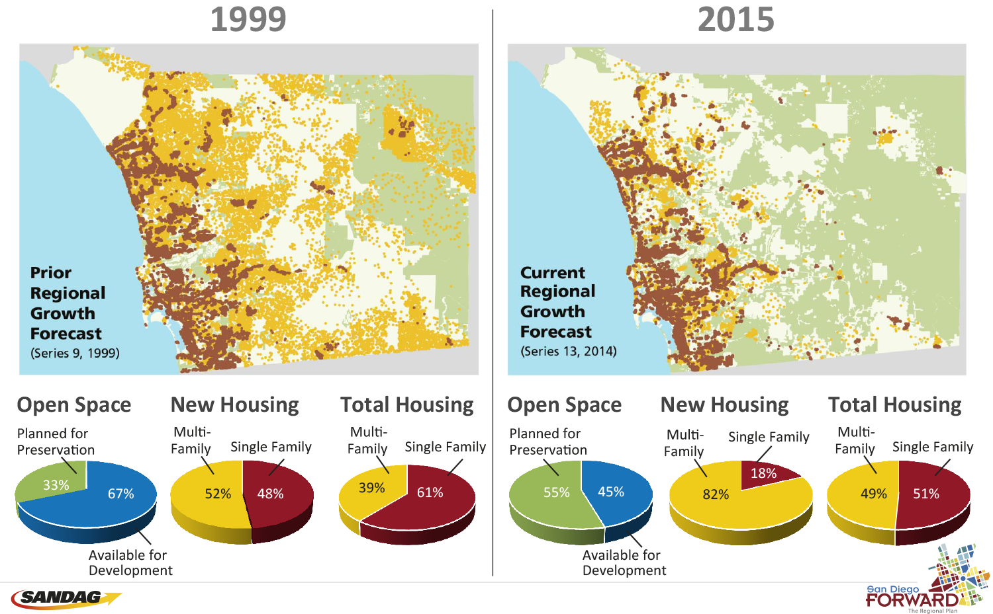
Our Changing Land Use Pattern…
Notes:
So our region is growing…….. but in different ways than previously anticipated. We are growing up and not out, with most of the growth occurring within our existing communities.
Our future used to look like the map on the left and you can see that plans called for us to spread out to the east.
Now our future looks like the map on the right. With people and housing in vibrant and active community centers and is the result of our cities focusing on more compact development.
This also results in more open space preservation with roughly 55 percent of our region preserved as open space by 2050, an area larger than the State of Delaware.

Slide 42
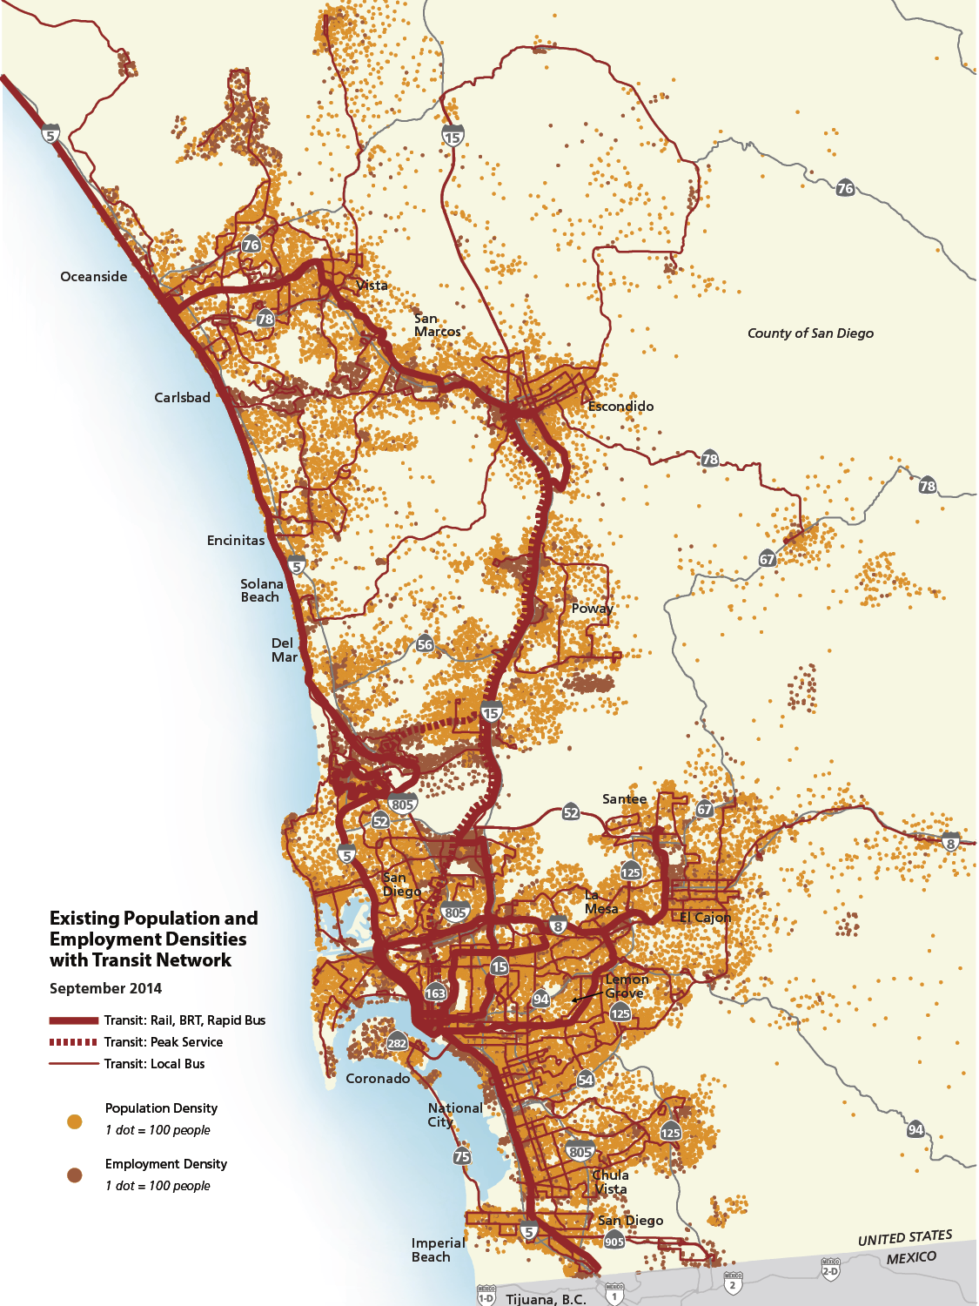

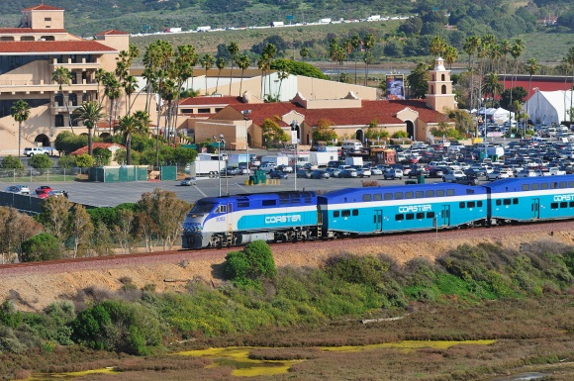
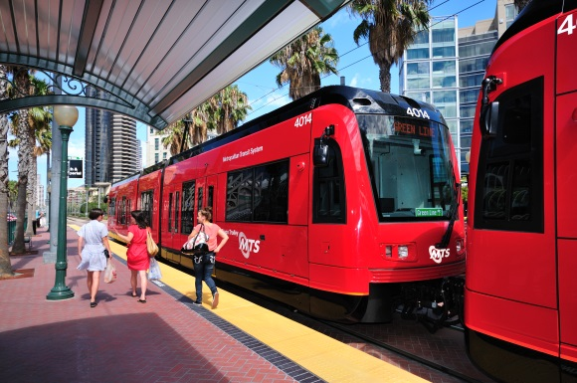
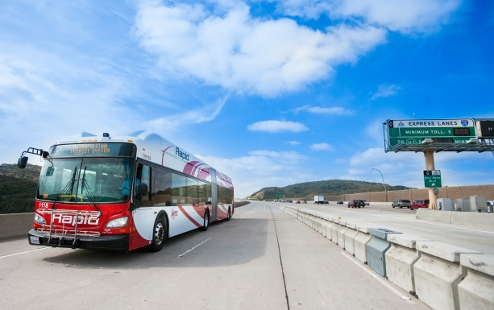

TODAY: Regional Transit
42
Notes:
Today Transit is about connecting where we live and where we work and where we play

Slide 43
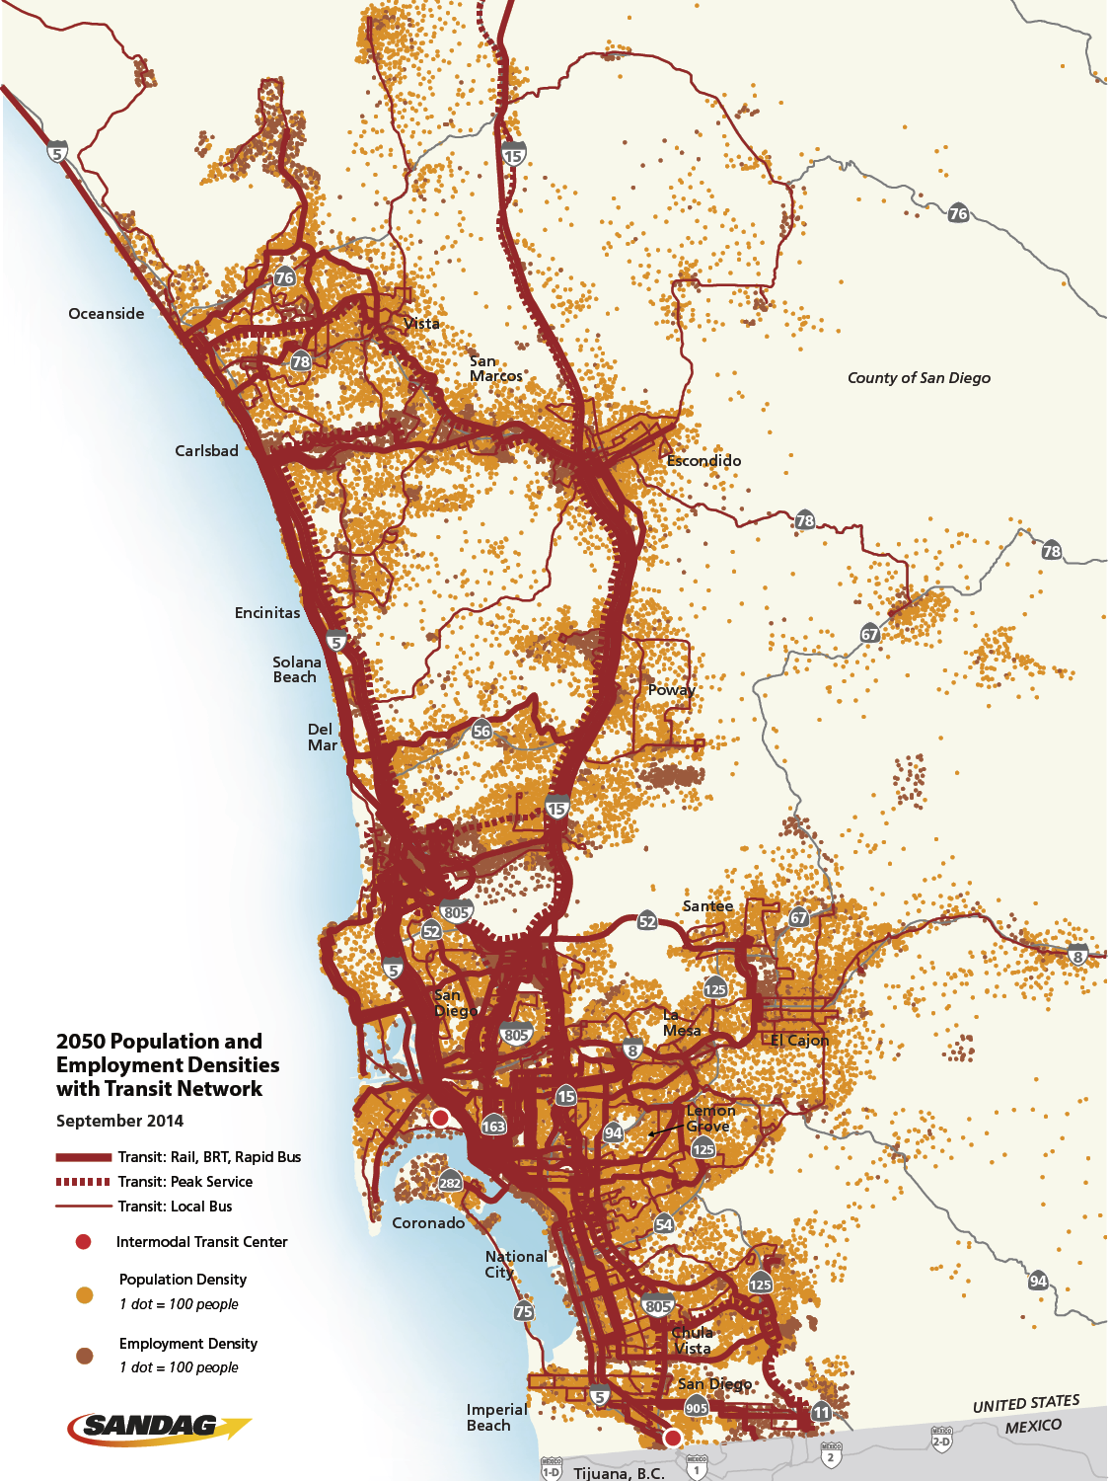
2050: More Transit Choices
Five new Trolley lines
12 new Bus Rapid Transit lines
20 new Rapid bus lines
New SPRINTER express service and extension
Continued COASTER double tracking
Four new streetcar lines
Two new intermodal transit centers
43
Notes:
To make these connections, the plan includes a tremendous capital improvement program through 2050:
Five trolley lines
12 Bus Rapid Transit lines
20 Rapid bus lines
SPRINTER express service and extension
Continued COASTER double tracking
Four streetcar lines
Two intermodal transit centers

Slide 44
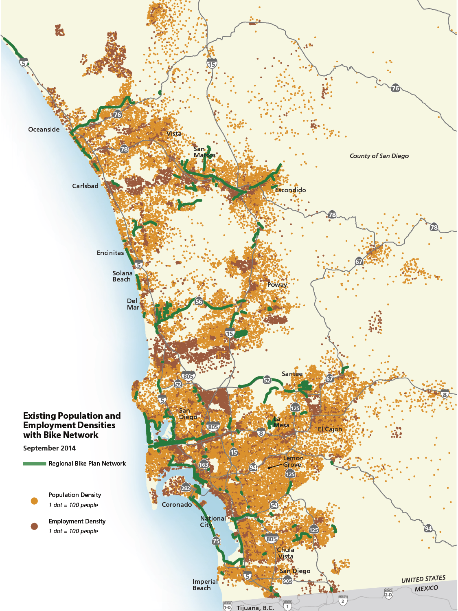
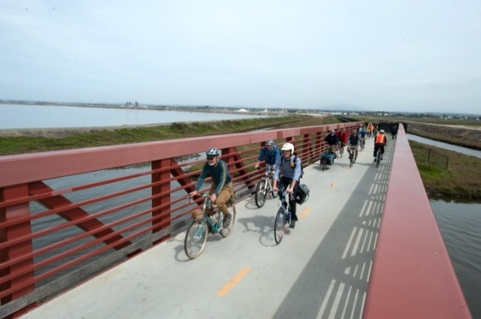
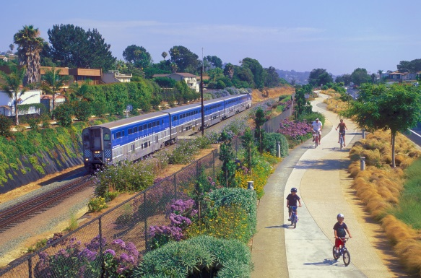
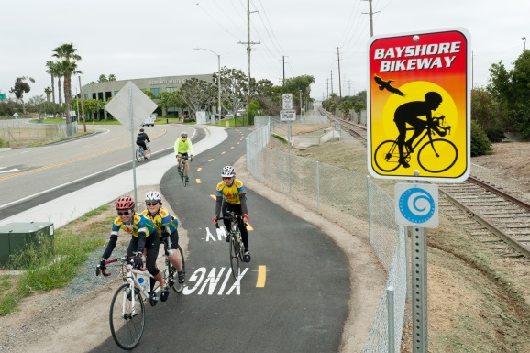
TODAY: Regional Bikeways
44
Notes:
Turning to smaller scale improvements – equally important
Investment in Active Transportation (bike/ped)
Right now we have dedicated riders and those that would never ride
Attention to those who would consider biking as an option – both for commute and other trips

Slide 45
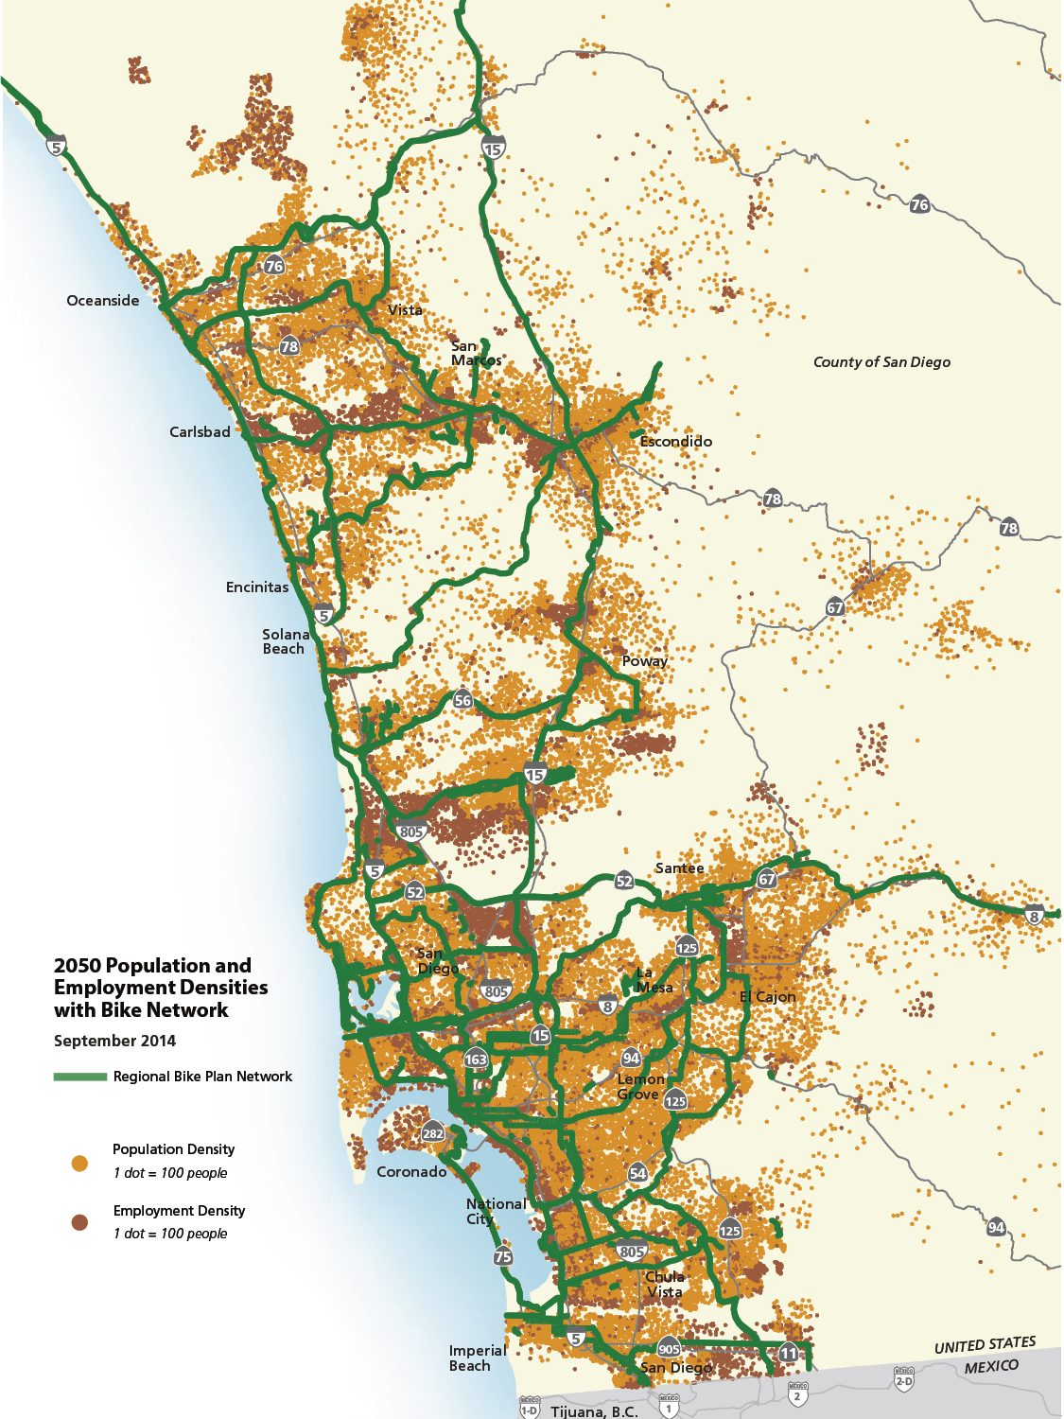
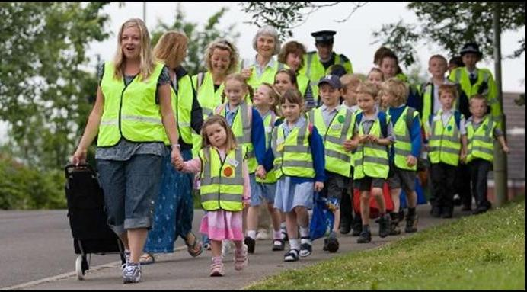
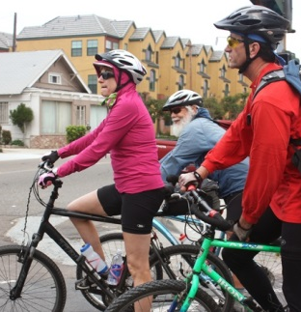
2050: More Biking and Walking Choices
More than 275 new miles of regional bikeways
In addition (not shown)
  $728M local bike projects
  $77M safe routes to school programs
  $180M local pedestrian safety and traffic calming projects
  528 safe routes to transit projects
  77 highway interchange improvements
45
Notes:
Build out numbers here
More than 500 miles of regional bikeways
Not shown on map are all the supporting investments – make it safer and easier for casual riders in addition to die hard cyclists (make it an option)
$728M local bike projects
$76.7M safe routes to school projects and programs
$180M local pedestrian safety and traffic calming projects
528 safe routes to transit projects ($1.025 B)
77 highway interchange improvements (dollars included with Hwy Projects)
For East County, the bicycle projects include:
San Diego River Trail in Santee (2035)
Rolando to Grossmont and La Mesa (2035)
La Mesa – Lemon Grove – El Cajon (2035)
El Cajon to Santee Connections (2035)
I-8 Corridor San Diego River Trail to Riverside Drive (2050)
SR 125 Corridor Bikeway in Santee and El Cajon (2050)
La Mesa Corridor (2050)
East County Northern Loop in El Cajon and the Unincorporated County Areas (2050)

Slide 46
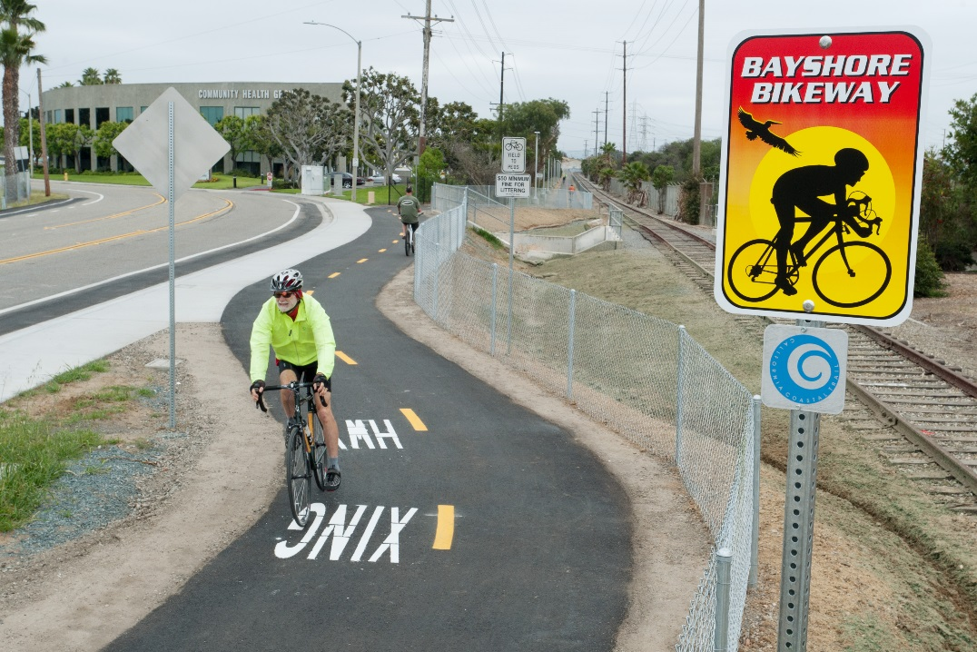
Regional Bike Early Action Program
$200 million initiative to expand the bike network countywide and finish high-priority projects within a decade.
42 projects totaling
about 77 miles of new
bikeways.
Provides Health,
Mobility & Economic
Benefits.
Notes:
Studies have shown that regions that have invested in bicycling have seen significant economic and health benefits. For example, a 2010 study estimated
the annual economic impact of bicycle recreation and tourism in Wisconsin to be $924 million and the potential value of health benefits from reducing short car trips and increasing bicycle trips to total nearly $410 million. Another study, published in 2011, found that commuter and recreational cycling in Iowa generates more than $400 million in economic activity in the state and $87 million in health savings.
Half of the bikeways are already under construction or well into the planning, design, and engineering phases.

Slide 47
Safe Routes to Transit
Safe Routes to Transit projects that enhance bicycle and pedestrian access in transit stop and station areas are identified in of San Diego Forward: The Regional Plan.

Slide 48
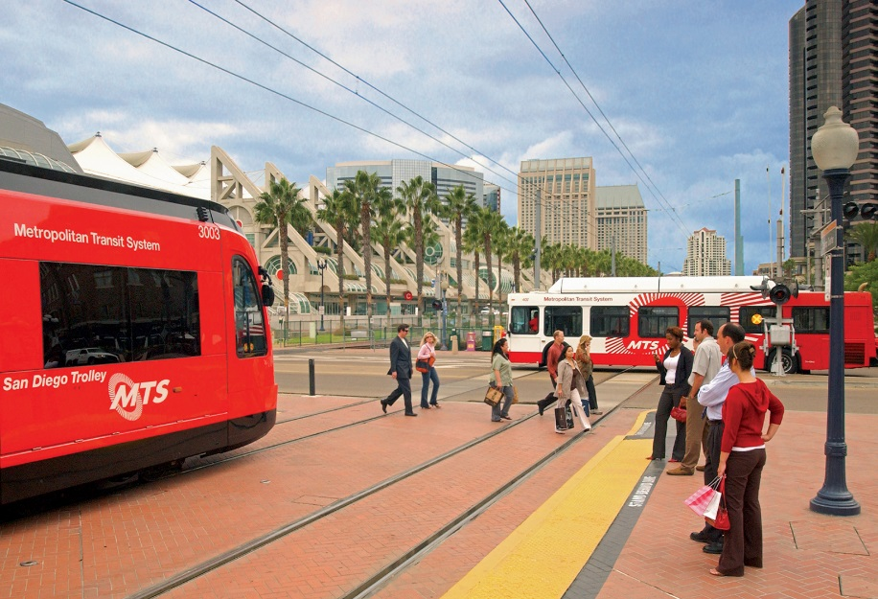
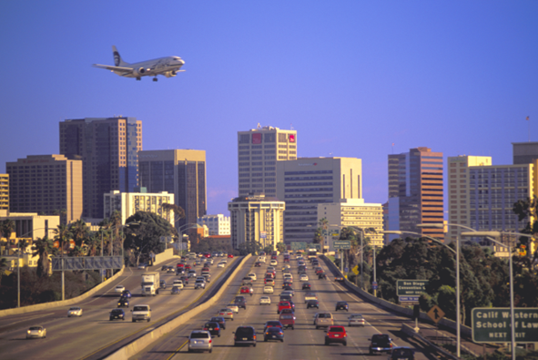
Transportation Project Evaluation Criteria
Evaluate transportation projects by modal categories including transit services, highway corridors, active transportation, freeway and HOV connectors, and rail grade separations
Physical Activity including reduced bicycle and pedestrian stress level now included as criteria

Slide 49
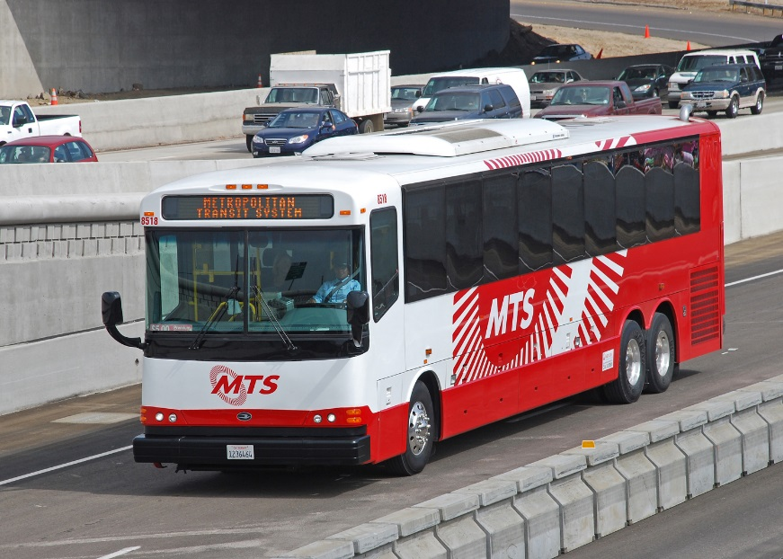

Scenario Performance Measures
Evaluate revenue constrained multimodal transportation network scenarios and provide a comparative assessment
Physical Activity including walking and biking included as performance measures

Slide 50

Local Efforts on Public Health
General plans with health considerations
Zoning amendments
Access to healthy food
Safe Routes to Transit
Safe Routes to School
Tribal governments
Notes:
Adopted: San Marcos, Chula Vista, National City, Vista, Escondido, La Mesa
In Process: Lemon Grove
Considering: Carlsbad
City of San Diego-Urban Agriculture and Community Gardens
City of Chula Vista-Worked with Local Farmers to provide fresh fruit & veggies in Corner Markets
City of La Mesa - Safe Routes to Transit Plan: Closing the Last Half Mile
Campo Band of Mission Indians - Campo Tribal Community Park Project & La Jolla Band of Luiseno Indians-Ped Friendly Paths
The Healthy Communities Campaign included the following two pass-through grant programs.
The Healthy Community Planning Grant Program awarded $496,600 to local agencies and tribal governments to add public health components to local planning efforts. Grant awards ranged from $14,650 to $75,000 each and included:
SR2S pass-through grants $340,000, leveraged $700,000

Slide 51


San Diego: Moving Toward a Healthy Region
Childhood Obesity Action Plan released
Growing Green, Growing Healthy Symposium
Healthy General Plans Workshop
SB 375
California Complete Streets Act
Prevention Fund: CDC Community Transformation Grant (CTG)
Affordable Care Act
County of San Diego, LiveWell, San Diego!
Formal partnership between SANDAG and HHSA begins
County of San Diego Chronic Disease Agenda:
3-4-50
ARRA/ CDC CPPW Grant
National Prevention Strategy released
Workshops:
Active Design
Complete Streets
Health Impact Assessment
Health Equity by Design Caltrans grant
California Local Public Health and Built Env’t Grant
2006
2007
2008
2009
2010
2011
2012
2020

Slide 52
Healthy Works Programs – Phases I and II
US Center for Disease Control (CDC) Grants
  In 2010, SANDAG receives $3 million from Communities Putting Prevention to Work (CPPW)
  In 2012, SANDAG receives $500,000 Community Transformation Grant (CTG)
  Phase I - CPPW Grant: $16 million for obesity prevention in San Diego County
    Healthy Nutrition: Increasing availability of fresh produce in communicates and facilitating breastfeeding workplace policies
    Healthy Schools: Improving nutrition and increasing physical activities in schools
    Healthy Places: Changing the built environment to increase physical activity ($3 million to SANDAG)
Notes:
$3 million was the down payment

Slide 53

Healthy Works Phase I (CPPW)
March 2010-March 2012
Healthy Community Mapping and Modeling
Regional Planning Policies and Metrics
Healthy Communities Campaign
Safe Routes to Schools
Active Commuters Transportation
Regional Bikeway Signage and Promotion
Notes:
3 million/CDC
Healthy Works Phase I: Communities Putting Prevention to Work (CPPW) Contract: March 2010-March 2012
HHSA partnered with SANDAG to implement six Communities Putting Prevention to Work (CPPW) projects that focus on integrating public health principles in local and regional planning, encouraging active transportation, and promoting Safe Routes to School.
Healthy Communities Atlas are GIS based maps for the San Diego Region used to identify areas that support health, as well as areas that need further investment in infrastructure, programs or policies. A GIS tool accompanies the Atlas, which can be used to perform customized queries and geographic analysis. We just recently had a request for the maps from the City of Lemon Grove for use in developing their Public Health Element for their General Plan Update.
PHSG-Key stakeholders in SD Region to provide input on Healthy Works Initiatives
HCC-SANDAG awarded 24 grants to local agencies, schools, tribal govt’s and CBO’s.
HIA-Developed a Healthy Communities Atlas that mapped existing data on social and physical determinants of health
Developed a health module for the SANDAG Community/Viz sketch planning tool that can quantify health co-benefits and impacts of proposed plans and projects at the local and regional levels.
Developed recommendations for enhancing the SANDAG activity-based reginoal transportation demand forecasting model to better account for active transportation trips, and quantify health co-benefits and impacts of proposed transportation and land use plans and projects at the regional level.
RCPP-Developed draft recommendations for a health and wellness policy framework and performance metrics that may be included in regional transportation and land use plans.
SR2S-Developed a Regional SR2S Strategic Plan to guide future SANDAG involvement in promoting walking and bicycling to school.
Developed and implemented two pass-through grant programs for local jurisdictions, school districts and CBO’s.
ACTC-Expanded Bike to Work Day promotions to include the entire month of May (2011) and implemented the Walk, Ride and Roll to School Campaign in 22 schools across the region.
RBPI-Developed bicycle wayfinding signage plans for several regional bicycle corridors to encourage biking for practical purposes, such as commuting to work, for shopping, and connecting to transit.

Slide 54
SANDAG’s Healthy Works Phase I Projects
Stakeholder engagement
Pass-through grant programs and incentives
Regional policies and programs
Tools and technical assistance
Notes:
The purpose of the Atlas is to compile, visualize, and analyze conditions related to health and wellness in the San Diego region. Existing data were used to develop a variety of health-related indicators at the Census block group level.
By collecting this information into an accessible format, the Atlas functions as a guide to San Diego’s health landscape. Using Census block groups as a consistent geography allows comparison between indicators. It also allows layering, querying, and mapping of multiple indicators in order to illustrate spatial clustering or convergence.
The Atlas was the first product in a series of evidence-based tools being developed for SANDAG as part of a grant from the Healthy Works program. The Atlas reflects the Healthy Works program’s focus on obesity prevention through physical activity and access to healthy foods. A GIS tool accompanies the Atlas, which can be used by SANDAG, the San Diego County Health and Human Services Agency, and other regional and local partners to perform customized queries and geographic analyses.
The Atlas maps and GIS tool can also be used to identify areas that already support health, as well as areas that need further investment in infrastructure, programs, or policies.
There are four main sections of the Atlas. Each pertains to an issue at the intersection of health and planning:
Physical Activity and Active Transportation
Access to sidewalks, access to transit stations and stops
II. Injury Prevention
Traffic Crashes, Bike/Ped Safety, Youth Safety
III. Nutrition
Access to Healthy Food, Fast Food Density
Food Deserts: Obesity is 20% higher in the least healthy food environments
30 million in US
1 million in CA
1 mile-Urban
10 miles-rural
IV. Air Pollution
Rather than focusing on health outcomes (for which there are little data available at the sub-county level), the Atlas focuses largely on health determinants, particularly those that are relevant to regional and local planning and decision-making. Most of the maps in the Atlas, therefore, are based on socio-demographic or physical environment data.
The Atlas maps also address children and low income populations under Communities of Concern. The impact of the built environment on health varies considerably for different demographic subgroups. Low-income households, minority populations, youth, disabled, and elderly populations are all more likely to be negatively impacted. Additionally, living in a low-income neighborhood is consistently associated with obesity and a higher body mass index.
There are four Communities of Concern:
1. Low-income areas have over one-third of all households earning under $30,000 per year
2. Minority areas have over 65 percent minority population
3. Low-mobility areas are those in which more than 25 percent of households do not own a car, 25 percent of the population has a disability, or 20 percent of the population is over 65 years of age
4. Low community engagement areas are those in which more than 20 percent of the population has a disability, 20 percent of households are non-English speaking, or more than 20 percent of the population does not have a high school diploma
The Communities of Concern maps are most useful to pinpoint where disparate conditions may already exist or where investment in infrastructure or programs might relieve health burdens.
The Atlas has been useful and frequently used since developed. Local jurisdictions have used it to assist in developing the public health element to their general plan update. University researchers have used the data in examining built environment effects on health outcomes and community stakeholders will now be able to use the new online tool recently developed by the SANDAG Technical Services Division to perform map queries.

Slide 55
CPPW Lessons Learned
Cultivate political leadership
Build relationships and partnerships between public health and transportation staff
Transportation and health professionals need to understand each others’ language and processes
Develop programs and projects where health and transportation interests share common outcomes (e.g., increase physical activity, promote active transportation)
Go where evidence points you
Notes:
The purpose of the Atlas is to compile, visualize, and analyze conditions related to health and wellness in the San Diego region. Existing data were used to develop a variety of health-related indicators at the Census block group level.
By collecting this information into an accessible format, the Atlas functions as a guide to San Diego’s health landscape. Using Census block groups as a consistent geography allows comparison between indicators. It also allows layering, querying, and mapping of multiple indicators in order to illustrate spatial clustering or convergence.
The Atlas was the first product in a series of evidence-based tools being developed for SANDAG as part of a grant from the Healthy Works program. The Atlas reflects the Healthy Works program’s focus on obesity prevention through physical activity and access to healthy foods. A GIS tool accompanies the Atlas, which can be used by SANDAG, the San Diego County Health and Human Services Agency, and other regional and local partners to perform customized queries and geographic analyses.
The Atlas maps and GIS tool can also be used to identify areas that already support health, as well as areas that need further investment in infrastructure, programs, or policies.
There are four main sections of the Atlas. Each pertains to an issue at the intersection of health and planning:
Physical Activity and Active Transportation
Access to sidewalks, access to transit stations and stops
II. Injury Prevention
Traffic Crashes, Bike/Ped Safety, Youth Safety
III. Nutrition
Access to Healthy Food, Fast Food Density
Food Deserts: Obesity is 20% higher in the least healthy food environments
30 million in US
1 million in CA
1 mile-Urban
10 miles-rural
IV. Air Pollution
Rather than focusing on health outcomes (for which there are little data available at the sub-county level), the Atlas focuses largely on health determinants, particularly those that are relevant to regional and local planning and decision-making. Most of the maps in the Atlas, therefore, are based on socio-demographic or physical environment data.
The Atlas maps also address children and low income populations under Communities of Concern. The impact of the built environment on health varies considerably for different demographic subgroups. Low-income households, minority populations, youth, disabled, and elderly populations are all more likely to be negatively impacted. Additionally, living in a low-income neighborhood is consistently associated with obesity and a higher body mass index.
There are four Communities of Concern:
1. Low-income areas have over one-third of all households earning under $30,000 per year
2. Minority areas have over 65 percent minority population
3. Low-mobility areas are those in which more than 25 percent of households do not own a car, 25 percent of the population has a disability, or 20 percent of the population is over 65 years of age
4. Low community engagement areas are those in which more than 20 percent of the population has a disability, 20 percent of households are non-English speaking, or more than 20 percent of the population does not have a high school diploma
The Communities of Concern maps are most useful to pinpoint where disparate conditions may already exist or where investment in infrastructure or programs might relieve health burdens.
The Atlas has been useful and frequently used since developed. Local jurisdictions have used it to assist in developing the public health element to their general plan update. University researchers have used the data in examining built environment effects on health outcomes and community stakeholders will now be able to use the new online tool recently developed by the SANDAG Technical Services Division to perform map queries.

Slide 56


Healthy Works Phase II (CTG)
July 2012-September 2016
Support work on San Diego Forward: The Regional Plan
Provide planning tools for local jurisdictions
Regional monitoring and evaluation for public health
SRTS Strategic Plan
Regional Complete Streets Policy and Implementation
Health Benefits and Impacts Analysis
Notes:
CDC 2.5 million Funded my position here at SANDAG
PHP-Develop recommendations for implementing a regional monitoring and evaluation program for physical activity and public health indicators
HIA-Build capacity throughout the region to conduct health asssessments on proposed projects, policies and plans at the regional and local level
Develop a technical assistance program to support local agencies in implementing health assessments
Develop protocols for future institutionalization of the health benefit and impact analysis tool for assessing health & social equity benefits and impacts of proposed transportation plans and projects.
CS-Develop a regional Complete Streets Policy
SR2S-Conduct a needs analysis and prioritize the recommendations identified in the SR2S Strategic Plan
Develop a phasing and funding strategy to implement the Regional SR2S Strategic Plan.

Slide 57



Tools: Healthy Communities Atlas
Maps existing conditions for social and physical factors that affect health outcomes in the region
Four categories:
  Active transportation
  Injury prevention
  Nutrition
  Air quality
Notes:
The purpose of the Atlas is to compile, visualize, and analyze conditions related to health and wellness in the San Diego region. Existing data were used to develop a variety of health-related indicators at the Census block group level.
By collecting this information into an accessible format, the Atlas functions as a guide to San Diego’s health landscape. Using Census block groups as a consistent geography allows comparison between indicators. It also allows layering, querying, and mapping of multiple indicators in order to illustrate spatial clustering or convergence.
The Atlas was the first product in a series of evidence-based tools being developed for SANDAG as part of a grant from the Healthy Works program. The Atlas reflects the Healthy Works program’s focus on obesity prevention through physical activity and access to healthy foods. A GIS tool accompanies the Atlas, which can be used by SANDAG, the San Diego County Health and Human Services Agency, and other regional and local partners to perform customized queries and geographic analyses.
The Atlas maps and GIS tool can also be used to identify areas that already support health, as well as areas that need further investment in infrastructure, programs, or policies.
There are four main sections of the Atlas. Each pertains to an issue at the intersection of health and planning:
Physical Activity and Active Transportation
Access to sidewalks, access to transit stations and stops
II. Injury Prevention
Traffic Crashes, Bike/Ped Safety, Youth Safety
III. Nutrition
Access to Healthy Food, Fast Food Density
Food Deserts: Obesity is 20% higher in the least healthy food environments
30 million in US
1 million in CA
1 mile-Urban
10 miles-rural
IV. Air Pollution
Rather than focusing on health outcomes (for which there are little data available at the sub-county level), the Atlas focuses largely on health determinants, particularly those that are relevant to regional and local planning and decision-making. Most of the maps in the Atlas, therefore, are based on socio-demographic or physical environment data.
The Atlas maps also address children and low income populations under Communities of Concern. The impact of the built environment on health varies considerably for different demographic subgroups. Low-income households, minority populations, youth, disabled, and elderly populations are all more likely to be negatively impacted. Additionally, living in a low-income neighborhood is consistently associated with obesity and a higher body mass index.
There are four Communities of Concern:
1. Low-income areas have over one-third of all households earning under $30,000 per year
2. Minority areas have over 65 percent minority population
3. Low-mobility areas are those in which more than 25 percent of households do not own a car, 25 percent of the population has a disability, or 20 percent of the population is over 65 years of age
4. Low community engagement areas are those in which more than 20 percent of the population has a disability, 20 percent of households are non-English speaking, or more than 20 percent of the population does not have a high school diploma
The Communities of Concern maps are most useful to pinpoint where disparate conditions may already exist or where investment in infrastructure or programs might relieve health burdens.
The Atlas has been useful and frequently used since developed. Local jurisdictions have used it to assist in developing the public health element to their general plan update. University researchers have used the data in examining built environment effects on health outcomes and community stakeholders will now be able to use the new online tool recently developed by the SANDAG Technical Services Division to perform map queries.
BLUE MAP: HOUSEHOLDS WITHIN WALKING DISTANCE OF HEALTHY FOOD
Base maps – single aspect or measured health indicator is displayed
This shows the percentage of households within walking distance (.6 miles / 1 km) of a grocery store or farmers market by census block group.
YELLOW MAP: LEVELS OF YOUTH PHYSICAL ACTIVITY SUPPORT
Composite maps – combination of multiple base maps that relate directly to health outcomes. They illustrate areas in the region where physical or social conditions converge to support or undermine an outcome.
Map displays Youth Physical Activity Support – a composite measure of non-motorized trails access, parks access, elementary school access, and presence of sidewalks

Slide 58

Active Commuters
Regional Bikeway Signage
Implementation of SANDAG Regional Bikeway Plan
Bike to Work Month
Bike signage network
Data collection and monitoring
Automated bicycle and pedestrian counter network

Slide 59



Tools: Regional Bicycle/Pedestrian
Counter Network
37 locations
Provide data for:
    local and regional monitoring
    grant funding opportunities
Notes:
Many of you may not be aware that the Region has a Bike/Ped Counter Network

Slide 60




Healthy Communities Campaign
Healthy Communities Grants
Eight healthy communities grantees, including two tribal governments
Health Impact Assessment
Pilot HIA
Trainings
Healthy Design Guidelines
Three active transportation planning grantees
Complete Streets workshops
Scoping and Assessment Report
Advancing Active Design workshop

Slide 61


Safe Routes to Schools (SRTS)
Regional SRTS Strategic Plan
Capacity Building and Planning Grants
Education, Encouragement and Enforcement Grants

Slide 62
San Diego Forward: The Regional Plan

Slide 63

Planning for Sustainability
Preserving our environment
Creating vibrant and healthy communities
Providing more transportation choices
  Transportation network
  Smart growth and TOD
  Active transportation
  Complete streets
Addressing climate change

Slide 64

Notes:
This slide shows the mobility hub concept which looks at making transit centers more attractive by supporting additional connecting modes of travel along with the development of advanced transportation technologies.

Slide 65
Smart Growth and Active Transportation Grant Programs
$560 million Smart Growth Incentive Programs started in 2008
Invested over $50 million to date
Over 100 local projects completed or underway
  Visual simulations and actual examples
Notes:
The TransNet Smart Growth Incentive programs will continue to provide funds for similar projects for decades to come.

Slide 66





E Street near Bayfront / E Street Trolley Station Chula Vista, CA
Notes:
66
Existing Conditions:
Very wide auto-oriented street with two lanes in each direction and no on-street parking
In this image, the train platform is behind the buildings on the left
The Chula Vista Urban Core Specific Plan calls for high-density development (45-210 feet high) for parcels near the Trolley station.
Click 1:
Public street improvements:
Pedestrian refuges with landscaping, painted crosswalks
Wide sidewalks with plantings near curbs to separate pedestrians from auto travel lanes
Bi-level street lamps with lower lights for pedestrians
Click 2: Mixed-use development
Click 3: Increasing development focused on trolley station
Higher-density development (eight to ten stories)
Possible grade separation of trolley, going over E Street. (An overpass rather than an underpass is simulated here to keep the trolley visible and reinforce TOD identity for the area)
Click 4: Fill in both sides of street with buildings oriented toward street
Transit, architecture, and public spaces function together to compose and vitalize urban life

Slide 67
E Street near Bayfront / E Street Trolley Station Chula Vista, CA

Slide 68





Old Palm Ave and Second Street
Imperial Beach, CA
Notes:
Existing Conditions:
Numerous driveways reduce opportunity for on-street parking critical to main street shops.
Narrow sidewalks
No pedestrian scale lighting
Click 1:
Remove double-left turn lanes and curb cuts for driveways
Encourage on-street parking
Improve pedestrian crossings
Widen sidewalks and install bicycle stands
Plant street trees on curb side of sidewalks and install pedestrian-scale street lighting
Consider transit accessibility. Will development and public improvements make this an attractive and useful destination?
Click 2:
Bring in main street-type buildings – in this case, a tall one-story building to start to frame the street as a public space
Click 3:
Carefully bring in additional density. This three-story building is an owner-proposed project; note the driveway in the middle of the building. An occasional driveway may be acceptable, but should not be encouraged in a main street environment
Click 4:
Additional infill to produce a satisfying experience for the pedestrian walking down the street

Slide 69
Old Palm Ave and Second Street
Imperial Beach, CA

Slide 70

Chula Vista: Third Avenue – Before
Looking south towards H Street
COMPLETE STREETS IN THE CITY OF CHULA VISTA

Slide 71


Chula Vista: Third Avenue – After
Before
COMPLETE STREETS IN THE CITY OF CHULA VISTA

Slide 72





Wayfinding
Chula Vista – Additional Treatments
Bus Stops
COMPLETE STREETS IN THE CITY OF CHULA VISTA

Slide 73



Sharrows
Bike racks
COMPLETE STREETS IN THE CITY OF CHULA VISTA

Slide 74
  How can transportation investments ensure
  healthy communities?

Slide 75
Healthy, Equitable Transportation Projects
Rochelle Carpenter
AMPO Conference
October 26th, 2016

Slide 76

Survey: Current Challenges in Healthy Transportation Planning?
What challenges does your metropolitan planning organization have in funding bicycling and walking projects and/or helping your members build them?
What information would be most helpful to you in a forthcoming guidebook for MPOs on planning for, funding, and helping your members build bicycling and walking projects?

Slide 77

2040 LRTP: Project Scoring Methodology

Slide 78

2040 Plan Prioritization: Health
Priority Areas
Health Priority Areas
3 out of 4:
Poverty
Unemployment
Carless Household
Aging (over age 65)
Notes:
Households with higher rates of chronic disease and poor self report health have at least three of the following: Poverty, Unemployment, Carless or over Age 65. The map shows the areas with 3 or more of the 4 characteristics.

Slide 79

Bicycle/Pedestrian Trip Potential: Green Hills

Slide 80

Columbia, TN: James Campbell Boulevard

Slide 81




Nashville, TN: Rapid Transit Corridors

Slide 82


Nashville, TN: Rapid Transit Corridors
Received 11 out of 11 “health equity” prioritization points
Highest number (almost 4,000 daily) of bicycle/pedestrian trips among projects in 2040 LRTP

Slide 83



Goodlettsville, TN: Conference Drive
Bus turn-outs, sidewalk improvements, lighting and more
422 potential walking and bicycling trips

Slide 84

Projects: Complete Streets
2040 Plan: 77% of roadway projects include sidewalks, bicycle lanes, or shared-use lanes
(up from 2% in 2030 Plan and 70% in 2035 Plan)
Notes:
500 projects were submitted for the plan and were scored on criteria in which 60% of the points are given for how well a project improves health and safety. Nearly 400 roadway projects were submitted, and almost 70% of the adopted roadway projects in the plan have a bicycle or pedestrian element. This is up from an estimated 2% in the previous plan.

Slide 85

2040 LRTP: Project Application Website

Slide 86
ITHIM: Impacts of Physical Activity via Transportation on Disease Rates

Slide 87

Broward County: Complete Streets on Hollywood Ave.

Slide 88

Broward County: Complete Streets on Hollywood Ave.

Slide 89

Phoenix: Study SRTS needs before funding projects

Slide 90

Dallas/Fort Worth: Incentivizing safe routes to school projects

Slide 91

Tulsa: Walkshops

Slide 92
Survey: Current Challenges in Healthy Transportation Planning?
What challenges does your metropolitan planning organization have in funding bicycling and walking projects and/or helping your members build them?
What information would be most helpful to you in a forthcoming guidebook for MPOs on planning for, funding, and helping your members build bicycling and walking projects?

Slide 93



Questions?
Austin/Capital Area MPO – Kelly Porter, AICP
San Diego/SANDAG – Carolina Illc, AICP
Nashville MPO – Rochelle Carpenter

