Slide 1
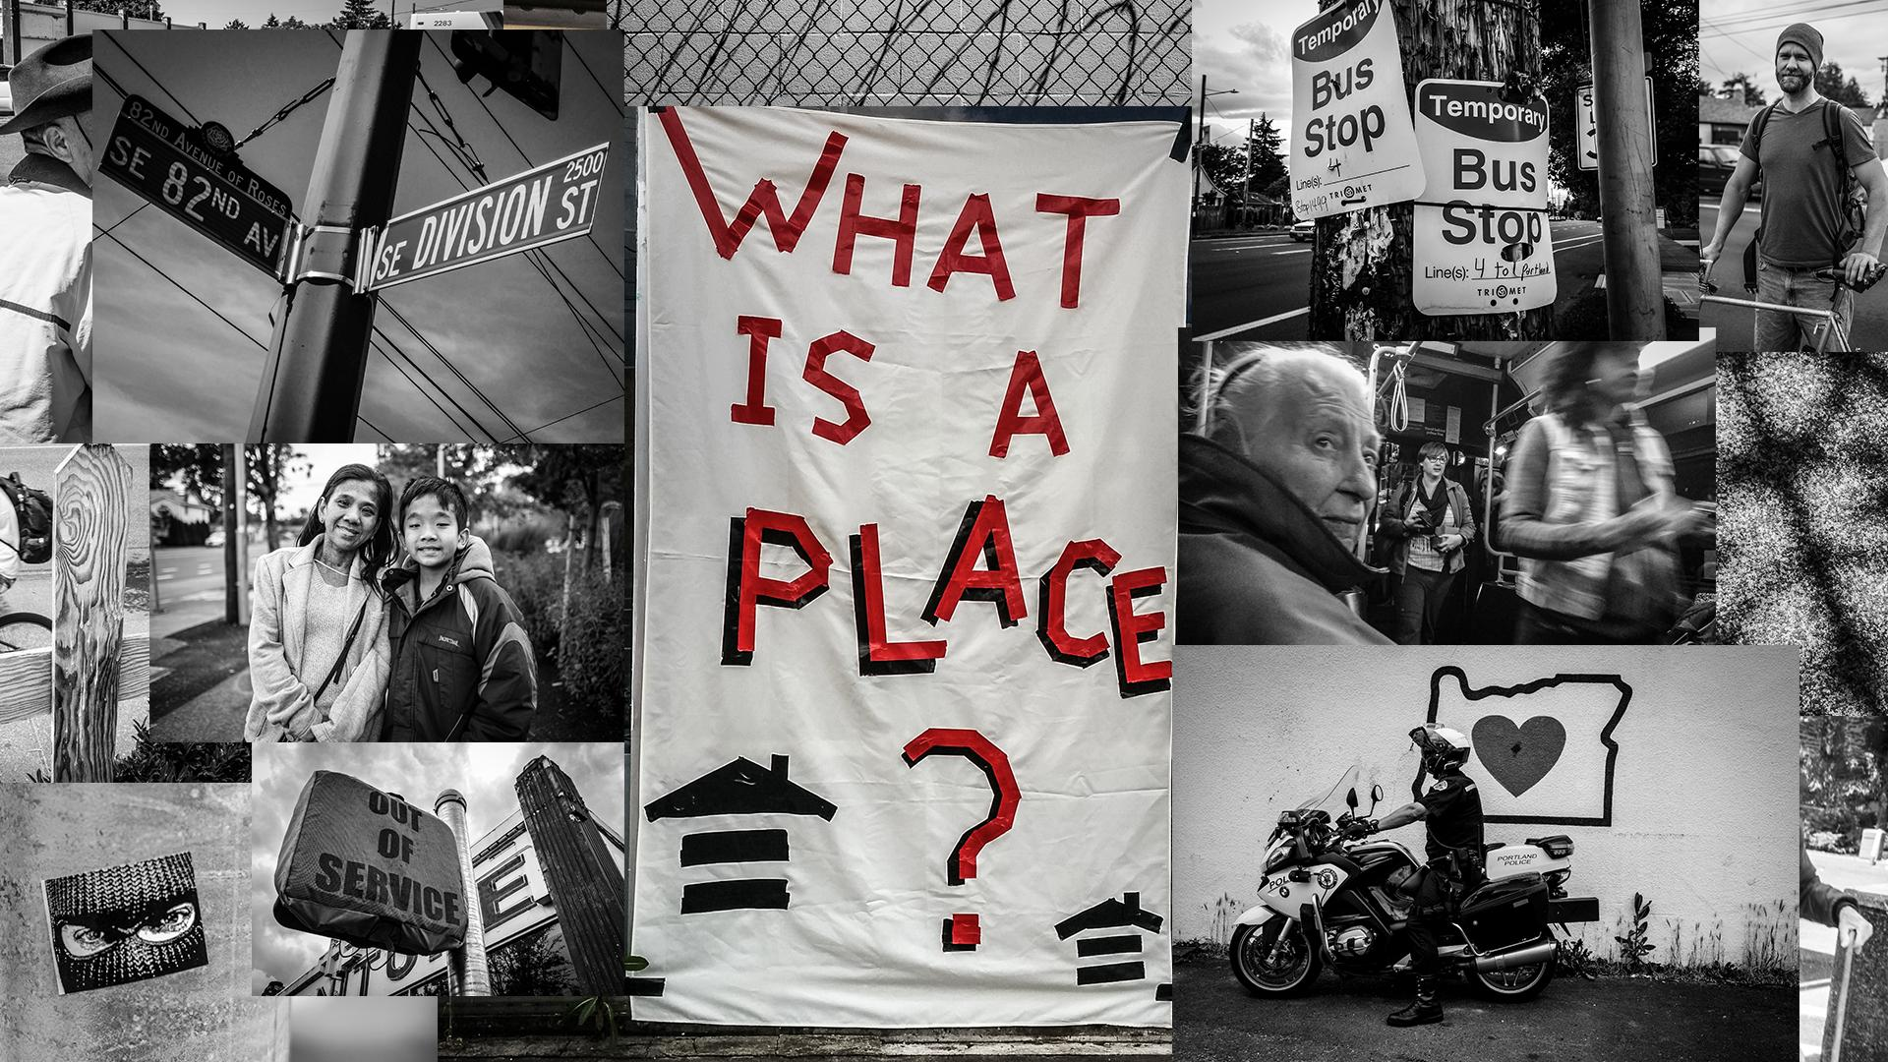
Creative Placemaking in Portland, Oregon

Slide 2
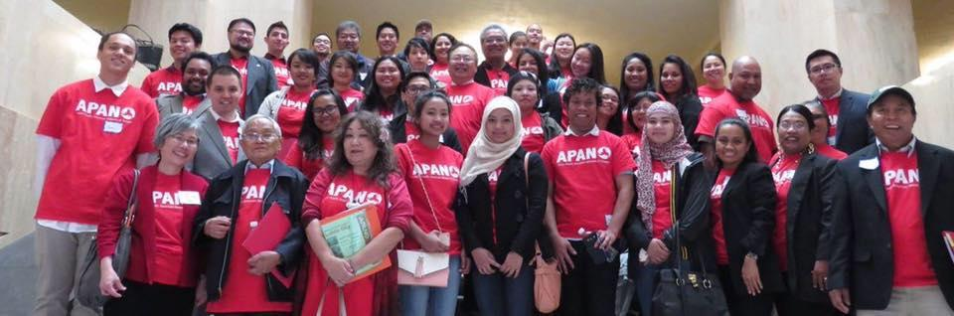
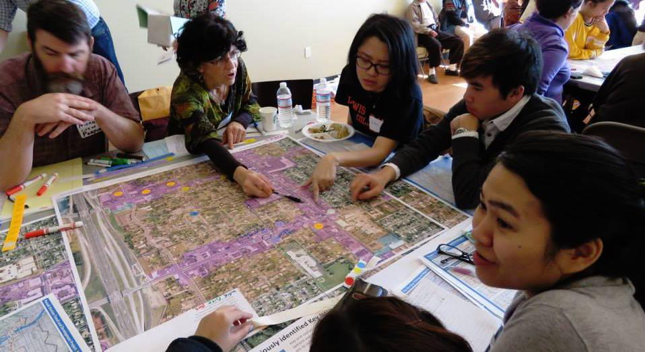
Introduction to APANO
Culturally Specific Organization
Statewide & Local Advocacy
Key Programs Areas
  Community Organizing
  Civic Engagement & Policy Advocacy
  Leadership Development
  Cultural Work
Fiscal sponsor of Cultural Corridors project in Portland
Not a CDC or service provider
Not an arts organization

Slide 3
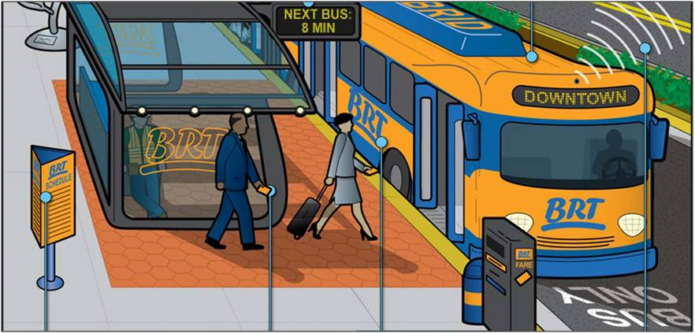
What is bus rapid transit (BRT)?
Larger buses
More comfortable stations
Transit priority leading to a faster, more reliable trip

Slide 4
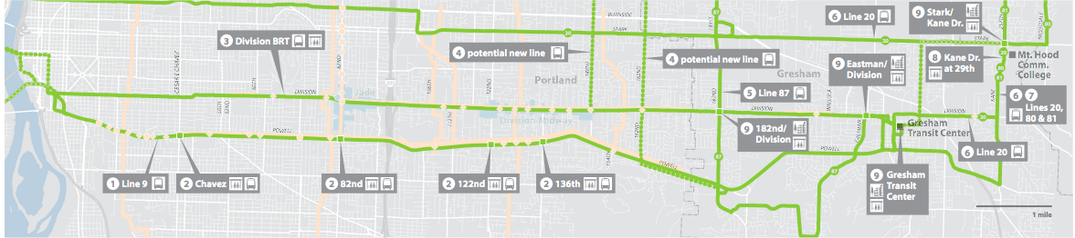


POWELL-DIVISION TRANSIT AND DEVELOPMENT PROJECT
A partnership of Metro, TriMet, the cities of Gresham and Portland,
Multnomah County and the Oregon Dept of Transportation
Division BRT line is a 15-mile corridor
Very high transit ridership
Connects high schools and higher education
Most diverse part of Oregon
Need for public investments in East Portland
Anticipated construction in 2019

Slide 5
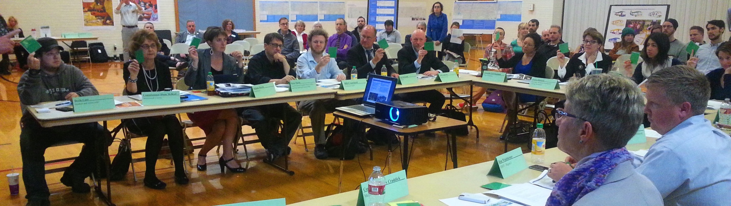
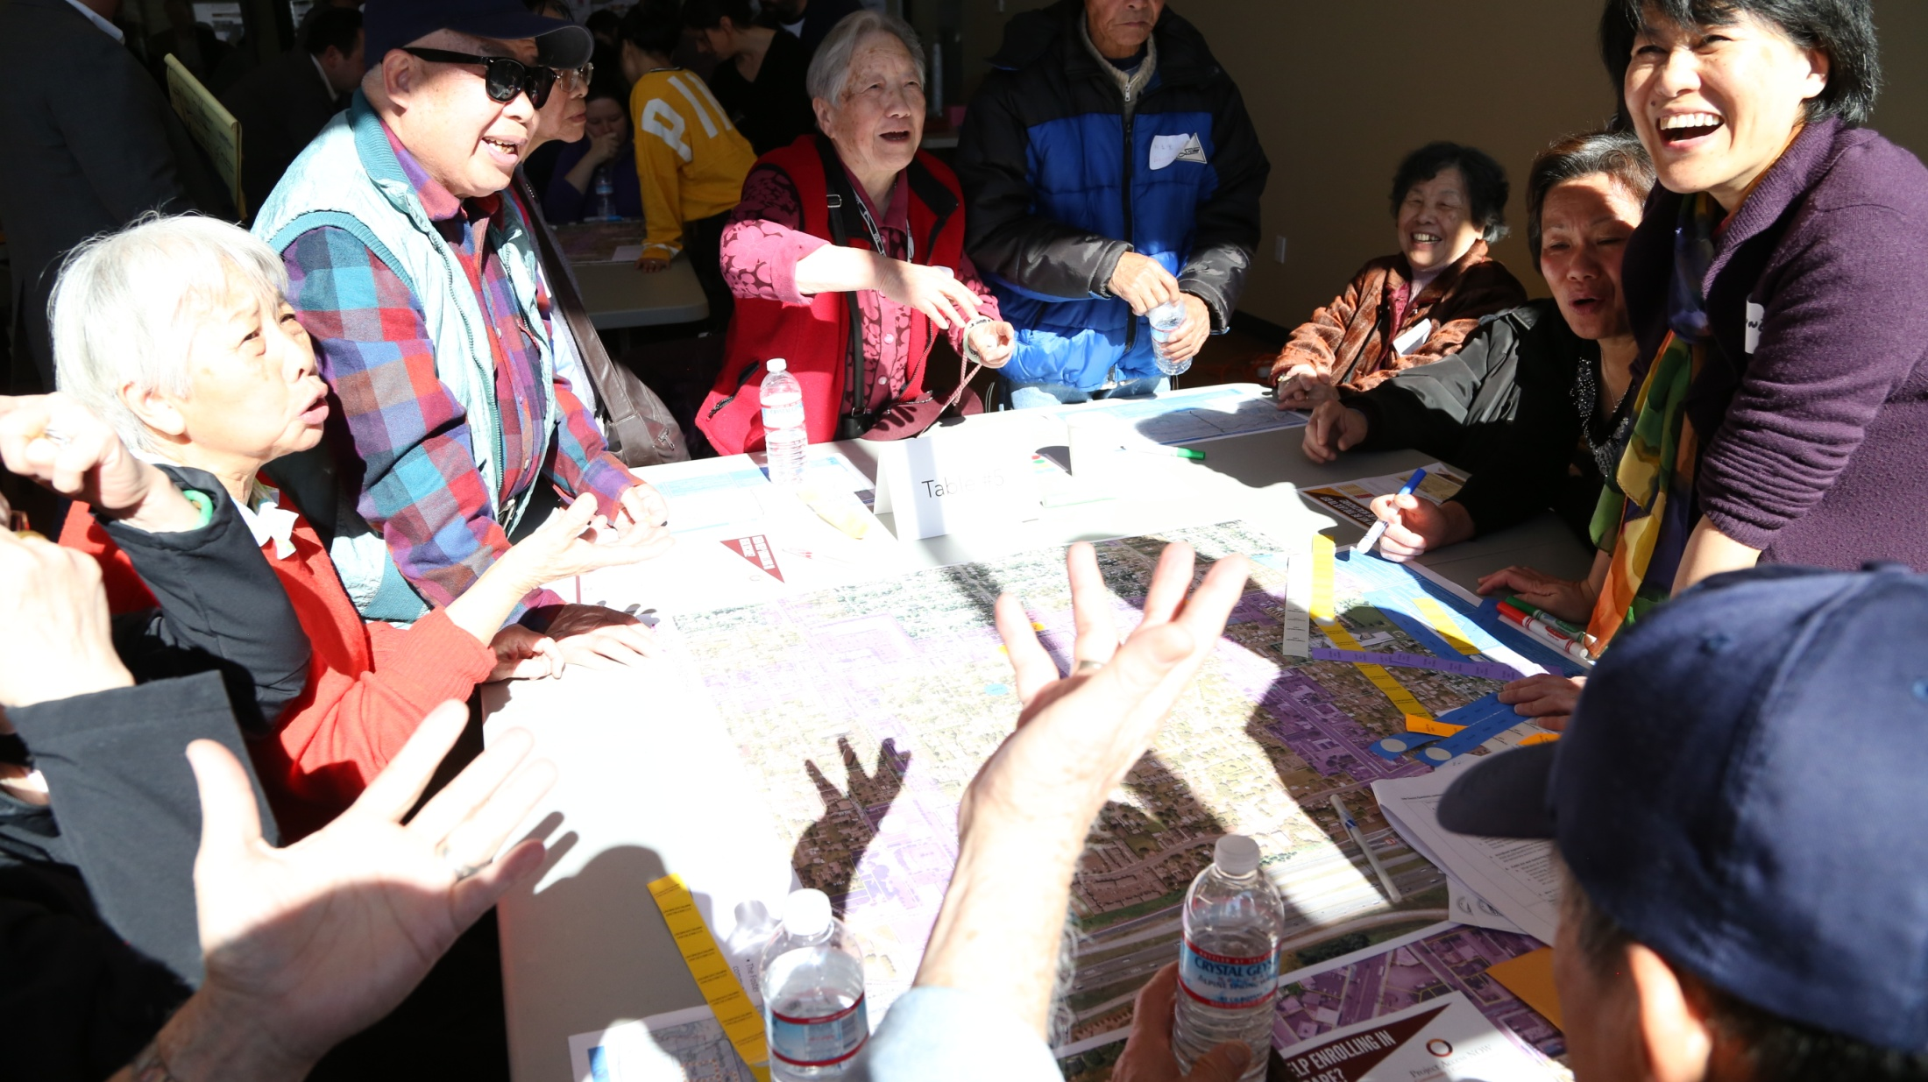
22-member Project Steering Committee
Communities of color
Neighborhood associations
Transit riders
Business representatives
Environmental advocates
Elected officials
Agency leaders
Educational institutions
Housing advocates
Health advocates
Environmental justice advocates
Traditional Community Outreach
Multi-Cultural Community Outreach
Youth Outreach

Slide 6
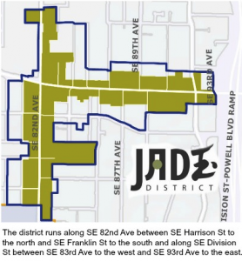
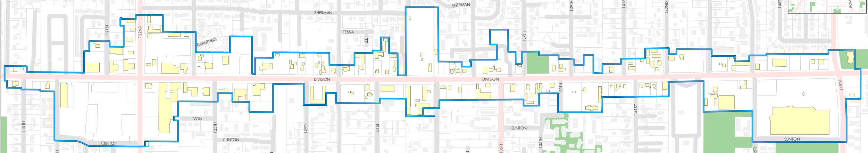
What are the Jade District & Division Midway?
Business districts in East Portland, Neighborhood Prosperity Initiatives
Micro Urban Renewal Areas (Community Control of Tax Increment Financing)
Lower income and vulnerable to gentrification and involuntary displacement.

Slide 7
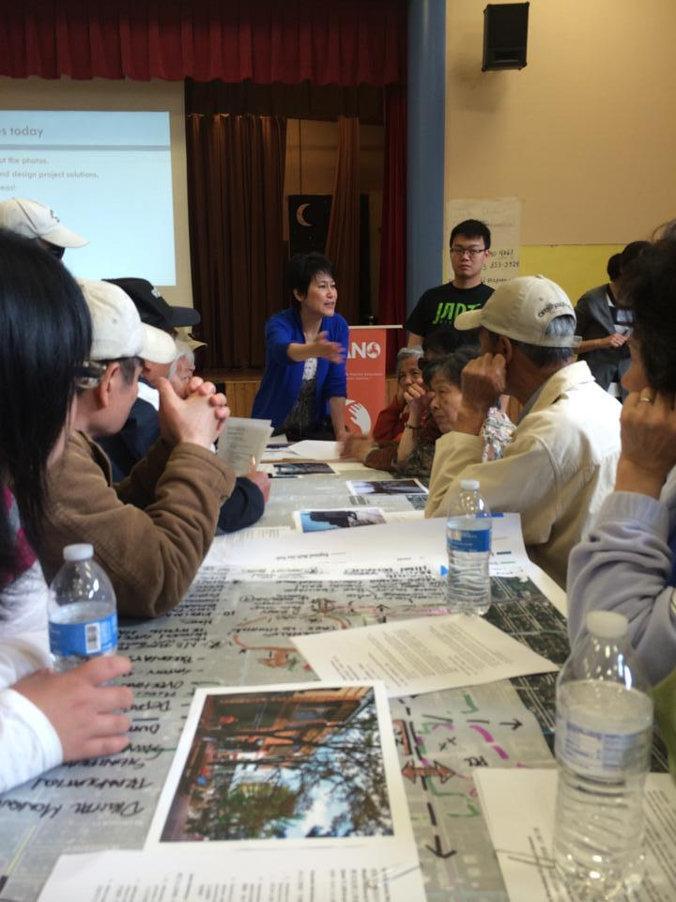
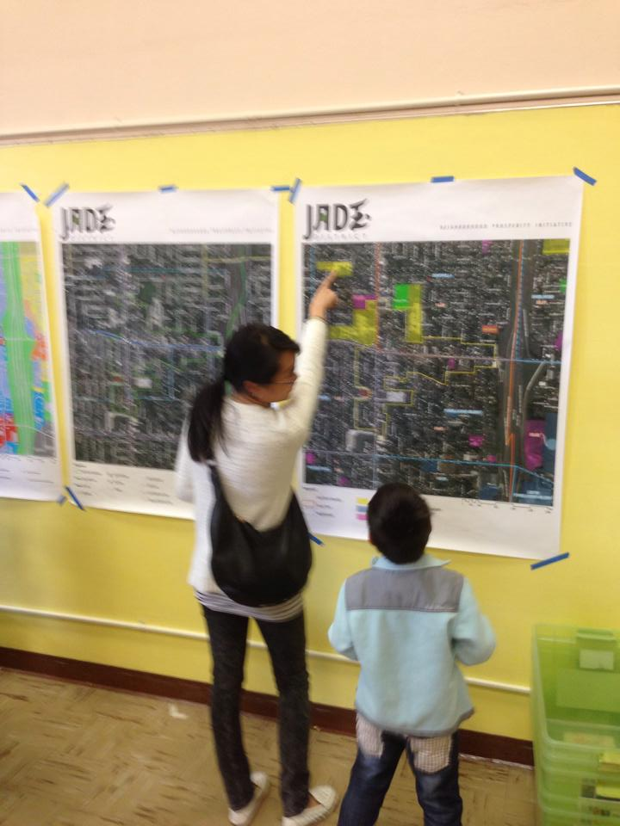
Jade District Visioning Process
Held in Cantonese, Vietnamese, Russian, Spanish, and English.
Priorities focused on built environment but touched upon health, education, and transportation.
Individual community workshops followed by a community wide charette.
Nearly 200 participants from community members across socioeconomic and age groups.

Slide 8
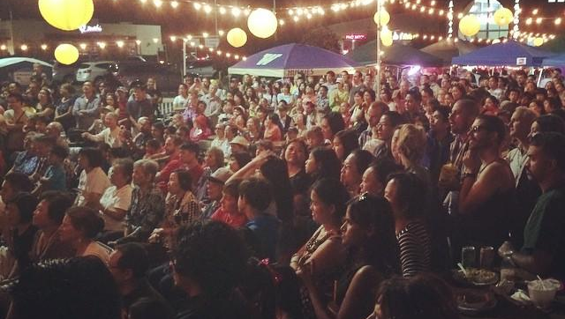
Making Visions Reality
Jade District Night Market
100 Local Vendors
Cultural Displays and Performances
25,000 Visitors
Organizing Opportunity
Now entering our 4th year

Slide 9
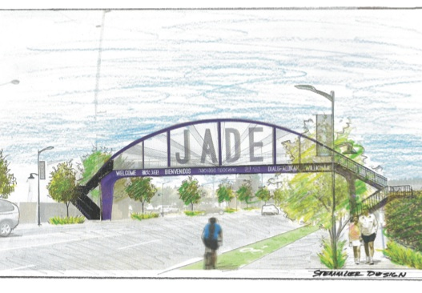
Opportunities for Creative Place-Making along Outer Division
Leveraging Transit Project to Meet Community Goals

Slide 10
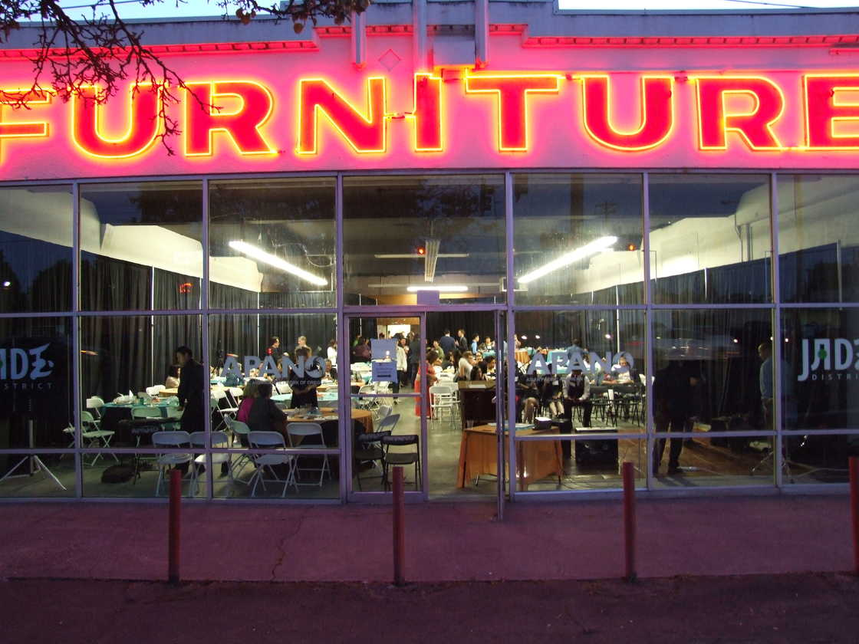
JAMS
Jade-APANO Multicultural Space
8,200 Sq Ft former furniture store
Metro owned TOD project
Leased free of charge to APANO
Future site of 48 units of housing
Future Community Center
Current community hub
Artist space

Slide 11
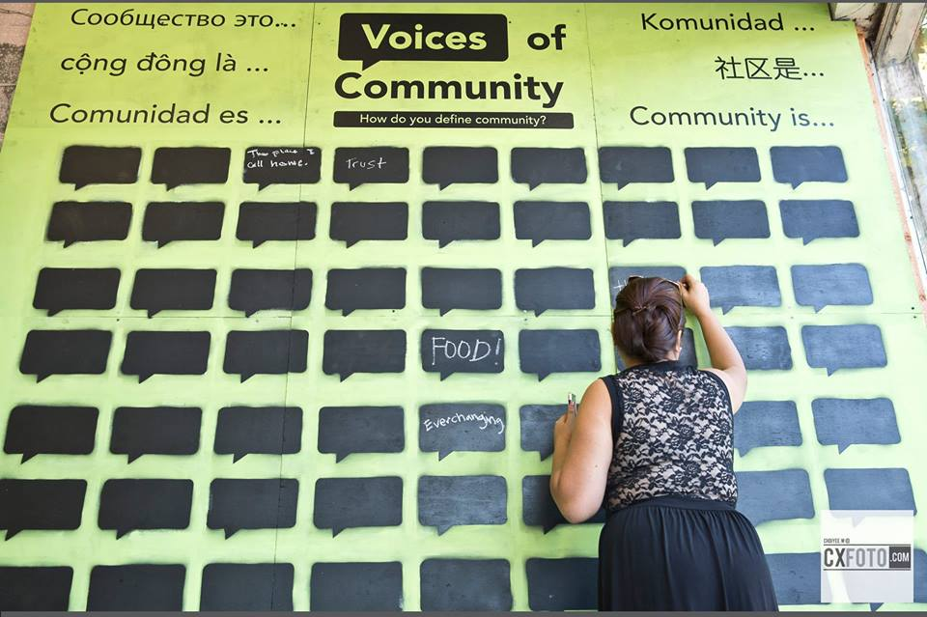
Our Values and Goals for Creative Placemaking
Advance our Community Vision in conjunction with BRT Project.
Do not fuel gentrification and displacement.
Celebration of “Diversity” is not enough.
Prioritize local community members and partners.
Complement community organizing on the ground.
Build community capacity to weigh in on decision-making.

Slide 12
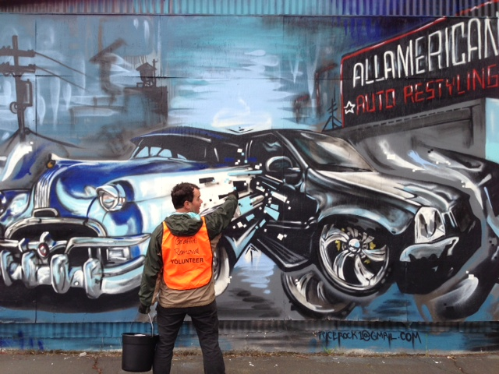
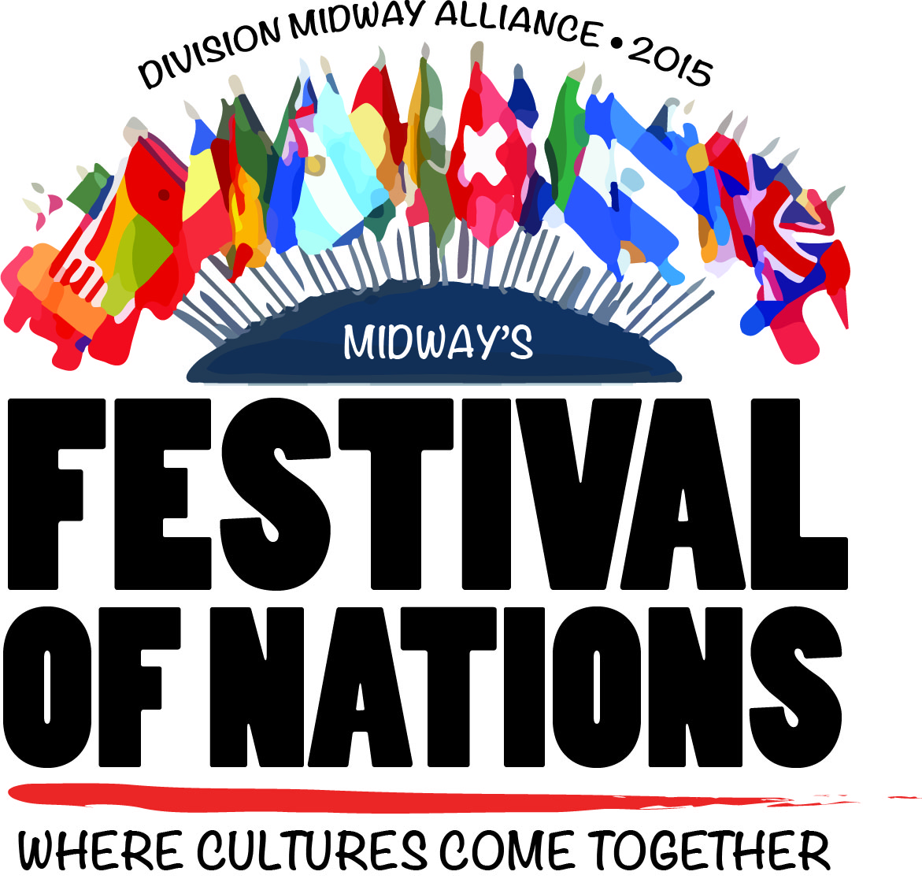
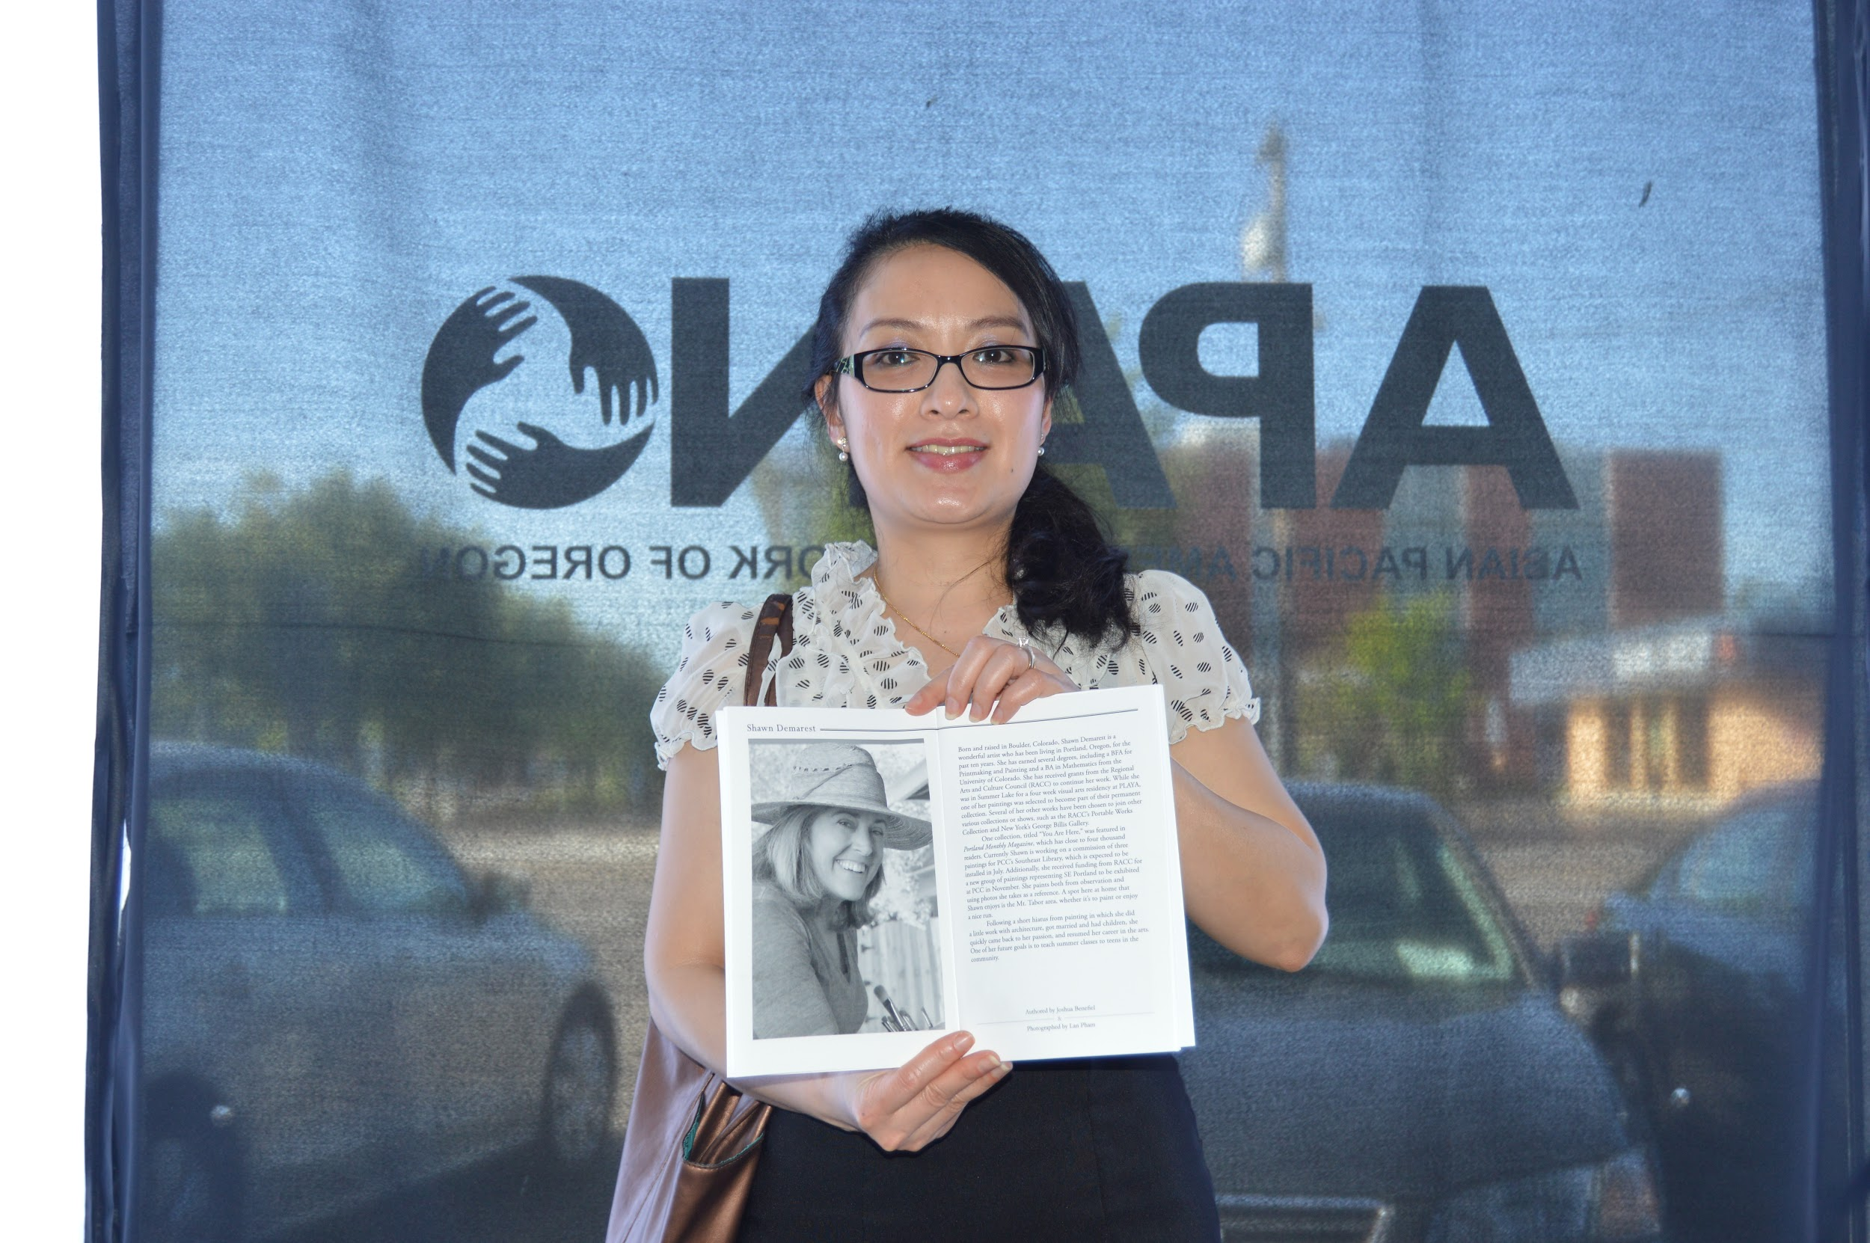
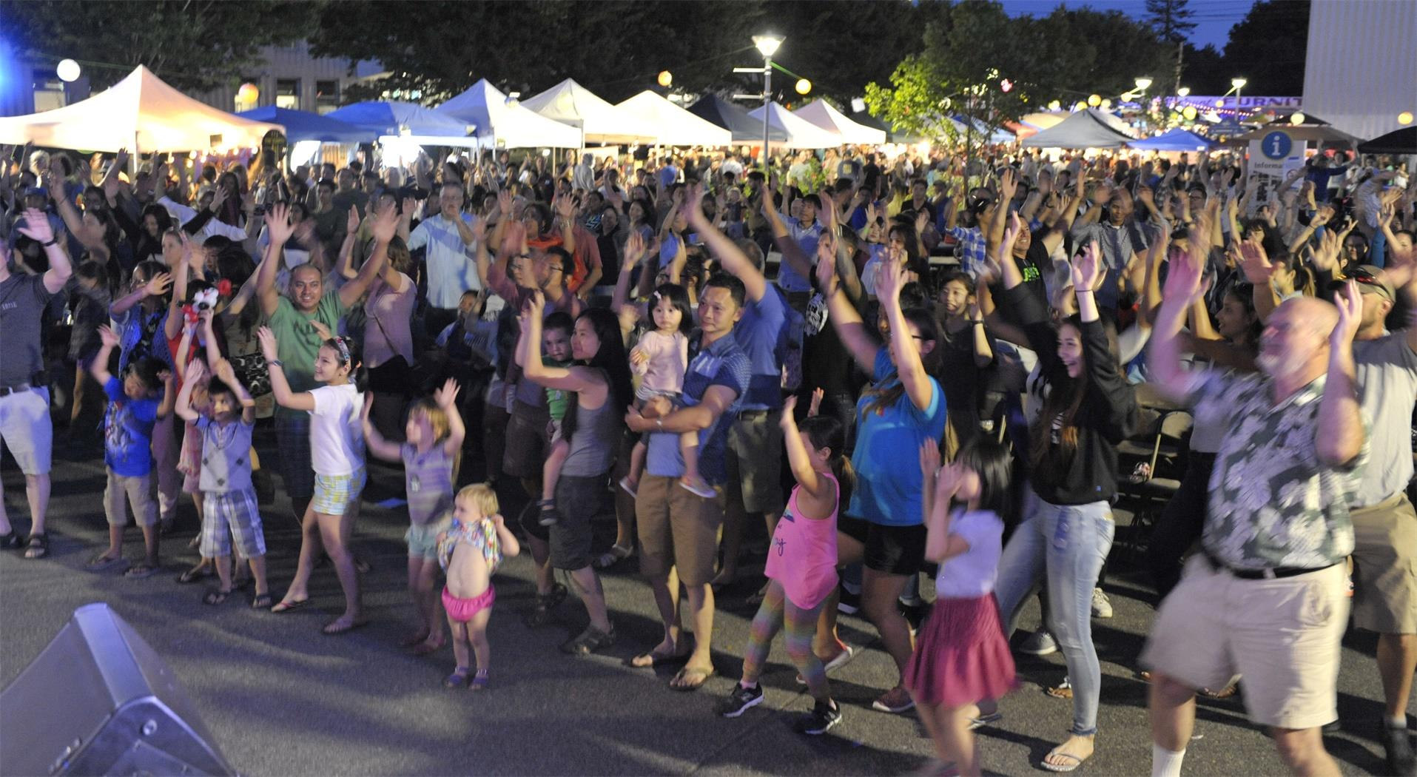
Projects Round 1 (2015)
Faces and Places
Tell it Slant
People’s Treasury of East Portland
One Voices, Many Languages
Dichos Populares
House of Bees
Mixing Together
Small Grants of $2,500

Slide 13
Lessons Learned from Year 1
Need to refine what “community art” is.
Need further dialogue and training to co-develop community serving projects.
Prioritize local community members, not just established artists.
Need to better integrate with broader professional arts community and government stakeholders.
Developing internal organizational infrastructure.
PAY ARTISTS BETTER!

Slide 14
Projects Year 2 (2016)
9 new projects of $2000-$5000
Resident Artist Collaborative (4 weekends of trainings for artists)
Stakeholder Steering Committee of local residents, electeds, agencies, arts organizations to guide process.
Creating Art Plan for Jade and Division Midway that will interface with Powell Division BRT project.
Built relationships with local arts funders to secure additional funding.

Slide 15

Year 2 Projects
Wish You Were Here
Writing group and Spoken Word
Voices of the Jade District
Oregon History Comic, Hung Far Low
Talk Story: Land is LIfe
Division Street Stories: SE Mixtape
Transit Inspired Interactive Performance
Unit Souzo, See Me, Hear Me
Mural Project
Total Project $75,000

Slide 16
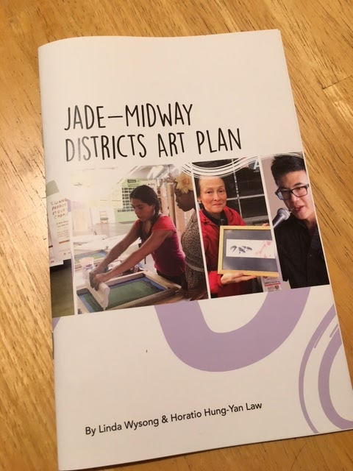
Year 3 (2017)
$7,000 grant including requirement for artist fee
Longer Grant Period to build relationships
Must undergo 4 weekend curriculum
Must interface with transit project
Guided by Jade-Midway Districts Art Plan
Advisory body of arts professionals
Guided by previous grantees
Community members select projects

Slide 17
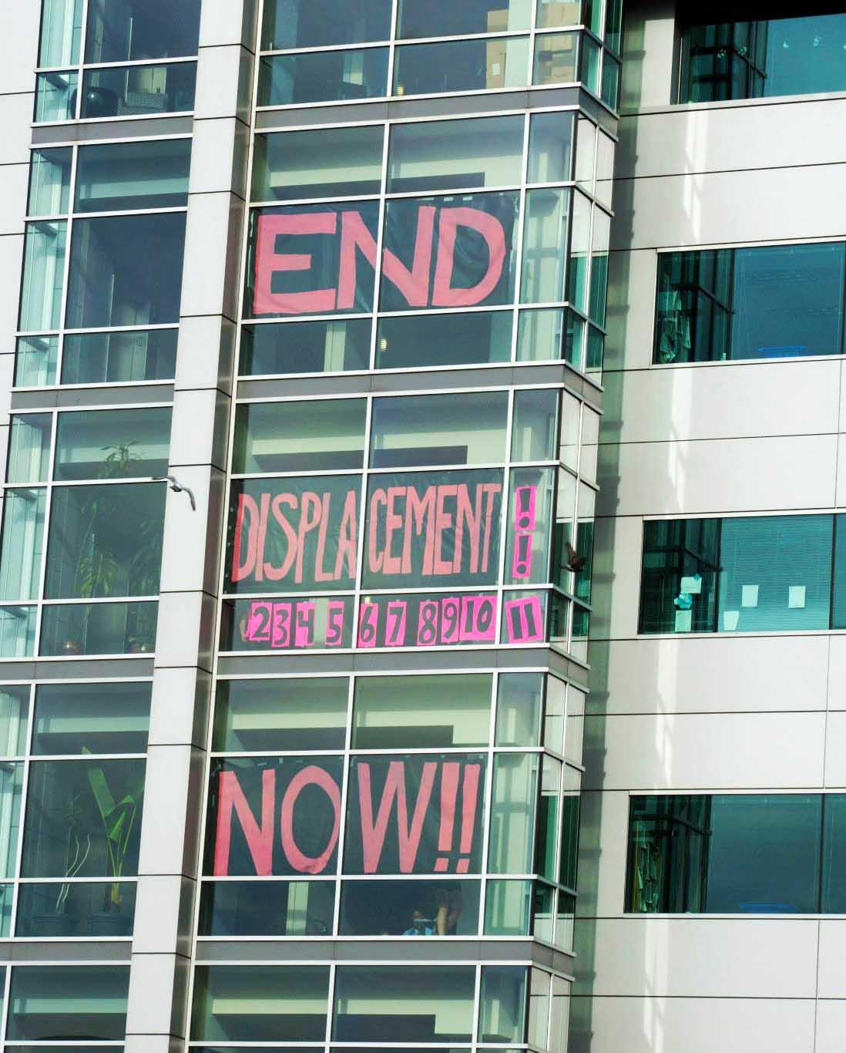
Influencing Public Policy
As an organizing/advocacy organization, already working on local anti-displacement measures.
Creative Placemaking complements our neighborhood organizing.
Seat at Metro’s Powell Division Steering Committee.
Recommendations for Portland’s Local Action Plan adopted.
Involvement in various coalitions such as Anti-displacement PDX.
Statewide lobbying on Inclusionary Zoning and WIN!

Slide 18
Contact Us!
Duncan Hwang, Associate Director
duncan@apano.org
Candace Kita, Cultural Work Coordinator
Candace@apano.org
Thank you!

