Slide 1
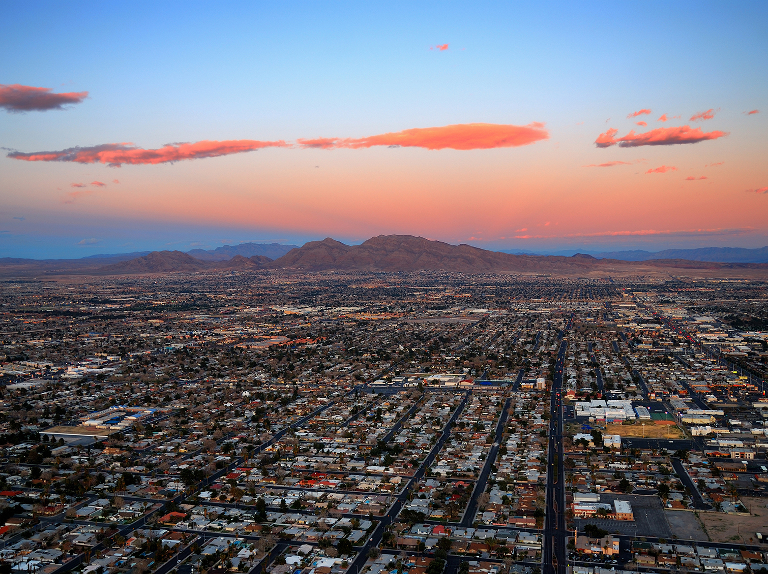
Air Quality Standards and Communication
Responding to Hyperbole
October 27, 2016
AMPO Annual National Conference

Slide 2

Air Quality Conformity Process
MPOs must demonstrate conformity to Air Quality standards
  TIP and RTP
  Transportation-related emissions must stay below a state-provided “budget”
Nonconformity can result in penalties, including withholding of funding
  Exceptions for safety, transit, and projects that improve air quality
Timing/Timeline is critical

Slide 3
Background
EPA proposed draft rule for comment
  New rule development process started in 2008
  Rule proposed in December 2014
  Comment period ended in March 2015
After comment period closed, U.S. Chamber of Commerce (as “Institute for 21st Century Energy”) put out three reports examining specific regions
Final rule released October 2015

Slide 4
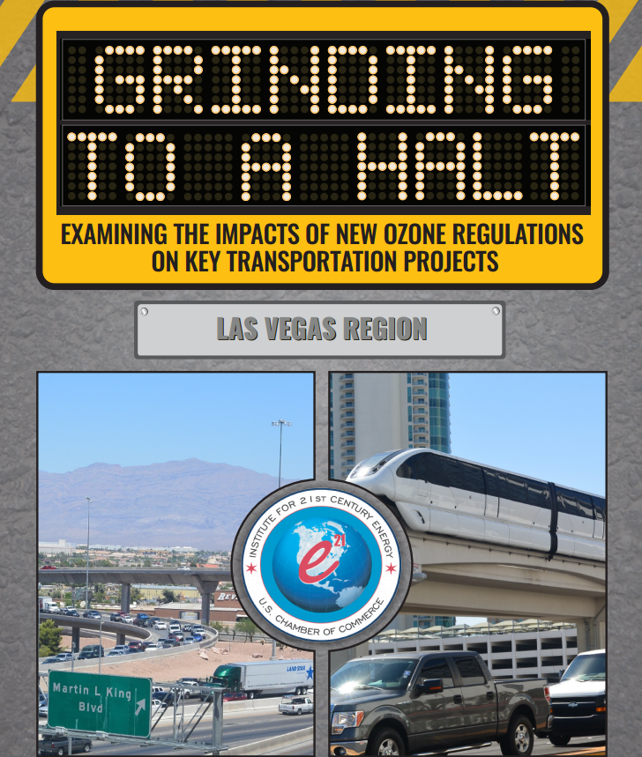
“Grinding to a Halt”

Slide 5
“Grinding to a Halt”
Makes four main points about new standards:
  Not technologically achievable
    “unknown controls”
  Background ozone accounts for significant portion
    About 50 ppb in Las Vegas region
  Economic and population growth prevents compliance
    In Las Vegas region, planners’ “hard work” offset by rapid growth
  High conformity costs and planning burdens
    Estimates that we spend about 9-18% of PL on conformity

Slide 6
“Grinding to a Halt”
Hypothesizes basic downward spiral:
  New Ozone rule = Nonconformity
  Nonconformity = Loss of funding
  Loss of funding = Projects can’t proceed
  Projects can’t proceed = Regional gridlock and economic stagnation
  Regional gridlock = worsening nonconformity
Potential outcome presented w/o alternatives
  Only presented worst case analysis; didn’t examine full range of EPA’s potential actions

Slide 7
Pressure on RTC to Respond
Chamber engaged directly with regional elected officials
Presented with a dire scenario, elected officials wanted RTC’s response
Without factual inaccuracies, little to actually refute
Considered alternatives:
  Refute it anyway, but a no-win outcome
  Agree with a seemingly hopeless outcome
  Try to explain actual expected minimal impacts
But little media traction; only two mentions

Slide 8
“Grinding to a Halt” Claims
“Grinding to a Halt” Claim
Region suffers from some of the worst traffic congestion in the country
Clark County will have extreme difficulty complying with new standards
Cost-effective methods to comply have largely been exhausted
EPA can begin withholding transportation funding as early as 2018
At least 10 projects for $346 million at immediate risk (FY18 & FY19), and another $1.4 billion is at longer-term risk
Population and economic growth wipe out ozone-reducing measures
Heavy burden on planning agency to conduct conformity determination and related planning

Slide 9
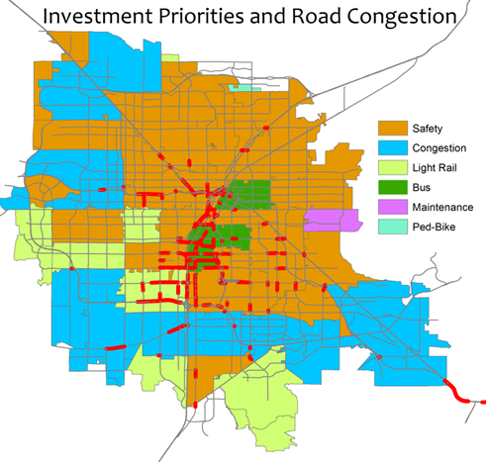
Worst traffic congestion in the country?
Managing Congestion ranked as 2nd regional priority in a recent transportation survey
Actual congestion (V/C >= 1.0) mostly concentrated around the Las Vegas Strip
TTI’s 2015 rankings:
  Travel delay per commuter: 27th
  Freeway Planning Time Index: 46th
  Cost per Commuter: 42nd

Slide 10
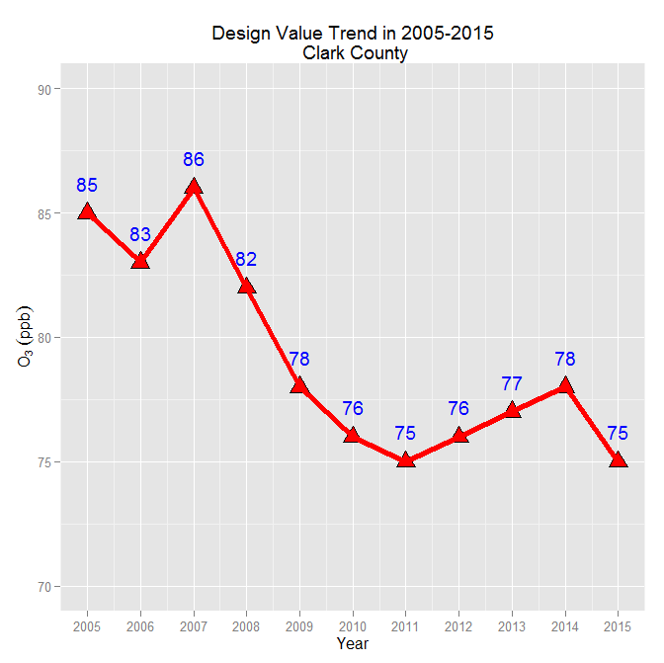
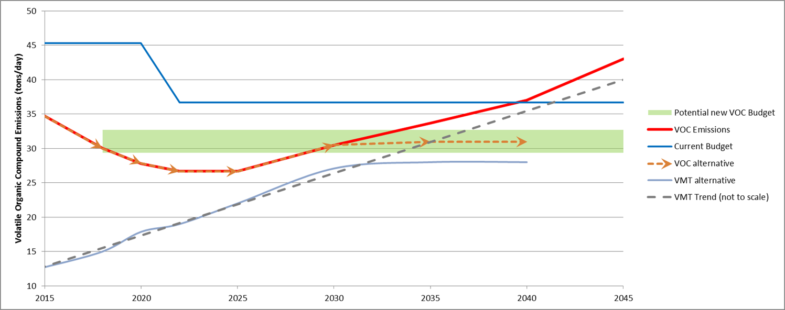
Extreme difficulty complying?
Presumably based on limits of vehicle technology
  CAFE standards
MANY sources – not just transportation – contribute to Ozone
Local AQ Dept will determine transportation sector’s “budget”
Current trends project transportation emissions decreasing over next ~10 years
Compliance will be a long-term issue, but NOT an immediate one
Current Trend

Slide 11
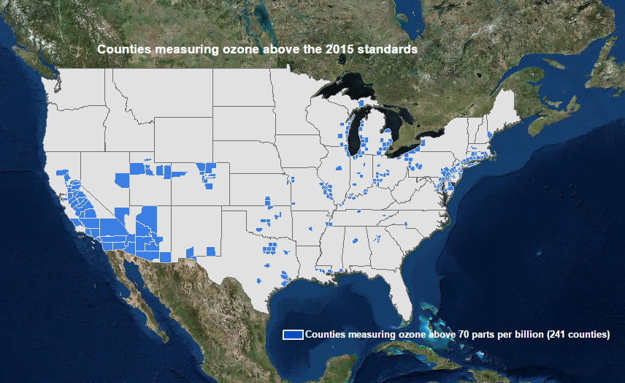
Projected Non-Attainment (2015)

Slide 12
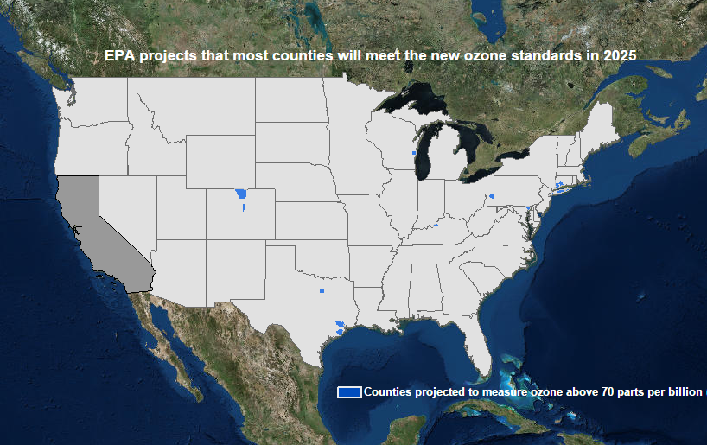
Projected Non-Attainment (2025)
Notes:
Only 14 counties

Slide 13
Begin losing funding in 2018?
2015
2016
2017
2018
2019
2020
1
2
3
4
5
① Standard Finalized – Oct. 2015 (effective date December 28, 2015)
② State recommendations on area designations due Oct. 2016
③ EPA finalize area designations/classifications due Oct. 2017
Likely based on 2014-2016 data - Marginal Non-Attainment
Date triggers planning and attainment deadlines
④ Infrastructure SIP due – Oct 2018
⑤ Marginal Area attainment date – Oct. 2020
Likely based on 2017-2019 data
RTC’s assessment:
  Barring multiple agency failures to act, AND
  Assuming emissions worsen with no agency response,
  Earliest we might see funding at risk is 2022
  (FOUR years later than “Grinding to a Halt” asserted)

Slide 14

Planning & Control Mandates
EXTREME
20 years to attain
TRAFFIC CONTROLS DURING CONGESTION
CLEAN FUELS REQUIREMENTS
PENALTY FEE PROGRAM FOR MAJOR SOURCES
SEVERE
15/17 years to attain
LOW VOC REFORMULATED GAS
VMT GROWTH OFFSET
VMT DEMONSTRATION
NSR REQUIREMENTS FOR EXISTING SOURCE MODS
ENHANCED I/M PROGRAM
CLEAN FUELS PROGRAM
SERIOUS
9 years to attain
MODELED DEMO OF ATTAINMENT
CONTINGENCY MEASURES FOR RFP
3% ANNUAL RFP UNTIL ATTAINMENT
ENHANCED MONITORING PLAN
BASIC I/M PROGRAM
CONTINGENCY MEASURES FOR FAILURE TO ATTAIN
MODERATE
6 years to attain
ROP (15% RFP OVER 6 YEARS)
VOC/NOx RACT FOR MAJOR/CTG SOURCES
ATTAINMENT DEMONSTRATION
TRANSPORTATION CONFORMITY DEMONSTRATION
MARGINAL
3 years to attain
NEW SOURCE REVIEW PROGRAM
MAJOR SOURCE EMISSION STATEMENTS
BASELINE EMISSION INVENTORY
PERIODIC EMISSION INVENTORY UPDATES

Slide 15
Claims vs Reality (1)
“Grinding to a Halt” Claim | RTC’s Assessment
Region suffers from some of the worst traffic congestion in the country | Depends on how you look, but Southern Nevada isn’t among “the worst traffic congestion in the country” Our measures of congestion indicate issues, but not major regional problems
Clark County will have extreme difficulty complying with new standards | Depends on the final rule, but even at the stricter level EPA’s analysis showed that Southern Nevada would comply by 2025 Our AQ modeling shows continued decrease in Ozone through ~2028; Final rule was the less stringent alternative
Cost-effective methods to comply have largely been exhausted; focus on “unknown controls” | After ~2028 we may need to take more focused actions; wise to start planning now History shows that requirements can be met (possibility AVs will accelerate transition to EVs)

Slide 16
Claims vs Reality (2)
“Grinding to a Halt” Claim | RTC’s Assessment
EPA can begin withholding transportation funding as early as 2018 | Assertion is HIGHLY dependent on our agency timeline; Only true if RTC and Dept of AQ completely ignore responsibility to develop a compliance strategy; Our estimate of earliest potential impacts was 2022 (based on adoption schedule for TIP and RTP); Actually an opportunity to enhance planning and programming
List of specific projects at risk | It would take inaction on RTC’s part for the projects to actually be at risk; Details of identified projects are incorrect

Slide 17
Claims vs Reality (3)
“Grinding to a Halt” Claim | RTC’s Assessment
Population and economic growth wipe out ozone-reducing measures | Even with rapid population and economic growth over last 20 years, emissions have been going down; Even so, this assertion may turn out to be correct, but that’s what an MPO is meant to address; Actually an opportunity to enhance planning and programming
Heavy burden on planning agency to conduct conformity determination and related planning | RTC already conducts broad range of conformity modeling and analysis for CO and PM10; Marginal additional cost for also examining ozone is pretty small; Planning activities may need to change, but for long-range impacts, not immediate ones

Slide 18
Overall series of RTC’s actions
Chamber report released August 2015
Our analysis and initial assessment
First response: Memo to General Manager – August 2015
  Answered one question: Will the impacts described by Chamber happen?
  But we were responding rather than leading
Final Rule release – October 2015
Presentation to Public Works Directors – January 2016
  Attempt to work through agencies’ staffs, rather than directly to elected officials
New Strategy: Take charge of communicating impacts
  Change discussion to talk about RTC’s activities, rather than the Report’s lingering pessimism
  Matrix/timeline describing our upcoming milestones:
    NAAQS-related actions
    RTC’s planning and project-delivery activities
    activities and potential impacts, rather than on responding to or debunking someone else’s analysis)
  Memo v2
  Timeline slides

Slide 19
RTC’s Planning-Related Assessment

Slide 20
Major issue with Grinding to a Halt
Perfect example of “stovepiping” regional issues
  Focused only on negative impacts
  Ignores potential benefits from new rule
  Assumes only MPO role is building roads and funding transit for economic growth… no other concerns:
    Public health
    Protecting the
    environment
Sphere of Interest Represented by
“Grinding to a Halt”
Economy
Quality of Life
Resources

Slide 21


RTC’s regional role
MPO
Transit Provider
Southern Nevada Strong

Slide 22
Treating Risk as Real
Chamber’s treatment of risk as reality:
  “Conformity lapses are triggered when an MPO”… is unable to demonstrate conformity.
  Many “ifs”, with mostly accurate “thens”
  Difficult structure to overcome, because a possible hypothetical can’t really be disputed, especially with a significantly large (but low probability) outcome
Saying “we won’t let that happen” wasn’t something that policymakers could interpret

Slide 23
Final Advice: Understand Motivations
Why did Chamber release “Grinding to a Halt”?
  Chamber was opposed to new ozone NAAQS years before it was released
  Focus of opposition was about impact on high-emitting energy producers and manufacturing sector
  Purpose may have been to broaden base of stakeholders opposed
Timing of the Report didn’t allow it to generate much traction
Important to note that the Report didn’t offer any recommendation for the region
Only offered a request to EPA to “take a more reasonable approach”

Slide 24
Questions or Comments?
Craig Raborn
rabornc@rtcsnv.com
702-676-1715

Slide 25
Finding the Opportunity
Opportunity:
  Leverage to improve planning process
  Opens future discussions about air quality issues
Separate “Current” issues from “Future” ones
Understand underlying reason for the trend

Slide 26
Lingering Issues
Our travel activity (SOV VMT) continues to increase
Ozone reductions probably due to CAFE standards
Impact from technology will taper mid-2020s; emissions may increase starting ~2028
Before then, Southern Nevada will need to end reliance on technology windfall and start implementing other solutions

Slide 27


NEW OZONE REGULATIONS
THE REGIONAL TRANSPORTATION COMMISSION OF SOUTHERN NEVADA

Slide 28
Ozone-related Action
US Chamber of Commerce releases “Grinding to a Halt” report
2025
Oct. 2015
Feb. 2016
Early 2018
Late 2018
Early 2019
Aug. 2015
Jun. 1, 2017
Oct. 1, 2016
Oct. 1, 2017

Slide 29
Ozone-related Action
New NAAQS released and standard changed from 75ppb to 70ppb
2025
Oct. 2015
Feb. 2016
Early 2018
Late 2018
Early 2019
Aug. 2015
Jun. 1, 2017
Oct. 1, 2016
Oct. 1, 2017

Slide 30
Ozone-related Action
EPA issues designation guidance
2025
Oct. 2015
Feb. 2016
Early 2018
Late 2018
Early 2019
Aug. 2015
Jun. 1, 2017
Oct. 1, 2016
Oct. 1, 2017

Slide 31
Ozone-related Action
State recommendation due
2025
Oct. 2015
Feb. 2016
Early 2018
Late 2018
Early 2019
Aug. 2015
Jun. 1, 2017
Oct. 1, 2016
Oct. 1, 2017

Slide 32
Ozone-related Action
EPA response to state recommendations
2025
Oct. 2015
Feb. 2016
Early 2018
Late 2018
Early 2019
Aug. 2015
Jun. 1, 2017
Oct. 1, 2016
Oct. 1, 2017

Slide 33
Ozone-related Action
EPA issues final area designations
2025
Oct. 2015
Feb. 2016
Early 2018
Late 2018
Early 2019
Aug. 2015
Jun. 1, 2017
Oct. 1, 2016
Oct. 1, 2017

Slide 34
Ozone-related Action
EPA designations implemented
2025
Oct. 2015
Feb. 2016
Early 2018
Late 2018
Early 2019
Aug. 2015
Jun. 1, 2017
Oct. 1, 2016
Oct. 1, 2017

Slide 35
Impact of Ozone action on RTC’s Process
MUST adopt TIP prior to conformity grace period ending; exact date will be known in early 2018
Ozone-related Action
None
2025
Oct. 2015
Feb. 2016
Early 2018
Late 2018
Early 2019
Aug. 2015
Jun. 1, 2017
Oct. 1, 2016
Oct. 1, 2017

Slide 36
Ozone-related Action
One year transportation conformity “grace period” ends
2025
Oct. 2015
Feb. 2016
Early 2018
Late 2018
Early 2019
Aug. 2015
Jun. 1, 2017
Oct. 1, 2016
Oct. 1, 2017

Slide 37
Ozone-related Action
EPA estimates Clark County in attainment
2025
Oct. 2015
Feb. 2016
Early 2018
Late 2018
Early 2019
Aug. 2015
Jun. 1, 2017
Oct. 1, 2016
Oct. 1, 2017

Slide 38


Slide 39
Questions or Comments?
Craig Raborn
rabornc@rtcsnv.com
702-676-1715

