Slide 1
Meaningful Public Input for…

Slide 2
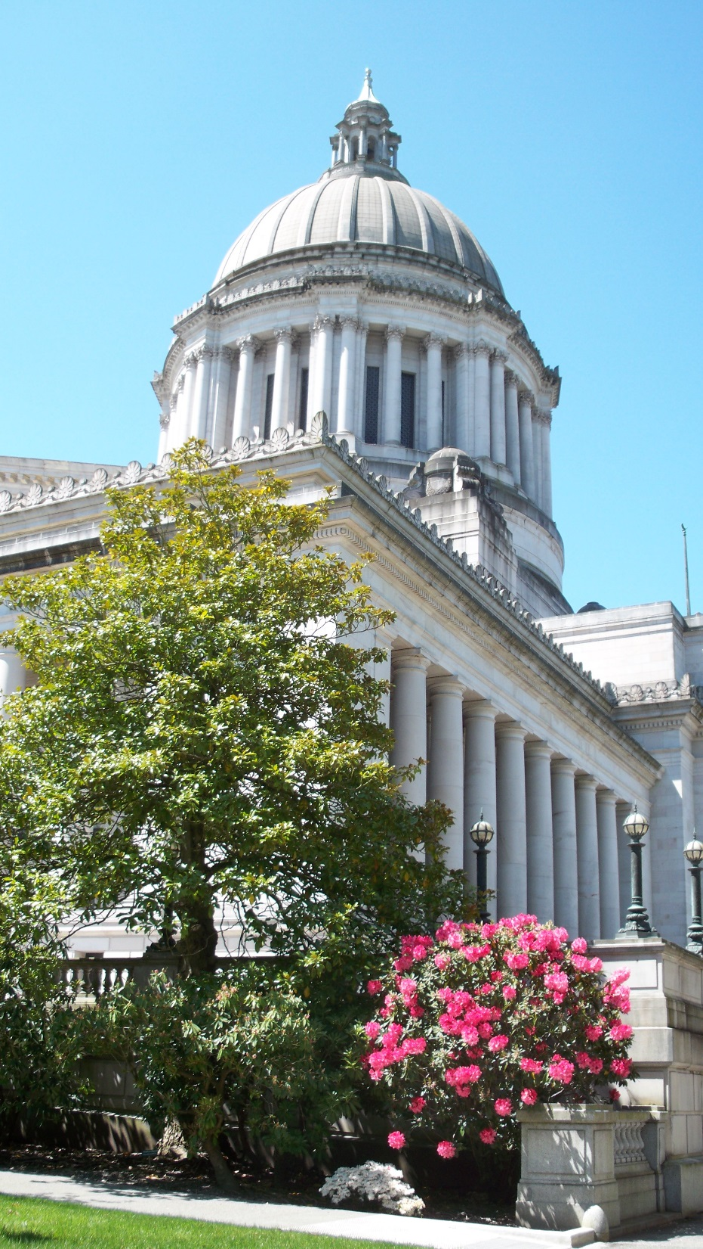
WHO ARE WE?
Thurston Regional Planning Council
Mid-sized MPO (just under 200,000)
Washington State
Olympia - State Capital

Slide 3
OBJECTIVES
Get people to think:
Regionally
Strategically
About the future and transportation

Slide 4
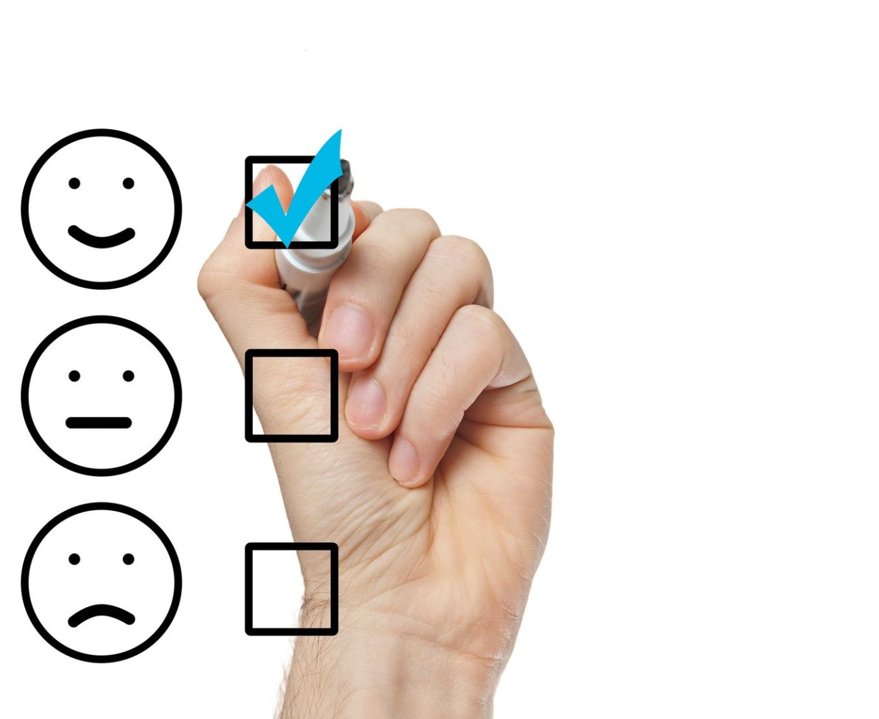
TOOLS
Short Video
Investment Calculator
Survey

Slide 5
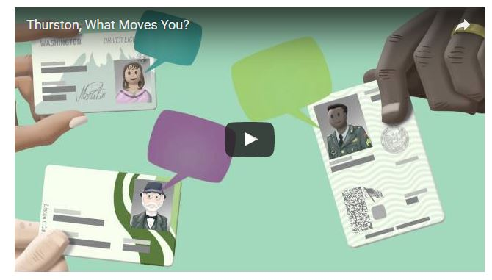
VIDEO
3½ minutes
Scripted by planning staff
Filmed video clips on iPad
graphics created in house
Staff participated
Policy board member did voice over

Slide 6
PURPOSE of the video
Think regionally about how the transportation system functions
Over 1,000 views

Slide 7
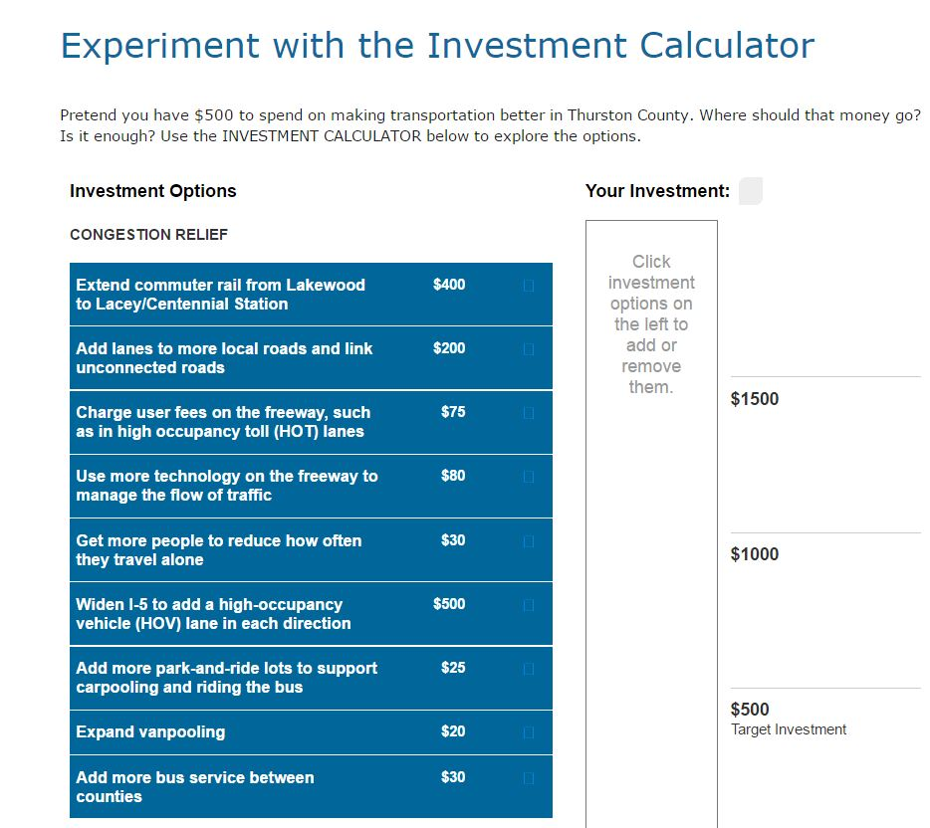
INVESTMENT CALCULATOR
Pretend you have $500 to spend on making transportation better in Thurston County.
Where should that money go?

Slide 8
INVESTMENT CALCULATOR
$
Options for:
Congestion relief
Local travel options
System maintenance
$1000s of dollars
of options
for a
budget
of $500 –
people were forced to
PRIORITIZE.

Slide 9
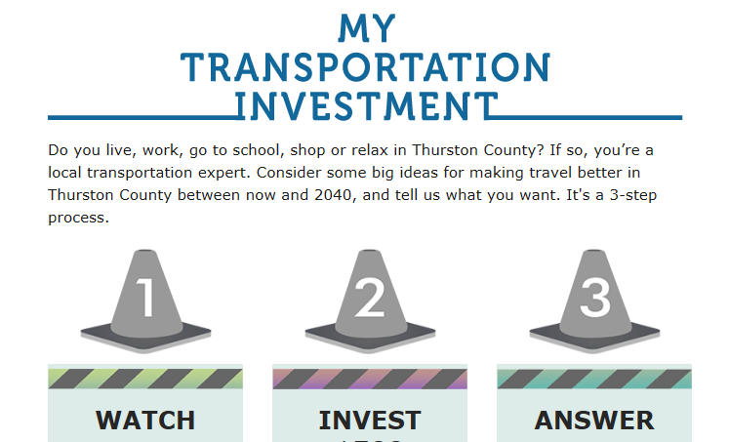
www.ThurstonWhatMovesYou.org

Slide 10
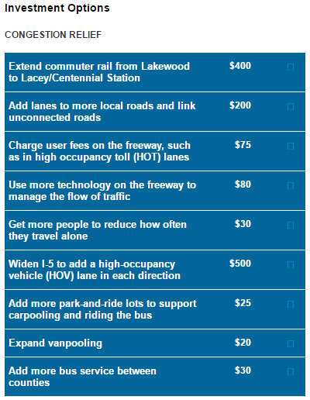
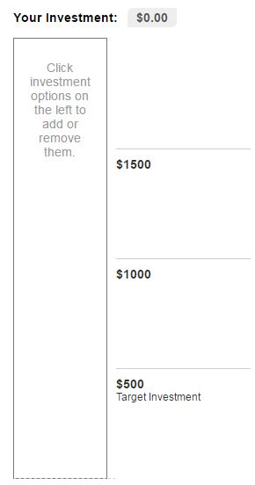
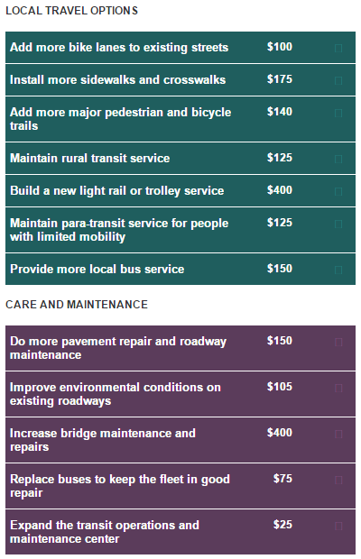

Slide 11
Widen I-5 to add a high-occupancy $500
vehicle (HOV) lane in each direction

Slide 12
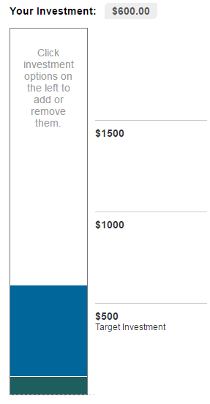
Add more bike lanes to existing streets $500
Widen I-5 to add a high-occupancy $500
vehicle (HOV) lane in each direction

Slide 13
Add more bike lanes to existing streets $500
Widen I-5 to add a high-occupancy $500
vehicle (HOV) lane in each direction

Slide 14
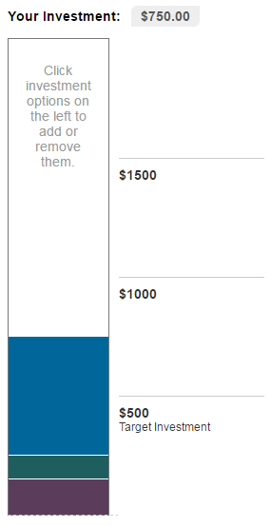
Add more bike lanes to existing streets $500
Widen I-5 to add a high-occupancy $500
vehicle (HOV) lane in each direction
Do more pavement repair and roadway $500
maintenance

Slide 15
HOW MANY?
1,449 Survey Respondents

Slide 16
^{questions 2 & 5:} CALCULATOR
Did it get used?
YES … by 75% of respondents
Was it useful?
YES … 85% said so

Slide 17
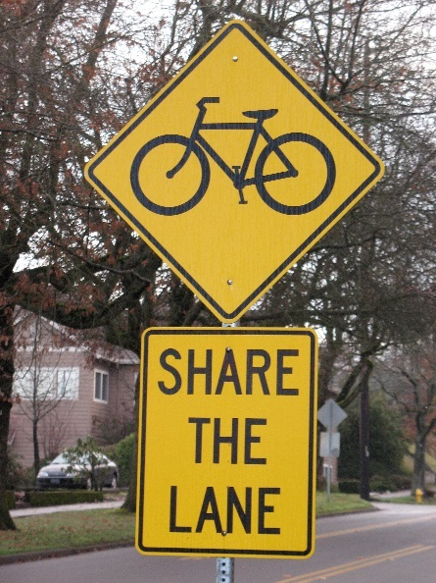
^{question 1:} TOP PRIORITIES
Me (60%+)
Bike Lanes
Sidewalks/Crosswalks
Trails
Pavement Repair
Other (245)

Slide 18
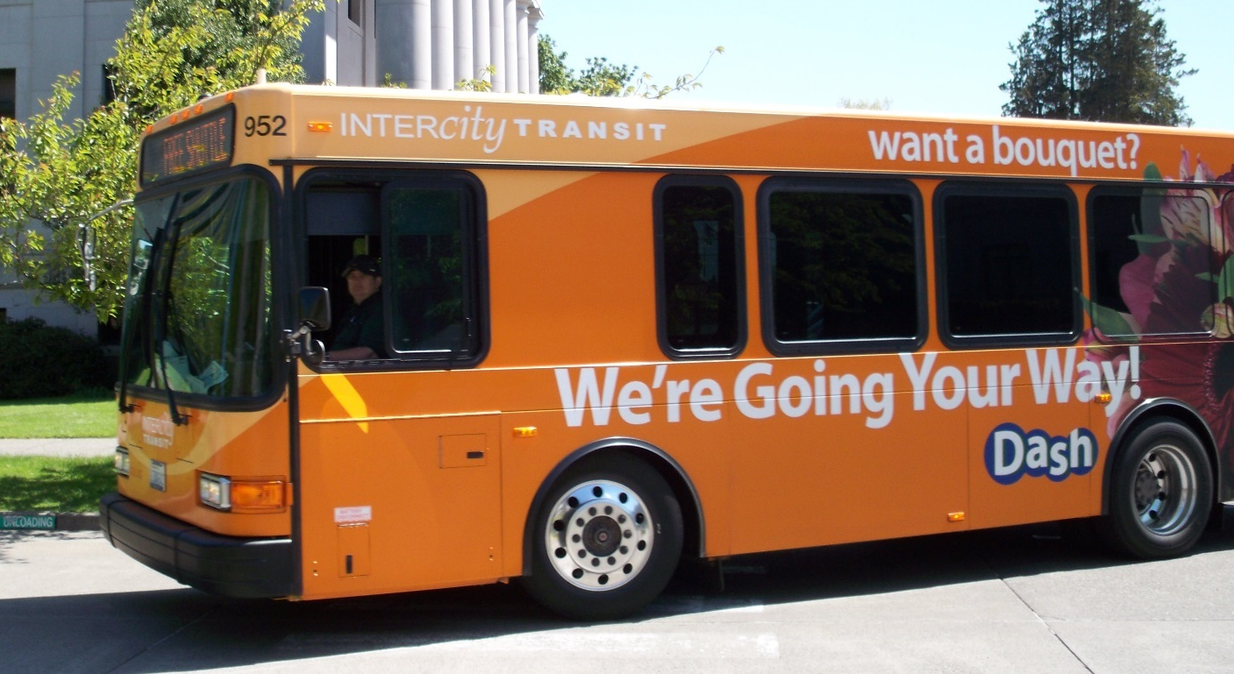
^{question 1:} TOP PRIORITIES
Me (60%+) Bike Lanes – Sidewalks – Trails – Pavement
Community (60%+)
Transit
Inter-County Bus & Rail
Vanpooling, Park & Ride, Commute Trip Reduction
Para-Transit & Rural Transit
Fleet Repair

Slide 19
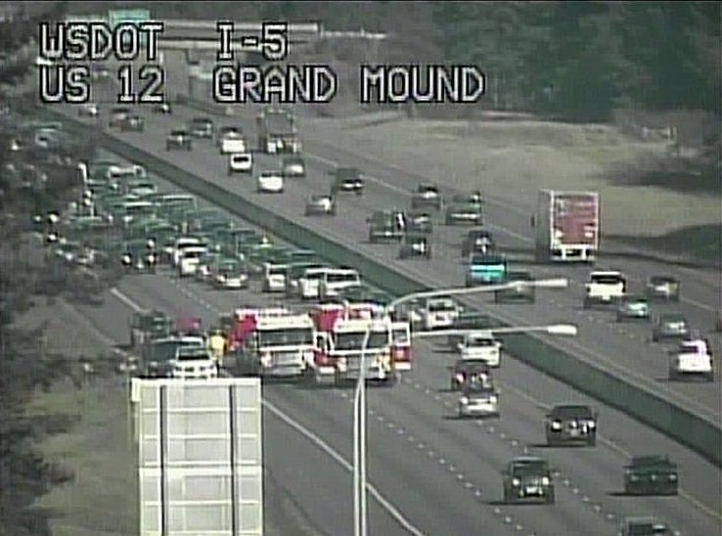
^{question 1:} TOP PRIORITIES
Me (60% +) Bike Lanes – Sidewalks – Trails – Pavement
Community (60%+) Transit
Commerce
Freeway – Widen
Tech
Fees
Repair – Pavement
Bridges

Slide 20
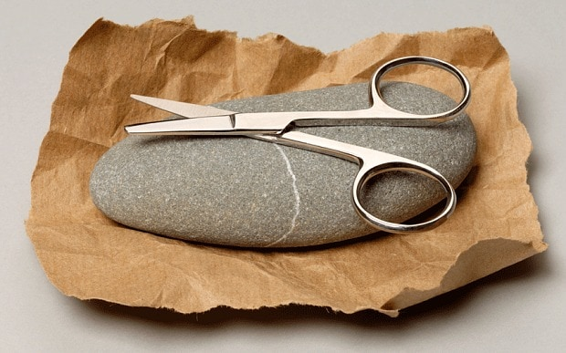
^{question 7:} PICK JUST 1 BIGGIE
Split Response…
1/3 Commuter Rail
1/3 Combo of Lower Cost
1/4 Light Rail

Slide 21
^{question 9:} IN 10 YEARS…
 | MORE | LESS | SAME | NONE
Drive |  | ✓
Walk | ✓ |  | ✓
Bicycle | ✓
Bus | ✓
Carpool |  |  | ✓ | ✓
Telework | ✓ |  |  | ✓
Train | ✓ |  |  | ✓

Slide 22
^{question 10:} WHY …
941 Responses
Retiring
Telework
Kids
Fuel Costs
. . .

Slide 23
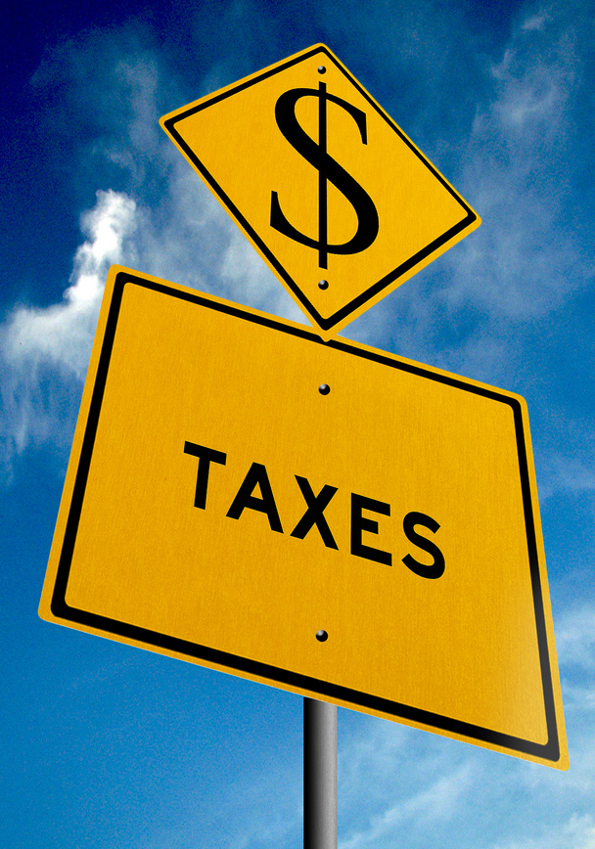
^{question 11:} TAX INCREASE
For transportation priorities you feel are important …
YES 66% of respondents

Slide 24
Contact:
Veena Tabbutt
tabbutv@trpc.org

