Slide 1
Forging a New Path on Corridor planning Studies the sr7 planning study
AMPO 2016 – Fort worth, tx
October 28, 2016
Roxana Ene, Project Manager, Broward MPO
Elisabeth Schuck, AICP, LEED GA, Tindale Oliver
Notes:
Multimodal-focused corridor studies are not a new practice. However, often these types of studies focus on implementing one type of improvement or identifying long-term, high-cost transformative projects rather incorporating short-term “low-hanging fruit” type improvements. This presentation examines the different types of improvements recommended for the SR 7 corridor in Broward County, focusing on three layers of recommendations: immediate corridor-wide improvements, short-term network connectivity projects, and long-term project development concepts, and discusses the intersection of different technical analyses and public outreach methods used to identify each layer.

Slide 2
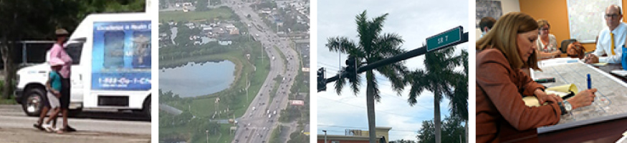
Agenda
Overview
Study Process & Innovative Concepts
Project Recommendations
Notes:
This presentation examines the different types of improvements recommended for the SR 7 corridor in Broward County, focusing on three layers of recommendations: low hanging fruit immediate corridor-wide improvements, short-term network connectivity projects, and long-term project development concepts. This presentation also highlights some innovative concepts for public outreach and technical analyses used to develop the project recommendations.

Slide 3
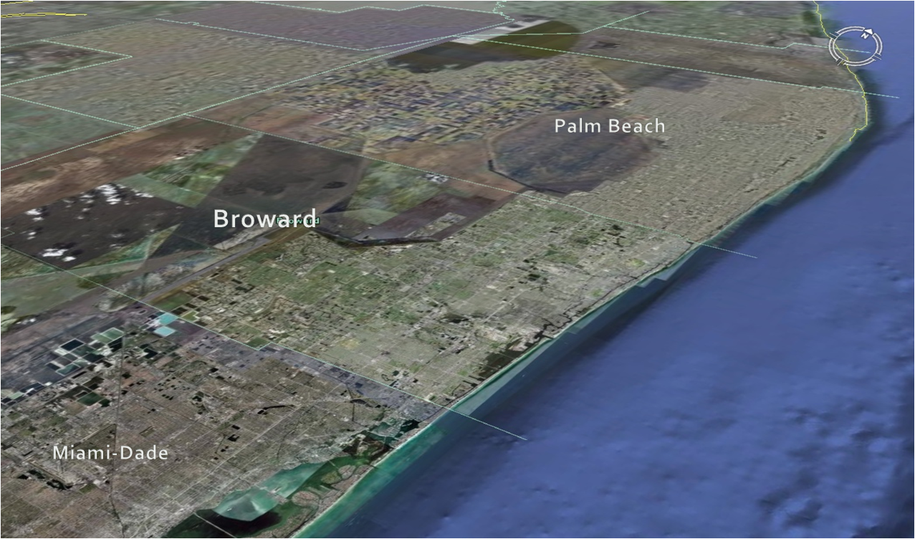
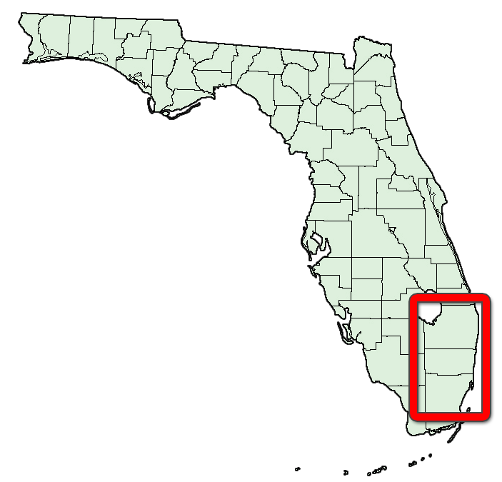
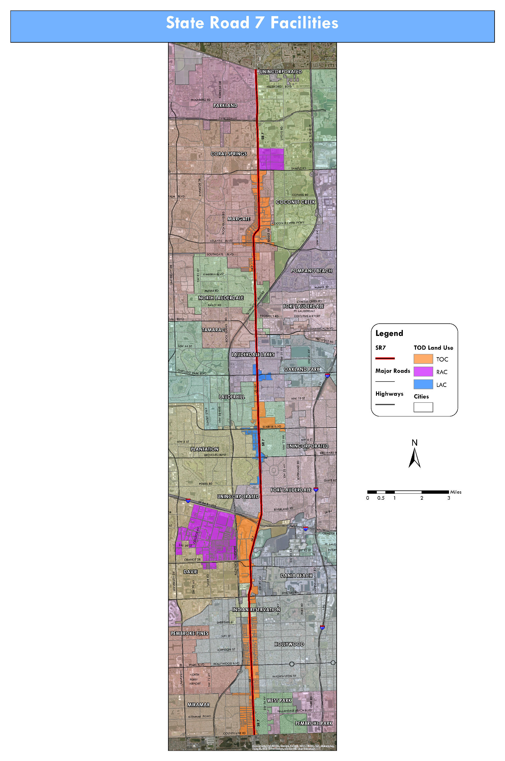


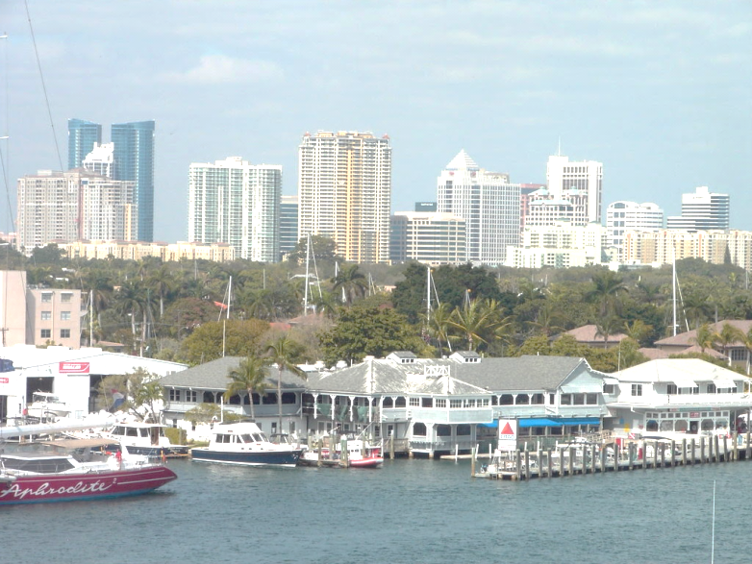
Broward Metropolitan Planning Organization
www.browardmpo.org
Everglades National Park
Fort
Lauderdale
Atlantic Ocean
www.browardMPO.org
Fort Lauderdale Skyline

Slide 4
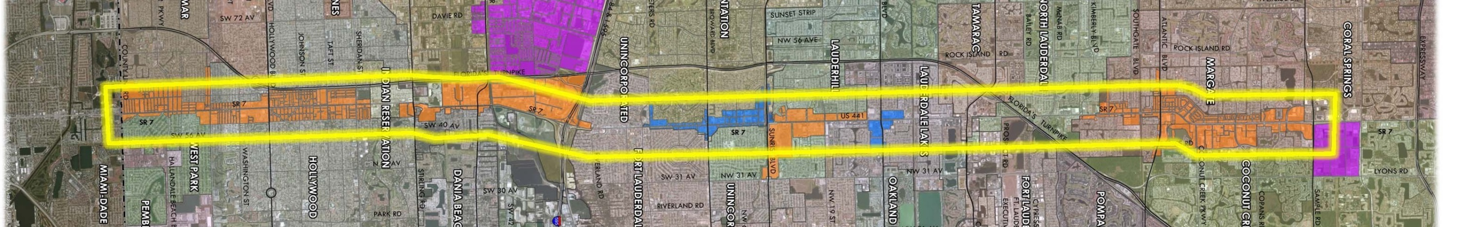
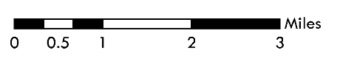
Overview:
Study Area and Purpose
½ mile on either side of SR 7 Miami-Dade County Line to Sample Road (20+ mi)
Identify congestion management & safety improvements for all modes
Enhance transit rider, bicyclist, & pedestrian experience
Develop short-term improvements for implementation (<5 years)
Identify longer-term improvements for project development
Be consistent with National Environmental Protection Act (NEPA)
SR 7 Study Area
Transit Oriented Corridor
Regional Activity Center
Local Activity Center
Notes:
Study Area description – SR 7
SR 7 is a north-south regional principal arterial through South Florida. This study focuses on a approximately 21-mile section of SR 7 from just south of the Miami-Dade County Line to north of Sample Rd and extends out ½ mile to both the east and west of SR 7.
Within the study area alone, the corridor impacts 15 municipalities, unincorporated Broward County, and the Seminole Tribe of Florida. The study area is characterized by predominantly commercial uses fronting the corridor with single family residential neighborhoods behind, with higher land use intensities in the south half of the corridor. The speed limit varies between 40 and 45 MPH and the existing ROW varies between 80 to 160 feet.
Multi-family development and other trip generators, including the Hard Rock Casino, car dealers, medical centers, hospitals, shopping centers, and schools to name a few examples, are found at major intersections and along the corridor. SR 7 has the highest transit ridership of any corridor in Broward and this is one reason we focused on improving transit and connectivity/accessibility to transit. The existing traffic volumes (60,000 to 80,000 VPH) and there is a high frequency of pedestrian and bicycle crashes within the study area, due to the high traffic, so improving overall mobility and safety for all users is the key focus of this study.

Slide 5




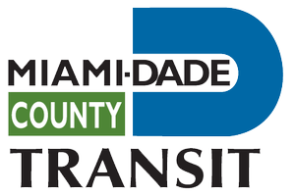



Public Outreach:
Innovative Concepts
The Project Advisory Committee (PAC) consists of the following agencies:
Broward County
Traffic Engineering Department
FDOT District 4
(Various Offices)
Broward MPO
Broward County Transit
Miami-Dade MPO
South Florida Regional
Planning Council
Miami-Dade Transit
South Florida Regional
Transportation Authority
Notes:
Due to the length of the corridor and high number of stakeholders involved, we created two groups for public outreach and feedback. The first group of stakeholders were more technical oriented and involved Broward County, Broward MPO, Florida DOT, the South Florida Regional Transportation Authority, and the South Florida Regional Planning Council. We also invited similar agencies from Miami-Dade County since this study reached the county line. The role of the PAC was to take information back to their agency and provide technical review and feedback.

Slide 6
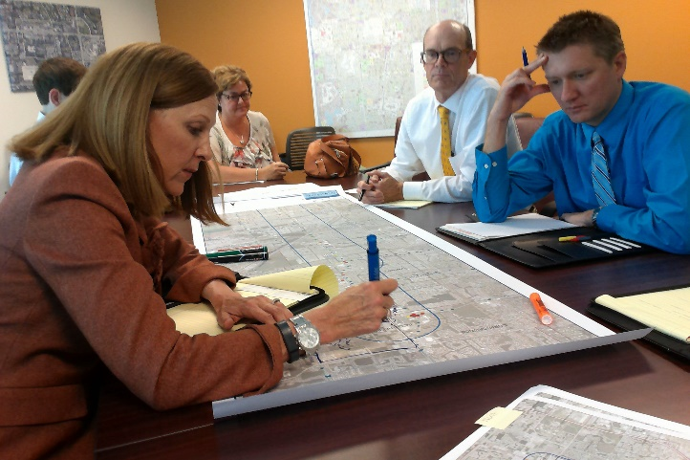
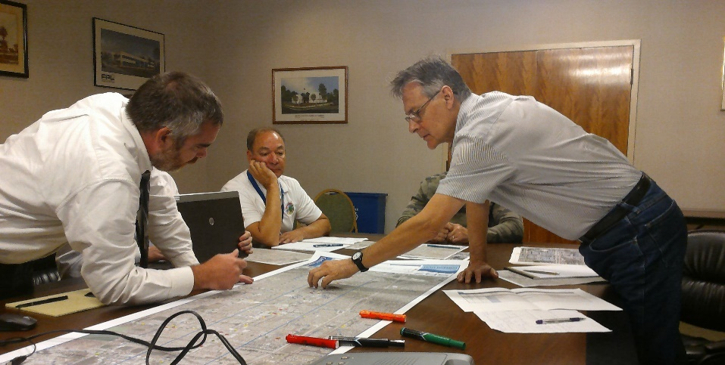
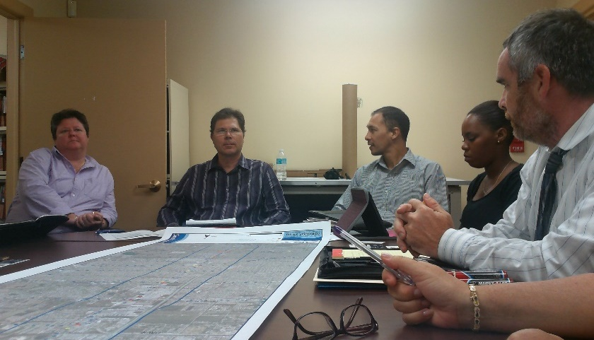
Public Outreach:
Innovative Concepts
  Four meetings to review:
    Project overview
    Initiatives and needs
    Preliminary recommendations
    Draft final recommendations
  Municipal Working Groups
  Grouped by geography (south, central, north)
South | Central | North
Dania Beach | Fort Lauderdale | Coconut Creek
Davie | Lauderdale Lakes | Coral Springs
Hollywood | Lauderhill | North Lauderdale
Miramar | Plantation | Margate
Pembroke Park | Tamarac
Seminole Tribe | Broward County
West Park
Notes:
The study area impacts 15 cities, the Seminole Tribe of Florida, and unincorporated Broward County and so the second group of stakeholders formed was the Municipal Working Group. The larger group was divided into three smaller working groups based on geography…a south, central, and north working group. Four meetings were held with the working groups to provide more in-depth discussions and review by the different local jurisdictions than would have been possible at the PAC level. Grouping the cities together geographically into subgroups also allowed for discussion of projects that crossed city boundaries.

Slide 7
Study Process: Overview
PUBLIC OUTREACH
Public Information Materials
Implementation Plan
In-Depth intersection review
Network Connectivity Analysis
2015
Corridor-Wide Safety Needs
2016
Safety hot spot analysis
Baseline conditions
Goals, Objectives and performance
Project Timeline
March
July
Notes:
The study itself lasted just under a year and a half and, like many corridor studies, there was a lot to accomplish during this time. The technical process flowed very much like a typical corridor study – establishing study goals and baseline conditions, identifying the safety and mobility issues to be addressed, recommending improvements, and developing the implementation plan. What was different about this study was the public outreach process and how we identified safety hotspot locations, which were the backbone of identifying locations for needed improvements.

Slide 8
Public Outreach:
Innovative Concepts
Public Outreach Activity | Estimated Number of Contacts
Email Campaigns | 3,500+
Text Message Campaigns | 183
Transit Intercept Survey | 1,143
Online Survey | 43
Community Meetings | 115+
E-townhall Meeting | 2,368
Total | 7,350+
Cost per Contact | $12.66
Notes:
Given that this study area was long, traditional public outreach methods, like workshops or open houses, probably wouldn’t be effective in reaching a lot of people or getting concrete input needed to develop recommendations. Therefore we developed a public outreach plan that focused on activities that would go to where the people are and not require them to go out of their routine to attend. Highlights include:
A project website and email campaign, which reached around 3,500 people
Conducting a transit intercept survey where we talked with over 1,000 transit riders throughout the corridor
Holding an e-town hall meeting where we attempted to robo-call all 21k registered household phone lines in the study area to participate in a virtual town hall meeting, Through this we reached nearly 2,400 people and nearly 200 people were participating at the end of the one hour call
Community meetings where we requested 10-15 minutes to talk about this study and get feedback during community meetings already planned.
All total we reached over 7,350 people through the public outreach plan.
Traditional outreach activities like public workshops can also be expensive in terms of the average cost per person reached. By keeping track of the number of people reach we can monitor how much it costs per person. If this type of calculation can be consistently on all projects, it can become a useful tool to create a performance measure and determine the efficiency in how outreach dollars are spent on these types of projects.

Slide 9
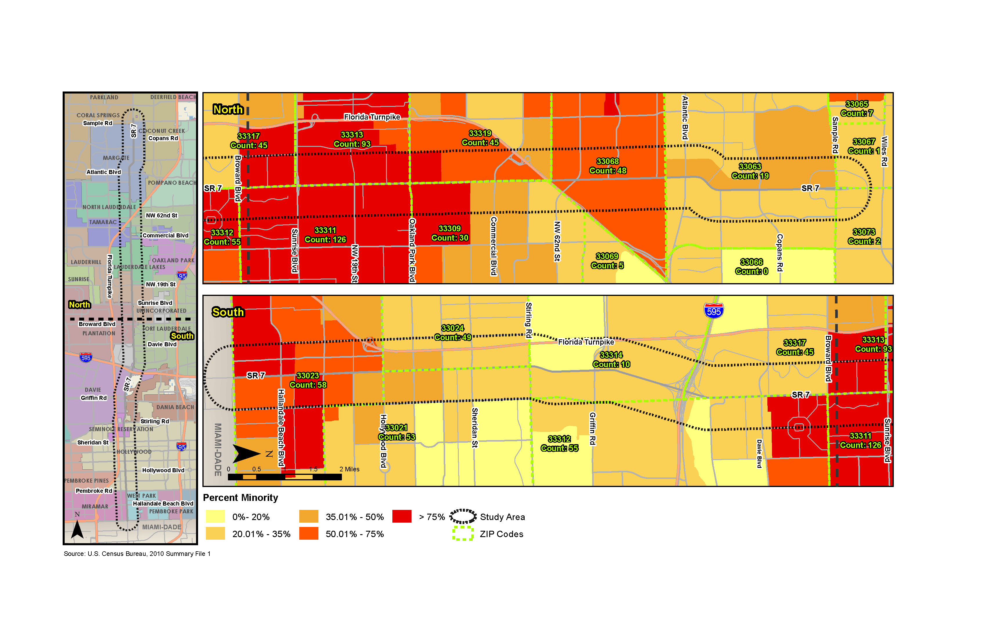
Public Outreach:
Innovative Concepts
Mid-project public outreach evaluation (January 2016)
Based on ZIP code data (838 (95%) within or adjacent to the study area)
Threshold fewer than 5% of total ZIP codes collected → 6 ZIP codes
Public outreach adjustments made
Evaluated against “Environmental Justice Areas”
45
93
45
48
19
55
126
30
Notes:
Another unique thing we did for the public outreach plan was to conduct an evaluation mid-way through the study to see how effective the activities had been in reaching people. Through the different outreach activities we collected home ZIP codes and how many people from each ZIP code were participating compared to different demographic variables. This helped us ensure participation not only throughout the corridor, but also that we were getting participation from areas with traditionally underserved populations. For example, this map shows the number of ZIP codes collected in the northern half of the study area compared to areas with higher percentages of minorities (shown in red). Doing this evaluation mid-way through the study helped us identify any areas we hadn’t yet reached so we could refocus outreach while there’s still time to make a difference. Using this strategy we were successfully able to redirect outreach activities mid-way through a study to maximize participation.

Slide 10


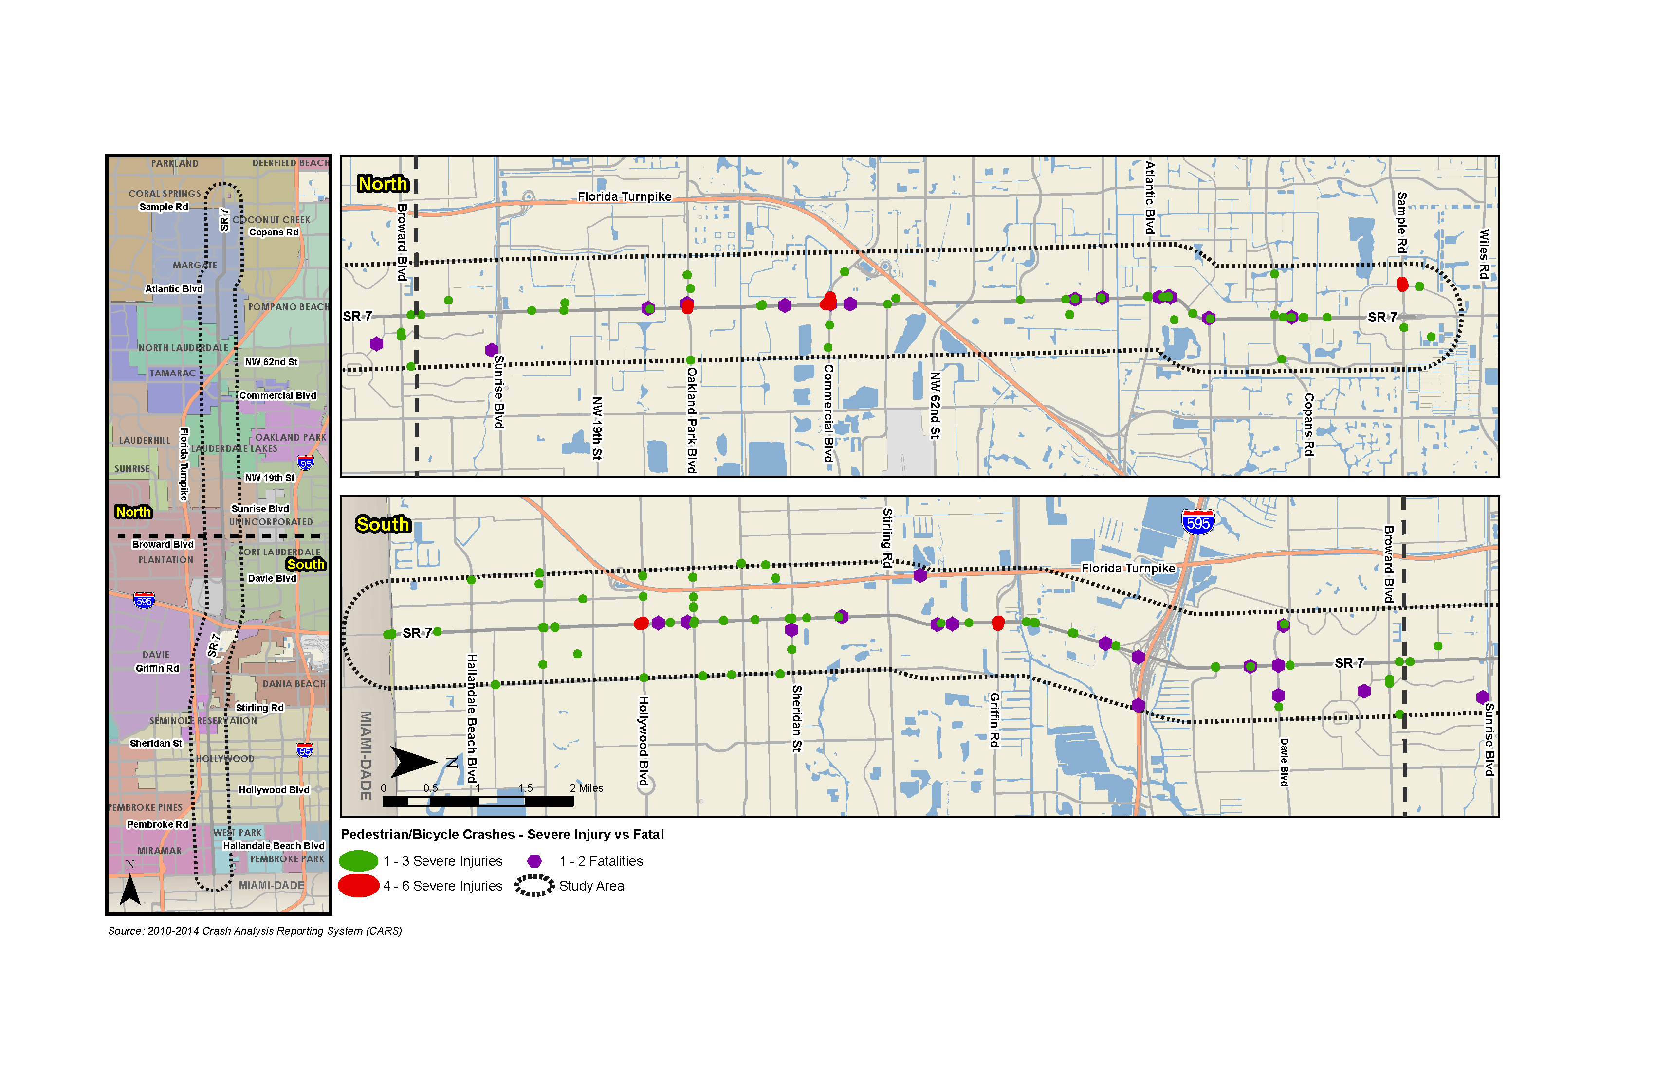
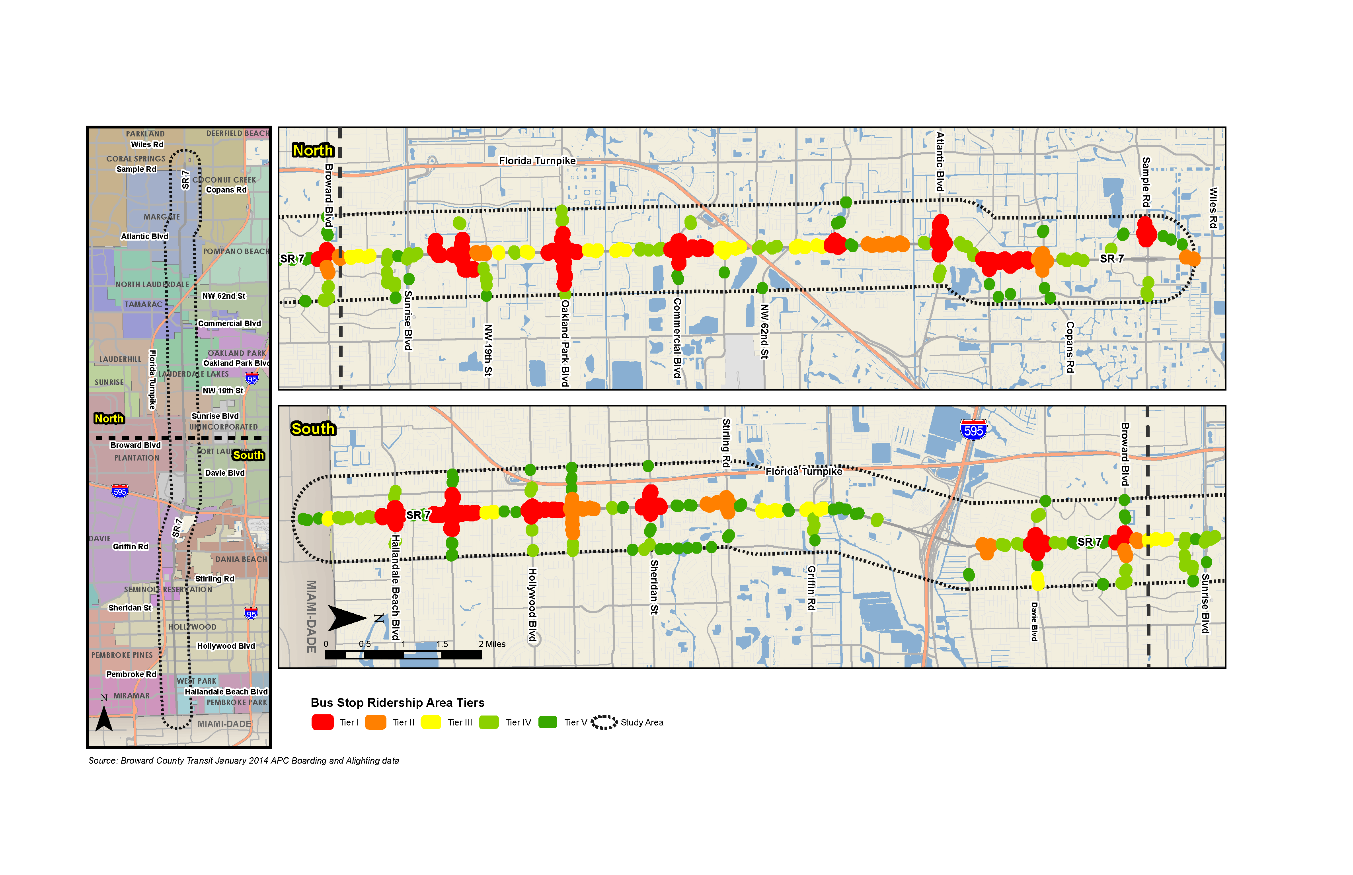
Study Process:
Innovative Concepts
Bike/Pedestrian Crashes
Transit Ridership
Notes:
Earlier Roxana mentioned the hot spot analysis as something unique in the technical analysis. Often, for studies like this focusing on multimodal improvements and safety, we’ll map out bus stop level transit ridership data and crash data to understand the relationship between users and safety. This map illustrates the north section of the corridor where we analyzed stop level transit ridership with red representing the highest ridership areas. This second map illustrates an analysis of bicycle and pedestrian crashes where the red areas are those with the highest occurrence of bike/ped severe injury and fatal crashes.
The length of the corridor made it difficult more difficult to identify safety issues or locations with high ridership and a lot of crashes.

Slide 11
Study Process:
Innovative Concepts
Safety “Hot Spot” analysis – Transit Ridership & Bike/Ped Crash data
High
Bus stop ridership tiers
Bike/ped crash tiers
Bus Stop Ridership Area Tier | Tier Break Values (avg daily riders)
I | >1,000
II | 501-1,000
III | 201-500
IV | 51-200
V | 0-50
Pedestrian and Bicycle Crash Area Tier | Tier Break Values (total crashes)
I | >14
II | 10-14
III | 6-9
IV | 3-5
V | 1-2
Bike/ped crash tier
Low
Low
High
Bus stop ridership tier
Notes:
So instead of looking at these two data sets separately, we identified bus stop ridership area tiers and bike/ped crash area tiers to correlate the two data sets and identify locations with both the highest transit ridership and the highest bike/ped crashes.

Slide 12
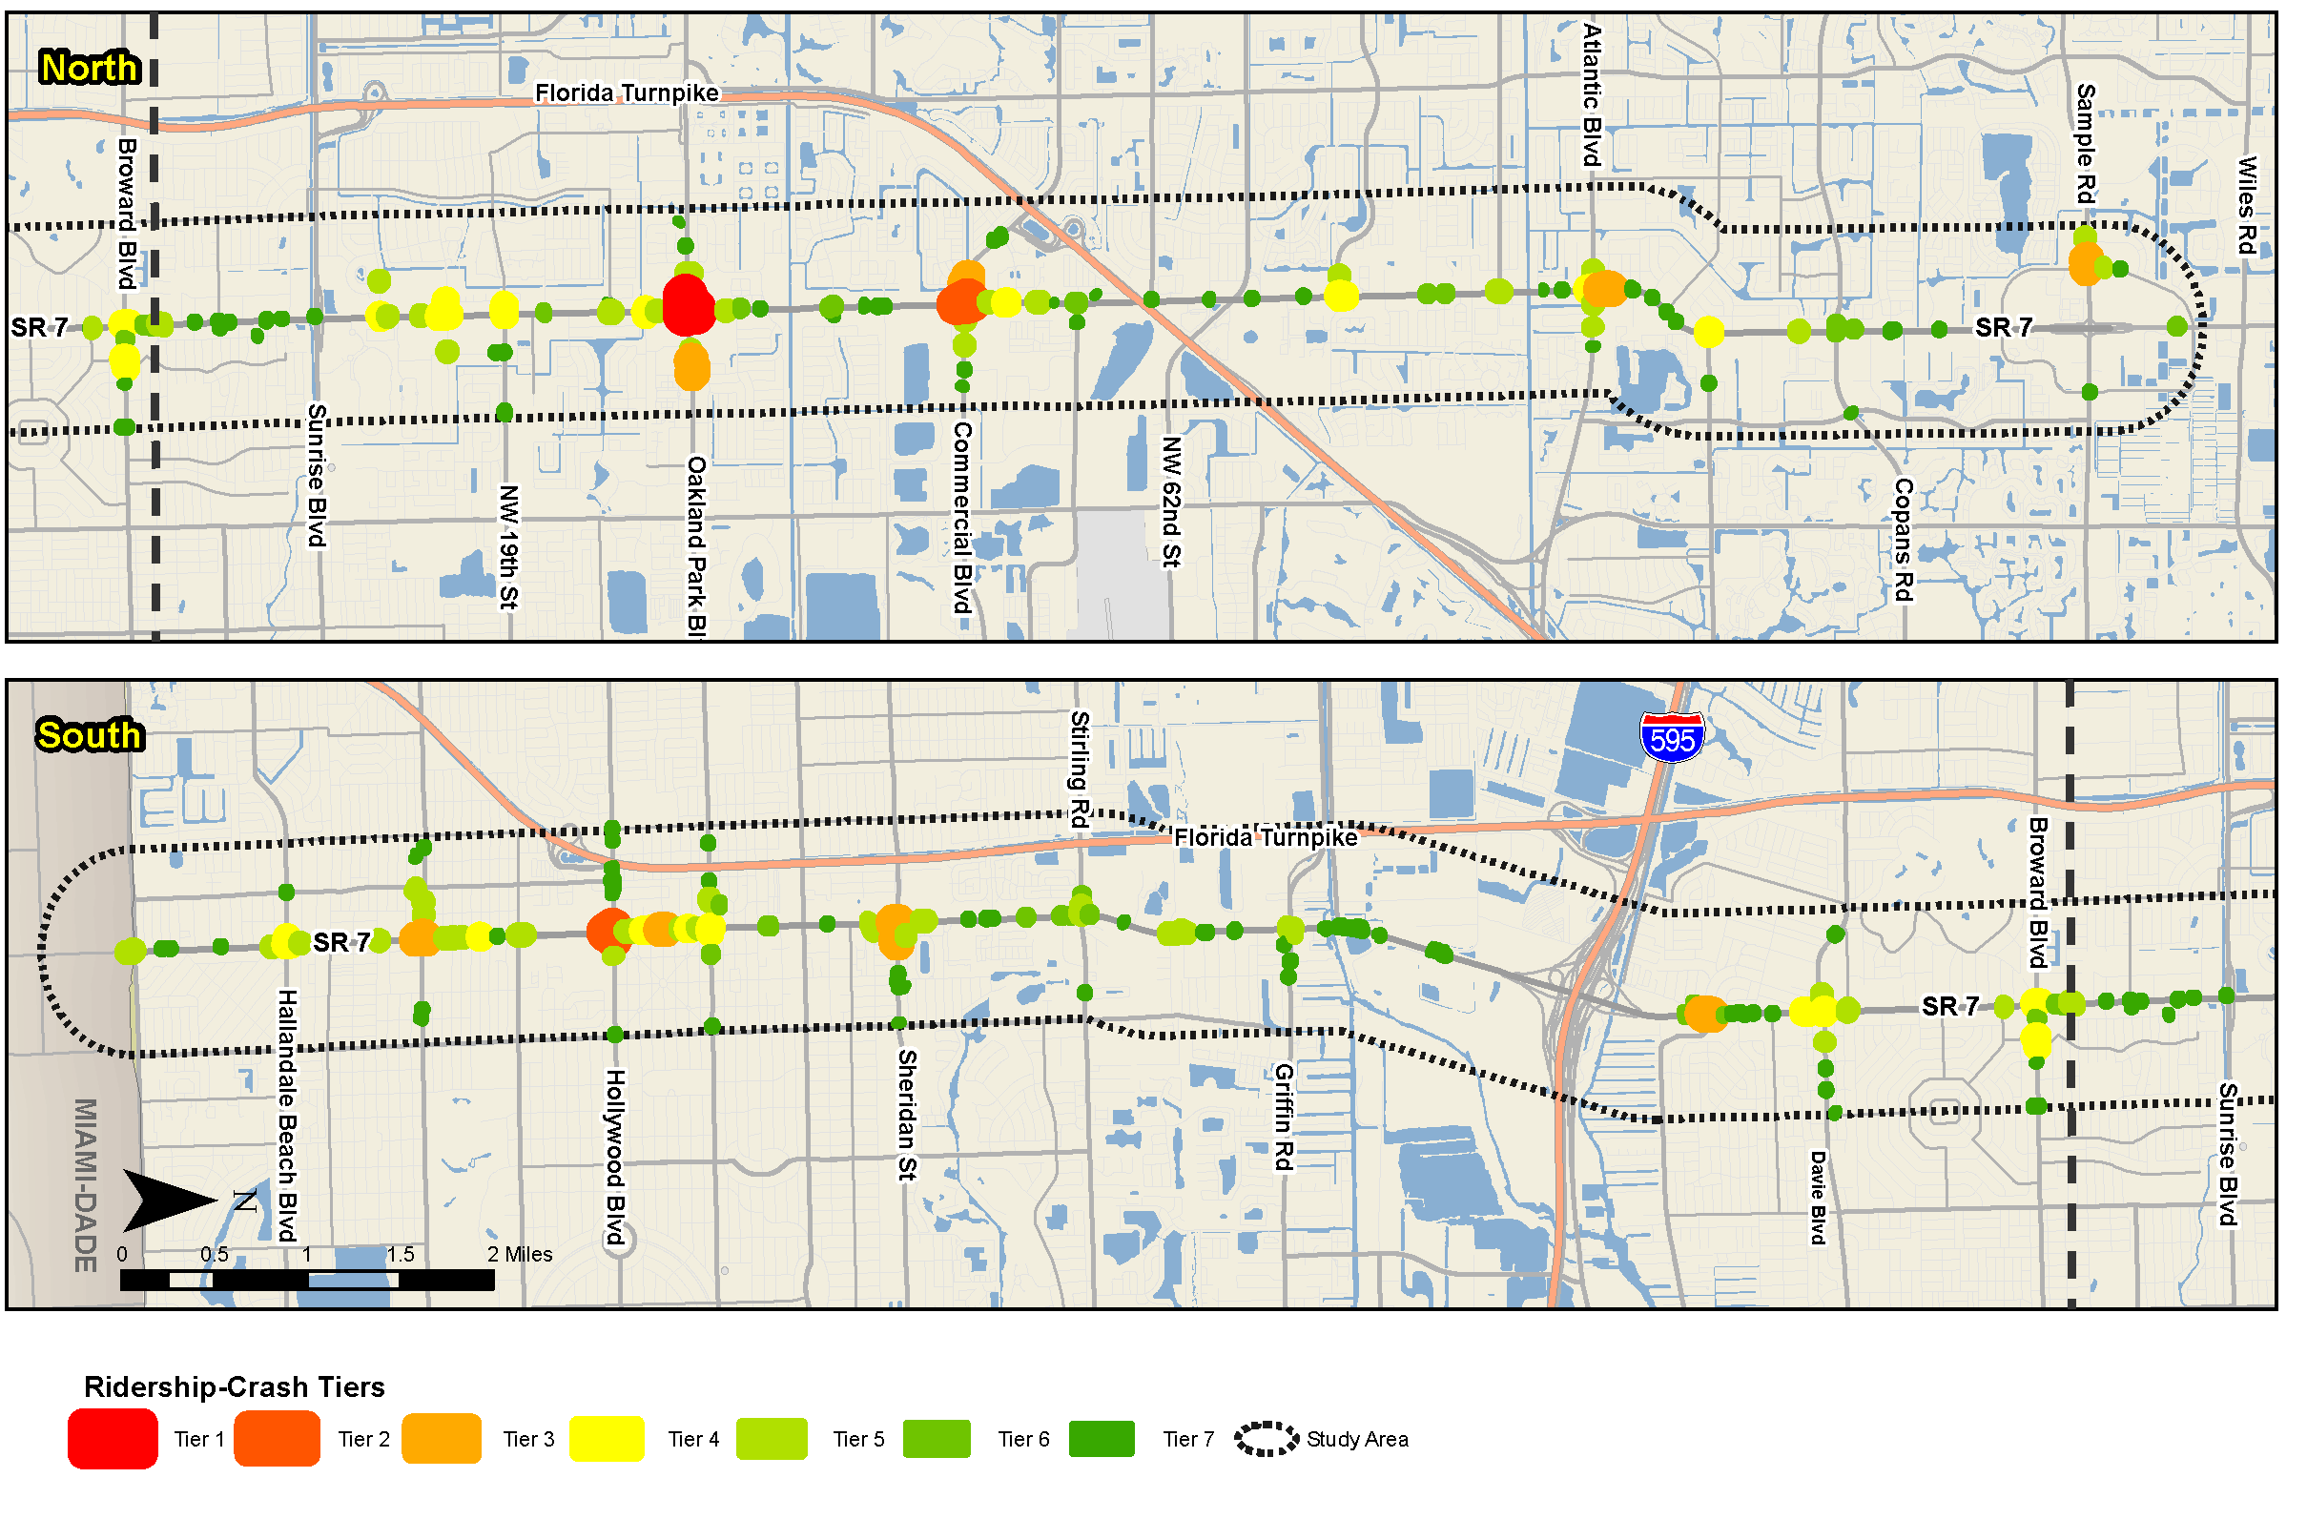
Study Process:
Innovative Concepts
Result:
Prioritized high ridership-crash areas
Benefits:
Simple process
Readily available data
Repeatable over time
Quantifiable results
1
2
5
4
3
Notes:
This map illustrates the top five high prioritized high ridership-crash areas or “safety hot spots” for the study area. By identifying these locations, we could then drill down to further examine the infrastructure and operations to identify concrete safety improvements so that will it safer for people walking and biking to popular transit stops.
The benefits of this analysis are that it’s a relatively simple process in GIS, it uses available stop-level transit ridership and crash data, it can be replicated over time and used as a performance measure to see if, once improvements are made, the hot spot locations diminish, and it’s a more quantifiable approach than looking at two separate maps to draw this same conclusion.

Slide 13
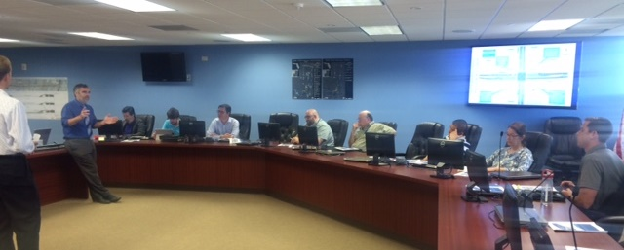
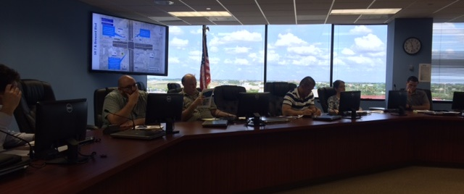
Project Recommendations
Corridor-wide improvements
Short-term bike/pedestrian network connectivity projects
Longer-term improvements at major intersections for project development
Notes:
As Roxana mentioned earlier, the study produced three categories or tiers of project recommendations - corridor wide improvements that are relatively simple and inexpensive – the low hanging fruit. Shorter term bike and ped projects were recommended to improve the bike/ped network connectivity within the study area. Longer term improvements were focused on major intersections along SR 7 and include the shorter term safety and connectivity improvements, but also longer term improvements focusing on enhancing transit operations and infrastructure. One of the more unique aspects to this project is that all recommendations can be done within the existing ROW unless a small easement or something is needed.

Slide 14

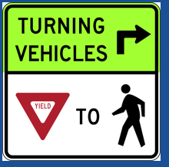
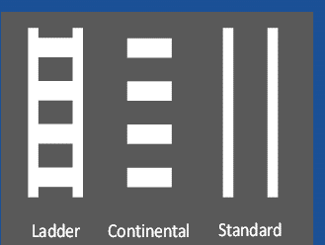
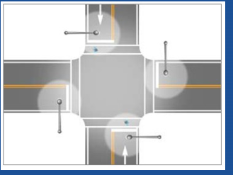
Corridor-Wide Improvements
Pedestrian Countdown Signal
Right-Turn ‘Yield to Pedestrian’ Sign
Enhanced Crosswalk Markings
Enhanced Intersection Lighting
Notes:
For the short-term corridor wide improvements, we evaluated all signalized intersections to identify locations along the corridor that did not already have pedestrian countdown signals, enhanced cross walk markings, or intersections that should be further studied for enhanced intersection lighting. We also looked at the intersections with higher traffic volumes to identify locations where RTYTP signs could be implemented.

Slide 15
Bike/Pedestrian Network Connectivity Improvements
Evaluated bicycle and pedestrian network connectivity projects:
  Field/Google Earth review
  Engineering assessment for constructability and ROW constraints
  Planning cost estimates
Projects prioritization based on:
Project Impacts
Project Benefit
  Existing conditions
  Demand potential (density, land use)
  Network connectivity
  Safety
  ROW (minor)
  Infrastructure
  Community
  Cost
Notes:
For the network connectivity projects we looked at the existing bike/ped network and identified any gaps where it made sense and was feasible to add facilities to better connect the network and to make sure that all transit stops and major activity centers had sidewalks connecting and preferably bicycle facilities. Preliminary engineering assessments were completed and it was through this that several projects were found to be not feasible due to ROW or constructability issues. The municipal working groups provided valuable input in identifying and evaluating network projects in each of their communities. Ultimately the list of network connectivity projects were prioritized based on different factors related to project benefit and impacts.

Slide 16
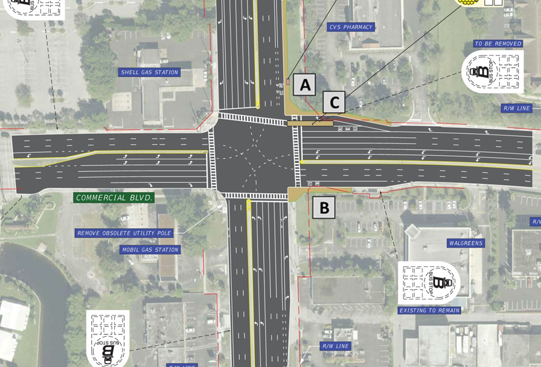
Longer-Term Improvements
C. Implement a pedestrian/bus island for the near-side WB bus stop; implement a queue jump application; provide a shelter.
A. Relocate the far-side NB bus stop closer to the intersection and create an open bus bay; implement a queue bypass lane; add a shelter
Upgrade pedestrian push buttons & signage
Remove obsolete utility pole from the SW corner
  Tighten all curb radii where feasible
SR 7 & Commercial Blvd
B. Create an open bus bay for the far-side EB bus stop; implement a queue bypass lane.
Planning level cost estimates: $302,000
Notes:
15 major intersections were evaluated for longer term improvements, of which 6 intersections included transit operational improvements, such as implementing queue jumps or bus/ped islands for near side stops to eliminate queuing in the right turn lane. At SR 7 & Commercial Blvd recommendations include short term improvements (list), and longer term improvements to move existing bus stops closer to the intersection, and create open bus bays, implement queue bypass lanes, and construct a pedestrian/bus island for the near side stop so the bus movement can be separated from right turning vehicles.

Slide 17
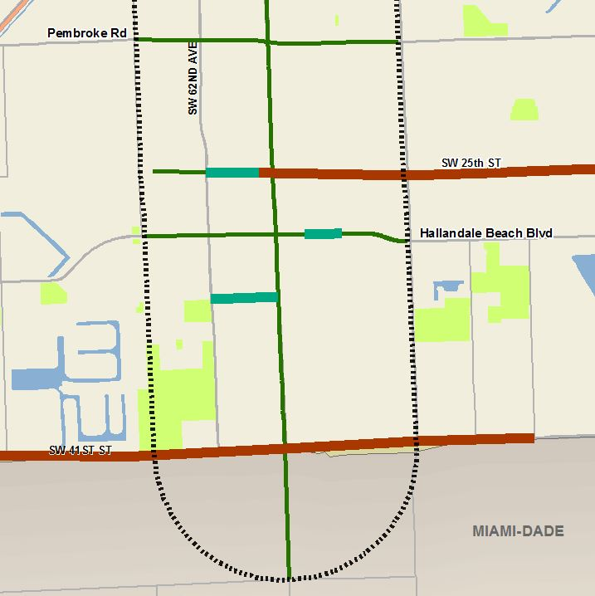
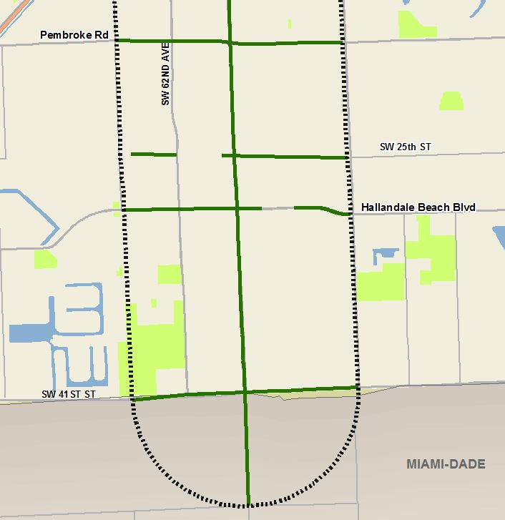
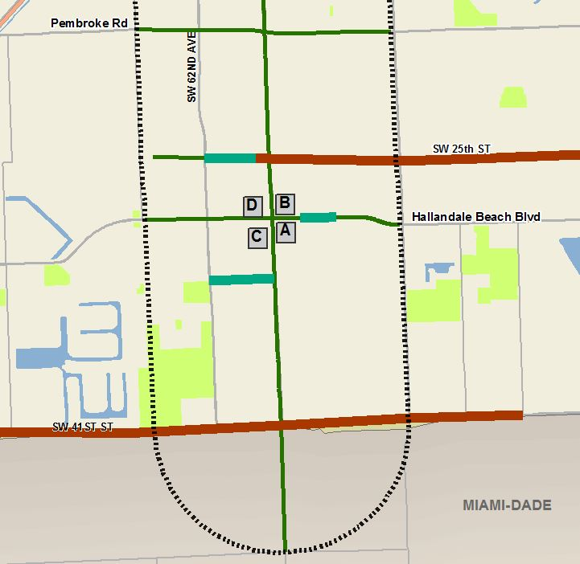
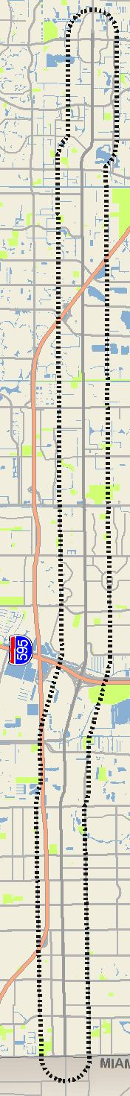
Project Recommendations
Miramar Pkwy/Hallandale Beach Blvd
Open bus bay NB
Queue bypass lane
Corridor-wide Improvements
Upgrade pedestrian push buttons & signage
Tighten curb radii where feasible
Evaluate “right turn yield to pedestrian” sign
Evaluate lighting in NE, NW, SW quadrants
WB queue jump
Relocate bus stop
Shelter
Open bus bay
Queue bypass lane
Open bus bay SB
Queue bypass lane
Notes:
The three tiers of projects were meant to complement each other and provide a comprehensive approach to safety and mobility for all users. In this particular location, at the intersection of SR 7 & Miramar Parkway, all three tiers of recommendations are present. The corridor-wide improvements include upgrading pedestrian push buttons and signage, tightening curb radii, and evaluating placement of RTYTP sign and improved lighting. The green lines illustrate existing bike/ped facilities. As you can see there were proposed pedestrian and bicycle facilities to close up some of the network gaps and provide better and safer access to the facilities along SR 7, including to the bus stops located at this intersection. There were also several longer term recommendations to improve transit operations, such as implementing queue bypass lanes, providing open bus bays, and relocating transit shelters closer to the intersection.

Slide 18
Implementation and Funding Plan
Priority Tier | Funding Source | Total Cost 2016 $ (millions) | 2021-2025 YOE $ (millions) | 2026-2030 YOE $ (millions) | 2031-2040 YOE $ (millions) | Total YOE $ (millions)
Tier 1 – Corridor-Wide Improvements | FDOT DDR* | N/A | $5 | -- | -- | $5
Tier 2 – Network Connectivity Projects | CSLIP** | $24.84 | $16.59 | $17.84 | $1.33 | $35.76
Tier 3 – Major Intersection Recommendations | Regionally Significant Transit Project | $1.76 | $0.26 | $2.74 | -- | $3.0
Totals |  | $26.60 | $21.85 | $20.58 | $1.33 | $43.76
*Amount of FDOT District Dedicated Revenue per FY 2017-2021 TIP (FM No. 4385181) programmed for SR 7 improvements **Broward MPO’s Complete Streets and other Localized Initiatives Grant Program
Notes:
The final project deliverable included an implementation plan for the three tiers of improvements – corridor wide, short term network connectivity and longer term major intersections. Tier 1 projects could be immediately funded through state revenue earmarked for SR 7 improvements. Tier 2 and 3 identified existing funds for programming into the Transportation Improvement Program. The corridor wide improvements, or low hanging fruit, particularly enhanced crosswalks and pedestrian countdowns identified for this corridor, will now be included on maintenance and resurfacing projects already programmed, so in reality these will be in reality done before 2021. The TIP has already programmed $1.2 million for 2018 for design of short term projects and $5 million for construction in 2021 and we look forward to seeing these recommendations constructed.

Slide 19
Questions?
Roxana Ene, TIP Coordinator/Project Manager
Broward Metropolitan Planning Organization
EneR@browardmpo.org
(954) 876-0042

Slide 20
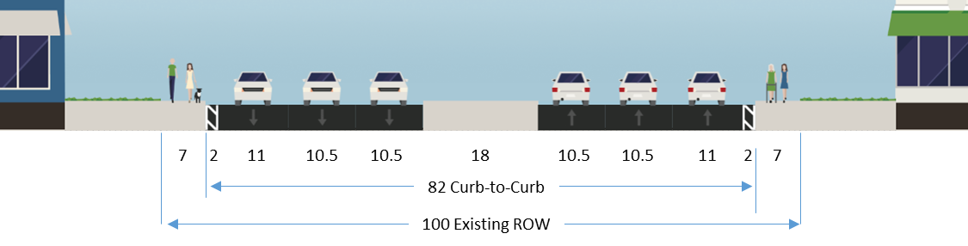
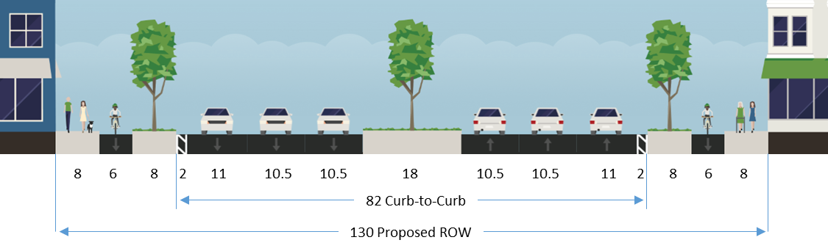
City of Margate
Existing Cross Section
Recommended Alternative
Notes:
City of Margate wanted to keep lanes of SR 7 narrow and promote designs that help to manage traffic speeds while accommodating all road users, particularly through it’s Town Center where walking and biking are encouraged.
City owned the ROW, but it was cost prohibitive to expand
Initially proposed a protected bike lane through the center median, but it was a relatively short length and would pose safety issues when bicyclists transitioned in/out of the median lane.
Three alternatives to the proposed center median design were developed through this project with the final selected being a Protected Bike Lane with Landscaped Buffer, which considers the re-using the existing outside curb (and drainage structures) as the basis for a protected bike lane.
Municipal working group discussions and city staff were key in transitioning from the center median concept to the recommended alternative.

Slide 21
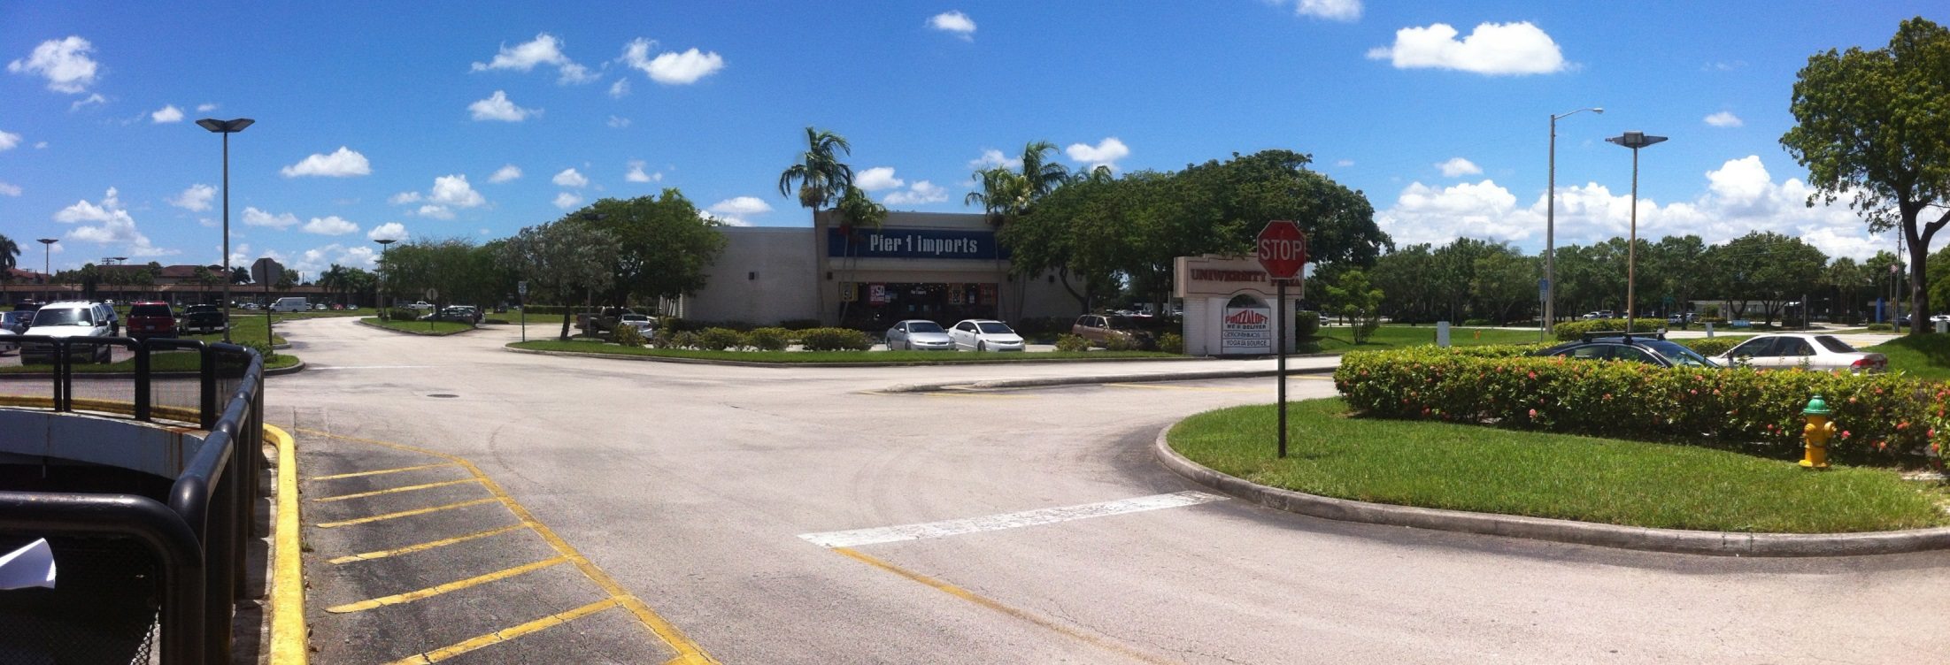
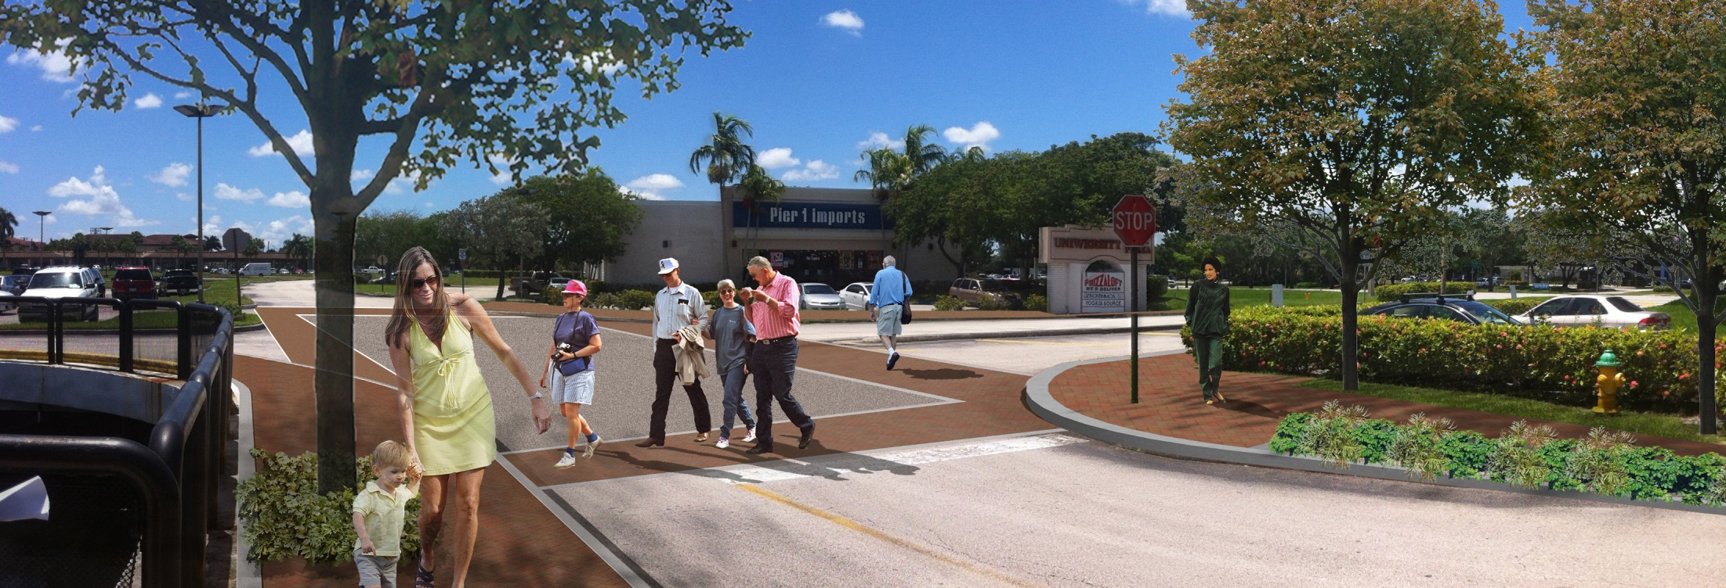
BEFORE
AFTER

Slide 22
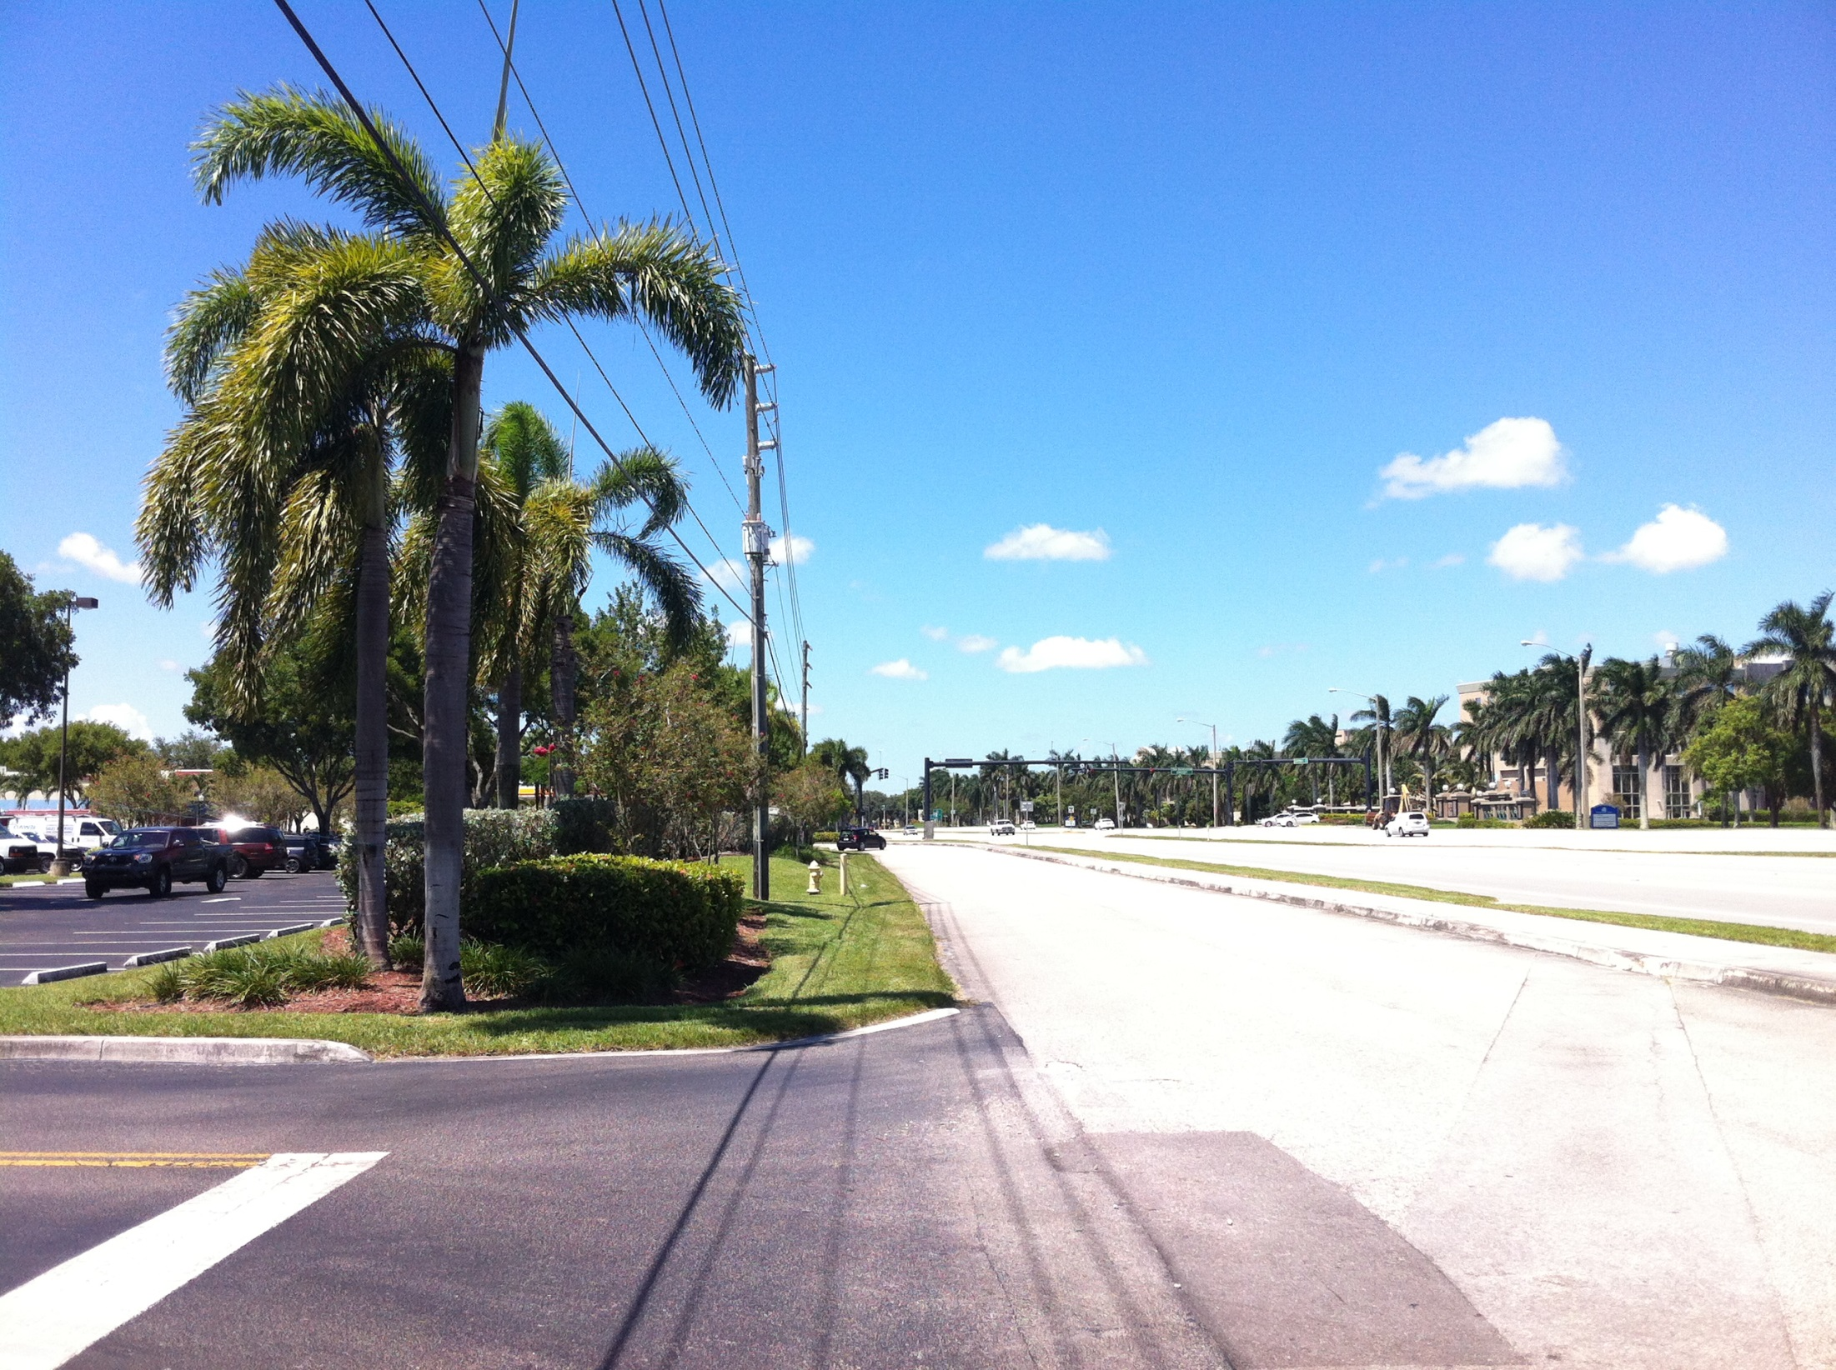
BEFORE

Slide 23
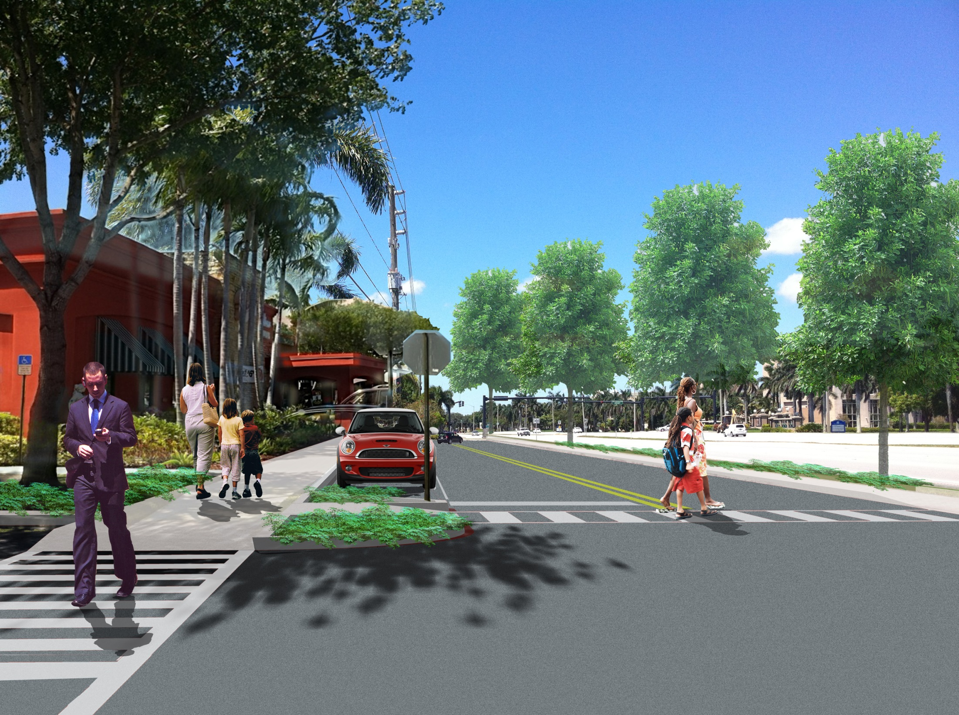
AFTER

Slide 24
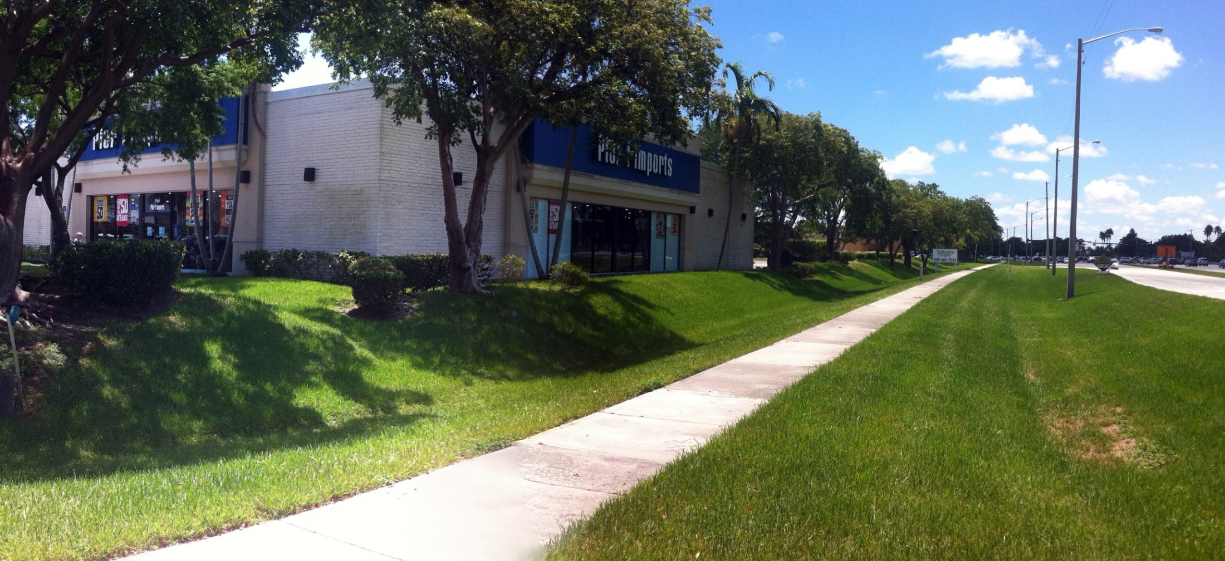
BEFORE
www.browardMPO.org

Slide 25
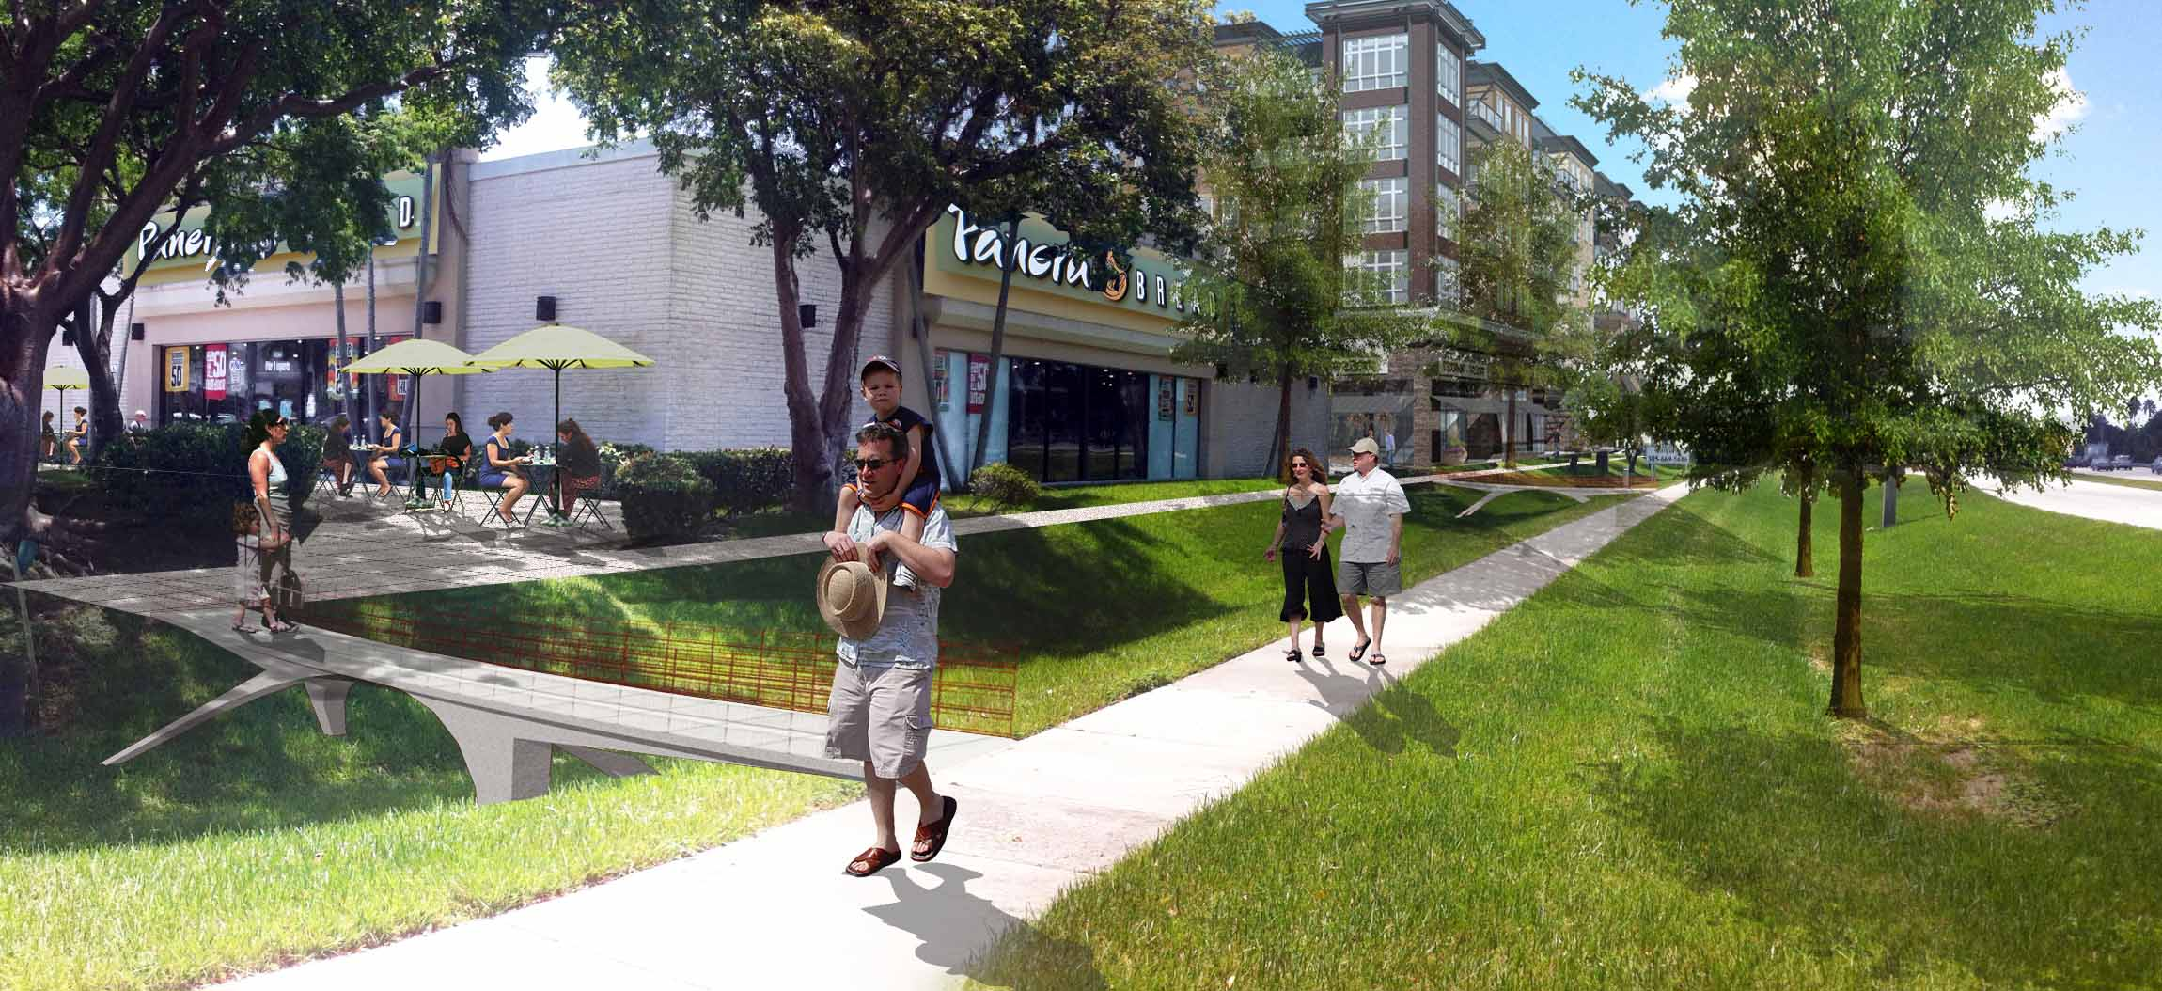
AFTER
www.browardMPO.org

Slide 26
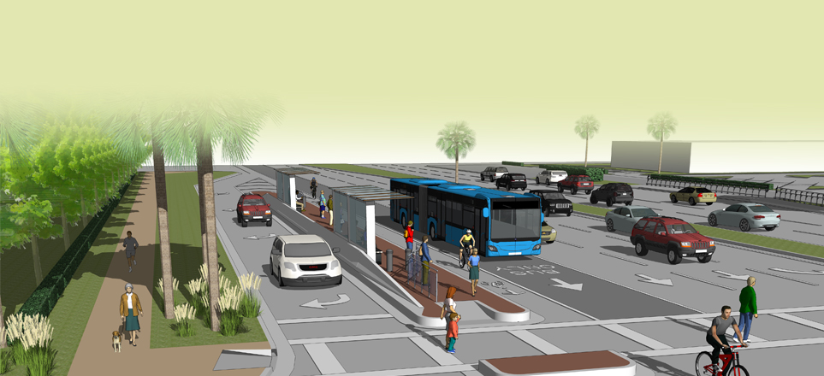
Bus Islands/Pedestrian refuge

