Slide 1
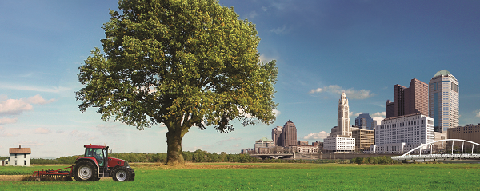
insight2050: A Regional Growth Scenario Analysis to Guide Central Ohio’s Future
AMPO National Conference
Fort Worth, Texas
October 27, 2016

Slide 2
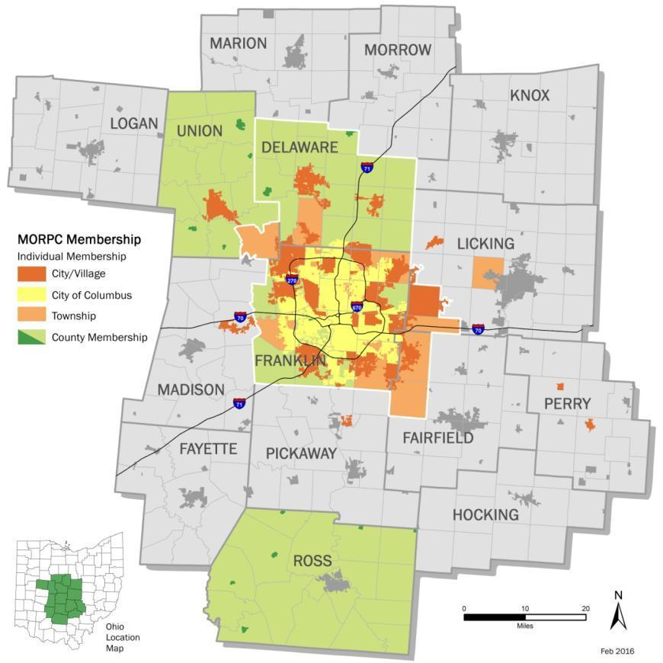
Who is MORPC?
Transportation Systems & Funding
Regional Data & Mapping
Energy & Air Quality
Planning & Environment
Public & Government Affairs
Notes:
MORPC is a voluntary association of local governments with over 60 members in 15 counties. Their work falls under the categories you see here.
MORPC assists its members across these areas to ensure that their communities continue to be vibrant and successful. Insight2050 is one of many projects initiated in the spirit of that mission.

Slide 3
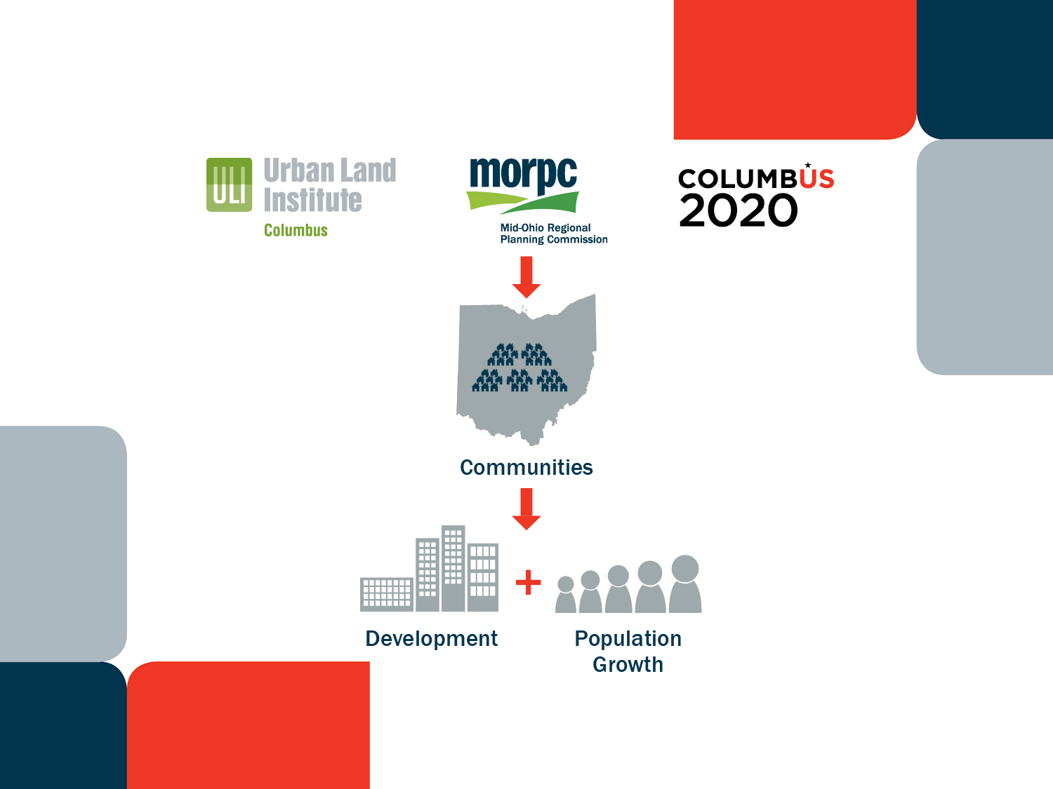
Notes:
insight2050 is a collaborative initiative among public and private partners designed to help communities proactively plan for development and population growth over the next 30+ years that is expected to be dramatically different from the past.
We kicked it off in March with a diverse steering committee representing both private and public sector and diverse interests and will have a final report available in about a month or so.

Slide 4


Who is Columbus2020?
Key objective: Increase economic development in Central Ohio.
Notes:
Columbus2020 is the region’s economic development arm – think of them as a regional chamber of commerce. Their work focuses on bringing new companies and jobs to central Ohio and attracting and retaining a skilled workforce

Slide 5
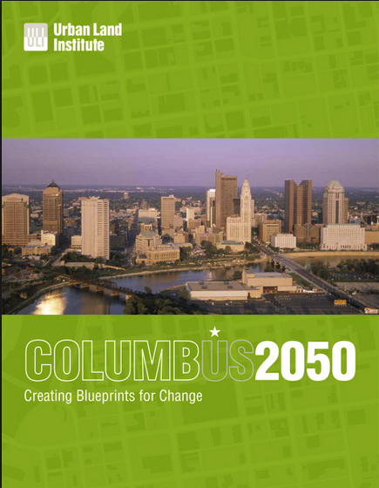
Who is ULI?
Multidisciplinary real estate forum to facilitate open exchange of ideas, information, and experience among industry leaders and policy makers dedicated to creating better places.
Notes:
ULI Columbus is a non-profit organization comprised of leaders in the fields of real estate and land use policy. This group facilitates the sharing of information and experience dedicated to creating better places.

Slide 6



Regional Connections

Slide 7
Home Rule
“Municipalities shall have
authority to exercise all
powers of local self-
government and to adopt
and enforce within their
limits such local police,
sanitary and other similar
regulations, as are not
in conflict with
general laws.”

Slide 8
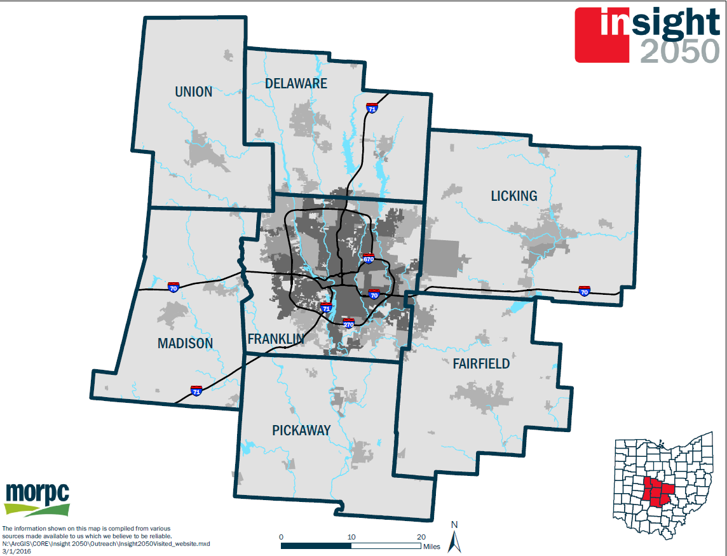

Slide 9
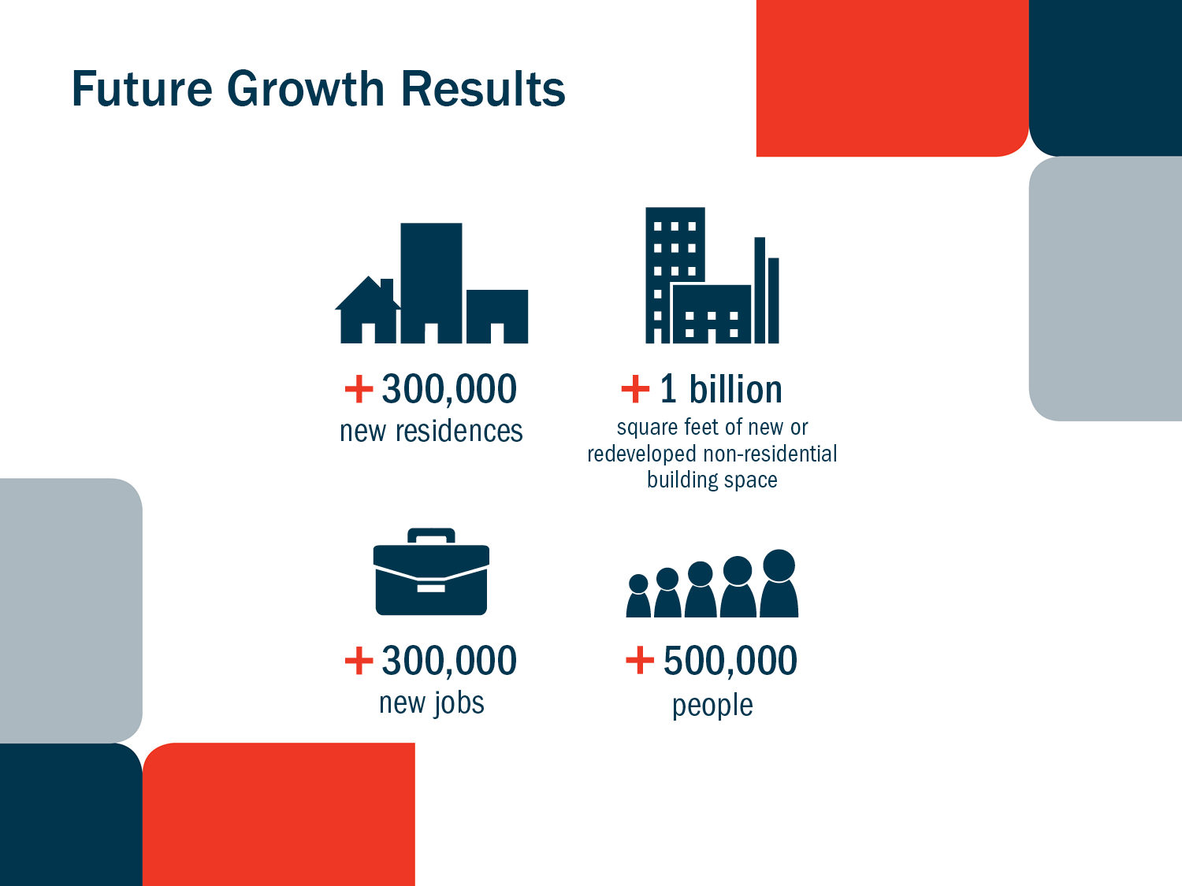
Notes:
What made us think that this project might be important was that …
We know that Central Ohio is expected to grow by more than 500K people and more than 300K jobs over the next 30 years. - conservative
We also know that that adding that many people is doable, because our region has done an outstanding job in the past 30 years to accommodate a similar amount of growth as they reacted to the demand on the ground.
Now, the big game changer is that all forecasts indicate that the demographic make-up of our future population growth will be drastically different than before. And that's the piece we need to be aware of.

Slide 10
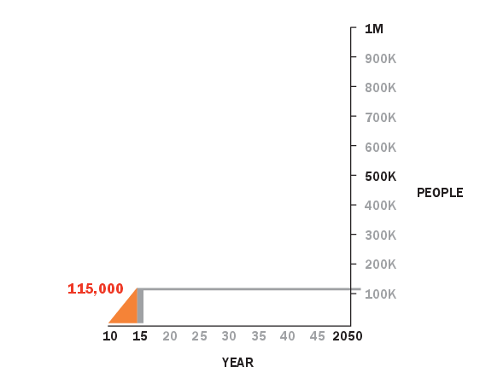
Actual Population Growth (2010-2015)
7-County insight2050 Region
Data provided by
U.S. Census

Slide 11
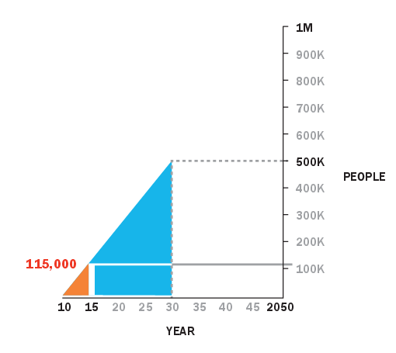
Projected Population Growth
7-County insight2050 Region
Data provided by
Ohio Development Services Agency

Slide 12
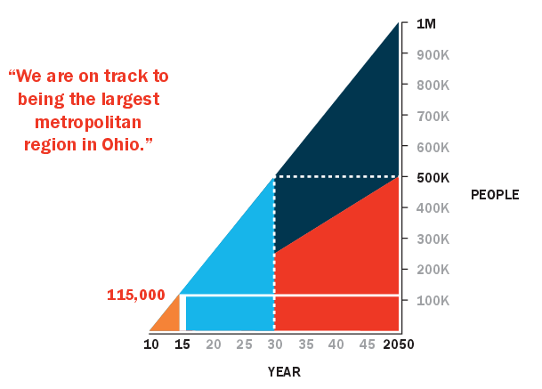
Projected Population Growth
7-County insight2050 Region

Slide 13
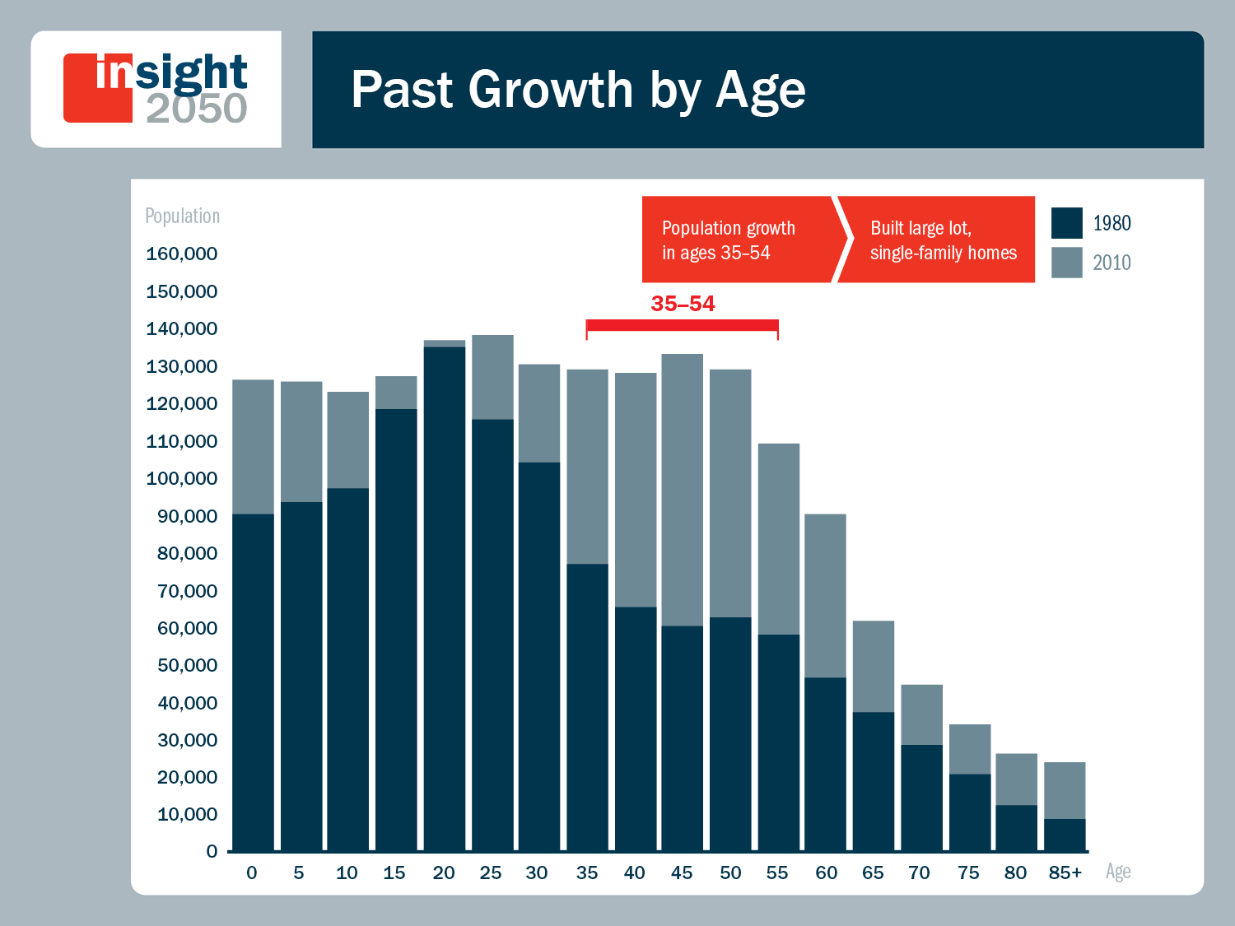
Notes:
When you look at this chart you can see is that the region’s past 30 years of growth was predominantly in the age group of 35-54 year olds, which are the prime child raising years and home buying years with higher disposable incomes. That type of population growth generated an extraordinary demand for single family detached homes on larger lots.

Slide 14
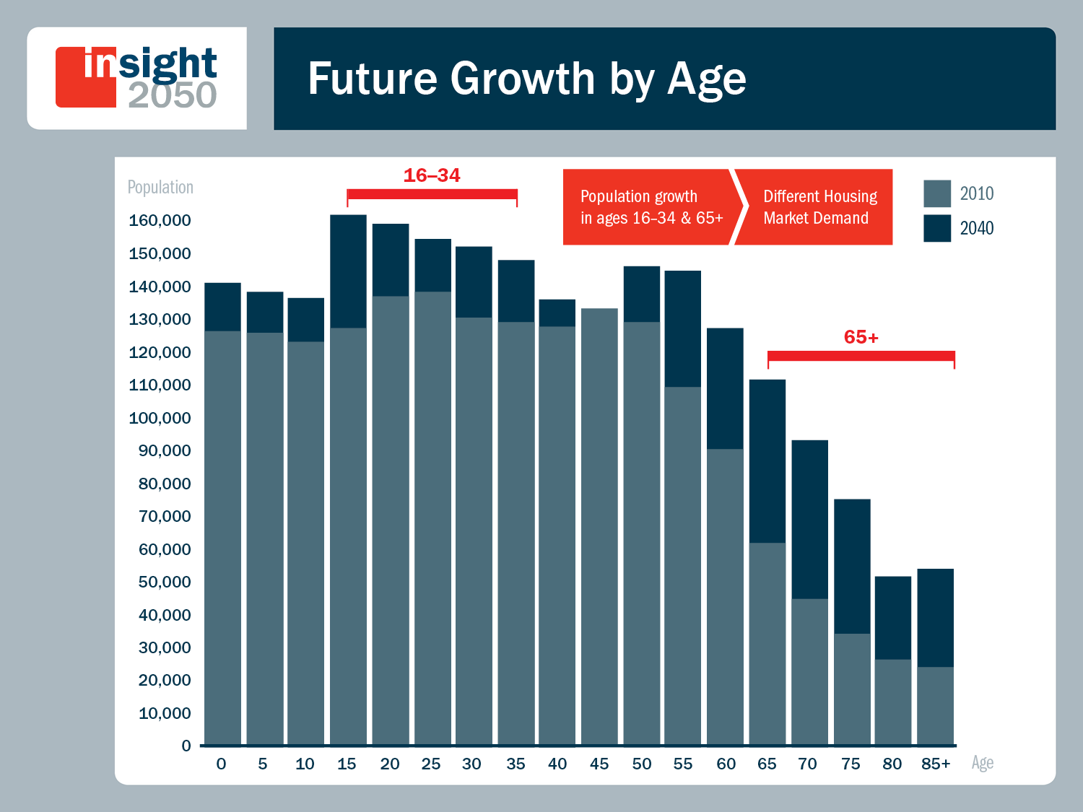
Notes:
Now looking ahead, you can see that the future growth over the next 30 years will be largely in the age group of 65 and older (doubling) and the younger generations (16-34 years). → In fact, an unprecedented 80 percent of our region’s future household growth will be households without children.
(While this includes Millenials, this growth will be driven substantially by the increasing numbers of “empty nesters” (one and two person households) as the Baby Boomers reach later stages of life in numbers greater than any previous generation.)

Slide 15
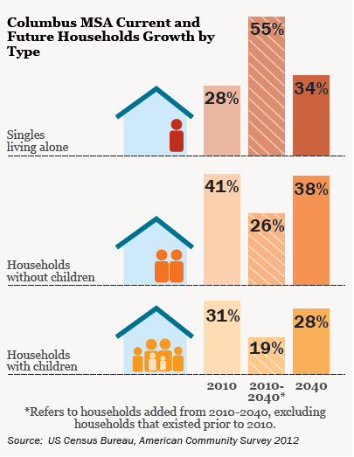
Household Growth By Type

Slide 16


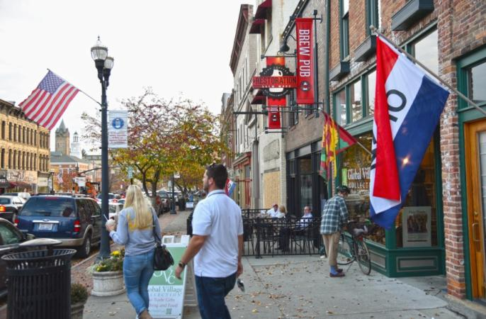
Growing Market Demand For:
Walkable neighborhoods
More transportation choices
Mixed/integrated use environments
Smaller residences, less maintenance
Mixed age, mixed income communities

Slide 17
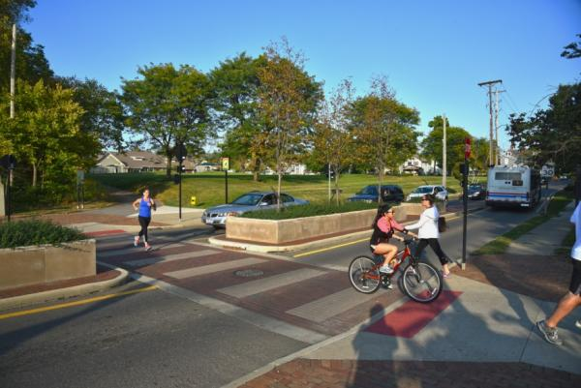
Growing Market Demand For:
Walkable neighborhoods
More transportation choices
Mixed/integrated use environments
Smaller residences, less maintenance
Mixed age, mixed income communities

Slide 18
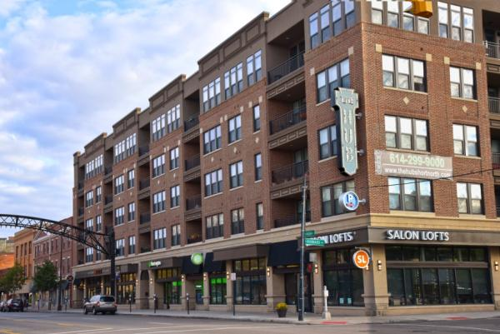
Growing Market Demand For:
Walkable neighborhoods
More transportation choices
Mixed/integrated use environments
Smaller residences, less maintenance
Mixed age, mixed income communities

Slide 19
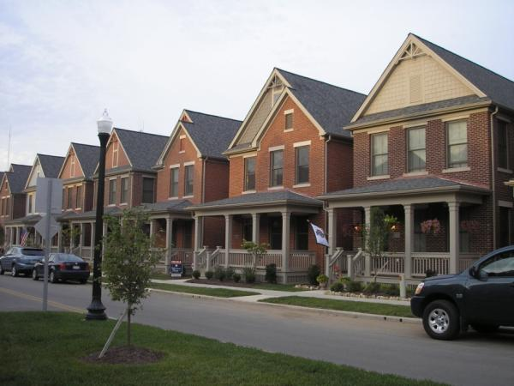
Growing Market Demand For:
Walkable neighborhoods
More transportation choices
Mixed/integrated use environments
Smaller residences, less maintenance
Mixed age, mixed income communities

Slide 20
Building Permits Per Year
Notes:
For some perspective – here are the last 15 years of housing growth
Blue is single family, yellow if multifamily
You can see the gangbuster growth pre-recession
The recession
The post recession ---
This is probably our new reality – and it’s about 5500 units per year
But continued growth is not guaranteed –
Half of the growth will straight from natural growth – more people being born than passing on
The other half is dependent on people want to come to Columbus and stay
Having OSU and other universities helps attract people.
It brought me here.
Or having one person here and attracting a spouse or a partner also adds people.
But keeping people here is the challenge.
So now I’m going talk a bit about what how we are preparing information for the next steps of insight2050

Slide 21

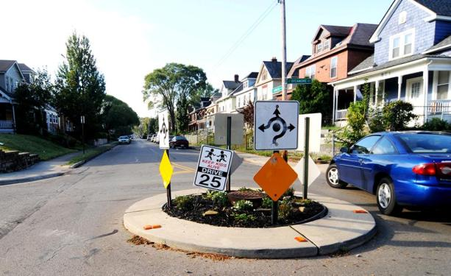
Ripple Effects
Notes:
Where and how our communities grow impacts infrastructure, too. Roads, and the amount of traffic on them, utilities, even the presence of sidewalks and bike lanes are all influenced by our choices for development.

Slide 22
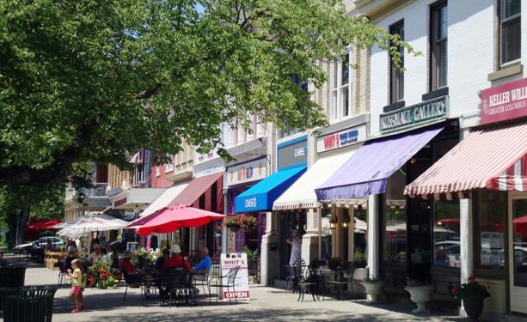
Ripple Effects
Notes:
Where and how our communities grow impacts infrastructure, too. Roads, and the amount of traffic on them, utilities, even the presence of sidewalks and bike lanes are all influenced by our choices for development.

Slide 23
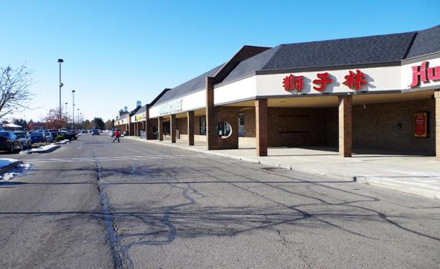
Ripple Effects
Notes:
Where and how our communities grow impacts infrastructure, too. Roads, and the amount of traffic on them, utilities, even the presence of sidewalks and bike lanes are all influenced by our choices for development.

Slide 24
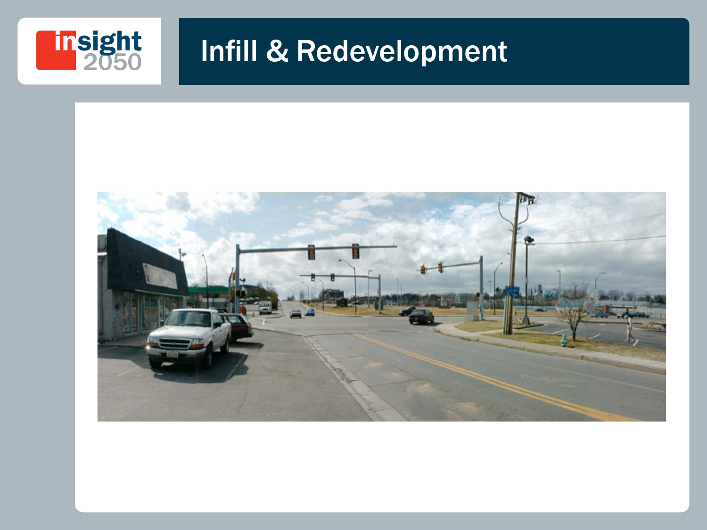
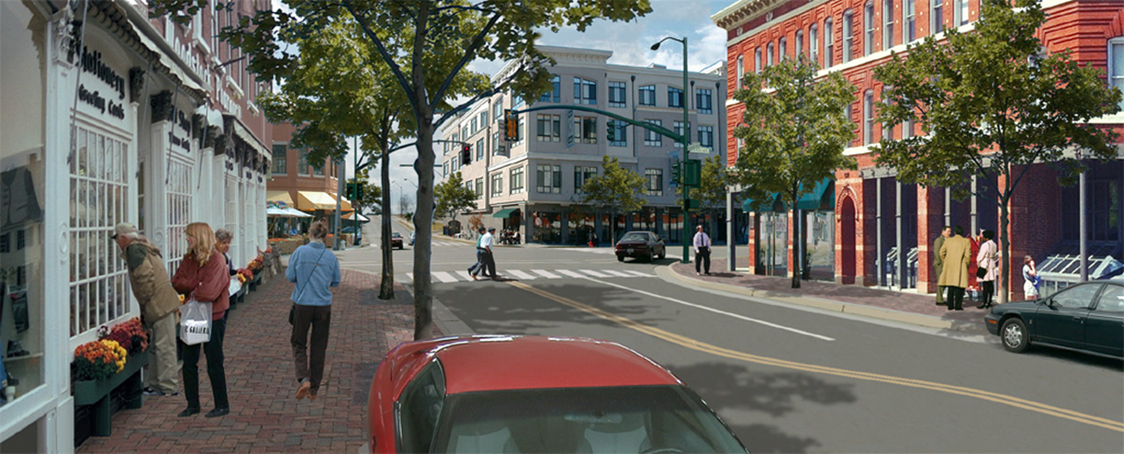
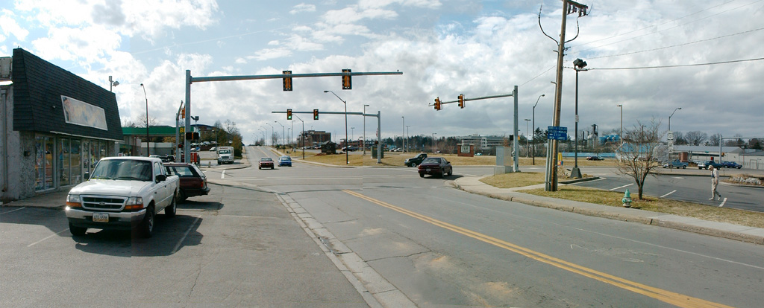
Notes:
You’re probably familiar with scenes such as this one: an intersection with some parking lots, nondescript businesses, little or no sidewalks or bike facilities, etc. These are prime opportunities for the infill and redevelopment we are describing. With some investment and changes over time, the area can look, feel, and function quite differently.
There is the opportunity to change this and create a place that meets what our residents are looking for:

Slide 25
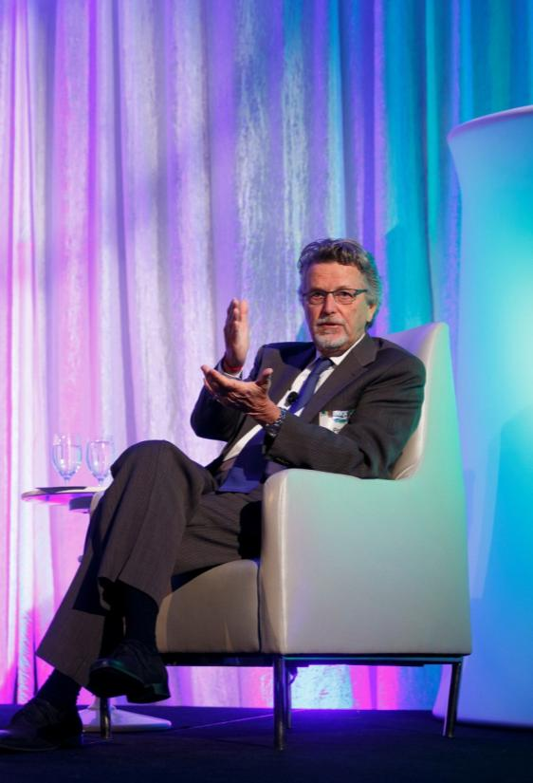
Regional Scenario Studies
“
You know where you are. The question now is: Where are you going? And that’s what insight2050 is all about – pick your future. What is the most efficient investment? People don’t get to see that until they do these scenario studies.”
~Peter Calthorpe
State of the Region 2014

Slide 26


Scenarios Overview
Scenario A
Past Trends
Develop in the same way as in the past
Scenario B
Planned Future
Develop according to community’s plans
Scenario C
Focused Growth
Develop with some infill & redevelopment
Scenario D
Maximum Infill
Develop with maximum infill & redevelopment
Notes:
We hired Calthorpe Associates to help us look at different scenarios of how we, as a region, could grow and how these different scenarios impact various metrics.
Scenario A: Past Trends
This scenario extends the land use and transportation investment decisions of the past decades forward to 2050.
Scenario B: Planned Future
The housing and job distribution of this scenario reflects the direction of local plans and policies from the cities and townships across the Central Ohio region.
Scenario C: Focused Growth
This scenario seeks to accommodate more growth in infill and redevelopment locations in and around existing cities and towns.
Scenario D: Maximum Infill
This scenario strives to maximize growth accommodated through infill on previously developed lands and within existing urban areas.

Slide 27
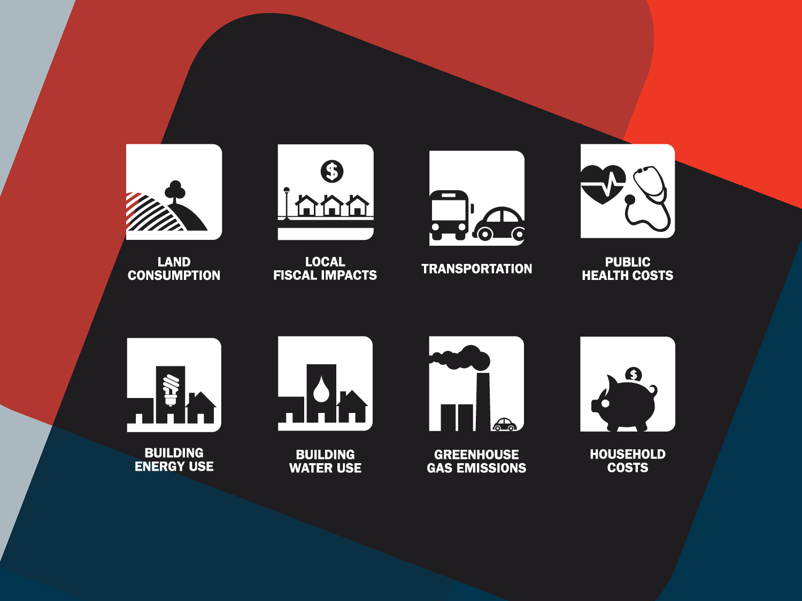
Notes:
Calthorpe’s analysis quantifies the effect of these growth scenarios on specific factors that affect the quality of life as well as the health, vitality, and competitiveness of our region:
EXTRAs:
- Land Consumption
Includes all previously undeveloped land that is urbanized from 2010-2050.
- Local Fiscal Impacts
Capital and ongoing operations and maintenance (O&M) costs for new local roads, sewer, water, waste­water infrastructure, and select services (2010-2050).
- Transportation
Miles driven in passenger vehicles in Central Ohio in 2050.
- Public Health Costs
Annual costs due to health incidences related to auto emissions, including hospitalization, premature mortality, and lost work days, in 2050.
- Building Energy Use
Cumulative energy (electricity and gas) consumed by new and existing residential and commercial buildings from 2010-2050.
- Building Water Use
Cumulative water used to serve and maintain new and existing homes from 2010 - 2050.
- Greenhouse Gas Emissions
Annual CO2e emissions from passenger vehicles, and residential and commer­cial buildings, in 2050.
- Household Costs
Annual automobile trans­portation (fuel, insurance, maintenance) and home energy and water costs, 2050

Slide 28
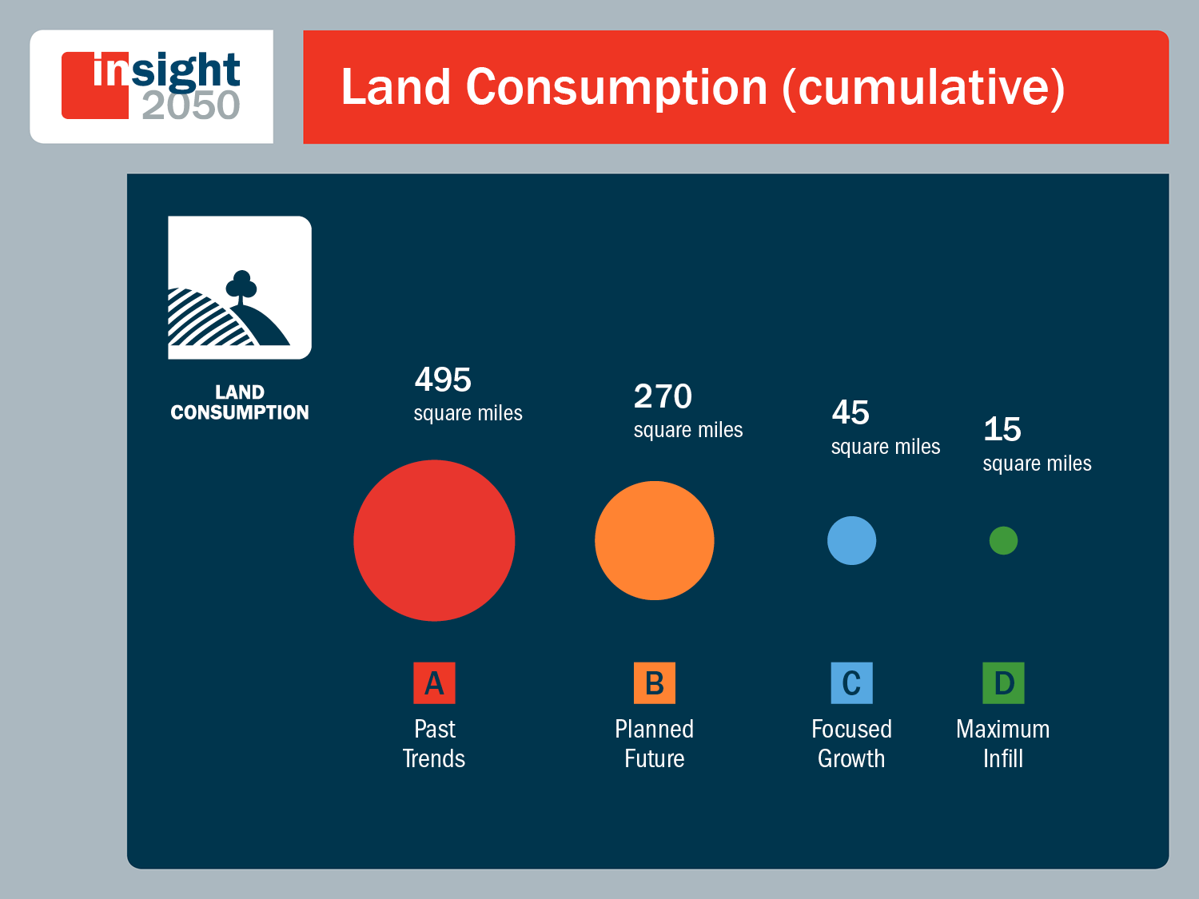
Notes:
Just to give you a few examples of what our consultant found.
In terms of land consumption, if we grew according to local plans, we would consume 270 more square miles of land. Compare that to the Focused Growth scenario, and we would reduce our land consumption foot print by 225 square miles, which is equivalent to the city of Columbus' jurisdictional boundaries.

Slide 29
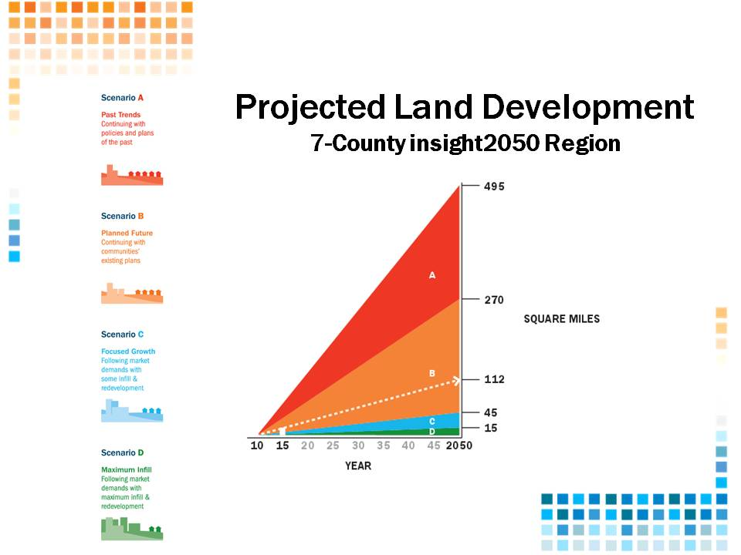
Notes:
Per Maria, this data is still correct for the current MTP update

Slide 30
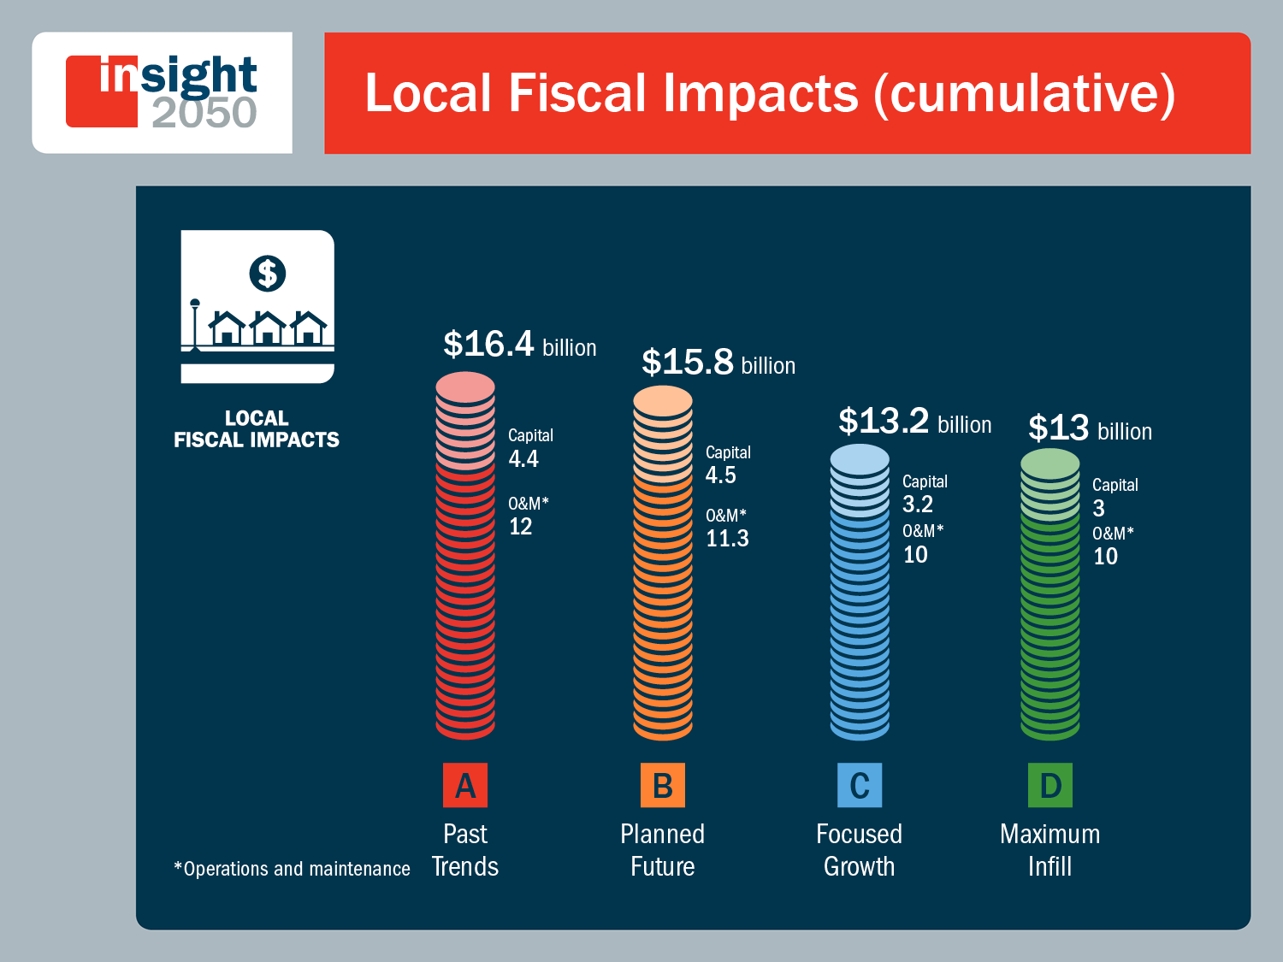
Notes:
Capital and ongoing operations and maintenance (O&M) costs for new local roads, sewer, water, waste­water infrastructure, and select services (2010-2050).
Scenario A: $408 Million Average Annual Costs Capital + O&M 2010–2050
Scenario B: $393 Million Average Annual Costs Capital + O&M 2010–2050
Scenario C: $329 Million Average Annual Costs Capital + O&M 2010–2050
Scenario D: $328 Million Average Annual Costs Capital + O&M 2010–2050
Development under the Focused Growth scenario would cost $4.4 billion less than under the Planned Future scenario.

Slide 31
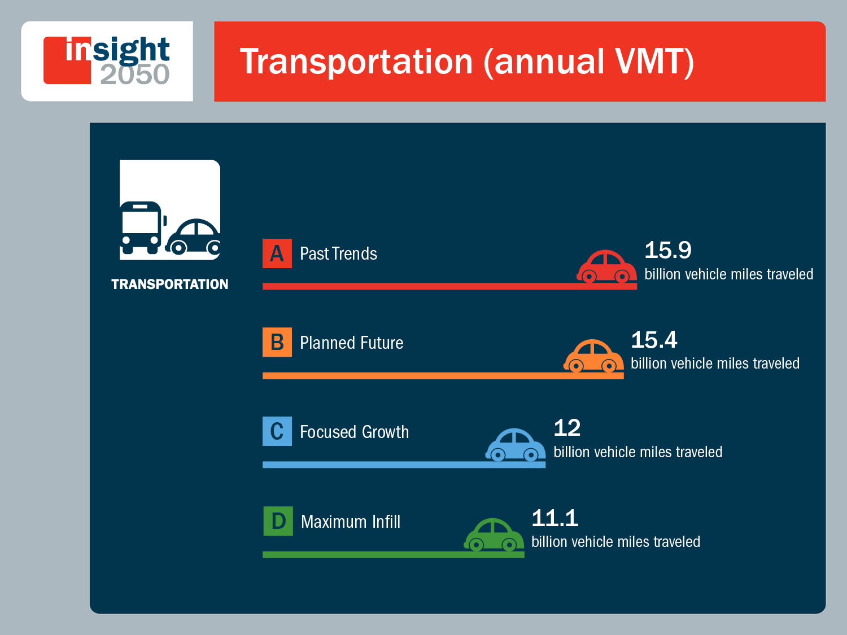
Notes:
- Other key considerations, such as access to robust transportation opportunities, will attract the fastest growing segments of the population – Millennials and Baby Boomers. Improved access to transportation has a direct impact on our commutes, which we can consider in terms of annual vehicle miles traveled.
Miles driven in passenger vehicles in Central Ohio in 2050.
Scenario A: 8,450 miles / year (per new resident, 2050)
Scenario B: 7,450 miles / year (per new resident, 2050)
Scenario C: 4,450 miles / year (per new resident, 2050)
Scenario D: 3,850 miles / year (per new resident, 2050)
Development under the Focused Growth scenario would result in 3.4 billion less vehicle miles traveled than under the Planned Future scenario.

Slide 32
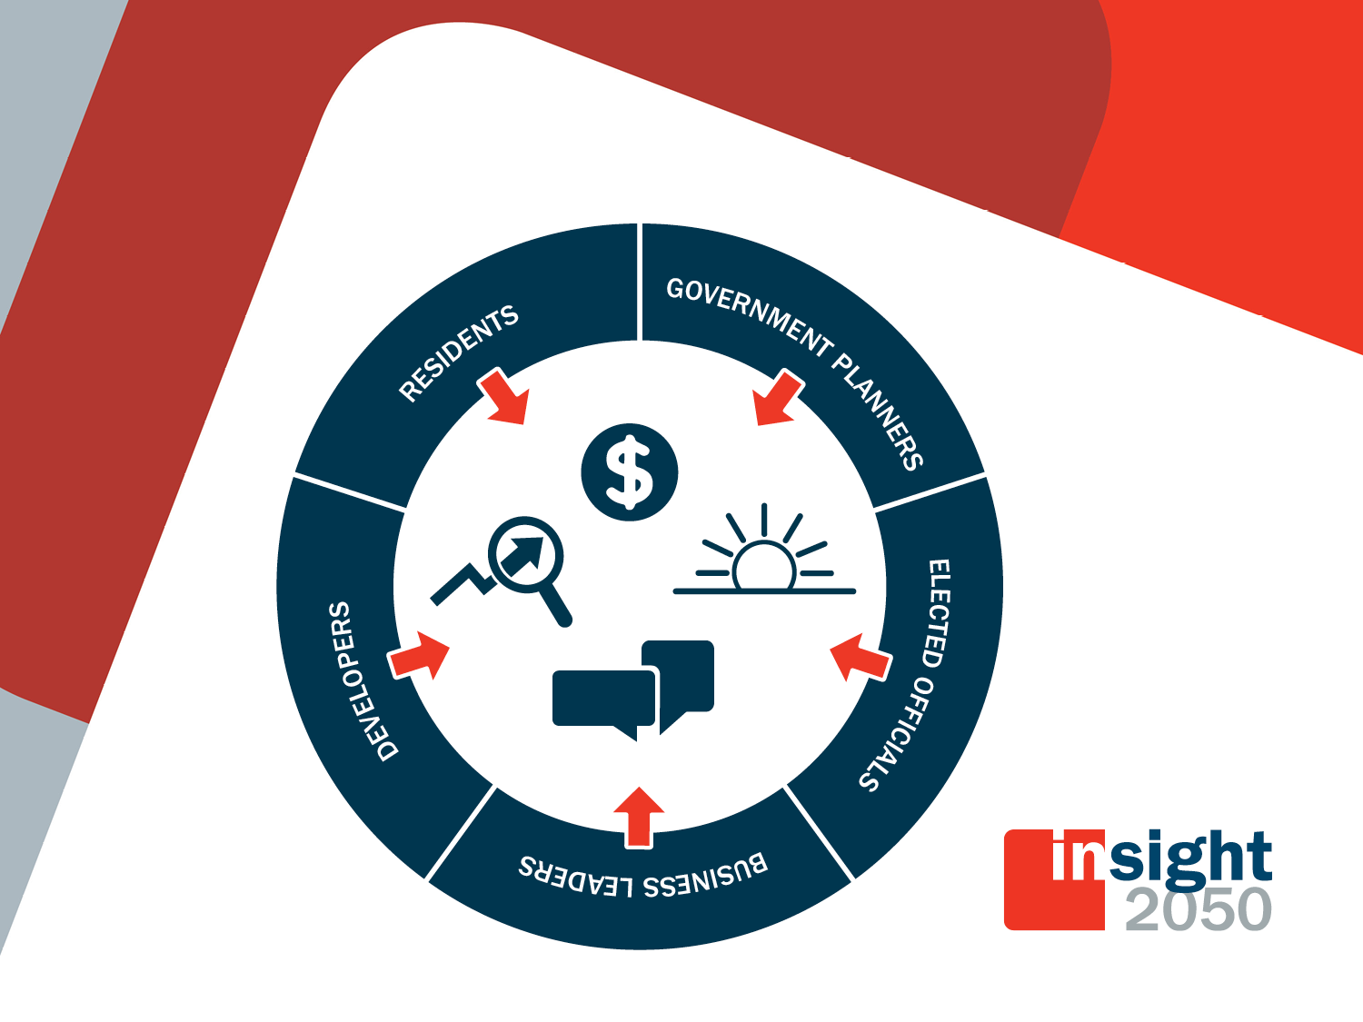
Notes:
What we really want to achieve with this collaborative project is to increase conversations and collaboration between our public and private stakeholders.
Keep conversation going within community and across communities to better our cities and the region.

Slide 33
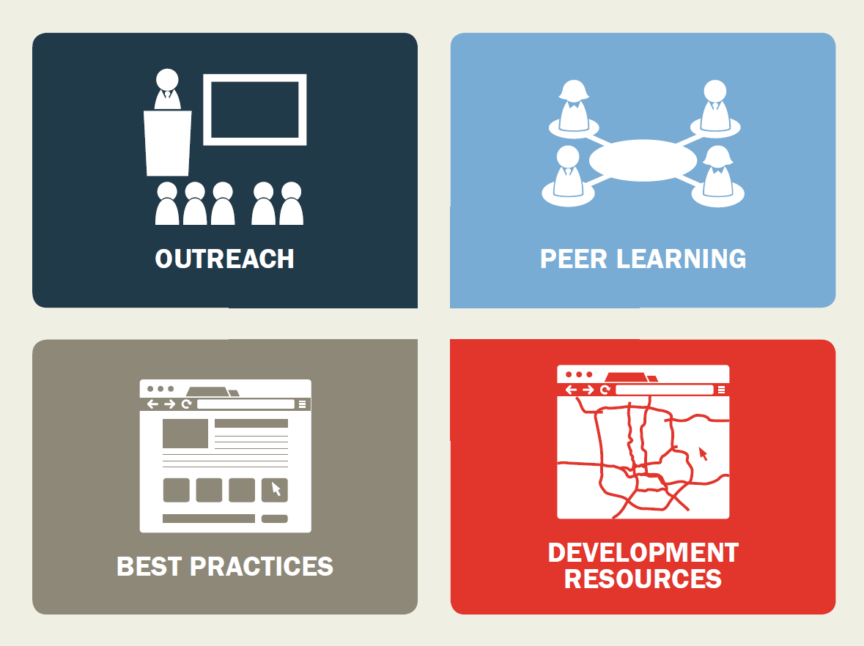
Phase II
Notes:
Phase II includes four components:
Outreach -- The insight2050 partners will continue sharing the findings of Phase I and the progress of the development of Phase II with local governments, businesses, the development community and residents through presentations, workshops, online communications and multi-media coverage.
Peer Learning – The insight2050 partners will identify peer communities throughout Central Ohio and provide them with opportunities to learn from communities that have faced similar challenges or share certain characteristics. These peer communities will be able to share best practices and “lessons learned” about transportation, land use and development planning, among other things.
Best Practices -- The insight2050 partners are creating an online inventory of local examples and case studies that exemplify successful development and land use planning efforts throughout Central Ohio and beyond. Information will include process documentation, photos, policy or ordinance templates, design-based resources, and development profiles. The information will be categorized by peer typology to ensure user-friendliness.
Development Resource -- The insight2050 partners will create a map-based infill and redevelopment directory that illustrates vacant and underutilized land that could be used for development. These opportunities will be shared with local decision makers, developers, and the business community to inform them and help prioritize infrastructure investment, land use, and economic development.

Slide 34
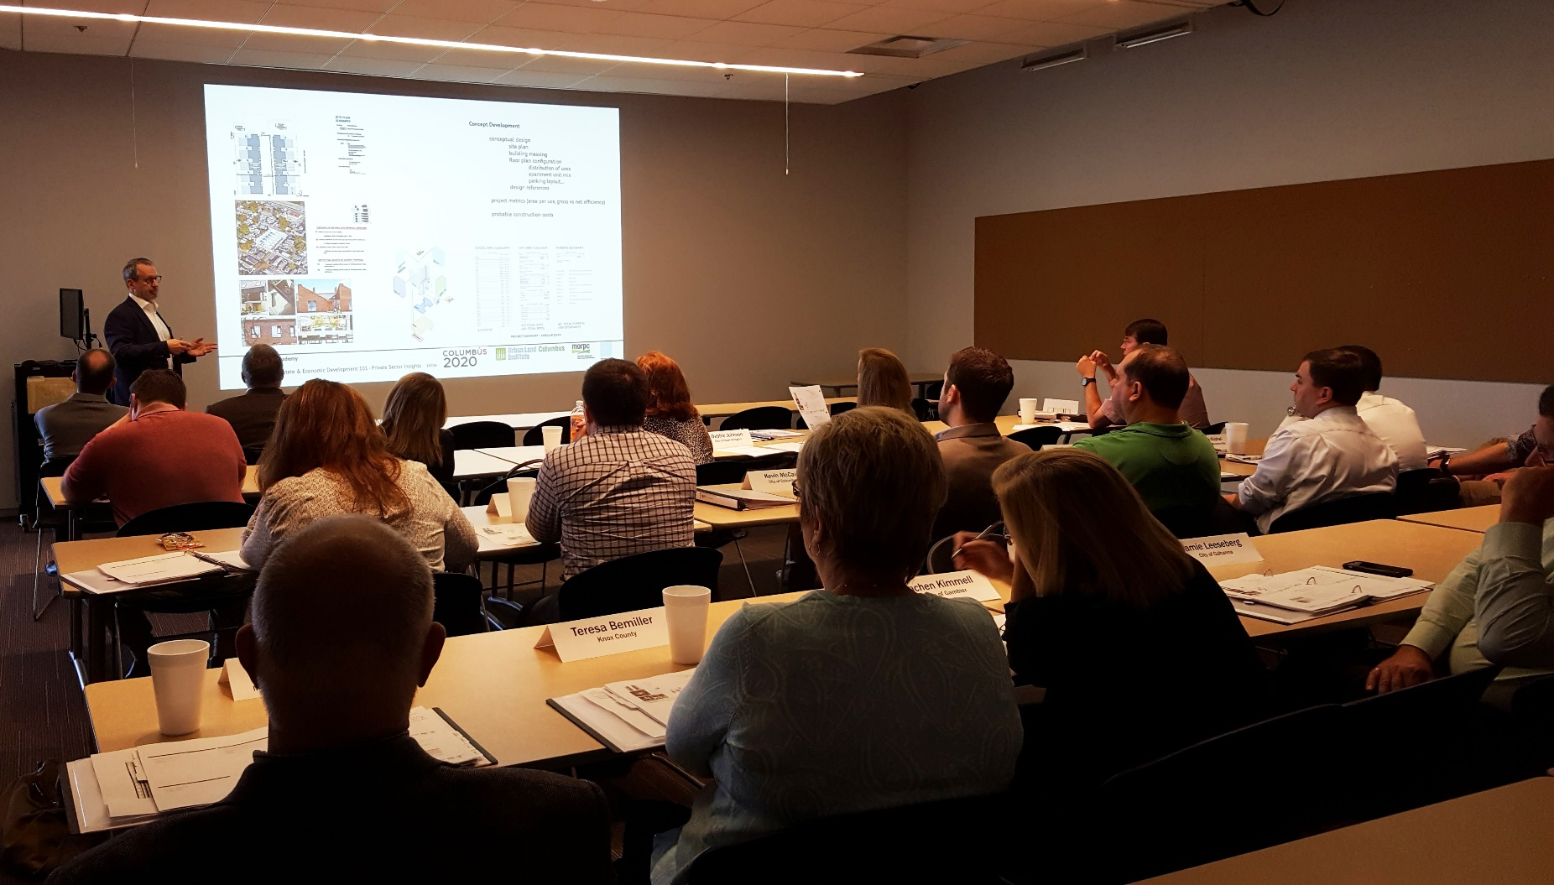
Academy for Elected Officials

Slide 35
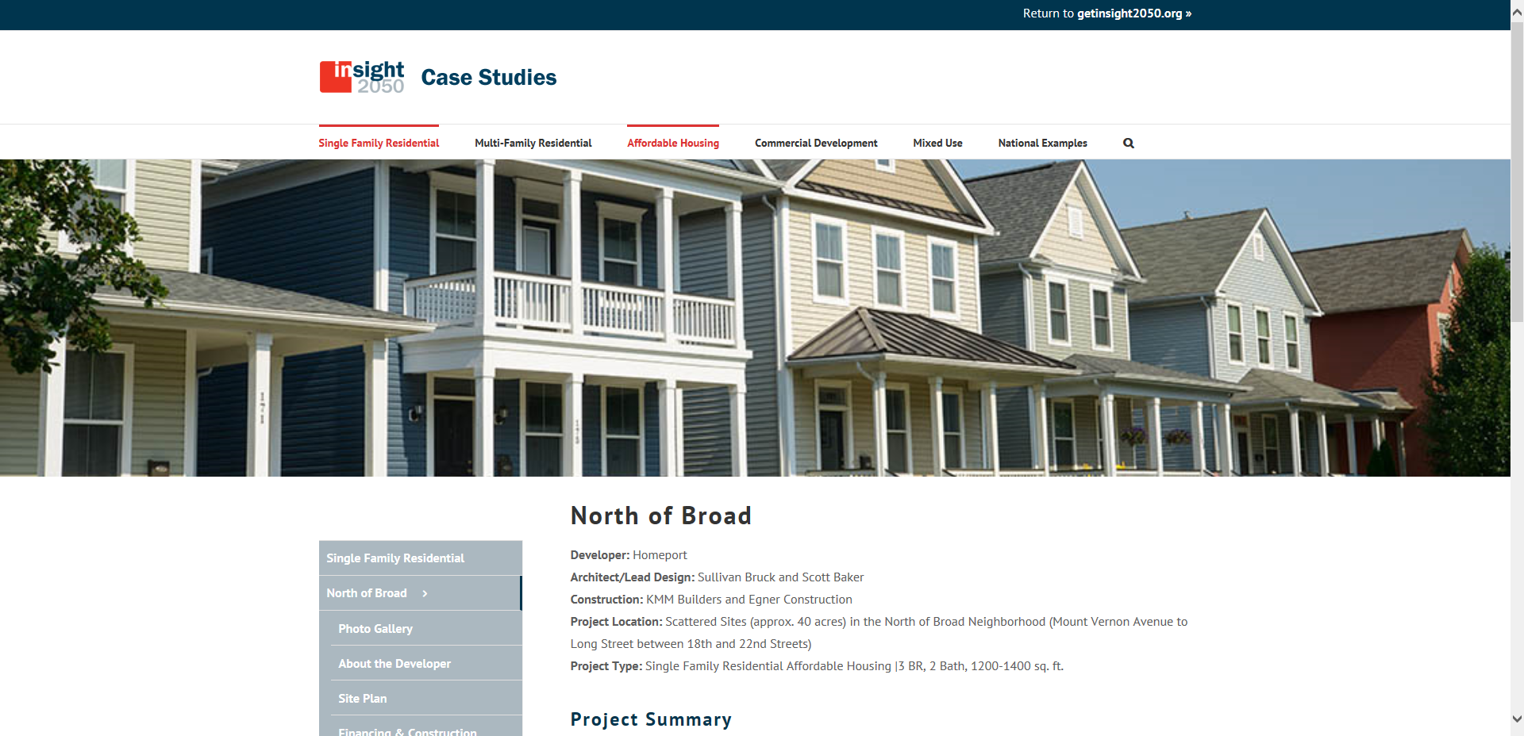
getinsight2050.org

Slide 36
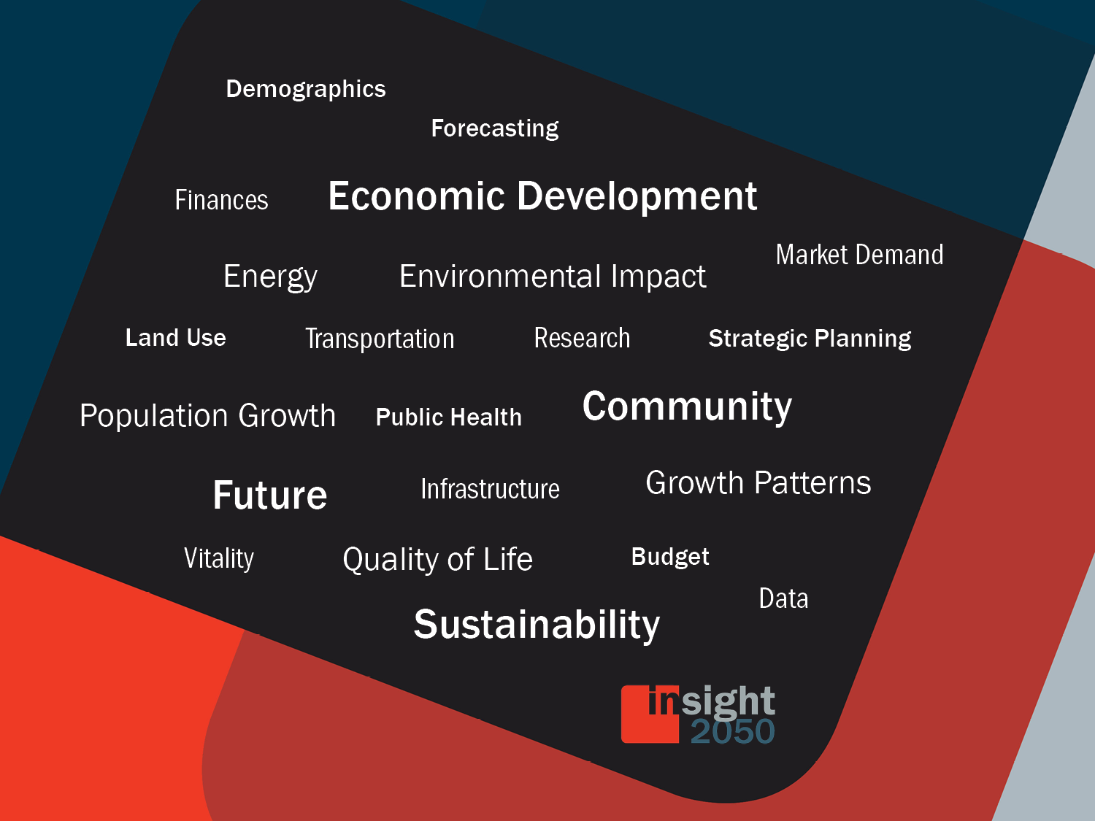

Slide 37







With Support From:

Slide 38

Jennifer Noll
Associate Planner
614-233-4179
jnoll@morpc.org
Notes:
Insight2050 contains a great deal of useful and interesting information. We encourage you to talk with your local government if insight2050 interests you, and we invite you to share your thoughts with us as well.

