Slide 1
Sketch Tools for Scenario Planning
Eli Knaap & Uri Avin
Association of Metropolitan Planning Organizations
10/22/14

Slide 2
Background; WHY now?
Megatrends:
Recent wave of tool development
Open Gov / Open Data
Federal Programs:
SCI
MAP-21
R&D initiatives:
OPTG
NCHRP
Case studies in tool applications

Slide 3
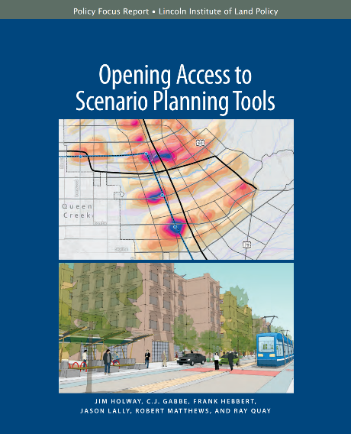
Purpose
What works?
When?
For who?
(why?)

Slide 4
Mythical Quest
An analytical engine that:
Is low cost
Has simple & intuitive interface
Imports local data with ease
Helps generate credible scenarios
Computes meaningful, digestible, (accurate) evaluation metrics in real time
Empowers citizens
Produces photo-realistic image of future scenarios

Slide 5
One Platform to Rule Them All?

Slide 6
Natural Tensions
Sketch tools versus models
Econometric, CA, etc.
Bottom up vs. top down
Process vs. outcome
Inclusion vs. expertise
Offline cogitation vs. online simplicity
Current conditions vs projections
i.e. juicy trends hard to forecast – needs offline work

Slide 7
State of the Practice vs. State of the Art?
How do contemporary tools deal with these tensions
Where are we now?
4 primary tools at different stages of maturity

Slide 8
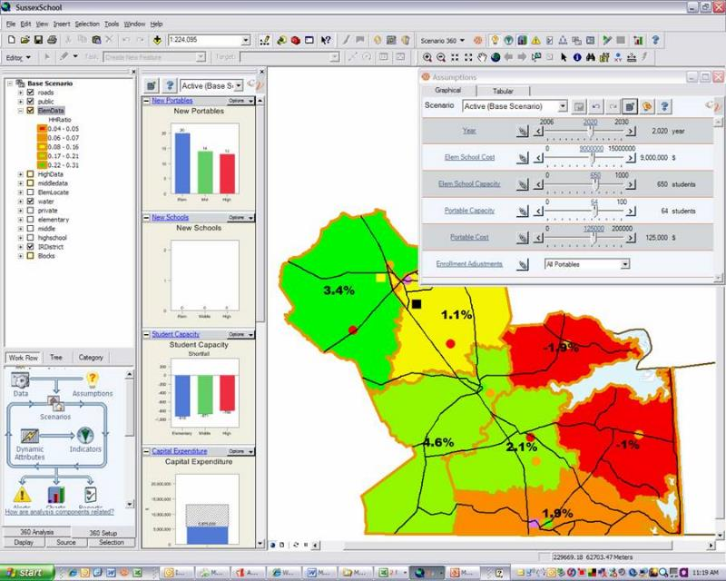
CommunityViz

Slide 9
CommunityViz
Evolution: Geosimulation Center, Orton family foundation, Placeways
Development: Mature
Strategy: make ArcGIS more flexible
Concept: open-ended w/ modules
Metrics: BYOS (bring your own data and calcs)
Newer versions allow selection from indicator list
Transparent
Assumptions and formula exposed and malleable

Slide 10
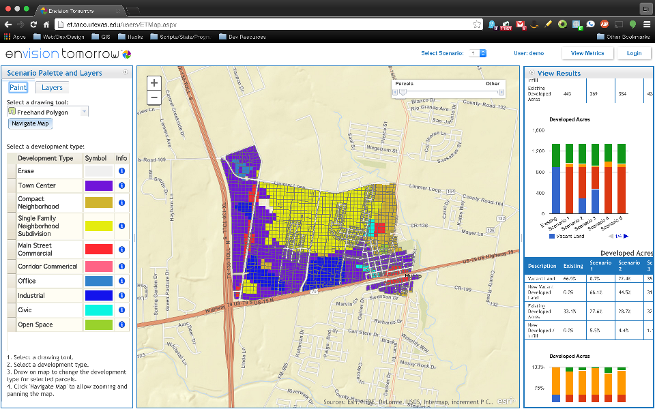
EnvisionTomorrow+

Slide 11
EnvisionTomorrow +
Evolution: Envision, Fregonese, SCI
Development: Adolescent
Strategy: facilitate data I/O in ArcMap
Concept: geodesign
Metrics: Choose from indicator list
Translucent
Assumptions implicit. Formula hidden but accessible

Slide 12
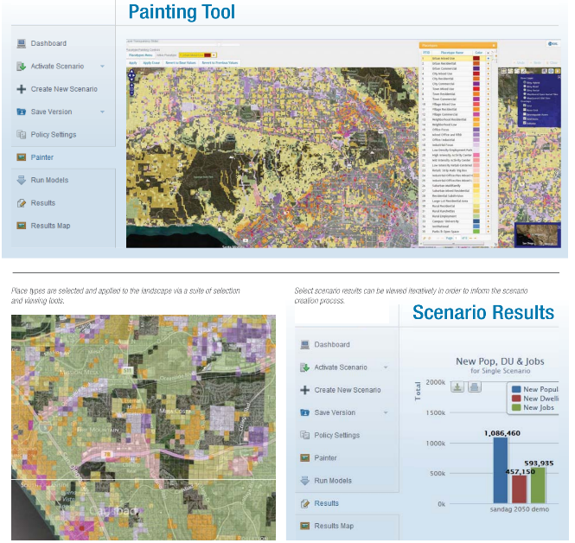
UrbanFootprint

Slide 13
Urban Footprint
Evolution: Calthorpe, SCI
Development: infancy
Strategy: modular/open source (server-based)
Concept: geodesign
Metrics: Choose from indicator list
Calibrated (by Calthorpe) for California
Opaque-ish
Cal based models
Assumptions and formula explicit but inaccessible

Slide 14
Tradeoffs
Familiar tools (e.g. ArcMap, Excel) or purpose-driven platform?
Cost
Experience
Build formula or choose formula?

Slide 15
Why use sketch tools?
Limited resources*
Not a substitute for limited time
No existing modeling framework
i.e. smaller regions/jurisdictions
Bottom-up planning culture
Accuracy less important than comparative stats
Guide land use/transportation simulations

Slide 16
Bottom line
The mythical quest continues!
Scenario planning is hard work, no matter what software is applied
Models need local calibration
Without significant data preparation and analysis, indicators will range from reasonable to wrong

Slide 17
Bottom line
Geodesign is a good for testing alternatives, less adept at testing policies
The real utility in sketch tools is realized through process

Slide 19
Where are we headed?
Sketch tools are getting more sophisticated
Data transformation and import wizards
Cloud-based computation and online interfaces
More scientific analytics*
Improvements in computation and UI make software more accessible for planners and citizens
Iterative scenarios during public meetings

Slide 20
Where are we headed?
But the econometric heavyweights are getting more intuitive
Simpler (read: comprehensible) UIs
Fewer data obstacles
Format standardization
Open data APIs
More flexible/scalable models
Rapid and realistic visualization engines
Cloud computation & online interfaces
Keep your eyes on the Synthicitys of the world

Slide 21
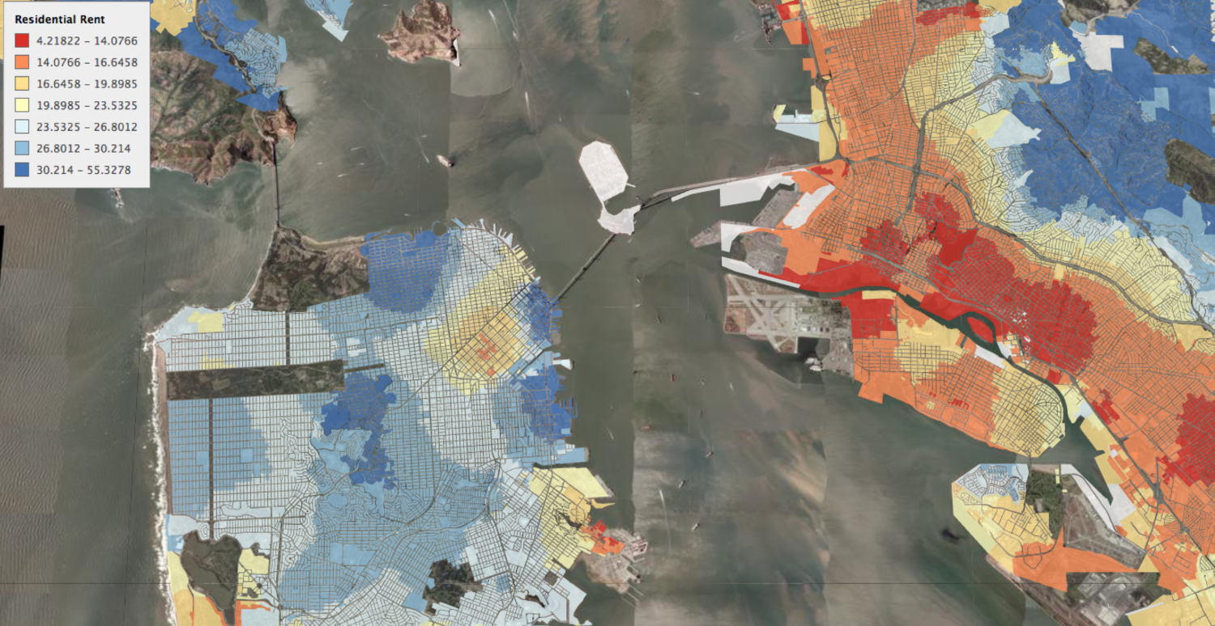

Slide 22
Thank you
Eli Knaap
eknaap@umd.edu
www.knaaptime.com

