Slide 1
Setting and Achieving Safety Targets
AMPO
Audrey Wennink, Cambridge Systematics, Inc.
October 23, 2014
Notes:
The purpose of this project was to understand the state of the practice in setting safety targets and to develop a framework to guide states in their future efforts in setting safety targets.

Slide 2
Agenda
MAP-21 Requirements
Safety Data
Benefits of Safety Focus
Safety Target Setting methods
Achieving safety targets at a regional level

Slide 3
Benefits of Increased Safety Focus by MPOs
SAVE LIVES
Improve community quality of life
Reduce congestion
Benefit air quality

Slide 4
Performance Management Framework
Notes:
Target setting is a central element of the six components of performance management
Setting Goals and Objectives. An organization’s policy goals and objectives define agency priorities and provide the foundation for performance-based planning and management decisions;
Selecting Performance Measures. Performance measures capture the expected outcomes implied by the goals and objectives and help an organi­zation monitor progress towards those outcomes;
Setting Performance Targets. Establishing a quantifiable target for each per­formance measure allows agencies to provide a concrete definition of objectives and gauge specific progress over time towards goals;
Allocating Resources. An organization builds on the preceding steps by allocating resources such as time and money through budgeting processes to achieve specific performance targets;
Measuring and Reporting Results. Monitoring and reporting progress to decision makers and other stakeholders allows organizations to identify key factors influencing performance and necessary actions to improve results; and
Quality Data. Effective decision making within each element of the perfor­mance management framework requires a solid foundation of accurate, timely, and appropriate data.

Slide 5
MAP-21 Required Safety Targets for MPOs
State DOTs and MPOs must establish targets for national measures
  Fatality number
  Fatality rate (i.e., fatalities per 100 million vehicle
  miles traveled)
  Serious injury number
  Serious injury rate (serious injuries per 100 million vehicle miles traveled)
Notes:
Moving Ahead for Progress in the 21st Century (MAP-21) solidifies the need for States and regions to set targets for a core group of performance measures .
The four mandatory safety targets required for each State and MPO are:
Fatality number
Fatality rate (i.e. fatalities per 100 million vehicle miles traveled)
Serious injury number
Serious injury rate

Slide 6


MAP-21 Optional Safety Targets for State DOTs
Urbanized Areas
  Fatalities
  Serious injuries
  Fatality rate
  Serious injury rate
Non-urbanized Areas
  Fatalities
  Serious injuries
  Fatality rate
  Serious injury rate

Slide 7
What Data are Needed to Set MAP-21 Targets?
Vehicle Miles Traveled data
  Model – need to estimate for all public roads
  Forecast growth rate
Fatality Data
Serious Injury Data
  Geolocated crashes
  Injury data and severity for each person, not each crash
  Categorized by injury severity to isolate serious injuries

Slide 8
Where are Safety Data Stored?
Federal Fatality Analysis Requirements System (FARS)
  Fatalities
State DOT-Maintained Crash Databases
  Fatalities
  Injuries by severity
Other data
  Vehicle Miles Traveled for all public roads

Slide 9
How Do I Access Crash Data?
Query national FARS database
  Data is available by county
Access State DOT data
  Make data request of State DOT
  Access reports prepared by State DOT
  Query state crash database directly
VMT data
  Model – need to estimate for all public roads
  Forecast growth rate
Notes:
In many states, a large proportion of crashes are off the state system. It is in the DOT’s interest to work with you and support MPOs’ increased safety analysis.

Slide 10
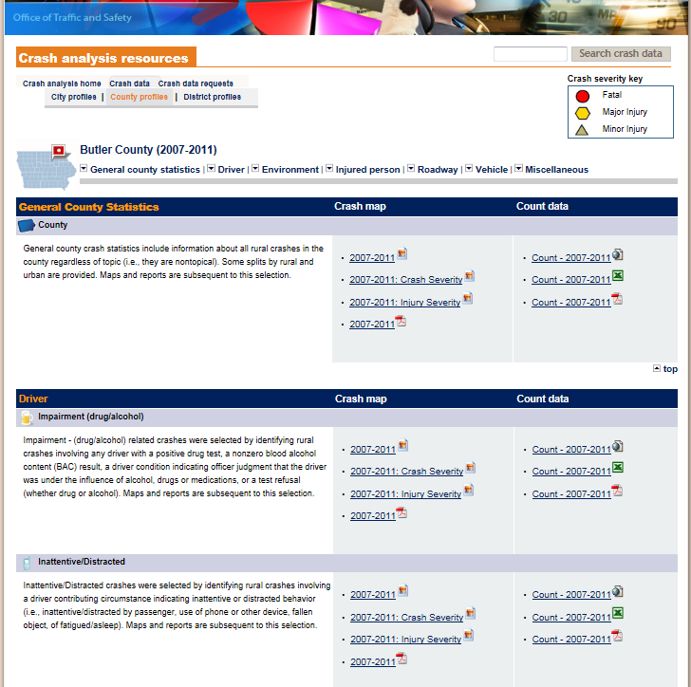
Iowa
Data
http://www.iowadot.gov/crashanalysis/data/county/butler.htm

Slide 11
Setting Safety Targets

Slide 12
Common Methodologies for Safety Target Setting by Transportation Agencies
Target set by committee, consensus or a leadership group through deliberation and discussion
Adopted Toward Zero Deaths
Adopted AASHTO Target to halve fatalities by 2030
Target based on output of forecasting or analysis tool
Mandated by policy makers
Target based on a linear fatality reduction trend line over a specified timeframe
Notes:
In the fall of 2012 an electronic survey was distributed to all SHSO and DOT safety representatives asking about the methods they used to set safety targets.
Many states used more than one methodology- these are not mutually exclusive.
These were the methods used, which will be explained further on the following slides.
Regardless of the method chosen, policymakers must approve of the target. Now we’ll walk through the first five methods.

Slide 13

Target Setting under MAP-21
Evidence-Based Targets

Slide 14
What Are Evidence Based Targets?
Evidence-Based Targets
  Estimate of achievements for specific set of investments, policies, and strategies
  Achievable
  Relatively short timeframe (up to 5 years)
Benefits
  Provide accountability for specific planning efforts
  Support consideration of investment tradeoffs across different program areas
  Realistic targets based on data and research are more likely to be accepted and supported by stakeholders
Notes:
Before we delve into methodologies for developing evidence-based targets, it is important to define this term.
Evidence-based targets take a more narrow approach to target setting – focused specifically on what can be achieved within the context of a set of investments, policies, and strategies defined within a specific implementation plan and a specific shorter term timeframe. Generally, these targets are usually set for five to ten years in the future when future trends can be forecasted with more accuracy based on available data.
Factors affecting the target setting process used
Span of control/agency jurisdiction
Performance-based resource allocation history/evolution of state-of-the-practice
Financial resources
Technical resources (i.e., planning and forecasting capability)
Timeframe
Political influence
Legislative influence
Organizational structure
Internal support/culture

Slide 15



Aspirational vs. Evidence-Based Targets
Toward Zero Deaths
Notes:
Evidence- based targets can be accompanied by aspirational or vision-based targets.
As noted earlier, many transportation agencies are setting vision-based targets for zero fatalities (vision zero, towards zero deaths, target zero) and for progress towards this vision (e.g., reduce fatalities by half within 20 years).
Toward Zero Deaths was established in the U.S. as a National Strategy on Highway Safety by FHWA in 2009.
In the survey, 23 states reported they have adopted TZD, most as an overarching, long-term vision statement. In a few cases zero has been adopted as the actual target.

Slide 16
Evidence-Based Target Setting
1
2
3
Safety Measure
Safety Measure
Safety Measure
Scenario 1
Scenario 2
Time
Time
Time
Where are we now?
Estimate existing trend
What external factors will impact our target?
Adjust trend for expected demographic and socioeconomic changes
What is the impact of improvements?
Estimate target based on forecasted fatality reduction from safety plans
Source: Safety Target Setting Final Report, December 2012, FHWA
Notes:
However, despite these challenges we must carry on and advance the practice of safety target setting.
As agencies begin the process of setting evidence-based targets, several approaches should be considered. The steps for using countermeasure data in target setting are relatively simple, although the implementation of these steps may be complex:
-Use trend analysis;
-Consider exogenous factors, i.e., population, demographic distribution; and
-Forecast fatality reductions based on planned implementation of proven countermeasures:
Identify potential for application of countermeasures (through SHSP, HSP, HSIP, or other planning processes);
Identify data on countermeasure impact;
Develop constrained list of countermeasures based on expected effectiveness and resources (i.e., expected lives saved per dollar of investment);
Estimate system, region, or State benefits based on the aggregation of expected countermeasures, discounting for potential overlap among emphasis areas.

Slide 17
Evidence-Based Target Setting
1
Safety Measure
Time
Where are we now?
Estimate existing trend
Notes:
The first step is to know what the trend would look like if business as usual were to continue, if existing trends were to continue into the future. Next we will look at an example of how this might look.

Slide 18
Trend Analysis – Fatalities and Serious Injuries
Cheyenne MPO Example
Fatalities
Serious Injuries
Cheyenne MPO
Notes:
The first and easiest step is to take several years of fatality data to estimate a linear trend moving forward. This can be done easily in spreadsheet software like Excel. The graphic on this slide shows actual fatality data for the Cheyenne MPO, which just went through the target setting process last month.
Fatality rate and serious injury rate also followed these same trends

Slide 19
Evidence-Based Target Setting
Exogenous Factors
2
Safety Measure
Time
What external factors will impact our target?
Adjust trend for expected demographic and socioeconomic changes
Notes:
Now we’ll move into the next step. Once the forecasted trend line is determined – which is indicated by the green line in the diagram – agencies will want to consider exogenous or external factors that will affect the trend line.
These are likely to be demographic or socioeconomic changes.

Slide 20
Adjust Target Based on Exogenous Factors
Vehicle Miles Traveled
Mode Shifts
Population Growth
Anticipated age cohorts with higher risk
  Younger drivers (under age 25)
  Older drivers (65 and over)

Slide 21
Population Trend – Cheyenne MPO

Slide 22
Vehicle Miles Traveled Trend - Cheyenne MPO
Notes:
Based on model; differs from WYDOT estimate

Slide 23
Adjust Target Based on
Exogenous Factors
National Fatalities per 100,000 Population
Notes:
As shown here young drivers have a higher fatality rate than the population at large.
If there will be a large proportion of a high-fatality age cohort during the time period for the target, a State or region may want to adjust the target based on that factor.

Slide 24
Evidence-Based Target Setting
3
Safety Measure
Scenario 1
Scenario 2
Time
What is the impact of improvements?
Estimate target based on forecasted fatality reduction from safety plans
Notes:
Evaluation is a critical element of transportation safety improvement.
States should use the safety analysis tools that have recently become available to adjust their targets. We will review those in the next slide.
Program and project evaluations help agencies determine which countermeasures are most effective in saving lives and reducing injuries. Agencies also may identify which countermeasures are not as effective as originally expected and reconsider or modify them in the future.
The results of all evaluations should be captured in a knowledge base to improve future estimates of effectiveness and for consideration in future decision-making and planning. This information is a critical input into evidence-based safety target setting. When States sets or updates a safety target, it should draw upon its body of knowledge of project effectiveness for use in forecasting future fatality reductions given a set level of resources. This information will help the State develop the most effective safety program possible and also ensure its fatality targets are realistic.

Slide 25



Adjust Target Using Countermeasure
Impact Data
Safety Analysis Tools
  Interactive Highway Safety Design Model (IHSDM)
  SafetyAnalyst
  Highway Safety Improvement Program Manual (HSIP Manual)
  Highway Safety Manual (HSM)
  Crash Modification Factors Clearinghouse
  (CMF Clearinghouse)
  Countermeasures That Work
IHSDM
Notes:
Here is a list of some of the safety analysis tools that have recently become available and will help with this step. What we want to note is that the practice of safety is not at the point where there is a single tool that can generate a systemwide target. Each of these can help with an element of your analysis.
Highway Safety Manual (HSM) – The HSM provides practitioners with information and tools to consider safety when making decisions related to design and operation of roadways. planning,
design, construction, maintenance, and operation.
Interactive Highway Safety Design Model (IHSDM) – The IHSDM is a suite of software analysis tools for evaluating safety and operational effects of geometric design decisions on highways.
SafetyAnalyst – SafetyAnalyst provides a set of software tools used by State and local highway agencies for highway safety management.
Highway Safety Improvement Program Manual (HSIP Manual) – The HSIP Manual provides an overview of the HSIP and presents State and local agencies with tools and resources to implement the HSIP. The manual provides information related to planning, implementation, and evaluation of state and local HSIPs and projects.
Crash Modification Factors Clearinghouse (CMF Clearinghouse) – The CMF Clearinghouse provides a regularly updated online repository of CMFs, which are used to forecast the impact of a countermeasure on crash frequency and severity
Countermeasures That Work – This resource updated annually by NHTSA documents the effectiveness of safety countermeasures for non-infrastructure oriented major highway safety problem areas (e.g. behaviors, population groups and vulnerable user types).

Slide 26
MPO Safety Self Assessment
Is safety explicitly expressed in our goals/objectives?
Is safety a criterion for prioritizing transportation projects?
Do we have a safety committee, or is safety a regular topic in policy committee meetings?
Have we developed a dedicated safety plan or conducted substantial safety analysis?
Do we participate in regional or state safety efforts related to improving driver behavior or safety culture?
Assessment of the regional level of commitment to safety will inform safety target setting

Slide 27
Target Setting Summary - Cheyenne
Measure | 2004-2008 Avg. | 2009-2013 Avg. | Actual Avg. Annual Change | 2016-2020 Prediction | Annual Target (2020) | Target Avg. Annual Change | Target Total Change by 2020
Annual Fatalities | 5 | 7 | +5.5% | 9 | 6 | -1.1% | -7%
Annual Serious Injuries | 47 | 27 | -10.4% | 0 | 19 | -5% | -30%
Annual Fatalities & Injuries | 445 | 421 | -1.1% | 388 | 340 | -3% | -19%
Fatality Rate | 0.8 | 0.94 | +3.3% | 1.1 | 0.87 | -1.1% | -7%
Serious Injury Rate | 7.3 | 3.8 | -12.3% | 0 | 2.6 | -5% | -30%
Notes:
Rates are impacted by high VMT growth forecast

Slide 28
MPO Safety Target Setting - Challenges
Data for crashes on non-State system may not be high quality, i.e.,
  Lack geolocation information
Serious injury data may not be high quality
Trend lines may be going up
May not understand anticipated impacts of future safety projects

Slide 29
Achieving MPO Safety Targets

Slide 30
Regional Safety Planning
How can an MPO make meaningful safety improvements?
  Participation/Coordination with the State Strategic Highway Safety Plan
  Develop dedicated safety plan
  Increase integration of safety into the MPO Planning Process
  Collaboration with local jurisdictions on applications for HSIP funds for safety projects

Slide 31


Participate in State SHSP
Contribute to development/Implementation of your State’s Strategic Highway Safety Plan
Ensure strategies will benefit MPO regions
States need to reduce fatalities on non state roadways

Slide 32
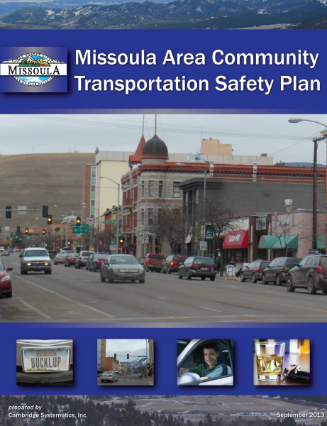
Develop a Dedicated Safety Plan
Regional plans identify safety needs that may differ somewhat from State needs in SHSP
Customize strategies to community
Develop partnerships

Slide 33
Conduct Review of Safety Integration into the Planning Process
Conduct Safety Self Assessment

Slide 34
Learn How to Help Local Jurisdictions Apply for HSIP Project Funding
State DOTs manage Highway Safety Improvement Program Funding
Funding targeted to safety infrastructure projects
Most states have annual application process
Requires safety analysis
MPOs can help local jurisdictions apply

Slide 35

Questions?
Audrey Wennink
awennink@camsys.com
312-665-0218

