Slide 1
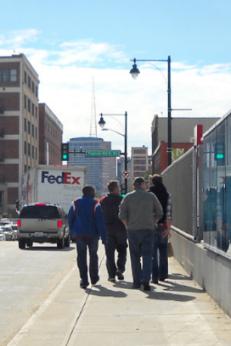
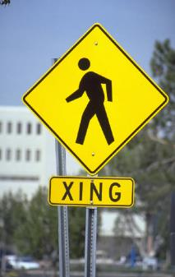
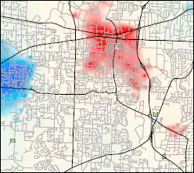
Examining Pedestrian Crash Hot Spots
AMPO Annual Conference
October 22, 2014

Slide 2

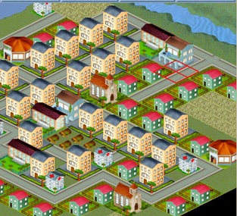


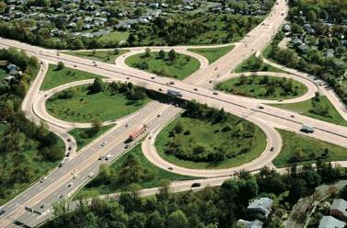

About Me

Slide 3
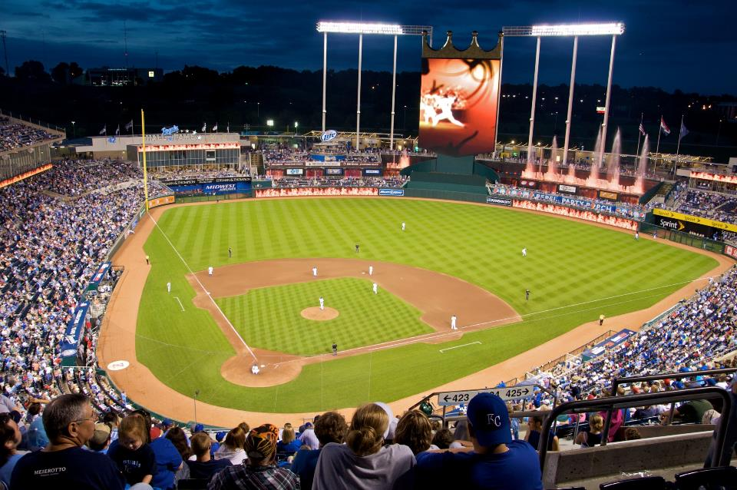


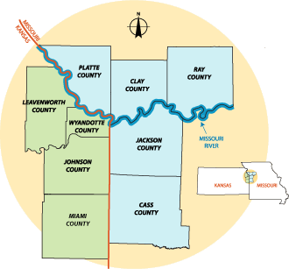
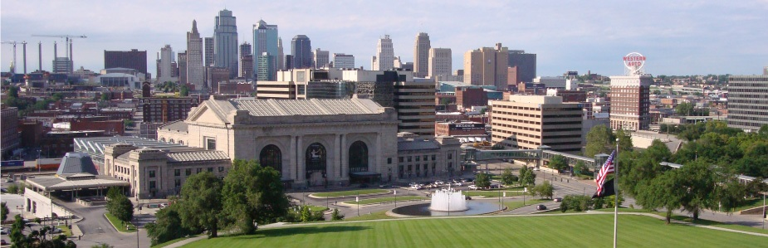
Mid-America Regional Council
MARC is a nonprofit association of city and county governments and the metropolitan planning organization for the bi-state Kansas City region.
I’m missing Games 1 & 2 of the World Series to be here!
Notes:
We are funded primarily through federal and state grants (primarily FHWA Community Planning Grant funds) and serve 119 cities within 9 counties.
We:
Coordinate policies
Develop regional transportation plans
Conduct research
Provide technical support to local cities

Slide 4
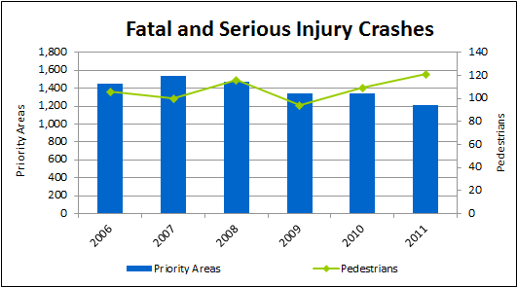
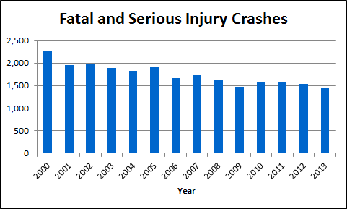
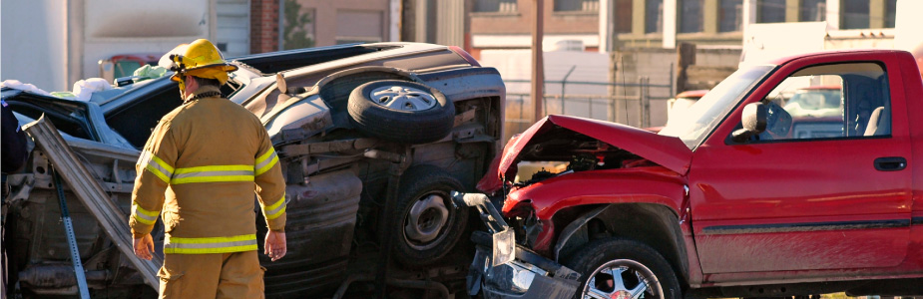
Safety Program
Notes:
A quick background on the project we were working on…
MARC works with local cities, law enforcement, and public health officials through work related to our safety program.
We track crashes on our region’s roadways and provide statistical reports to our stakeholders.
We also work with our regional partners to address safety issues and concerns through our planning and programming processes.
Between 2000 and 2013, the number of fatal and serious injury crashes in our region steadily decreased; however, when we examined specific high-priority areas, we noticed that pedestrians was the lone category that was experiencing increases.
As a result, MARC wanted to further explore the data in greater detail to better understand the situation.
This led to our Pedestrian Crash Analysis project, in which we collected the geo-locations of pedestrian crash incidents from our State Departments of Transportation and mapped them using ArcMap software.

Slide 5
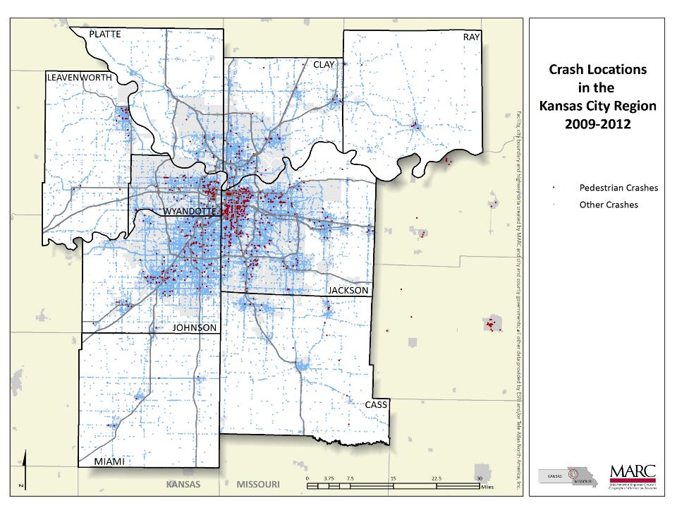
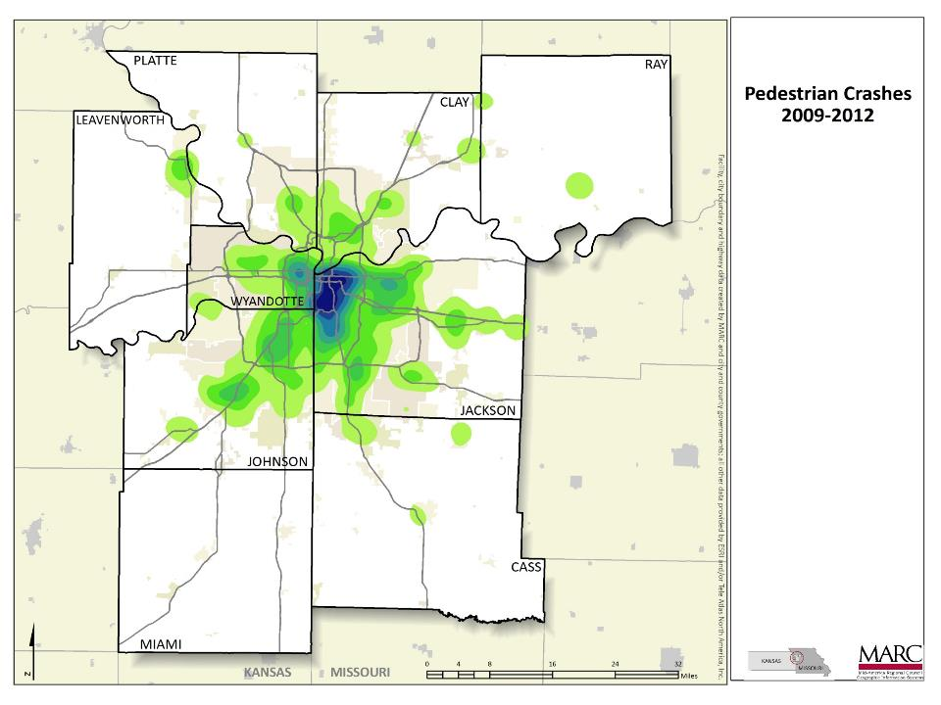
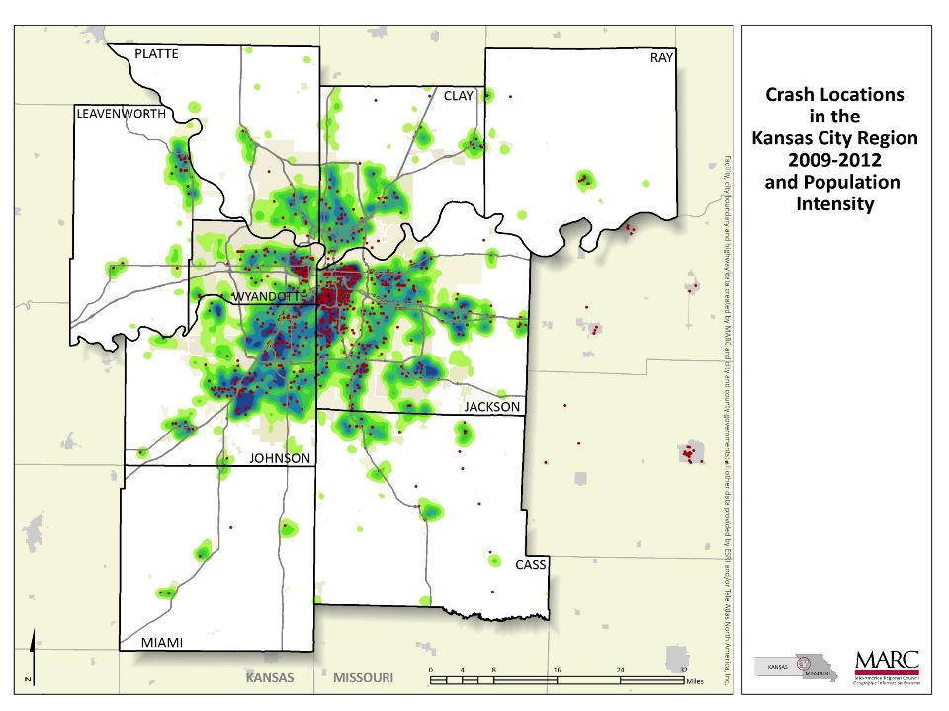
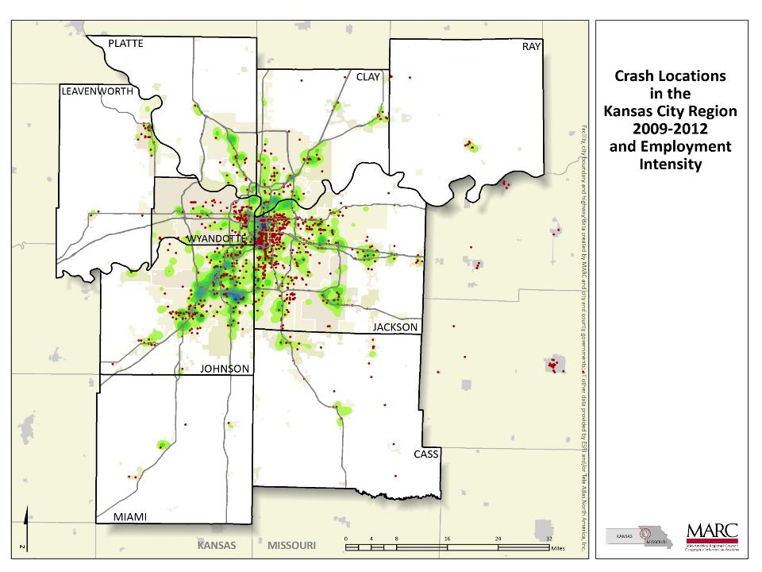

Notes:
Here are what the results look like.
We were interested in identifying geographical trends or patterns to support any countermeasure efforts.
At first, we compiled a simple heat map displaying the concentration of incidents throughout our region.
While it indicates areas with high concentrations of crashes, it doesn’t necessarily indicate whether or not there’s a significant safety issue exists.
The large number of reported crashes may be due to higher levels of exposure, meaning there’s higher levels of walking and pedestrian activity in those locations (often associated with higher density).
This was confirmed when we looked at the crashes in context to population & employment density.
In order to identify areas of concern for pedestrians throughout the region, we had to first determine exposure rates for pedestrians.

Slide 6

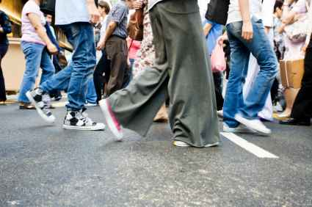
Determining Exposure
Issues with using the ACS to determine exposure:
  Survey only asks about one trip purpose: Journey to Work
  Survey asks, “How did you usually get to work last week?”
  Margins of Error are large for single years and smaller populations.
Notes:
We first looked at the American Community Survey (ACS) because it provides the most publicly accessible snapshot of commuter mode data in the U.S.
However, there are several problems with using the ACS for determining walking exposure.
Journey to Work – In most places, more trips are taken as a pedestrian for other purposes (e.g., walking to school, the store, or recreational purposes).
“How did you usually get to work last week?” – Any mode other than the respondent’s predominant mode isn’t recorded at all.
Margins of Error – Using 5-Year estimates is best; however, this can be difficult for smaller areas, or areas with small populations.
While we can get a general sense of pedestrian exposure at the regional level, it’s hard to determine this at the Census tract or block group level due to Margins of Error.
As a result, we decided to utilize our travel-demand model to help us produce estimates.

Slide 7
Travel-Demand Model
DEMOGRAPHIC
INFORMATION
ZONE (TAZ)
LAYER
INPUT
PROCESS
HH INCOME Sub-model
HH SIZE Sub-model
RESULTS
Auto Ownership
Model
Travel Time Skims
- Roadway
- Transit
TRIP
GENERATION
1
SPECIAL GENERATOR
(KCI AIRPORT)
ROADWAY
NETWORK
TRIP
DISTRIBUTION
2
Feedback loops
MODE CHOICE
3
TRANSIT
NETWORK
Initial feedback of logsums
EXTERNAL S
  Generation
  Distribution
TIME OF DAY
ASSIGNMENT
4
LINK VOLUMES
LINK SPEEDS
Notes:
MARC uses a Traditional 4-Step Model
Trip Generation
Trip Distribution
Mode Choice (auto and transit)
Trip Assignment (trips are assigned to network + volumes)
The modeling software/platform is EMME
However, our model is only able to generate estimates for automobile and transit modes; this is due to a lack of data on walking volumes for our region.
Mode share % for walking in our region is so small
It’s hard to determine exact trip destinations for walking
As a result of not having good rates for pedestrian exposure, we decided to use automobile outputs from our travel-demand model as a proxy for exposure rates.

Slide 8
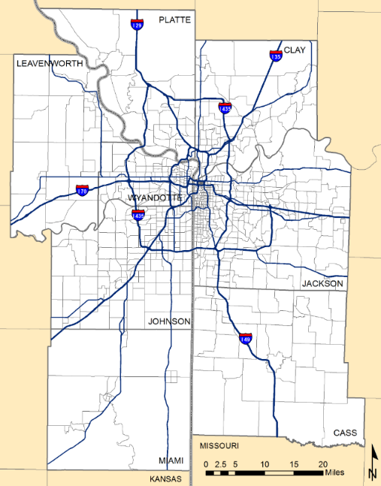
Traffic Analysis Zones
TAZs are the primary unit of analysis in travel-demand forecasting.
  In terms of size, they’re similar to Census tracts.
  The Kansas City region contains 951 TAZs.
TAZs represent where trips begin and end.
Notes:
MARC’s travel-demand model produces statistics for TAZ geographies.
Output data from the travel demand model (i.e., automobile trip information [origins and destinations]) for TAZ geographies was then used for a Hot Spot Analysis.

Slide 9
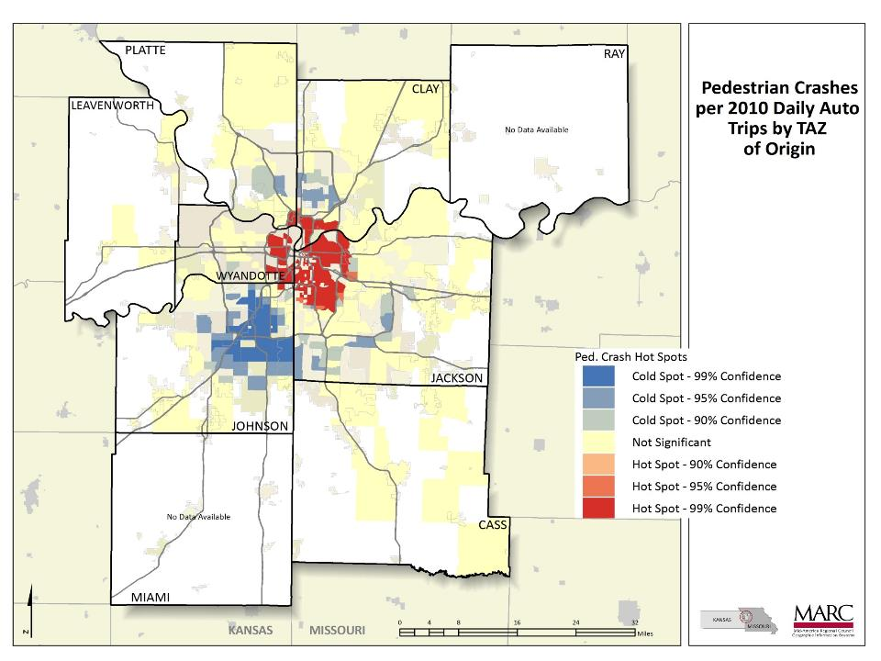
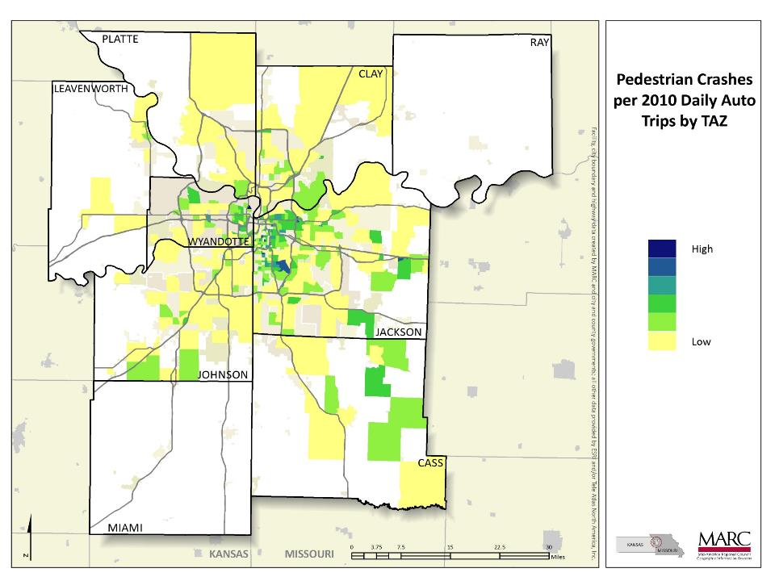
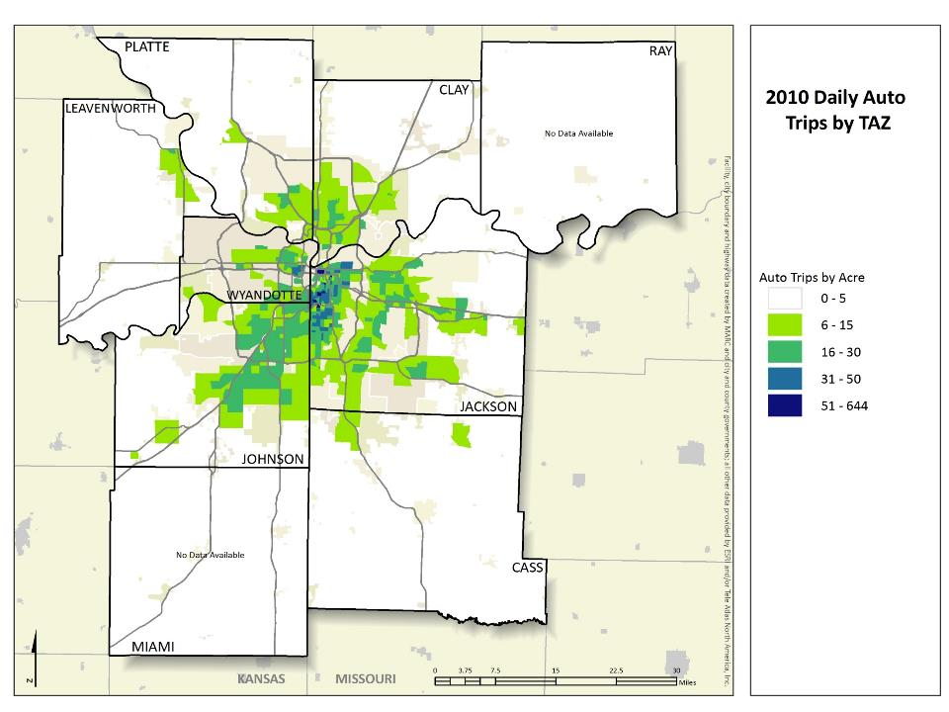
Notes:
Here is a map showing our travel-demand model outputs for TAZ geographies (daily auto trips per acre).
We were then able to use this information to create pedestrian crash rates for TAZ geographies.
We were then able to use these outputs and rates from our travel-demand model to conduct a regional Hot Spot Analysis in ArcGIS.
We utilized the G-i-star analysis tool in ArcGIS which looks at each TAZ in context to neighboring features.
Purpose was to examine whether or not high or low numbers of crashes cluster spatially, and whether they’re statistically significant or not.
Red areas on the map indicate a high number of pedestrian crash incidents in relation to the number of automobile trips in those areas; additionally, the clustering of incidents IS statistically significant based on their distance from one-another.
Blue areas on the map indicate a low number of pedestrian crash incidents in relation to the number of automobile trips in those areas; additionally, the clustering of incidents IS NOT statistically significant based on their distance from one-another.

Slide 10
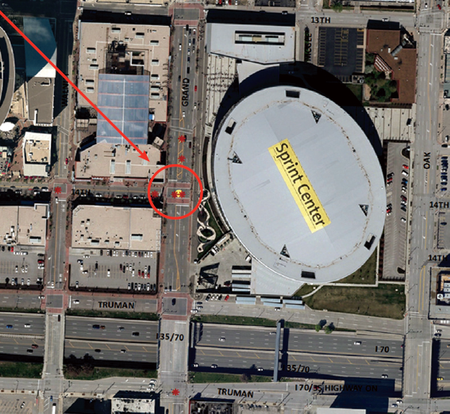
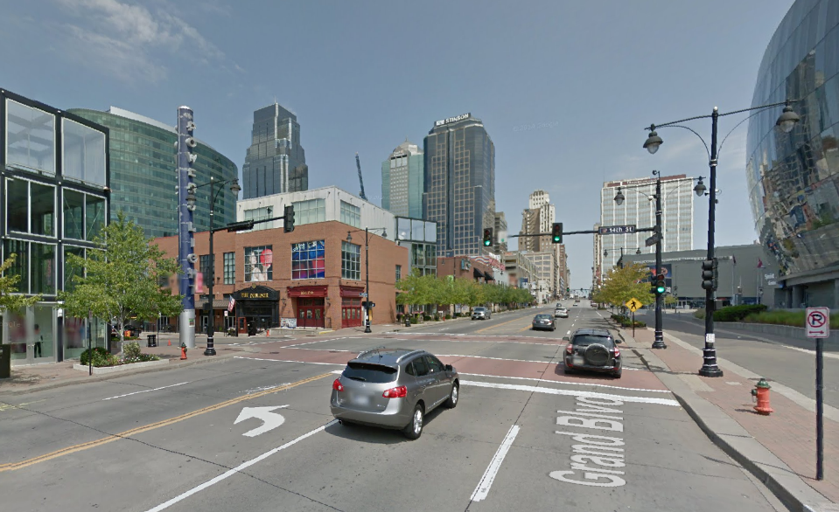
Next Steps
Notes:
We used outputs from the travel-demand model to examine pedestrian crash hot spots at a regional level.
The next step would be to overlay “high-crash locations” to identify areas of concern, and then drill down at a site-specific level.
Examining crash reports
Looking at infrastructure in place
Identifying potential, low-cost reactionary improvements.

Slide 11
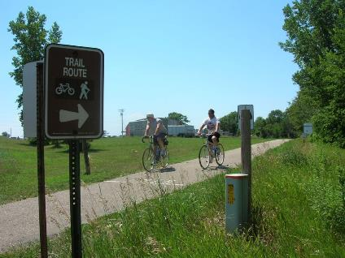

For more information
Stephen Lachky
Transportation Planner II
slachky@marc.org
816-701-8247
www.marc.org

