Slide 1
Funding Localized Initiatives
Developing a Programmatic Approach to Off-system Needs
AMPO Annual Conference | October 23, 2014
Paul Flavien, Broward MPO and Todd Brauer, Whitehouse Group Inc.

Slide 2
Today’s Presenters
Paul Flavien, ACIP
Todd A. Brauer, AICP, PTP
Broward MPO
Transportation Planner / Project Manager
Contact information
(954) 876-0045
flavienp@browardmpo.org
Whitehouse Group Inc.
Vice President / Project Manager
Contact information
(954) 482-8409
tbrauer@wgianalytics.com

Slide 3
What We Intend to Communicate
An appreciation of the challenges and opportunities of developing a program to fund off-system projects as part of development of a LRTP and TIP
Associated risks and benefits of implementing a programmatic approach to these projects
Assessment of cost in time and resources as well as statutory requirements required of a program

Slide 4
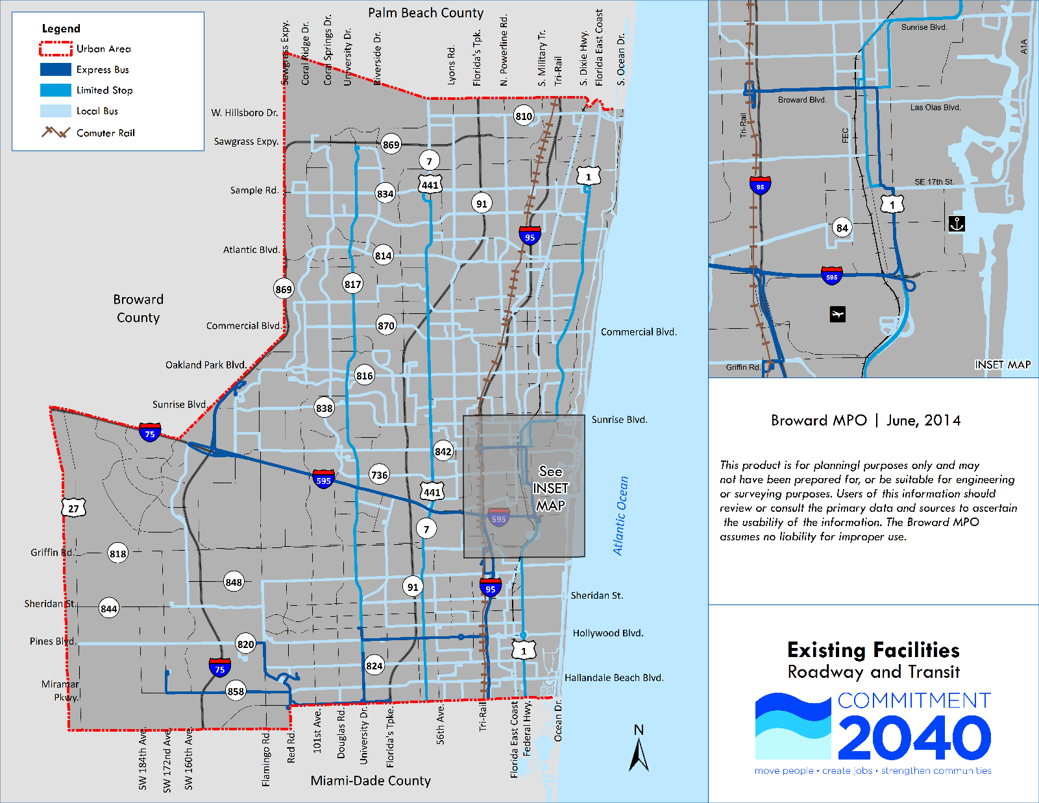

Slide 5
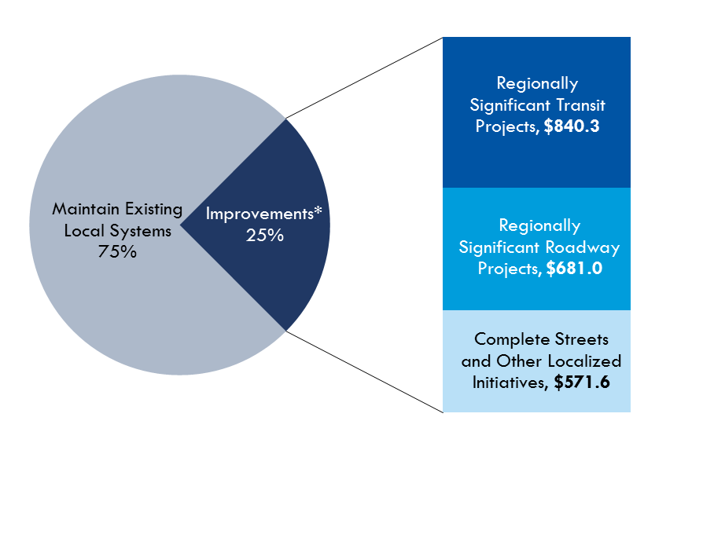
How We Allocated Dedicated Funds
Transit program
Funds may be used to construct transit improvements, including bus, rail, park and ride lots and commuter assistance programs. Funds may be combined with Other Arterial Construction and ROW program funds.
Other Arterials Construction and ROW programs
Funds may be used to add roadway capacity, improve intersection geometry and configurations, roadway grade separations and signalization upgrades.
TMA and TALU programs
Funds may be used to plan, design and construct bicycle and pedestrian facilities as well as local, ‘off-system’ roadway improvements.

Slide 6
Program Framework and Purpose
Consolidate non-regionally significant projects into one program with four areas
Complete streets
Safety and security
Sustainability initiatives
Technology Advancement
“Fast track” projects that qualify as CE or 4(f) condition under NEPA

Slide 7
Enabling Legislation and Legal Definition
MAP-21
23 USC § 134 (j)(3)(B)(ii) and 23 USC § 134 (i)
Regionally significant projects (line item)
23 CFR § 450.204

Slide 8
What Direction the Board Provided
Program area
Example projects
2019-2020
2021-2025
2026-2030
2031-2040
Totals
Complete streets
$13.0
$32.5
$32.5
$65.0
$142.9
Bicycle and pedestrian
Safety and security
Education and traffic calming
$15.1
$37.7
$37.7
$75.3
$165.8
Sustainability initiatives
Mobility hubs and greenways
$9.9
$24.7
$24.7
$49.4
$108.6
Technology advancement
$14.0
Intelligent systems
$35.1
$35.1
$70.1
$154.3
Totals
$52.0
$129.9
$129.9
$259.8
$571.6

Slide 9
How We Determine Project Eligibility
Purpose and need
Inclusion in local plans
Public support
EJ/Title VI
Ability to fund O&M

Slide 10
How We Fund These Projects
Periodic funding cycle begins with outreach
Eligible projects are evaluated and ranked
Using both objective and subjective measures
Approval and TIP inclusion

Slide 11
How We Evaluate and Rank Projects
Objective measures
Multimodal safety data
Transit ridership data
Traffic count data
System plans
Subjective measures
Geographic distribution
Quality of life

Slide 12
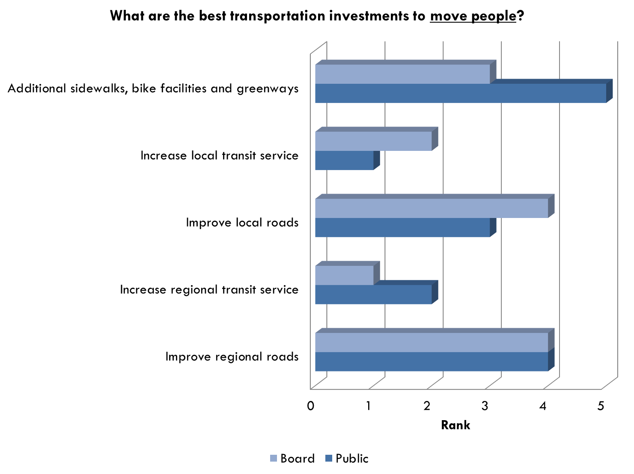
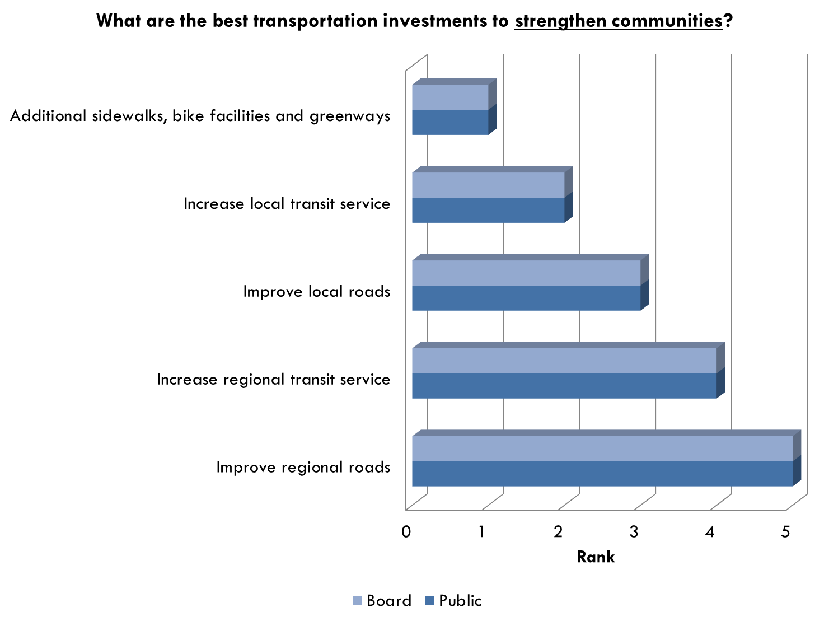

Slide 13
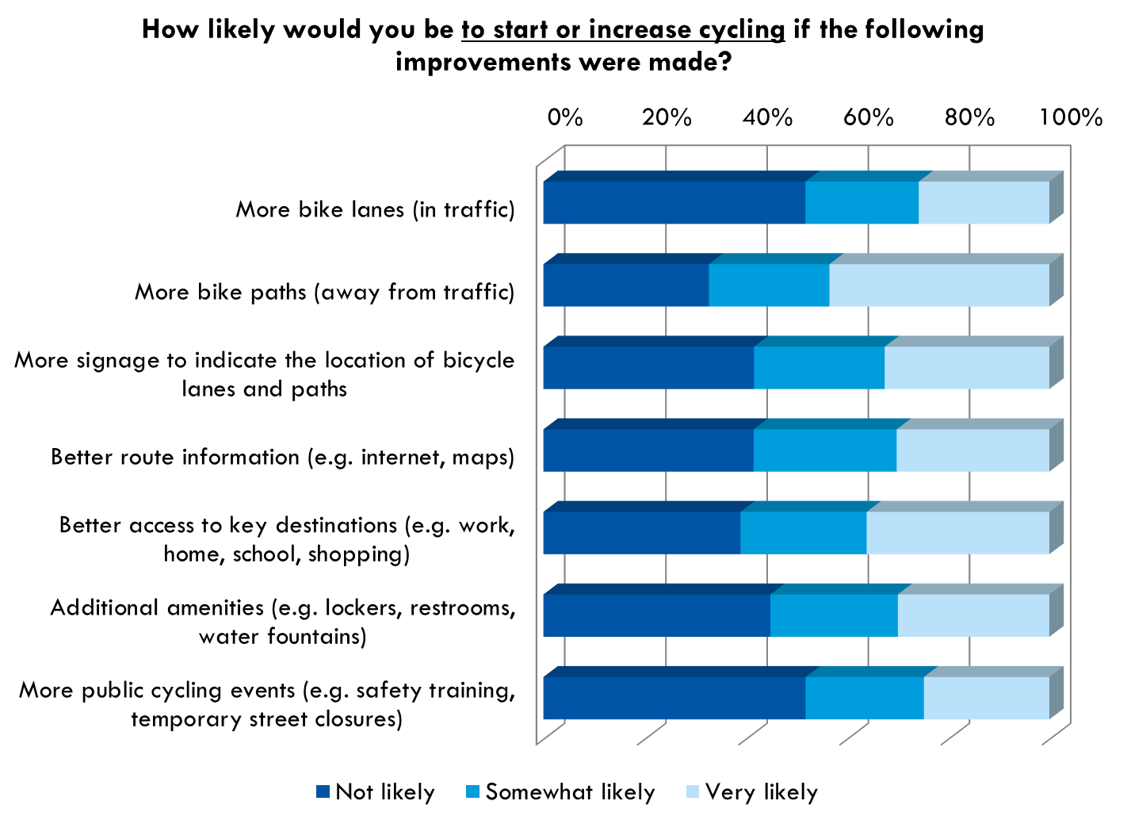
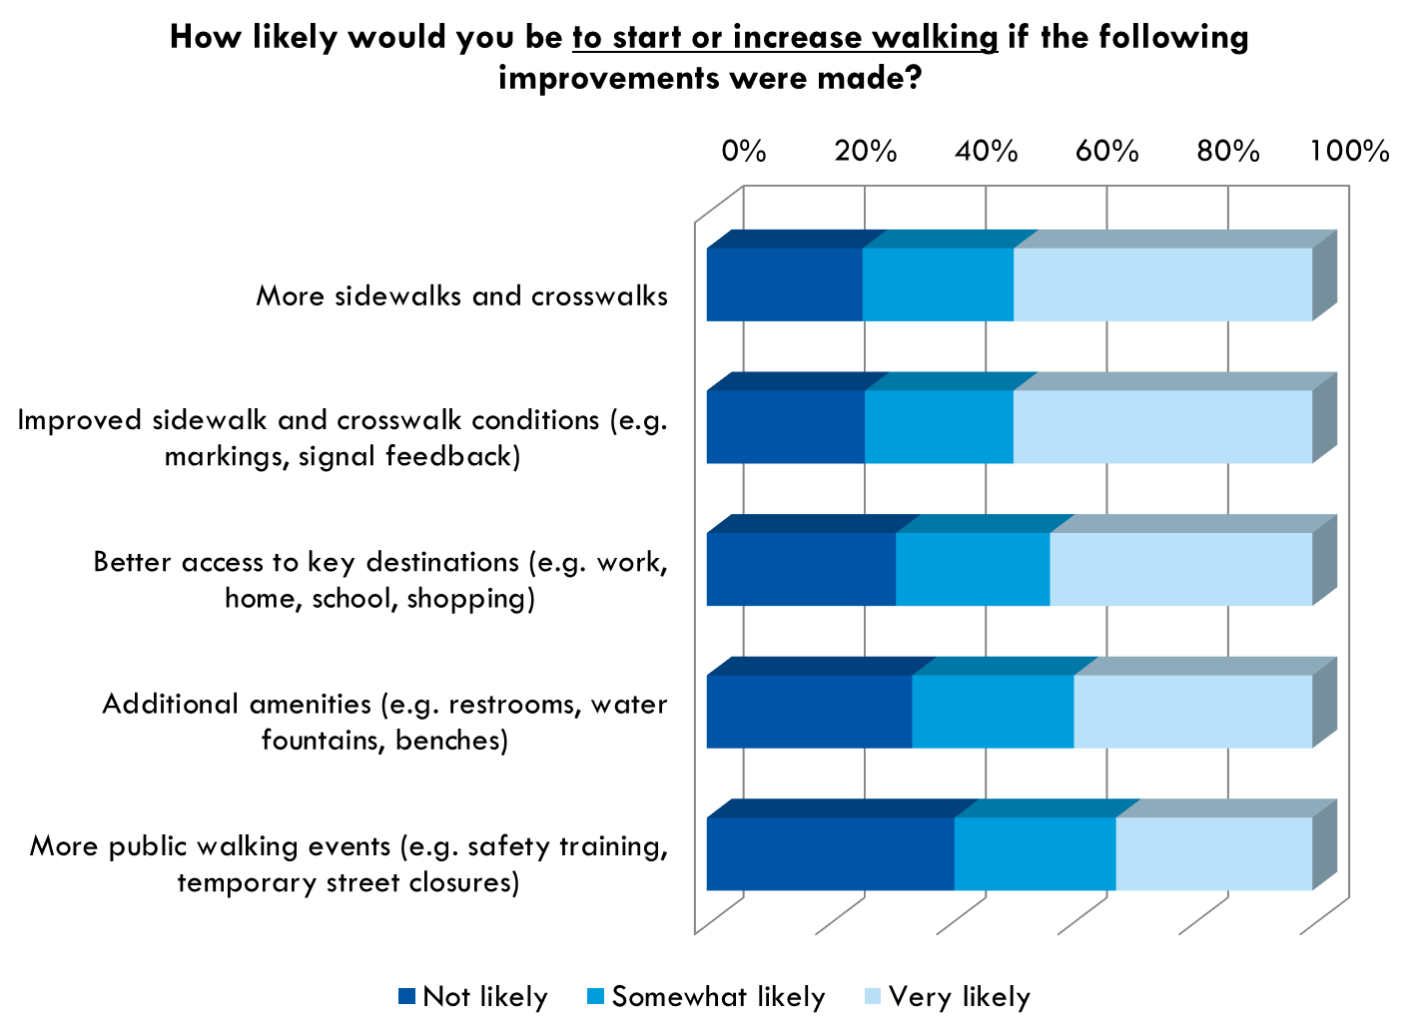

Slide 14
Lessons We Learned
Continued coordination needed with USDOT, Board and stakeholders
There are many different ways to evaluate and rank these types of projects
Ask a lot of questions

Slide 15
Questions & Answers

