Slide 1

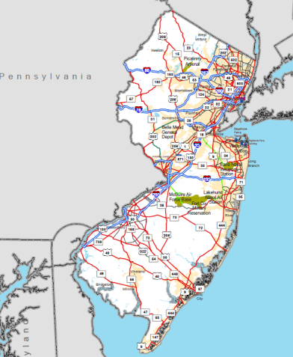
New Jersey Pilot Study
Testing Potential MAP-21* System Performance Measures
2014 AMPO Annual Conference
October 24, 2014
Keith Miller
Principal Planner
Data & Forecasting
North Jersey Transportation Planning Authority
*Moving Ahead for Progress in the 21st Century Act

Slide 2
















NJTPA Region
13 counties, 2 major cities
6.6 million people
3.7 million jobs
Road Network:
147 million vehicle miles each day
26,000 road miles (177 miles toll)
4,800 bridges
Transit Network:
732,000 trips daily
13% of commuters ride transit
250 bus routes
390 miles commuter rail track,
150 stations
Bergen
Essex
Newark
Hudson
Ocean
Hunterdon
Passaic
Jersey City
Somerset
Middlesex
Sussex
Monmouth
Union
Morris
Warren

Slide 3

Overview
Pilot Project Approach
Corridors
Data
System Performance Measures
  Delay
  Reliability
Issues, Next Steps

Slide 4

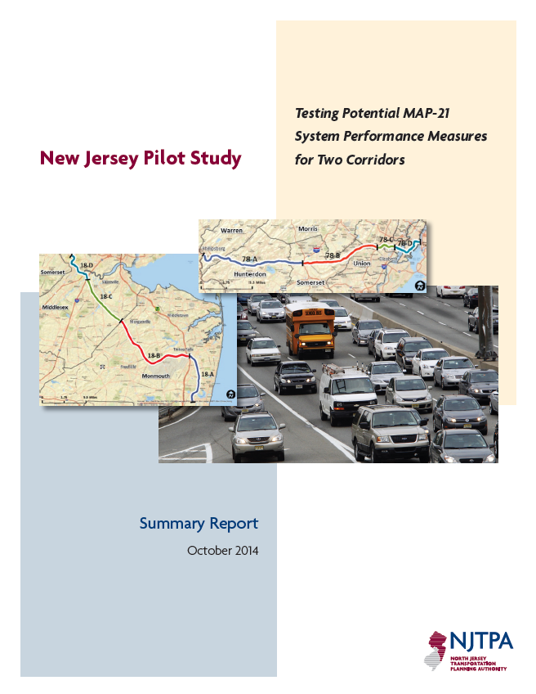
Project Approach
Test performance measure methodologies
  MAP-21: Congestion, System Performance of Interstate System & NHS
  Test AASHTO*-recommended measures for
  delay and reliability
  Use archived operations data
  Two New Jersey corridors (Interstate, arterial)
  Propose/test alternate
    Formulations
    Thresholds
    Aggregation
  Assess results – what the values are telling us
  Note barriers, challenges, assumptions,
  workarounds
  Collaborate with NJDOT
Develop a summary report
  http://www.njtpa.org/Planning/Performance-Analysis/NJPilotReportDraft.aspx
DRAFT
*American Association of State Highway and Transportation Officials

Slide 5

Fundamental Concepts
Measures deal with roadways (as opposed to trips)
  Segments of roads – and sum up for the region
  Actual speeds, travel times on particular segments
  Reference or threshold speeds and travel times
  Numbers of vehicles, numbers of people traveling
  Types of vehicles (autos, buses, trucks)
Context may be taken into account
  Place type: urban / suburban / rural / etc.
  Functional class
  Other?

Slide 6

What is a Threshold?
Standard, reference point, expectation
Delay
  Travel time in excess of threshold = delay
  When does “delay” start?
  What “delay” can we impact/afford to address?
Reliability (or Variability)
  “Unexpected” travel time compared to threshold (e.g., 2 times longer than expected)
  What do travelers expect as a “reliable” travel time?
  Dependent on time of day?
  What can we impact/afford to address?

Slide 7

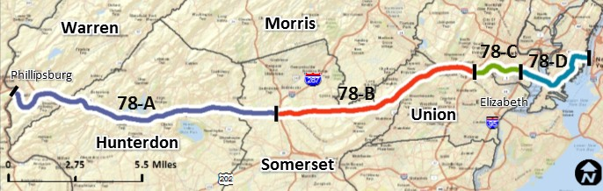

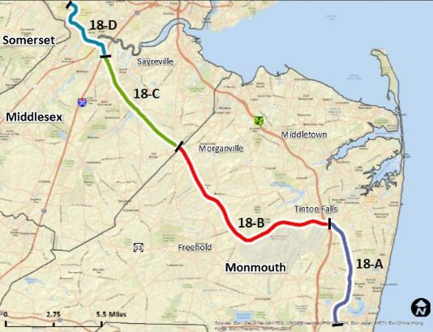


Pilot Corridors
Chosen based on regional importance, unique features and familiarity
Interstate; rural/urban; local/express; toll/free
  Entire length – 67.8 miles
  Divided into 4 sub-corridors:
    - PA border to I-287 (30.8 miles)
    - I-287 to GSP (22.6 miles)
    - GSP to NJ Tpk (5.4 miles)
    - NJ Tpk to Holland Tunnel (9.0 miles)
NHS freeway/arterial; limited access/ signals; urban/commercial/semi-rural
  Entire length – 45.3 miles
  Divided into 4 sub-corridors:
    - NJ 138 to GSP (14.3 miles)
    - GSP to US 9 (16.1 miles)
    - US 9 to NJ Tpk (9.5 miles)
    - NJ Tpk to Hoes Lane (5.4 miles)

Slide 8






Data Gathering & Processing
Archived Travel Times
  I-95 Corridor Coalition
  Vehicle Probe Project (VPP) Suite
Vehicle/Truck/Bus Volumes
  NJDOT Congestion Management System (CMS)
  NJ TRANSIT General Transit Feed Specification (GTFS)
  NJDOT Weigh-in-motion (WIM)
Vehicle Occupancy (Person Volumes)
  Plan4Safety (Crash database)
  NJ TRANSIT (Bus load factors)
Vehicle Probe Project Suite

Slide 9

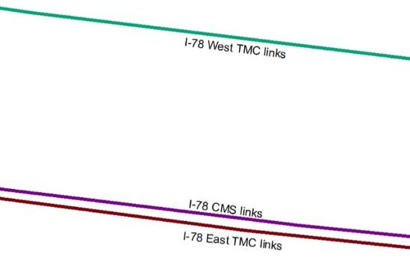

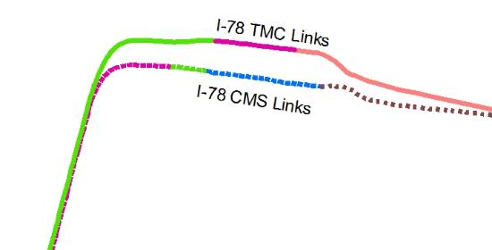

Conflation of
Travel Time and Volume Data in GIS
Different feature representation
Positional inaccuracy
Vehicle Probe Project Suite
DISCONNECT
Segmented differently
Difference in feature identification

Slide 10

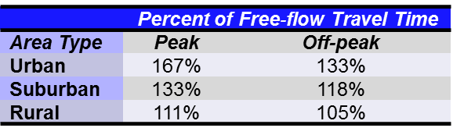
Threshold Variations
Free-flow travel time
Maximum throughput
Median travel time(s)
“Acceptable” travel time
Policy implications to each!

Slide 11

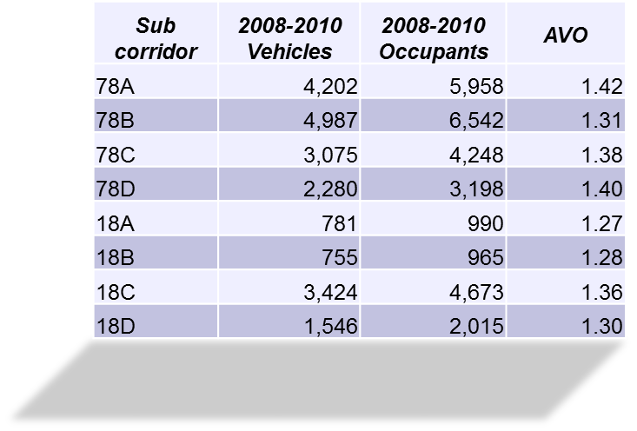


Measurement Unit Variations
Vehicles (vehicle-hours, vehicle-miles)
Persons (person-hours, person-miles)
    Auto, bus passengers
Buses
Trucks

Slide 12

Performance MeasureS:
DELAY
Example Results
 | Delay in 2012
I-78 | 3,830,000 person-hours
NJ 18 | 1,070,000 person-hours
Testing Potential MAP-21 System Performance Measures

Slide 13

Annual Hours of Delay (AHD)
Compare travel times with threshold
  Delay Time = travel time in excess of threshold
  Delay × Volume (vehicles or persons or trucks or buses)
AASHTO Method
  Calculate delay for "average week” x 52 weeks
Alternate Method: Actual Total Annual Delay
  Data for each day in the year
  “Average week” data underestimates annual delay (average may be below threshold even if individual values are above)

Slide 14



AHD Results Example: I-78 (TMC-level)
Free-flow
N
Threshold Dramatically Affects What Counts as “Delay”
  Free-flow
  Maximum throughput
  (85% of posted speed)
  Others tested:
    Yearly median
    Day/Hour median
    “Acceptable” travel time by place type and time-of-day
78-C
78-D
Max. Throughput
N
78-C
78-D

Slide 15

Results of Threshold Variation
Each threshold option has unique policy implications for “delay”
Threshold | Person-hours of Delay
 | 18C | 78D
Free-flow | 1,038,000 | 2,320,000
Maximum Throughput | 607,000 | 2,043,000
dense urban area
rural area

Slide 16

Performance Measures:
RELIABILITY
Example Results
 | Reliability in 2012
I-78 | 1.38
NJ 18 | 1.41
Testing Potential MAP-21 System Performance Measures

Slide 17

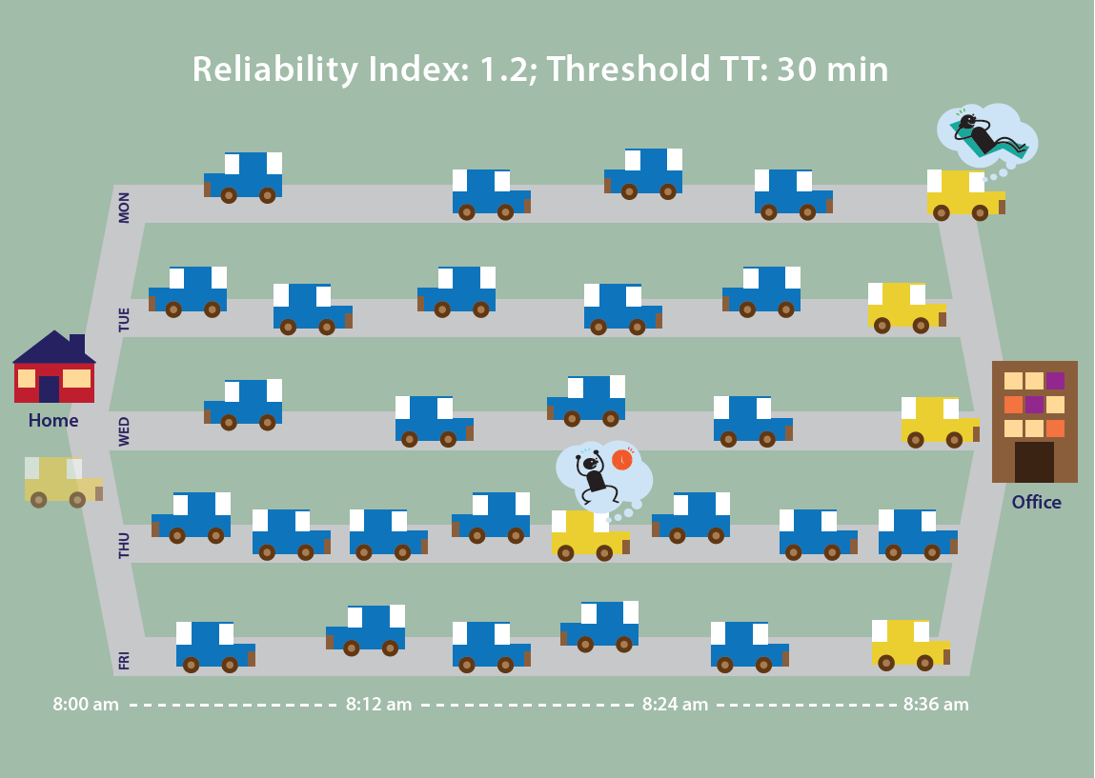
Reliability Index
How much do travel times vary from day to day?
Reliability of travel times
How much do travel times vary from day to day?
AASHTO method (RI₈₀): 80th percentile longest travel times compared to a threshold TT
RI₈₀: Multiplier to threshold
travel time to ensure on-time
arrival four out of five days,
if traveling in most
congested time of day

Slide 18



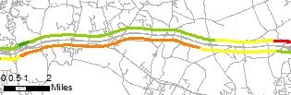

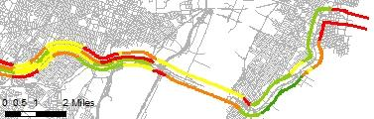
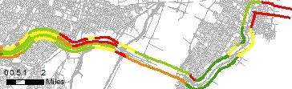
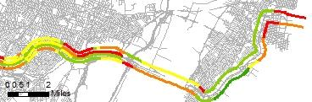
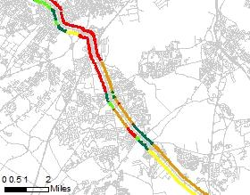
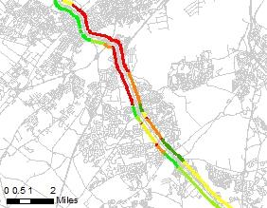
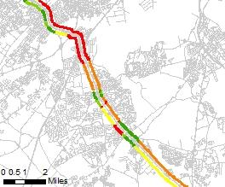
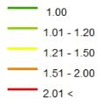
Different Thresholds Yield Different Results and Interpretations
Threshold: Free-flow TT
Threshold: Max Throughput TT
Threshold: Yearly Median TT

Slide 19

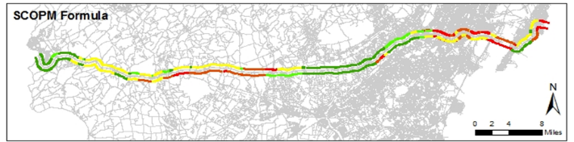
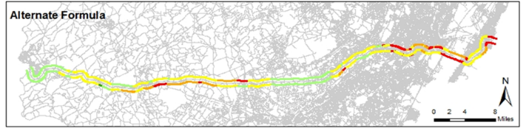
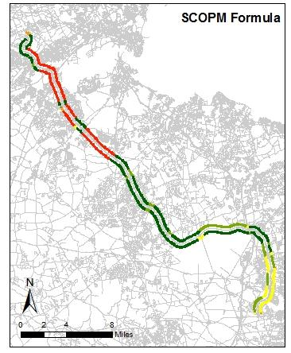
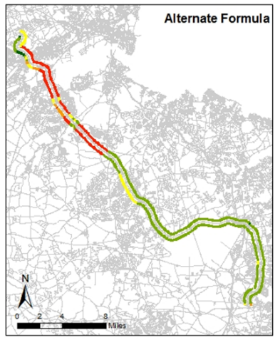

Using Thresholds that Take Into Account Time-of-Day
AASHTO Formula (RI₈₀)
Predictable congestion can be reliable
NJTPA formula looks at the expected travel time at the same time of day as the 80th percentile longest time, to get at most unreliable time of day.
NJTPA Formula (TTR_{Max})
AASHTO Formula (RI₈₀)
NJTPA Formula (TTR_{Max})
RI₈₀ = Max 80th percentile TT/ Threshold TT
TTR_{Max} = Max (80th percentile TT/ Threshold TT)

Slide 20

Issues & Challenges
Complexity of analysis, available tools
  data to measure persons, trucks, buses
  data on arterials (signalized, improved probes)
How to interpret reliability
  worst time of day? predictability? variability?
How to aggregate meaningfully
  weighting to represent the whole system, customers, trips
How to set appropriate thresholds
  consistency, context-sensitive?

Slide 21

Next Steps
    Continue to coordinate with partners
Explore the policy implications of thresholds
Measuring changes over time, from place to place
Test corridors/years with recently completed projects (“Telling the story” about project effectiveness)
Measure entire trips (O-D data needed)
Emphasize users, land use context, supporting economic growth, efficient use of infrastructure, environment, and other critical planning priorities
MAP-21 proposed rule (January?)
February?

Slide 22




Thank You
Keith Miller
Principal Planner
Data & Forecasting
kmiller@njtpa.org
One Newark Center, 17th Floor
Newark, NJ 07102
(973) 639-8400
www.njtpa.org

