Slide 1
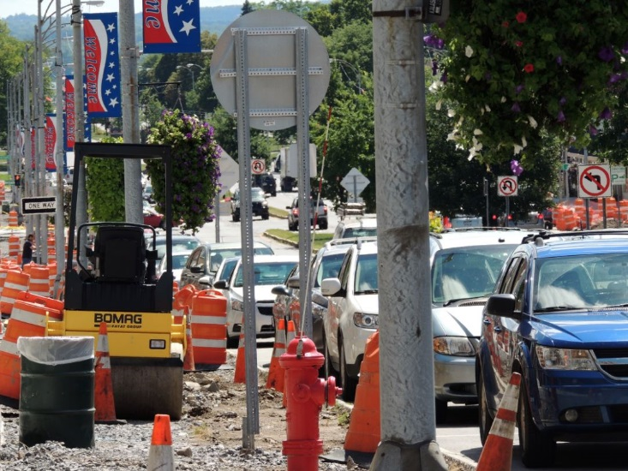
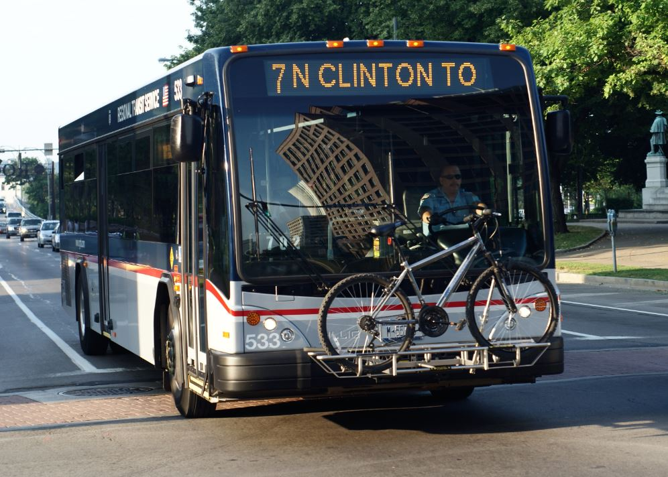
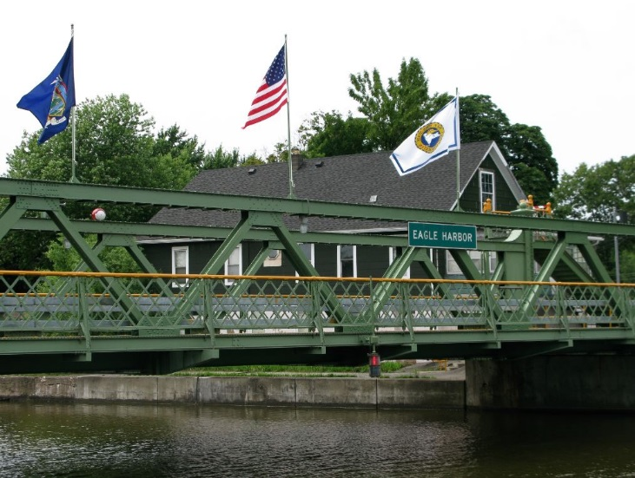
Performance-Based Programming
Connecting Investment Decisions to Strategic Direction
Richard Perrin, AICP
2014 AMPO Annual Conference
October 23, 2014

Slide 2

Our Current Situation
  “We’ve got no money, so we’ve got to think.”
  - Ernest Rutherford

Slide 3
Key Result Areas
Internal Operations
Strategic
Direction
(LRTP)
Concept
Development
(UPWP)
Investment
Decisions
(TIP)
Customer Engagement

Slide 4
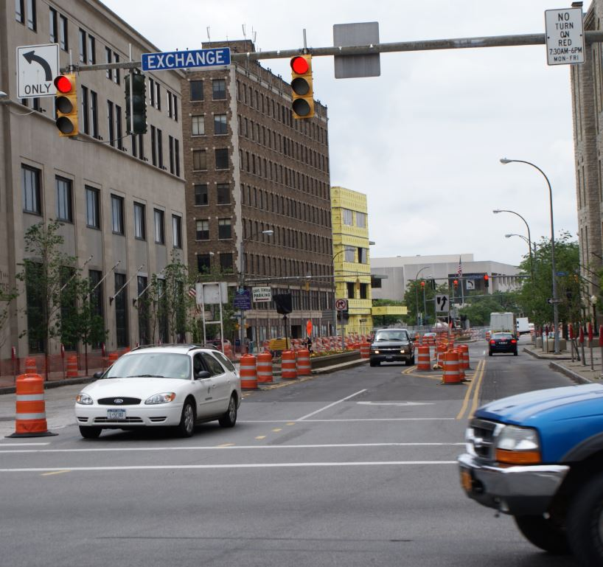
Drivers for Revising TIP Project Selection Process
  Reduced Revenues
  Increased Availability
  of Data
  Regional Consensus
  Forthcoming Federal
  Requirements
Provided optimal opportunity for assessing and revising
how projects are evaluated and prioritized for inclusion in
the fiscally constrained TIP

Slide 5
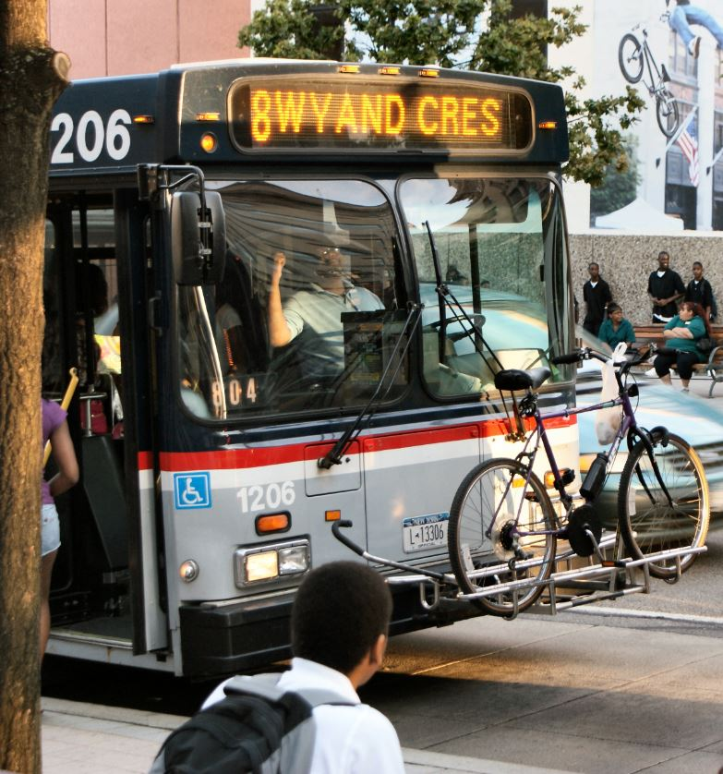
Keys to Performance-Based Planning & Programming
  Identify what’s important
  to customers
  Make measures meaningful
  and understandable
  Embed measures in investment
  decisions
  Use measures to articulate
  results and needs

Slide 6

LRTP 2035 Performance Measures
  Provide benchmarks, desired changes, and likely changes for key metrics of system performance
    Safety
    Preservation
    Mobility
    Accessibility
    Environment
  Cover all modes and multiple
  environmental considerations

Slide 7

LRTP 2035 Performance Measures
  Selected outcome-based
  measures instead of
  activity-based
  Clearly defined each measure
  Utilized real-world data as
  opposed to modeled data
  Worked with member agencies
  to ensure consistency with
  their priorities, metrics, and
  reporting

Slide 8
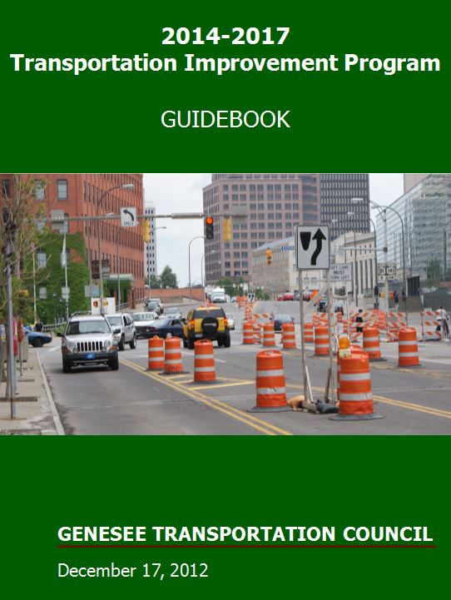
Process
  Selected project evaluation criteria
    Directly linked to and prioritized
    based on LRTP 2035
  Identified the right questions
    Included in application package
    Expanded upon in presentations
  Produced Rater’s Guide
    Defines score for each criterion
    based on estimated project
    impact
    Provides consistency among
    raters and across TIP updates

Slide 9
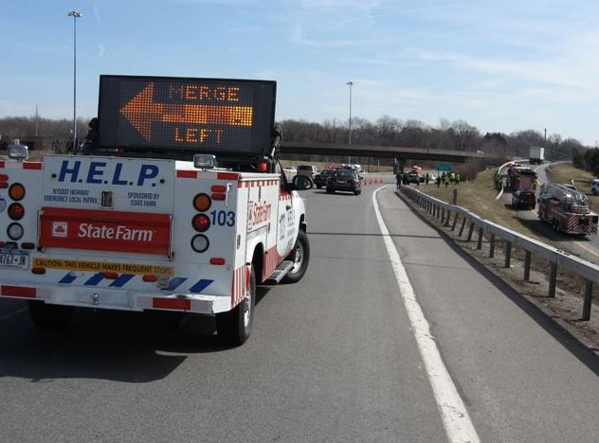
Evaluation Criteria
  Common (up to 100 points)
    Safety (20)
    Mobility & Accessibility (20)
    Community & Economic
    Development (15)
  Modal (up to 30 points each)
    Highway & Bridge
    Public Transportation
    Bicycle & Pedestrian
    System Management
    & Operations
    Goods Movement
    System Continuity
    & Optimization (20)
    Environment (10)
    Fiscal Responsibility (15)

Slide 10
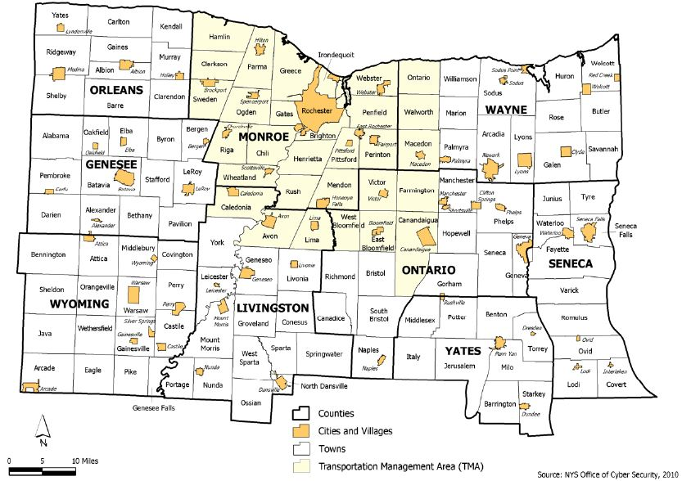
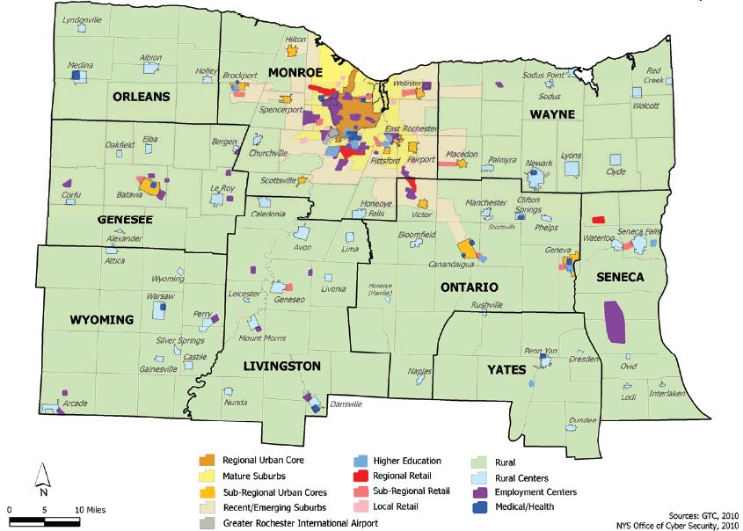
Evaluation Criteria

Slide 11
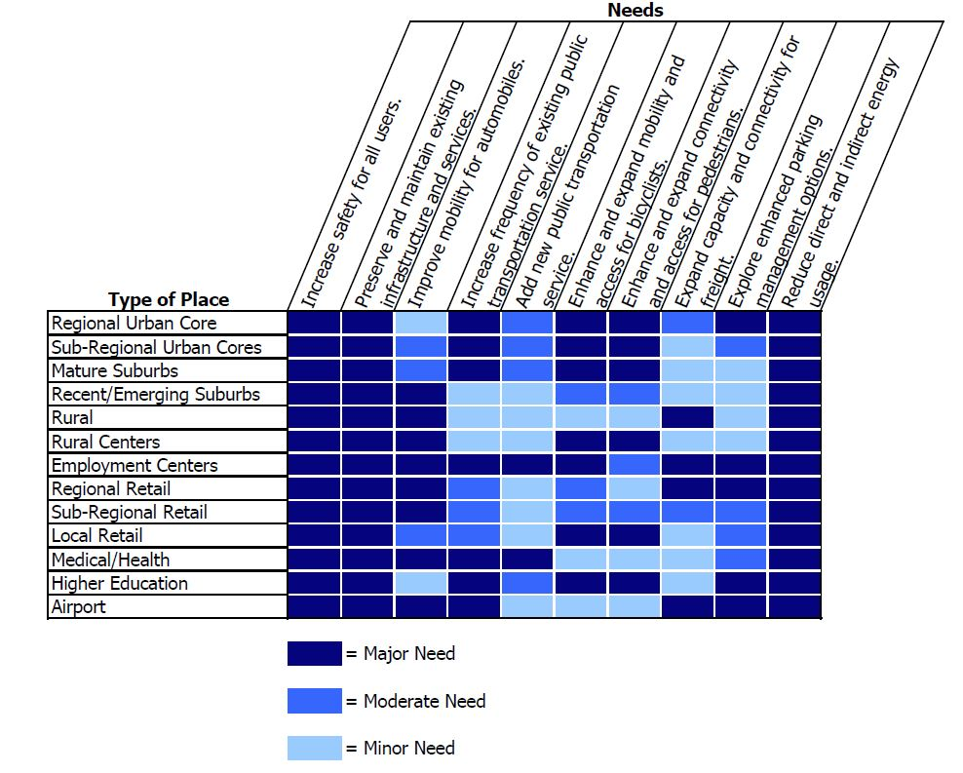
Evaluation Criteria

Slide 12
Lessons Learned
  Cooperation and critical thinking are key
    Technology and data are not replacements
    Early and continuous involvement of member agencies
  Quantitative does not equal objective
    Requires improved understanding of what determines system and modal performance
  Adaptive = Structure + Flexibility
    Balance principles with responsiveness
    Can’t exclude non-system performance considerations
  Reassessment is a requirement
    Change for the sake of change is not progress…
    …but there is always room for improvement

Slide 13
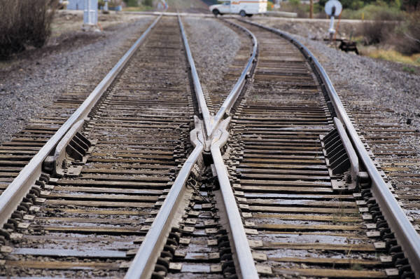
Get Ahead or Fall Behind
  “Even if you’re on the right track, you’ll get run over if you just sit there” – Will Rogers

Slide 14
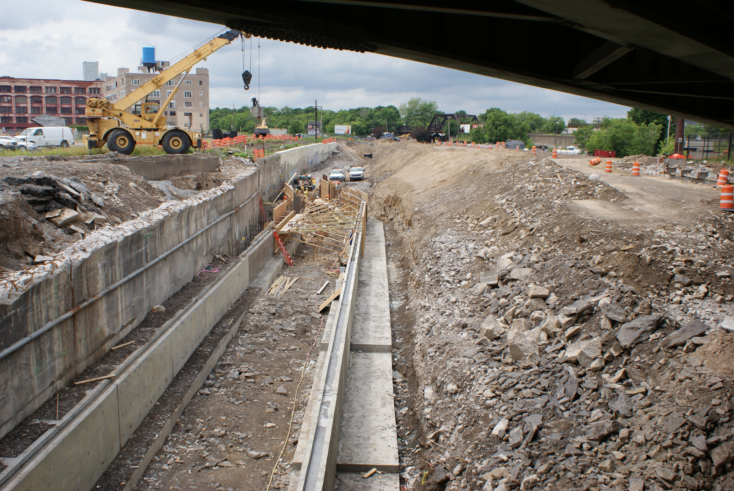

Our Response
Project
Selection
Fund the
best projects
with the
limited funds
available
Project
Delivery
Complete
projects
on-time
and
on-budget
Project
Addition
Effectively
communicate
the need for
additional
investment
Photo Credits: GTC staff and Texas Tribune photo illustration by Todd Wiseman and Corey Leopold

Slide 15


GENESEE TRANSPORTATION COUNCIL
50 West Main Street-Suite 8112
Rochester, NY 14614
www.gtcmpo.org
@gtcmpo
The Metropolitan Planning Organization for the Genesee-Finger Lakes Region

