Slide 1
Thinking like a Futurist
Effects of Next-Generation Vehicles on Travel Demand and Highway Capacity
Mike Wallace, Fehr & Peers
Director of Behavior Analysis & Forecasting
AMPO ANNUAL conference | October 21, 2014

Slide 2
outline
Thinking like a futurist
Intro: FP Think
PART I: Demographic & Socioeconomic Trends
PART II: Vehicle Evolution
How does this change things?

Slide 3
what
is FP THINK
www.fehrandpeers/fpthink
FP Think is our latest initiative designed to enhance our clients’ understanding of how disruptive forces in technology, demographics, and socioeconomics may affect their transportation planning decisions.
A team of Fehr & Peers staff has completed our initial research effort, and has developed tools and resources to help our clients begin to navigate two of the most interesting and momentous changes that will shape the transportation landscape for decades to come.

Slide 4
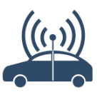
what
is FP THINK
Fehr & Peers “skunk works”
Two research topics investigated thus far–
Demographics and Vehicle evolution
Absorb our findings with an appropriate level of excitement and/or skepticism

Slide 5
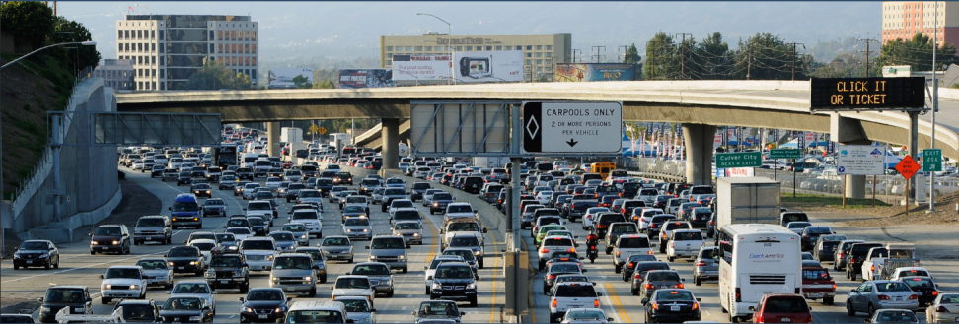
part 1
Demographic & socioeconomic trends
Examined several potential changes in demographics and travel choice, in relation to their impact on travel
Notes:
Driving in the US started declining in 2004 after 50 years of steady growth. We tried to identify why, and identify whether it would return. We examined demographics, generational preferences, technology and social networking, the changing workplace and the “new economy.”

Slide 6
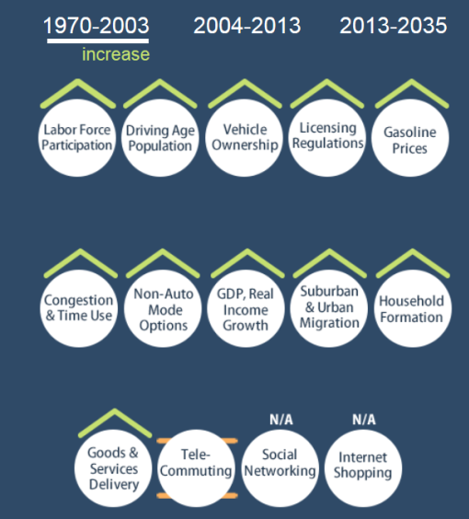
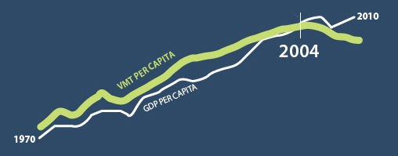
trends
Factors Impacting VMT
North bay Engineers club thinking like a futurist

Slide 7
trends
1970 to 2004; increase
Notes:
Josh, do you want the factor circles as well as the line graph?

Slide 8
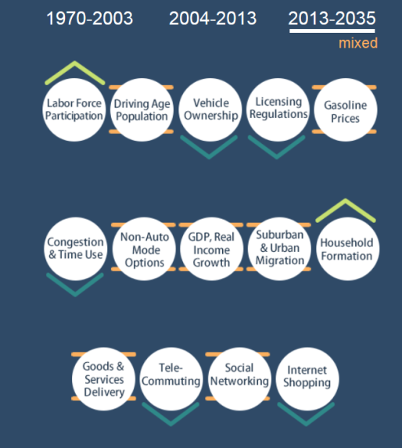
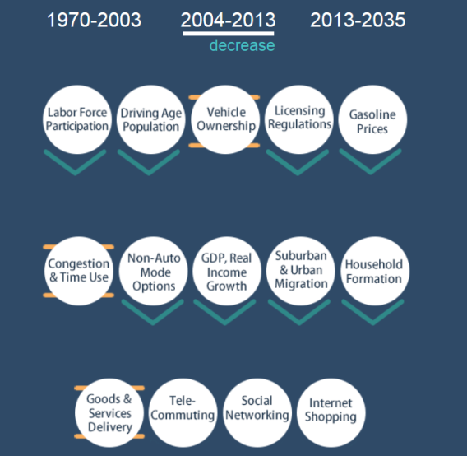
trends
Factors Impacting VMT
North bay Engineers club thinking like a futurist

Slide 9
trends
2004 to 2013; decrease
Notes:
Josh, do you want the same graph…or the tow that Chris uses on his, if that’s the case, do we have the orginals or I should redesign so that they match these and the website “look”

Slide 10
trends
Factors Impacting VMT
North bay Engineers club thinking like a futurist

Slide 11
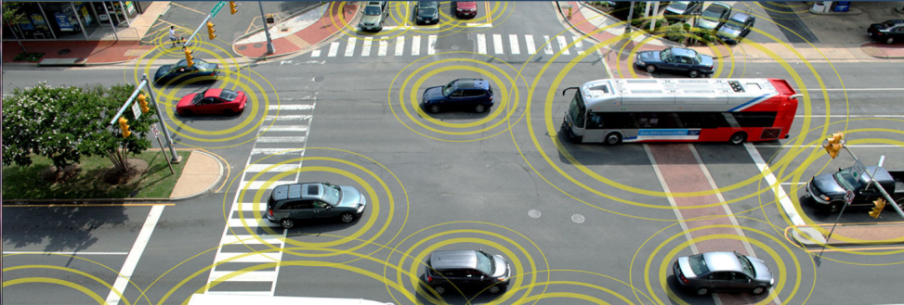
part 2
Vehicle evolution
Looked at autonomous and connected vehicles and their impact on how we think about transportation projects

Slide 12
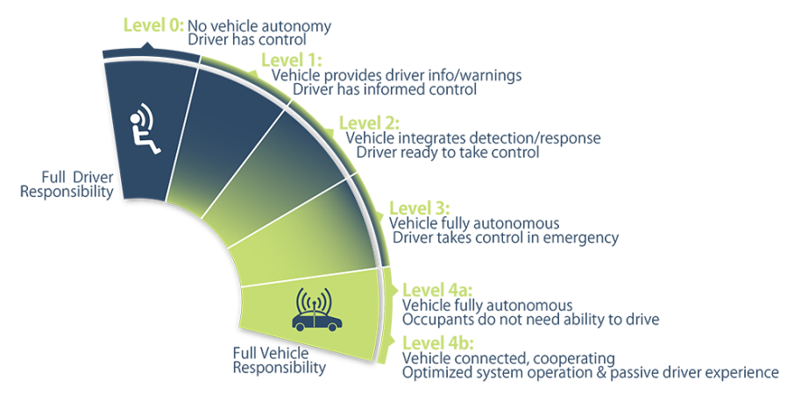
evolution
vehicle
Level Definitions

Slide 13
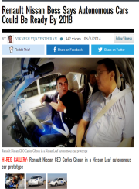
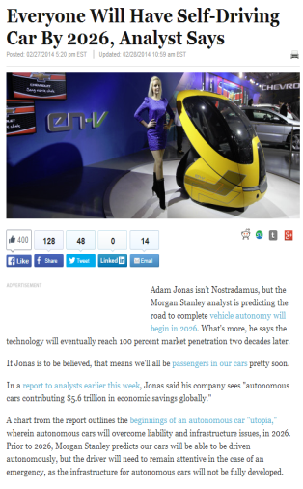
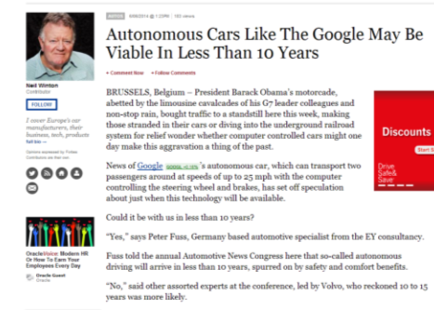
evolution
vehicle
factors
Technology
Licensing/Insurance
Legal/Liability
Privacy/Security
Cost/Equity
Popularity of cars as service
Notes:
Prius lawsuit (accelerators)
GM ignition switches
$5M insurance to drive AV
Your vehicle will be broadcasting where it is every second
Uber valuation

Slide 14
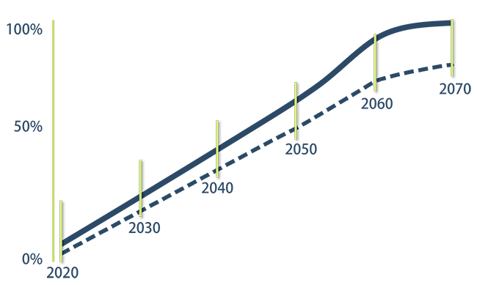
evolution
vehicle
Fleet absorption
Predicted growth in autonomous vehicle travel, as percent of all highway vehicle miles traveled (VMT).

Slide 15
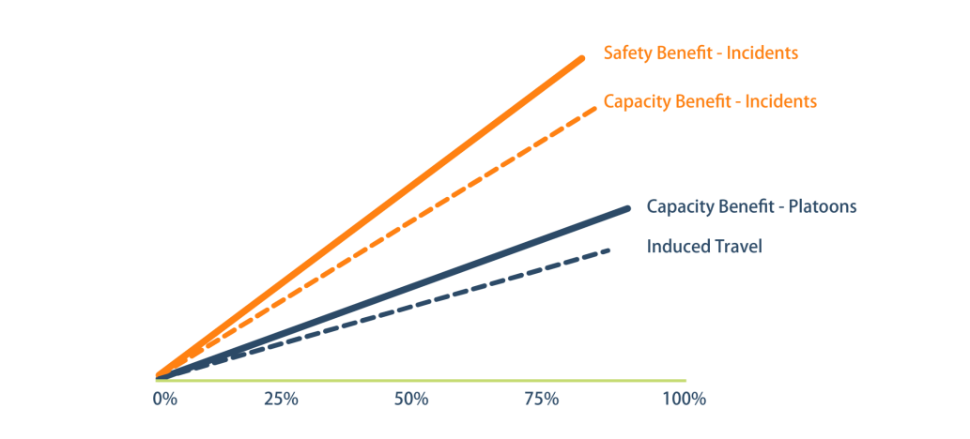
evolution
vehicle
Impacts vs. fleet absorption
Do you want descriptor text placed here?

Slide 16
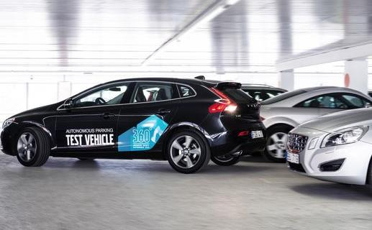
changes
to come?
Parking Outcomes
Capacity outcomes

Slide 17
changes
to come?
Capacity outcomes
Autonomous Fleet Mix
Capacity Increase
50%
20-30%
75%
30-40%
95%
50-100%
Source: http://www.fehrandpeers.com/fpthink/nextgenerationvehicles/
Notes:
Bullet pt #2-not sure what combined VMT info graphic you want.

Slide 18
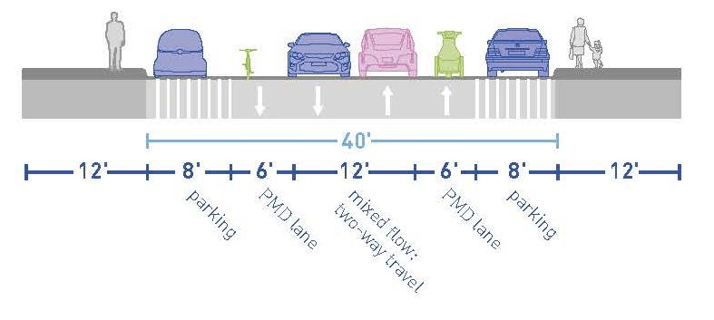
changes
to come?
Roadway design
Notes:
Bullet pt #2-not sure what combined VMT info graphic you want.

Slide 19
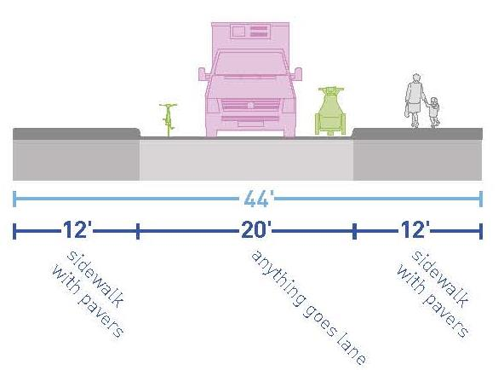
changes
to come?
Roadway design
Notes:
Bullet pt #2-not sure what combined VMT info graphic you want.

Slide 20
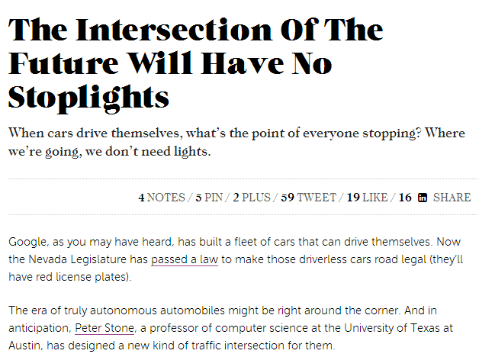
changes
to come?
Capacity outcomes
Notes:
Bullet pt #2-not sure what combined VMT info graphic you want.

Slide 21
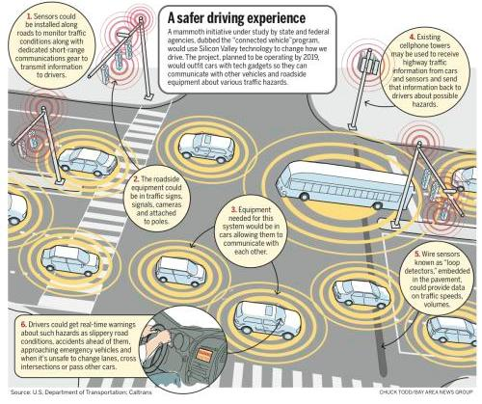
changes
to come?
Capacity outcomes
Notes:
Bullet pt #2-not sure what combined VMT info graphic you want.

Slide 22
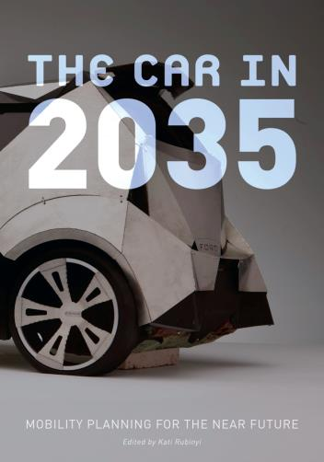
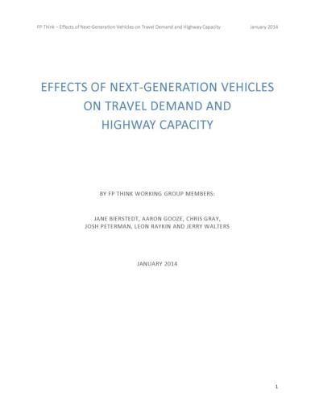
changes
to come?
resources

Slide 23
Thinking like a Futurist
Effects of Next-Generation Vehicles on Travel Demand and Highway Capacity
Mike Wallace, Fehr & Peers
Director of Behavior Analysis & Forecasting
m.wallace@fehrandpeers.com
AMPO ANNUAL conference | October 21, 2014

