Slide 1
Driverless Transportation What Should You Be Planning For
October 21, 2014
Michael Rodriguez, AICP
EDR Group
John Estrada
DriverlessTransportation

Slide 2
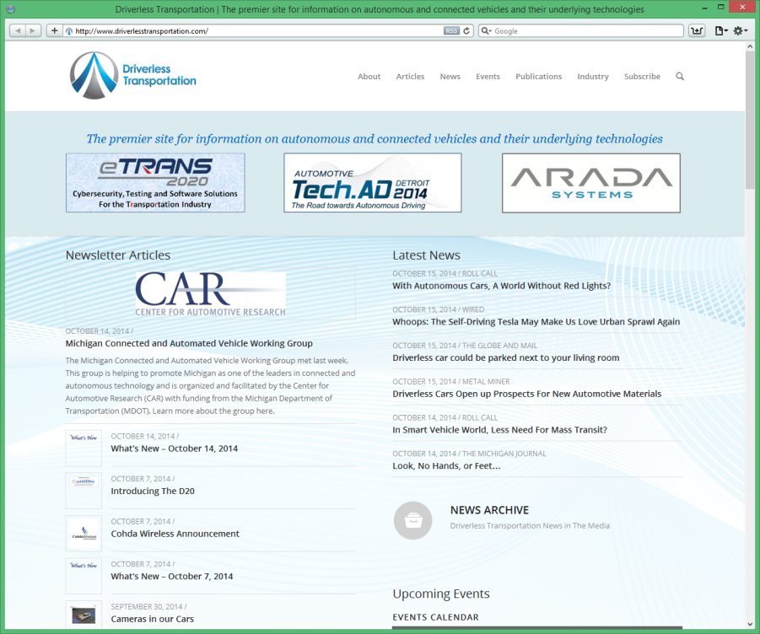
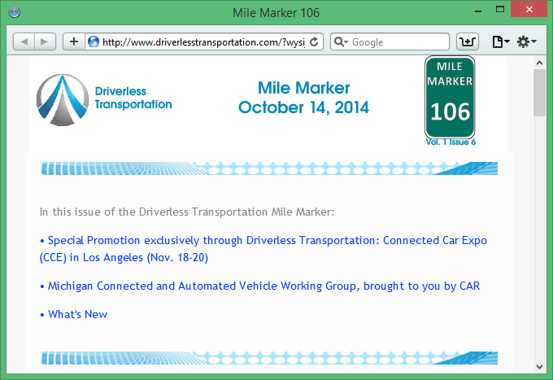
DriverlessTransportation.com
The premier site for information on autonomous and connected vehicles and their underlying technologies
Follow Us On Twitter: @DriverlessTrans
Subscribe to the Mile Marker Newsletter
www.driverlesstransportation.com/subscribe

Slide 3
About EDR Group
Economic Development Research Group, Inc.
Est. 1996
Boston, MA – Tyson’s Corner, VA – Chicago, IL
Assisted MPOs nationwide
Portfolio
Transportation economics
Energy & Environment Economics
Economic Development Programs
Economic Impact & Benefit/Cost Analysis
TREDIS® Software

Slide 4
About EDR Group
TREDIS® Use
TREDIS® Use

Slide 5
ECONOMIC MODELS
How to Assess
Benefit-Cost Analysis
Economic Impact Analysis
Direct
Impacts
Indirect Impacts
Induced Impacts
Operating
Capital
Benefits
Societal
System User
Direct User
Costs

Slide 6
Value of Time
Reflects the opportunity cost - ‘what else could I be doing instead of driving?’
Proportional to wages
Changes based on trip type
Peak vs Off-peak
Business vs Leisure

Slide 7
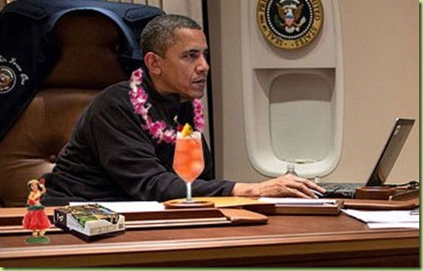
Productive Travel Time
Think of intercity trains, planes and buses
Users can be productive while in transit.
Productive travel time is valued differently than unproductive travel time
Driving cars is very unproductive!

Slide 8
Example of Time Comparison
Driving
Assume VOT =$20/hr
No-Build takes 2hrs =$40
Build takes 1.5hrs = $30
Congestion costs = $40-$30=$10
Project reducing congestion saves $10 for that trip
Driver is 0% productive while driving

Slide 9
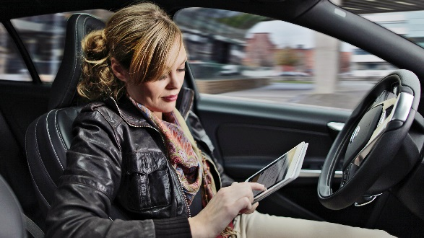
Example of Time Comparison
Driverless
Assume VOT =$20/hr
Assume 50% productivity
No Build takes 2hrs =$40
+50% productive = $20 bonus
Net = $20
Build takes 1.5hrs = $30
+50% productive = $15 bonus
Net = $15
Congestion costs = $20-$15 = $5
Project reducing congestion saves ONLY $5 for that trip

Slide 10
Depends on Level of Analysis
Individual Level
Aggregate Level
A user in an AV has a lower value of time
Therefore, user doesn’t care as much about congestion.
Depending how productive user can be.
Depends on overall market penetration of AVs
A project can actually try to increase market penetration.
AVs reduce congestion by efficiencies.
Have network effects.
System will have blend of AVs and regular vehicles.

Slide 11
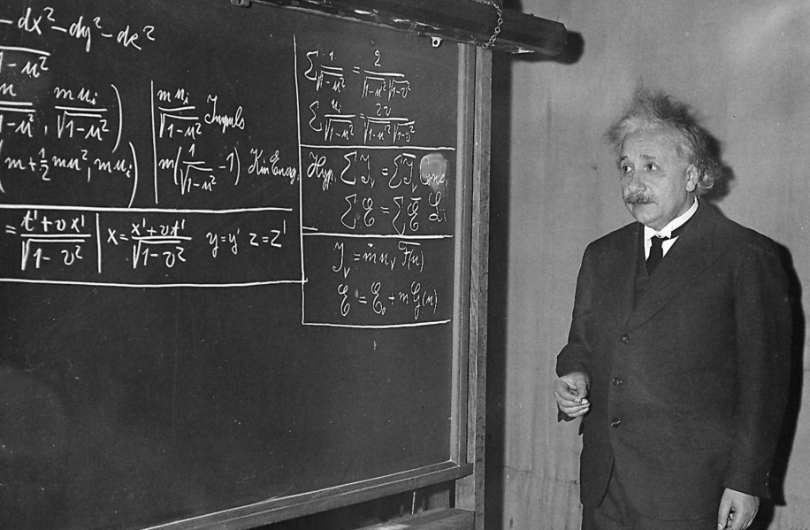
Some Math
$User Benenefit=$ ${[VOT}_{NB}∙{TT}_{NB} −{PR}_{NB}∙{VOT}_{NB}∙{TT}_{NB}$] $−$ ${[VOT}_{B}∙{TT}_{B} −{PR}_{B}∙{VOT}_{B}∙{TT}_{B}$]
VOT= Value of Time
TT= Travel Time
PR= Productivity rate in vehicle
NB = no-build
B = Build

Slide 12
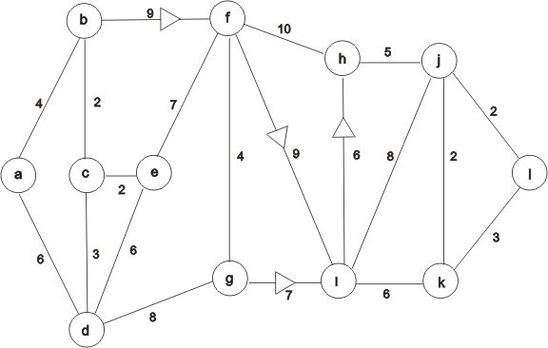
Network Effects
AVs will impact the rest of the network
Can travel at higher speeds
Can increase reliability effects.
Reduce VHT for other networks on the system.
Significant effects for high AV market penetration

Slide 13
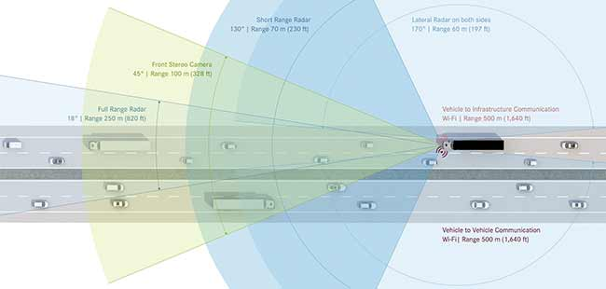
Freight
Business Costs = Driver wage + Commodity Cost + Operating Costs
AV takes out driver wage
Adds capital cost of initial investment
Has network effects

Slide 14
Back to Economic Impacts
Direct
Impacts
Indirect Impacts
Induced Impacts
Time Savings for passengers
Freight savings
Business Savings
Money re-spent in the economy.
Greater purchases in other areas
Household re-spending
Tolls
Jobs
Value Added
Output

Slide 15
Planning For All of This
Transportation Models can assume effects of driverless transportation
Use Economic Models to calculate
Benefit-cost Analysis
Economic Impacts

Slide 16
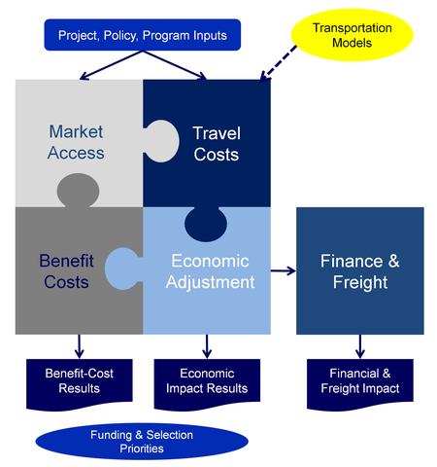
TREDIS®
Allows for use of AVs as a unique mode
Can estimate impacts of freight savings
Can estimate B/C of AV policies

Slide 17
That’s Very Interesting,
But Why Do I Care Now?

Slide 18
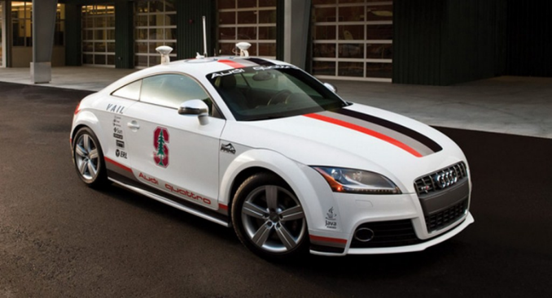
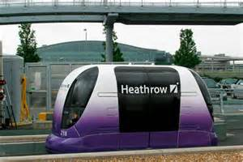
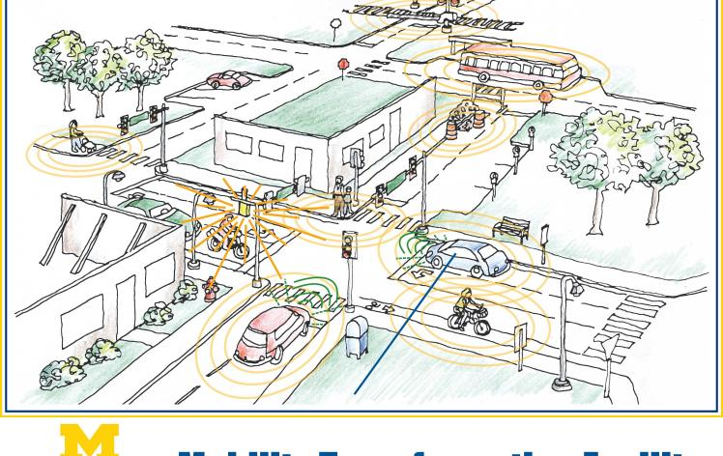
Driverless Transportation Is Coming…
“Google's Sergey Brin: You'll ride in robot cars within 5 years.”
c-net, September 2012
“I am committing to be ready to introduce a new ground-breaking technology, Autonomous Drive, by 2020, and we are on track to realize it.”
Nissan and Renault CEO Carlos Ghosn, August 2013
Tesla cars “should be able to do 90% of miles driven within three years”
Elon Musk, Tesla CEO, September 2013
“Super highway: A14 to become Britain's first internet-connected road”
The Guardian, October 2013”

Slide 19
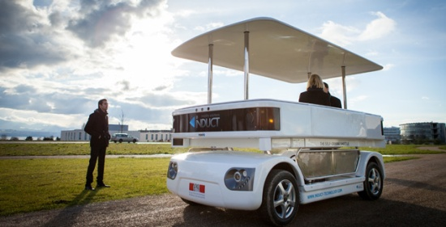
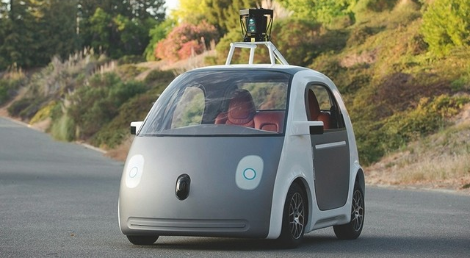
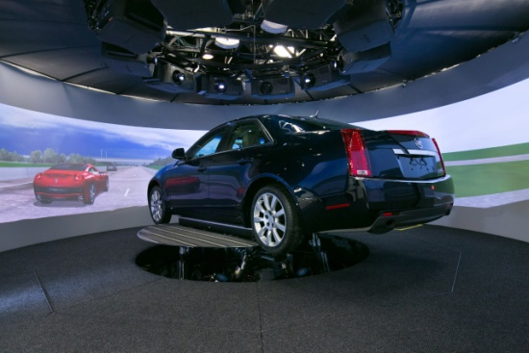
Moving Even Faster in 2014
Induct announced rollout out of its NAVIA on college campuses and military bases
Google announced they had 700,00 miles of testing and their new vehicle designed for low speed urban roads
Mary Barra, GM CEO, Announced that Cadillac will have Super Cruise starting with the 2017 Model Year

Slide 20
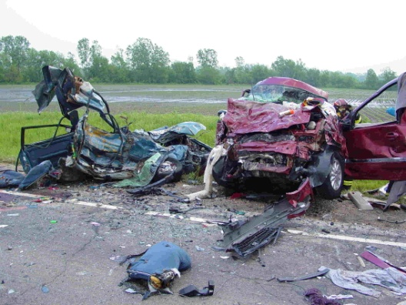
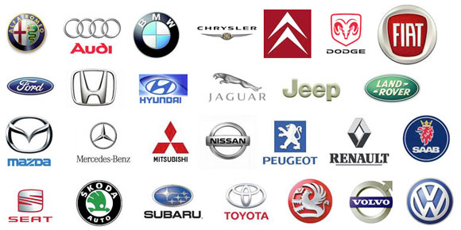
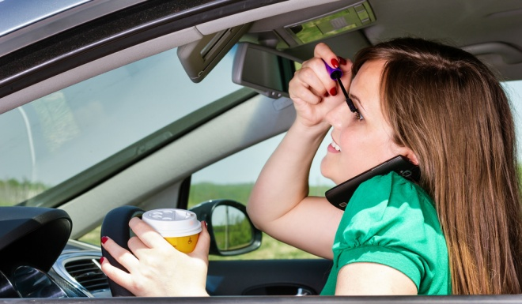
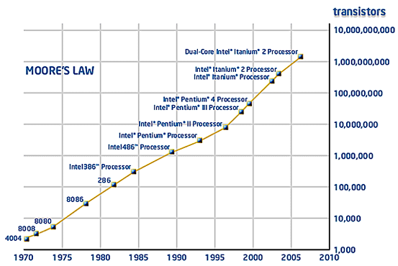
What Is Driving This Change?
>
Notes:
People Are Terrible Drivers
32,000 people in the U.S. and over a million worldwide are killed each year in car accidents
95% of this is due to driver error
In the U.S., it is the #1 killer of people age 1 - 34.
Cars are as safe as they are going to get.
The best way to avoid accidents is to replace the driver with something that won't be drunk, drowsy, drugged or distracted.
Driving is the Distraction
People would much rather be doing something else, anything else while they are driving.
The allure of “perfect driving machine” is a myth
Money, Money, Money
Over $121 billion is wasted each year by commuters due to time and fuel spent in traffic
The opportunities for reinventing businesses are just too large
Benefits to other business like delivery, long haul trucking and taxi services of removing the driver cost are just too great
In addition, all that extra time means people can be consuming Google Ads or TV Ads or paying for more Netflix movies.

Slide 21
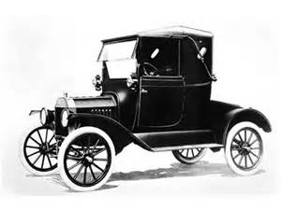
It’s Going To Be Big
Autonomous Vehicles “have the potential to save the U.S. economy roughly $450 billion per year”
ENO Report, October 2013
“Sales of driverless vehicles are expected to surpass 95.4 million by 2035 representing 75% of all light-duty vehicle sales”
August 2013 report by Navigant Research
Driverless Transportation will be a tremendously disruptive technology

Slide 22
Bigger Still, According to Morgan Stanley
Bull / Bear
$0.7 to $2.2 trillion
4.4% to 14% GDP
This slide provided by:

Slide 23
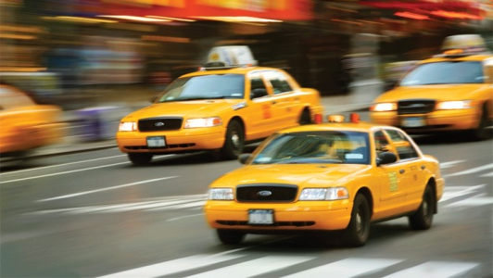
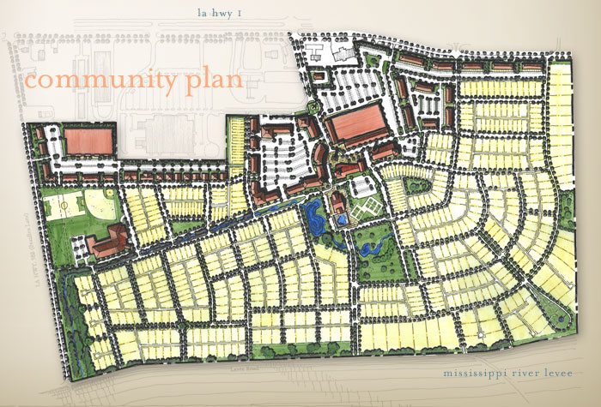
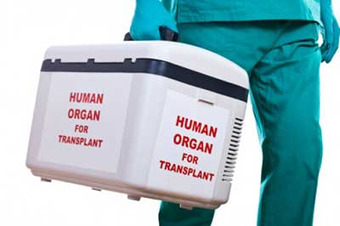
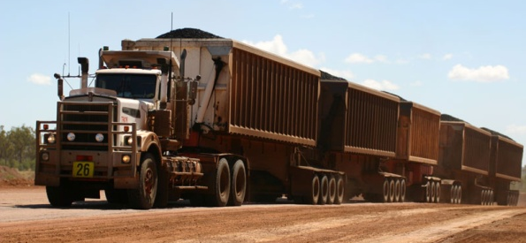
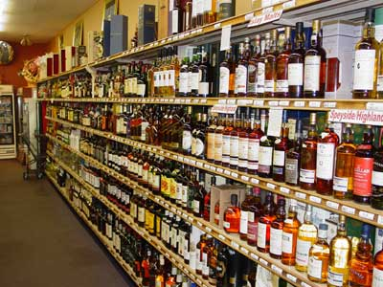
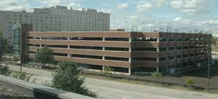
And It will Impact A Lot

Slide 24
NHTSA Levels
No-Automation (Level 0): The driver is in complete and sole control of the primary vehicle controls – brake, steering, throttle, and motive power – at all times.
Function-specific Automation (Level 1): Automation at this level involves one or more specific control functions. Examples include electronic stability control or pre-charged brakes, where the vehicle automatically assists with braking to enable the driver to regain control of the vehicle or stop faster than possible by acting alone.
Combined Function Automation (Level 2): This level involves automation of at least two primary control functions designed to work in unison to relieve the driver of control of those functions. An example of combined functions enabling a Level 2 system is adaptive cruise control in combination with lane centering.
Limited Self-Driving Automation (Level 3): Vehicles at this level of automation enable the driver to cede full control of all safety-critical functions under certain traffic or environmental conditions and in those conditions to rely heavily on the vehicle to monitor for changes in those conditions requiring transition back to driver control. The driver is expected to be available for occasional control, but with sufficiently comfortable transition time. The Google car is an example of limited self-driving automation.
Full Self-Driving Automation (Level 4): The vehicle is designed to perform all safety-critical driving functions and monitor roadway conditions for an entire trip. Such a design anticipates that the driver will provide destination or navigation input, but is not expected to be available for control at any time during the trip. This includes both occupied and unoccupied vehicles.

Slide 25
Levels Are Not Sufficient
4
Need To Include
Where The System
Operates To Really
Track What Is Happening
3
2
1
Dedicated
Roadway
Somewhat Dedicated
Roadway
Limited
Public
Roadways
All

Slide 26
Where Are We Today
In Production
🚛
4
🚆
🚆
Mining Vehicles
3
Some Subway/Rail Systems
Airport Terminal Trains
🚘
2
ACC & Lane Tracking
🚘
1
Auto-Braking, Adaptive Cruise Control (ACC)
Dedicated
Roadway
Somewhat Dedicated
Roadway
Limited
Public
Roadways
All

Slide 27
Where Are We Today
Announced
🚆
4
🚆
🚛
Major New Subway Systems
🚆
🚘
3
Downtown Pod Cars
🚛🚛
🚘
2
🚘
ACC & Lane Tracking
🚘
1
Limited Platooning
Dedicated
Roadway
Somewhat Dedicated
Roadway
Limited
Public
Roadways
All

Slide 28
What’s On The Horizon
🚘
Coming
🚆
🚛
🚘
4
🚆
One Car Anywhere 15 yrs
🚆
🚘
🚘
Small Town Systems 3 – 7 yrs
3
🚛🚛
🚛🚛
Highway Driving
3-5 Years
2
🚘
🚘
🚘
1
Platooning – One Driver
3 – 5 Years
Dedicated
Roadway
Somewhat Dedicated
Roadway
Limited
Public
Roadways
All

Slide 29
For More Information
Michael Rodriguez
mrodriguez@edrgroup.com
John Estrada
john@driverlesstransportation.com
@DriverlessTrans
Thank-You

