Slide 1


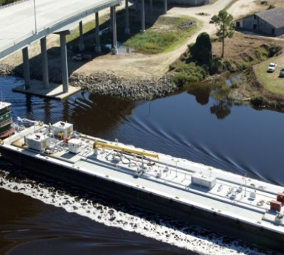
Freight Transportation Plan
Savannah, GA
AMPO Conference - October 23, 2014

Slide 2
Presentation Outline
Why MPO Freight Planning
CORE MPO Freight Plan
  Overview
  Study Area
  Data (November 5, 2014 FHWA Webinar – Using FAF data for Freight Planning)
  Freight advisory committee

Slide 3
Why MPO Freight Planning
MAP-21
  Federal
    National freight strategic plan
  State
    Freight advisory committee
    Comprehensive plan for immediate and long-range freight-related planning and investment.
  MPO
    Freight shippers and freight transportation services providers participate in MPO process
    MPO planning processes consider projects and strategies to
      Increase accessibility and mobility of people and for freight
      Enhance integration and connectivity of the transportation system, across and between modes, for people and freight.
Notes:
Federal
Within three years of enactment of MAP-21, DOT to develop a national freight strategic plan in consultation with States and other stakeholders, and to update the plan every five years.
State
Encourage each State to establish a freight advisory committee composed of a representative cross-section of public- and private-sector freight stakeholders.
Encourage each State to develop a comprehensive plan for its immediate and long-range freight-related planning and investment.
MPO
Continues ability for freight shippers and providers of freight transportation services to participate in metropolitan transportation planning processes.
Continues requirement that planning processes provide for consideration of projects and strategies to
increase the accessibility and mobility of people and for freight; and
enhance the integration and connectivity of the transportation system, across and between modes, for people and freight.

Slide 4
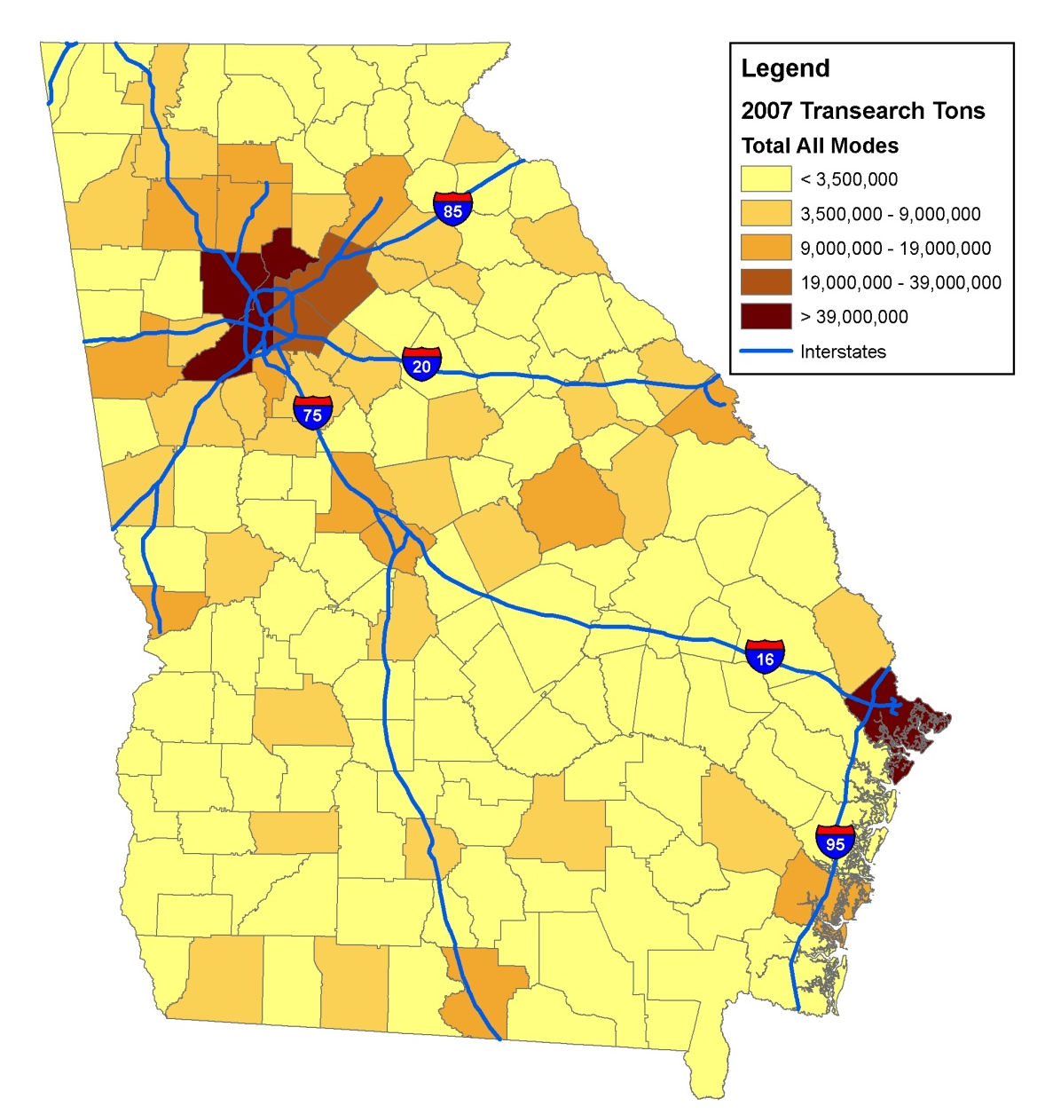
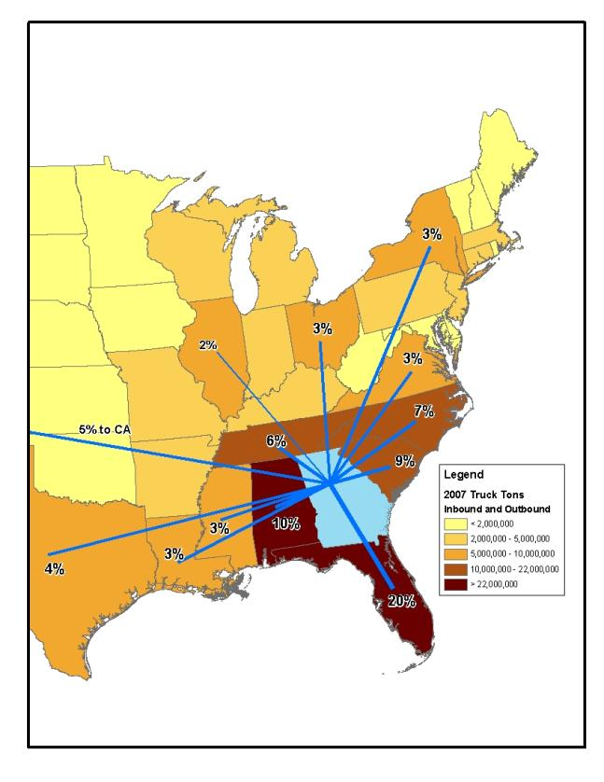
Why MPO Freight Planning
GDOT Freight & Logistics Plan: Macro-scale
  Emphasis on connectivity, efficiency and safety
    All modes analyzed: road, rail, air, and marine ports
    Goods movement within, to/from, and through Georgia
  Focus on key corridors and major “last mile” routes
Freight Tonnage in/out of Ga. counties
Truck Flows in/out metro Atlanta
Truck destinations from Port of Savannah
www.dot.state.ga.us/freight
Notes:
Small and medium-sized MPOs often rely heavily on statewide freight studies and plans to provide guidance on local freight planning
Statewide efforts put more emphasis on major metropolitan areas and on interstate and state highways.
The statewide analysis and recommendations are at a higher level and not detailed enough to accommodate the needs of the smaller urban areas.
GDOT Freight Plan – 3 recommended infrastructure improvements for the Savannah area

Slide 5
Why MPO Freight Planning
MPO Freight Plan: Regional/Local Scale
  Emphasis on regional/local freight impacts and needs
  Integration with statewide freight planning efforts
  Help performance-based planning
Notes:
Need comprehensive understanding of impacts of freight on local infrastructure, land use and economic development
Freight movements are a local issue and places pressure on the local infrastructure
Freight movements impacts the local land use, economic development, safety and security, community quality of life, and the natural environment
MPO and local planning and economic development agencies need to work together for better freight-related land use planning .
The Savannah, GA region has a population of around 300,000 but is the home of the nation’s fourth largest container port and the Georgia Port Authority, which impacts the region as well as inter-modal freight traffic.
Savannah is also home to one of the largest military installations in the nation – Hunter Army Airfield /Fort Stewart – which has a profound impact on the region’s transportation system and economic development.
Need to integrate with statewide effort by focusing on last-mile connections
Specific infrastructure improvement recommendations will be incorporated into the MPO planning process – MTP, TIP, CMP, etc.

Slide 6
CORE MPO Freight Plan Objectives
Provide a blueprint for the Savannah region regarding
  Freight-related infrastructure improvements
  Freight-related land use planning
  Freight linkage to economic development
Notes:
Provide a blueprint for freight-related infrastructure improvements, resource allocation, land use planning, and economic development for the Savannah Area
Understand current and projected freight movements
Understand current and projected freight needs
Provide linkage between freight and economic activities
Provide linkage between freight and land use
Recommend strategies to improve freight movements, service delivery, infrastructure investments, and land use planning

Slide 7
CORE MPO Freight Plan Overview
Task 1
  Project Management and Freight Advisory Committee Establishment
Task 2 – Task 7
  Assessment of freight needs, land use, and economic development
Task 8
  Final Report and Documentation – Freight, Goods and Services Plan

Slide 8
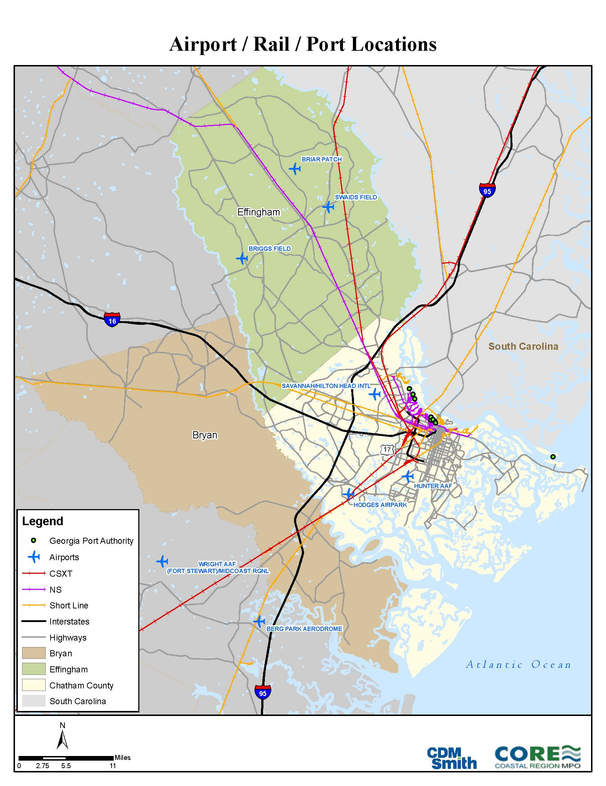
CORE MPO Freight Plan Study Area
Savannah Metropolitan Statistical Area (MSA)
  Chatham County
  Bryan County
  Effingham County

Slide 9
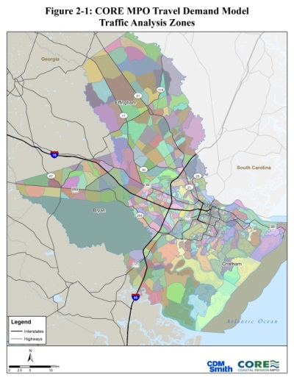
CORE MPO Freight Plan Study Area
Savannah MSA
  Consistent with MPO Travel Demand Model area
  Census data available
  A part of the FHWA FAF metro region
  Employment and economy integration

Slide 10
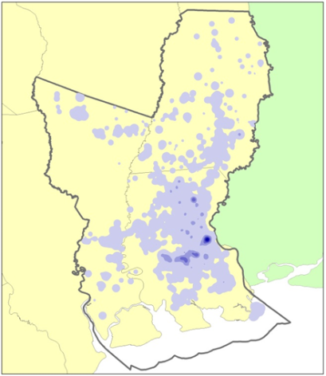
CORE MPO Freight Plan Data
FAF Disaggregation
  Freight Analysis Framework (FAF)
  County Business Patterns
  BEA Input-Output Accounts Data
  Longitudinal Employment Household Dynamics (LEHD)
  USDA Agriculture Data
  Coal Generated MWh from EIA
Notes:
Transearch data – used by state DOTs and larger MPOs with more financial resources. Database is licensed to the specific agency and cannot be shared.
Freight Analysis Framework (FAF) and US Census Longitudinal Employer-Household Dynamics (LEHD) data
Free
Used to obtain information on key modes, freight corridors, commodities, tonnage, value, as well as freight origins and destinations trough disaggregation
Information to be supplemented by reports and plans of the local economic development and freight transportation agencies as well as industry survey results
Output to be validated by input provided through the freight advisory committee process
Freight Analysis Framework 3.3
Based on 2007 Commodity Flow Survey
2011 Provisional FAF and Forecast to 2040
County Business Patterns
Annual series that provides subnational economic data by industry
BEA Input-Output Accounts Data
Relationships between various industries in the economy
Longitudinal Employment Household Dynamics (LEHD)
Provides Census Block level jobs data
USDA Agriculture Data
Farm Employment
Coal Generated MWh from EIA

Slide 11
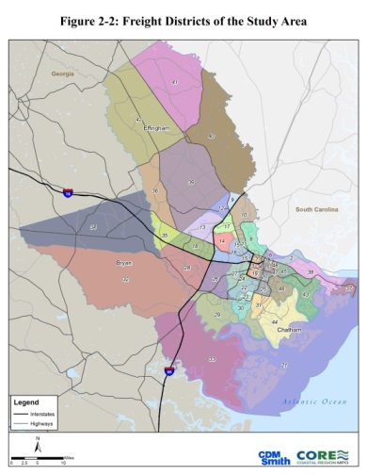
CORE MPO Freight Plan Data
FAF Disaggregation
  Methodology - Build a relationship between commodity production and consumption and industry and population by freight district
Notes:
Transearch data – used by state DOTs and larger MPOs with more financial resources. Database is licensed to the specific agency and cannot be shared.
Freight Analysis Framework (FAF) and US Census Longitudinal Employer-Household Dynamics (LEHD) data
Free
Used to obtain information on key modes, freight corridors, commodities, tonnage, value, as well as freight origins and destinations trough disaggregation
Information to be supplemented by reports and plans of the local economic development and freight transportation agencies as well as industry survey results
Output to be validated by input provided through the freight advisory committee process
Freight Analysis Framework 3.3
Based on 2007 Commodity Flow Survey
2011 Provisional FAF and Forecast to 2040
County Business Patterns
Annual series that provides subnational economic data by industry
BEA Input-Output Accounts Data
Relationships between various industries in the economy
Longitudinal Employment Household Dynamics (LEHD)
Provides Census Block level jobs data
USDA Agriculture Data
Farm Employment
Coal Generated MWh from EIA

Slide 12
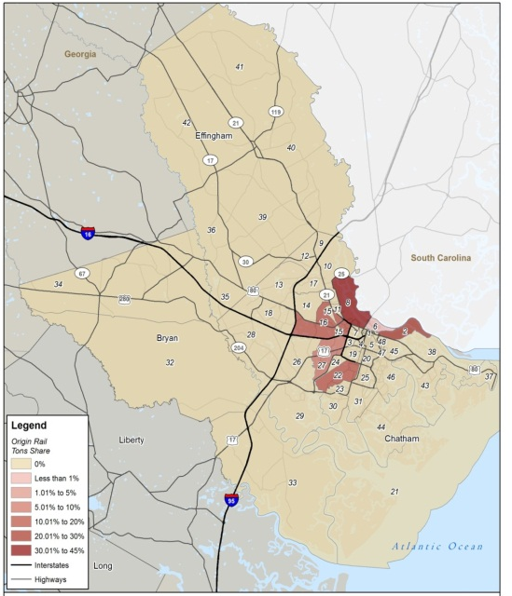
CORE MPO Freight Plan Data
FAF Disaggregation
  Results – Information on key modes, freight corridors, commodities, tonnage, value, as well as freight origins and destinations
Origin | Destination | KTons
Freight District 08 | Atlanta, GA | 211.1
Freight District 22 | Atlanta, GA | 183.1
Freight District 16 | Atlanta, GA | 124.7
Freight District 08 | Houston, TX | 81.3
Freight District 22 | Houston, TX | 80.3
Freight District 08 | Minneapolis, MN | 80.1
Freight District 22 | Minneapolis, MN | 74.2
Freight District 08 | State of Georgia | 54.7
Freight District 16 | Houston, TX | 54.1
Freight District 27 | Atlanta, GA | 51.3
Notes:
Transearch data – used by state DOTs and larger MPOs with more financial resources. Database is licensed to the specific agency and cannot be shared.
Freight Analysis Framework (FAF) and US Census Longitudinal Employer-Household Dynamics (LEHD) data
Free
Used to obtain information on key modes, freight corridors, commodities, tonnage, value, as well as freight origins and destinations trough disaggregation
Information to be supplemented by reports and plans of the local economic development and freight transportation agencies as well as industry survey results
Output to be validated by input provided through the freight advisory committee process
Freight Analysis Framework 3.3
Based on 2007 Commodity Flow Survey
2011 Provisional FAF and Forecast to 2040
County Business Patterns
Annual series that provides subnational economic data by industry
BEA Input-Output Accounts Data
Relationships between various industries in the economy
Longitudinal Employment Household Dynamics (LEHD)
Provides Census Block level jobs data
USDA Agriculture Data
Farm Employment
Coal Generated MWh from EIA

Slide 13
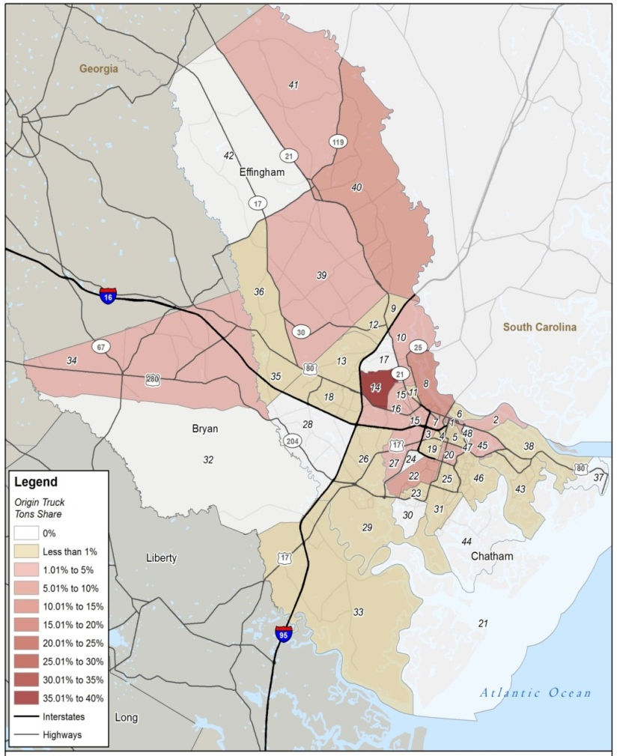
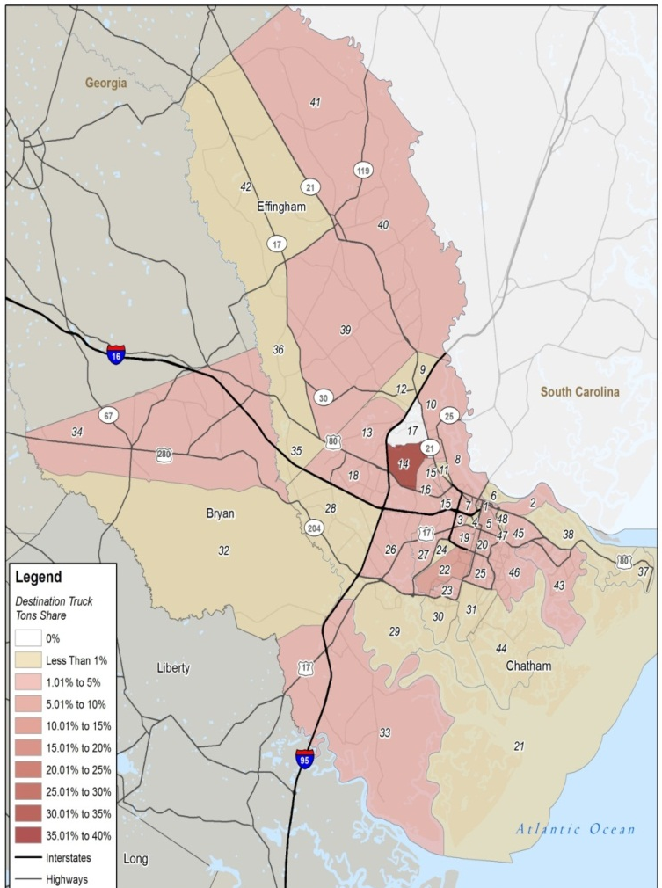
CORE MPO Freight Plan Data
FAF Disaggregation
Notes:
Transearch data – used by state DOTs and larger MPOs with more financial resources. Database is licensed to the specific agency and cannot be shared.
Freight Analysis Framework (FAF) and US Census Longitudinal Employer-Household Dynamics (LEHD) data
Free
Used to obtain information on key modes, freight corridors, commodities, tonnage, value, as well as freight origins and destinations trough disaggregation
Information to be supplemented by reports and plans of the local economic development and freight transportation agencies as well as industry survey results
Output to be validated by input provided through the freight advisory committee process
Freight Analysis Framework 3.3
Based on 2007 Commodity Flow Survey
2011 Provisional FAF and Forecast to 2040
County Business Patterns
Annual series that provides subnational economic data by industry
BEA Input-Output Accounts Data
Relationships between various industries in the economy
Longitudinal Employment Household Dynamics (LEHD)
Provides Census Block level jobs data
USDA Agriculture Data
Farm Employment
Coal Generated MWh from EIA

Slide 14
CORE MPO Freight Plan Data
FAF Disaggregation
Origin | Destination | KTons
Freight District 08 | Atlanta, GA | 2,413.2
Freight District 16 | Houston, TX | 942.6
Freight District 16 | Atlanta, GA | 801.8
Freight District 14 | Houston, TX | 746.2
Freight District 08 | State of Georgia | 695.0
Freight District 10 | Atlanta, GA | 687.7
Origin | Destination | KTons
Newark, NJ (New York) | Freight District 14 | 1,557.2
Newark, NJ (New York) | Freight District 16 | 1,467.3
Newark, NJ (New York) | Freight District 10 | 1,169.7
Atlanta, GA | Liberty County | 937.5
Newark, NJ (New York) | Freight District 22 | 866.8
Newark, NJ (New York) | Freight District 08 | 864.8
Notes:
Transearch data – used by state DOTs and larger MPOs with more financial resources. Database is licensed to the specific agency and cannot be shared.
Freight Analysis Framework (FAF) and US Census Longitudinal Employer-Household Dynamics (LEHD) data
Free
Used to obtain information on key modes, freight corridors, commodities, tonnage, value, as well as freight origins and destinations trough disaggregation
Information to be supplemented by reports and plans of the local economic development and freight transportation agencies as well as industry survey results
Output to be validated by input provided through the freight advisory committee process
Freight Analysis Framework 3.3
Based on 2007 Commodity Flow Survey
2011 Provisional FAF and Forecast to 2040
County Business Patterns
Annual series that provides subnational economic data by industry
BEA Input-Output Accounts Data
Relationships between various industries in the economy
Longitudinal Employment Household Dynamics (LEHD)
Provides Census Block level jobs data
USDA Agriculture Data
Farm Employment
Coal Generated MWh from EIA

Slide 15
CORE MPO Freight Plan Data
FAF Disaggregation
2040 Mode Values
2040 Top Ten Commodity by Tonnage by Truck
Notes:
Transearch data – used by state DOTs and larger MPOs with more financial resources. Database is licensed to the specific agency and cannot be shared.
Freight Analysis Framework (FAF) and US Census Longitudinal Employer-Household Dynamics (LEHD) data
Free
Used to obtain information on key modes, freight corridors, commodities, tonnage, value, as well as freight origins and destinations trough disaggregation
Information to be supplemented by reports and plans of the local economic development and freight transportation agencies as well as industry survey results
Output to be validated by input provided through the freight advisory committee process
Freight Analysis Framework 3.3
Based on 2007 Commodity Flow Survey
2011 Provisional FAF and Forecast to 2040
County Business Patterns
Annual series that provides subnational economic data by industry
BEA Input-Output Accounts Data
Relationships between various industries in the economy
Longitudinal Employment Household Dynamics (LEHD)
Provides Census Block level jobs data
USDA Agriculture Data
Farm Employment
Coal Generated MWh from EIA

Slide 16
CORE MPO Freight Plan Data
Other Data sources
  State DOT
    Rail
    Statewide Freight and Logistics Plan
    Crash Data
    Traffic Data
    Bottlenecks
  Regional/Local Level
    MPO Travel Demand Model
    Local Reports (airport, port, SEDA, other)
    Comprehensive Plans (DCA website)

Slide 17
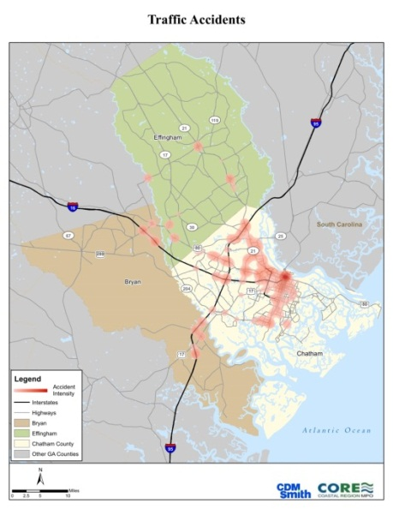
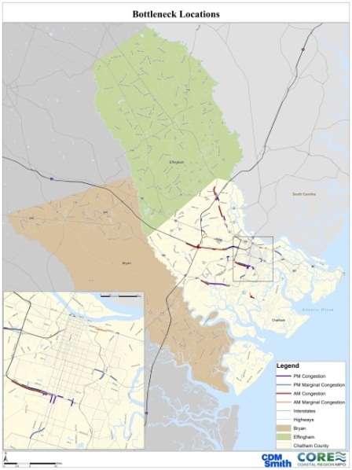
CORE MPO Freight Plan
State DOT Data sources
  Safety and Security
    “Hot Spots” - locations with high truck crashes or rail related accidents
  Bottlenecks
    AM and/or PM time period
    Traffic direction
    Level of service (LOS) grade from the survey
    Weighted according to AADT on the segment

Slide 18
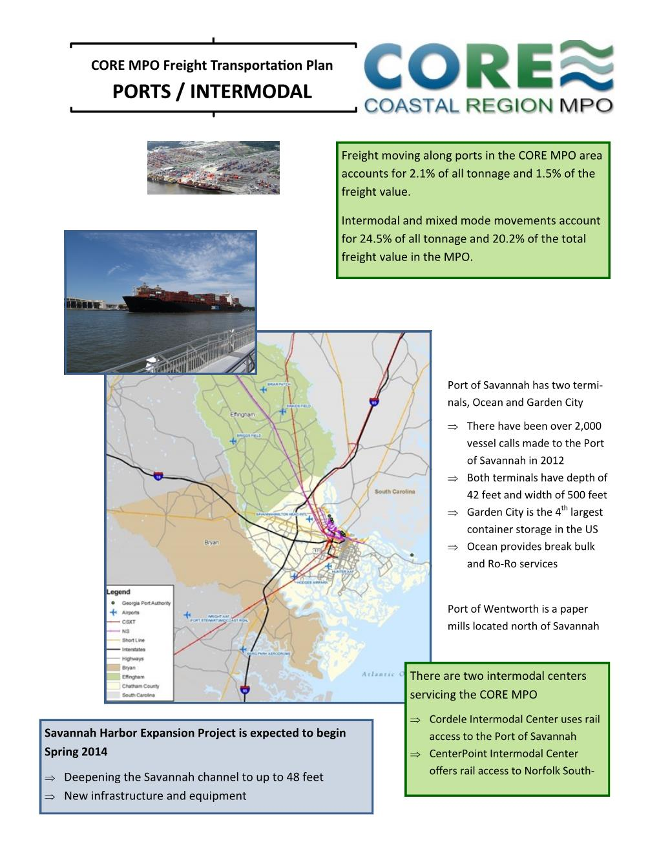
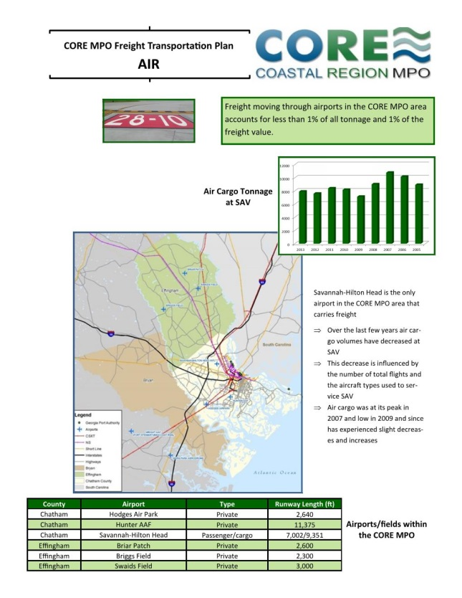
CORE MPO Freight Plan Data
Regional/Local Data sources

Slide 19
CORE MPO Freight Plan Data
Lessons
  Free data available for smaller MPOs
  Supplement information by local reports/plans and industry survey results
  Validate output by freight advisory committee process

Slide 20
CORE MPO Freight Plan
Freight Advisory Committee
Who
  Airport, rail, and seaport representatives
  Carriers, shippers, and freight industry workforce
  Economic development agencies
  Local governments

Slide 21
CORE MPO Freight Plan
Freight Advisory Committee
Critical Roles
  Review MPO’s freight-centric goals and objectives
  Provide freight data and input
  Help validate study output
  Provide liaison between MPO and freight community
  Help more people understand MPO process
  Provide regional perspective and collaboration
  Possible opportunity for private investment in select projects
  Establish an advisory committee to MPO Board

Slide 22
CORE MPO Freight Plan
Project Website
http://www.thempc.org/Transportation/FreightTransportationPlans.html

Slide 23
Questions?

Slide 24
Thank You!
Contact Information
Zhongze (Wykoda) Wang
Transportation Administrator
Chatham County - Savannah Metropolitan Planning Commission
110 E. State Street
Savannah, GA 31401
Phone: 912-651-1466
Email: wangw@thempc.org

