Slide 1
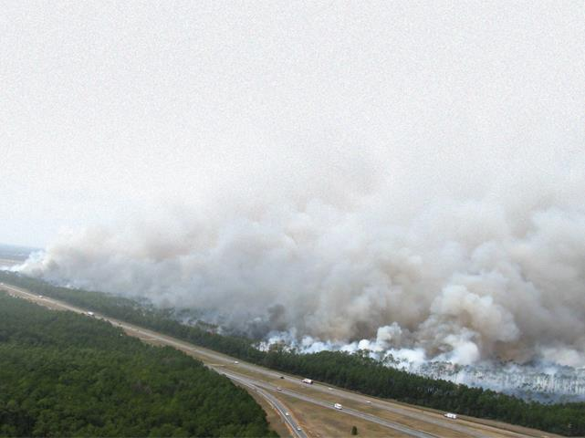
Extreme Weather and Climate Change Vulnerability Assessment of Central Texas Transportation Infrastructure
Federal Highway Administration (FHWA) Pilot Project
presented to
AMPO Annual Meeting
October 23, 2014
Capital Area Metropolitan Planning Organization
City of Austin, Office of Sustainability
Cambridge Systematics, Inc.
Notes:
Introductions…
CAMPO was one of 19 MPOs and state DOTs across the country to receive a Federal Highway grant to pilot an extreme weather and climate change vulnerability assessment of transportation infrastructure. This project kicked off in November 2013 and since that time we’ve completed several early tasks that we wanted to update you on this afternoon.

Slide 2
Project overview
Cathy Stephens, CAMPO

Slide 3
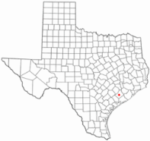
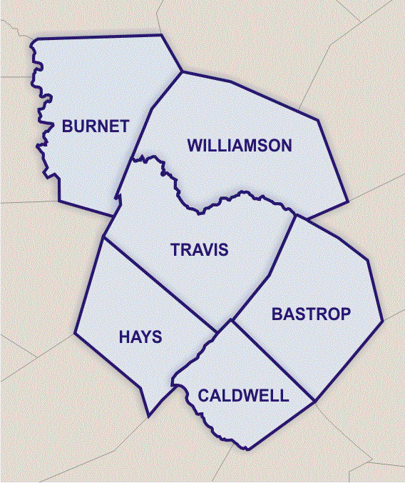
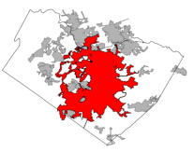
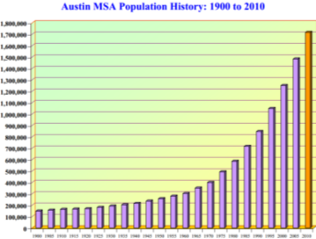
The CAMPO Region
Project Area
Population (April 1st, 2013)
  City of Austin: 842,750
  Regional: 1,870,872
  Regional 2040: 4,100,000
Notes:
A 6-County area in Central Texas.
Austin is the largest city, and is very active with climate change and environmental initiatives.
Other counties have fast growing populations as well.
Williamson to Travis – 90,000 people make this commute daily
IH-35 is an international, national, state, regional and locally roadway.
Population Growth – 89% between 2010 - 2035
3

Slide 4
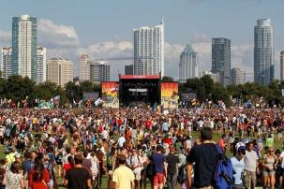

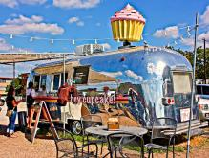
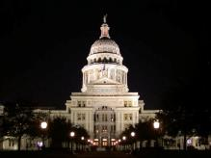

Local Flavor
Live Music Capitol
  SXSW
  ACL LIVE
  ACL music fest
  Circuit of the Americas
UT Austin
Food trucks
State Politics
High Tech

Slide 5
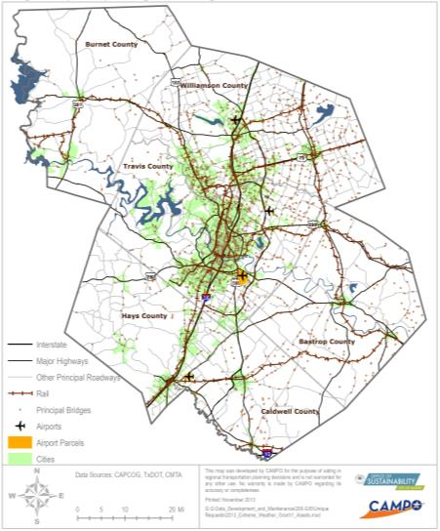
Regional Transportation System
Six counties covering 5,300 square miles
12,420 lane miles
1 Commuter rail line
Local, express, BRT service
41.8 million vehicle miles traveled daily
31.2 million transit boardings each year
Notes:
Recap of proposed scope and objectives
Analyzing regional transportation system
Working with a consultant to complete framework steps, do stakeholder outreach, analyze dynamically downscaled climate data and assemble final report.
Goal: Systematic consideration of future climate change vulnerability and risk into transportation decision making
Overview of project achievements to date
What project steps have you completed?
Received approval to add this project to our UPWP and approval to start work from TxDOT
Received support from regional leadership
Selected consultant
Data collection for asset inventory
5

Slide 6
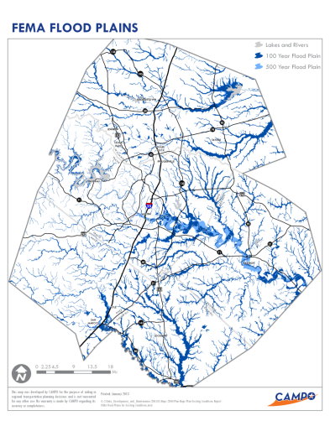
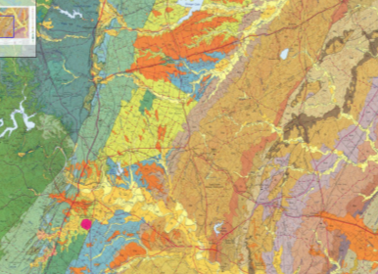
Physical Characteristics
Topography and geology
    West – rocky hill country
    East – flatter, softer soils
Source: Geologic Atlas of Texas, Texas Water Development Board
Source: CAMPO, FEMA
Notes:
Topography
Hills to west, floodplains are to the east in flatter areas
Geology
Limestone to west
More topsoil to the east (clay and sand)
Impacts how long roads last (buckling)
6

Slide 7
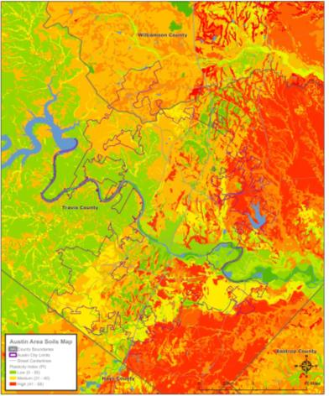
Soil Plasticity
Clay soils on the east side have high soil plasticity
Causes pavement, road bed and utility problems when soil expands and shrinks with varying soil moisture
Notes:
10/22/2014
7

Slide 8
Extreme Weather in Central Texas
Key weather stressors
  Flooding – vulnerable to flash floods, tropical storms
  Drought – ongoing drought
  Extreme Heat – 2011 90 days over 100 degrees
  Wildfire – 2011 wildfires
  Extreme Cold – 5 ice days last winter
Region’s rapid growth contributes to impacts

Slide 9
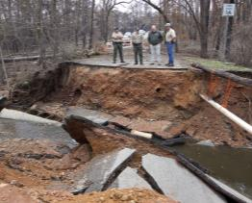
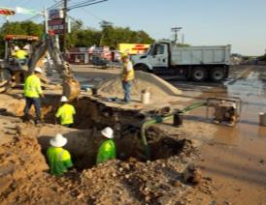
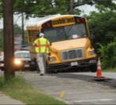
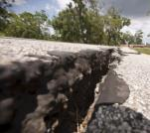
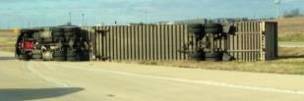
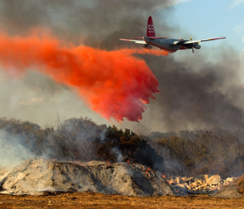
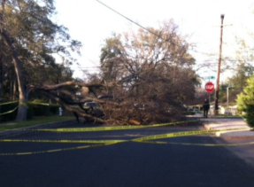
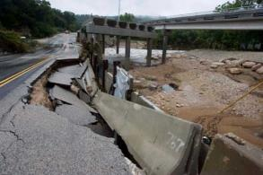
Impacts of Extreme Weather
Sinkhole - 2009
Buckling roads - 2009
Aftermath of wildfire - 2011
Drought: Disrupted Water - 2011
High winds - 2013
Wildfires - 2011
Flooding: Tropical Storm Hermine - 2010
Fallen tree - 2013

Slide 10
Pilot Project Overview
Assess the transportation system’s vulnerability to the impacts of extreme weather, now and future
  Roads, rail, transit
Incorporate results into the 2040 planning process to increase extreme weather resilience
  Nature of results will determine how they are incorporated
Share results with partners, stakeholders and public
  City of Austin, TxDOT, Capital Metro, FHWA
Started project in early 2013, will wrap up in 2014

Slide 11
Approach & Results
Josh DeFlorio, Cambridge Systematics

Slide 12
FHWA Assessment Framework

Slide 13
Inventory & Criticality
Transportation data collection and integration
Screening in GIS using criticality indicators
Workshop with agencies to select critical, potentially vulnerable assets
Selected 9 assets for screening

Slide 14
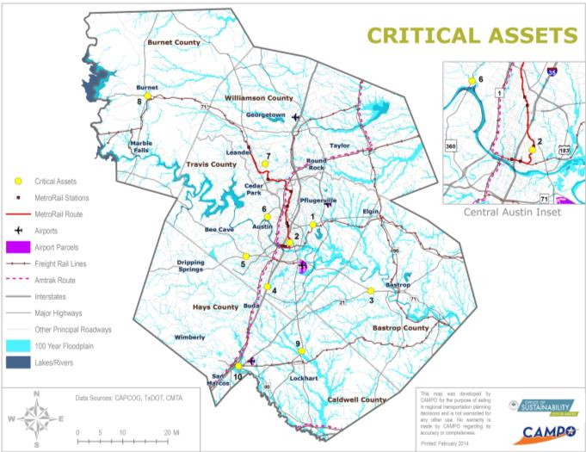
Critical Assets Screened
Notes:
1. US 290 at Johnny Morris Rd.
2. CMTA MetroRail Red Line south of MLK Jr. Station
3. SH 71E/SH 21 junction
4. I-35 at Onion Creek
5. US 290/SH 71W - Y at Oak Hill
6. Loop 360/FM 2222 interchange
7. FM 1431 near Parmer Ln.
8. US 281/SH 29 intersection area (Burnet)
9. US 183/SH 130 north of Lockhart
10. SH 80 at Blanco River

Slide 15
Sensitivity
Sensitivity focus groups with infrastructure managers
Identified stressors of concern
  Flooding, drought, extreme temperatures, wildfire, “extreme” cold
Developed suggested risk indicators and thresholds

Slide 16
Illustrative Sensitivity Indicators
Sensitivity Indicators
Adaptive Capacity Indicators
24-hour precipitation design threshold
Criticality
Average inundation velocity
Evacuation route?
Scour criticality
AADT
Flooding
Wildfire Threat
Truck traffic volume
Soil plasticity
Detour length
Drought
Pavement binder
Functional class
Truck traffic volume
Heat
Wildfire sensitivity
Wildfire
Whether roadway is elevated
Cold/Ice

Slide 17
Climate Data
Dr. Kerry Cook, UT-Austin
Used RCM (instead of BCSD)
  Advantages: Physics-based, broader range of variables (soil moisture)
  Disadvantages: Inability to vary emissions/GCMs to develop scenarios (varied geography instead)
Three “scenarios”—geographic, rather than emissions-based
Outputs served as inputs to Vieux model, other assessment platforms

Slide 18
Example
Number of Dry Days Per Year
Scenario 1: 4 per year (4 additional dry days); 1.5% increase
Scenario 2: 4 per year (4 additional dry days); 1.5% increase
Scenario 3: 3 per year (4 additional dry days); 1.0% increase

Slide 19
Hydrology
Worked with Vieux, contractors for City of Austin Flood Early Warning System (FEWS)
Translated outputs from RCM to hydro model inputs (key variables included heavy [99th percentile] rainfall events)
Adjusted impervious surface estimation based on development forecasts
Derived projected current and 2040 flood hazard areas, estimated depths, flow rates, and velocity at cross widths

Slide 20
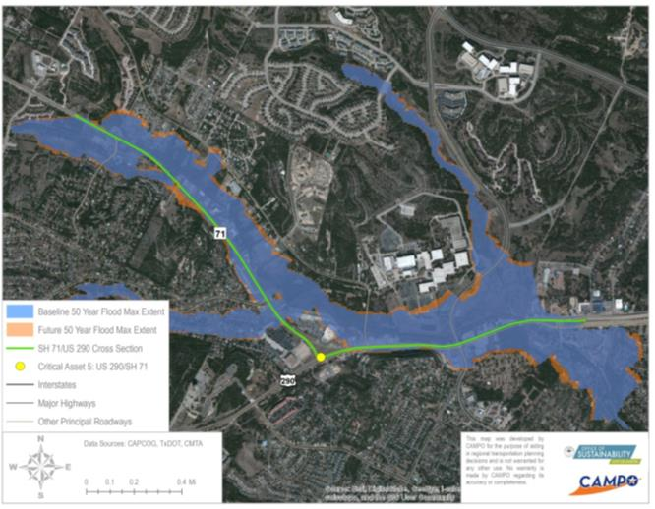
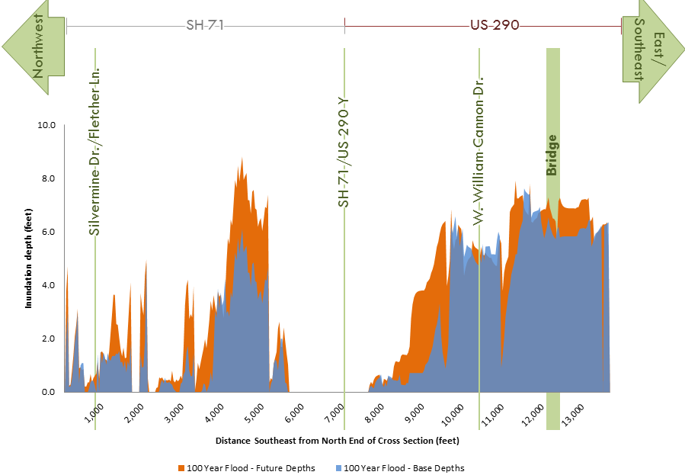
Example
FEWS Flood Hazard Area

Slide 21
Vulnerability Screening
Worked with FHWA Vulnerability Assessment Scoring Tool (VAST)
Based on climate outputs and sensitivity indicators conducted screening analyses for 9 critical assets, developed preliminary risk hypotheses
Convened agency focus groups to help validate and refine hypotheses

Slide 22
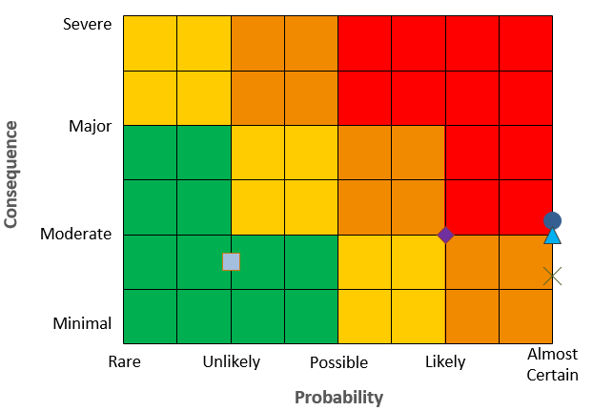
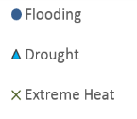


Sample Risk Analysis
Highest risk to flooding
Drought, heat, and wildfire moderate-high risk
Low sensitivity to heat

Slide 23
Preliminary Results 1
Issue is less catastrophic, region-wide impacts (e.g., unlike some coastal communities)
Challenges more about situational, localized risks (e.g., flooding) AND regionwide 1) asset management issues (e.g., deterioration due to drought) and 2) emergency response (e.g. safe evacuation routes)
  E.g., wildfire pinch points

Slide 24
Preliminary Results 2
Flooding risk is case by case, impacts depend greatly on robustness of infrastructure, threat may be exacerbated by more intense extreme rainfall events, increasing urbanization
Heightened drought risk, relevant for assets situated on expansive clay soils
  Decrease in soil moisture may worsen issues

Slide 25
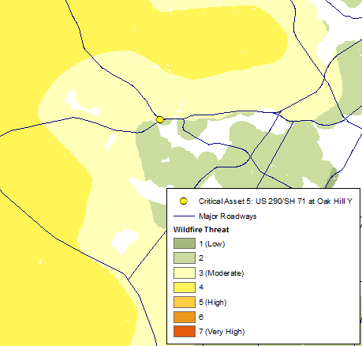
Preliminary Results 3
Soil moisture correlated with heighted WF risk, few direct impacts on infrastructure, but leads to disruptions, delays
Extreme temperature, almost certain to increase in frequency, but not of great concern
Icing events, although rare (expected to become rarer) cause regionwide disruptions

Slide 26
Preliminary Lessons Learned
Avoid the climate change debate
  Focus on extreme weather vulnerability
Approach operating agencies with care
Growth, other non-climate stressors, can affect extreme weather impacts
Explain model uncertainty

Slide 27
Next Steps for CAMPO region
Incorporate the results into the 2040 Planning process
Summit of pilot partners, peer regions
  Texas MPOs
Incorporate into City of Austin multi-sectoral plans
Proceed to adaptation and/or expand/refine risk picture

Slide 28
Thank you!
Cathy Stephens
CAMPO
cathy.stephens@campotexas.org
Josh DeFlorio
Cambridge Systematics
jdeflorio@camsys.com

