Slide 1

Integrating Operations into a Metropolitan Transportation Plan
AMPO Operations Working Group Meeting
Boston, MA
2010

Slide 3

M&O Subcommittee
Traffic engineers
$4 million - Surface Transportation Program
Criteria for projects
M&O Strategic Plan
Notes:
Up to 2% of total TRIP allocation to District 5 for coordinated signal retiming.

Slide 4
Accomplishments
Student driver education/training
Community Traffic Safety Teams (CTST)
Field Audits
Peer Exchange
Notes:
4
There are four major elements for the Regional Crash Database System; the crash database itself, GIS map display, data analysis tool, and the reporting module.
The consultant, Professor Bejleri from University of Florida, is currently working on bringing the data from DHSMV and PRIDE into the system and modifying the analysis tools for our area.
(He is also testing to make sure the data importing process is sound
and verifying the location information, such as creating street name alias table, and intersection and address matching )
We are waiting for DHSMV to sign the MOU in order to provide us with 2004-2006 data and data for 2008 and beyond (Long-Form and FHP Short-Form)
We have budgeted $21,800 to obtain PRIDE data from 2008-07 to 2009-04 (non-FHP Short-Form)
After the completion of this project, which is at the end of this year, we will compare our database with the ones that local agencies have, to make sure the data matches with each other, and
we should be able to provide accurate crash data and crash analysis for the local agencies upon their requests
Our objective is to maintain a 5-yr complete set of crash data for the 3-county area, for both Long and Short Form crashes
The following slides will show some of the functionality of the database and the analysis tool:

Slide 5
Accomplishments (cont’)
Web-base regional crash database
Advanced ITS projects
Safety Conscious Plan
Travel Time and Delay Studies
Notes:
5
There are four major elements for the Regional Crash Database System; the crash database itself, GIS map display, data analysis tool, and the reporting module.
The consultant, Professor Bejleri from University of Florida, is currently working on bringing the data from DHSMV and PRIDE into the system and modifying the analysis tools for our area.
(He is also testing to make sure the data importing process is sound
and verifying the location information, such as creating street name alias table, and intersection and address matching )
We are waiting for DHSMV to sign the MOU in order to provide us with 2004-2006 data and data for 2008 and beyond (Long-Form and FHP Short-Form)
We have budgeted $21,800 to obtain PRIDE data from 2008-07 to 2009-04 (non-FHP Short-Form)
After the completion of this project, which is at the end of this year, we will compare our database with the ones that local agencies have, to make sure the data matches with each other, and
we should be able to provide accurate crash data and crash analysis for the local agencies upon their requests
Our objective is to maintain a 5-yr complete set of crash data for the 3-county area, for both Long and Short Form crashes
The following slides will show some of the functionality of the database and the analysis tool:

Slide 6
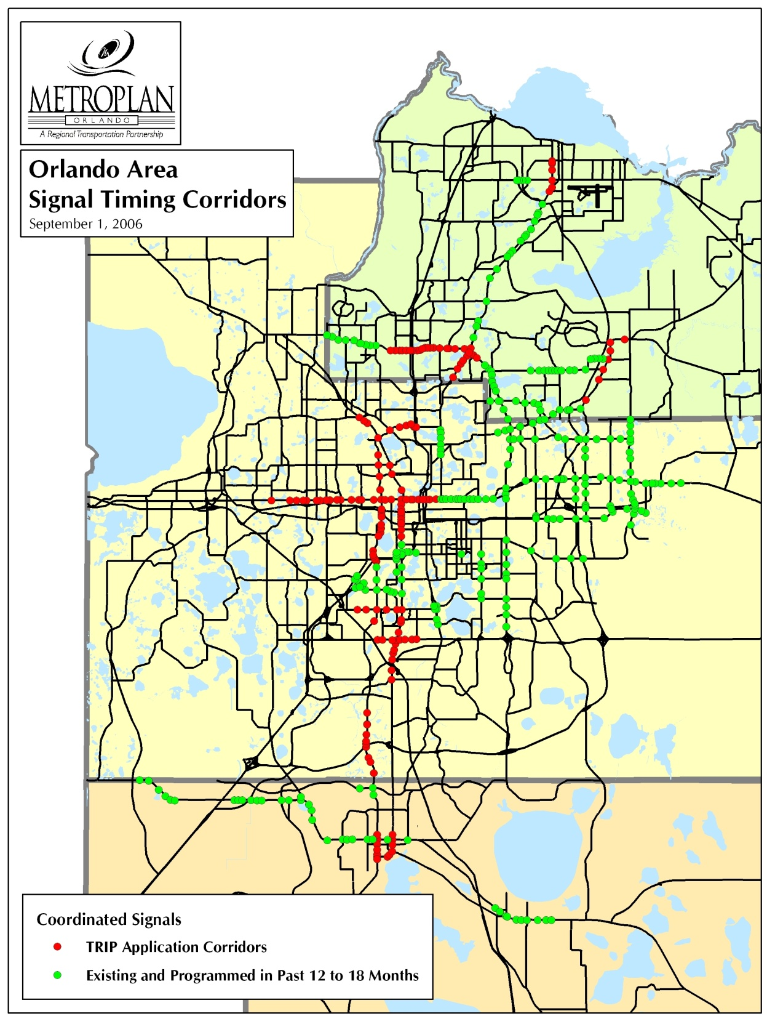

Slide 7
FY 08 Status Report

Slide 8
FY 08 Status Report

Slide 9
FY 08 Status Report
BENEFITS
AM Peak Hour Savings: $ 21,091
PM Peak Hour Savings: $ 40,110
Overall Project Cost: $ 816,000
Value to community received after
27 Peak Hours

Slide 10
FY 09 Signal Retiming B-C Analysis Calculations
SR 434 from Tollgate Trail to Wayman St
Summary of Measures of Effectiveness & Benefit Cost Analysis
 | AM PEAK HOUR |  | PM PEAK HOUR
MOE's | Before | After | Before | After
Total Travel Time (vehicle - hrs) | 268.46 | 216.75 | 375.46 | 257.36
Total Fuel Consumption (gallons) | 240.74 | 232.83 | 267.26 | 262.71
 | AM PEAK HOUR |  | PM PEAK HOUR
BENEFITS
User Benefit Per Day | $897.59 |  | $2,009.47
Annual User Benefit | $269,276.83 |  | $602,841.66
Total Annual User Benefit | $872,118.48
Total Signal Retiming Annual Cost | $11,926.92
User Benefit / Cost Ratio | 73.12

Slide 11
B/C Ratio Summary – Seminole County
S No. | Street | From | To | Annual User Benefit | Annual Cost | B/C Ratio
1 | US 17/92 | SR 46 (1st St) | 3rd St | $91,803.70 | $3,905.78 | 23.50
2 | SR 434 | Sand Lake Rd | Jamestown Blvd | $97,494.71 | $3,861.20 | 25.25
3 | SR 434 | Tollgate Trail | Wayman St | $872,118.48 | $11,926.92 | 73.12
4 | SR 434 | Mitchell Hammock Rd | Palm Valley Dr | $482,533.47 | $9,678.71 | 49.86
5 | SR 436 | Wilshire Dr | Casselton Dr | $933,847.95 | $17,509.32 | 53.33
6 | SR 46 | Park Dr | Sanford Ave | $115,608.62 | $3,905.78 | 29.60
7 | CR 46A | SR 417 NB Ramp | SR 417 SB Ramp | $50,435.76 | $3,861.20 | 13.06
8 | SR 426 | Old Howell Branch Rd | Dean Rd | $380,396.32 | $13,717.86 | 27.73
9 | Red Bug Lake Rd | SR 417 EB | SR 417 WB | $160,113.12 | $3,861.20 | 41.47

Slide 12
B/C Ratio Summary – Orange County
S No. | Street | From | To | Annual User Benefit | Annual Cost | B/C Ratio
1 | Alafaya Tl (SR 434) | Challenger Pkwy |  | $513,383.90 | $1,566.12 | 327.81
2 | Aloma Ave (SR 426) | Phelps Ave | Palmetto Ave | $953,161.33 | $12,879.55 | 74.01
3 | Colonial Dr E. (SR 50) | Murdock Blvd | Avalon Park Blvd | $1,490,036.19 | $17,219.72 | 86.53
4 | Conway Rd (SR 15) | Michigan St | Hoffner Ave | $494,870.99 | $10,402.71 | 47.57
5 | Goldenrod Rd (SR 551) | Lake Underhill Rd | Charlin Pkwy | $599,118.16 | $15,889.85 | 37.70
6 | Orange Ave (SR 527) | Drennan St | Nela Ave | $1,132,333.09 | $16,309.01 | 69.43
7 | Semoran Blvd (SR 436) | Aloma Ave | Baldwin Park St | $605,321.47 | $8,345.03 | 72.54

Slide 13
B/C Ratio Summary – City of Orlando
S No. | Street | From | To | Annual User Benefit | Annual Cost | B/C Ratio
1 | Curry Ford Rd (SR 552) | Conway Rd | Woodgate Blvd | $758,784.55 | $10,402.71 | 72.94
2 | Semoran Blvd (SR 436) | Dahlia | T.G. Lee Blvd | $1,609,694.32 | $29,036.14 | 55.44
3 | Colonial Dr (SR 50) | Mills Ave | Old Cheney Hwy | $917,396.80 | $21,948.58 | 41.8
4 | Hoffner Ave/Narcoossee Rd | Goldenrod Rd | Lee Vista Blvd | Under Construction
5 | Mills Ave (SR 15/600) | Marks St | Rollins St | Under Construction
6 | Central Blvd | Brown Ave | Mills Ave | Under Construction

Slide 14
B/C Ratio Summary - Osceola
S No. | Street | From | To | Annual User Benefit | Annual Cost | B/C Ratio
1 | US 17/92 - US 441 | Osceola Pkwy | Columbia Ave | $277,945.12 | $6,439.77 | 43.16
2 | US 192 - US 441 | Denn John Ln | Turnpike NB Ramp | $392,859.77 | $11,660.18 | 33.69

Slide 15
Annual Time & Fuel Savings
Roadway Name | Limits | Annual Time Savings (vehicle hours) | Annual Fuel Savings (gallons)
Alafaya Trail | Challenger Pkwy | 29,747 | 3,580
Aloma Ave | Balfour Dr to Palmetto Ave | 55,695 | 3,997
Conway Rd | Michigan Ave to Hoffner Ave | 28,900 | 2,168
CR 46A | SR 417 NB Ramp to SR 417 SB Ramp | 2,941 | 248
Curry Ford Rd | Conway Rd to Woodgate Blvd | 44,537 | 2,048
Goldenrod Rd | Bates Rd to Charlin Pkwy | 33,464 | 11,266
Orange Ave | Drennan St to Nela Ave | 66,660 | 1,937
Red Bug Lake Rd | SR 417 EB to SR 417 WB | 9,425 | 279
SR 426 | Old Howell Branch Rd to Dean Rd | 22,050 | 2,603
SR 434 Part A | Sand Lake Rd to Jamestown Blvd | 5,627 | 804
SR 434 Part B | Tollgate Trail to Wayman St | 50,945 | 3,740

Slide 16
Annual Time & Fuel Savings (continued)
Roadway Name | Limits | Annual Time Savings (vehicle hours) | Annual Fuel Savings (gallons)
SR 434 Part C | Mitchell Hammock Rd to Palm Valley Dr | 28,567 | 1,087
SR 436 | Aloma Ave to Baldwin Park St | 35,151 | 3,781
SR 436 | Wilshire Dr to Casselton Dr | 54,198 | 6,009
SR 436 | Dahlia Dr to T.G. Lee Blvd | 94,372 | 4,971
SR 46 | Park Dr to Sanford Ave | 6,811 | 170
SR 50 | Mills Ave to Old Cheney Hwy | 53,560 | 4,106
SR 50 | Murdock Blvd to Avalon Park Blvd | 86,449 | 9,749
US 17-92 | SR 46 (1st St) to 3rd St | 5,385 | 266
US 17-92 | Osceola Pkwy to Columbia Ave | 15,982 | 2,634
US 192 | Denn John Ln to Turnpike NB Ramp | 23,056 | 1,079
Total Savings |  | 753,522 | 66,521

Slide 17
LOS “F” (failing) Miles Comparison: Before and After
Direction-Peak Hour | BEFORE %(Miles) | AFTER %(Miles)
NB/EB –AM | 3.3% (1.7) | 1.77% (1.0)
NB/EB – PM | 10.62% (5.6) | 4.1% (2.2)
SB/WB – AM | 8.41% (4.4) | 3.84% (2.0)
SB/WB – PM | 12.29% (6.5) | 4.88% (2.6)
Total | 18.3 (35%) | 7.7(15%)

Slide 18
Long Range Transportation Plan
Notes:
18
There are four major elements for the Regional Crash Database System; the crash database itself, GIS map display, data analysis tool, and the reporting module.
The consultant, Professor Bejleri from University of Florida, is currently working on bringing the data from DHSMV and PRIDE into the system and modifying the analysis tools for our area.
(He is also testing to make sure the data importing process is sound
and verifying the location information, such as creating street name alias table, and intersection and address matching )
We are waiting for DHSMV to sign the MOU in order to provide us with 2004-2006 data and data for 2008 and beyond (Long-Form and FHP Short-Form)
We have budgeted $21,800 to obtain PRIDE data from 2008-07 to 2009-04 (non-FHP Short-Form)
After the completion of this project, which is at the end of this year, we will compare our database with the ones that local agencies have, to make sure the data matches with each other, and
we should be able to provide accurate crash data and crash analysis for the local agencies upon their requests
Our objective is to maintain a 5-yr complete set of crash data for the 3-county area, for both Long and Short Form crashes
The following slides will show some of the functionality of the database and the analysis tool:

Slide 19
Alternative Land-Use
Smart Growth
Regional Goals/Measures
Integrated Regional System
Balanced Multi-Modal System
System Safety
Efficient & Cost-Effective System
Quality of Life/Community Compatibility
Environmental Sensitivity
Notes:
19
There are four major elements for the Regional Crash Database System; the crash database itself, GIS map display, data analysis tool, and the reporting module.
The consultant, Professor Bejleri from University of Florida, is currently working on bringing the data from DHSMV and PRIDE into the system and modifying the analysis tools for our area.
(He is also testing to make sure the data importing process is sound
and verifying the location information, such as creating street name alias table, and intersection and address matching )
We are waiting for DHSMV to sign the MOU in order to provide us with 2004-2006 data and data for 2008 and beyond (Long-Form and FHP Short-Form)
We have budgeted $21,800 to obtain PRIDE data from 2008-07 to 2009-04 (non-FHP Short-Form)
After the completion of this project, which is at the end of this year, we will compare our database with the ones that local agencies have, to make sure the data matches with each other, and
we should be able to provide accurate crash data and crash analysis for the local agencies upon their requests
Our objective is to maintain a 5-yr complete set of crash data for the 3-county area, for both Long and Short Form crashes
The following slides will show some of the functionality of the database and the analysis tool:

Slide 20
Congestion Management Planning (CMP) Process
Select performance measures
Collect data
Evaluate alternatives
Select projects
Monitor improvements

Slide 21
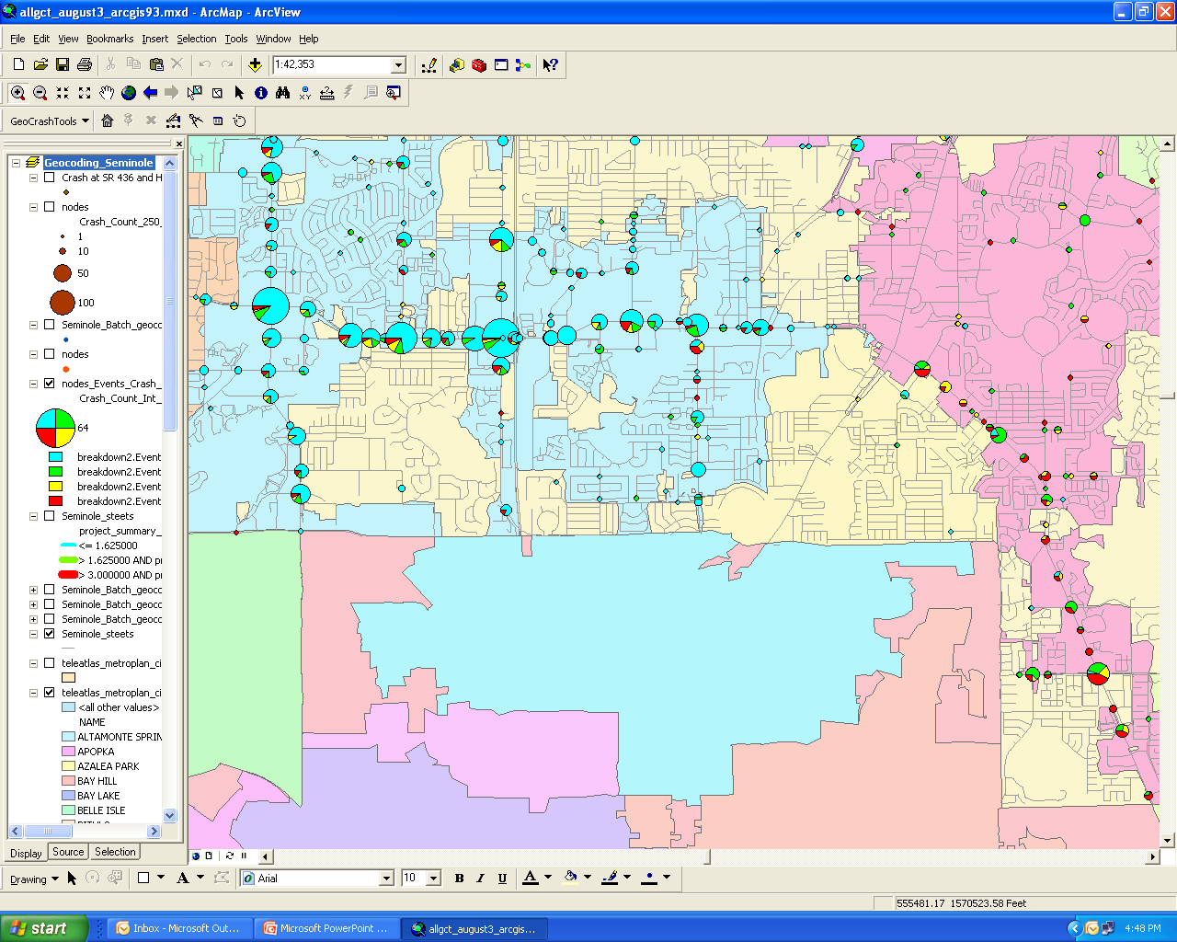
Planning Process: Performance Measures
Daily congestion level
Percent of speed limit
Bicycle/pedestrian user satisfaction
Transit ridership
High crash locations
Crash rate
Incident severity

Slide 22
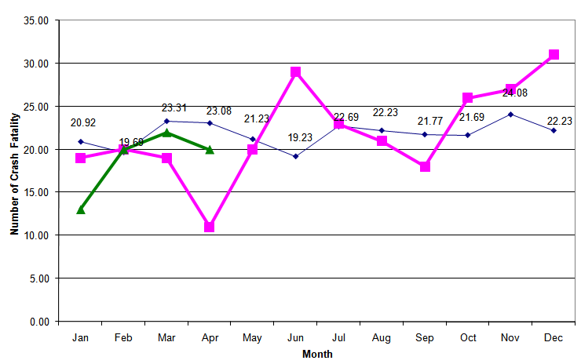
Planning Process: Collect Data
Current activities:
Tracking the Trends
Travel time and delay
Transportation survey
Upcoming activities:
Constrained Roadways
Regional Crash Database
Safety studies

Slide 23
Planning Process: Evaluate Alternatives
Transportation demand management
Traffic operational improvements
Bicycle/pedestrian connections
Transit
Technology

Slide 24
Planning Process: Select Projects
Rank and prioritize strategies:
Consider cost, funding, benefits
Don’t just move a bottleneck
Coordinate improvements

Slide 25
Planning Process: Monitor Improvement
Report on performance measures
New data collection and evaluation strategies

Slide 26
Additional Considerations
Champion(s)
“Low hanging fruit”
ITS Architecture
Partners
Notes:
26
There are four major elements for the Regional Crash Database System; the crash database itself, GIS map display, data analysis tool, and the reporting module.
The consultant, Professor Bejleri from University of Florida, is currently working on bringing the data from DHSMV and PRIDE into the system and modifying the analysis tools for our area.
(He is also testing to make sure the data importing process is sound
and verifying the location information, such as creating street name alias table, and intersection and address matching )
We are waiting for DHSMV to sign the MOU in order to provide us with 2004-2006 data and data for 2008 and beyond (Long-Form and FHP Short-Form)
We have budgeted $21,800 to obtain PRIDE data from 2008-07 to 2009-04 (non-FHP Short-Form)
After the completion of this project, which is at the end of this year, we will compare our database with the ones that local agencies have, to make sure the data matches with each other, and
we should be able to provide accurate crash data and crash analysis for the local agencies upon their requests
Our objective is to maintain a 5-yr complete set of crash data for the 3-county area, for both Long and Short Form crashes
The following slides will show some of the functionality of the database and the analysis tool:

Slide 27


