Slide 1
Briefing on Management, Operations, and Technology Planning Activities at the National Capital Region Transportation Planning Board
Andrew J. Meese, AICP
National Capital Region Transportation Planning Board
Metropolitan Washington Council of Governments
AMPO Operations Work Group
Boston, Massachusetts
July 26, 2010

Slide 2
Today’s Presentation
Management, Operations, and Intelligent Transportation Systems (MOITS) – our MPO operations committee
Metropolitan Area Transportation Operations Coordination (MATOC ) Program
Congestion Management Process

Slide 3
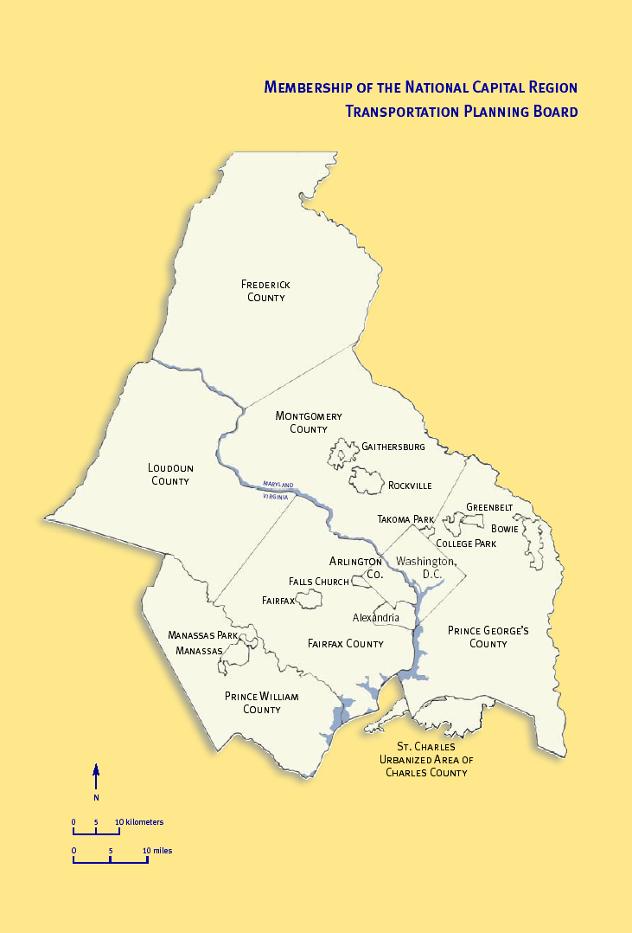
TPB
The TPB is the National Capital Region Transportation Planning Board
A separate board, housed at the Metropolitan Washington Council of Governments (COG)
The TPB is the officially designated MPO for Washington, D.C., Suburban Maryland, and Northern Virginia
TPB members include representatives of local governments; state transportation agencies; state and District of Columbia legislatures; and the Washington Metropolitan Area Transit Authority (WMATA)
Notes:
-

Slide 4
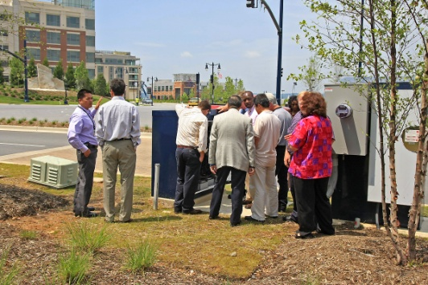
MOITS
MPO committee structure includes two “Management, Operations, and Intelligent Transportation Systems (MOITS)” committees
  Board-level Policy Task Force
  Staff-level MOITS Technical Subcommittee
    Regional ITS Architecture Subcommittee
    Traffic Signals Subcommittee
    Other Subcommittees (currently inactive)
The core mission of the MOITS committees is to advise the TPB on transportation management, operations, and technology
  And to serve as a forum for information exchange on these topics among members

Slide 5
History of MOITS
Began in January 1997 as the ITS Task Force
1999: Expanded into Policy and Technical Task Forces
  Because of budgetary discussions with policy implications (earmark funding)
2001 (pre-9/11): Added management and operations focus
2001-2006: Post-9/11 emergency planning focus
  Met jointly with or in lieu of a separate emergency transportation committee (RESF-1)
2006: Separate RESF-1 committee was permanently established
2007: MOITS Technical Task Force became a standing subcommittee of the TPB
2008: Official formation of the “MATOC Program” independent of MOITS – real-time regional coordination

Slide 6

Finding a New Direction for MOITS
MOITS spent most of the 2000’s focusing on post-9/11 emergency transportation planning activities, or on planning for the establishment of MATOC
By 2009, separate emergency transportation (RESF-1) and real-time operations coordination (MATOC) entities were firmly established
It was time to (re)examine the direction of MOITS – the M&O planning function under the MPO
The MOITS Technical Subcommittee recommended development of a strategic plan for MOITS

Slide 7
Overview of the MOITS Strategic Plan
The Strategic Plan for the MOITS Planning Program was developed over the August 2009 – June 2010 time frame by a consultant team and TPB staff
Officially approved by the TPB on June 16, 2010
Main desired outcomes of the strategic plan were to guide upcoming MOITS activities, and provide a list of potential regional projects for future funding opportunities
Strong interest expressed by the TPB’s 2010 Chairman, David Snyder

Slide 8
Some Notable Aspects of the MOITS Strategic Plan
Strategic plan developed within the parameters of the already-existing TPB “Vision”
  Vision, goals, objectives, and strategies were already set for us by our Board officials
Committee desire to identify specific regional projects, to be ready for funding opportunities
These led us to develop a relatively detailed technical document
We considered how strategic planning done by an MPO/ multi-agency planning committee differs from what would be done by a private company or “implementing” agency

Slide 9
Building from the TPB Vision
Two goals from the TPB Vision (1998), along with their associated objectives and strategies, were the key goals for MOITS
  Management, performance, maintenance, and safety (Goal 3)
  Technology to maximize system effectiveness (Goal 4)
The MOITS Strategic Plan builds upon the TPB Vision by identifying four additional “tactical actions”
  Provide regional situational awareness of transportation system conditions
  Regionally coordinate operating procedures
  Inform travelers’ decision-making
  Integrate systems and processes

Slide 10
Features of the MOITS Strategic Plan
Emphasis Areas
  Technical topics that are in the MOITS purview and lend themselves to a regional-level focus
Best Practices
  Anticipated to be especially effective in achieving desired outcomes
Performance Measures
  Metrics to assess MOITS impacts
How MOITS-Related Activities Will Directly Benefit the Public
  In addition to agency/systems efficiencies
Proposed Projects and Strategic Efforts
  A list of priority regional-level projects or activities, and estimates of funding needed
Key Recommendations
  Guiding the future activities of the MOITS program

Slide 11
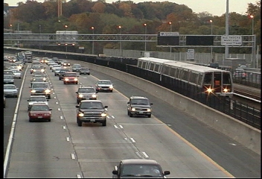
Emphasis Areas Identified in the MOITS Strategic Plan
Systems engineering-based topics in the MOITS purview
  ITS Data Warehouse
  Multi-modal Coordination
  Transit Signal Priority
  Interactive Traveler Information
  Transportation Operations Data Sharing
  HOV Lane Management
  Regional Traffic Management
  Regional Parking Management
  Maintenance and Construction Activity Coordination
Other topics are being addressed in venues/committees that convene the necessary stakeholders, in close coordination with MOITS

Slide 12
Best Practices
The Strategic Plan identifies a number of recommended “best practices”
  Defined as a process or activity anticipated to be especially effective in achieving a desired outcome
Best practices are structured as recommended general actions for the region or for individual agencies/jurisdictions
The plan’s proposed projects build in part off of the best practices
The MOITS Technical Subcommittee serves as a continuing forum for identifying and promoting best practices

Slide 13

How MOITS-Related Activities Directly Benefit the Public
Safety: reduce the chances of secondary incidents in traffic backups through MATOC and other traffic management programs
Reduced delays: through efficient operations/ reduced duration of incidents
Better availability of information: through better data via the sources the public knows and relies upon, such as radio traffic reports, web sites, and smart phone apps
Better quality of information: questions such as whether to travel, when to start, what mode to take, and what route to take depend rely upon good information about the status of the transportation system
Better responsiveness of transportation systems to traveler needs: agencies can better prepare for and provide services that meet needs, such as where and when congestion and traffic incidents occur, or when traffic or transit demands are highest
Increased travel options: technologies and associated operations and management activities enable the public to have more options for travel, such as HOT lanes or priority transit services – get the most out of the existing infrastructure

Slide 14
Proposed Projects and Strategic Efforts – Unfunded
Sustain MATOC/RITIS
Upgrade RITIS regional ITS data warehouse capabilities
Enhance RITIS data sharing capabilities
Support 3rd party development of trip planning “apps”
Deploy integrated corridor management technologies (pilot)
Deploy park-and-ride parking availability information (pilot)
Develop special event traffic management plans
Develop a regional managed lane facilities (HOV, HOT, ETL) coordination process (e.g. annual summit meetings)
Develop a venue and process for coordinating maintenance and construction schedules (e.g., semi-annual meetings)
Develop a venue and process for interjurisdictional signal timing coordination

Slide 15
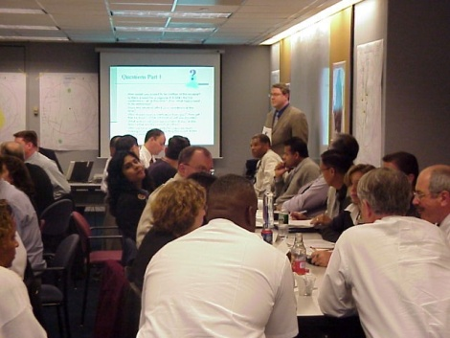
Key Recommendations Identified in the MOITS Strategic Plan
Continue MOITS roles in advising the TPB and regional information exchange
Strengthen coordination among MOITS, MATOC, RESF-1, and WMATA
Strengthen focus on the tactical actions (situational awareness, operating procedures, informing travelers, and systems interoperability) identified in the strategic plan
Strengthen MOITS role in developing regional project proposals
Encourage best practices
Strengthen understanding of MOITS performance measurement and benefit-cost analysis
Inform decision makers on the recommendations of the MOITS Strategic Plan, and encourage funding of recommended projects

Slide 16

Strategic Plan Outlook
The MOITS Strategic Plan is serving as a major guide for upcoming MOITS activities, and as a source for prioritized project proposals as funding opportunities arise
www.mwcog.org/transportation/committee/committee/documents.asp?COMMITTEE_ID=46

Slide 17

Metropolitan Area Transportation Operations Coordination (MATOC) Program Background
Joint program of the District of Columbia, Maryland, and Virginia departments of transportation (DDOT, MDOT, and VDOT) and the Washington Metropolitan Area Transit Authority (WMATA)
Established in 2008
Mission – provide real-time situational awareness of transportation operations/incidents in the National Capital Region
Activities –
  Communicate consistent and reliable information that enables operating agencies and the traveling public to make effective and timely decisions
  Develop and maintain tools and processes needed to facilitate coordinated operating agency responses
    Operate and share information the automated Regional Integrated Transportation Information System (RITIS)
    Complement RITIS information with targeted notifications and coordination activities by a designated MATOC facilitator and support staff

Slide 18
Metropolitan Area Transportation Operations Coordination (MATOC) Program Status
Establishment was funded by a SAFETEA-LU earmark
  Coming to an end September 30, 2010
Efforts to establish ongoing support for MATOC with other funding
  Partial funding has been pledged for FY 2011; the program will continue for now
Transitioning to a “permanent” home at the University of Maryland Center for Advanced Transportation Technology

Slide 19
Congestion Management Process
Three-pronged approach
  CMP component of long-range plan
  Project-level CMP information in TIP
  CMP Technical Report
New 2010 Congestion Management Process Technical Report
  Final draft now awaiting approval
  Features our first-ever analysis of the I-95 Corridor Coalition INRIX real-time speed data archive
  www.mwcog.org/transportation/committee/committee/documents.asp?COMMITTEE_ID=46

Slide 20
I-95 Corridor Coalition Vehicle Probe Project Data Analysis at TPB – Uses
Congestion Management Process (CMP)
Speed validation in travel forecasting models
Speed distribution for air quality modeling

Slide 21
Getting the I-95 Corridor Coalition/ INRIX Probe Data
Signed Data Use Agreement
Downloaded archived data (5-minute increments) through the I-95 Traffic Monitoring website
Data processing
  Converted text file to SAS® dataset
  Calculated the four performance measures
  File size: 7+ GB, 100+ million records in a year for the region
  Computing time and resource: several hours with Intel® Xeon™ 3.20GHz CPU, 2GB RAM
Visualization
  Used Navteq®-provided translation table to match INRIX Traffic Message Channel (TMC)–coded data to our Navteq® GIS network
  Created display maps that show directional data/performance measures
Processed data as needed for other applications (e.g. travel demand and air quality modeling)

Slide 22
Use of the Probe Data Archive in the CMP
Congestion monitoring and assessment
  Hours of congestion
  Travel time index
Travel time reliability analyses
  Planning time index
  Buffer time index
Cross-comparisons with other data sources (e.g., roadway aerial photography)
  Traffic congestion “snapshots” (e.g., impacts of a major traffic incident)

Slide 23
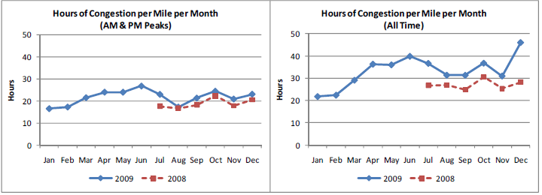
Hours of Congestion

Slide 24
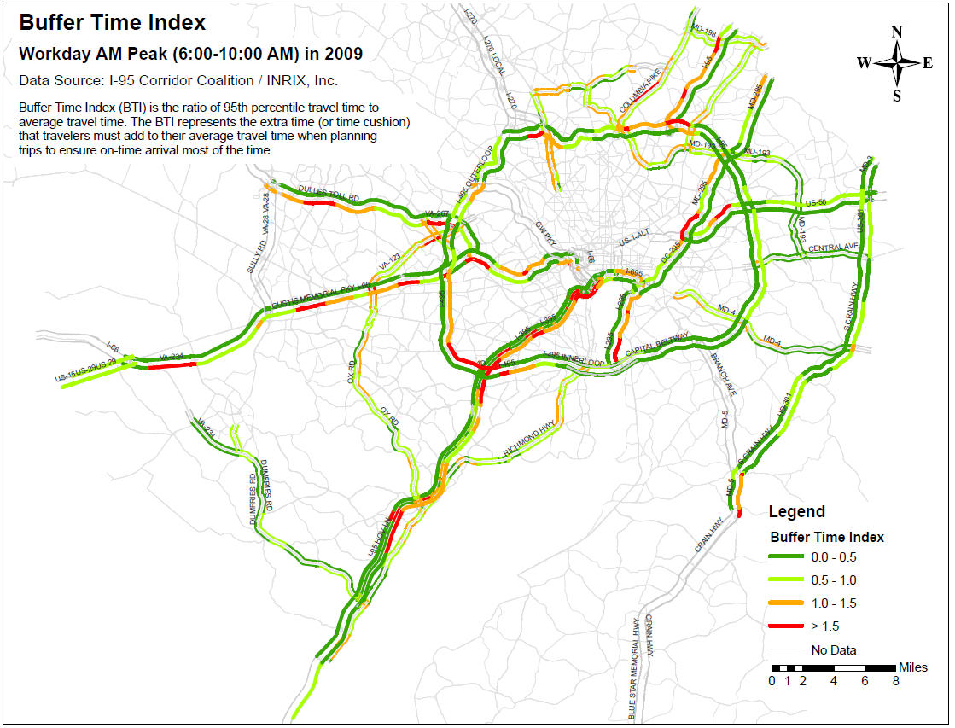
Buffer Time Index (Reliability)
Buffer time index = (95th percentile travel time – average travel time) / average flow travel time

Slide 25
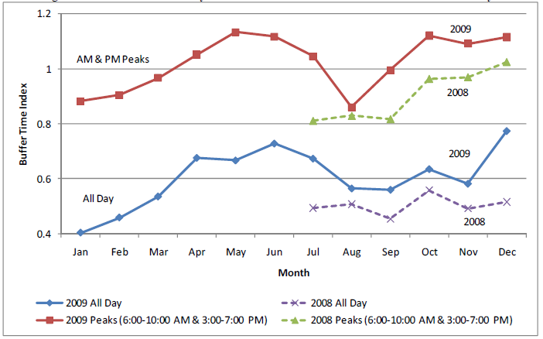
Monthly Variation of Buffer Time Index

Slide 26
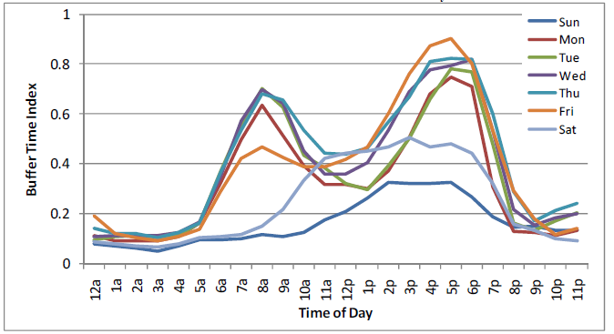
Time of Day and Day of Week Variation of Buffer Time Index

Slide 27
Two Additional Performance Measures
Travel time index
  Actual travel time / free flow travel time
Planning time index
  (95th percentile travel time – free flow travel time) / free flow travel time
Maps, monthly variation, and daily variation were also developed or analyzed

Slide 28
Congestion Impacts of the November 4 & 5, 2009 Montgomery County, Maryland Traffic Signal Malfunction

Slide 29
Speed Distribution for Air Quality Modeling (MOVES)

Slide 30
Advantages and Caveats of the Probe Data
Advantages
  Continuous monitoring (24/7/365)
  Probe-based speed data is superior to location-fixed detector speed data
  Geo-referenced (TMC-based)
  National comparability
Caveats
  No traffic volumes
  Technical details regarding data collection and processing remain unrevealed
    Issue of independent validation
  Currently limited coverage in the National Capital Region / purchase price for more coverage

Slide 31
Potential Future TPB Uses of Probe Data
Expanded coverage
  Beyond the current partial coverage
  Arterials
    Strong interest, few alternative data sources
    Supplement or supplant other data collection activities
Quarterly congestion snapshots
Time of day travel forecasting model development
Cross comparisons with other data sources (e.g., traffic.com, Skycomp, other probe data providers)
Special studies
Overall: I-95 CC Vehicle Probe Project has been beneficial to TPB activities

Slide 32
Questions?

