Slide 1
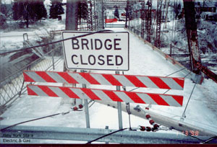
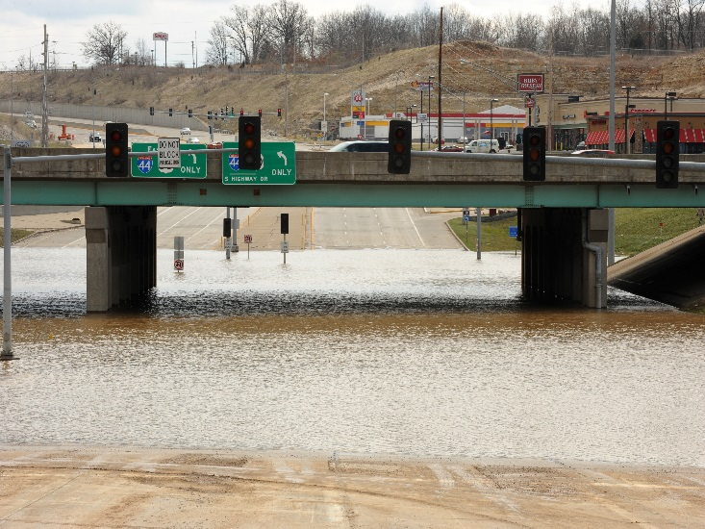
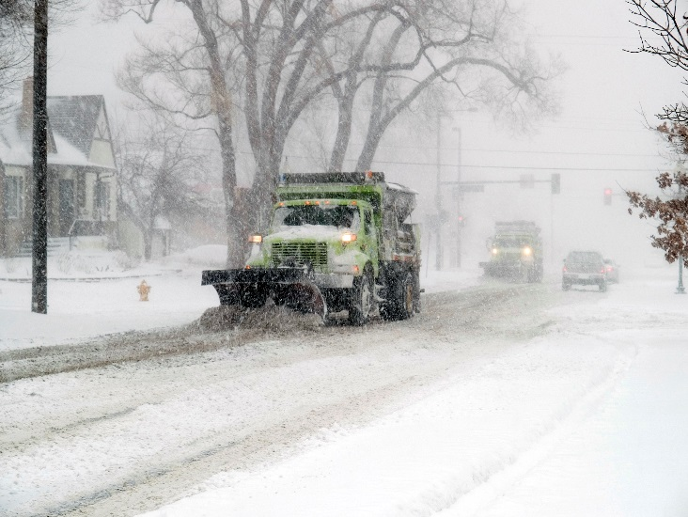
Assessing Transportation Asset Vulnerability to Hazard Impacts in the Genesee-Finger Lakes Region
FEMA News Photo
FEMA/Jocelyn Augustino
FEMA/Michael Rieger
Joseph M. Bovenzi, AICP Frederick A. Frank, LEED AP BD+C
AMPO Annual Conference – Savannah, Georgia
October 18, 2017

Slide 2
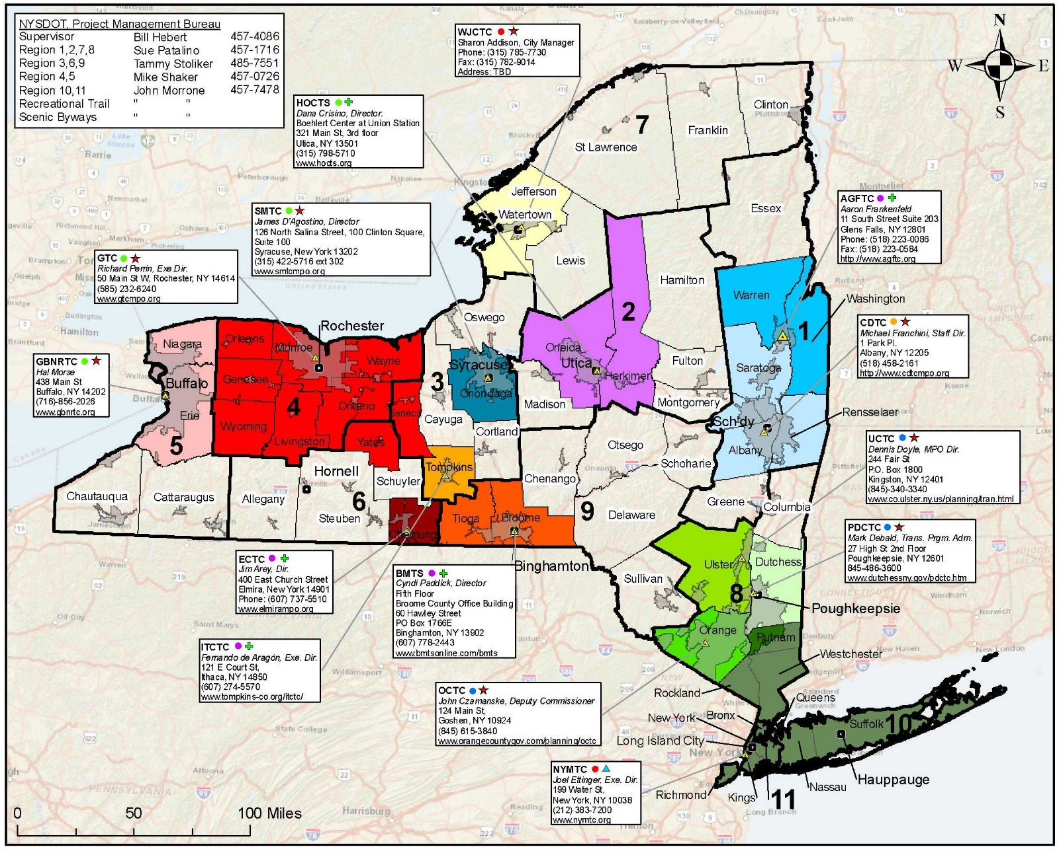
New York State Metropolitan Planning Organizations
GTC Planning Region
Source: New York State Association of Metropolitan Planning Organizations (NYSAMPO)
Notes:
Map of NYS showing the state’s 14 MPO planning areas (color coded). The GTC planning region is the large red block in the western part of the state, centered on Rochester.

Slide 3
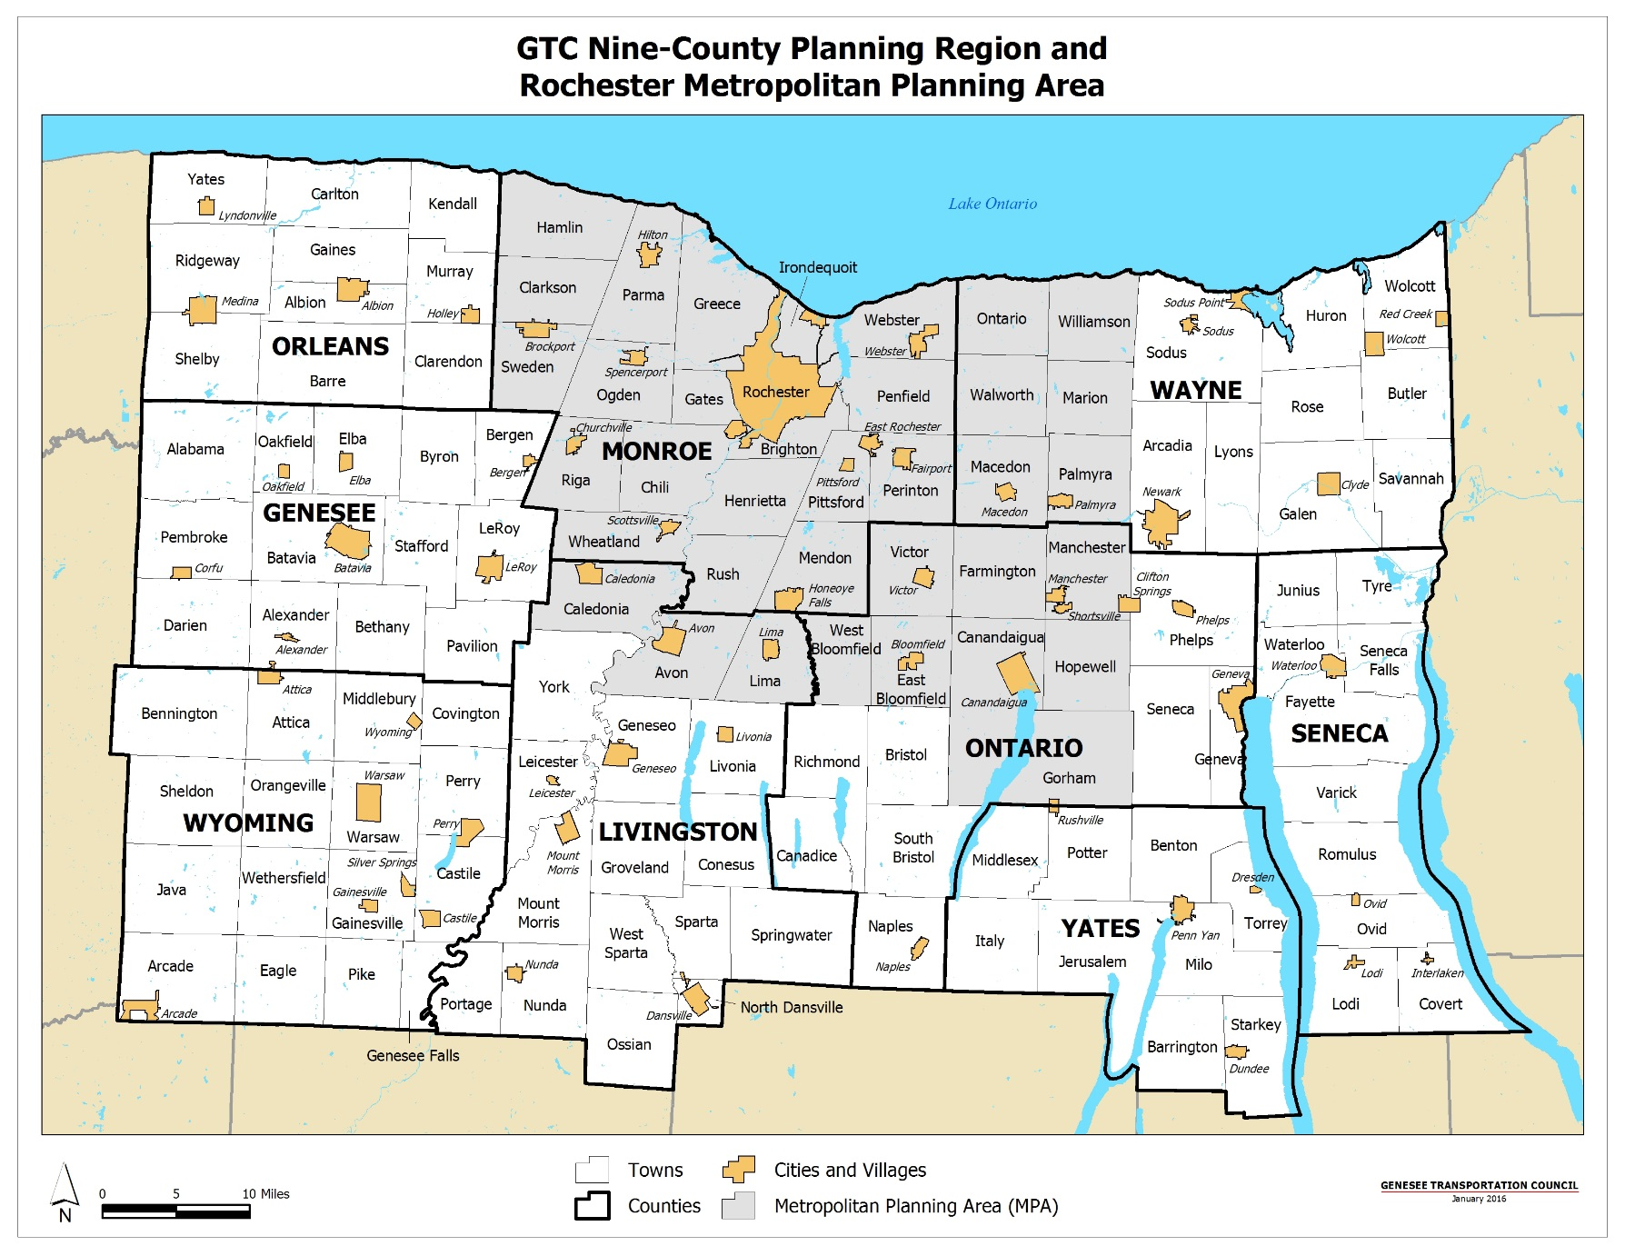
Notes:
Regional Profile:
Nine counties, 188 municipalities (4 cities, 125 towns, 59 villages)
Dark Yellow – Cities and Villages; Light Gray – Metropolitan Planning Area (MPA)
About 4,700 square miles
About 1.2 million residents
About 544,000 jobs
Manufacturing, agriculture, and food processing are primary industries
About 27,000 lane miles in total; about 7,300 lane miles (30%) are federal-aid eligible
About 1,600 highway bridges
Modest expected growth in population and employment
Diverse land use and development conditions – urban centers to rural areas
18 colleges and universities with enrollment about 88,0000 students
Numerous historic, cultural, and recreational resources (Erie Canal, 8 of 11 Finger Lakes)

Slide 4
Planning for Hazard/Climate Change Impacts
  Long Range Transportation Plan 2035
    Emerging Opportunities and Issues – The Impacts of Climate Change: Mitigation and Adaption
      Lessen the expected impacts of climate change on transportation infrastructure by reducing GHGs
      Evaluate the vulnerability of critical infrastructure to ensure hazard impacts are accounted for in design and operations
  Unified Planning Work Program
    Task Number 5750 – Genesee Finger Lakes Regional Critical Transportation Infrastructure Vulnerability Assessment
Notes:
The LRTP 2035 includes eight “Emerging Opportunities and Issues”, which are key planning considerations addressed by the LRTP. One of them is to factor the impacts of climate change into the transportation planning decision-making process by ensuring that the anticipated impacts of climate change, including increased occurrences of severe weather, are factored into asset design and operations. A vulnerability assessment project was developed for inclusion in the UPWP.
In the context of climate change, the term mitigation refers to efforts to cut or prevent the emission of greenhouse gases - limiting the magnitude of future warming. It may also encompass attempts to remove greenhouse gases from the atmosphere.
It differs from climate change adaptation, which refers to the actions taken to manage the unavoidable impacts of climate change

Slide 5
Study Purpose and Background
  Purpose
    Determine the vulnerability of critical transportation assets to natural and human-caused hazards
    Propose solutions for preventing and/or reducing hazard impacts on those assets
  Background
    No previous region-wide assessments
      Need to understand system vulnerabilities in addition to asset vulnerabilities
    Limited funds for transportation infrastructure projects
      Inform programming of scarce federal funds
Notes:
The project purpose was twofold:
Investigate asset vulnerability to hazards.
Identify potential solutions.

Slide 6
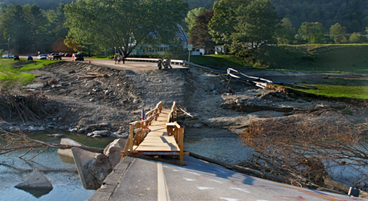
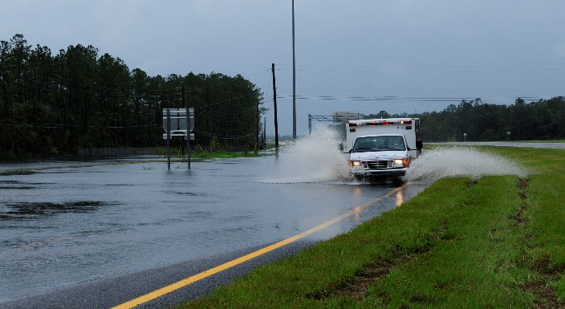
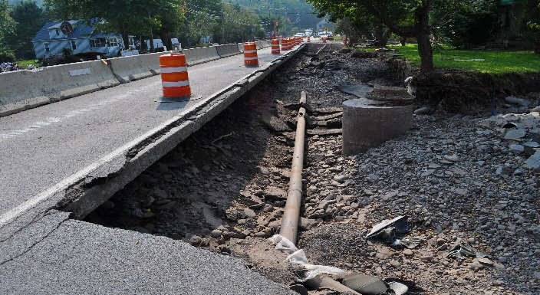
Study Purpose and Background (continued)
  Background
    Broad scope
      Includes infrastructure (roads, bridges, culverts) and facilities (operations centers, highway garages, fuel storage)
    Build on Climate Change adaptation initiatives
      Extreme weather events drive up operations, maintenance, and repair costs
FEMA/Angela Drexel
FEMA/Barry Bahler
FEMA/Elissa Jun

Slide 7
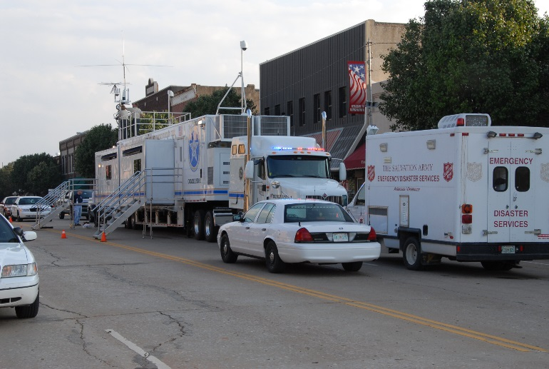
Participants
  New York State Department of Transportation
  New York State Thruway Authority
  New York State Police
  Rochester Genesee Regional Transportation Authority
  County and City of Rochester Agencies:
    Highway/Public Works
    Emergency Management
    Planning
    Law Enforcement
FEMA/Marvin Nauman
Notes:
List of all the agencies that participated in the project steering committee.

Slide 8
Critical Transportation Assets
  Assets which are essential to the functioning of a community’s transportation system
    Support Safety, Efficiency, and Reliability
  Four categories:
    Infrastructure – Roads, Bridges, Overpasses, Tunnels, Culverts
    Facilities – Operations Centers, Highway/Public Works Garages, Fuel Storage, Transit Garages, Police/Fire Stations
    Equipment – Traffic Signals, Signage, ITS Field Devices, Communications Network, Fleet Vehicles
    Personnel – Employees, Contractors, Vendors
Notes:
Asset: Broad definition; collectively, every item that makes up the transportation system.
There are four categories of transportation assets:
Infrastructure
Facilities
Equipment
Personnel

Slide 9
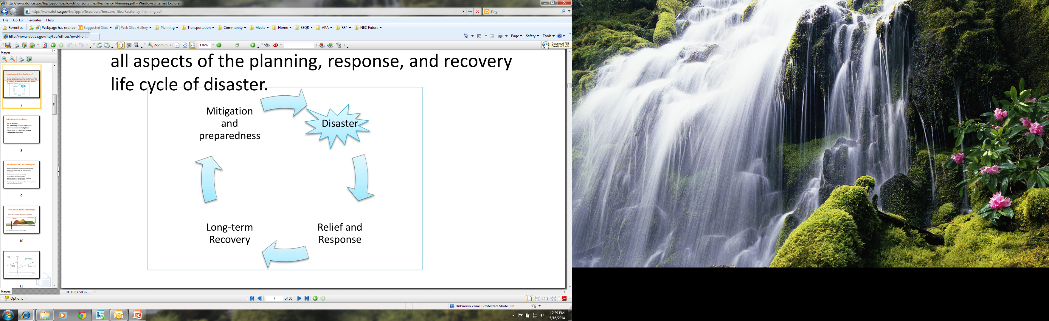
Resiliency
Ability to adapt to changing conditions and prepare for, withstand, and rapidly recover from disruption
Enhance assets to a “New Normal”
Notes:
DHS Risk Lexicon definition. Resiliency focuses on the adaptation process by preparing, withstanding, and recovering from hazard impacts.
A resiliency program should seek not merely to return a system or its components (assets) to the status quo, but enhance them to a “New Normal” – a higher baseline that makes them stronger and more resistant to hazards.
Scalability – a resiliency program can be applied to any geography (statewide, regional, county, municipal).

Slide 10
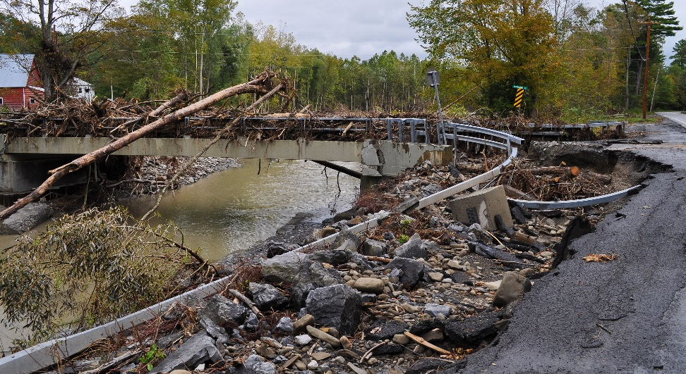
Vulnerability
  Physical feature or operational attribute that renders an asset open to deliberate harm or susceptible to a hazard
    Location
    Design
    Operation
    Vulnerability Assessment – Process of identifying system/asset vulnerabilities
FEMA/Elissa Jun
Notes:
DHS Risk Lexicon definition.
A vulnerability assessment is the process of identifying what those physical features or operations attributes are that makes an asset vulnerable.

Slide 11
Transportation Vulnerability Assessment Process
Identify a community’s or region’s critical transportation assets (Inventory Assets)
2. Identify the natural and human-caused hazards that can impact that critical assets (Hazard Extents)
3. Understand the consequences of hazard events on your transportation assets (Hazard Impacts)
4. Prioritize transportation assets that are most vulnerable to hazard events (Prioritize Assets)
5. Develop strategies to avoid or minimize impacts to vulnerable assets (Strategies)
Monroe County DOT
FEMA/Barry Bahler
Notes:
Summary of Vulnerability Assessment development process:
Step 1: Develop an inventory of regional assets;
Step 2: Identify hazard extents;
Step 3: Determine hazard impacts on assets;
Step 4: Prioritize assets most vulnerable to hazards;
Step 5: Develop strategies that minimize hazard impacts (loss, disruption, etc.).
This process is modeled on the FHWA Climate Change Vulnerability Assessment Pilots.

Slide 12
Inventory – Critical Transportation Infrastructure
Roads
Bridges
Culverts
Railroads
DPW Garages
Operations Centers
  Traffic
  Transit
Emergency Management Facilities
Hospitals
Police/Fire
National Guard
Notes:
This map of Wayne County shows the results of the inventory. All roads classified as arterials and collectors are shown. Bridges are shown, and height and/or weight limited bridges are identified. Railroads are also included. Facilities, such as public works/highway garages, operations centers, and emergency response facilities including police and fire stations. One unique site in Wayne County is the Ginna nuclear power plant, which presents a unique security concern.
Sources of information for the Inventory include existing plans and reports such as NYS and county hazard mitigation plans, GIS data, including NYS ORPS data which provided the “first cut” of the inventory, and stakeholder input through steering committee meetings.

Slide 13
Identify and Profile Hazards
Natural
  Floods
  Winter Weather
  Severe Storms
  Landslides
  Seismic Activity
  Sinkholes
  Extreme Temperatures
  Wildfire
Human-Caused
  Structural Failure
  Fire
  Hazardous Material Spills
  Roadway accidents
  Derailments
  Sabotage/Acts of Terrorism
Notes:
Hazards investigated for this planning process. These were based on the NYS All-Hazard Mitigation Plan and a review of the hazard mitigation plans for the nine counties in the planning region.

Slide 14
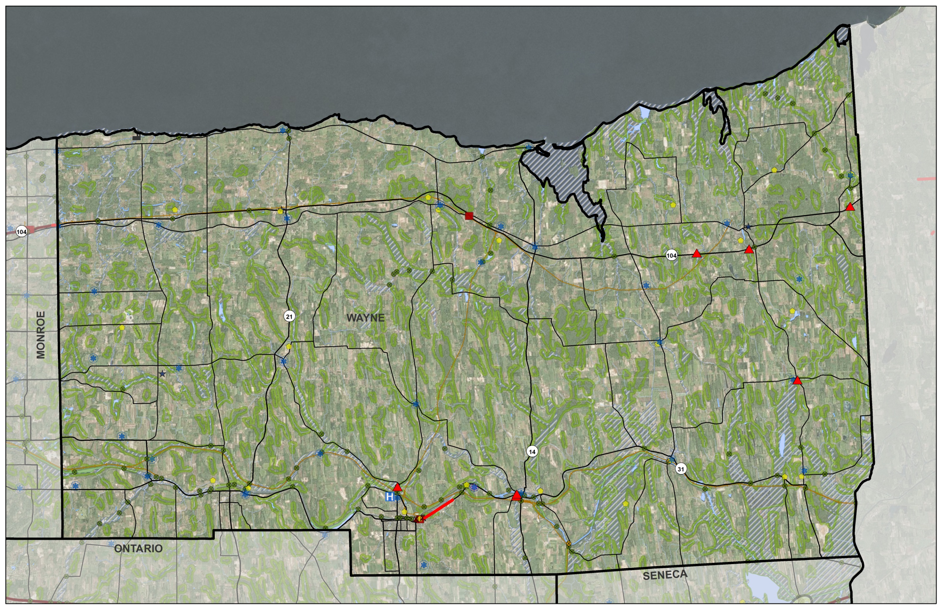
Wayne County: Asset Vulnerability
Notes:
This map of Wayne County shows the impacts of identified hazards on assets. Road sections, bridges (triangles) and assets (squares) highlighted in red are the most vulnerable assets to hazards like flooding.

Slide 15
When is a Transportation Asset Vulnerable?
Vulnerability
Sensitivity
Likelihood
Exposure
Consequence
Four Key Factors:
Sensitivity – Can the transportation system operate with this asset impacted?
Likelihood – What is the likelihood/ frequency of a hazard impacting the asset?
Exposure – Is the asset exposed to multiple hazards and for long durations of time?
Consequence – What is the severity of the hazard impact on the asset?
Notes:
There are four key factors in determining asset vulnerability:
Sensitivity (of the system) – Can the system function without a specific asset?
Likelihood – What is the likelihood of a hazard impacting the asset?
Exposure – How many hazards is the asset exposed to and how often?
Consequence – What is the impact of the hazard on the asset?

Slide 16
Vulnerability Assessment Scale
 | 1 | 2 | 3 | 4 | 5
 | Insignificant = 1 | Minor = 2 | Moderate = 3 | Major = 4 | Catastrophic = 5
Sensitivity | Partial closure, no detour needed | Partial closure, minor detour needed | Full closure but available detours | Full closure, few detours | Full closure, extensive detours, transportation system fails
Likelihood | Occurs once every 25 years | Occurs once every 10 years | Occurs once every 5 years | Occurs once per year | Occurs more than once per year
Exposure | Hazard duration less than 1 hour Very localized (partial impact of single asset) | Hazard duration a couple hours Localized (full impact of single asset) | Hazard duration 1 day Scattered (multiple assets impacted) | Hazard duration 2-3 days Widespread (all assets in a geography are impacted) | Hazard duration 3+ days Widespread impacts to all assets
Consequence | Delays or loss of operations/ use up to 30 minutes A few minor injuries Financial impact | Delays or loss of operations/ use up to one hour Some minor injuries | Loss of operations/ use up to two days Multiple injuries requiring hospitalization | Loss of operations up to 30 days Multiple severe injuries and/or a single fatality | Loss of operations/ use exceeding 30 days Multiple severe injuries and/or fatalities
Notes:
Five-point scale – ranging from Insignificant (1) to Catastrophic (5).

Slide 17
Vulnerability Assessment Scale
 | 1 | 2 | 3 | 4 | 5
 | Insignificant = 1 | Minor = 2 | Moderate = 3 | Major = 4 | Catastrophic = 5
Sensitivity | Partial closure, no detour needed | Partial closure, minor detour needed | Full closure but available detours | Full closure, few detours | Full closure, extensive detours, transportation system fails
Likelihood | Occurs once every 25 years | Occurs once every 10 years | Occurs once every 5 years | Occurs once per year | Occurs more than once per year
Exposure | Hazard duration less than 1 hour Very localized (partial impact of single asset) | Hazard duration a couple hours Localized (full impact of single asset) | Hazard duration 1 day Scattered (multiple assets impacted) | Hazard duration 2-3 days Widespread (all assets in a geography are impacted) | Hazard duration 3+ days Widespread impacts to all assets
Consequence | Delays or loss of operations/ use up to 30 minutes A few minor injuries Financial impact | Delays or loss of operations/ use up to one hour Some minor injuries | Loss of operations/ use up to two days Multiple injuries requiring hospitalization | Loss of operations up to 30 days Multiple severe injuries and/or a single fatality | Loss of operations/ use exceeding 30 days Multiple severe injuries and/or fatalities
2
3
4
3
Notes:
Each asset is scored based on where it falls along the five point scale for each of the four factors. In this example, the asset has a Sensitivity of 2, meaning that if it were closed or capacity was reduced, it would have a minor impact on the functionality of the overall transportation system. The likelihood is 3, meaning that a hazard is likely to occur once every five years.
In this example, the overall result is a vulnerability score of 12 out of a possible 20.

Slide 18
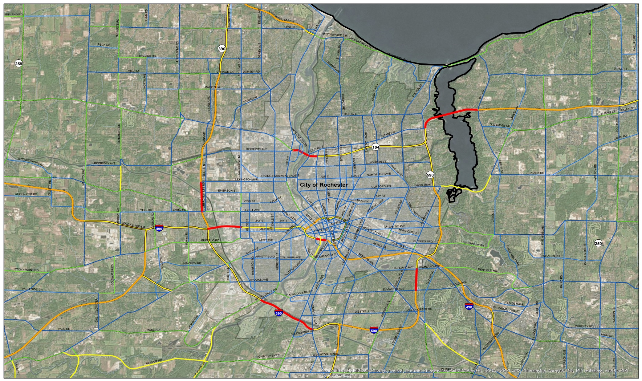
Example of Prioritized Road Segments
Notes:
Prioritized road segments in and around the City of Rochester. Example from report.

Slide 19
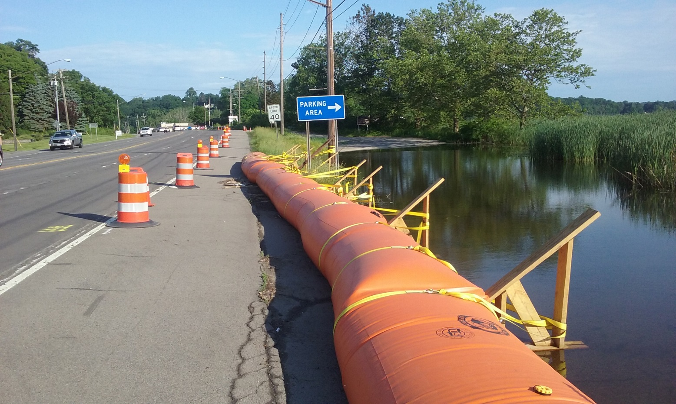
Empire Blvd. (NYS Route 404)
Notes:
Location: Empire Boulevard (NYS Route 404) at the south end of Irondequoit Bay.
Spring/early summer 2017: This road was in danger of flooding due to high water levels on Irondequoit Bay (same water level as Lake Ontario). NYSDOT deployed a “Tiger Dam” along a section of the road at the south end of the bay to protect the road from flooding. The temporary dam was filled with water.
The dam was installed on June 2, 2017. It is a good example of a low cost temporary solution to address the potential of flooding at a specific location.

Slide 20
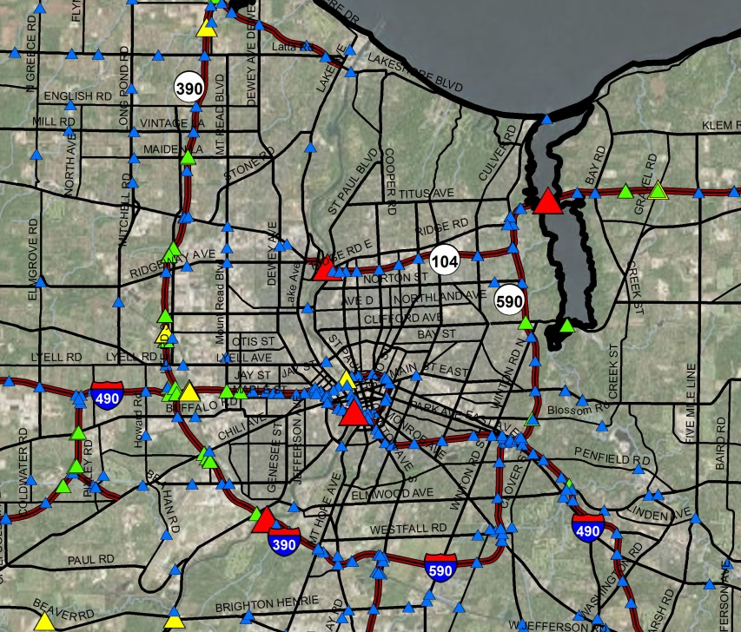
Example of Prioritized Bridges
Notes:
Prioritized bridge segments in and around the City of Rochester. Example from report.
Map showing facilities is similar (point features vs. line features).

Slide 21
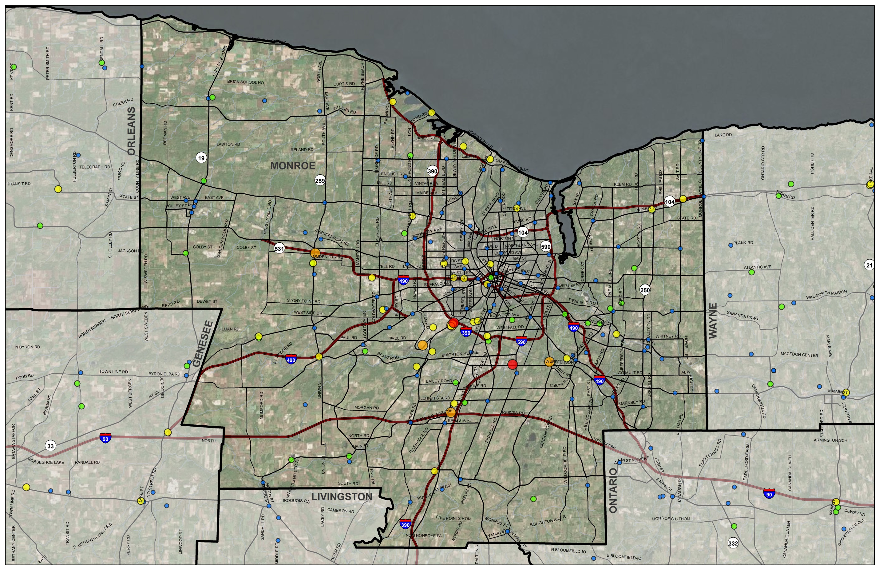
Example of Prioritized Facilities
Notes:
Prioritized facilities in and around the City of Rochester. Example from report; similar to bridge map as it depicts point features.
The two facilities ranked “High” are the Regional Traffic Operations Center (RTOC) and the NYSDOT-Region 4 HQ.

Slide 22
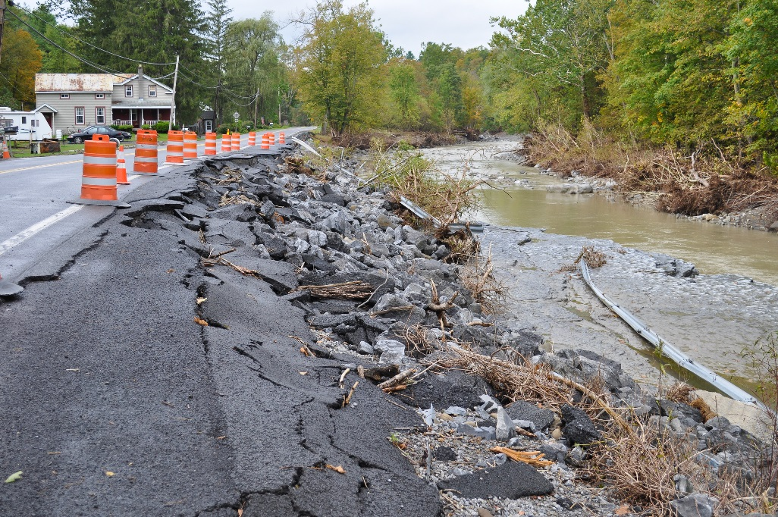
Hazard Mitigation Strategies
Five Categories:
  Planning and Policy
  Communication, Education, and Awareness
  Infrastructure and Construction
  Natural and Land Resource Protection
  Operations and Maintenance
FEMA/Elissa Jun
Notes:
Strategies organized into five Categories:
Planning and Policy (12)
Communication, Education, and Awareness (4)
Infrastructure and Construction (18)
Natural and Land Resource Protection (3)
Operations and Maintenance (2)
Emphasis is on Categories 1 & 3: Planning & Policy (1) and Infrastructure & Construction (3).
39 Recommendations in total

Slide 23
Planning and Policy Strategies
Interagency/inter-municipal coordination and resource sharing
Implement ITS/TSMO plan recommendations
  Communications
  Preparedness and Response
Incorporate flood mitigation strategies into agency and local planning efforts
Areas for additional investigation:
  Watershed planning
  Downstream hazard studies

Slide 24
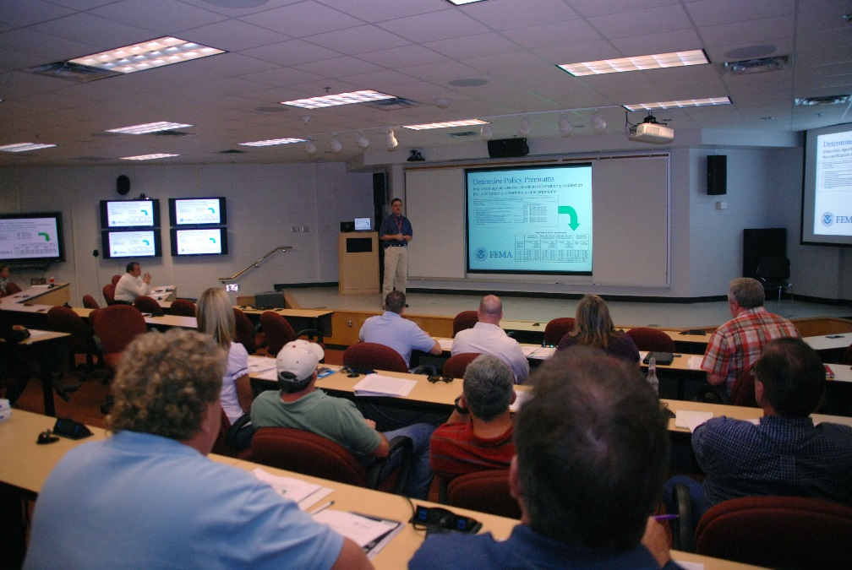
Communication and Education Strategies
Education and Awareness
  Training classes
  Public outreach
Improve flood risk assessment data
  Update and publicize flood maps
Publicize hazard mitigation techniques
FEMA/Jennifer Smits

Slide 25
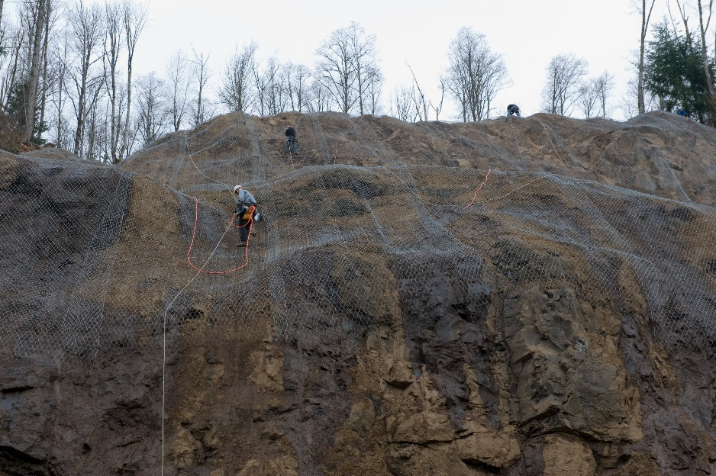
Infrastructure and Construction Strategies
Green infrastructure
  Rain gardens, permeable pavements, bioswales
Relocation and elevation of critical infrastructure
Improving stormwater drainage capacity and functionality
Slope stabilization
FEMA/Adam DuBrowa

Slide 26
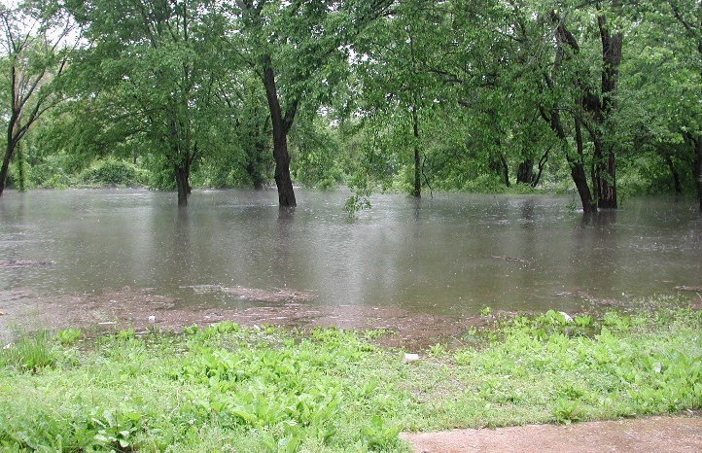
Natural/Land Resource Protection Strategies
Protect and restore natural floodplains
  Protect, enhance, and integrate natural landforms that mitigate flooding into transportation infrastructure
Create and preserve floodplain, open space, wetland, and spill areas
FEMA/Anita Westervelt
Notes:
Where possible, use the natural landscape to minimize disruption from hazard events. For example, a road running through a flood prone area could have culverts installed so that water on one side of the road will not rise up and overtop the road; rather it will be able to flow through the culverts and spread out on the surrounding land.

Slide 27
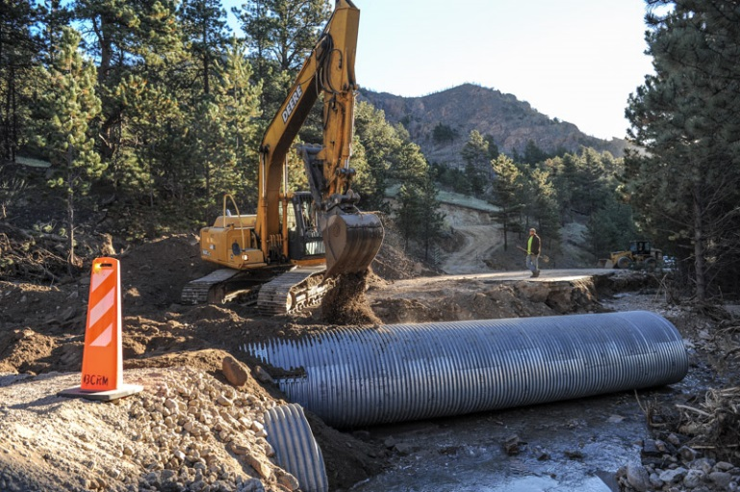
Operations and Maintenance Strategies
Maintenance of drainage systems and flood control structures
  Replace undersized culverts
Debris maintenance
Clear debris from drainage ditches, catch basins, culverts, etc.
FEMA/Michael Rieger

Slide 28
Lessons Learned
The planning process is as important as the final report because it develops partnerships and builds consensus to advance strategies
  Interagency and inter-municipal coordination and cooperation
Integrate vulnerability-related considerations into the transportation infrastructure investment decision-making process
Integrate Vulnerability Assessment findings into the local land use and policy decision-making process
Notes:
Key lessons learned:
Planning process is important
Integration of vulnerability-related considerations into the investment decision making process (TIP selection criteria)
Integration of vulnerability-related considerations into local land use and policy decision-making process

Slide 29
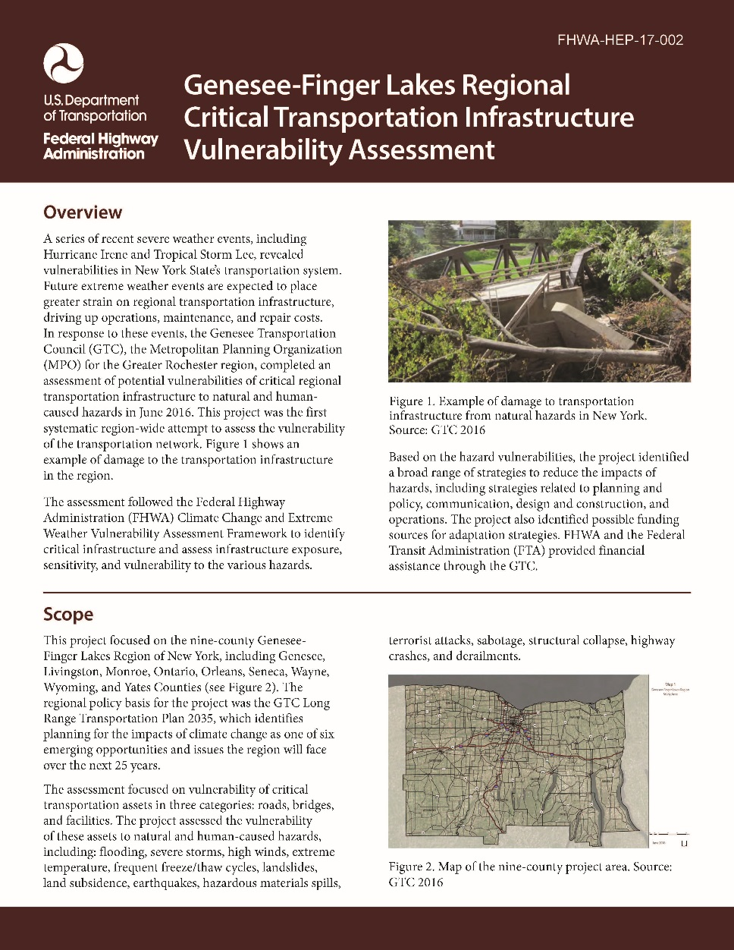
FHWA Case Study
GTC’s Vulnerability Assessment was featured as an FHWA case study on resiliency planning
Availability:
  FHWA Website
  Environment
    Sustainability
      Resilience
        Case Studies
Publication Number: FHWA-HEP-17-002
Notes:
GTC’s Vulnerability Assessment was featured in an FHWA publication (case study) on resilience research and implementation. A brief four-page report is available online on the FHWA website (posted May 1, 2017).
Publication Number: FHWA-HEP-17-002.

Slide 30
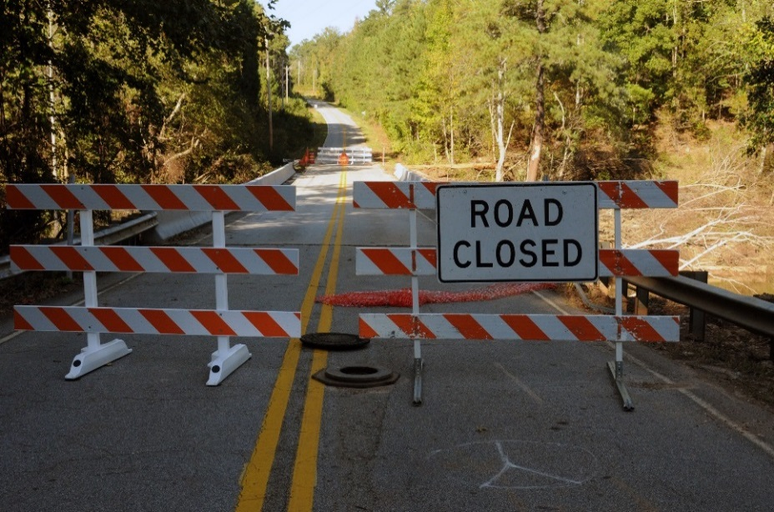
What’s Next?
Integrate findings into investment decision-making process
  Multi-year highway & bridge plan
  TIP
Develop Local Bridge Vulnerability Assessment
Regional Flood Model
  Better understand flood impacts
FEMA/George Armstrong
Notes:
One key action is to integrate the report’s findings into agency funding plans. The idea is to add an additional data point to help agencies make optimal decisions regarding transportation investments-a preventive maintenance project on a bridge might not make sense if it is not addressing a bridge’s broader hazard vulnerabilities.
GTC staff is proposing two follow-on projects in next year’s UPWP – a local bridge vulnerability assessment and a regional flood model. The local bridge assessment will give us additional information on local bridges, which were not analyzed as part of the regional vulnerability assessment, and the flood model will address the key challenge of not having good floodplain data, especially for areas outside Monroe County.

Slide 31


GENESEE TRANSPORTATION COUNCIL
50 West Main Street-Suite 8112
Rochester, NY 14614
www.gtcmpo.org
@gtcmpo
The Metropolitan Planning Organization for the Genesee-Finger Lakes Region
Notes:
Thank you – any questions?

