Slide 1


Mobility Performance Measures Program
2017 AMPO Annual Meeting

Slide 2
The ease with which people and goods move throughout the region.

Slide 3
Foundations
2000
2013

Slide 4
Performance Measures
Quantity
  Person miles
  Vehicle miles
  Truck miles
Quality
  Speed
  Delay
  Reliability
  Maneuverability
Accessibility
  Connectivity to intermodal facilities
  Employment proximity
Utilization
  % system severely congested
  % travel severely congested
  Vehicles per lane mile
  Duration of congestion

Slide 5
Corridor Analysis
Westbound

Slide 6
Evolution
2014-15
2015

Slide 7
Evolution
New measures and benchmarks in LRTP
Quantity
  Transit ridership
Safety
  Total crashes
  Fatal crashes
Livability
  Miles with bike and pedestrian accommodations
Utilization
  Transit load factor
  Lane-miles added
Economic impacts
  Cost of congestion
  Cost of crashes

Slide 8
Evolution
2018
2016-17

Slide 9
Evolution
New measures (2017)
Quantity
  Transit ridership
  Freight shipped (port)
  Enplanements (aviation)
Operations
  Response times
  Incidence clearance
FHWA Reliability (test)
  Level of travel-time reliability (LOTTR)
  Truck-time reliability (TTTR)

Slide 10
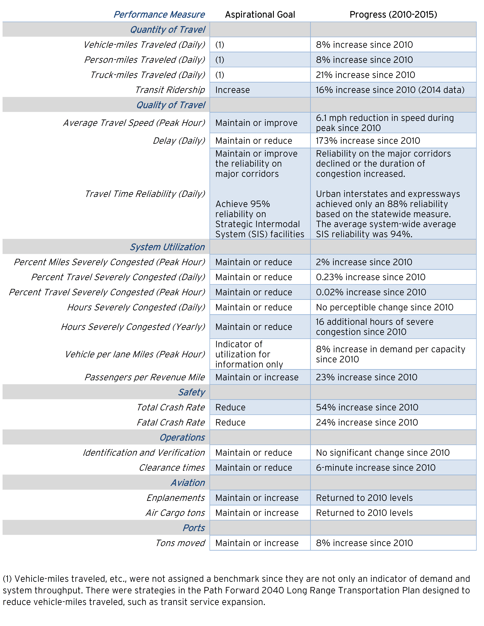
FHWA measures
LOTTR
TTTR
Resiliency (?)
Air-quality emissions
  New data sources
Probe vehicle data
2018

Slide 11
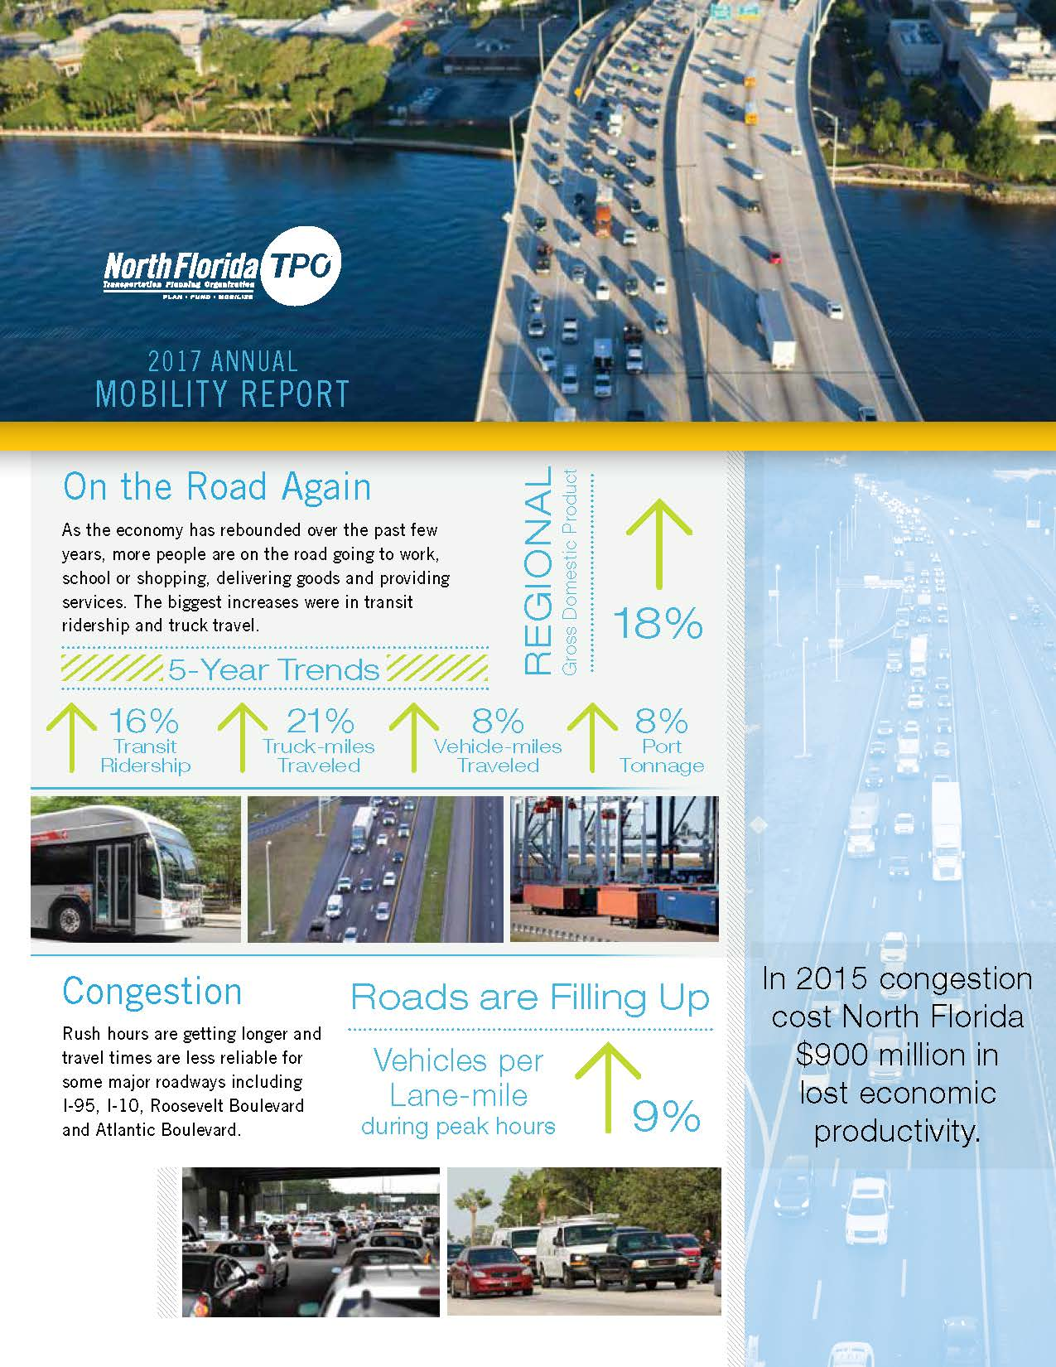
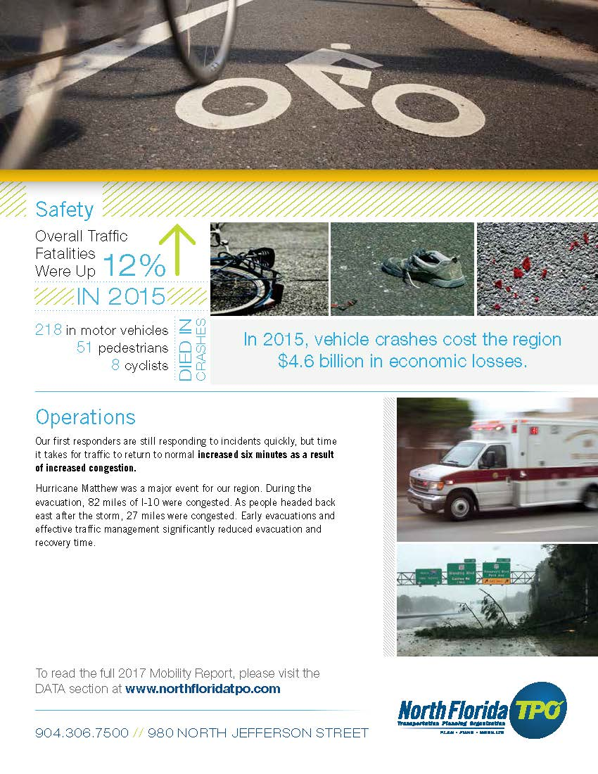
2017 Report

Slide 12
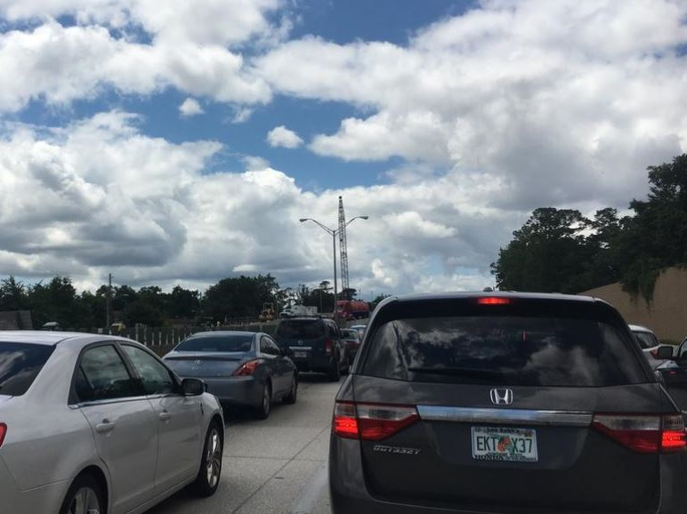
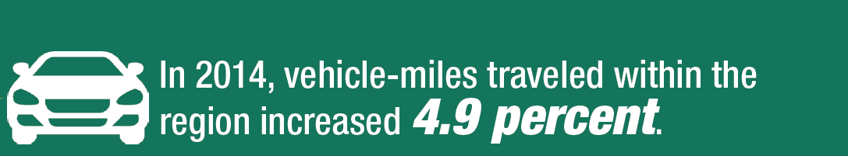
Vehicle-miles increased by 8%.

Slide 13


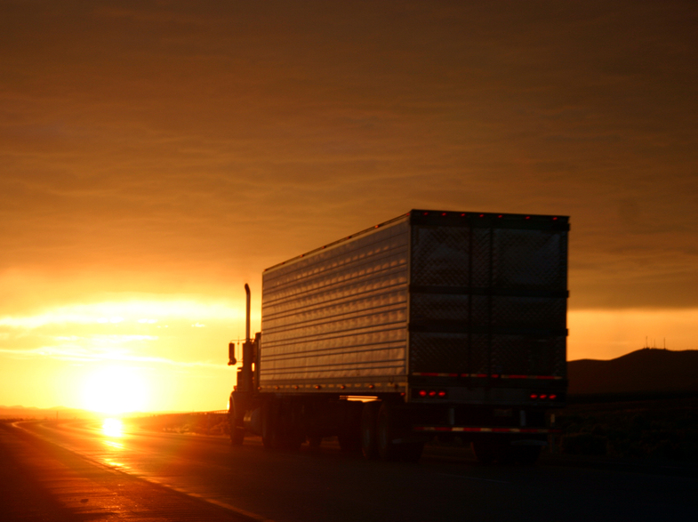
Truck-miles increased 21%.

Slide 14
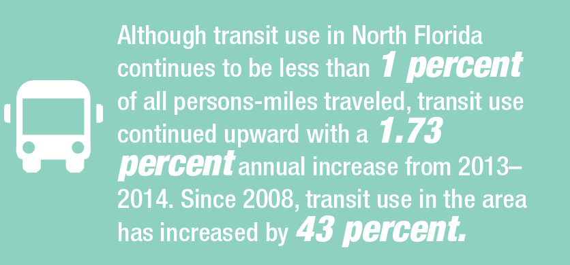
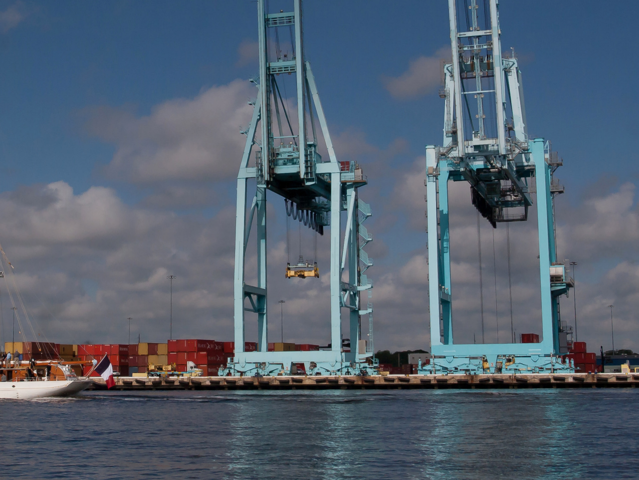
Port tonnage is up 8%.

Slide 15
Gross Regional Product and VMT
18% Increase in GRP

Slide 16
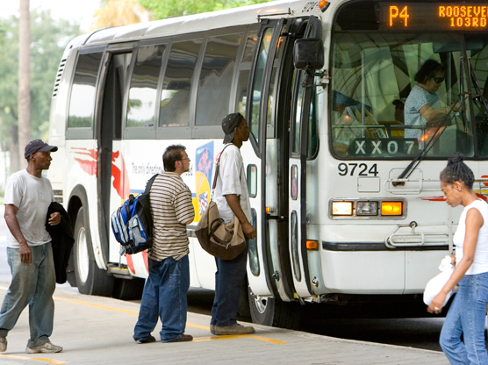
Transit ridership is up 16%
and 43% since 2008.

Slide 17

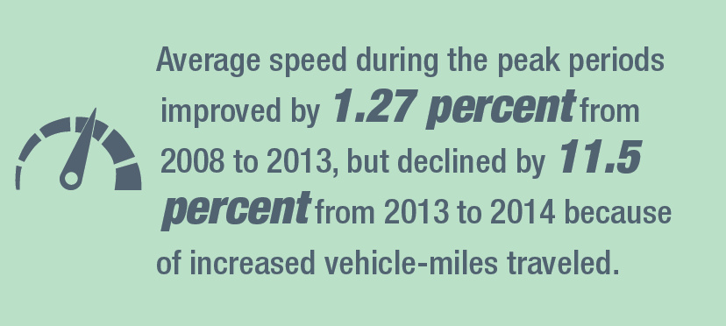
Delays increased by 11.5%.

Slide 18
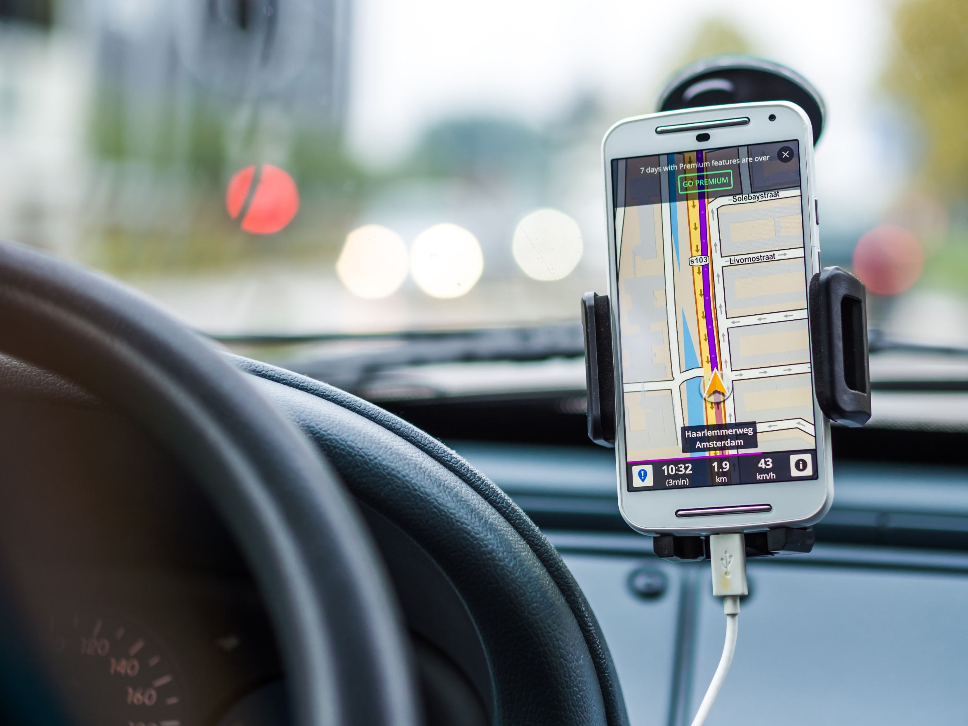

Corridor reliability
I have to be at work at 8 am. My trip usually takes about 20 minutes but I leave at 7:30 am to ensure I arrive on time.

Slide 19
Speed by time of day
Reliable speed = 45

Slide 20
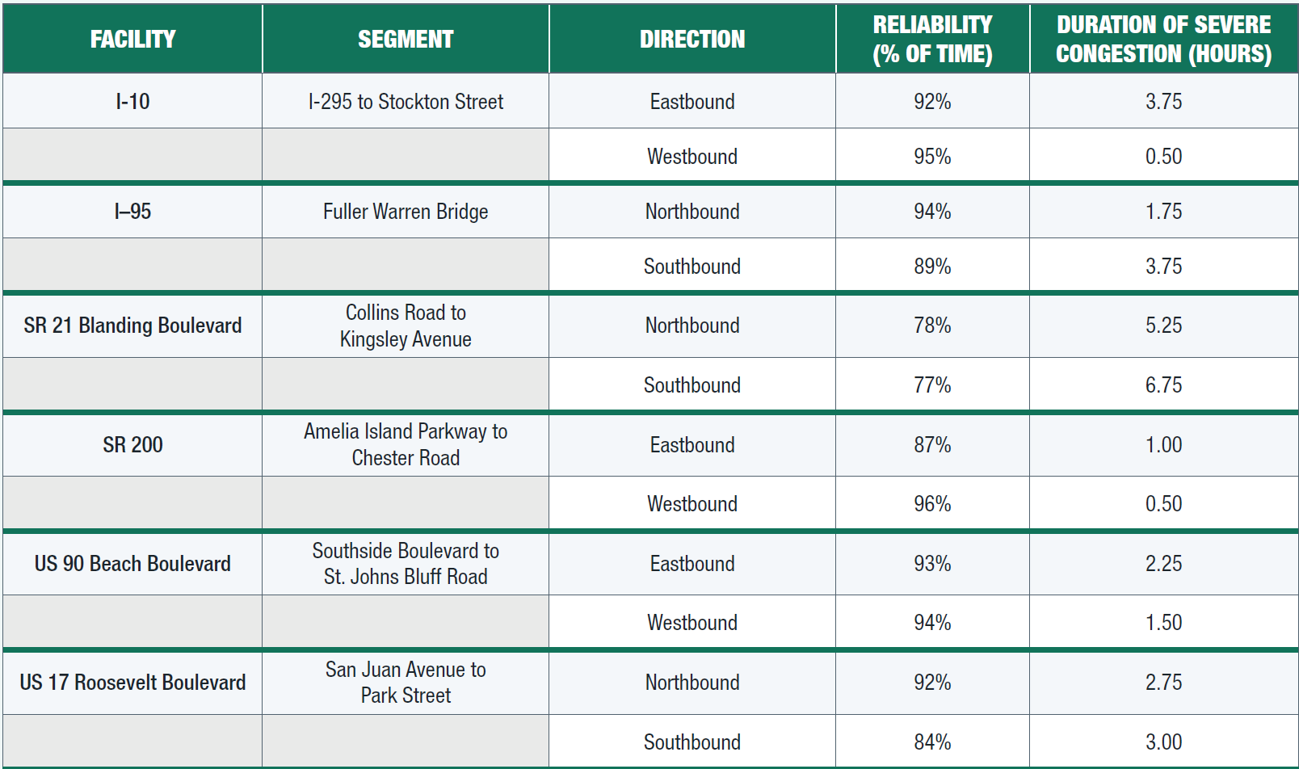
2015 Data

Slide 21
Measure | Peak 6-10 am
On-time reliability % travel at 45 mph > | 89%
LOTTR 80th-percentile = 952 (sec) median 253 | 3.76
TTTR 95th-percentile = 1,541 (sec) median 253 | 6.09
2016 Data

Slide 22
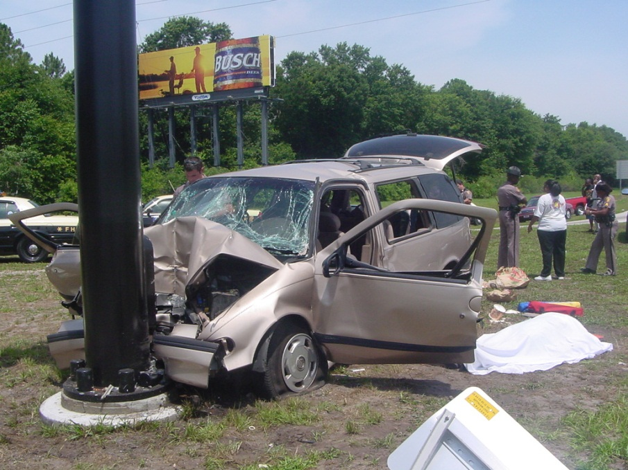
54% increase in crash rate
24% increase in fatal crashes

Slide 23
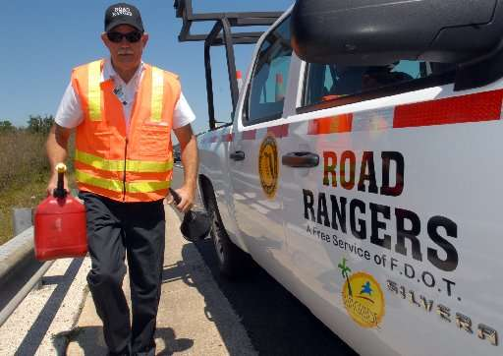
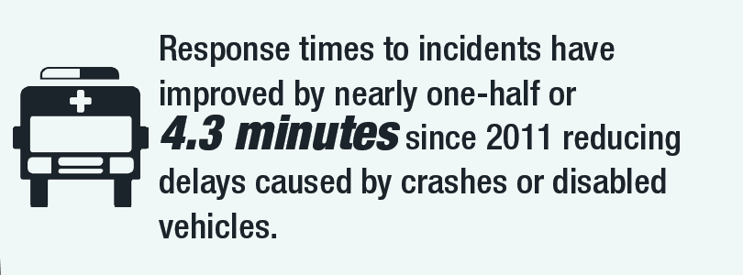
Clearance times longer by 6 minutes.

Slide 24
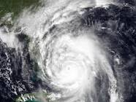
82 miles evacuation
27 miles recovery
Hurricane Matthew

Slide 25
Congestion
$900 million
Crashes
$3.7 billion

Slide 26
Challenges
Communicating
  Focus on few most important
  Report cards for technical
New Measures
  Prior years
Systems vs corridor reporting

Slide 27
Mobility is not an end in itself.
It is the means to form connections with our community through relationships, jobs and consuming the goods and services that define our quality of life.

