Slide 1
When Big Data Meets Better Data
APMO Conference, October 18, 2017
Keith Brockington, AICP, GPATS & Greenville County, SC
Allison Fluitt, PE AICP, Kimley-Horn and Associates

Slide 2
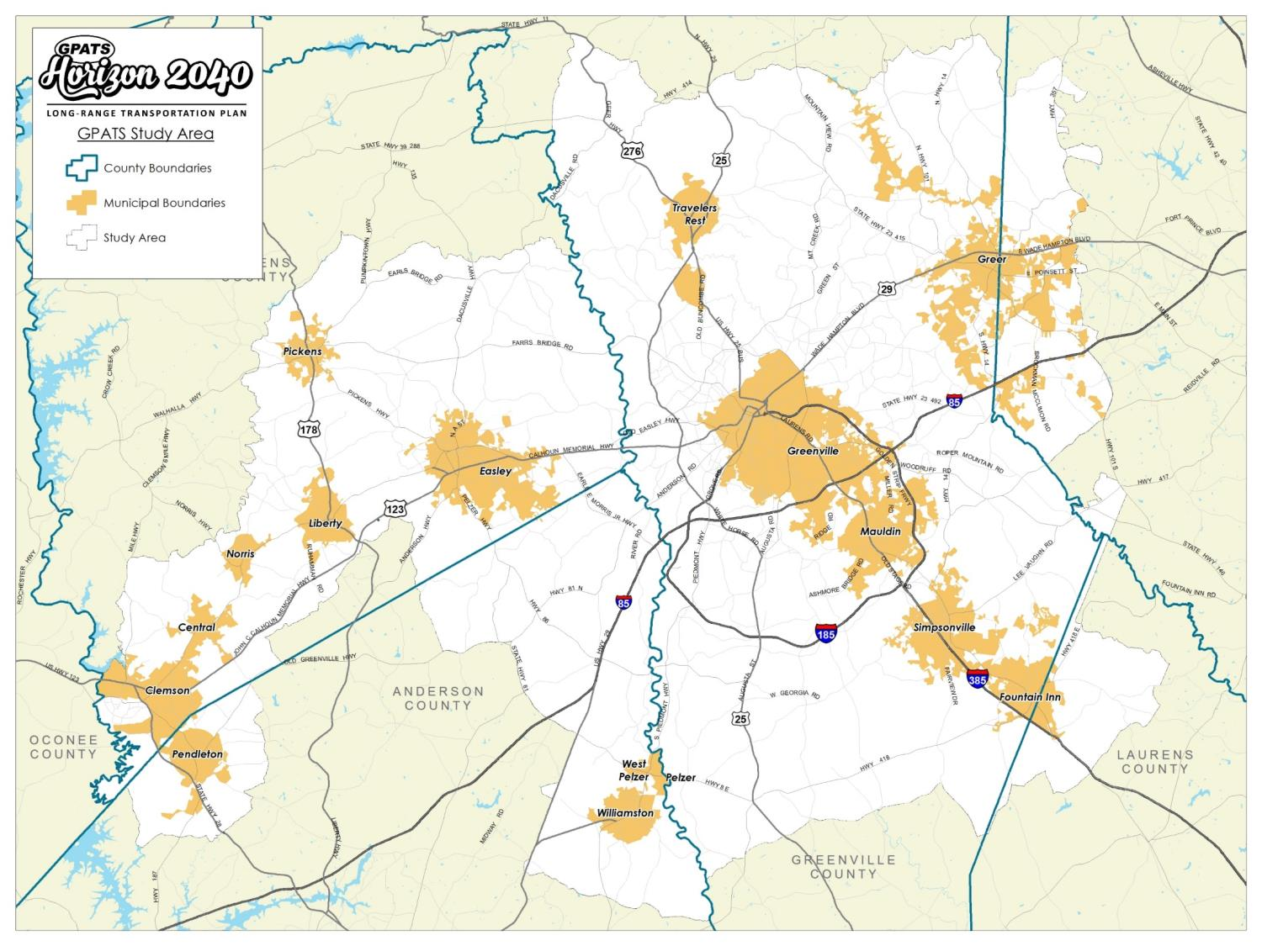
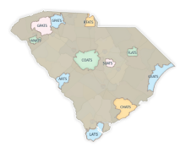
Study Area
Portions of Greenville, Pickens, Anderson, Laurens, and Spartanburg Counties
777 square miles
700,000+ population

Slide 3
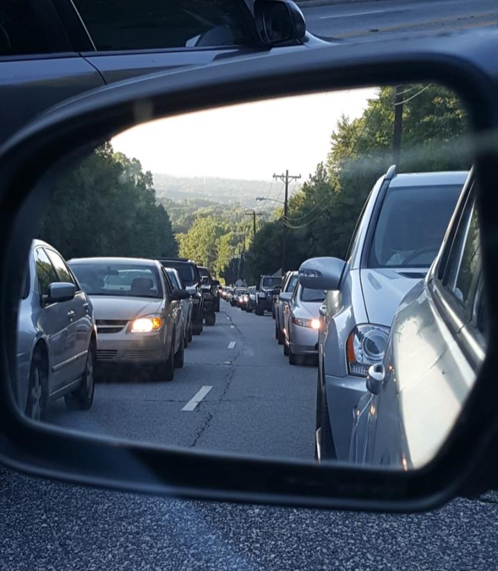
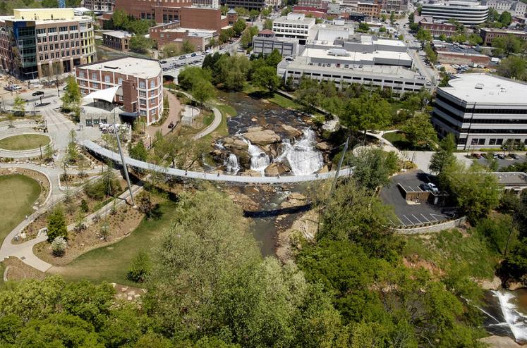
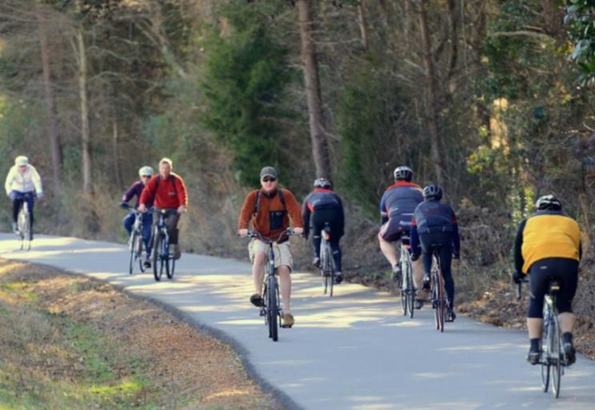
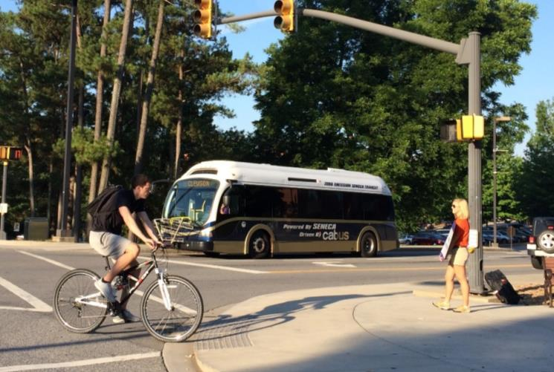
Horizon2040 Approach
Shifting Paradigms = Existential Crisis
Rapidly Urbanizing
National Recognition
Shifting Demographics
Aging and Tech-savvy
From Textiles to Educational/Healthcare/Technology Research
Modal Shifts
Desire for walkable communities
Shifts away from vehicle ownership
Transit needs for job/education/healthcare access
Strong focus from Technology sector for Automated R&D
Increasing Traffic Congestion

Slide 4
Horizon2040 Approach
Knowledge that Priorities have Shifted
VS. Historical Funding Priorities
South Carolina “Guideshare” (80% STBG, 20% State)
Approx. $18 million per year
New Roads
Widenings
Intersections
Recent years
Bike and Pedestrian facilities WITH Road Projects
Signal Timing
NO Dedicated Guideshare for Alternative Transportation
GPATS Needed to find out the actual Public Will.
MASSIVE Public Outreach Effort for Horizon2040

Slide 5
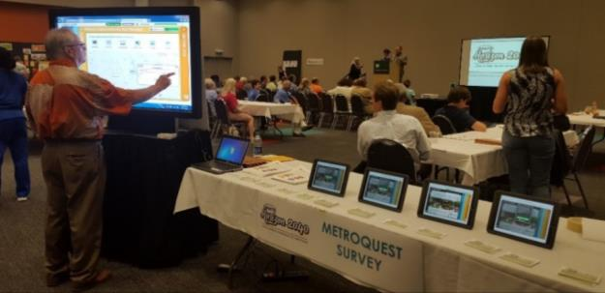
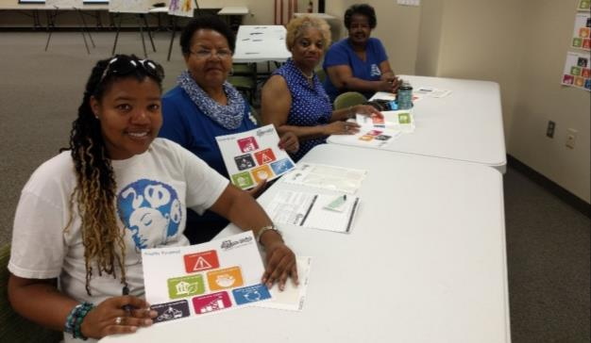
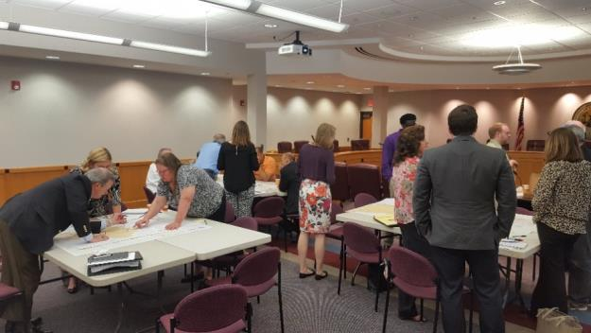
Public Outreach
Policy Committee Meetings
3 meetings (June 2016, April 2017, Aug 2017)
Regional Workshops
Visioning (Sept 2016)
Open House (Aug 2017)
Sub-Regional Community Meetings
Round 1 (8 meetings; Oct 2016)
Round 2 (9 meetings; May-June 2017)
Stakeholder and Small Group Interviews
25 meetings (January – April 2017)
Focus Group Work Sessions
3 sessions (March 2017)
Statistically-Valid Survey
525 households; 95% level of confidence
MetroQuest Survey
1,436 participants; 1,800 comments; 33,110 data points
www.GPATS.org
Social Media

Slide 6
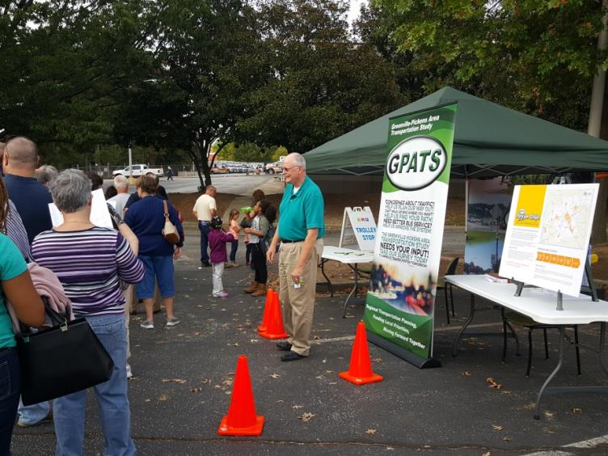
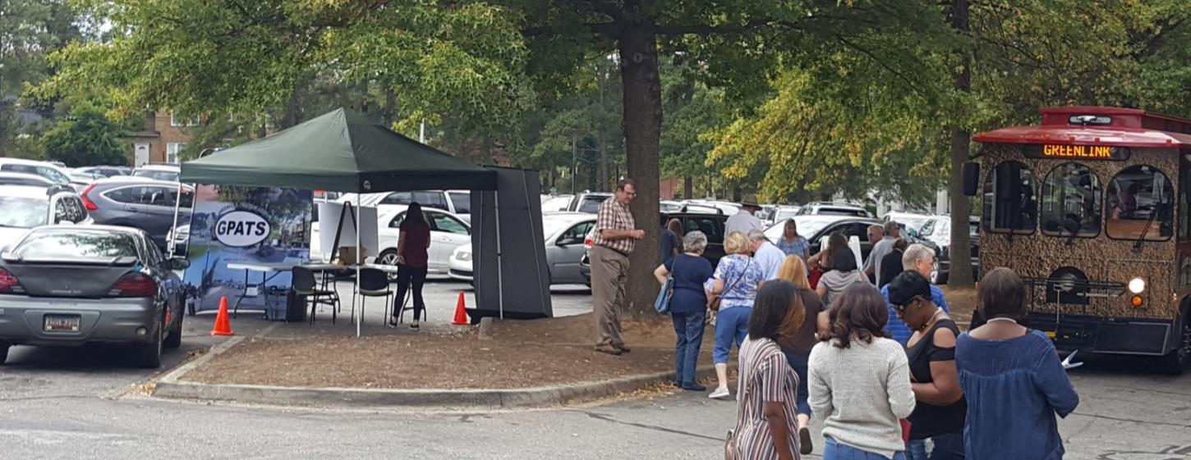
Public Outreach
Fall for Greenville Trolley Stop
Captive Audience
Regional Draw
Getting to Event = Concerned About Transportation
Massive Response Hike!

Slide 7
Guiding Principles
Culture & Environment
Enhance the region's quality of life by preserving and promoting its valued places and natural assets.
Growth & Development
Make traveling more efficient by coordinating transportation investments with land use decisions.
Safety & Security
Promote a safe and secure transportation system by reducing crashes, making travel reliable and predictable, and improving emergency response.
Economic Vitality
Support regional economic vitality by making it easier to move people and freight within and through the region.
Mobility & Accessibility Provide a balanced transportation system that makes it easier to bike, walk, and take transit.
System Preservation & Efficiency
Extend the life of the transportation system and promote fiscal responsibility by emphasizing maintenance and operational efficiency.

Slide 8
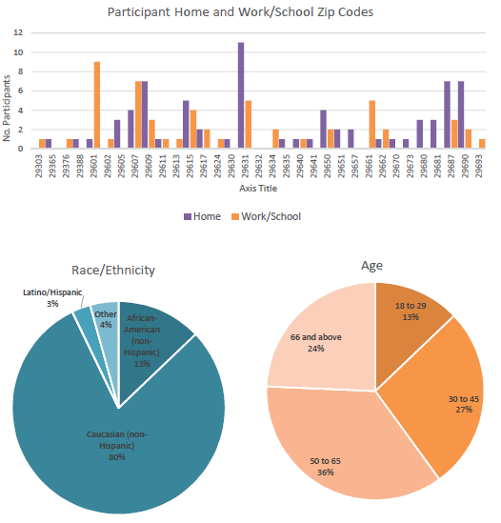
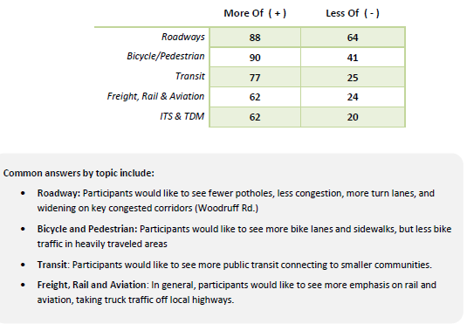
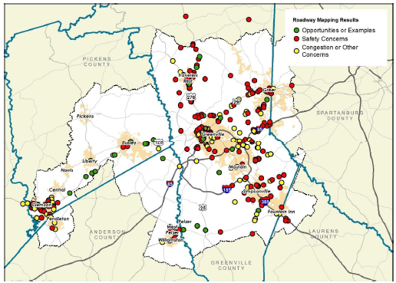
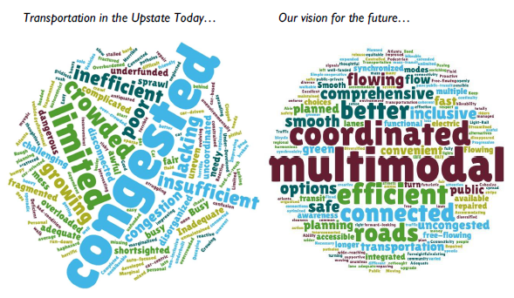
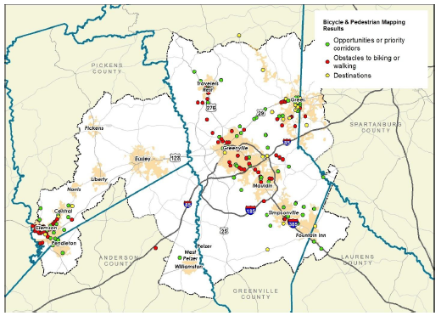
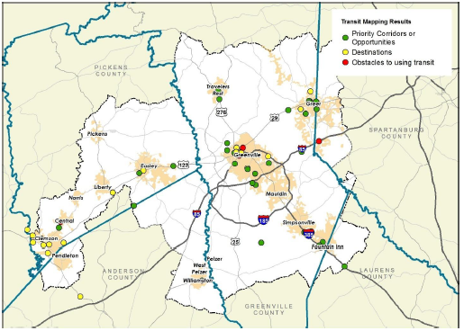
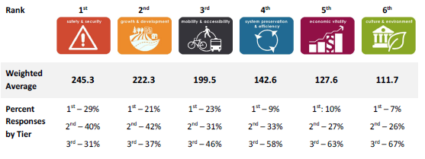
Regional and Sub-Regional Meetings: ~475 participants
Activity-Based Meetings
One Word
Priority Pyramid
Thought Wall
More or Less
Mapping
Exit Questionnaire

Slide 9
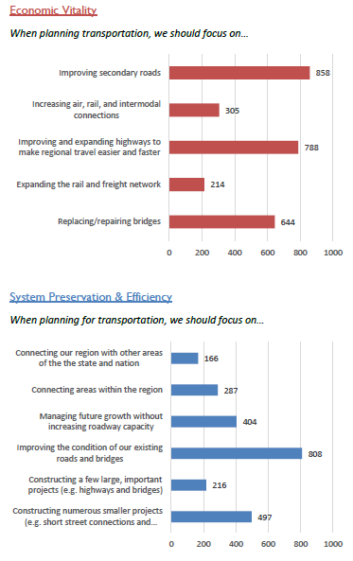
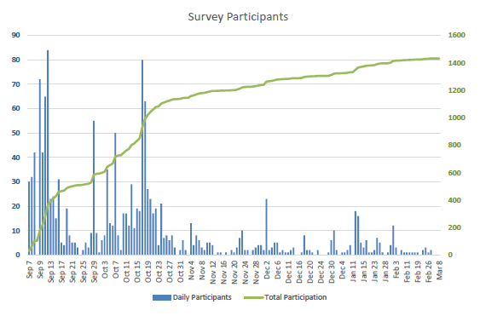
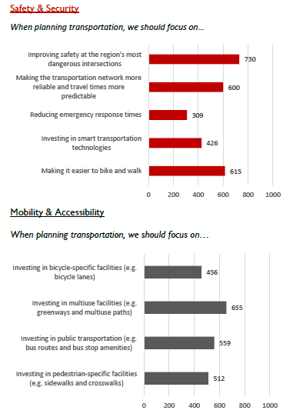
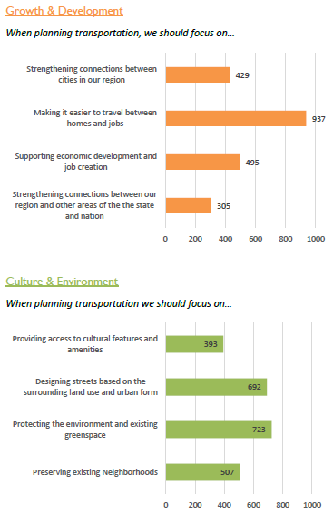
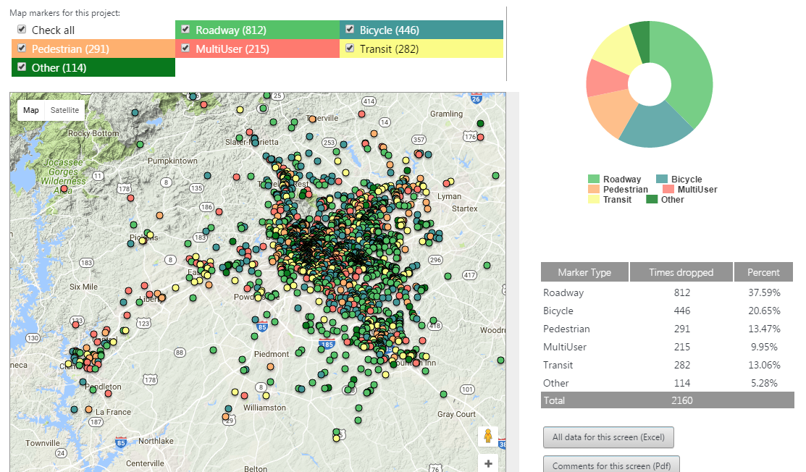
MetroQuest: 1,436 participants

Slide 10
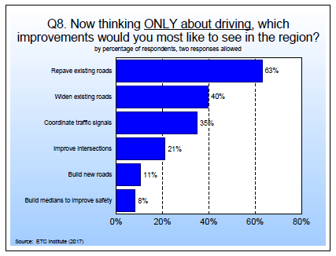
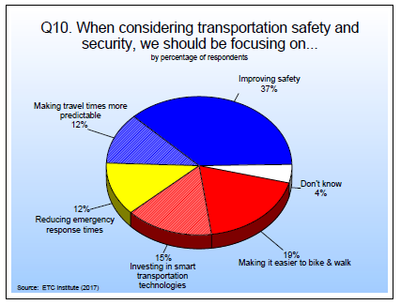
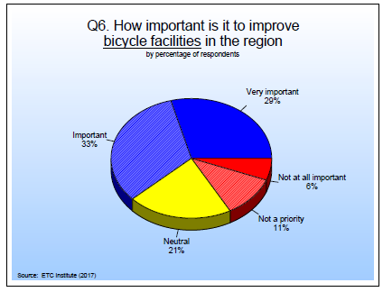
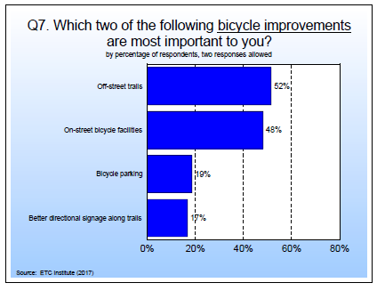
Statistically Valid Survey: 525 respondents (95% CI)

Slide 11
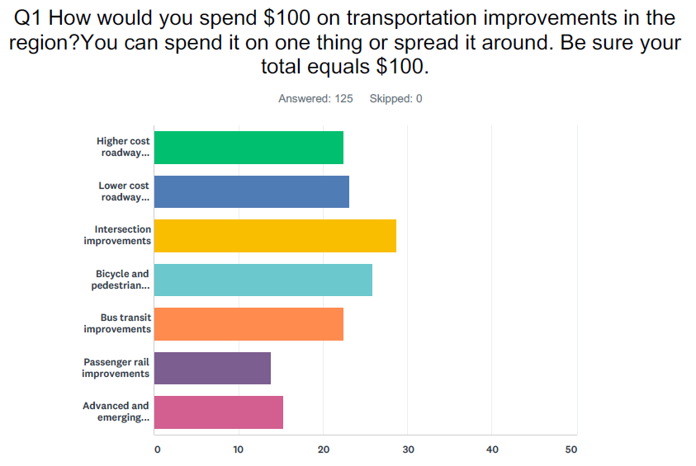
Final Survey

Slide 12
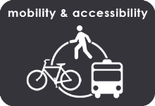
Key Takeaways….FROM THE PUBLIC
The region is growing rapidly, leading to increased congestion and travel delays.
Safety should be a priority as road improvements are considered.
Active transportation is popularity throughout the region, and we should expand the opportunities for residents to bike and walk to their destinations.
There is widespread interest to provide public transportation to expanded service areas.
Improving our transportation system is linked to regional economic development.
Our Transportation Priorities
1st
2nd
3rd
4th
5th
6th

Slide 13
Roadway Recommendations
Greenville County
94 corridors
98 intersections
Pickens County
17 corridors
23 intersections
Anderson County
7 corridors
8 intersections
Spartanburg County
4 corridors
1 intersection
Laurens County
1 corridor
1 intersection

Slide 14
Bicycle & Pedestrian Recommendations
Designates on-street and off-street bicycle facilities
695 proposed projects
Sets priority sidewalk zones around elementary and middle schools
145 designated areas
Coordinates with roadway recommendations to take advantage of incidental improvements

Slide 15
Financial Constraint – Costs vs. Revenues
Cost
vs
Revenues
Corridors
GPATS Guideshare Revenue (including inflation)
$920+ million
 | Amount
2017-2023 | $110,343,000
2024-2030 | $126,546,000
2031-2040 | $180,780,000
Total | $417,669,000
Intersections
$430+ million
*Funding availability for years not already programmed in the currently adopted STIP.
Bike/Ped
$343+ million

Slide 16
Financial Constraint – Guideshare Modal Split

Slide 17
Financial Constraint – Guideshare Modal Split

Slide 18
What Does This Mean For GPATS?
18 high priority bicycle and pedestrian projects can be funded using the allocated revenue
Funding structure is able to better respond to performance measurement
Percentages can be revisited in subsequent plans as new public feedback is analyzed
Robust public feedback dispels the notion that “we only hear from the advocates”
Elected and appointed officials can more clearly understand the voice of their constituents
Funding levels are better aligned with public will

Slide 19
www.gpats.org
When Big Data Meets Better Data
APMO Conference, October 18, 2017
Keith Brockington, AICP, GPATS & Greenville County, SC
Allison Fluitt, PE AICP, Kimley-Horn and Associates

