Slide 1
Telling the MPO story
Why and how to use the web to tell your story
Ben Hampton and Abigail Zenner TPB Communications Team 2017 AMPO Annual Conference Public Involvement (Part 2) October 18, 2017

Slide 2
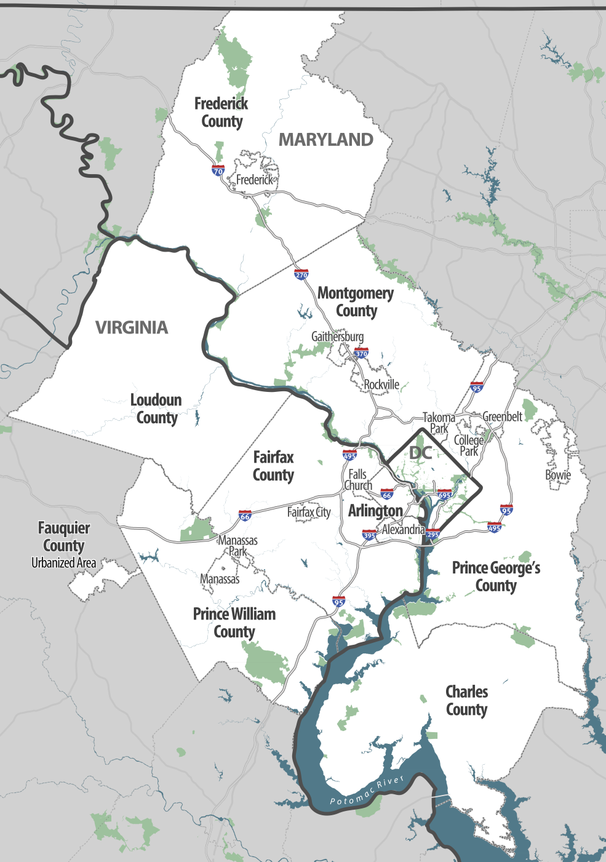
About the TPB
MPO for the National Capital Region
3 states, 23 member jurisdictions
3,500+ square miles
5.5 million people, 3.2 million jobs
Multimodal system
2017 AMPO Annual Meeting
October 18, 2017

Slide 3
Using the web to tell your story
Why is it so important to tell your own story, and to do it using the web? Because…
You can tell it best
The internet is where people are
It’s easy and inexpensive—sort of
You can cultivate your network and champions
2017 AMPO Annual Meeting
October 18, 2017
Notes:
We want to talk today about using the web to tell the MPO story
Why is it so important to do that? Well, a few points we want to make here…
You can tell it best – this was our biggest early motivation – media coverage was down, and what coverage there was wasn’t very accurate
Internet is where people are – people in our world talk a lot about meeting people where they are – well, guess what, most people are on the internet now! (esp with phones, social media) – does that capture “everyone”? No. But it’s a bigger audience than it’s ever been, and keeps growing.
Other beautiful thing: publishing to the internet is (relatively) cheap and easy – you can do it yourself, great tools, etc. – sort of: it still takes skill and time to do it well, and we’ll get into that
Biggest thing that serves MPO goals – cultivating your network, getting champions to work for you to spread your message; also: because successful public involvement can’t happen without communications, they need to know you exist, AND they need to understand what you do, what’s going on, how they can be involved
build & engage a community of people (on the internet) who are passionate about a topic
Why? Why is it so important to use the web to tell your own story?
• Because you can tell it best. (You’re closest to it)
• Because the internet is where people are. (Duh. But seriously… / Meet people where they are.)
• People should hear it directly from you in an accessible way not interpreted by others. (Journalists, advocates)
One of the big fears in our shop was how our story was getting reinterpreted by outsiders; we didn’t have control of our messaging
Cheap and easy—sort of
Cultivates your network and champions (you look good, people are equipped with information that they can then share, you stay in their daily sphere – there’s a lot of MPO goals this meets!)

Slide 4
What we challenge ourselves to do
1
2
Create clear, compelling content that non-experts can understand
Get that content in front of more (of the right) people more often
2017 AMPO Annual Meeting
October 18, 2017
Notes:
The two main things we focus on in our work:
Creating clear, compelling content that non-experts can understand
There is such thing as too-hard to understand, too-much to understand
Get that content in front of more people
So, Abigail is going to start with creating clear, compelling content
Then, I’ll be back to talk about how we went about getting our content in front of people

Slide 5
How to be clear and compelling?
What makes a good story, blog post, content?
}
1. News
2. Message
3. Accessibility
2 out of 3
isn’t enough
…and they get progressively harder
2017 AMPO Annual Meeting
October 18, 2017
Notes:
Read them out then explain…..
Before you start writing, answer 2 questions:
1. news what facts am I reporting? Say what you are doing
2. message what message should readers get from it and why should they care?
Answer the question, “what does this mean for me?”
What you do, what’s going on, and how can they be involved?
As you write, remember:
3. accessibility am I writing in a way my readers (who are regular laypeople) will get the message?

Slide 6
How to be clear and compelling?
Put the most important info first.
More specific details and less important points come later.
most important message
details
2017 AMPO Annual Meeting
October 18, 2017
Notes:
People are busy and there’s a ton of information out there.
Put the most important info first.
More specific details & less important points come later. An inverted triangle– news method.

Slide 7
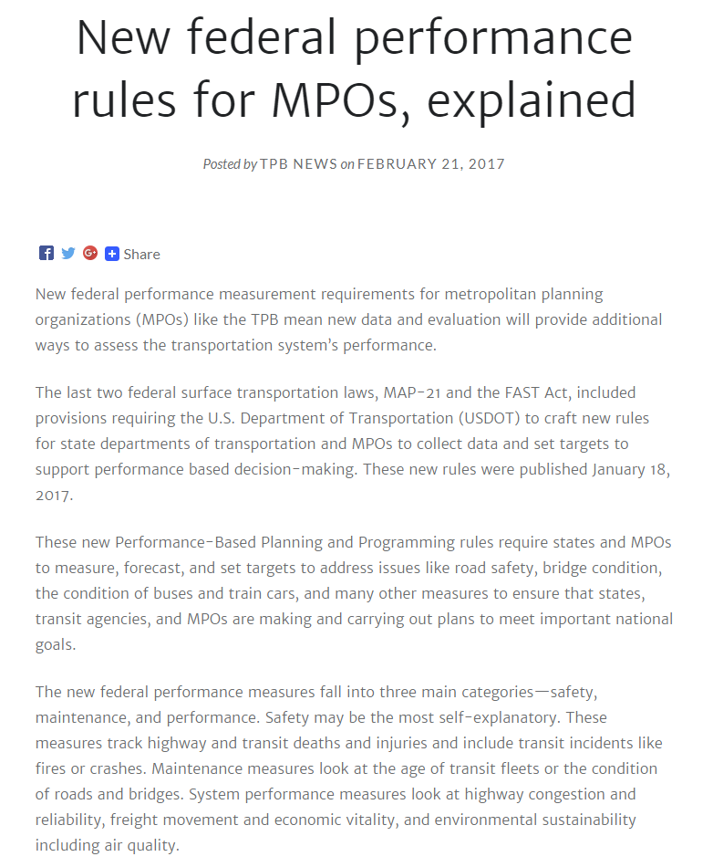
How to be clear and compelling?
Most blog posts only need 2 sentences to sum them up.
One sentence to explain what it is, and a 2nd to set context.
2017 AMPO Annual Meeting
October 18, 2017
Notes:
Most blog posts only need 2 sentences to sum them up.
One sentence to explain whatever you’re presenting, and a 2nd to set necessary background context. You may have been trained like I was to write up background information then a thesis sentence but that buries your main point.
So get to that point immediately. Say what it is and why your readers should care. That way they can tell right away if they want to stick with it. If not, at least they got the main point.

Slide 8
How to be clear and compelling?
ALWAYS USE
SIMPLE
LANGUAGE
2017 AMPO Annual Meeting
October 18, 2017
Notes:
This part is my favorite one.
o Most people don’t like to read technical memos, reports, or press releases. Give them something interesting and easy.
o The clearer your story is, the easier it will be for people to understand. Even technical people want to be able to read things written in a non-technical way.

Slide 9
How to be clear and compelling?
JARGON
EXPLAIN WHAT YOU MEAN!
Residents, people who live near a project….
Explain: adding a new sidewalk, adding lanes, repaving, planting trees, fixing broken pavement….
Autonomous, driverless, self-driving-- vehicles
App based ride-hailing companies like Uber or Lyft. Avoid calling it “sharing.”
Stakeholders– who are they?
Improvements– what kind?
AVs– audio visual?
TNCs– what the heck is a Transportation Network Company?
2017 AMPO Annual Meeting
October 18, 2017
Notes:
Go the extra mile to explain jargon. / Use plain language, avoid jargon, and have a clear message.
Make it easy, relatable, and conversational
Avoiding jargon seems simple until you realize how much jargon you use all the time.
EXAMPLES!
Refer to people who do things or live near places in your region not as abstract ideas. People who walk, people who bike, people who live in…..
Now that we’ve talked about great content, Ben will talk about some ways we have worked on sharing it.

Slide 10
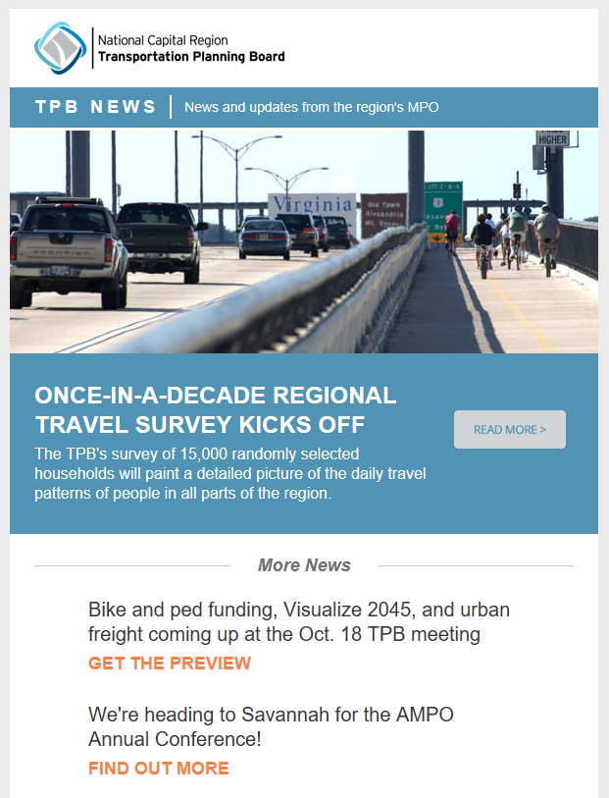
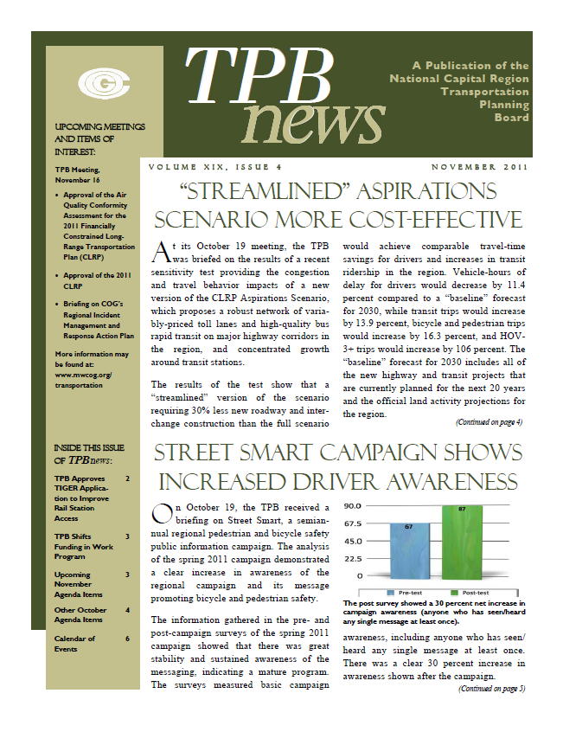
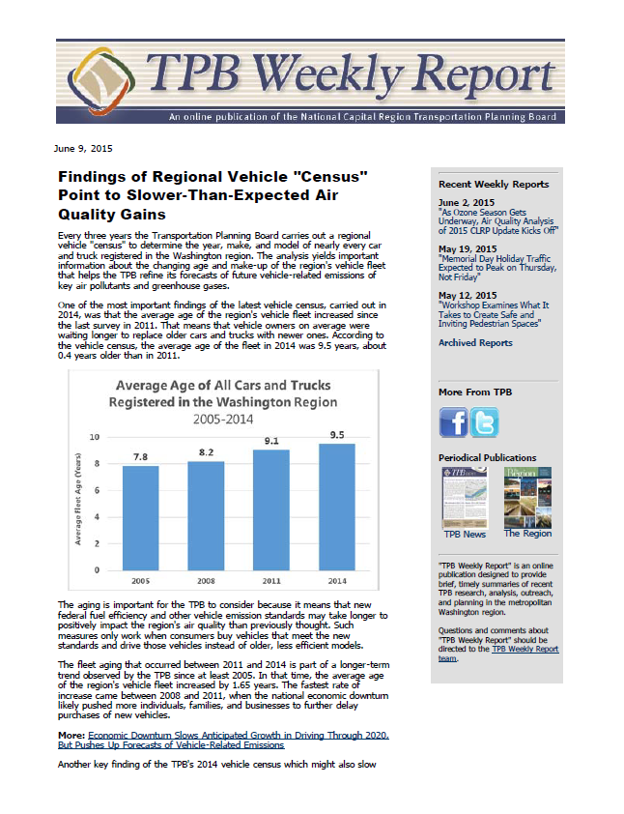
Getting content in front of people
Print-Only
E-Publication
“TPB News”
2017 AMPO Annual Meeting
October 18, 2017
Notes:
Two main things we’ve done to get content in front of people. One thing was to retool our publications—the vehicles we use.
When I arrived in 2011, I inherited TPB News, a print newsletter mailed out once a month; good documentation, but the downside was it was in print, it was only monthly – we just weren’t on the internet
So, in 2012, we launched a new weekly e-publication to complement print TPB News – single article, kind of like a blog, but went in depth on a work product or activity, or process, or decision by the board – (board members, cmte members, etc)
In 2016, we retooled – we got rid of the print newsletter, totally overhauled/redesigned our electronic newsletter, made it more traditional newsletter, set up a “digital news site,” and then made a concerted effort to promote via social media and to coordinate with our central comms/public affairs office…
So that was one thing…
But, there’s more competition than ever!
//
E-newsletters are back joining with other social media trends but they need to link to compelling content or no one will read them.
People choose to follow you or subscribe– making it a good way to connect with your stakeholders
BUT– there is also more information out there and more competition than ever. Making it more important that you be clear and compelling.

Slide 11
Getting content in front of people
SOCIAL MEDIA
LOCALMEDIA
EMAIL
PARTNERS
“TPB News” tpbne.ws
2017 AMPO Annual Meeting
October 18, 2017
Notes:
And the other main thing was expanding to a multi-channel approach.
This is not super-complicated, and it’s not necessarily novel – but it was new for us
Walk through diagram:
Have our email
But also make sure we’re promoting and sharing content on social media
Then worked with our comms office to coordinate story pitches to local reporters
Then the more we were doing on these, the more of our board members, committee members, member agencies, partner organizations would share our content
All of this has turned into an increase in traffic to our TPB News digital news site – that means more people are seeing what we write and post about our work – and we know more of the right people are seeing it too – agency staff, elected officials, advocacy organizations, the public

Slide 12
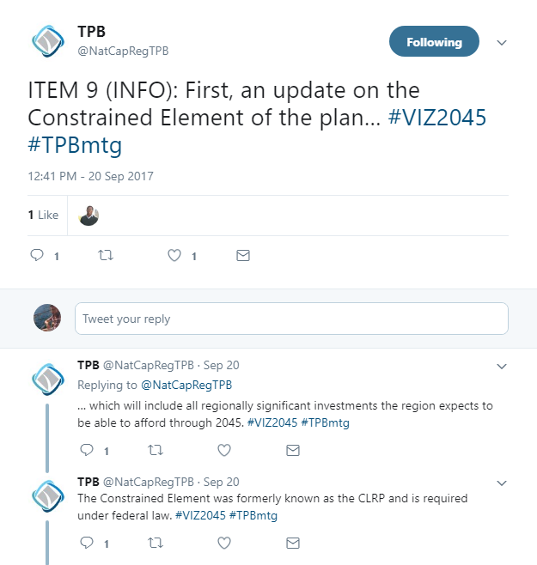
Getting content in front of people
Example: “Live-tweeting” Monthly MPO meetings
Meetings are in the middle of the workday
News happens
Packed news cycle
#TPBmtg
mwcog.org/TPBmtg
2017 AMPO Annual Meeting
October 18, 2017
Notes:
Related example – not just promoting TPB News ---- live-tweeting of our monthly board meetings
First of all, board meetings happen from noon to 2 on Wednesdays – YOU CAN SEE WHY THIS MIGHT BE A PROBLEM -- not many people can come. And so, basically, if you weren’t in the room, you wouldn’t know about a lot of what was going on.
Not long after I started our weekly e-publication, I realized just how much of our “news” was tied to board meetings – report releases, study findings, event proclamations – so board meetings are very rich on content
And then I realized what a packed news cycle it is – and that our weekly publication, with one article, didn’t let us talk about everything that was going on
So, I started live-tweeting the meetings.
In any given month, we have about 5-8 substantive items. We try to explain the highlights for each and provide helpful context for what’s going on.
POINT TO EXAMPLE
We often have great slides in our PPT presentations – data, photos, summaries – so we try to include as much graphic content as possible.
We use the hashtag #TPBmtg.
And we set up a webpage where this feed lives, along with a live audio player, and the meeting agenda, memos, and presentations. So it’s place where people can follow along, and also get some added-value narration.
The secret that some people surely have figured out – we draft 80% of the tweets in advance, then our main job during the meeting is posting them at the right time, and only having to summarize in real-time the discussion among our board members, which is challenging, but having so much of the content pre-drafted helps. And that process usually takes a full day to do. We probably tweet a total of 40-60 times during most meetings. It’s a lot, but it’s also a very focused time – 2 hours once a month. We’ve mostly gotten good feedback.
Any given month, we have 20-30 people listening to the audio feed; and we often see a lot of Twitter interaction (likes, RTs, new followers).
AND, I’ll just say, that our meeting is actually today, so you can go see the feed in action at mwcog.org/TPBmtg

Slide 13
Getting content in front of people
Example: Record-breaking Visualize 2045 response
MetroQuest public input survey
6,215 survey responses!
Web + social + email integrated approach
Network activation
2017 AMPO Annual Meeting
October 18, 2017
Notes:
And then just real quick wanted to share a recent example of how our integrated, multi-channel approach activated our network: record-breaking response to a public input survey for our new long-range plan update, called Visualize 2045.
We used MetroQuest to ask people about their general attitudes and opinions
The survey ran for about 8 weeks this summer
I’ll just go ahead and tell you that we got over 6,000 responses. We were hoping for about 2,500.
We wanted to cast a wide net and create buzz, so we planned an integrated approach, creating a website where we could direct people to take the survey but also learn; we were pretty aggressive on social media – over 350 direct tweets; we started a new “Visualize 2045” email newsletter, using the same template as for TPB News
And all of this activated our network – it showed them that this was a big deal. AND, we also created an ambassador program that enlisted the help of our stakeholders to spread the word --- and by having all of this in place, it made it easy for them.
So, anyway, that’s just a quick highlight of that outreach and how our multi-channel system was able to deliver results not only for directly EXPLAINING our work and telling our story, but also INVOLVING the public.
With that, I know we’re about out of time. So, I want to stop there…

Slide 14
Ben Hampton TPB Communications Manager (202) 962-3275 bhampton@mwcog.org Abigail Zenner TPB Communications Specialist (202) 962-3237 azenner@mwcog.org | mwcog.org/TPB
Metropolitan Washington Council of Governments 777 North Capitol Street NE, Suite 300 Washington, DC 20002

