Slide 1
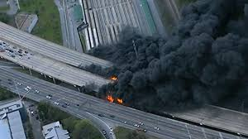
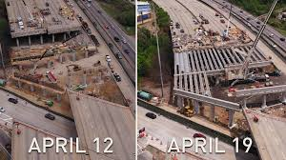
October 18, 2017
How Big Data Helped Atlanta during the I-85 Bridge Collapse
AMPO Annual Conference
Response, Recovery & Resiliency
by
Guy Rousseau, Atlanta Regional Commission
Matt Pettit, Citilabs

Slide 2
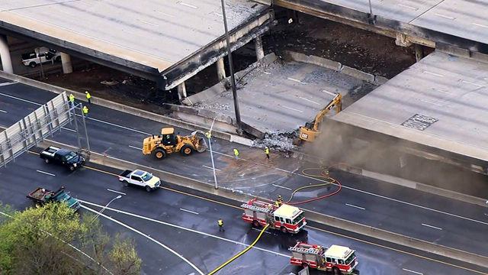
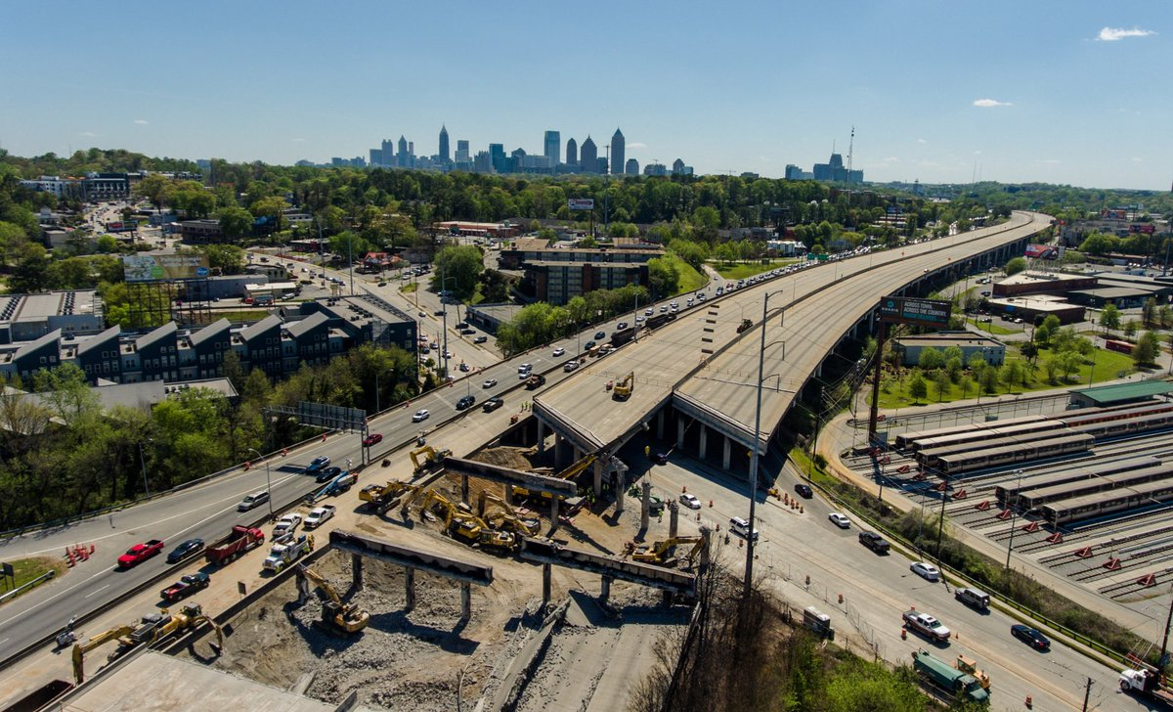
Introduction & Context
March 30: Fire underneath I-85 caused the bridge to collapse and altered the commutes for hundreds of thousands of commuters.
Around 243,000 trips go through the impacted area each weekday.
Eastern half of the I-285 perimeter impacted the most, but travel was impacted all throughout the region, with a minimum of 30% increase in volumes across network.
Many MARTA stations, especially those in the northern part of the region, have experienced large increases in ridership after the bridge collapse.
75% of the businesses in the area have experienced a loss of customers due to the collapse.
Bridge reopened on May 15, 6 weeks later …

Slide 3
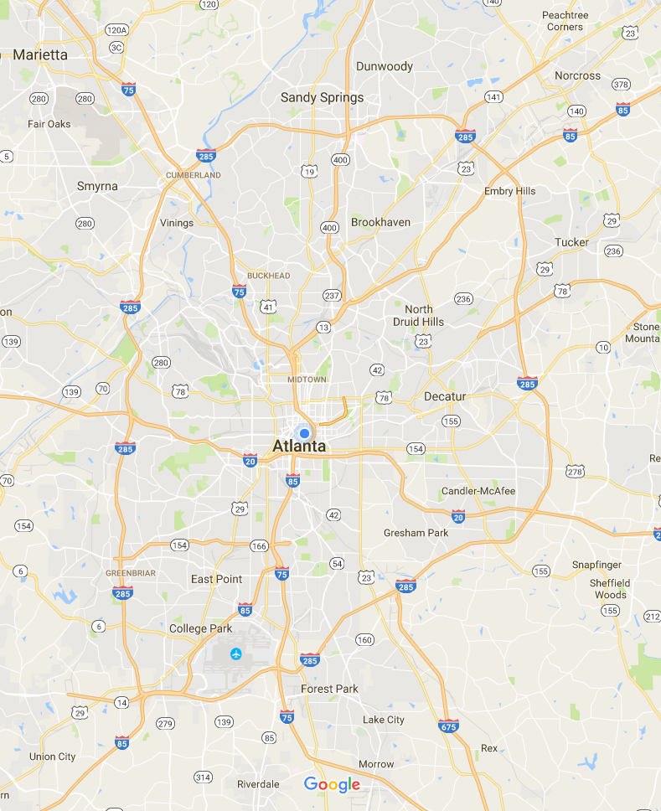
Historic Traffic Counts
Around 243,000 trips travel through the affected area daily
191,000
297,000
297,300
214,000
134,000
194,900
185,000
350,000
243,000
289,000
171,000
Source: Georgia DOT Traffic Counts
2015 Average Annual Daily Traffic (AADT)
http://geocounts.com/gdot/

Slide 4
How big data can Help
How to Leverage the Strength of All Available Data
Notes:
So…where does the data come from? What goes into Streetlytics?
4 main components:

Slide 5
Mobile Location Contribution to Streetlytics Fusion Engine
Mobile Location Contribution to Streetlytics Fusion Engine

Slide 6
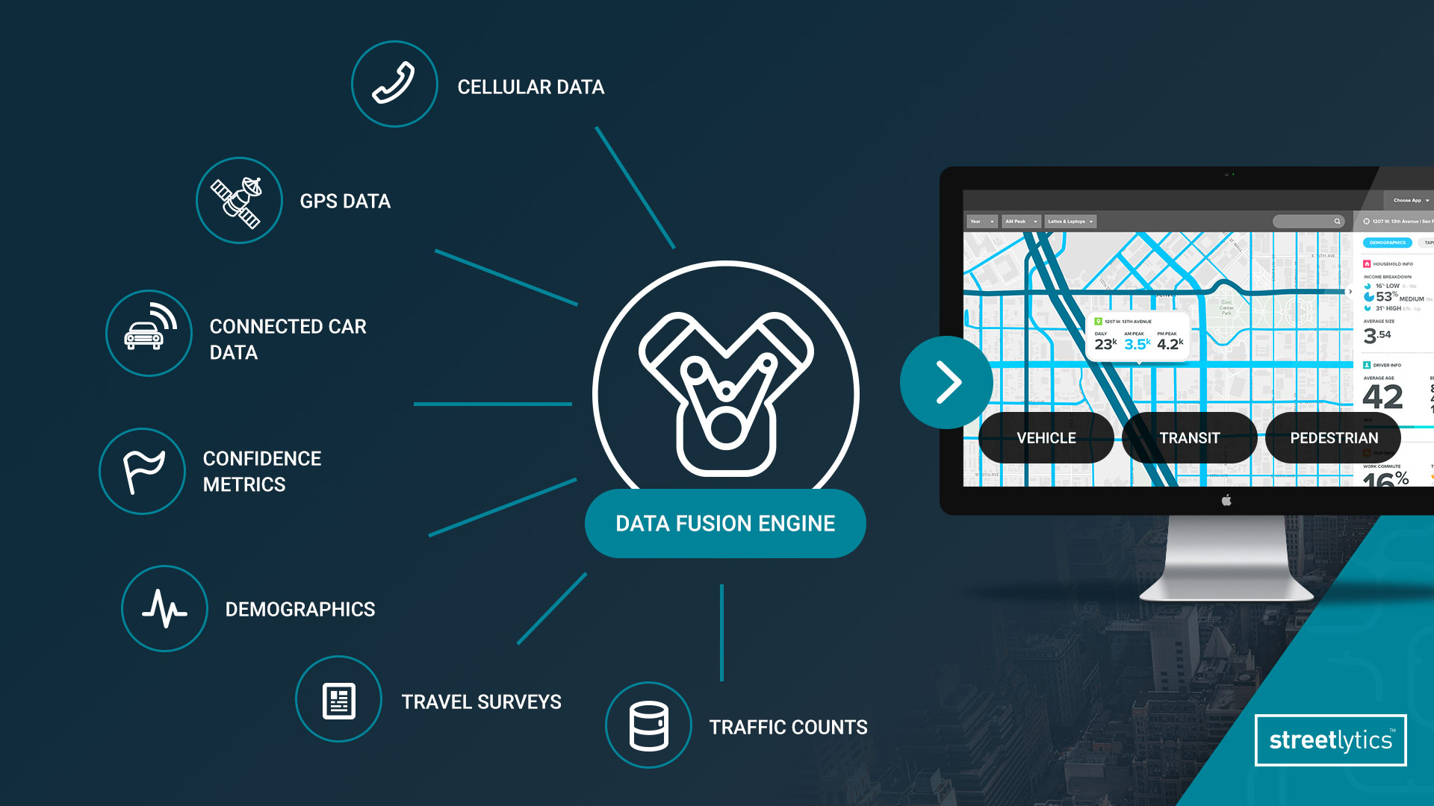
Streetlytics Process From Data to Insights

Slide 7
What Can We Understand

Slide 8
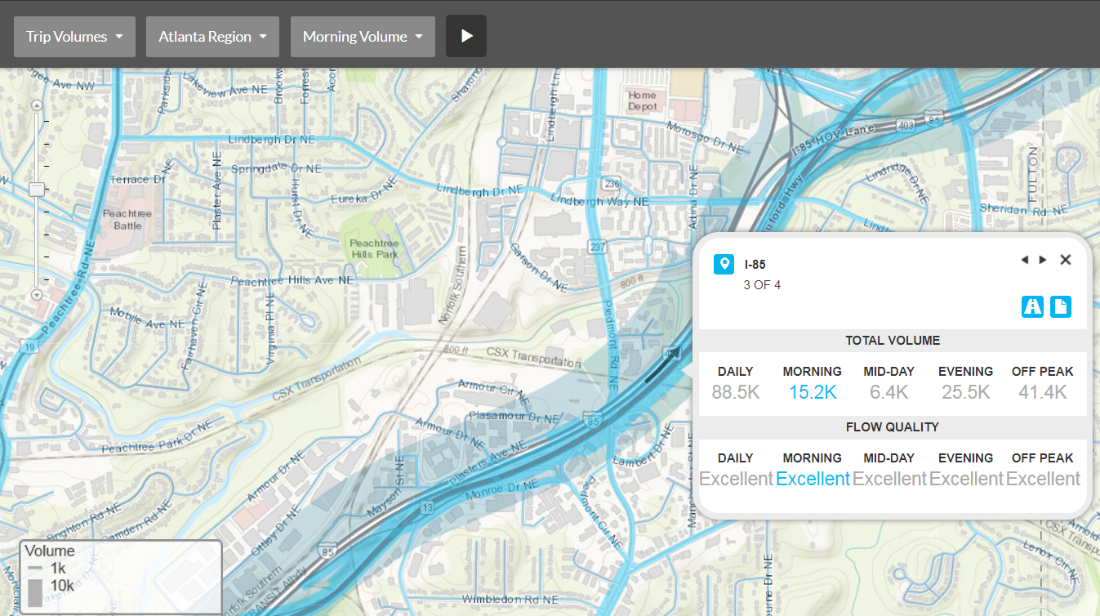
Vehicular Volumes

Slide 9
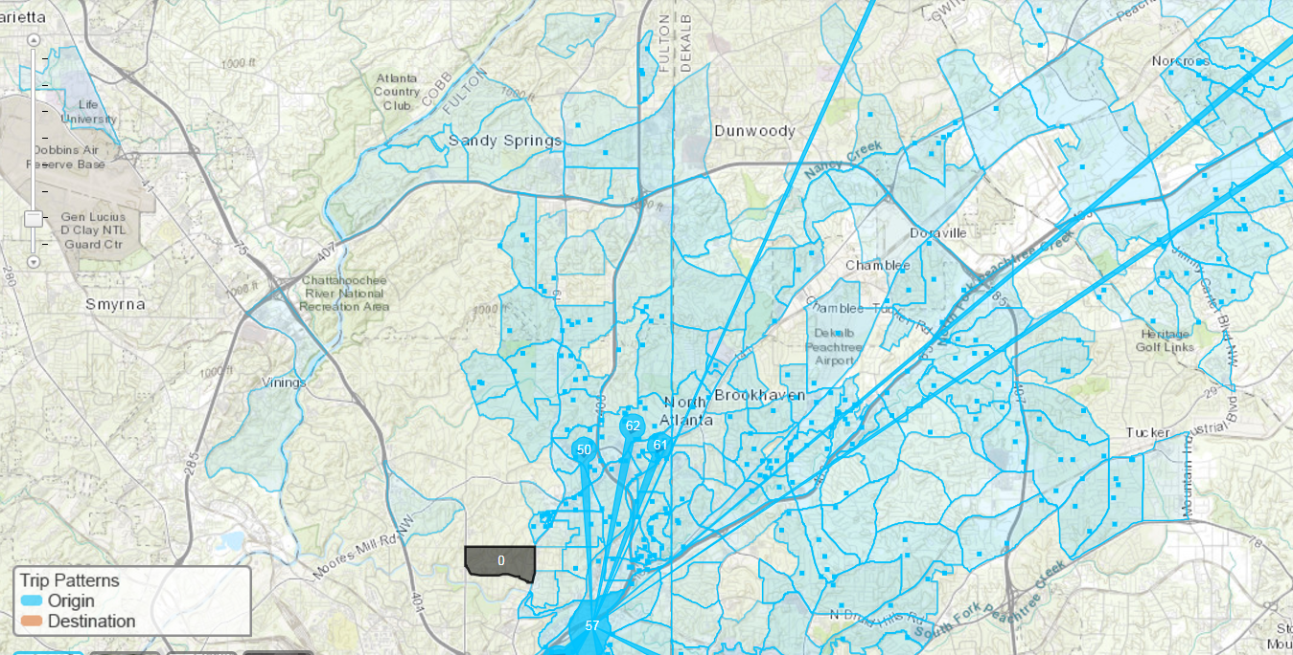
Trip Patterns

Slide 10
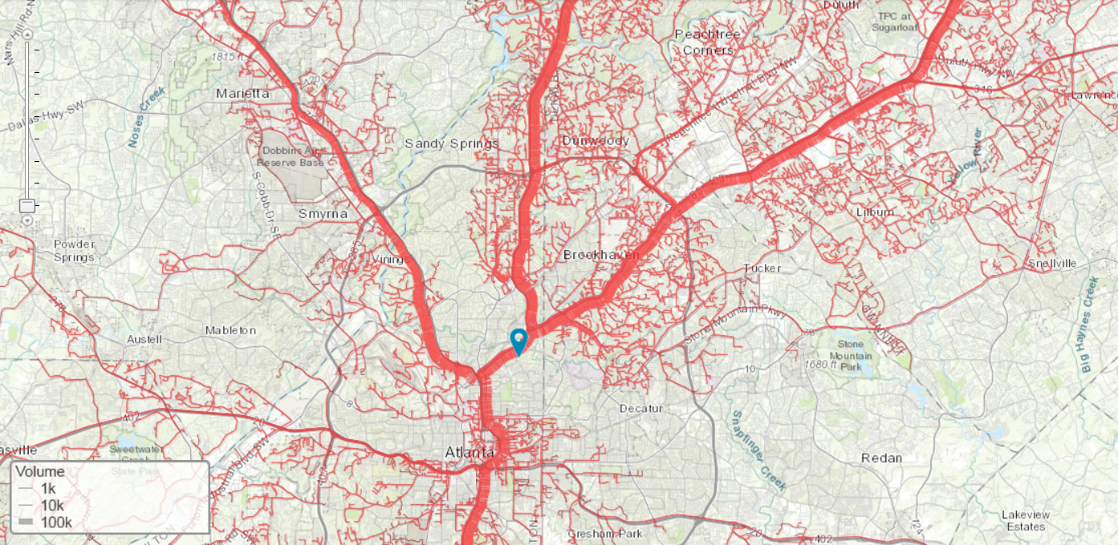
Select Link Analysis

Slide 11
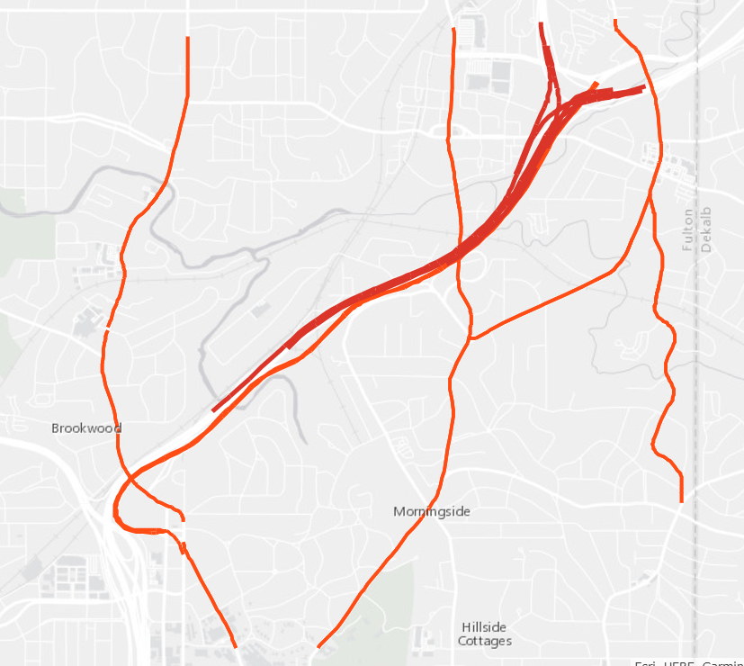
What Do We Want to Know
What are the vehicular volumes and trip patterns throughout the day
AM Peak vs. PM Peak travel
What are the vehicular volumes and trip patterns of adjacent roadways
ArcGIS Online Story Map created to demonstrate impact
http://arcg.is/0LC1mW

Slide 12
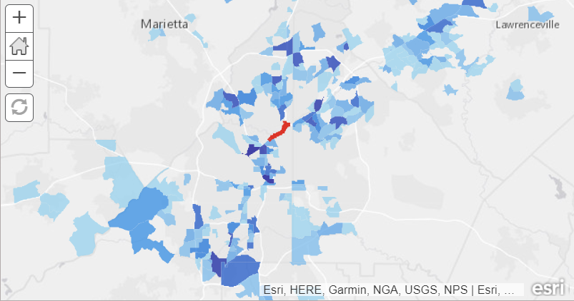
AM Trip Destinations

Slide 13
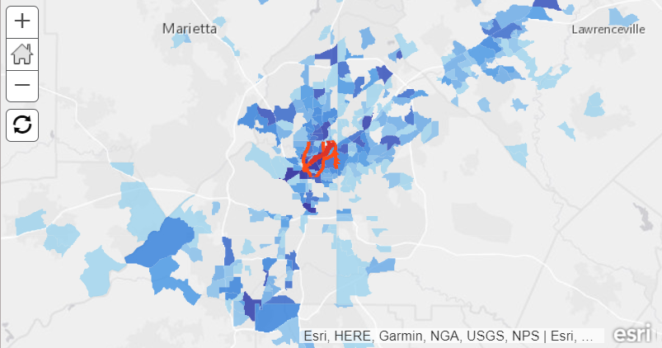
AM Trip Destinations

Slide 14
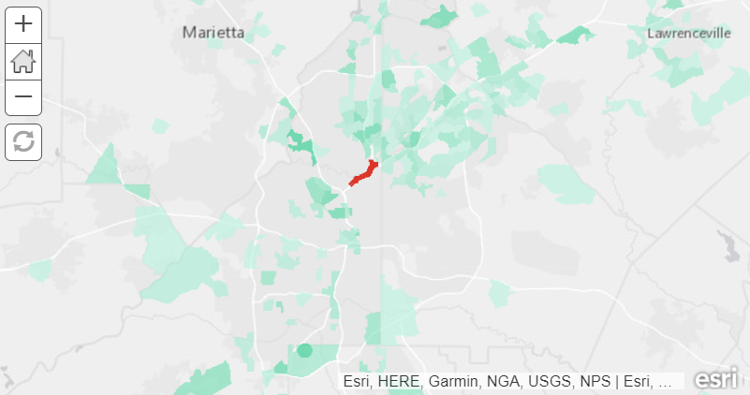
AM Trip Origins

Slide 15
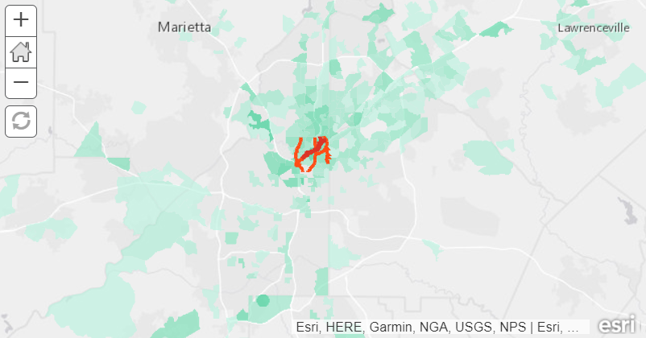
AM Trip Origins

Slide 16
Who travels on I-85?
The affected area on I-85 is a critical link in the transportation network
In the morning travel period, trips routinely flow from as far south as Newnan and from as far north as Cumming
Trip Origins
Trip Destinations
I-85 Closure
Green = trip origins
Blue = trip destinations
Source: Citilabs Analysis for ARC using Streetlytics
https://www.streetlytics.com/
Notes:
For this graphic - AM Peak is defined as 7 am - 9 am
Data is from October 2016, Monday through Thursday work week periods

Slide 17
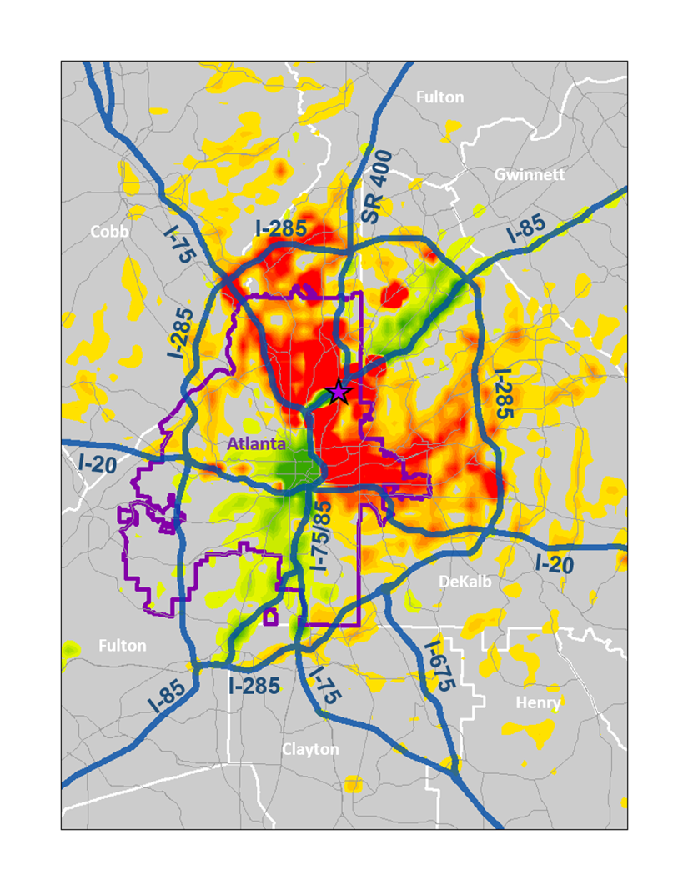
The Impact: Traffic Congestion
AM Peak Period Traffic Congestion
System-Wide Impacts
Minimum of 30% increases in volume throughout network; some areas 50%
Congestion on Arterials
Congestion in Unexpected Places
Slower Travel Speeds
“Peak Spreading”: Starting Earlier & Ending Later
% Change in Volume : Red = Increase
Source: ARC Activity Based Travel Model, Network 2015
Model Simulation Parameters: I-85 Closure, Piedmont partially open with operational restrictions
Time Period: AM Peak (6-10 AM)
http://www.atlantaregional.com/transportation/modeling

Slide 18
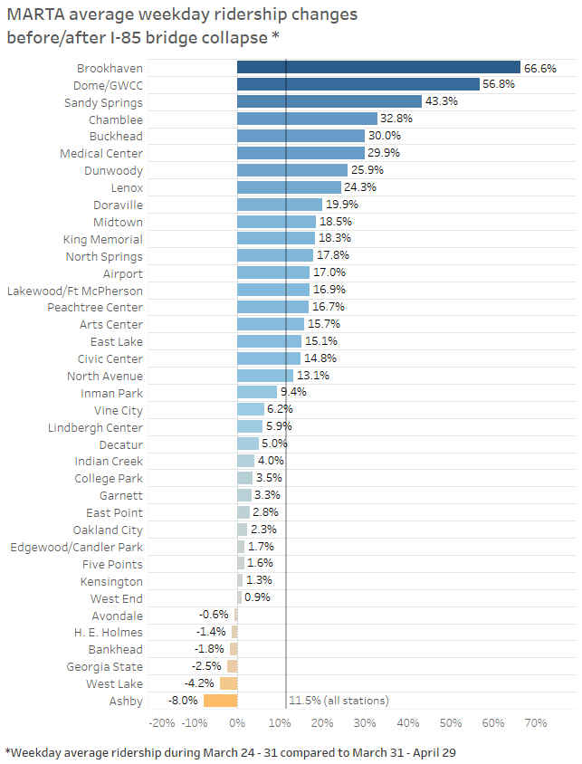
Transit Usage
This chart uses MARTA ridership data to show the change in average weekday ridership by rail station before and after the I-85 bridge collapse.
The chart compares the average number of riders boarding stations on weekdays during March 31 – April 29 (after the collapse) to the average number of riders during weekdays March 24 – 31 (before the collapse).
The MARTA stations in blue had the greatest % increase in ridership. Many of the northern stations experienced large increases, such as the Brookhaven station which had a 67% increase in ridership.
Source: MARTA ridership data

Slide 19
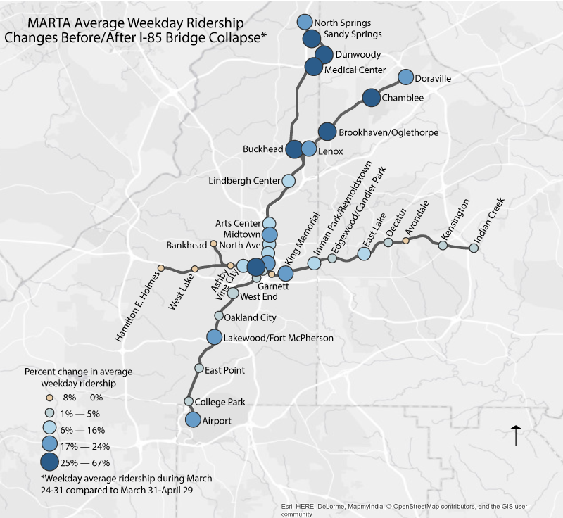
Transit Usage
This map uses the same MARTA ridership data to show the change in average weekday ridership by station.
The circles are symbolized by the % values shown in the previous chart.
The MARTA stations symbolized by large blue circles had the greatest % increase in ridership. Many of the northern stations experienced large increases.
Source: MARTA ridership data

Slide 20
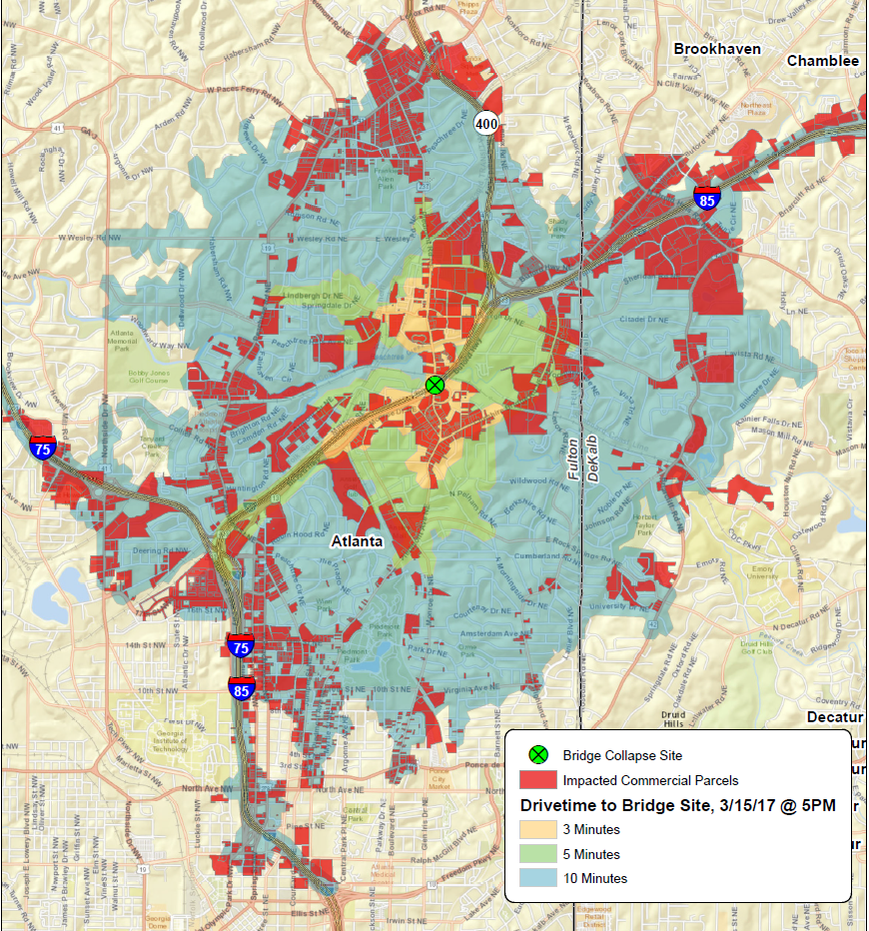
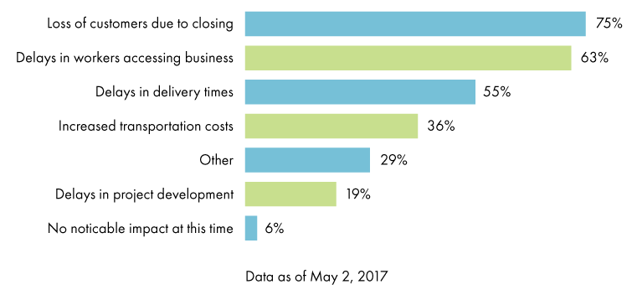
Business / Economic Impact
The red on the map shows commercial parcels within 3, 5, and 10 minutes drive to the site of the bridge collapse under normal conditions
The Invest Atlanta “I-85 Business Impact Survey” found that 75% of impacted businesses in the area had experienced a loss of customers due to the I-85 closure.
Source: ARC analysis, Fulton County parcels; Invest Atlanta

Slide 21
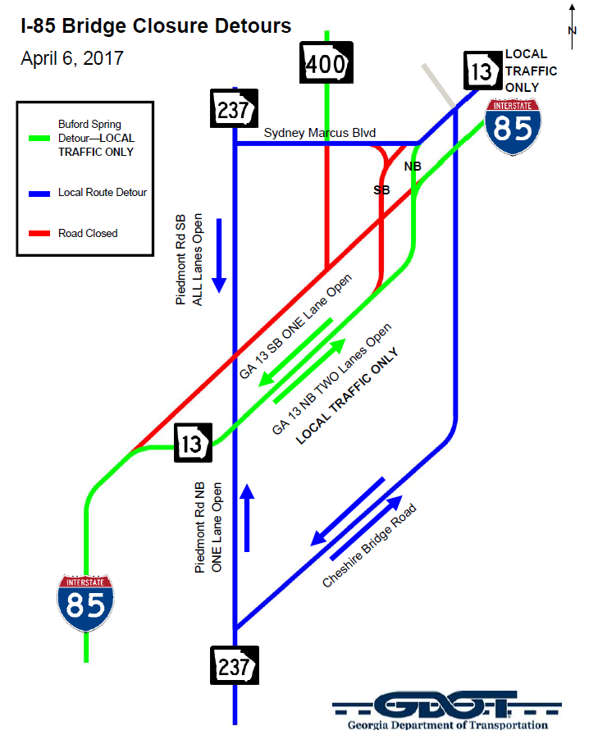
Examples of Responses
Detours, Reroutes & Closures in place
Alter Signal Timing
Increase Capacity Substantially on Arterials
Local governments adding police to intersections to ensure that people “Don’t Block the Box”
City of Atlanta suspending all non-essential roadwork
Transit systems have implemented route adjustments to avoid the I-85 closure
MARTA has increased headways on rail system during peak travel periods and added nearly 1,200 new parking spaces
Gwinnett County and GRTA added routes from park and ride lots to MARTA’s Chamblee and Doraville stations

Slide 22
Conclusion & Lessons Learned
Invest in “Big Data” & Traffic Models
Work with Planning Partners & Stakeholders
Analyze Effective Connections between Specific Origin-Destination Pairs
Freight Planning & Distribution Logistics
Develop a Resiliency Framework:
Network Redundancy
Travel Alternative Diversity
Network Spare Residual Capacity

