Slide 1
Performance Metrics:
[Making lemonade out of federal and state Requirements]
AMPO – Performance Panel I
October 18, 2017
Jeff Pollack, AICP, ENV SP
Transportation Planning Director, Corpus Christi MPO

Slide 2
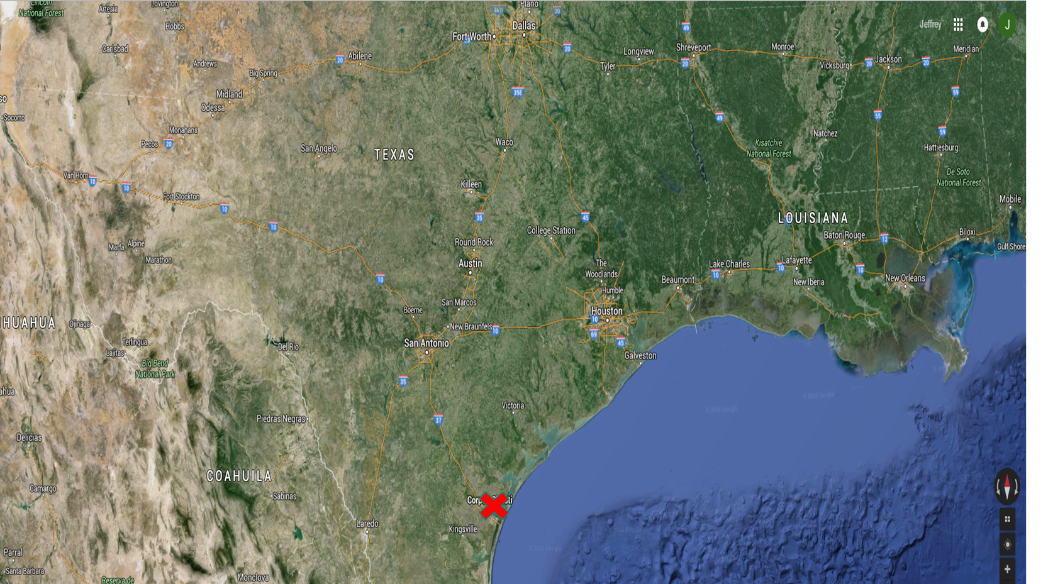

Slide 3
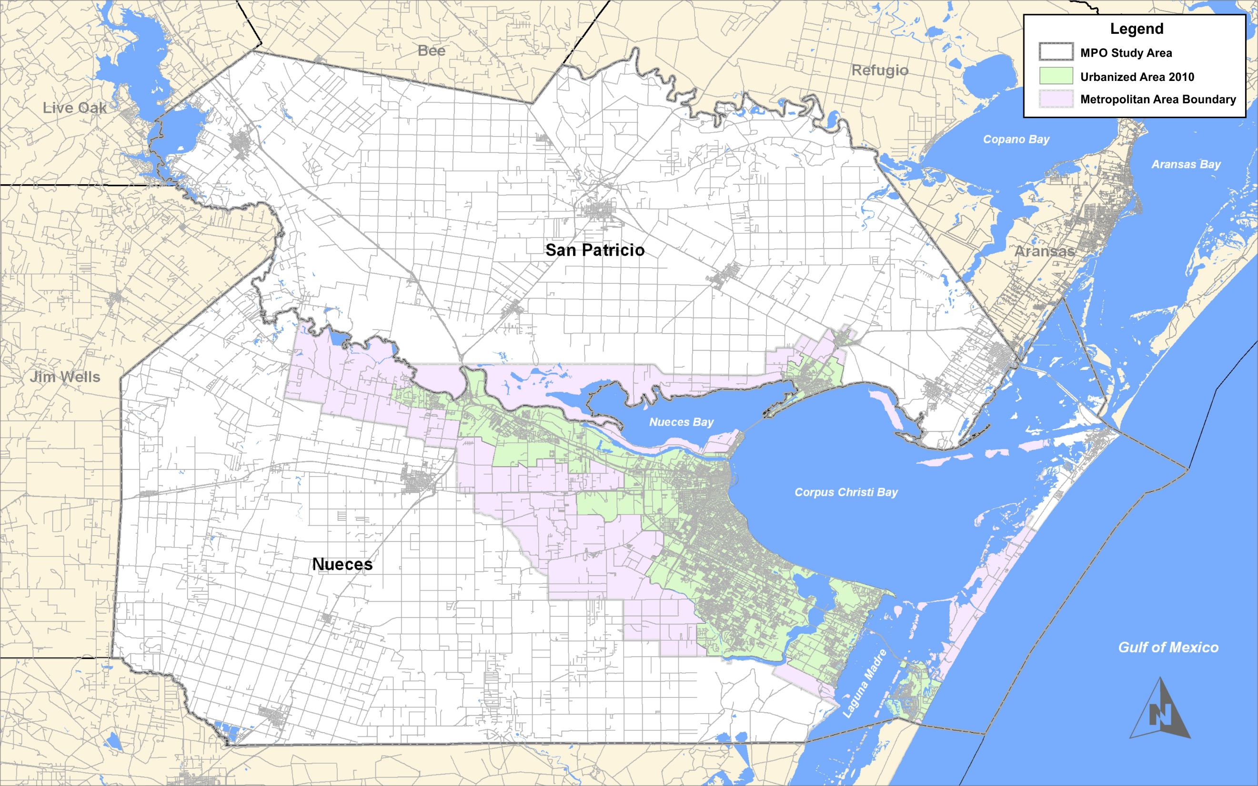
Notes:
Urbanized areas about 325K

Slide 4
Member Entities:
City of Corpus Christi
City of Portland
Nueces County
San Patricio County
TxDOT Corpus Christi District
Port of Corpus Christi Authority
Corpus Christi Regional Transportation Authority
Notes:
In short, we are a small TMA with relatively few jurisdiction who have a historically been very congenial and made decisions about prioritizing capital expenditures collaboratively, albeit in a rather reactionary and subjective way. Bottom line is that the system wasn’t broken and no one was particularly looking to fix anything.
This is the context onto which was overlain the fed/state requirements for a performance basis for planning was overlain. . . .

Slide 5
Texas House Bill 20
Texas Transportation Commission must:
Adopt/review performance measures and metrics
Evaluate projects selected for funding (per state UTP)
Evaluate project delivery
MPOs must:
Develop a 10-year plan
Develop project recommendation criteria
Notes:
Anyone here from the TX Legislature? In their infinite wisdom, our state legislature passed a bill adding another layer to the MPO planning framework, because everyone knows that best way to fix inefficiency and budget shortfalls is more process.
As it turns out, HB 20 proved to be the cover that I needed to justify “fixing” a system that wasn’t broken, and it forced us to undertake a very long, hard look at the dusty laundry list of projects that was our MTP.
What’s more, admittedly, the requisite 10-year plan has proven to be a very practical scale over which to plan transportation projects b/c it dovetails with the state’s 10-year Unified Transportation Program . . .

Slide 6
Regional Goal Areas | Performance Measurement Topics | Performance Metrics
Safety | Crashes | Metric 1
 |  | Metric 2
 | Fatalities | Metric 1
 |  | Metric 2
System Reliability | Efficiency and Economic Competitiveness (Congestion) | …
 |  | …
 | Infrastructure Condition | …
 |  | …
 |  | …
Multimodal Use & Opportunity | Active Mobility | …
 |  | …
 | Transit | …
 |  | …
Stewardship | Equity / Accessibility | …
 |  | …
 |  | …
 | Environmental Impact | …
 |  | …
Notes:
Internally, our ambition in proactively defining a performance-based planning framework was twofold:
Create a framework that was flexible and customizable enough not to undermine the spirit of regional collaboration or preclude the opportunity for local on-the-ground knowledge to influence decisions about funding allocations
B. Reflect—and codify– the philosophical principals that motivate and guide us at the staff level and have been IMPLICITLY—although not necessarily EXPLICITYLY-- established at the Policy Board level, such as a commitment to fostering multi-modalism, particularly active modes of mobility and a commitment to exhausting non-capacity interventions before considering capacity projects
4 Goal Areas, 8 Performance Measurement Topics, 60 Performance Metrics
Master matrix includes definition, Data Source, and Scoring Methodology for all metrics
Infinitely customizable in terms of ability to weight metrics and/or compare only a subset of metrics/performance measurement topics
All metrics pass the sniff test, i.e. data are available without unreasonable process or assumptions

Slide 7
Goal Areas | Performance Measurement Topics | (Sub-Topic) | Performance Metrics
Safety | Crashes |  | Annual total crashes (all types)
 |  |  | Annual total vehicle-on-vehicle crashes
 |  |  | Annual total vehicle-on-pedestrian crashes
 |  |  | Annual Averages Crashes (all types)/Mile
 |  |  | Annual Average Vehicle-on-vehicle Crashes/Mile
 |  |  | Annual Average Vehicle-on-pedestrian Crashes/Mile
 |  | Bike Safety | Annual Average Vehicle-on-bicycle Crashes/Mile
 |  |  | Annual total vehicle-on-bicycle crashes
 | Injuries & Fatalities |  | Annual Total Pedestrian & Bike Fatalities
 |  |  | Annual Average Pedestrian & Bike Fatalities/VMT
 |  |  | Annual Average Fatalities (all modes)/VMT
 |  |  | Annual Average Incapacitating Injuries (all modes)/VMT
 |  |  | Annual Total Incapacitating Injuries
 |  |  | Annual Total Fatalities (all modes)

Slide 8
evaluating the performance of the transpo system overall (dark blue)
Goal Areas | Performance Measurement Topics | (Sub-Topic) | Performance Indicators (Metrics)
System Reliability | Efficiency and Economic Competitiveness (Congestion) |  | Planning Time Index
 |  |  | Commuter Stress Index
 |  |  | Travel Time Index
 |  |  | TomTom Traffic Index (*when available)
 |  |  | INRIX Average Annual Hours Spent in Congestion
 |  |  | Level of Service (LOS)
 |  |  | Volume (ADT) to design (daily) capacity ratio
 |  |  | Ratio: (% r in total VMT) to (% r in population) for 5 yrs
 |  |  | Total Freight Throughput (Port Tonnage)
 | Infrastructure Condition |  | Pavement Condition Index (PCI)
 |  |  | On Freight Priority Network?
 |  |  | Average PCI of Freight Priority Network
 |  | Bike Infrastructure Condition | % of RTA Stops/Stations with Bike Parking
 |  |  | Miles of Cycle Track Constructed in Reporting Year
 |  |  | Miles of Off-road Multi-use Trails Constructed in Reporting Year
 |  |  | Miles of Bicycle Boulevards Implemented in Reporting Year
Notes:
In discussing the different metrics for the various performance measurement topics, it’s important to note a distinction in scale of applicability:
Some of these metrics are only measurable and relevant at the individual corridor scale and are thus only useful in evaluating/comparing individual projects (green)
Some of them are only measurable at community wide scale and are thus only useful in evaluating the efficacy of the transportation system overall (gold)
Some of the metrics are scalable and are applicable/useful in comparing individual projects AND in evaluating the performance of the transpo system overall (dark blue)

Slide 9
Goal Areas | Performance Measurement Topics | (Sub-Topic) | Performance Indicators (Metrics)
Multimodal Use and Opportunity | Active Mobility | Bike Demand | Bikeshare annual calories burned
 |  |  | Bikeshare annual total miles ridden
 |  |  | Bikesharetotal active members
 |  |  | Bikeshare annual trips taken
 |  |  | # (annual) commuter bicycle trips logged on Strava
 |  |  | # (annual) registered bicycle commuter users on Strava
 |  |  | % of respondents ride a bike (for any reason) at least once a week
 |  |  | % of respondents (to a community survey to be repeated every 3-years) who agree/agree strongly with BMP vision statement
 |  |  | On Bicycle Mobility Network?
 |  |  | Bike ADT
 |  |  | % (or #) of Individuals cycling to Work
 |  |  | % (or #) of Individuals walking to Work
 |  | Rider Experience | % respondents (to a community survey to be repeated every 3-years) feel that local drivers are too aggressive toward cyclists
 |  |  | % of respondents didn't feel safe from vehicles on the existing bike facilities.
 |  |  | % of respondents (to a community survey to be repeated every 3-years) reported an absence of bike facilities (e.g. bike lanes or paths) along the streets on which they would like to ride.
 |  |  | % of respondents cited the poor condition of existing bike facilities as a reason for not riding more often
 | Transit |  | Is Project on a Transit Fixed Route?
 |  |  | Is Project on a High Frequency Transit Fixed Route?
 |  |  | Annual Transit Boardings (fixed route)
 |  |  | Annual Bike Boardings (fixed route)
 |  |  | Annual Non-ambulatory Boardings (fixed route)
 |  |  | Annual Transit Revenue Service Hours
Notes:
In discussing the different metrics for the various performance measurement topics, it’s important to note a distinction in scale of applicability:
Some of these metrics are only measurable and relevant at the individual corridor scale and are thus only useful in evaluating/comparing individual projects (green)
Some of them are only measurable at community wide scale and are thus only useful in evaluating the efficacy of the transportation system overall (gold)
Some of the metrics are scalable and are applicable/useful in comparing individual projects AND in evaluating the performance of the transpo system overall (dark blue)

Slide 10
Goal Areas | Performance Measurement Topics | (Sub-Topic) | Performance Indicators (Metrics)
Stewardship | Equity/ Accessibility |  | Project in "Equity Target Area" (e.g. area scores ≥ 70% per demographic indicators in EJ Screen Tool)?
 |  |  | Project limits include direct access to school
 |  |  | Project limits include direct access point to low income housing
 |  |  | Project limits include direct access point to primary food resource
 |  |  | Project limits include direct access to primary medical resource
 |  |  | Project limits include direct access to civic institution
 | Environmental Impact |  | Project Avoids Environmental Target Areas? (e.g. area scores ≥ 70% per environmental indicators in EJ Screen Tool)
 |  |  | Project Includes Water Quality BMP?
 |  |  | Number of 8-hour Exceedances above Federal Ozone Standard
Notes:
In discussing the different metrics for the various performance measurement topics, it’s important to note a distinction in scale of applicability:
Some of these metrics are only measurable and relevant at the individual corridor scale and are thus only useful in evaluating/comparing individual projects (green)
Some of them are only measurable at community wide scale and are thus only useful in evaluating the efficacy of the transportation system overall (gold)
Some of the metrics are scalable and are applicable/useful in comparing individual projects AND in evaluating the performance of the transpo system overall (dark blue)

Slide 11
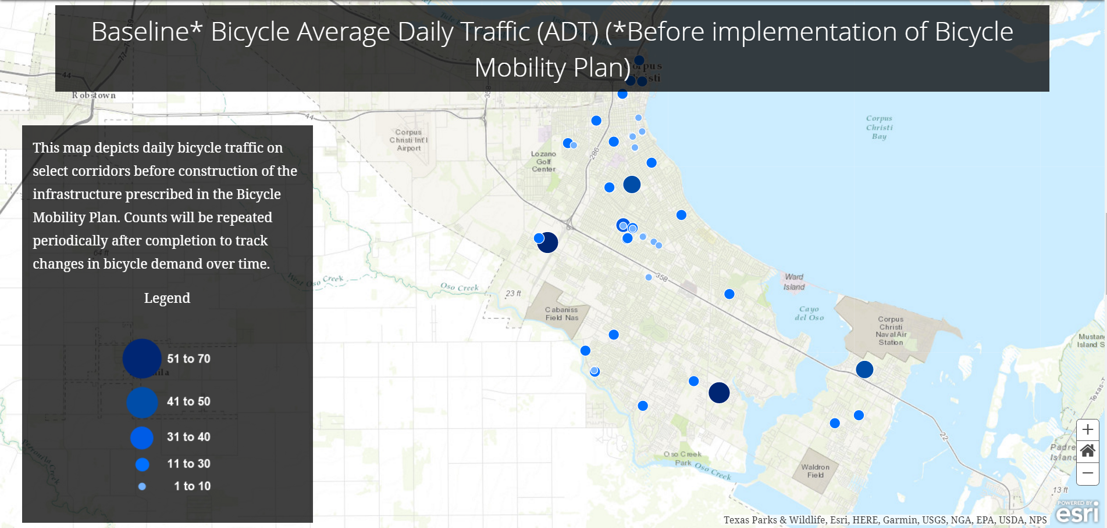
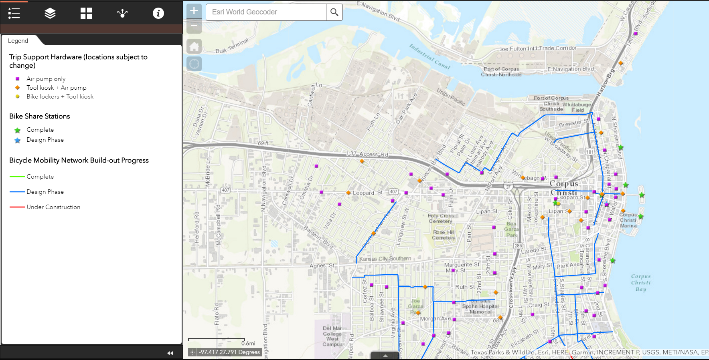
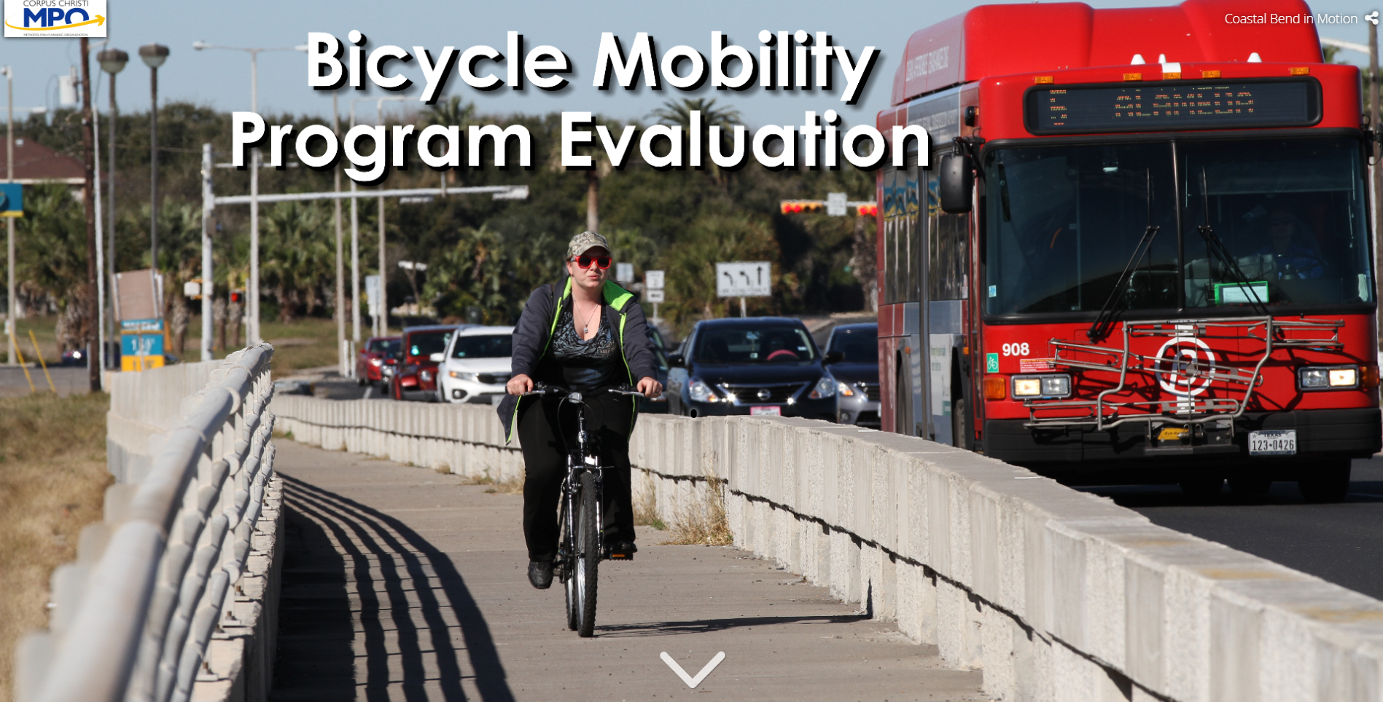
www.Coastal BendInMotion.org
Notes:
I alluded earlier to our MPO’s focus on non-vehicular modes. Last year at this event, I presented the first phase of our Strategic Plan for Active Mobility, our Bicycle Mobility Plan. That work has been identified as a national best practice and implementation is well underway; I’d welcome the chance to visit with any of you about that work after this session, but I mention it now b/c I want to share a discrete tool that we’ve set up to foster accountability and transparency in our evaluation of that program. We report the data for all of our bicycle mobility related performance metrics—which are part of our larger performance-based framework– through a story map that is available through our program website.
You can see from these screen grabs that we report on:
the status of infrastructure
trends in bike demand (as measured through bicycle counts)
rider experience (per a community survey that we plan to repeat every 3 years or so).
trends in safety metrics

Slide 12
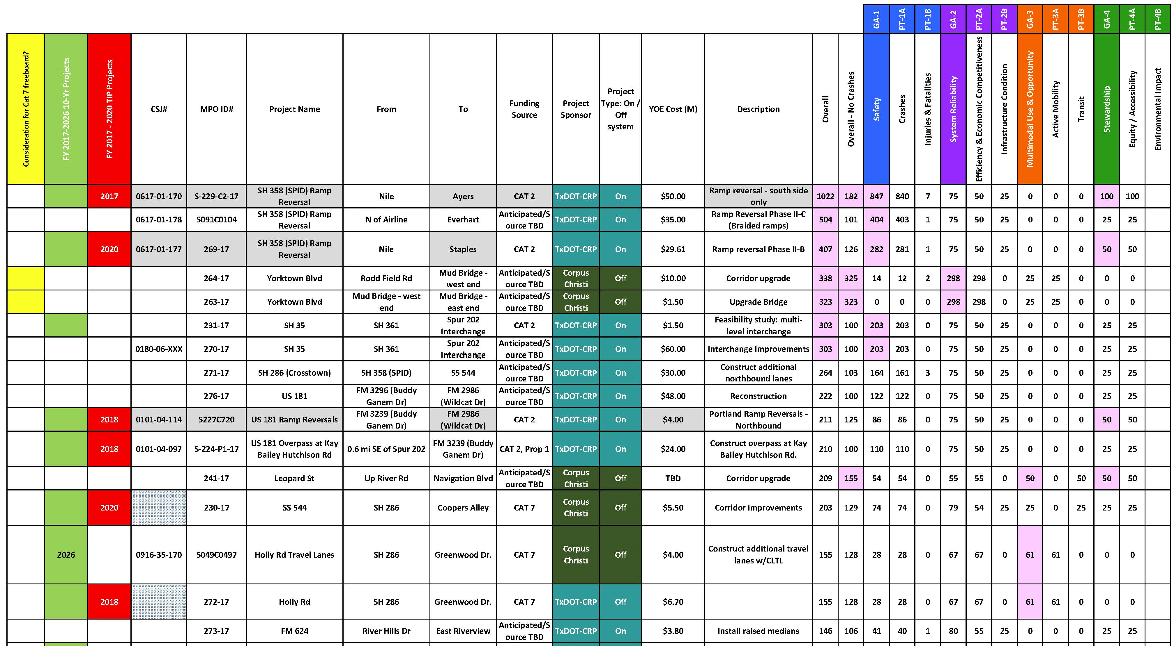
Notes:
Pilot application:
All projects in MTP were scored for all metrics; no weighting factors or multipliers except for one:
> Volume to design capacity ratio: multiplied by 100 to make scale of data ranges commensurate with metrics
Yes/no binary metrics scored with 25 for yes, 0 for no, which translates into a meaningful, but not overly influential, value. ** This value is infinitely cusomizable
Obviously units are highly variable for different metrics; units are irrelevant. All metric scores for a given project added to yield composite score and afford apples to apples comparison

Slide 13
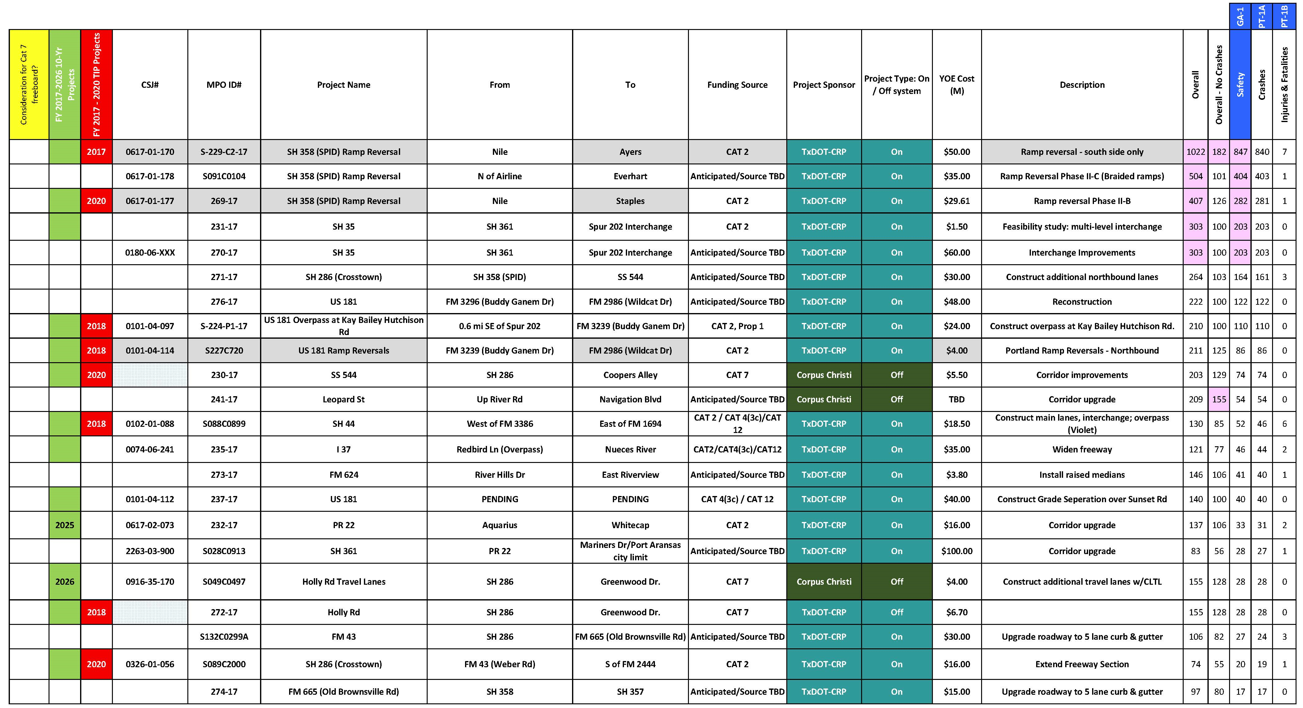

Slide 14
“The CMP uses an objectives-driven, performance-based approach to planning for congestion management. Through the use of congestion management objectives and performance measures, the CMP provides a mechanism for ensuring that investment decisions are made with a clear focus on desired outcomes.”
“. . . the CMP shall be developed and implemented as an integrated part of the metropolitan transportation planning process; however, Federal regulations are not prescriptive regarding the methods and approaches that must be used to implement a CMP.”
www.ops.fhwa.dot.gov
Notes:
Entire performance-based planning framework lives is embedded in our Congestion Management Process.
We’ve learned the hard way that (from FHWA feedback) that this is an unconventional way to approach the CMP, but our justification for this is straightforward and goes something like this:
As a region, recurring congestion is not the principal determinant of how we prioritize capital investments in transportation. In other words, for our MPO, the “desired outcomes” referenced in this quote from FHWA aren’t explicitly related to congestion.
2. We have 6 metrics in our performance-based planning framework that address congestion explicitly, and thus we have a data basis for this decision (that recurring congestion is not our biggest issue)
3. As such, we’ve made the decision to address congestion (recurring and non-recurring) implicitly—although still directly– in the context of broader mobility and efficiency objectives under the following premise:
In so much as congestion is a function of inefficiency in the transportation system, all of the activities undertaken by an MPO to enhance transportation efficiency—from travel demand management to capacity projects—are congestion management strategies and fall under the CMP.
4. The objectives that we’ve defined for our regional transportation system (as required by the CMP) correlate to the 4 goal areas that highest tier of organization for our performance-based planning framework, and thus the performance measurement topics and associated performance metrics are our means of evaluating progress toward these regional objectives

Slide 15
jpollack@cctxmpo.us
www.corpuschristi-mpo.org
www.CoastalBendInMotion.org

