Slide 1


I-10 & I-17 Spine Corridor Master Plan
Optimizing Online Public Involvement for Broad & Diverse Outreach
Audra Koester Thomas

Slide 2
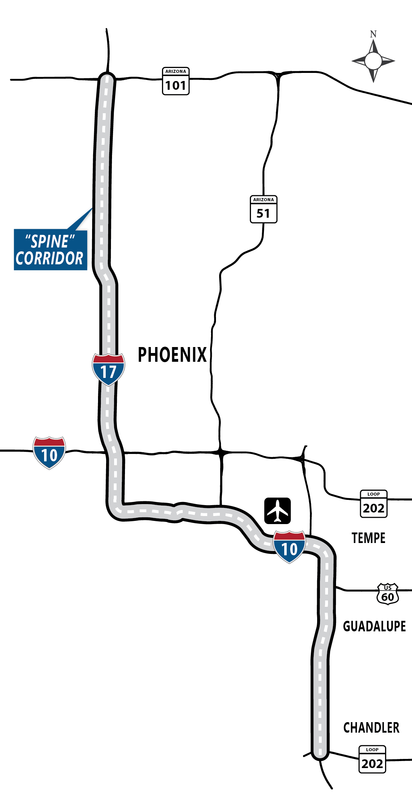
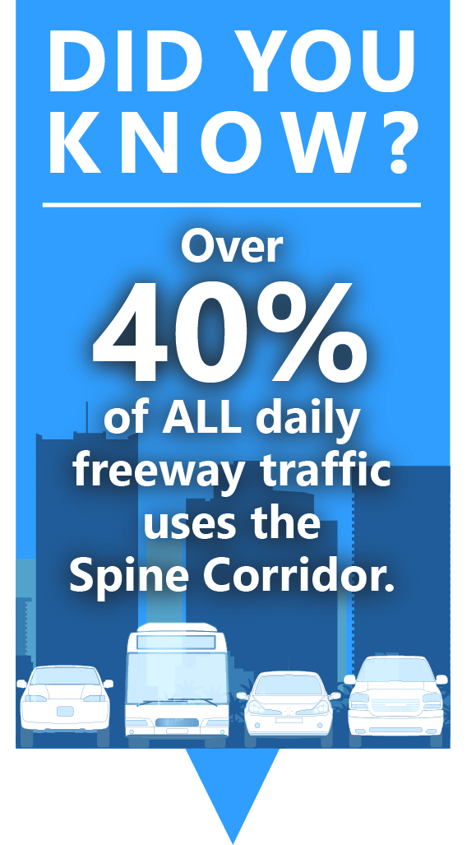
31-mile corridor
$1.47 billion programmed

Slide 3
❶ Offer multiple ways to engage

Slide 4
Public meetings
Presentations
Social media
Online tool

Slide 5
❷ Provide insightful, delightful opportunities

Slide 6
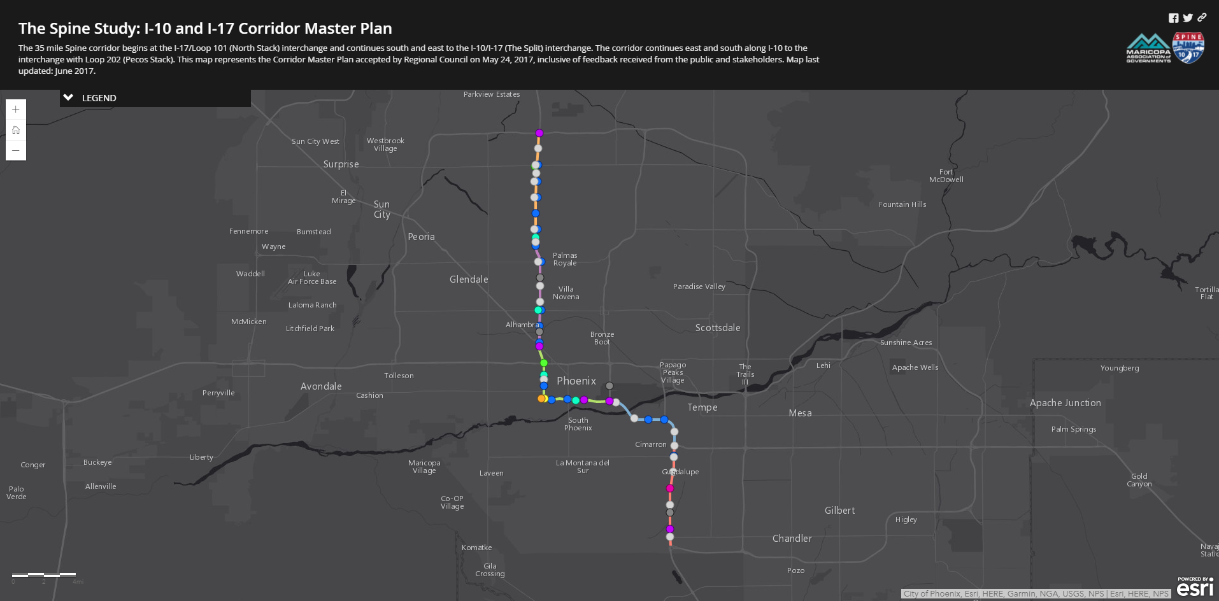

Slide 7
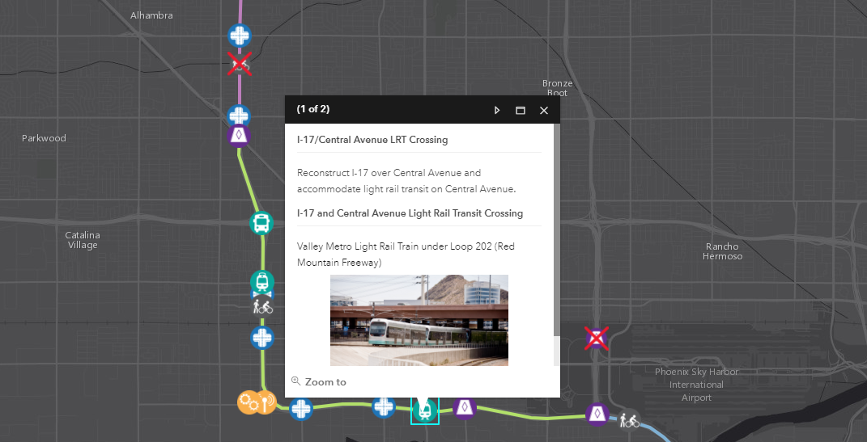

Slide 8
❸ Communicate back results

Slide 9
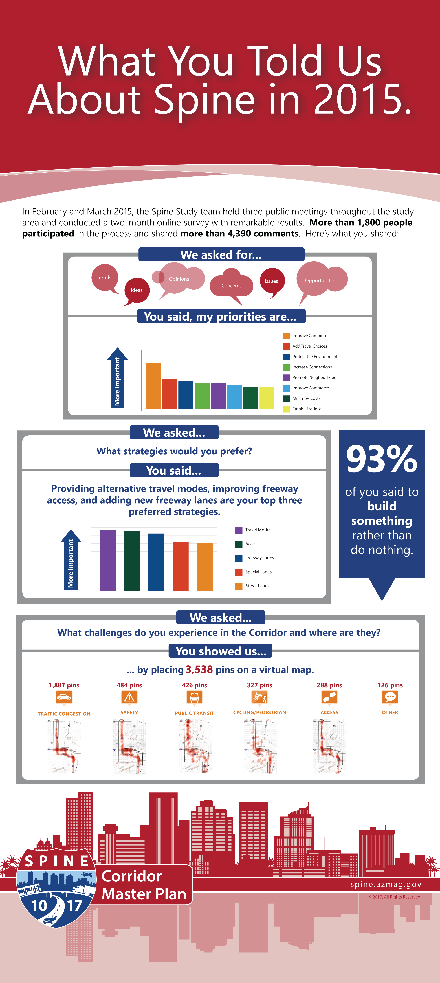

Slide 12
So…what?

Slide 13
68 total attendees at 3 public meetings
over 1,800 online participants

Slide 14
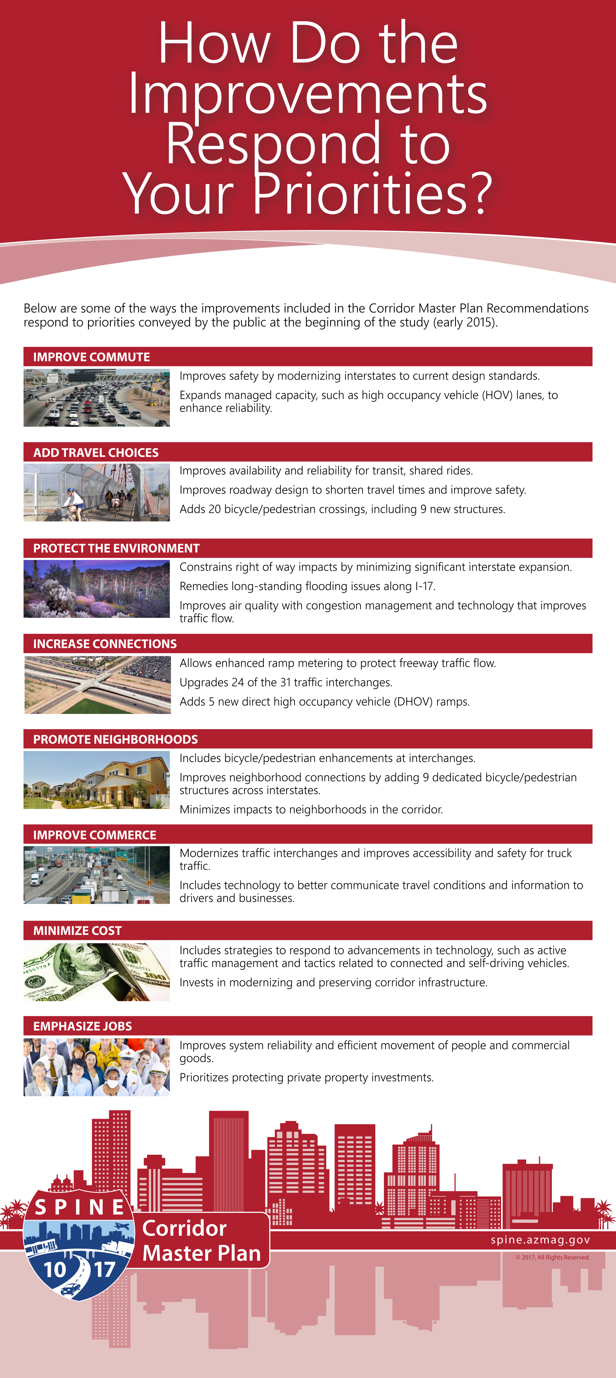
Detailed how the study recommendation responded to priorities conveyed by the public at the beginning of the study.

Slide 15
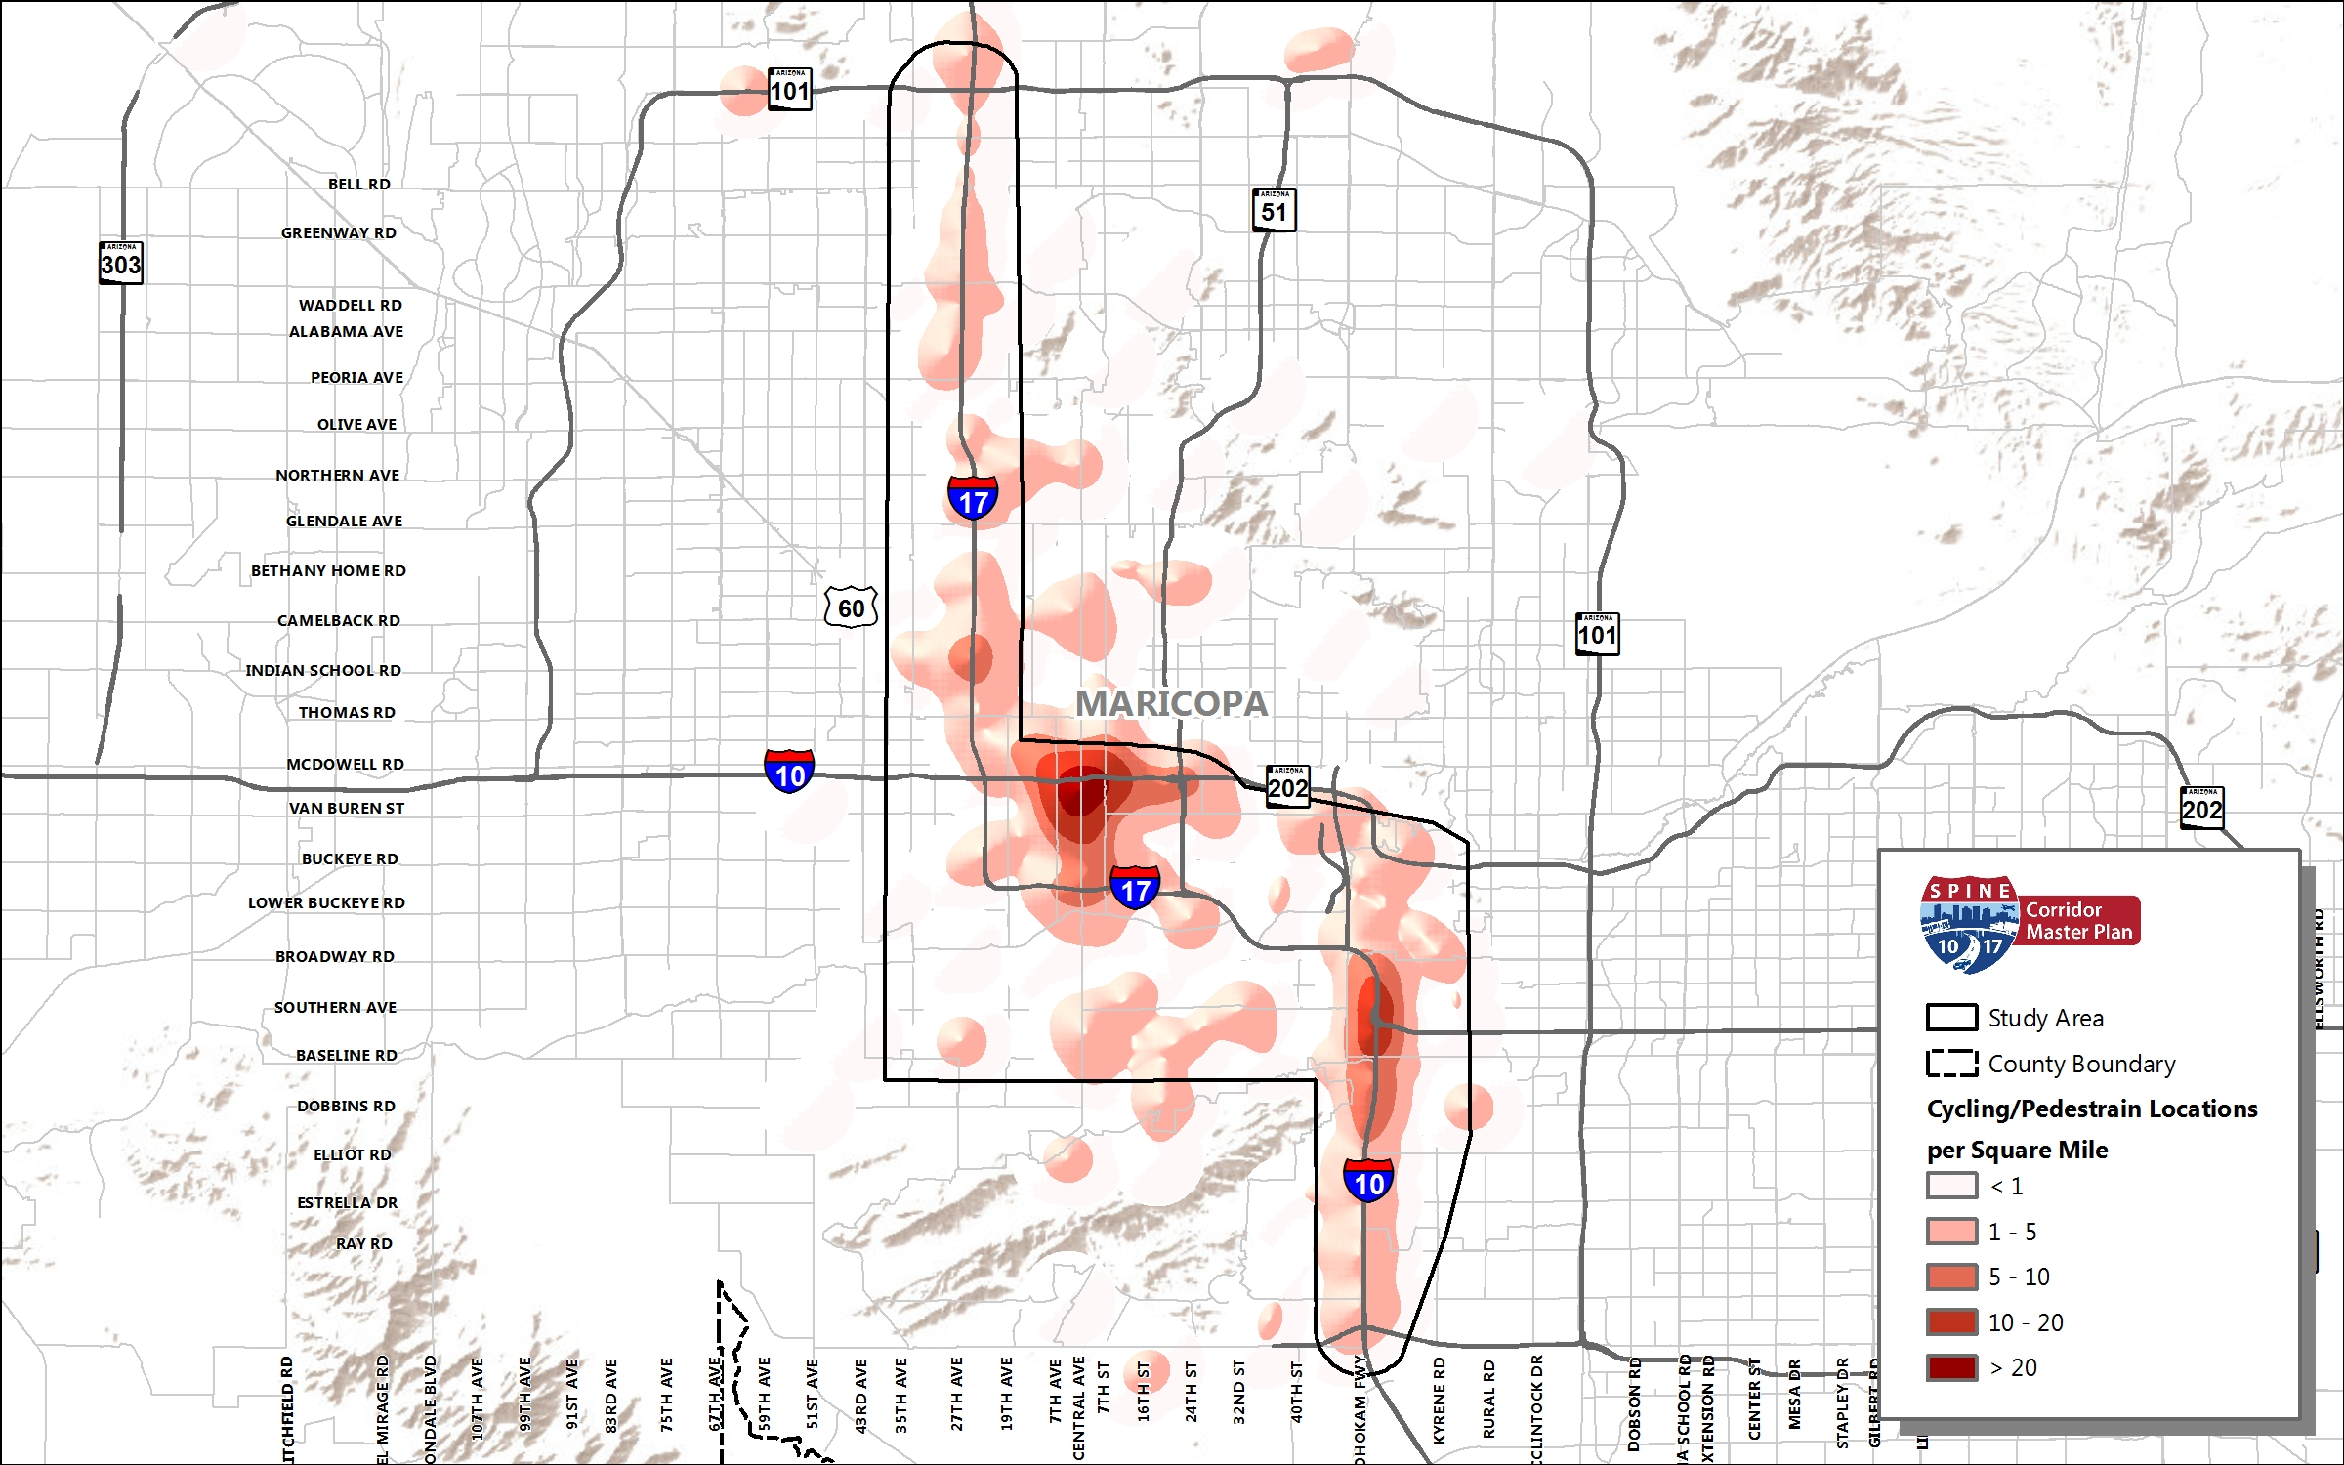
Garnered precise feedback.

Slide 16
I-10 & I-17 Spine Corridor Master Plan
Optimizing Online Public Involvement for Broad & Diverse Outreach
Audra Koester Thomas
Transportation Planning Program Manager
602.254.6300
akthomas@azmag.gov spine.azmag.gov

