Slide 1
Thursday Oct 6, 2016, 9:05pm – day prior to Hurricane Matthew

Slide 2
Thursday Oct 6, 2016, 11:07pm – day prior to Hurricane Matthew

Slide 3
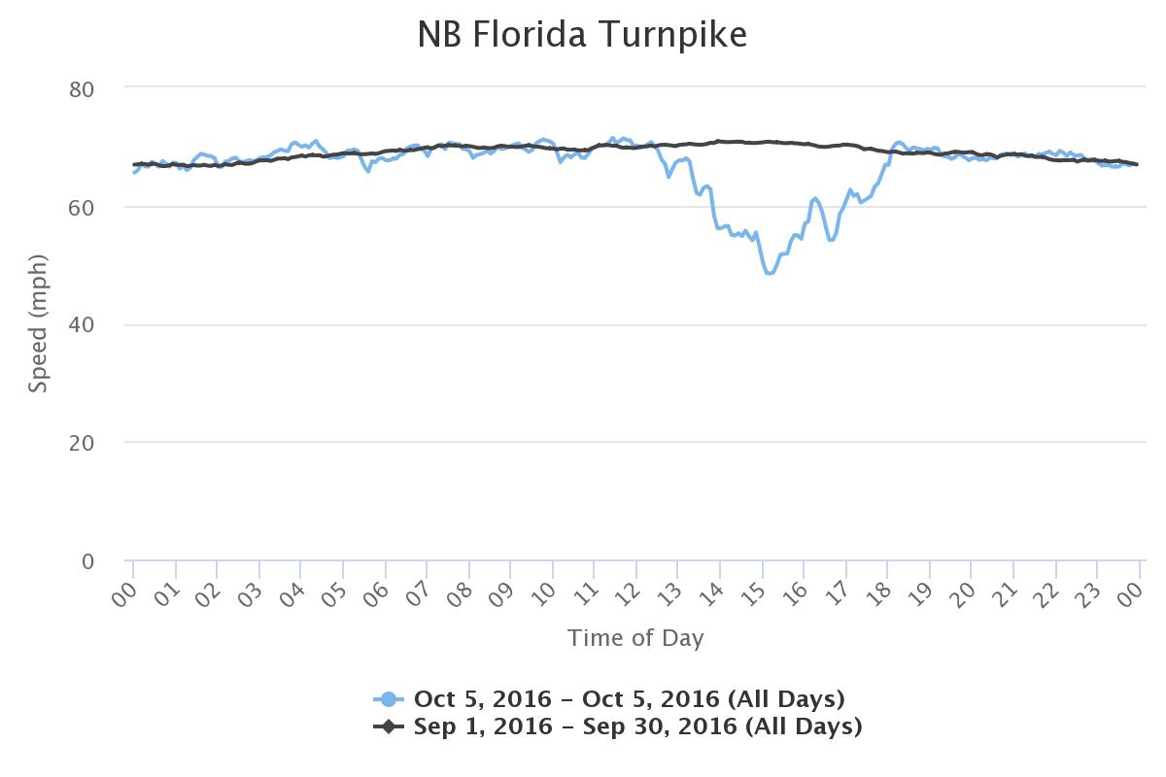
Hurricane Matthew Evacuation – NB Florida’s Turnpike, October 5, 2017 (one day before landfall)

Slide 4
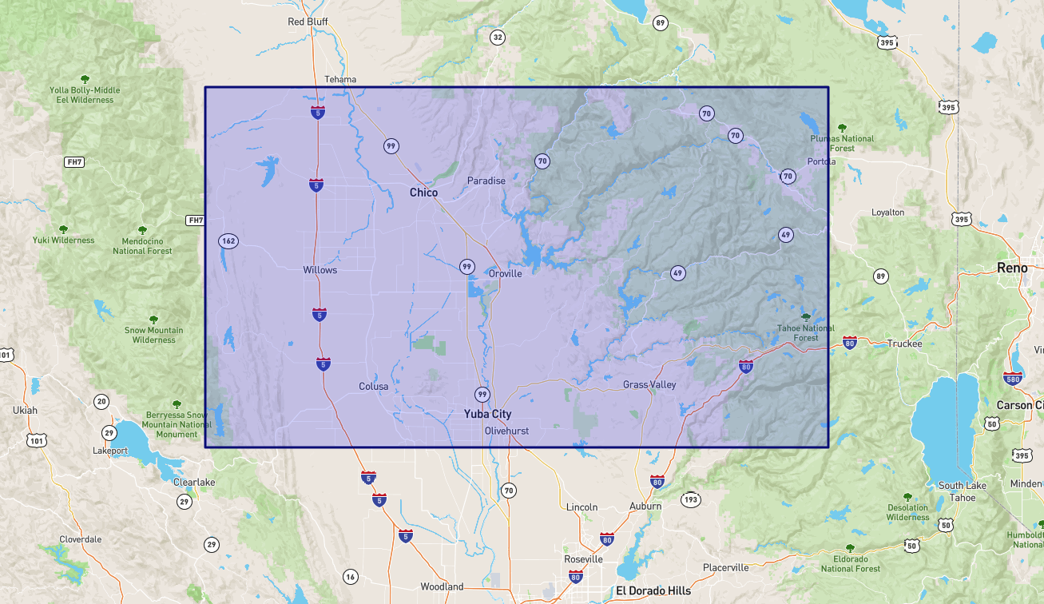
Oroville Dam Mandatory Evacuation
Approximately 70 miles north of Sacramento
Approximately 180,000 people evacuated
Impacted three counties Butte, Sutter and Yuba
Mandatory evacuation lasted three days

Slide 6
NB CA 99/149 and SB CA 70 Exiting Oroville – Sunday, February 12, 2017
Mandatory evacuation order given at 4:58 pm 2/12/17

Slide 7
Conclusions
Probe Data Has Many Before and After Uses
General Uses:
Calibrate Travel Demand Models
Trips patterns with routing
Detailed speed and travel time profiles
Assessing system changes over time
Relative trip volumes
Linking demographic information with associated trips
Freight Movements
Signal System Performance
Work Zone Performance
Emergency Operations - Before:
Plan Evacuation/Diversion Routes
Calibrate Travel Demand Models
Emergency Operations After:
Assess Actual Driver Behavior
Evaluate Actual Routes used
Efficiency of Operations,
Develop Lessons Learned for Future Operations

Slide 8
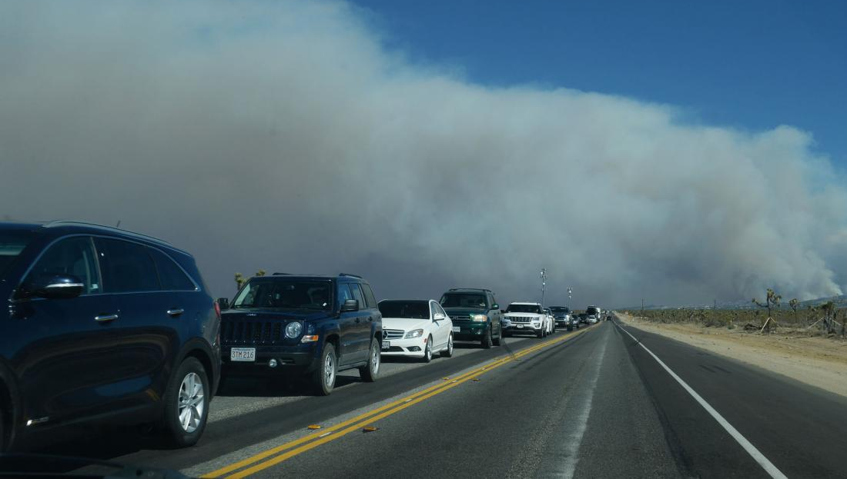
Questions?
Gary Carlin
425-495-5476
gary.carlin@inrix.com
Photo credit: UPI.com – Blue Cut Fire 2016

