Slide 1
Approach to Transportation Planning for Connected and Automated Vehicles
Association of Metropolitan Planning Organizations
Annual Conference
Fort Worth, Texas October 2016

Slide 2
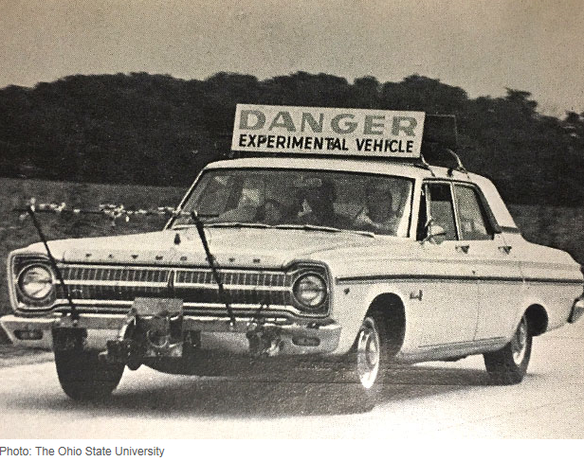
July 1969, IEEE Spectrum
The Electronic Highway, by Robert E. Fenton and Karl W. Olson, Ohio State University
There seems little question that vehicle automation is technologically feasible; however, a tremendous amount of effort in both research and development will be required before a satisfactory automatic system is in operation. This effort must involve not only vehicle-control studies, but also an intensive investigation of the present driver-vehicle complex, since the knowledge gained will be necessary for the proper specification and introduction of the control system components. Further, the need exists for intensive overall system studies so that optimum strategies can be chosen for headway spacing control, merging and lane changing, and the interfacing of automated highways with other modes of future transportation.

Slide 3
Transportation Planning is Changed
The landscape of transportation planning is different today from the past several decades
Predictable Changes from the past
  increase in women entering the workforce in greater numbers
  decrease in household sizes
  no paradigm to follow on the
    scale/magnitude of CAV
    unpredictability of the impacts of CAV
This leaves today’s transportation planners with the dilemma of expecting transformation changes from technology but not being able to adequately determine the impact that the technology will have.

Slide 4
CAVs Potentially Addresses
All Goal Areas
Safety
Infrastructure Condition
Congestion Reduction
System Reliability
Freight Movement and Economic Vitality
Environmental Sustainability
Reduced Project Delivery Delays

Slide 5
Additional Expected Benefits
Innovation Economy
Repurposed/Reoriented Land Use/Growth
Increased Productivity
Improved Workplace Mobility
Improved Accessibility and Equity
Improved Livability
  Active Transportation
  Less Noise Pollution

Slide 6
What Planners May be Thinking
Unawareness of Potential Impacts
Skepticism
Uncertainty
Too Far Removed to Consider Now
Many Game Changers; not just AV
        “Planning for Cars that Drive Themselves”
        Erick Guerra, University of Pennsylvania, 2015

Slide 7


3 Keys to Transportation Planning for AV/CV
Research and Monitor Behavioral Changes
Forecast AV/CV Impacts
Scenario Planning for Uncertain Future
With AV/CV
Without AV/CV

Slide 8
1. Research and Monitor Behavioral Changes
  Polling Attitudes and Stated Preference
  Refining over Time with Revealed Data
  Seek to Develop Greater and Better use of Passive Data
    Coordination with Private Sector vendors and aggregators
    Research and Demonstration Projects
    As Connected Automated Vehicle (CAV) replace AV, secure public access to data

Slide 9
1. Research and Monitor Behavioral Changes (cont.)
Seek to Build Integrated Data System for:
  Public Data Policy,
  Technology, and
  Sharing

Slide 10
Needs for AV Integrated Data System
  Policy: Cooperatively Determine which Data is held Privately and which Data can/must be in Public Domain
  Technology: Create Transportation Management Centers (TMCs) and other Public Institutions to Gather, Process, Disseminate Data
  Sharing: Create and Incentivize Data Sharing at ALL Levels
    User – Trip/Tour Planning
    Corporate - value added services
    Public Agency – Planning, Research & Development

Slide 11
2. Forecast AV/CV Impacts
Demonstrate Capacity Impacts/Potential of AV/CV
  Digitally using Computer Models
  Testbeds, connecting physical vehicles and infrastructure
  Field Testing, AI Development
Estimate Impacts with Existing Tools
Develop and Implement New Tools as Deployment Occurs
Do both Regional Modeling and Regional Simulation
  Modeling (Calibrated to observed behavioral data)
  Simulation (Impose scenarios into modeling frameworks)

Slide 12
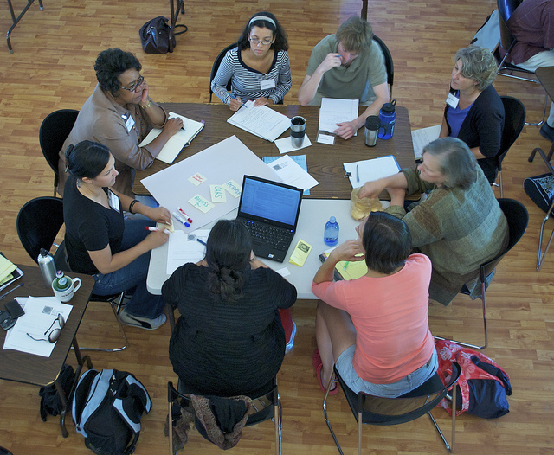
3. Scenario Planning
  Education, Training
  Develop Reasonable Scenarios, Timeframes
  Coordinate Common Themes across Regions

Slide 13

Scenario Planning is…
The use of multiple possible futures to assess various impacts and prepare for them
Active stakeholder engagement
Designed for Uncertain Futures
Not the same as alternatives analysis

Slide 14
Not planning as usual…
Scenario Planning | Alternatives Analysis
Multiple Futures | Pick One and Stick with It
Uncertain, descriptive | Measureable, quantifiable
Focus on Magnitude and Likelihood | Focus on Timeframe and Trend
Reliance on Prediction could be Detrimental | Accurate Prediction is Assumed
Variations in Impacts, focus on Relationships | Maximize Specifically Desired Benefits
Needs Judgement, Assessment of impacts from Multiple Scenarios | One Decision is Clearly Better than Others and Impacts from Losers are not considered
Active Public Engagement | Active Public Engagement

Slide 15

A Simple Difference:
Alternatives Analysis
Assess multiple futures, then pick one
Scenario Analysis
Assess multiple futures, prepare for impacts

Slide 16
Scenario Planning Process
Scenario Planning Process (Automated Futures)
  Develop Alternative Scenarios
    AV/CV - Use Cases
  Determine Fundamental Impacts from all Scenarios
    Requires acceptance of risk in initial years
    Better confidence as deployment occurs
  Assess both Likelihood and Magnitude of Impacts
    Better confidence as deployment occurs
  Consolidate Plans to Address Most Likely and Impactful Items
    Don’t throw away the less likely/impactful
  Re-assess Less Likely and Impactful Items Periodically

Slide 17
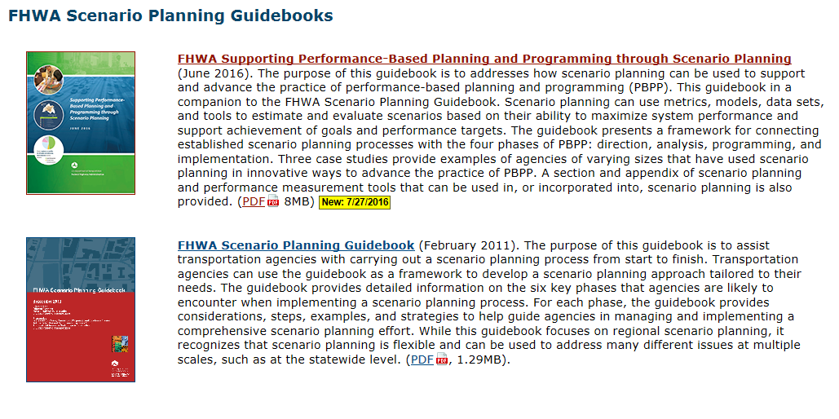
FHWA Scenario Planning Guidebooks:
“The ultimate outcome is a shared future vision that provides a framework for transportation priorities, goals, recommendations, and investments. Through comparing scenarios and discussing their possible outcomes, the technique helps participants to identify and challenge assumptions about the future, discuss tradeoffs, and make better decisions.”
http://www.fhwa.dot.gov/planning/scenario_and_visualization/scenario_planning/

Slide 18
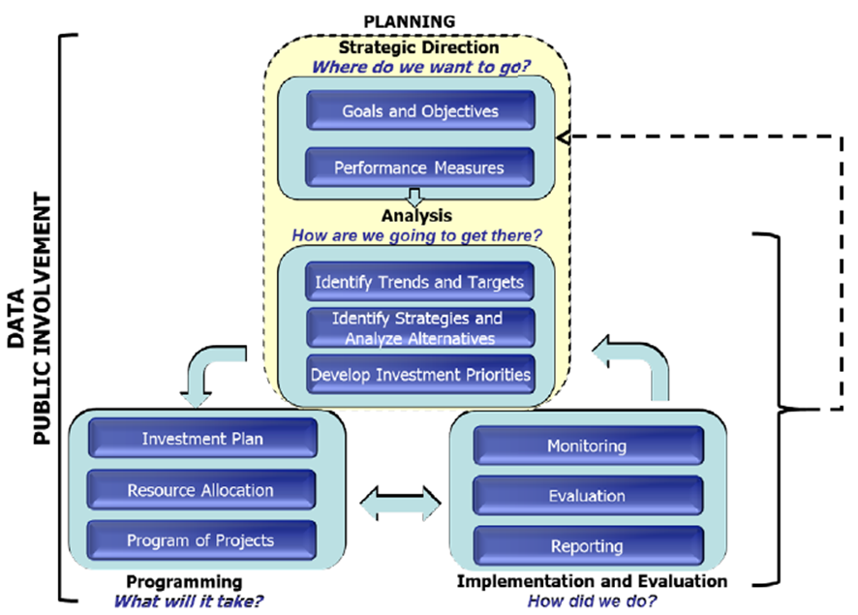
PBPP: Performance Based Planning Process (FHWA)

Slide 19
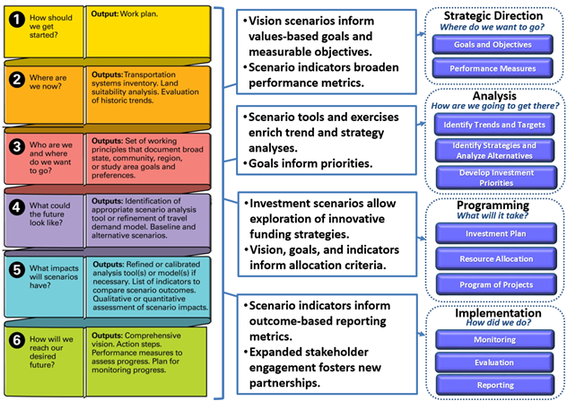
A Framework for Integrating Performance Based Planning and Programming with Scenario Planning
“Supporting Performance-Based Planning and Programming through Scenario Planning” FHWA, June 2016, Hannah Twaddell (ICF), Alanna McKeeman (ICF), Michael Grant (ICF), Jessica Klion (ICF), Uri Avin, Kate Ange (Renaissance), Mike Callahan (Renaissance), Online at http://www.fhwa.dot.gov/planning/scenario_and_visualization/scenario_planning/scenario_planning_guidebook/index.cfm . Accessed July 2016.

Slide 20
Scenario-Integrated PBPP
PLANNING
PLANNING
Strategic Direction
Where do we want to go?
Strategic Direction
Where do we want to go?
Goals and Objectives
Goals and Objectives
Performance Measurement
Performance Measurement
Analysis
How are we going to get there?
Analysis
How are we going to get there?
Scenario Development
Identify Trends and Targets
Multiple Scenario Analysis
Identify Strategies and Analyze Alternatives
Scenario Consolidation
Develop Investment Priorities
Assess Magnitude and Likelihood
Prioritize Actions

Slide 21
Conceptual Use Concepts
Help to Imagine
  Operational Characteristics
  Use Patterns by Various Population Segments
  Critical Hurdles and Gaps
CAVs, SAVs, Delivery, Freight
Some ideas
  City Center
  Exclusive Lanes
  Smart Corridors

Slide 22



7
TC
3
1
4
Transition Facility
City Center
PNR
KNR
8
TC
AV Freight Access
2
9
5
10
Mass Transit
Manual Auto
SAV
Private AV
6
Smart Corridor
TC

Slide 23
Features of City Center Concept
100% AV Zone (AVZ)
Smart Corridors/Automated Freight Delivery
Transit Transfer Centers
Transition Facilities
Automated Parking (perimeter/internal)
Pricing Schema (TNC/Fleet discount?)
Added Safety, Active Transportation, Density, Open Space, Reduced Noise

Slide 24
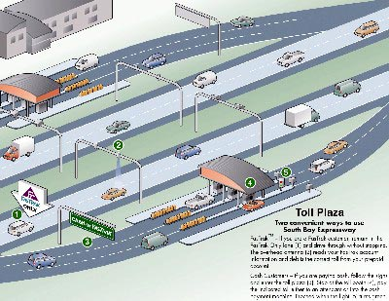
AV Transition Facility
AV mode
Bypass (AV Only)
Transition Facility
Guides manually operated vehicles to safe lanes where AV mode is turned on
Guides AV to safe zone where driver can take over
Other AVs can pass directly through facility
Manual mode

Slide 25
Making decisions based on past certainty when faced with knowledge of an uncertain future is folly.

Slide 26
Contact
Tom Williams
TTI-Austin
512-407-1124
t-williams@tti.tamu.edu

