Slide 1
OVERVIEW
Tolled Managed Lanes Dan Lamers, P.E.
Automated Vehicles Natalie Bettger
Peak Shoulder Project Jory Dille
Big Data Arash Mirzaei, P.E.
Travel Demand Management Sonya Landrum
Innovative Funding Adam Beckom

Slide 2
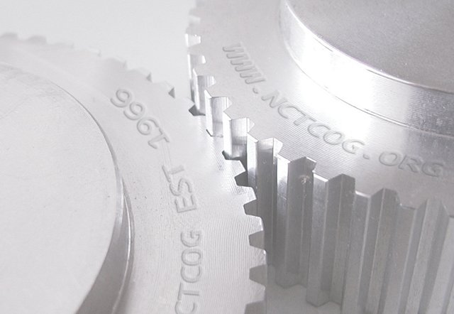
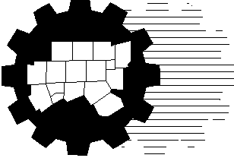
Managed Lane Performance Data
AMPO
October 27, 2016
Dan Lamers, P.E.
North Central Texas Council of Governments
Transportation Department

Slide 3
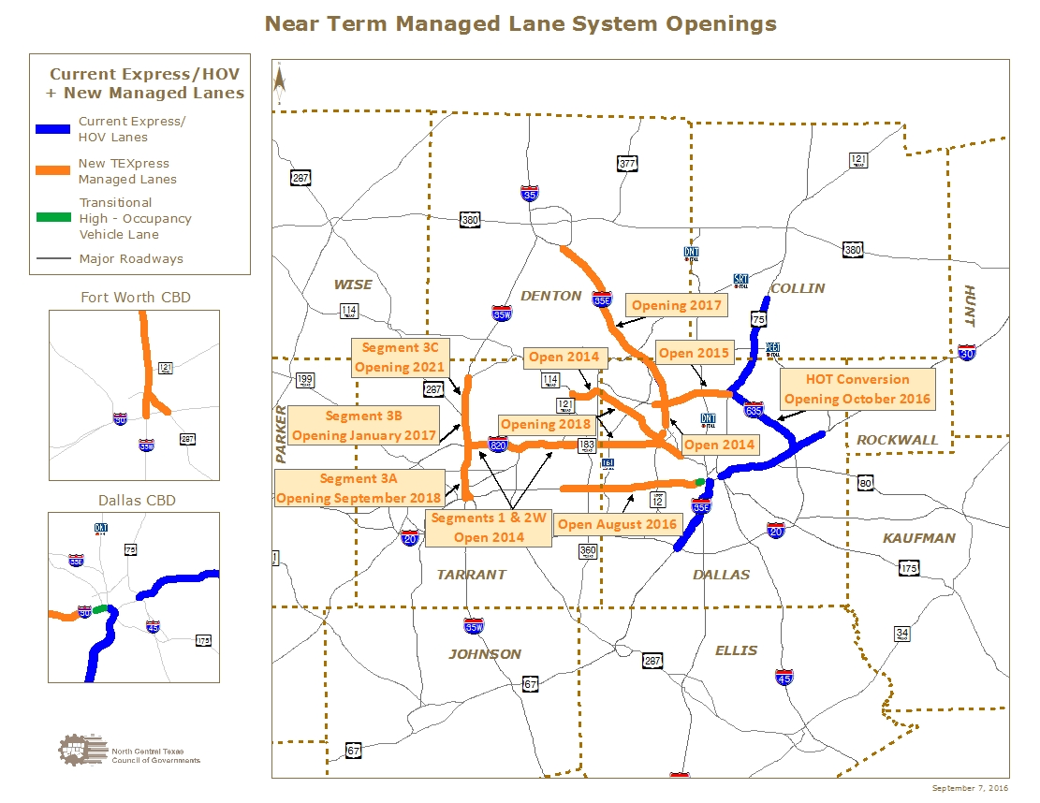

Slide 4
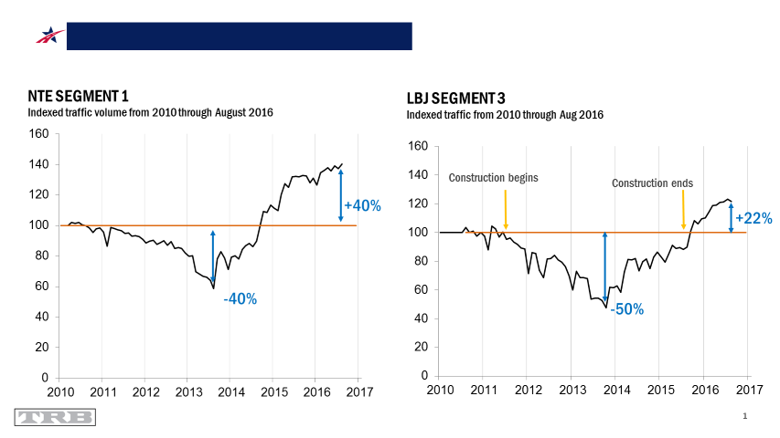
4

Slide 5
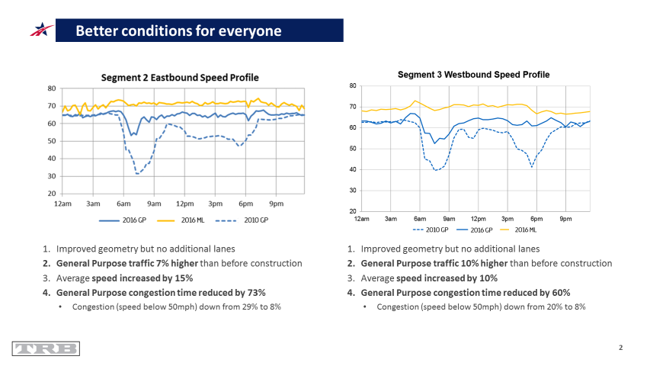
5

Slide 6








  TEXpress Lanes Are For Everyone
6+ million
different vehicles have used the LBJ & NTE to date
5 in 14 users are new
to the TEXpress Lanes each month
The most common car makers seen on the TEXpress Lanes are Toyota, Ford, Honda
Only 15% of cars are luxury brands
More than 10 in 14 users
view the TEXpress Lanes favorably
7 million
people live in Dallas-Ft. Worth
6
Source: NTE & LBJ Managed “TEXpress” Lanes: Key Facts After Initial Operations, Alberto Gonzalez, June 10, 2016
Notes:
6
Obviously there are out of state and out of town but the number is pretty impressive

Slide 7

Automated Vehicles:
Overview of Technologies and Implications
Association of Metropolitan Planning Organizations
October 27, 2016
Natalie Bettger
North Central Texas Council of Governments
Notes:
Opening remarks.

Slide 8
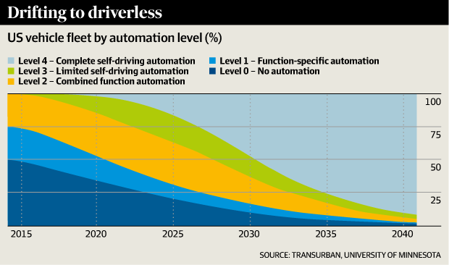
Autonomous Vehicles: Long Term
Notes:
Experts envision fairly speedy adoption. This chart by big road operator Transurban and U. of MN predicts that by end of our 2040 plan the overwhelming majority of vehicles will be capable of fully autonomous operation. [Use pointer]

Slide 9
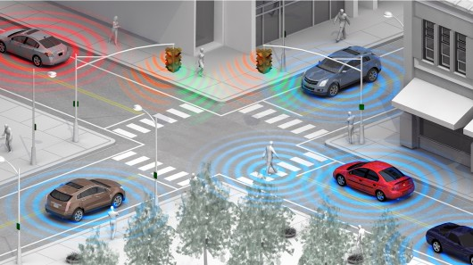
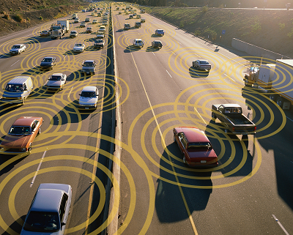

Connected Vehicles
Notes:
The federal government is driving vehicle-to-vehicle connections using a dedicated wireless band called DSRC. Each vehicle will broadcast a basic safety message—its speed, direction of travel, braking action, etc. that other vehicles in the vicinity can use to avoid crashes and deal with risks such as black ice or flooding. USDOT has indicated that it intends to mandate equipping new vehicles with this technology beginning in 2020, but the proposed rule has been a long time coming.

Slide 10
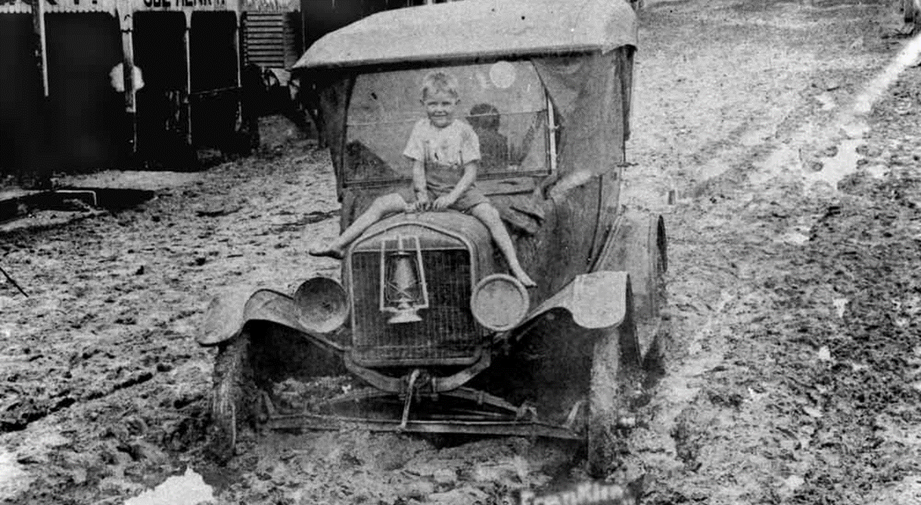
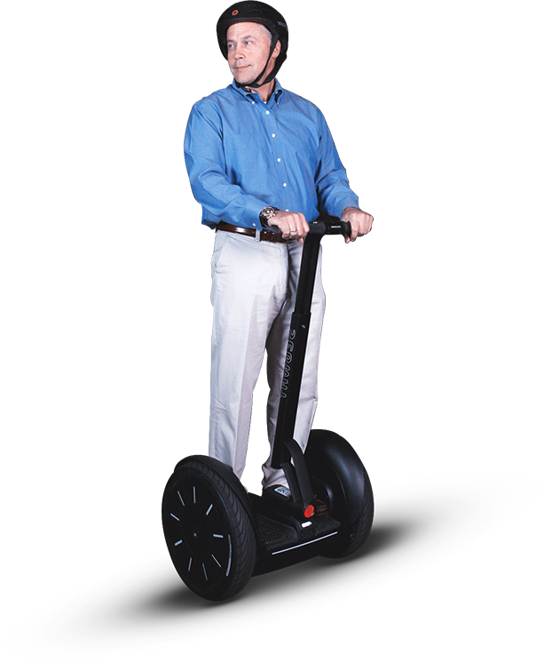

Challenges to AV Adoption
Technology limits
Consumer acceptance
Privacy/cybersecurity
Legal/regulatory
Infrastructure mismatch
Notes:
Folks have been working on vehicle and highway automation for a century. There are significant challenges before there is success this time. [Go through each briefly.]

Slide 11
Preparing Region For AVs
New position
Maintain current assets in good repair
Make transportation data accessible in real-time
Support shared mobility services
Factor AVs into planning decisions
Support AV development, e.g. IH 30 pilot test corridor
Target AVs to pursue social equity goals and economic development
Notes:
This region can take prudent steps to be ready for vehicle automation. AVs need well-maintained highways/streets to function—lane markings key. The more real-time information about our system that is readily available to designers and operators of automated vehicles, the faster and better they will roll out here. Shared mobility services are important to increase the vehicle occupancy rate—which will help reduce congestion where technology alone cannot. Factor AVs into planning/capital investment decisions—are there opportunities for using technology to deliver improvements more cost-effectively than physical expansion of our system. Test bed—I-30. Smart corridor opportunities. If done right, AV can benefit less advantaged perhaps more than anyone—target AV development and early deployment at improving lives of disabled/poor.

Slide 12
SH 161
Peak Shoulder Project
AMPO Conference
10/27/2016
Presented by Jory J. Dille

Slide 13
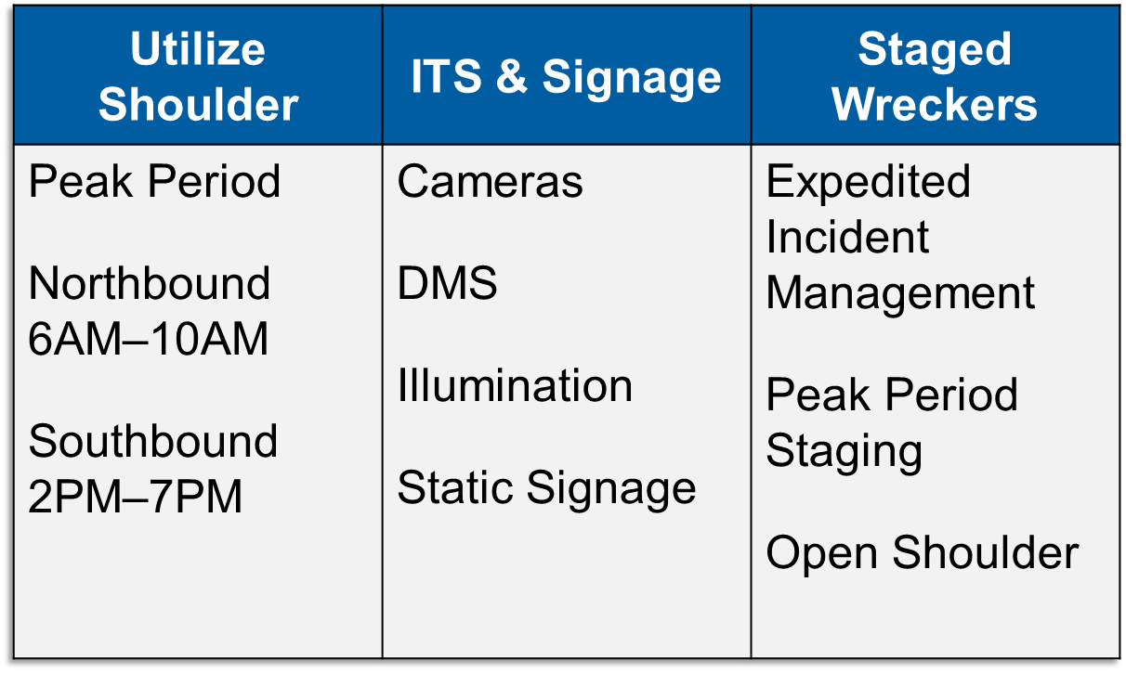
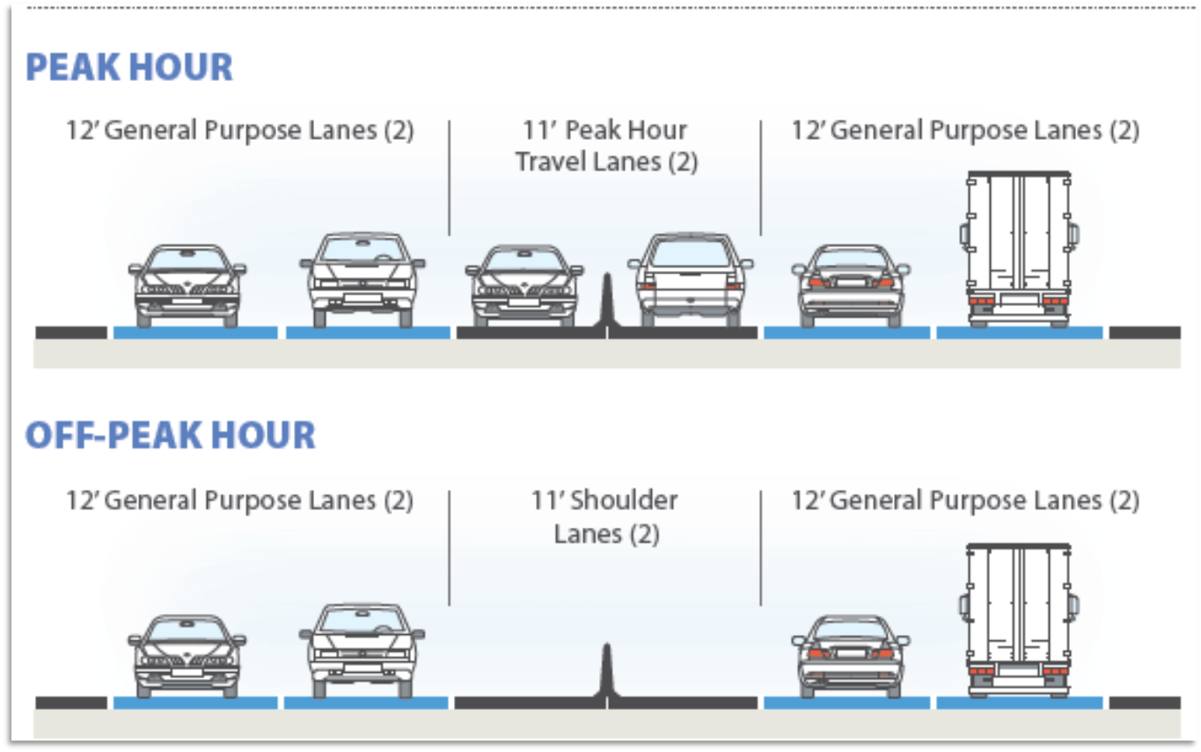
PROJECT INFORMATION
$4.25M PROJECT COST
Notes:
I start out with TxDOT’s Crash Records Information System… (CRIS).
CRIS is a statewide crash database provided by TxDOT
We started receiving the data back in 2007
The data we have goes as far back as 2003 and as recent at April 2012

Slide 14
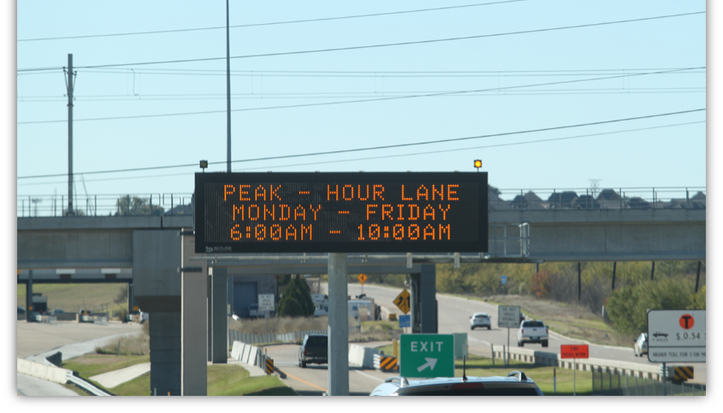
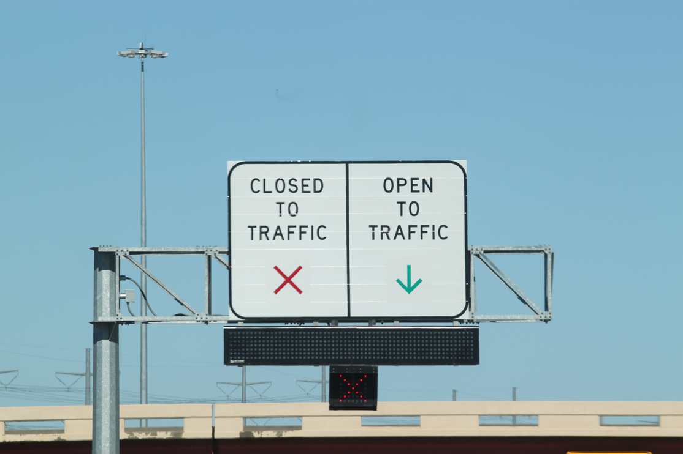
DAILY OPERATIONS
Sweeping lane prior to AM and PM openings
  Verify there are no obstructions (e.g., vehicles or debris)
  Remove light debris
Communication to DalTrans for signs/signals
On-call wrecker staged in corridor during operation hours
*Source of Images: Texas Transportation Institute (TTI)
Notes:
I start out with TxDOT’s Crash Records Information System… (CRIS).
CRIS is a statewide crash database provided by TxDOT
We started receiving the data back in 2007
The data we have goes as far back as 2003 and as recent at April 2012

Slide 15

OBSERVATIONS
Daily volume increase
Average speeds increase
DIRECTION | BEFORE | AFTER
NORTHBOUND | 56,930 | 65,738
SOUTHBOUND | 55,042 | 75,671
*As of May 2016
*As of September 31, 2016
16 MPH
15 MPH
Average Speed Increase
Average Speed Increase

Slide 16
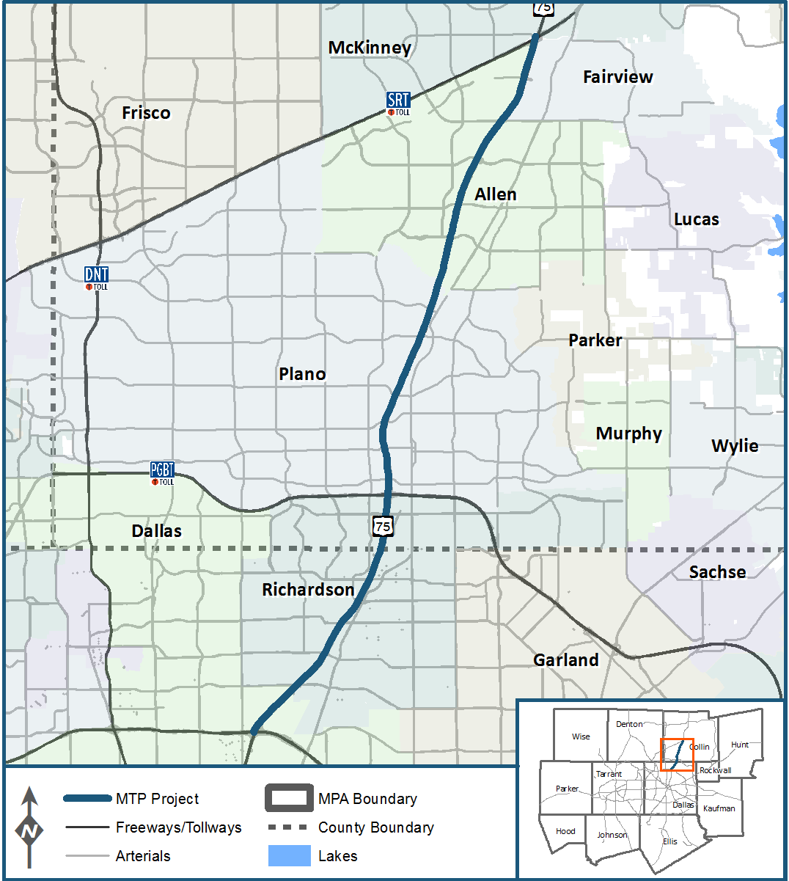
NEXT STEPS
Review after data collection
Identified for 8 lanes (4 NB, 4 SB) in the North Texas Metropolitan Transportation Plan (MTP) 2040 - http://www.nctcog.org/trans/mtp/2040/
Take lessons learned for possible usage on US 75

Slide 17
Use of Big Data in Planning
Arash Mirzaei, P.E.
Senior Program Manager
Model Development and Data Management

Slide 18
Transportation Planning Data
Census (Decennial, ACS, CTPP,…)
Travel Surveys (Household Travel, On-Board,…)
System Data (Traffic Counts, Ridership,…)
Big Data
  Speed (NPMRDS/FHWA)
  Origin-Destination

Slide 19
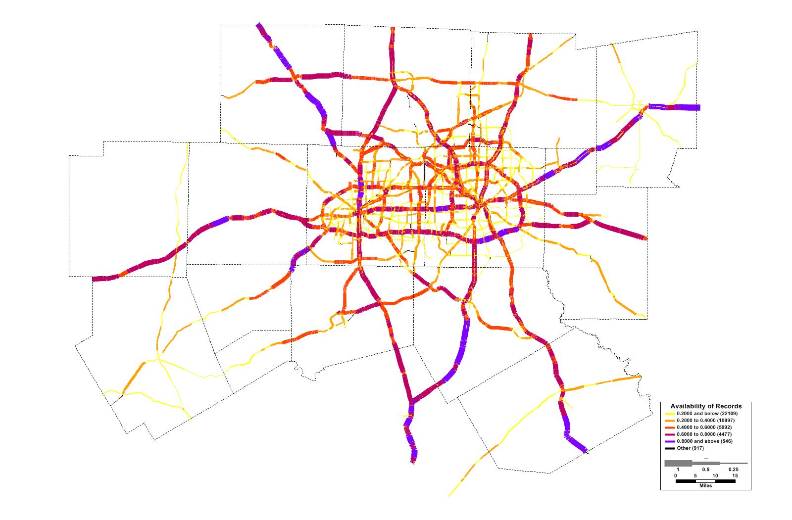
Travel Times Every 5 Minutes
9,300 miles of roads
809 millions of records

Slide 20
Congestion Heat Map

Slide 21
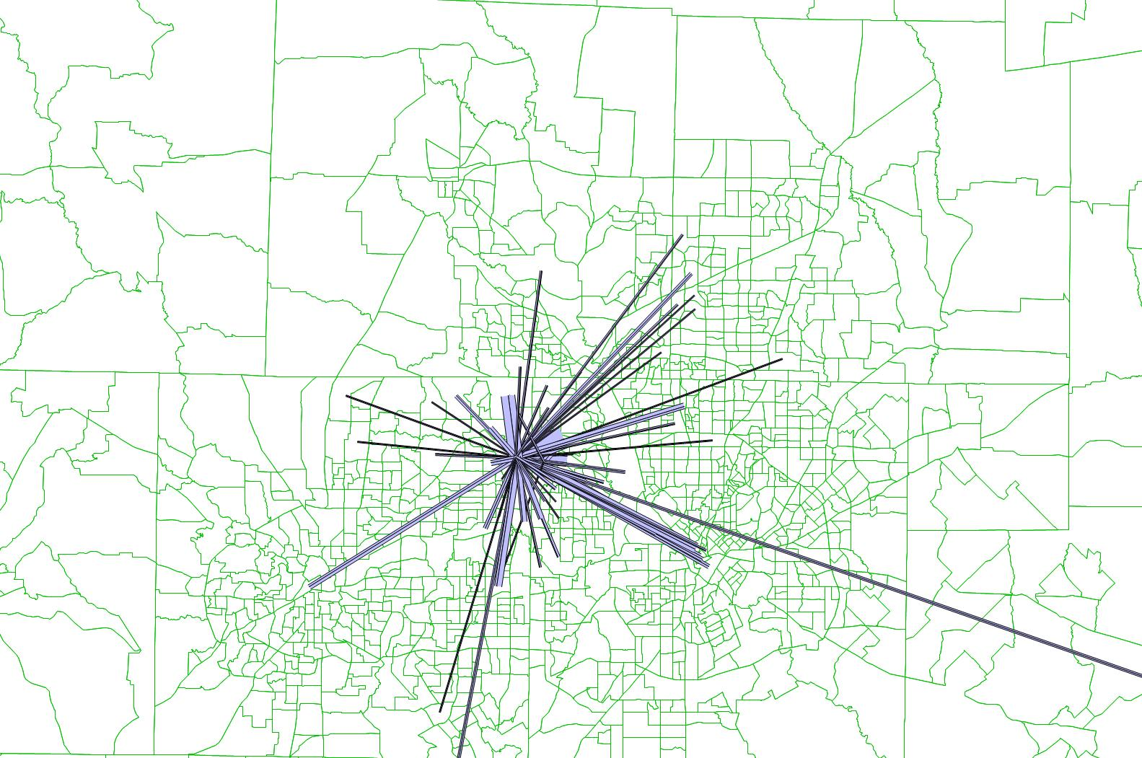
Cellphone Data
February 2016.
450,000 OD pairs
DFW Airport

Slide 22
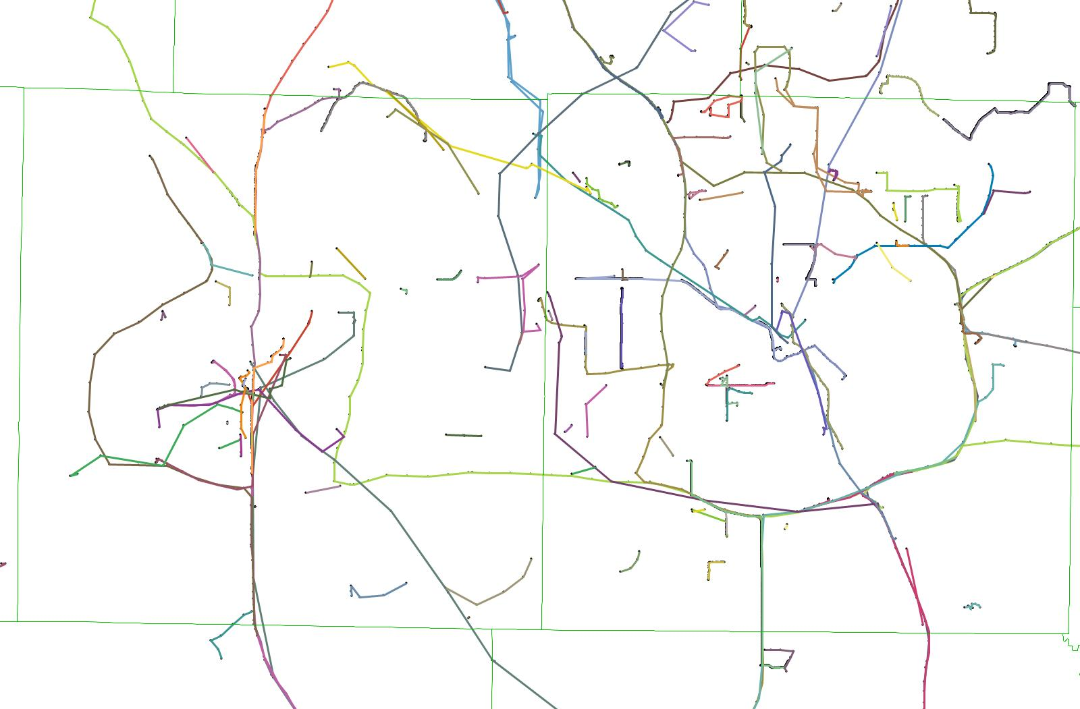
GPS Trips
Jan-Apr 2016
29 Million Trips
1.608 Billion points

Slide 23


Travel demand management
strategies in North Central Texas
and
Try Parking It website
(TRYPARKINGIT.COM)
overview
2016 AMPO Annual Conference
Host Spotlight: Sharing Innovation From Dallas-Fort Worth
October 27, 2016
Sonya Jackson Landrum

Slide 24

What is Travel Demand Management (TDM)?
  NCTCOG TDM Goal: Implementation of strategies that reduce the demand for drive-alone travel on roadways by offering alternatives to driving alone.
  Regional TDM-Related Programs and Initiatives:
  Regional Employer Trip Reduction (ETR) Program
  Regional Vanpool Program
  TryParkingIt.com, Ride-match and Commuter Tracking
  System
  Park-and-Ride Facilities
  Bicycle / Pedestrian Initiatives
  Transit Initiatives

Slide 25
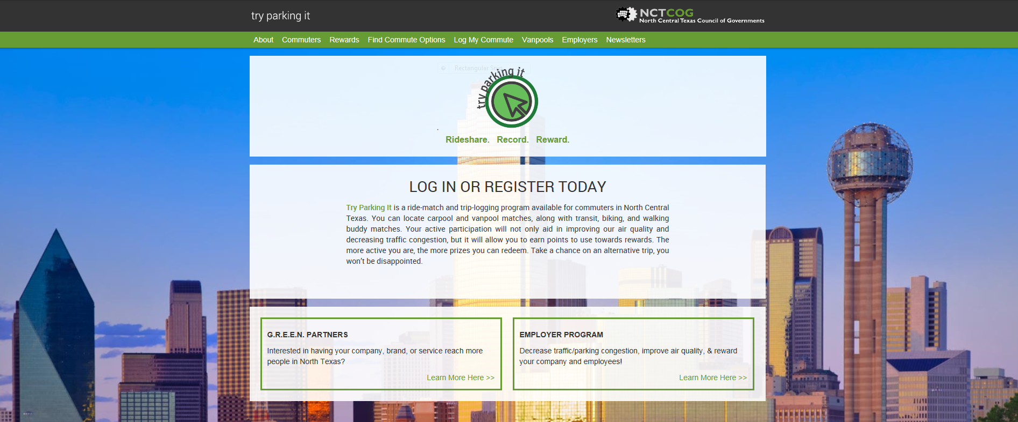
TryParkingIt.com Overview
North Central Texas’ Commuter Ride-match and Trip Logging Website
Notes:
Website Features:
Device Responsive
Simple Registration Process (Can Associate with Facebook
Account)
Easy Access Dashboard Layout
Multi-modal Trip-logging Capabilities
Rideshare Matching (Carpool and Vanpool)
Transit, Biking, and Walking Partner/Mentor Matching
Along-the-Way Route Matching
Interactive Mapping Capabilities (Bike Paths/Points of Interest)
Integrated Reward System
Contest, Purchase, and Milestone Rewards
G.R.E.E.N. Rewards Partners
Employer Portals and Administrators
Survey Administration Capabilities

Slide 26
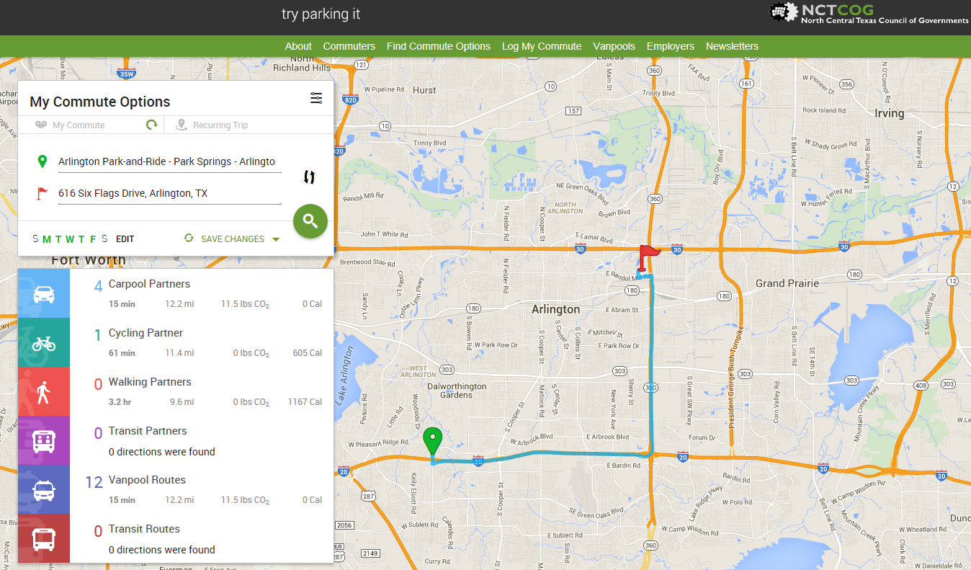
Rideshare Matching and Commute Options

Slide 27
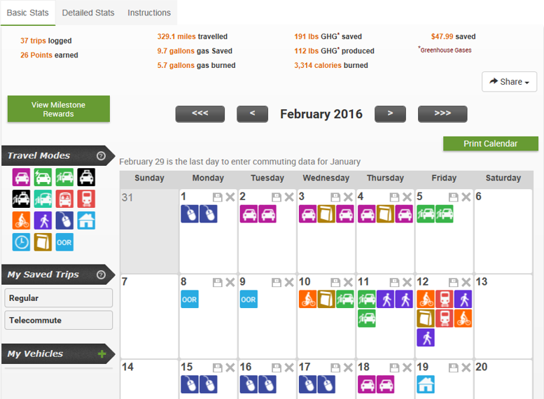
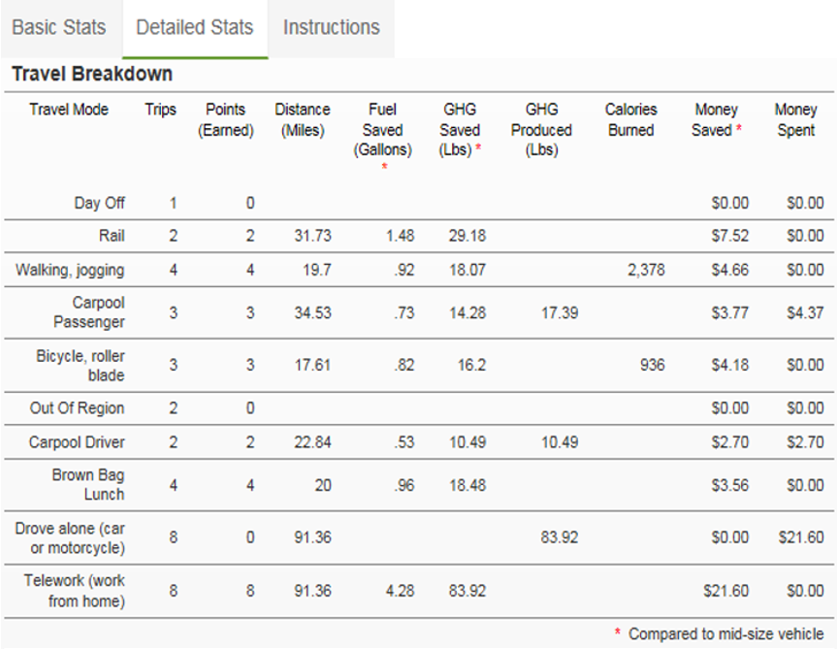
Commute Calendar:
Trip Logging and Savings Report
Commute Calendar: Commute Savings Report
Commute Calendar:
Multi-Modal Trip Logging

Slide 28
Innovative Funding
Adam Beckom
North Central Texas Council of Governments

Slide 29
Innovative Funding Solutions
Transportation Development Credits (TDCs)
SH 360 CDA Partnership

Slide 30
What are TDCs?
A financial accounting tool approved by the Federal Highway Administration (FHWA) that allows states to use federal funding without the requirement of a local match
These credits are non-cash credits allocated to states (and later to regions) as a representative value to account for toll road and tolled managed lanes that benefit the federal system.
TDCs do not increase available funding for a project, but are used in lieu of a match to federal funding

Slide 31
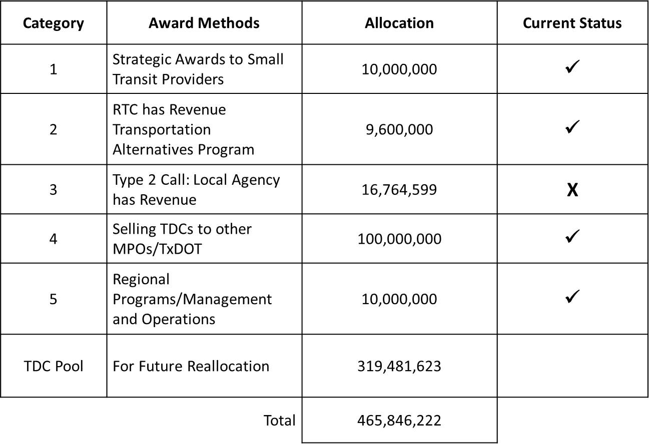
Status of Categories for TDCs

Slide 32
MPO Revolver: Background
Dilemma:
Regional Transportation Council (RTC) does not have significant local funds available to pay for expenses associated with regular programs.
Solution:
$10 million Texas Department of Transportation (TxDOT) funds (in exchange for 100 million TDC’s) would be placed on projects with existing local funds. Then, the local funds would be sent to RTC/NCTCOG to create the Revolver Fund.
In August 2014, the RTC approved staff to negotiate a transfer of up to 150 million in TDCs to other Metropolitan Planning Organizations (MPOs) (50 million) and/or TxDOT (100 million), contingent on RTC approval of the final transfer.
The MPO Revolver Fund solution provides cash flow to regional programs and projects

Slide 33
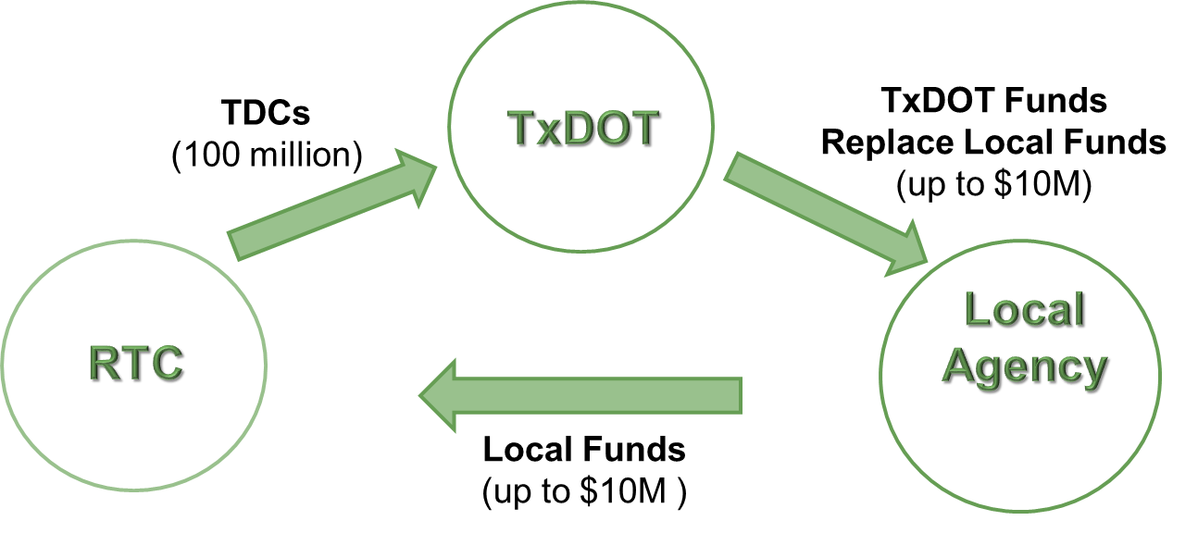
MPO Revolver: Process
A three-party exchange is needed in order to secure the dollars for the MPO Revolver Fund.

Slide 34
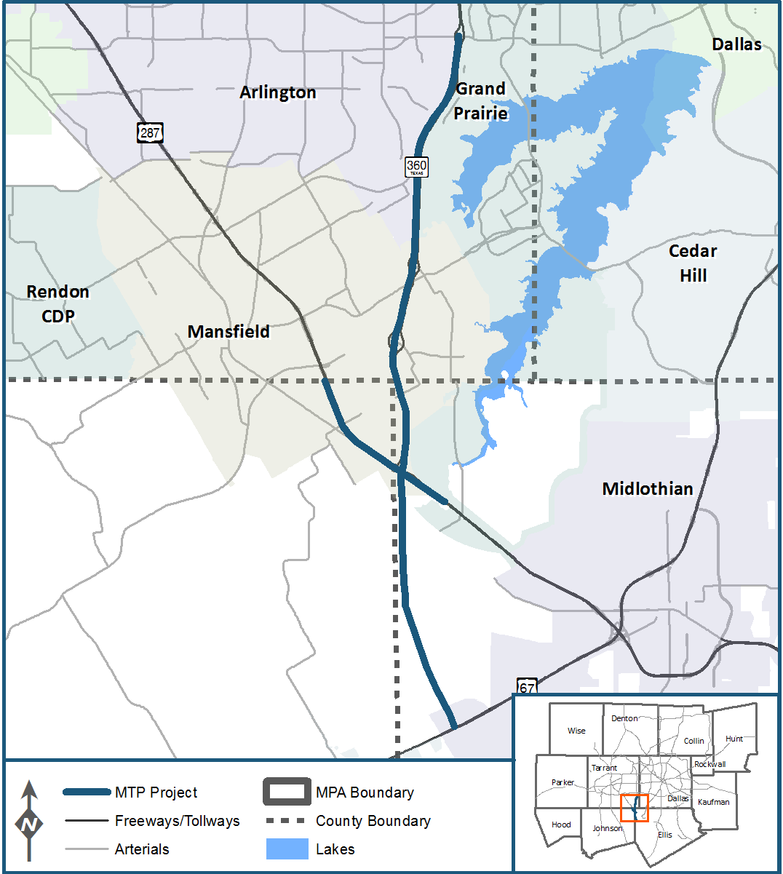
SH 360 CDA Partnership
South of IH 20 to US 287
$330 Million Design-Build Project
TxDOT: Constructing the project and advancing funding
North Texas Toll Authority (NTTA): Maintain and operate the facility upon completion
RTC: Commits toll revenues to pay for construction and provides a financial backstop to cover the debt service plus operations and maintenance if the toll underperforms.
Outcomes
50/50 Revenue sharing between TxDOT/RTC and NTTA
Advances project toward completion in late 2017/early 2018

