Slide 1


Megaregions: Memphis MPO At-A-Glance
AMPO Annual Conference
October 26, 2016

Slide 2
Overview
About Memphis MPO
About Midsouth Megaregion
Freight Overview
  Freight Stakeholder Engagement
  Freight Plans
Other Projects: TDM Update, Greenprint & Aerotropolis
Mega Regions Summit – December 2016

Slide 3
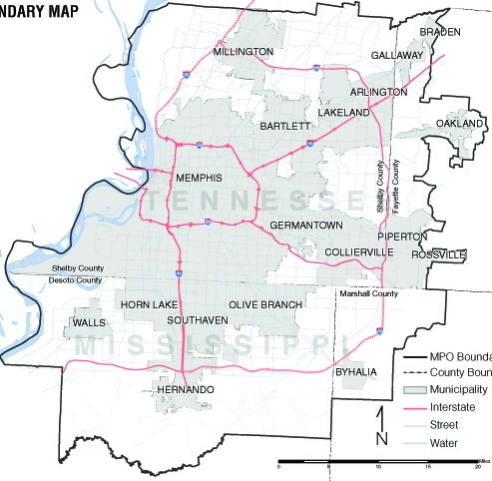
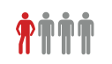

About Memphis Urban Area MPO
Bi-State MPO- TN & MS
Tri-State MPO- Coordination with West Memphis MPO
Non- Attainment
Tri-State Area
West Memphis MPO, AR
Population
1.1 million
Tri-State Non Attainment
1 in 4
employed in transportation and related sector
Transit covers two States (TN and AR)
West Memphis is one of the highest ridership routes for MATA. System wide 10 million trips

Slide 4


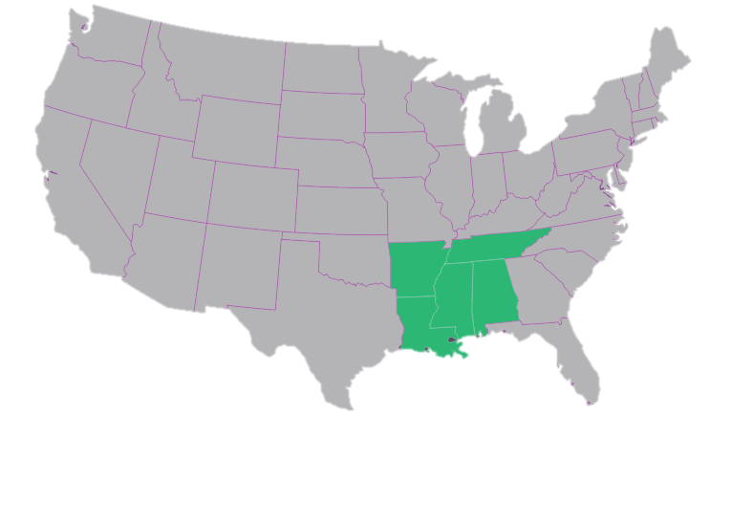


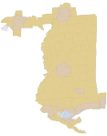



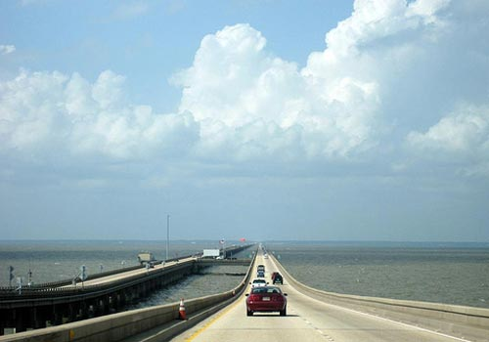


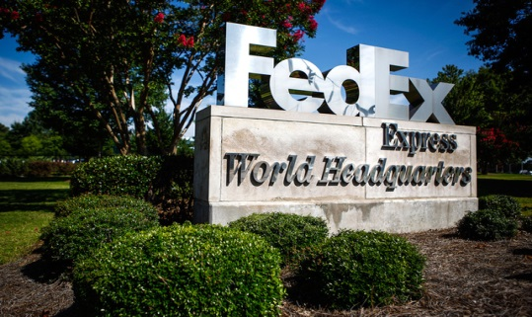




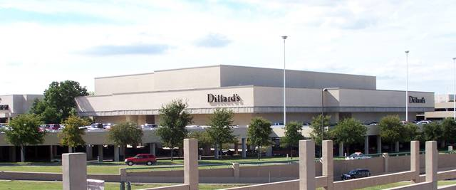
About Midsouth Megaregion
Portions of AL, AR, TN, AR and entire MS
Lake Pontchartrain
Major Cities
Memphis, TN
Little Rock, AR
New Orleans, LA
Jackson, MS
Baton Rouge, LA
Mobile, AL

Slide 5
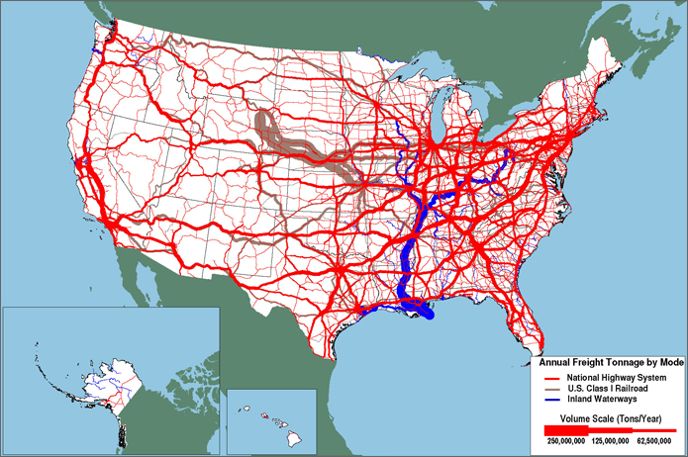


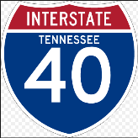

Freight Overview-Memphis: America’s Aerotropolis
4 R’s
Rail, Road, River, Runway
Over $600 million invested by 5 class 1’s
Busiest US cargo airport in North America, 2nd busiest in the world (was busiest airport in the world for 16 years in a row).
4th Largest Inland Port
May be

Slide 6
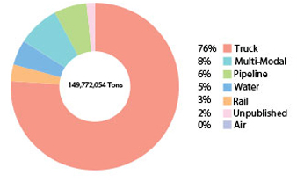
Freight Overview-Memphis: America’s Aerotropolis
Mode | Inbound (tons) | Outbound (tons) | Total (tons) Including local | Value ($ in million) | %age of value per ton
Runway | 16,360 | 42,869 | 59,229 | $ 12,509.52 | $211,206.00
River | 1,041,200 | 5,909,937 | 7,191,583 | $ 909.47 | $126.46
Rail | 1,973,780 | 2,813,773 | 4,816,421 | $ 2,993.68 | $621.56
Road | 51,659,190 | 38,513,478 | 113,896,465 | $349,820.00 | $3,071.39
Source: FAF Data 2012
Percent of Tons by Mode

Slide 7
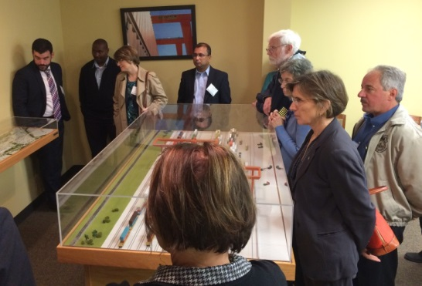
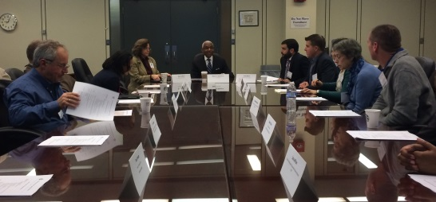
Freight Stakeholder Engagement
Freight Advisory Committee
2013 -Major Change
  Conducted a FHWA peer exchange
    Washington DC
    Chicago
    Atlanta
    Cincinnati
  Restructured Freight Advisory Committee
Membership includes Tri-State Area
  Chair- Policy Board Member
  Vice Chair- FAC Member
National Freight Advisory Committee Site Visit – Memphis- 2014

Slide 8


















Freight Committee Membership - A Few
Just a few listed here………….

Slide 9
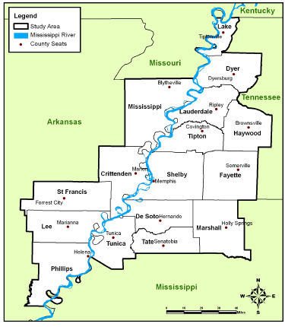
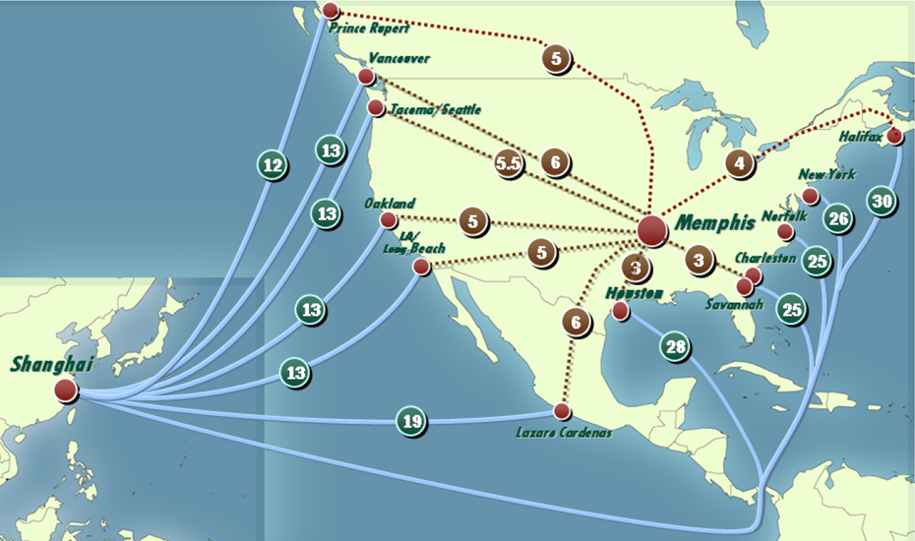
Freight Plans – 2008 Freight Plan
MPO partnered with the Greater Memphis Chamber of Commerce
How we fit in the global supply chain? Panama Canal
Infrastructure inventory and evaluation
Recommendations of improvements
16 County Study Area – TN, MS and AR

Slide 10
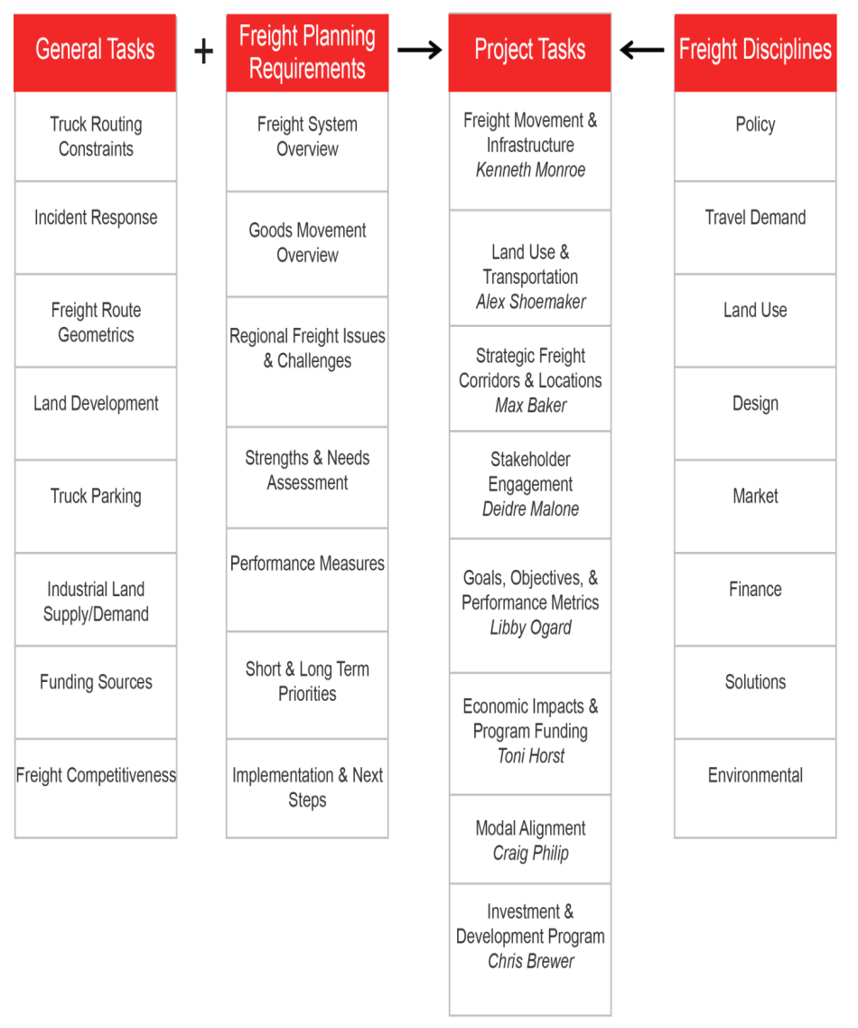
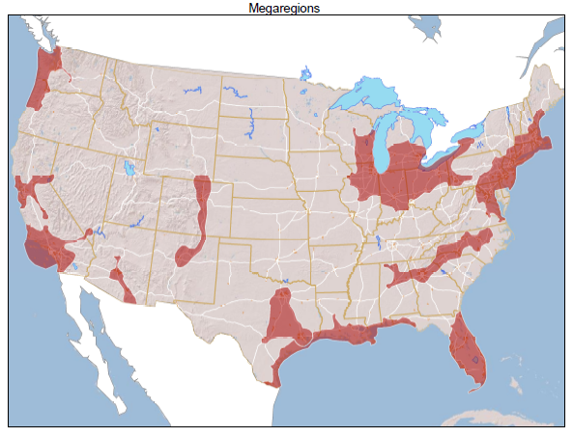
Freight Plans – 2016 Regional Freight Plan - Underway
Regional Connections across North America
Peer Regions:
  Regional economic features
  Transportation network connections
  Potential for regional connections
  Areas of concentrated growth

Slide 11
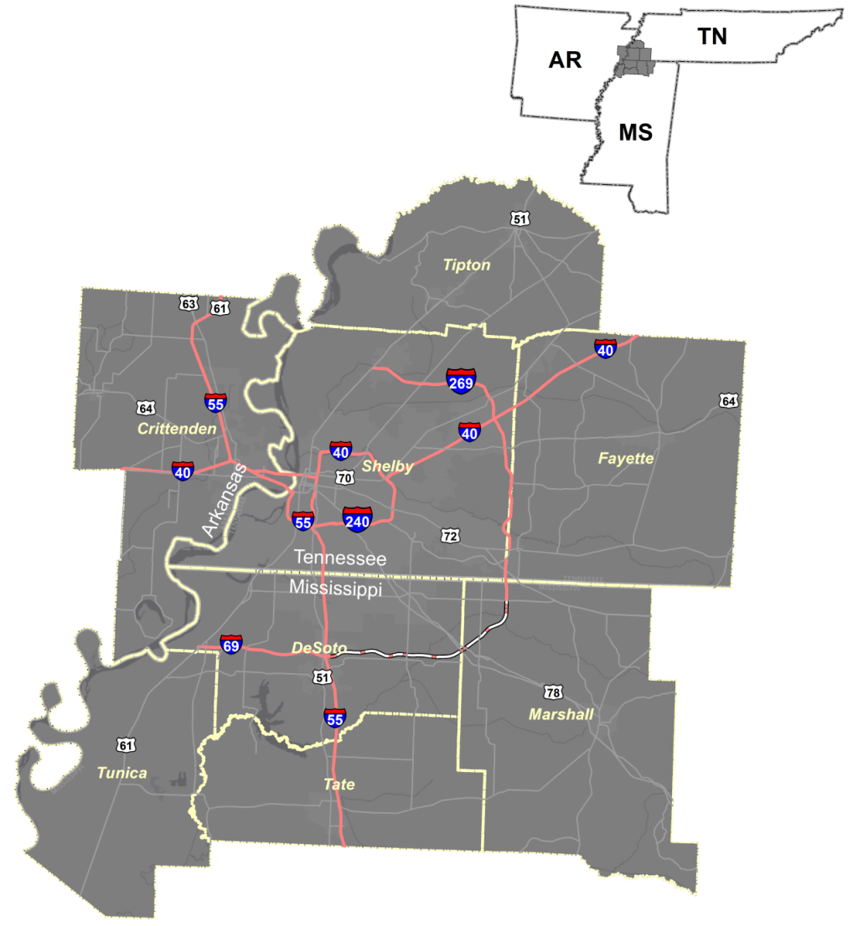
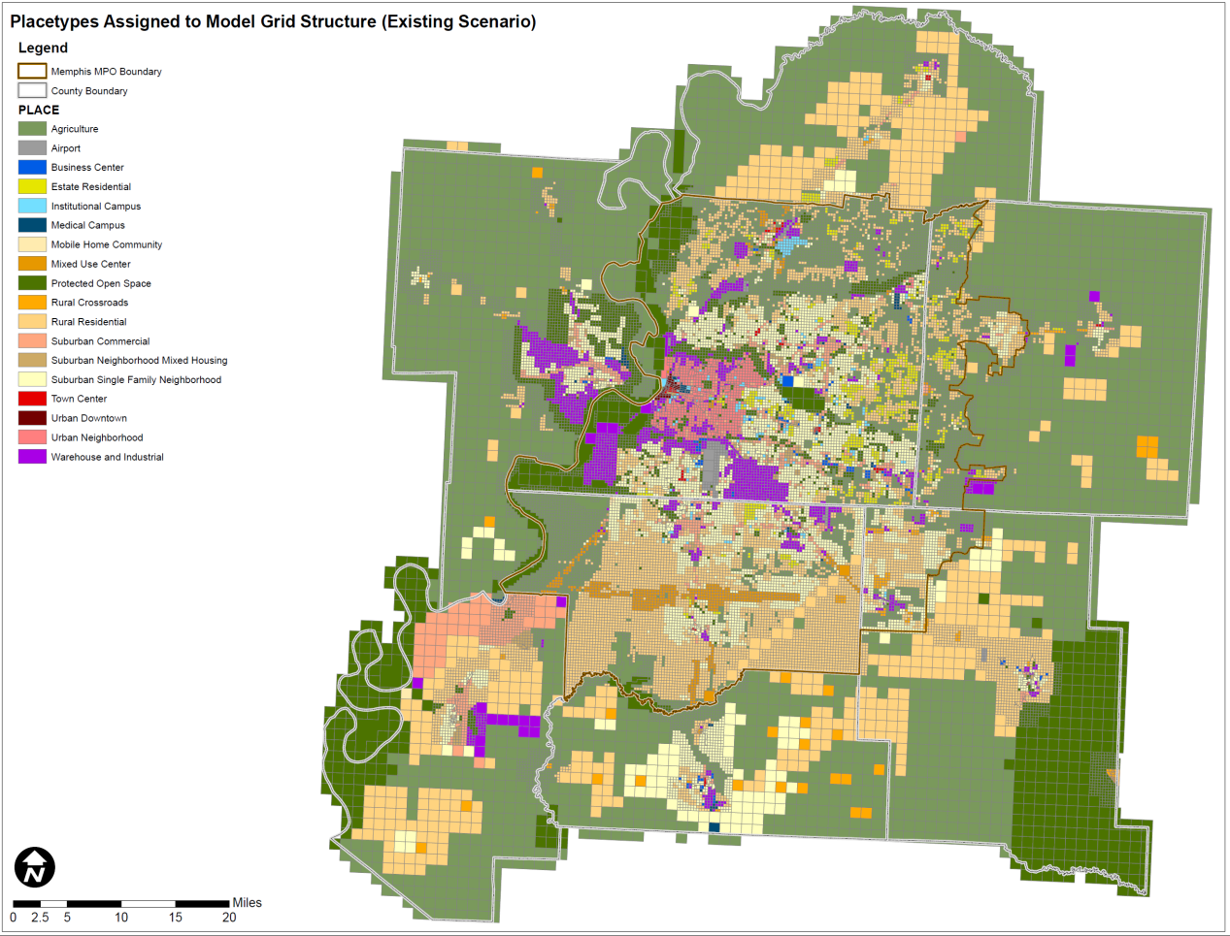
Other Projects – Model Expansion – 2013-15
  TDOT, MDOT, AHTD, Memphis MPO and West Memphis MPO

Slide 12
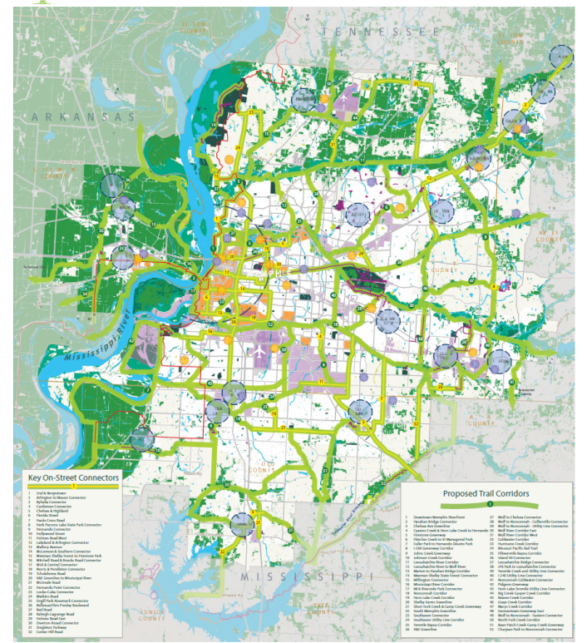
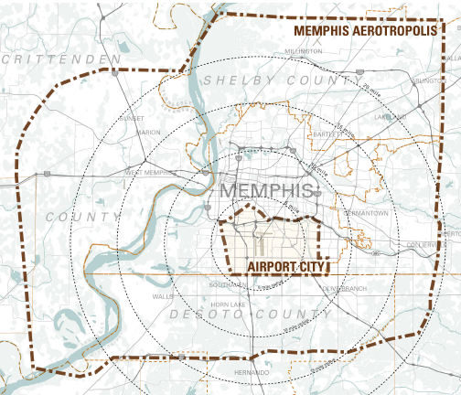
Other Projects – Greenprint & Aerotropolis
Greenprint Plan
2011 -HUD Regional Planning Grant $2.6 million
25 year plan- identifying region wide network of green space areas
Aerotropolis Master Plan
2010 -HUD Community Challenge Grant to Memphis $1.2 million
Comprehensive Master Plan for area around the Airport

Slide 13
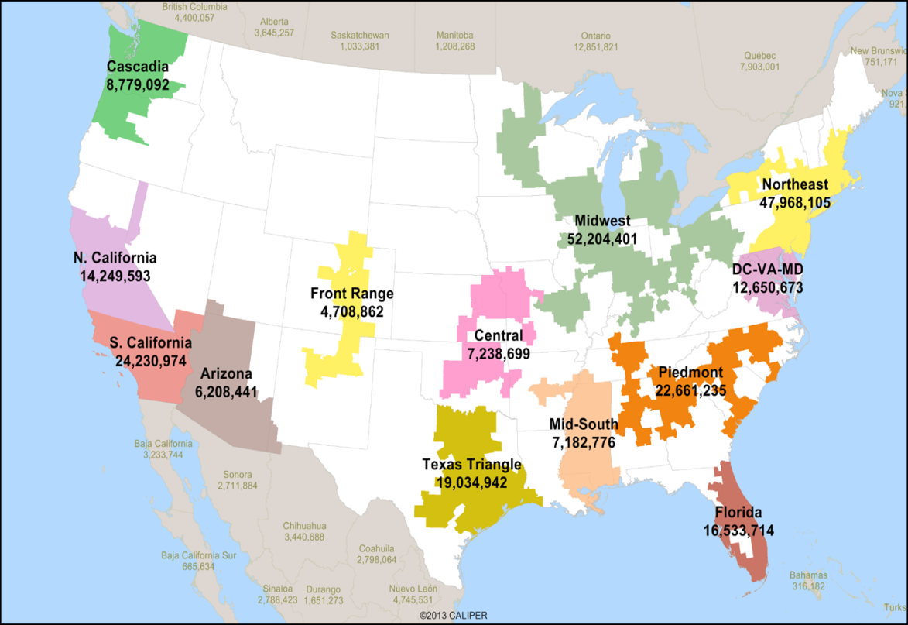



Megaregions Conference December 2016
Focus: Freight
Partners:
  FHWA-MS & FHWA-TN
  Memphis MPO
  University of Memphis- Intermodal Freight Institute
Mid South Covering:
  Tennessee
  Mississippi
  Arkansas
  Louisiana
Guest Speakers:
  St Louis Region

Slide 14
Contact
Ms. Pragati Srivastava, AICP
Pragati.Srivastava@memphistn.gov
www.memphismpo.org

