Slide 1
Turn-Key Solutions & Smart Communities
Darren Poikonen
IoT Product Development
Verizon
PTE16581

Slide 2
Why Smart Communities?
Risk Mitigation in deployment & operations
Security First
Drive Economic Development & Innovation
Positive & Active Citizen Engagement
Trusted Data Mgmt: Open Data, Privacy
Simplicity & Ease of Execution
Need creative business models
Operational Efficiencies & environmental sustainability solutions

Slide 3
Smart Communities Drivers
Notes:
All over the world, cities are changing and growing. They have to maintain livability, sustainability and resiliency in the face of significant challenges. Population growth is one of the largest issues facing cities, as increasing populations impact city economies, housing and the workforce. Rapid urbanization is straining city resources and stretching budgets.
At the same time, the demographics within cities are changing. Patterns of immigration, both from outside of countries and from rural areas to urban areas, are changing the face of cities.
And in the United States and many other countries, retiring baby boomers will place a larger burden on social services in the near future.
More and more citizens demand digital services and engagement. They are used to commercial services that are available instantly on all of their devices, and have begun to expect the same from city government.
Cities must keep pace with the expectations of their citizens, tourists and businesses, or risk losing citizens and businesses to other areas. With an increasingly mobile global population, residents won’t stay put for long.
Cities must:
Improve aging infrastructure, transportation efficiencies and public safety.
Boost livability, conservation and resiliency to attract residents, businesses, investors and visitors.
Work with changing priorities due to tighter budgets, new legislation and compliance requirements.

Slide 4
Innovative Solutions

Slide 5
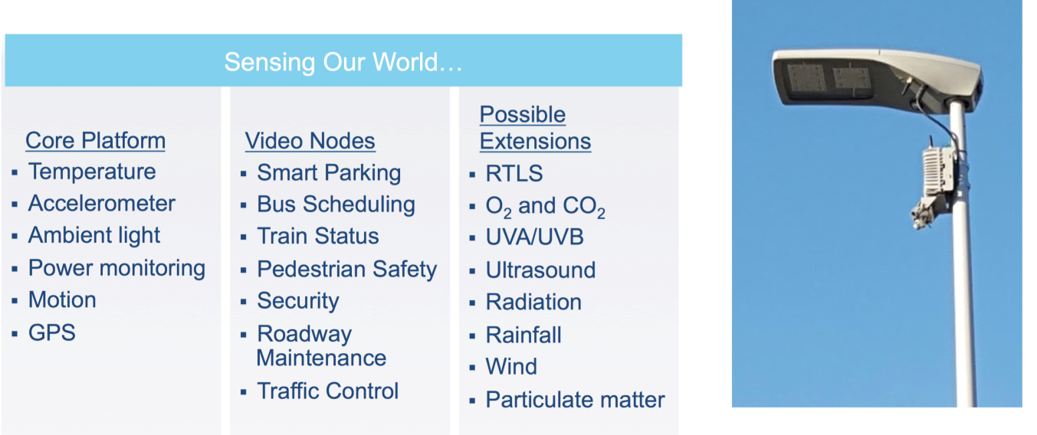
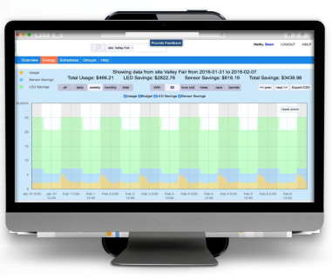
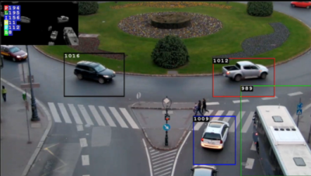
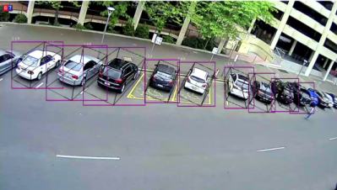
Lighting\Energy\Video
Aligning Solutions to City Needs
Ensure Citizen Safety
Promote economic equality
Engage Citizens
Reduce Traffic Congestion
Increase Sustainability
Benefits
Intelligent Lighting
Public Safety
Traffic Solutions
Parking Management
Security & audio sensors
City Wifi
Lighting Energy Management
Traffic Incident Management
Parking

Slide 6
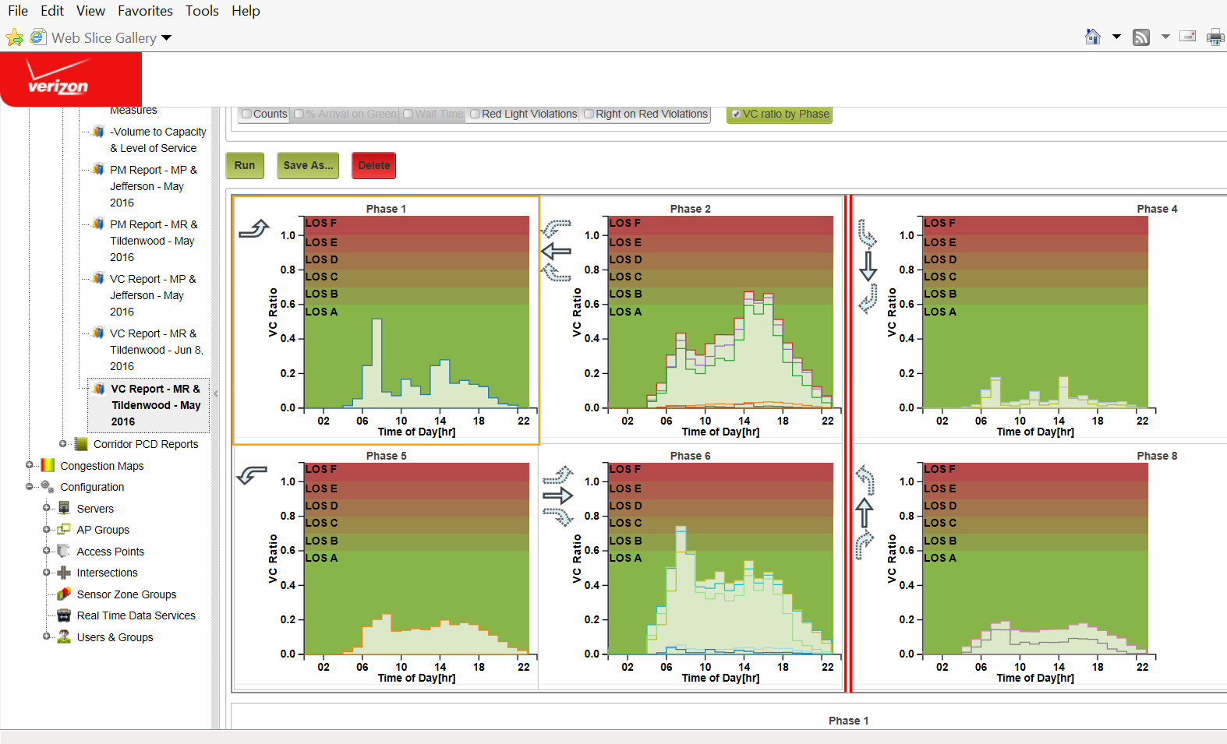
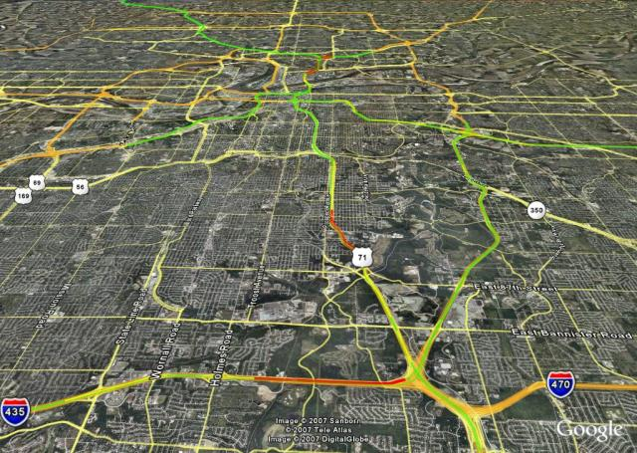
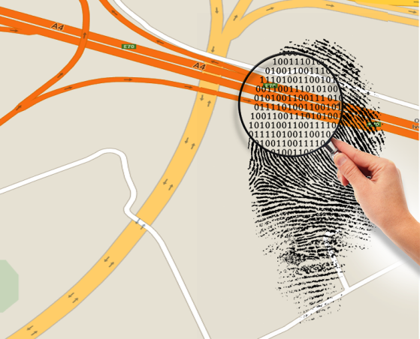
Smarter Roadways
What Can our Roads Tell us?
Empower Traffic Agencies
Reduce Traffic congestion
Validate Results
Reduce Emissions
Increase Knowledge
Sensor Data | Network Data | Integration
Magnetometer Microradar WiFi Sensing Hi-Res Analytics Performance Metrics | No Hardware Large Scale Real Time Historical Reporting Congestion Mitigation | Data Feeds System Integration Cross Platform Analytics
Benefits
Granular Traffic Data
Optimized Signals
Real Time Information
Reduced Congestion
Improved Traffic Safety
Performance Metrics
Real Time Conditions
Analytics

Slide 7
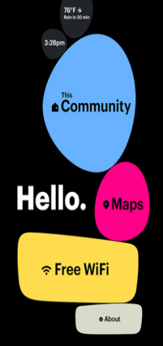
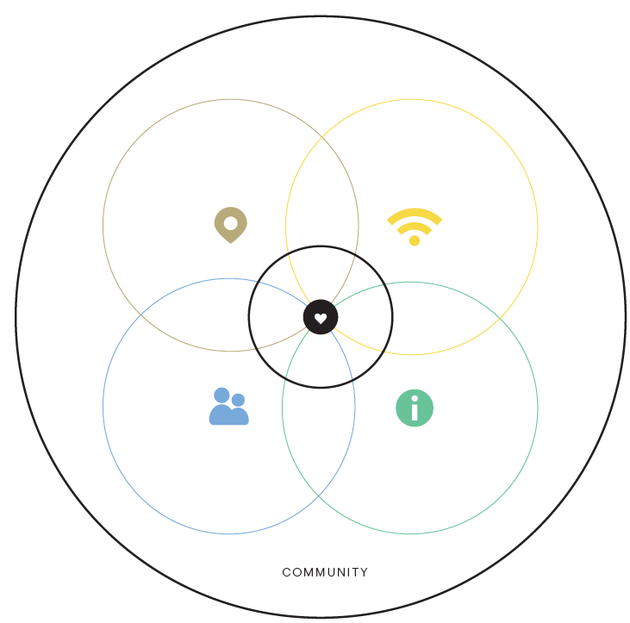
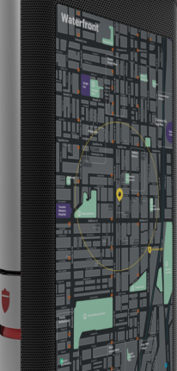
Humanizing Urban Digital Experience
The digital kiosk hardware and software is designed to humanize the citizen engagement experience within urban communities.
INFORM
ENGAGE
Map, wayfinding & real-time transit schedules
Weather & Other Outdoor Sensor Data
Community messaging
One interactive and two media screens
Locate POIs
Neighborhood news, real estate listings, school information, and event calendar
Hyper-local deals & targeted advertising
Boston mobile app
Functional & Focused
Relevant & Personal
CONNECT
PROTECT
Free, secure public Wi-Fi
Enhanced cellular service 4G/5G (future)
Mobile device charging
NFC payment system
Cameras, Microphones & speakers
Security Camera
Emergency notification and LED emergency bar
Emergency backup power and solar charging
Comprehensive privacy & industry leading network security
Approachable & Intuitive

Slide 8
The technology is there….why aren’t we?
Here’s why
Who design’s it?
How do we get it installed?
Who handles configuration?
How do we integrate it with existing systems?
How do we keep it updated?
When it breaks….who fixes it?
Do I need to hire additional staff?
Do I have the IT resources to manage the data?

Slide 9
Waves of Data
Storage
Analytics
Cross Platform Integration
Backup
Avoiding data silos
“Cities have the potential to generate over 4 terabytes of data per day per square kilometer of urbanized land”

Slide 10
Fragmented IoT Deployments…..Complex Ecosystems
Design Services Provider
Hardware Manufacturer
IoT Platform Provider
Systems Integrator
Security Services Provider
Cloud Services Provider
Connectivity Provider

Slide 11
Turn-Key Solution Advantages
Pre-engineered solutions
Installation\maintenance services
Cross platform integration & analytics
Streamlined vendor & contract management
Reduced burden of ownership
Minimized impact on human resources
Faster Deployments
Cost Savings
Economies of Scale
Reduced Risk

Slide 12
Holistic Smart Community Approach
Security & Data Protection
ThingSpace & Data Analytics
Prof & Managed Services & SI Ecosystem
Citizen Focused
Holistic Customer Experience
Solutions from connectivity layer to street layer to citizen layer
Proven expertise in deploying and managing complex solutions for city leaders
Focus on security and data protection at every level
Market Place
Traffic Mgmt
Advertise
Lighting
Innovation Labs
Video
Digital Signage
Healthcare: Track & Trace
Venues
SMB Solutions
Citizen Engagement
Grid Wide
Mobile to Cloud
Share & Fleet Mgmt
Developer Community
Water & Gas
Economic Development & Citizen Engagement
Smart City Solutions
Fiber
Small Cell
4G / 5G
Connectivity

Slide 13
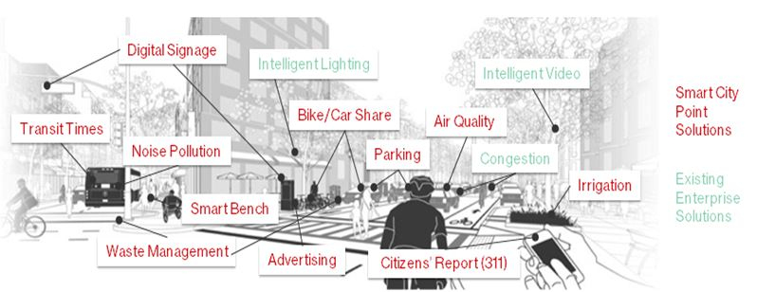
Bringing It All Together
Devices
Networks
IoT Platforms
Applications

Slide 14
Turn-Key Attributes
Hosted
Connected
Managed
Supported
Tested
Delivered As a Service
Priced to match funding sources
It’s not about the solution!
It’s about the desired outcome!

Slide 15
Thank You

