Slide 1
What is Big Data, and What Is It Good For?
AMPO 2016
Catherine Manzo, Sr. Director of Sales & Customer Engagement
Catherine.Manzo@streetlightdata.com

Slide 2
Agenda
Introduction
What is “Big Data”?
Defining Your Big Data Goals
Case Studies

Slide 3
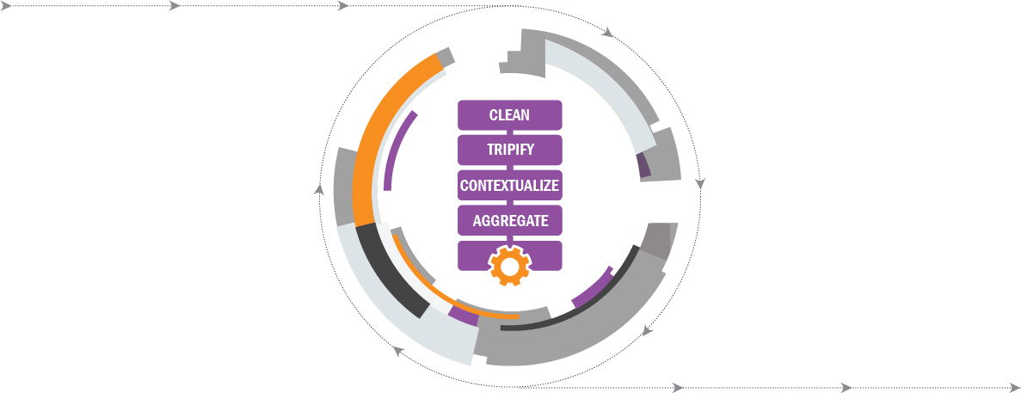
StreetLight Data Transforms “Big Data” from Mobile Devices into Transportation Analytics
Input: “Big Data”
Processing: RouteScience® Technology
Web App Output: StreetLight InSight Metrics
Anonymous
and accurate
Location Data
To design, prioritize, optimize and manage transportation, StreetLight InSight® Metrics:
Accurately describe current mobility patterns,
Persistently measure changes over time, and
Are diagnostic and predictive.
Road network,
land use, parcel, census and more
Contextual Data
Notes:
So, why am I qualified to talk about Big Data? Because I work for StreetLight Data. Here’s how it works. We partner with a range of companies to obtain billions of geospatial data points that are created by mobile devices. These devices include connected cars, smart phones, wearables like fitbits and smart watches. This locational “Big Data” is combined with contextual data, like land use, parcel, and census data sets. We pull it all into our algorithmic processing engine, which we call RouteScience. This processing engine cleans inaccurate data points, links them together into trips, blends in context, and aggregates trips into groups to protect individual privacy.
When you use StreetLight InSight, our app taps into that RouteScience engine to extract the specific mobility Metrics that match your project’s unique parameters. This means you’ll get analytics like Origin-Destination matrices as well as trip attributes like trip length, speed, purpose, and circuitry and everything processes in a matter of minutes to hours.

Slide 4
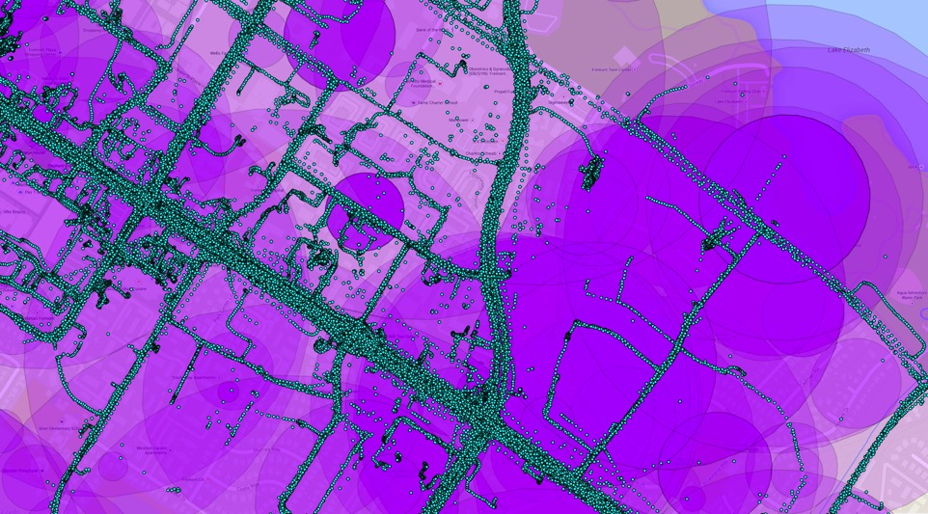
Big Data Often Means Repurposing Data
Most Big Data was not created for the purposes of transportation analytics Or even location.
Repurposing data creates certain benefits (like cost and availability) and detriments.
Notes:
The data that we use here at StreetLight Data was not designed for transportation planners. That means there’s significant processing and statistical analysis required to make it useful for transportation purposes.

Slide 5
There are Different Types of Mobile Device “Big Data”
These types of raw mobile data received by StreetLight. Within seconds, StreetLight contextualizes and transforms this data into powerful insights.
Trillions of cellular, GPS, and LBS data points are creating billions of trips each year.
Notes:
When we talk about Big Data at StreetLight Data, we’re thinking about the location records that mobile devices create. This image shows two different types of mobile device data: navigational GPS and Cellular Network Data. As you can see, they vary significantly in terms of spatial precision. However, it’s also important to note that sample size and ping rates also vary according to the type of data you use. For some applications, it’s better to use GPS data, and for others, it’s better to use other types of Big Data. I’ll dig into this in more detail in our case studies.

Slide 6
Do You Know What You Want?
I have a VERY specific question and no flexibility on output
I have a specific question
I have a broad but actionable question
I like pretty maps
Notes:
Given the massive volume of information that Big Data can provide, it’s important to think strategically about how you’re going to use it before you begin your analysis. Define your goals, because otherwise, you may wind up with a bunch of pretty maps – but zero next steps.

Slide 7
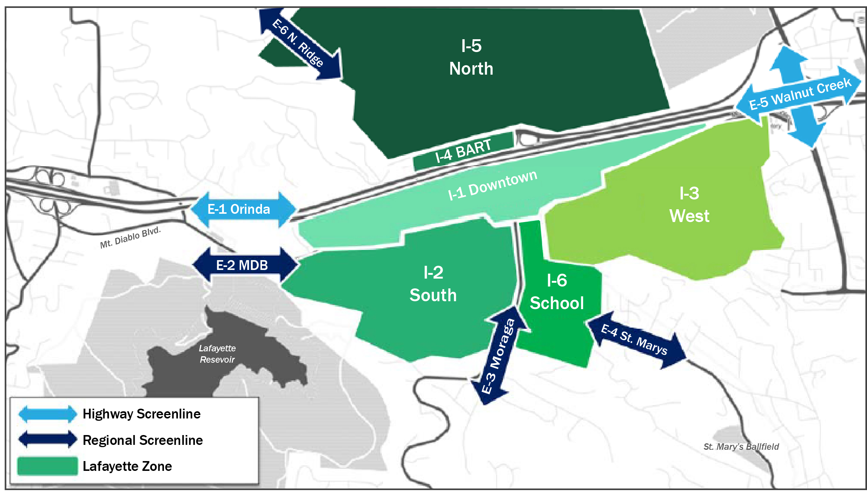
Big Data, Used Correctly, Can Create Key Analyses That Answer Clear Questions Very Quickly
I have a VERY specific question and no flexibility on output
I have a clear, specific question
I have a broad but actionable question
I have a high level question
Notes:
Client needed to know the types of trips that were causing congestion on a particular downtown corridor in Lafayette, CA.
We had a very successful use case. A) The question was clear. For traffic passing through the city’s downtown corridor – where did they come from, and where are they headed? Are they local trips, or are they external trips? That’s a clear question – it’s really to perform a select link studies with defined internal and external zones. We set that up in our application, ran the project, and had an answer in under two hours…not to mention visualizations and a bigger sample size than a survey could have ever gotten.
You can also easily perform much simpler corridor studies in a matter of minutes. Instead of sending an engineer out to drive down a corridor and measure the amount of time it took to pass through, you can find out the average travel times at different times of day, days of the week, and more by analyzing big data. You get a much more accurate picture of travel times, and the information is much more effecient to collect.

Slide 8
Big Data Can Also Be Combined With Existing Data Sources and Tools to Answer Questions
I have a VERY specific question and no flexibility on output
I have a clear, specific question
Notes:
For example, in Napa California, planners needed to calibrate their travel demand with real-world data, and they also wanted to identify the cause of congestion – was it external trips from tourists, internal trips from folks living in Napa, or something in-between?
They used Big Data in combination with traditional data sources such as surveys and license plate studies to answer their very specific question and to collect real-world calibration data. Because they needed to answer a very detailed question for the purposes of their travel demand model, the best solution was to use an array of data sources.
Ultimately, the Big Data analytics we provided demonstrated that many more trips were coming from commuters who worked in Napa but lived in neighboring counties. This contradicted the popular wisdom, which blamed traffic on tourists.
Because the planners used a variety of data sources for their work, they ended up with a big picture of travel behavior as well as exact counts that they needed for their travel demand model. Importantly, the real-world data from mobile devices that obtained provided critical, empirical evidence that the popular wisdom around congestion’s cause was not accurate.

Slide 9
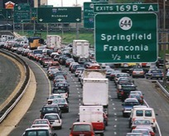
Big Data Can Answer Broad Questions that Weren’t Reasonable to Ask Before
I have a VERY specific question and no flexibility on output
I have a specific question
I have a broad but actionable question
I like pretty maps
Notes:
This next point is one of the more exciting things. Big Data can do “traditional” things faster, broader, more easily, more accurate, bigger sample. And I that’s good. But it can also let us do things that weren’t impossible before. We had a really fun Transportation Demand Management Project in Northern Virginia with VDOT, Michael Baker, SSTI, and others. Here, the question was broad and expansive, but in the best possible way.
Instead of saying – I want to build a transit line here….now let’s do a little analysis to feed my simulation model, we started alot earlier in the process. We said – Which miles of road in the entirety of Northern Virginia woudl be the BEST for transit? We made a very clear rubric for this ranking – It’s “good” if the road is a) Congested and b) Cars on the road have a very high propensity to share origin and destinations. We then ranked all the road segments in the study. We created similar rubrics for the best “bikeable” traffic jams, etc.
The result – our clients had a triaged list that helped guide their TDM plans. It helped them focus on where they could probably get the biggest bang for their limited bucks. AND it provided a very clear and compelling mode of communication with stakeholders in a series of stakeholder meetings. After the final decision are made, we can also do detailed analysis to guide model development AND, once things are put in place, we can MEASURE if they’re having the impact we all expected.
THAT’S a data-driven approach that doesn’t just improve on the old way of doing things, it’s transforms the practice.

Slide 10
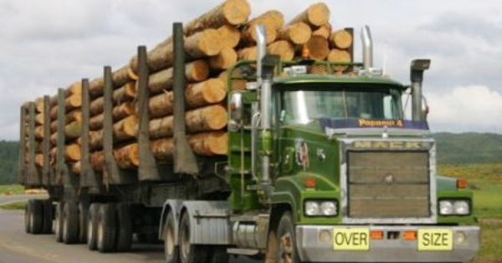
But You Can’t Push the Data Where it Can’t Go – Especially if It Wasn’t Created “For” Your Purpose
I have a VERY specific question and no flexibility on output
I have a specific question
I have a broad but actionable question
I have a high level question
Notes:
We had a client who wanted freight analytics. We collect trillions of data points off of fleet management systems every day. So, it seemed like a great fit. But, when it came down to it, they didn’t want to analyze the trucks, they wanted to analyze the of a very particular commodity from their district – let’s say logs. They wanted to know where THOSE logs end up, over many transfers from truck to other trucks to warehouses to barge or rail. We can make a lot of inferences and assumptions to try to kind of derive the flow of the logs from the flow of trucks…but fundamentally it’s going to be limited. Because the data we’re taking advantage of isn’t geared to measure this. We ultimately recommended a survey if they needed that level of information.

Slide 11
Asking Vague Questions or “Visualizing Trends” Without an Objective Probably Won’t Work Out Well
Big Data
I have a VERY specific question and no flexibility on output
I have a specific question
I have a broad but actionable question
I like pretty maps
Notes:
Lastly – a bad use case is to use big data just to “explore” or visualize without having a real action or a concrete question in mind. A lot of my career is around pretty maps – but if you see pretty maps just for the sake of pretty maps, there’s probably a waste of time or data. People do love saying they used Big Data – I call that the Big Data halo effect. If people just want to visualize something and don’t know why – I don’t think that’s a great use of Big Data. I think that’s a use of the Big Data Halo effect.
It’s not that the vague questions are bad. They’re often about important topics. BUT The best practitioners take those vague, high level desires and turn them into a series of concrete questions amenable to the data available, and they consider the type of big data they want to use.

