Slide 1
US Business 77
Corridor Study
2016 AMPO Annual Conference
Fort Worth, Texas
October 28, 2016

Slide 2
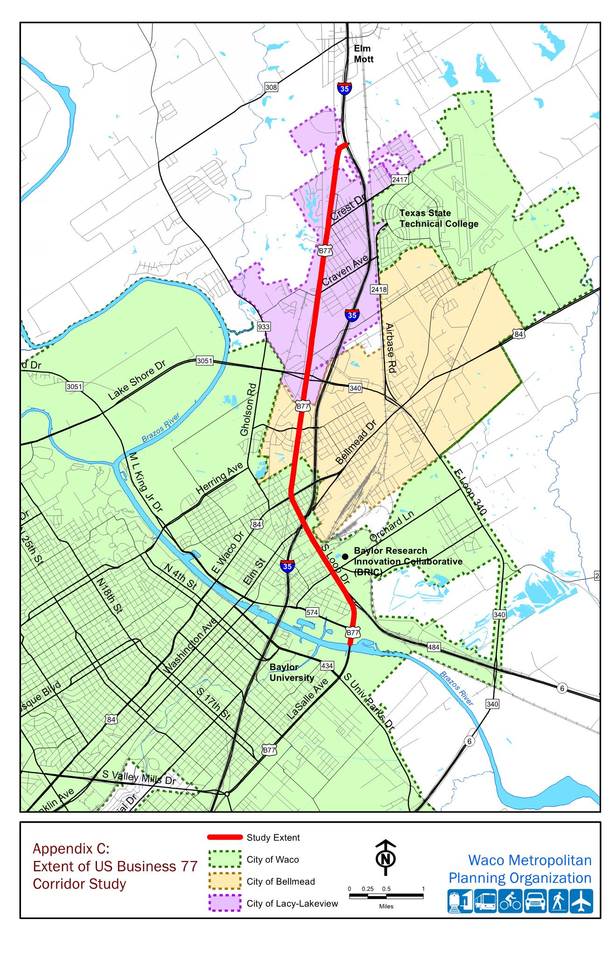
Outline of Presentation
Business 77 Study Purpose
Corridor Stakeholder Engagement
Development of Concepts
Illustrative Design
Implementation Strategy

Slide 3
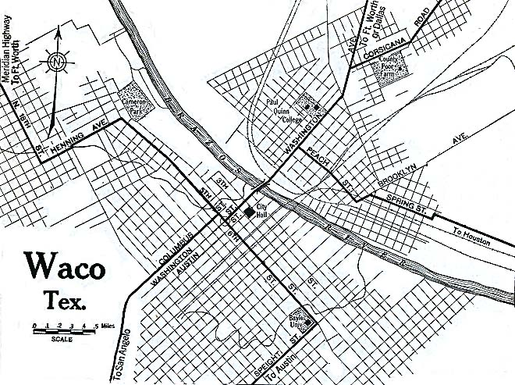
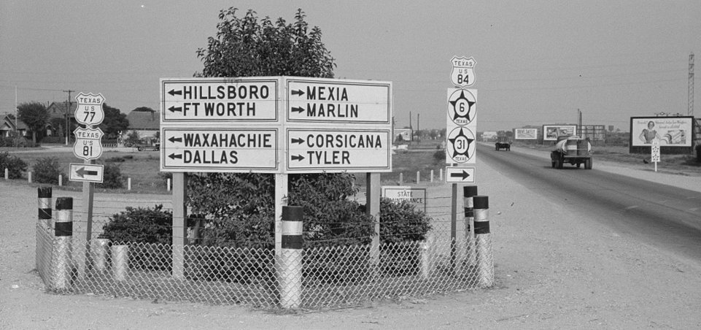
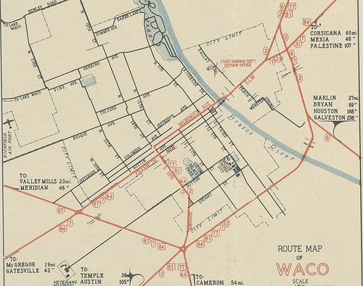
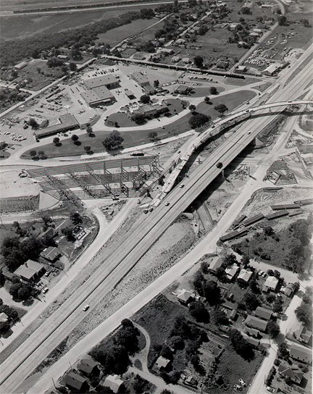
Business 77 Corridor History
1930’s: Original US 77/81 – Dallas to San Antonio Hwy
1950 – Freeway section built from US 84 to Brazos River
US 84 realigned to Waco Dr
Plans to convert entire US 77/81 corridor to a freeway
1956: Establishment of Interstate Hwy System
Decision to locate IH-35 on separate alignment
1960’s to 1980’s
Closure of Connally AFB, General Tire
Shift of land uses to IH-35 corridor

Slide 4
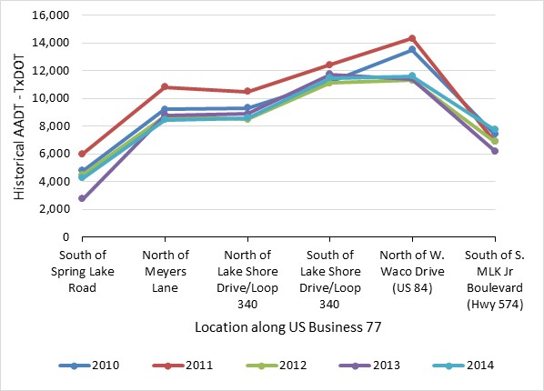
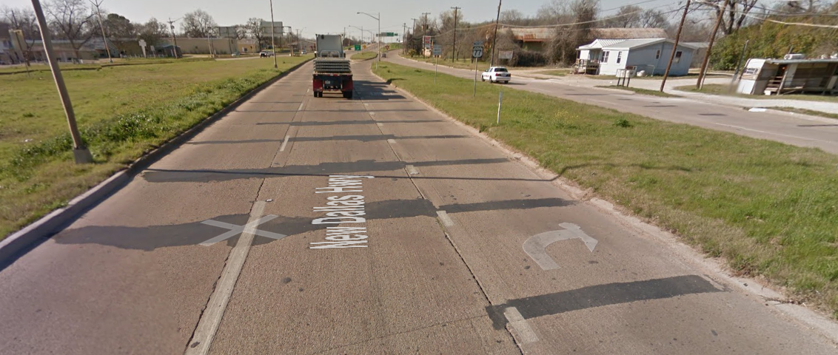
Business 77 Current Status
Traffic Volumes below Capacity
Elm Mott to US 84 – 30% to 50% of capacity used
US 84 to Brazos River – 15% to 20% of capacity used
Facility will require reconstruction within next 20 to 25 years
Patched pavement and joints
90 to 100 year old bridge structures

Slide 5
Business 77 Study Purpose
If reconstruction will be necessary, should we:
Rebuild with current design?
If we redesign, do we:
Create boulevard design?
Reduce structures & lane-miles for maintenance?
Improve property access?
Provide same, less or more capacity for future?

Slide 6
Project Steering Committee
Agency members: TxDOT, MPO, Waco Transit, Waco, Bellmead, Lacy Lakeview
Stakeholder members: business, residential, organizations
Role:
Provide input, guidance
Review and provide feedback
Encourage local involvement

Slide 7
Project Scope

Slide 8
Project Schedule
Project Schedule
Project Workshop Feb 1-4

Slide 9
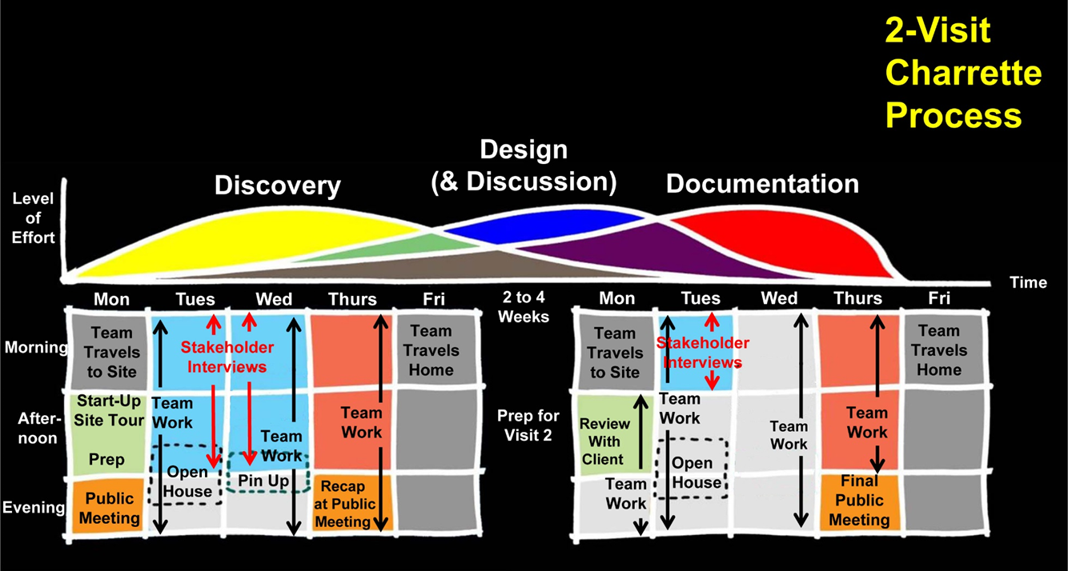
Public Workshop Process

Slide 10
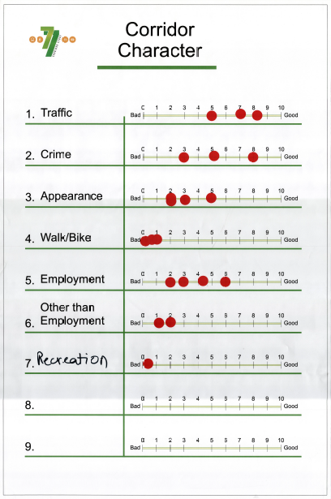
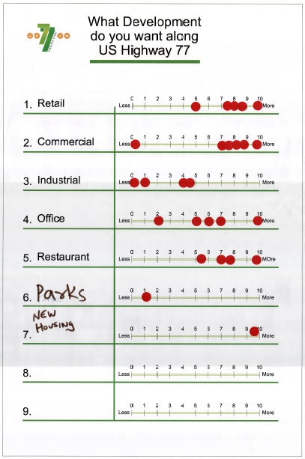
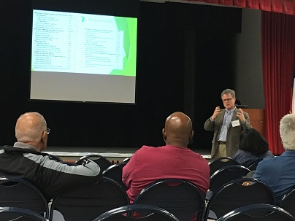
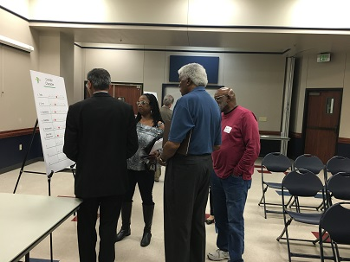
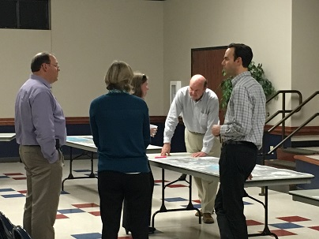
Public Meetings during Workshop
Feb 1 Public Meeting – Issues & Needs
Format: Presentation with Breakout Sessions
Presentation: Purpose, Existing Conditions
Breakout Sessions: Constraints, Issues, Needs, Opportunities
Feb 4 Public Meeting – Concepts and Priorities
Format: Presentation with Breakout Sessions
Presentation: Concepts by Zone, Major Improvement Items
Breakout Sessions: Feedback on Concepts, Priorities

Slide 11
Table exercises – Corridor Character
What do you like & wish to preserve?
What do you dislike & want to change?
What is missing that you like to see created?
Open to all opportunities

Slide 12
What We Heard- What you want on the corridor:

Slide 13
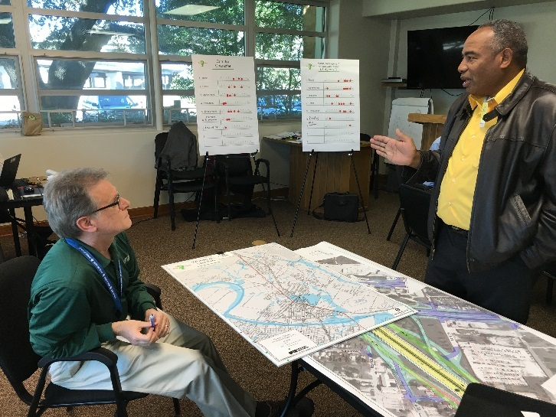
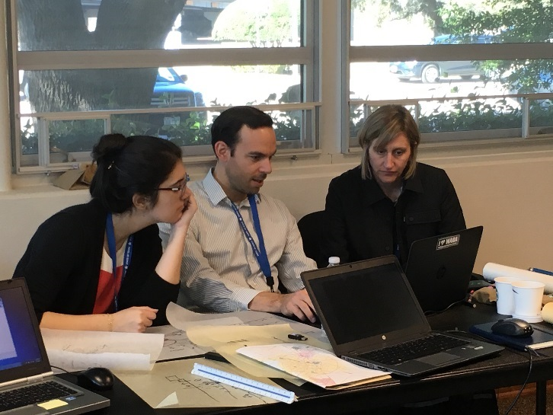
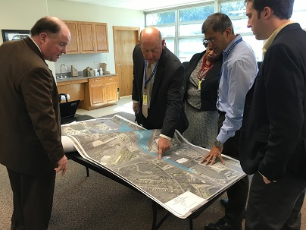
Public Open House during Workshop
Feb 2 & 3 from 4:00 to 6:00 pm
Format: Drop in on the project team working session
Presentation: View the work in progress
Interaction: Ask questions, provide comments

Slide 14
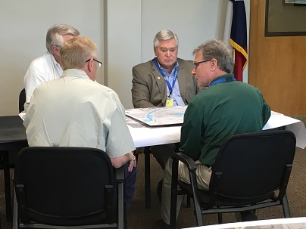
Key Person Interviews during Workshop
 | Tuesday Feb 2, 2016 | Wednesday Feb 3, 2016 | Thursday Feb 4, 2016
8am
8:30am |  | Keith Bond, Public Works and City Manager, City of Lacy-Lakeview | Octavio Garza, Public Works Director, City of Waco
9am |  | Dave Morrow, President Waco Bike Club plus two other members | Mark Mason, Manager of Flint Hills Resources, Chemical Plant
9:30am |  |  | Rock McNair, Baylor University
10am | Dewayne Banks, Business Owners, (254) 855-7521 | Clint Peters, Director of Planning, City of Waco
10:30am |  | Megan Henderson, Waco Downtown Development Corp
11am | Ed Mazanec, Business Owner - Mazanec Construction | Bo Thomas, City Manager, City of Bellmead
11:30am | Dale Fisseler, City of Waco, CM; Wiley Stem, Deputy CM; Deidra Emerson, ACM
12pm
12:30pm
1pm | Pastor Jimmy Hunter, Toliver Chapel Baptist Church
1:30pm
2pm | Wes Holt, Connally ISD Superintendant, (254) 296-6460 | Solomon Thomas, TxDOT
2:30pm | David Marek, Wallace Group (for Developers of MLK east of BUS 77)
Feb 2 & 3 from 8:00 am to 3:00 pm
Format: Individual and small group discussions
Invitees: Agencies, businesses, land owners, residents
Interaction: Team questions, agency & public input

Slide 15
Character Zones
Marlin Hwy Interchange
MLK Jr. Blvd
McLane Stadium
Baylor University

Slide 16
Character Zones
Connects
SH 6 and IH-35
SH 6 to
College Station

Slide 17
Character Zones
IH-35 Interchange
(Redesigned by TxDOT
Baylor Research and Innovation Collaborative
Railroad

Slide 18
Character Zones
US 84 Interchange

Slide 19
Character Zones
Behrens Circle
Retail
HEB
Sam’s Club

Slide 20
Character Zones
Home Depot
FM 3051/Loop 340 Interchange
Walmart

Slide 21
Character Zones
Alamo Steel
Railroad
Meyers Ln
Tymco

Slide 22
Character Zones
Flood Plain, Rural
Residential
E. Craven Ave

Slide 23
Character Zones
Connally ISD
TSTC
E. Crest Dr

Slide 24
Character Zones
IH-35 Interchange
Connally ISD

Slide 25
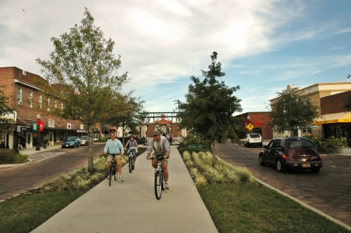
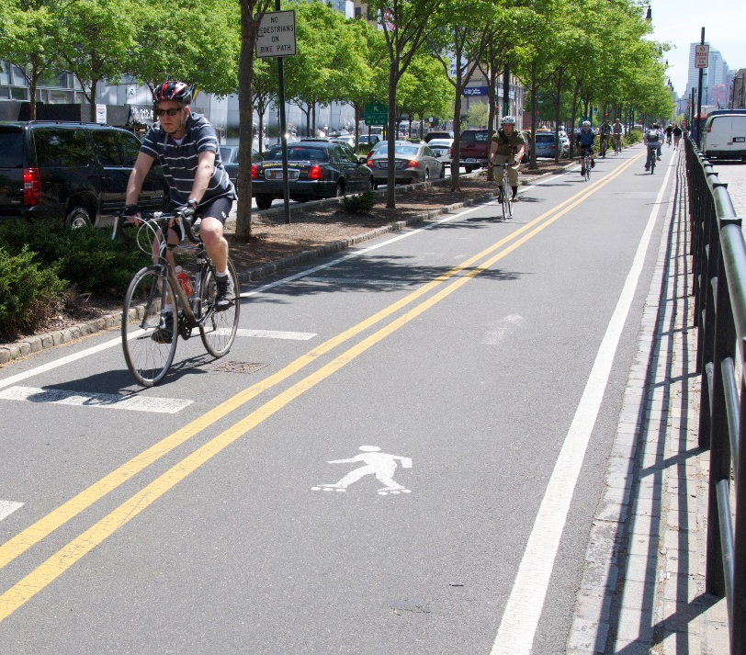
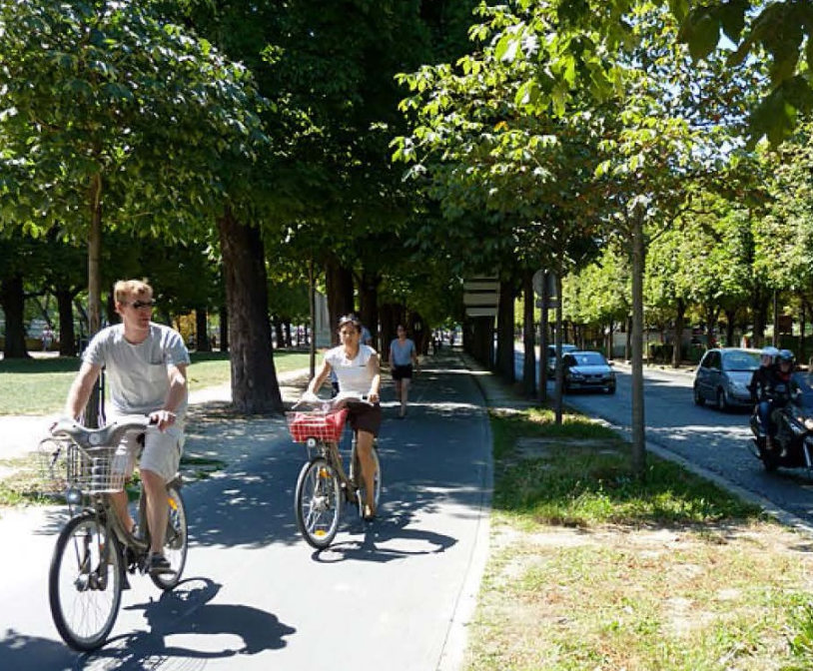
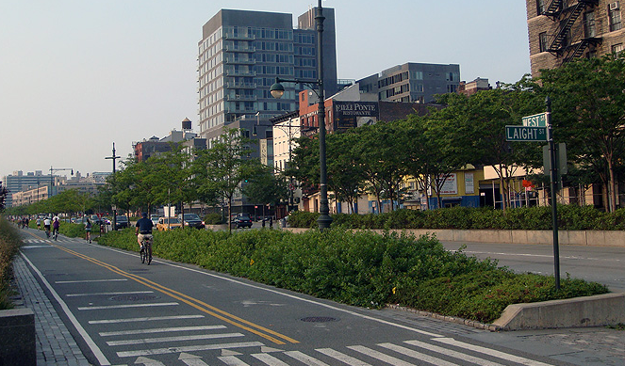
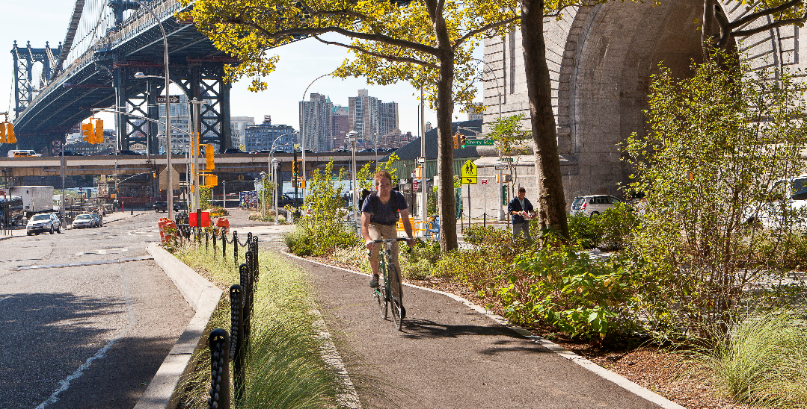
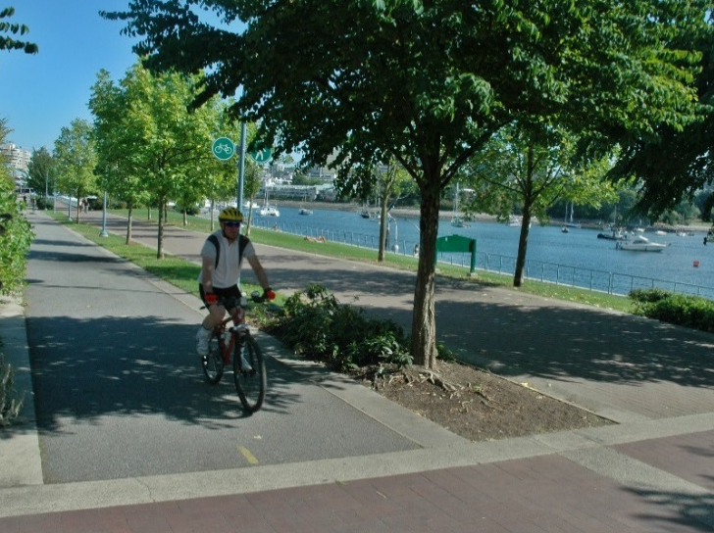
Pedestrians and Bicyclists

Slide 26
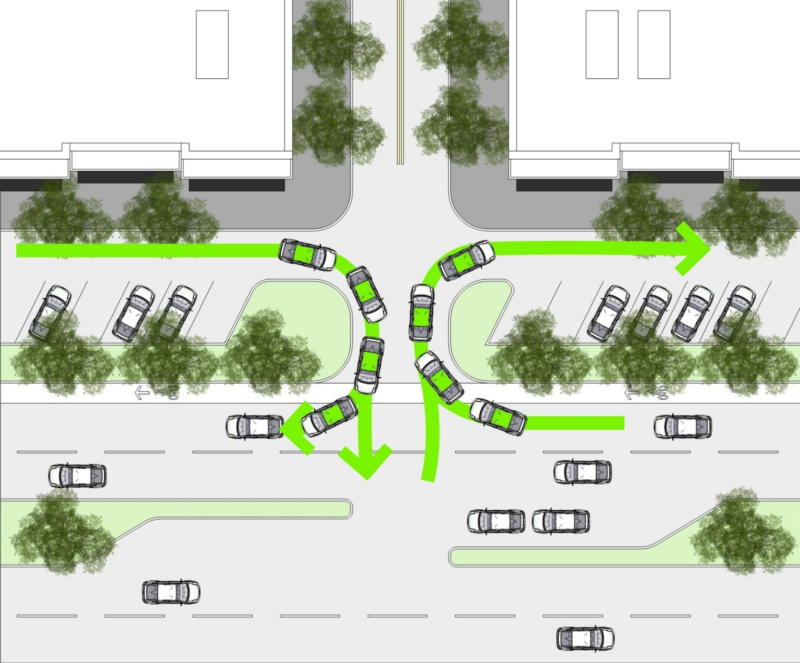
Special Use Parallel Roads
Convert to 1-way
Add parking, as needed
Add pedestrian amenities, as needed
At industrial, convert ownership and maintenance

Slide 27
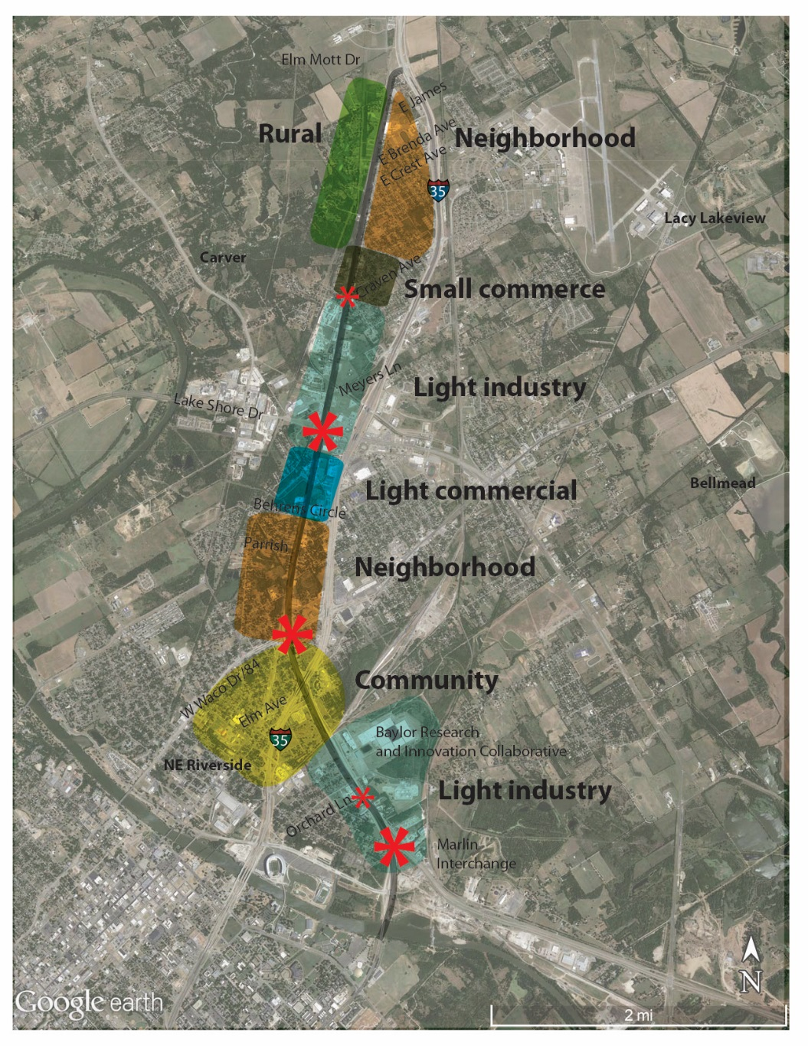
Emerging Features
Boulevard
Access control
Special use parallel roads
Bicycle and pedestrian accommodations
Roadway network enhancement
Special intersection treatments

Slide 28
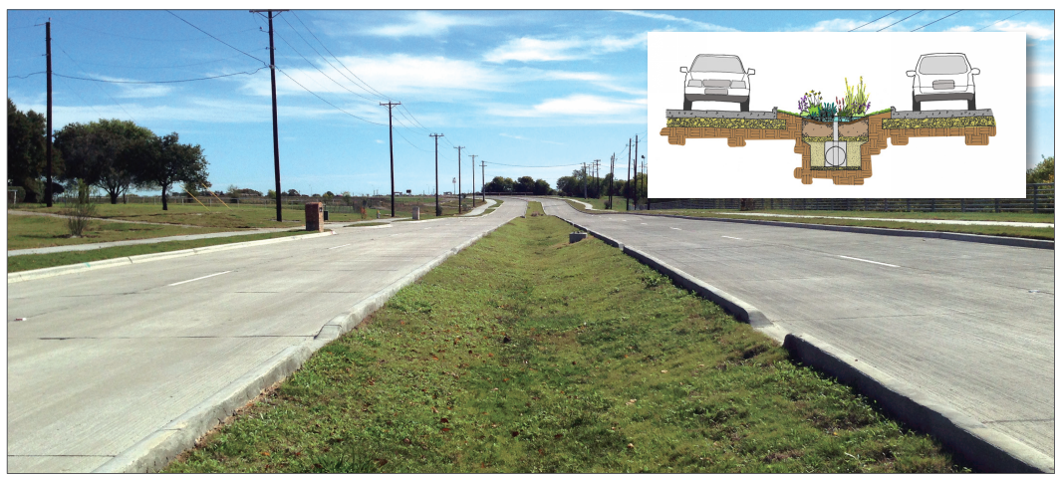
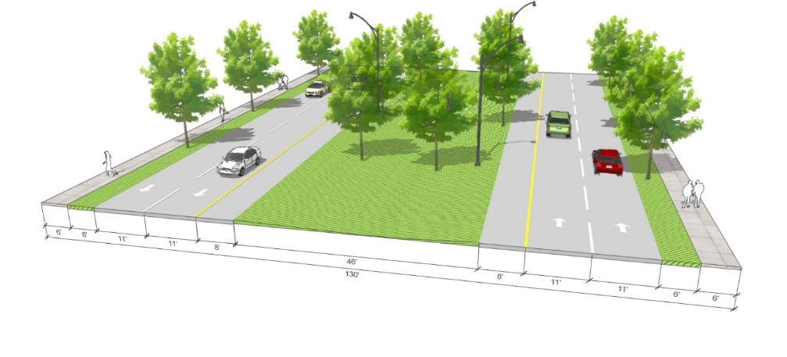
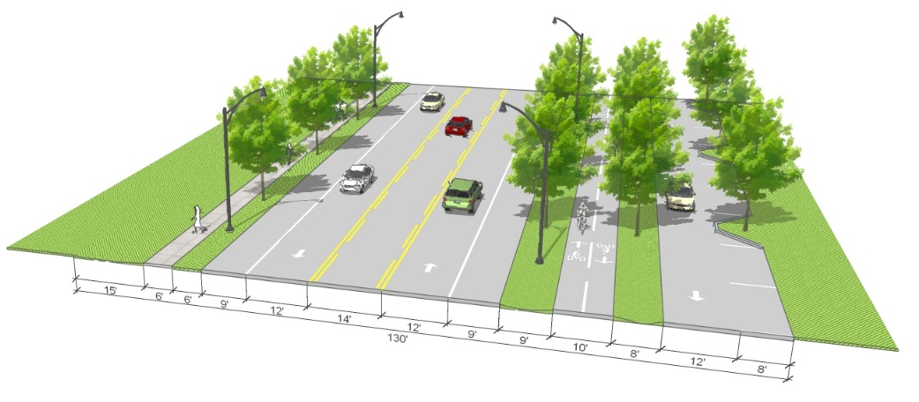
Boulevard Section
Four 13’ travel lanes w/ curbs
Approximately 20’ median
Retain center drainage
Create pass-thru curbs to median drainage
Landscape/xeriscape some median areas
Remove shoulders and add outside curbs, pass-thru where needed

Slide 29
Access Control
Physical Medians, Openings, Driveways
Left turn bays in median
Formalize driveways
Driveway consolidation if possible
Retain key parallel service roads
Enhance parallel Old Dallas Road
Provide ample strategic median openings
Keep some short segments of parallel roads for special uses
Create shared parking zones

Slide 30
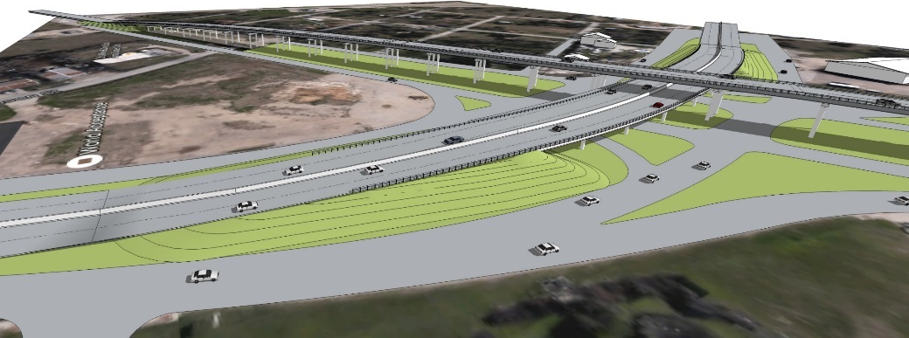
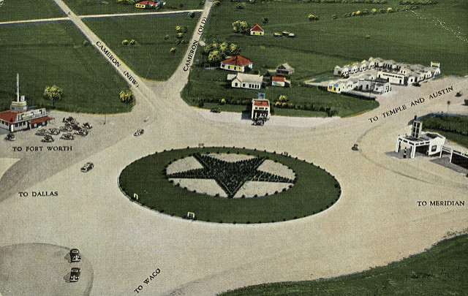
Special Intersection Treatments
Bring multi-level intersections back to grade
Marlin Highway
Orchard Lane
Waco Drive (Potts interchange)
Consider modern roundabouts at key locations
Marlin Highway
Orchard Lane
Waco Drive
Behrens Circle
Craven Avenue
Crest Drive

Slide 31
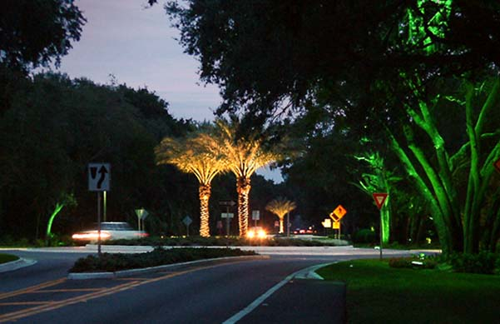
Modern Roundabouts
Perform as good of better than signals under certain traffic conditions
Create a less intense traffic operation
Can denote transition between character zones

Slide 32
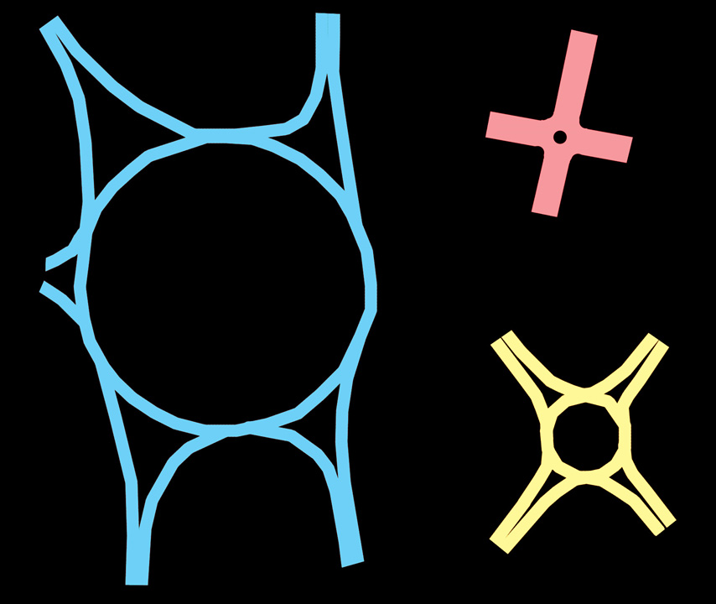
Mini-Traffic
Circle
Traffic Circle
Modern
Roundabouts
In Context
Modern
Roundabout

Slide 33
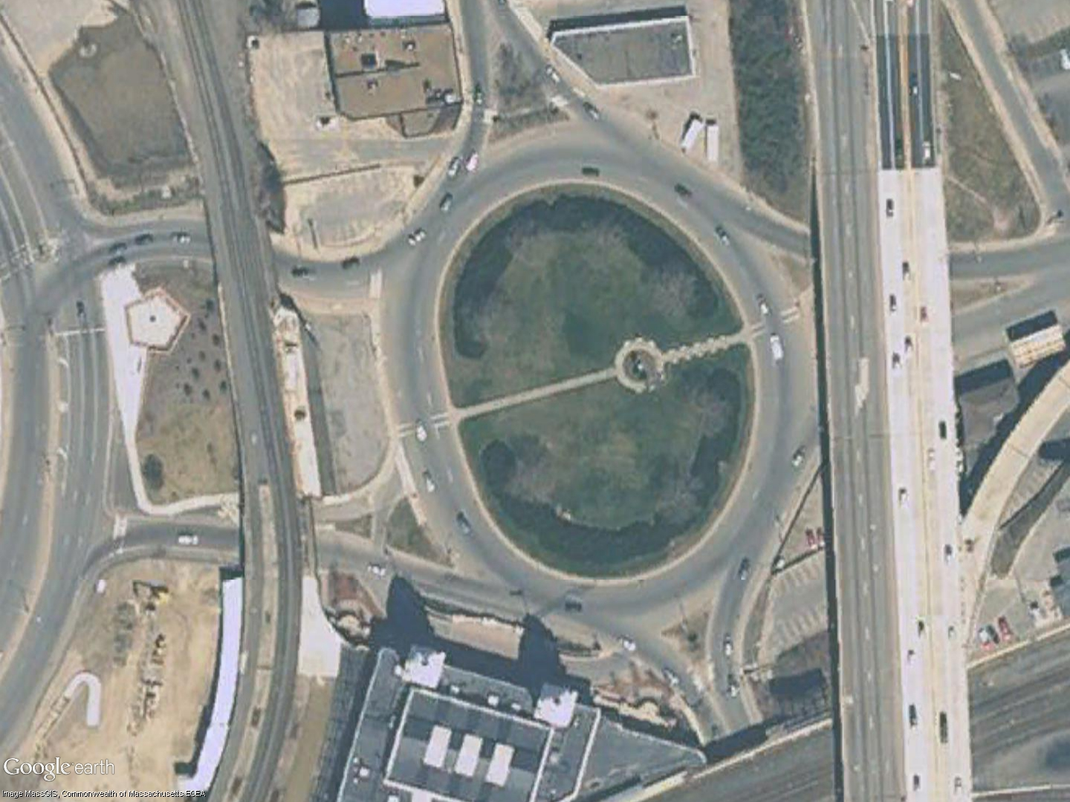
Before:
Traffic Circle
Worcester, MA

Slide 34
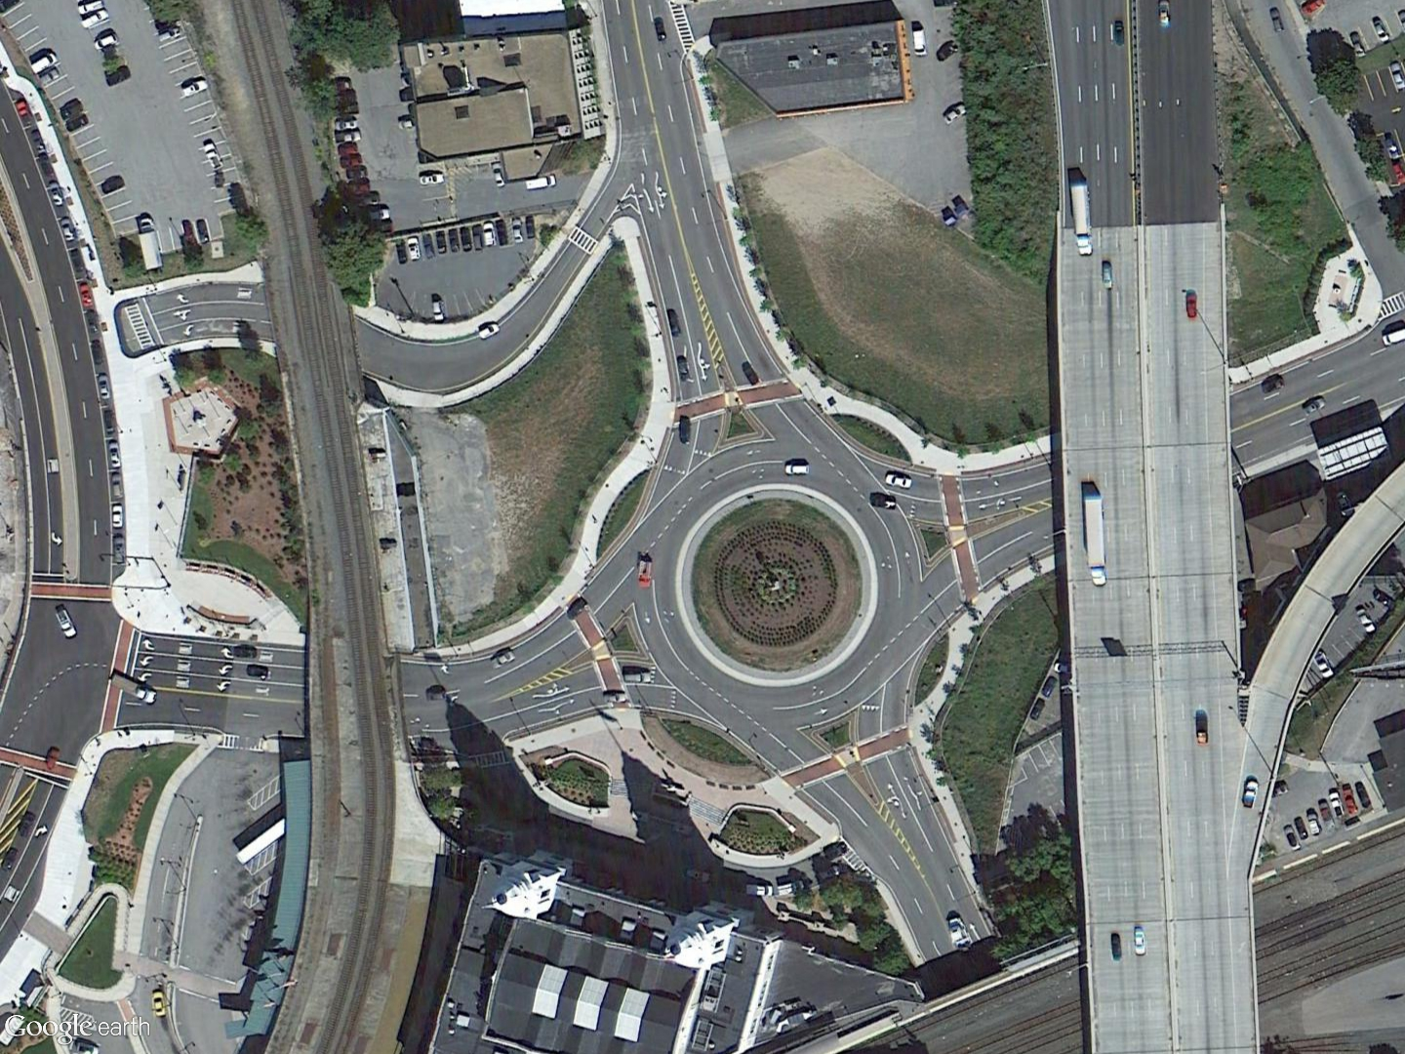
After:
Roundabout
Worcester, MA

Slide 35
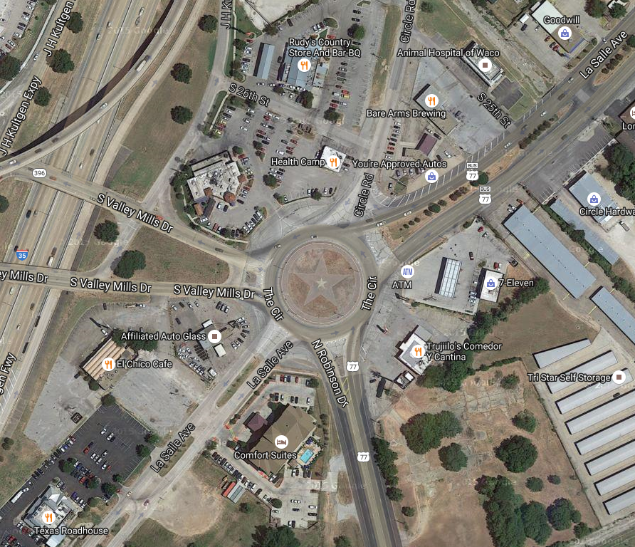
Comparison to the size of Waco’s Old Traffic Circle
Worcester, MA
Waco, TX

Slide 36
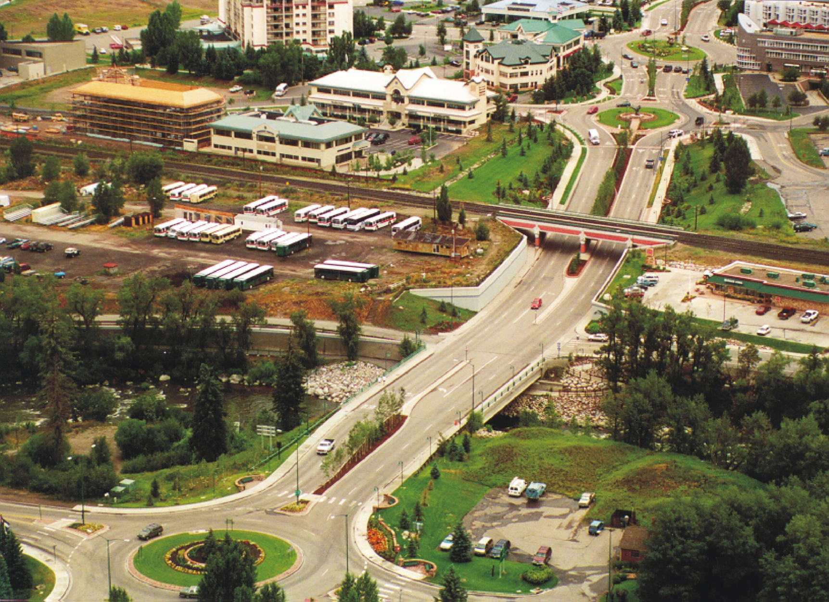

Slide 37
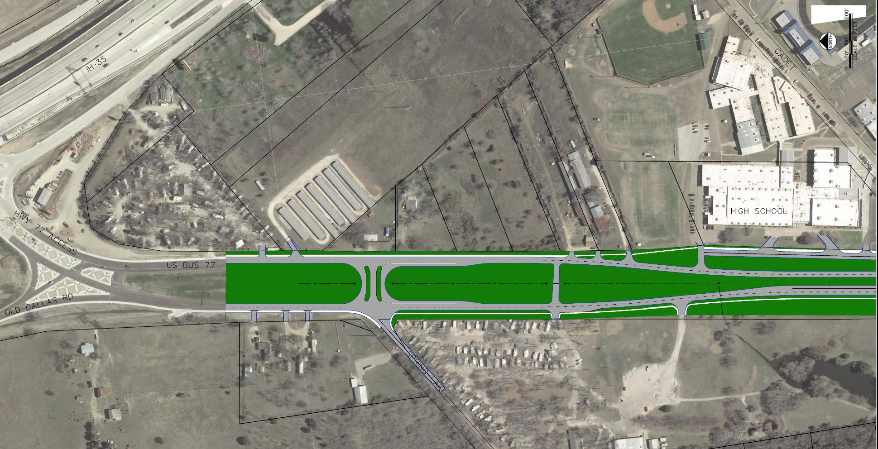
Illustrative Design of BUS 77, p1
Cadet Way
Sidewalk
N. Lacy Drive
BUS 77
Sidewalk
Bus Pullover
N

Slide 38
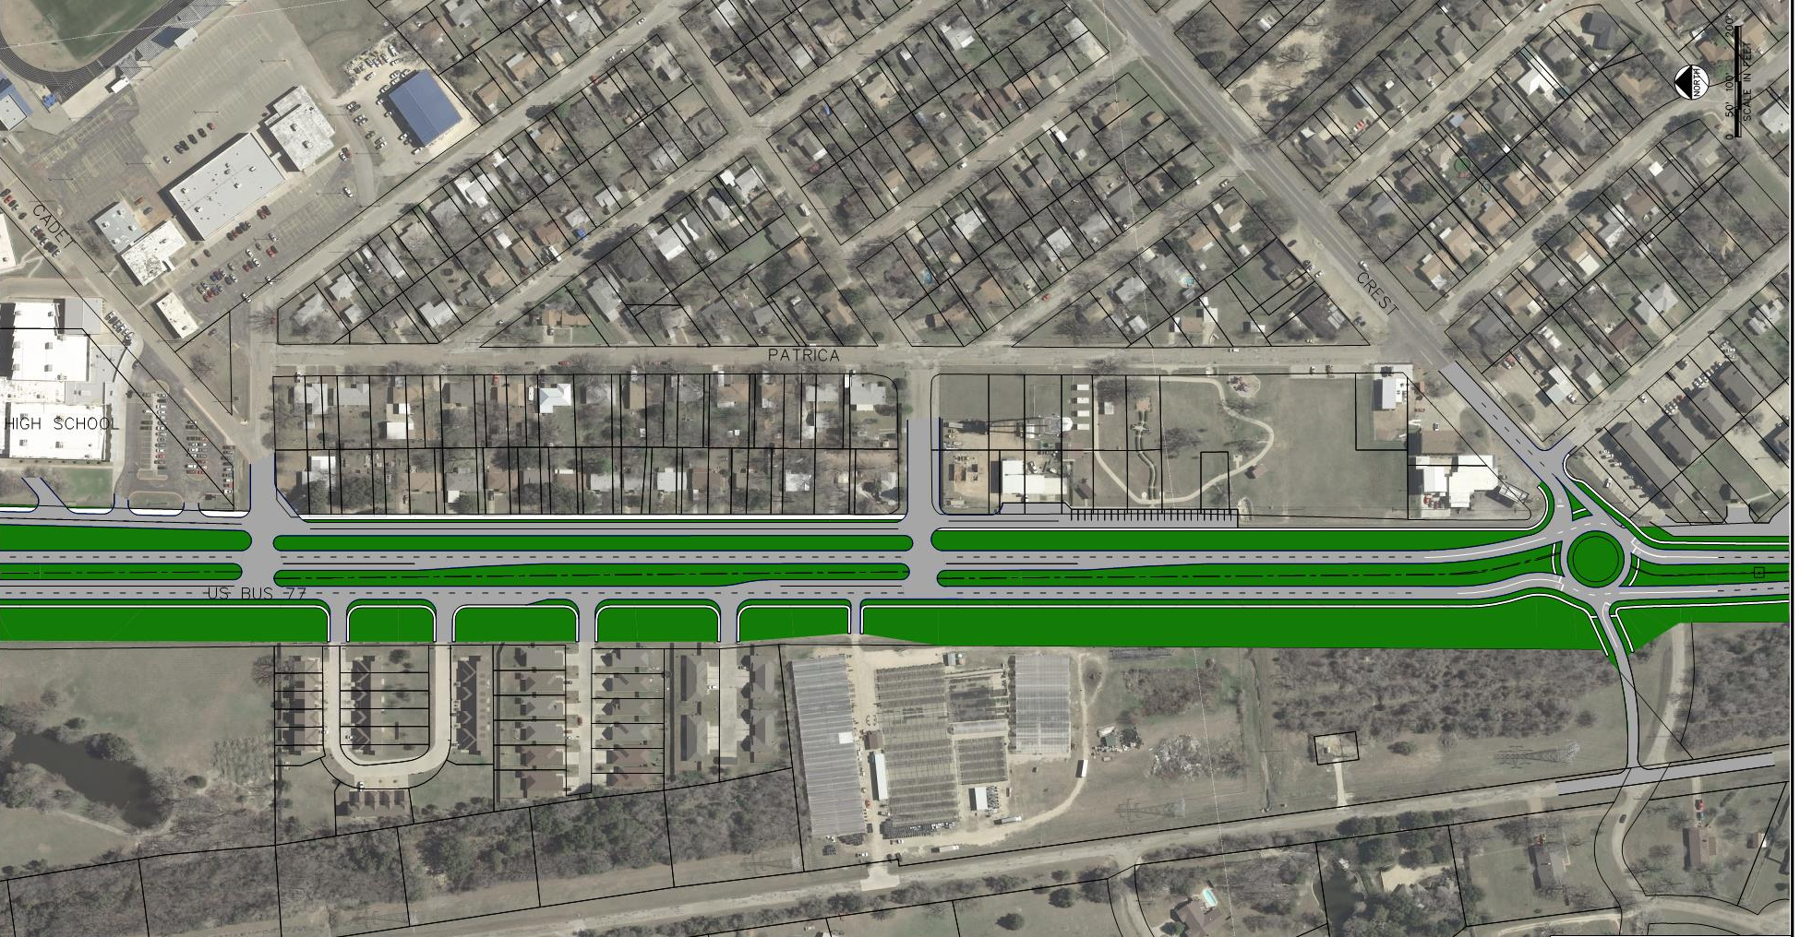
Illustrative Design of BUS 77, p2
Cadet Way
N. Lacy Drive
Sidewalk
N. Lacy Drive (end)
Sidewalk
Bus Pullover
BUS 77
N

Slide 39
Crest Drive (FM 2417)
Closely spaced stops on Crest Drive create driver confusion
CREST DRIVE
US BUS 77
US BUS 77
CREST
N

Slide 40
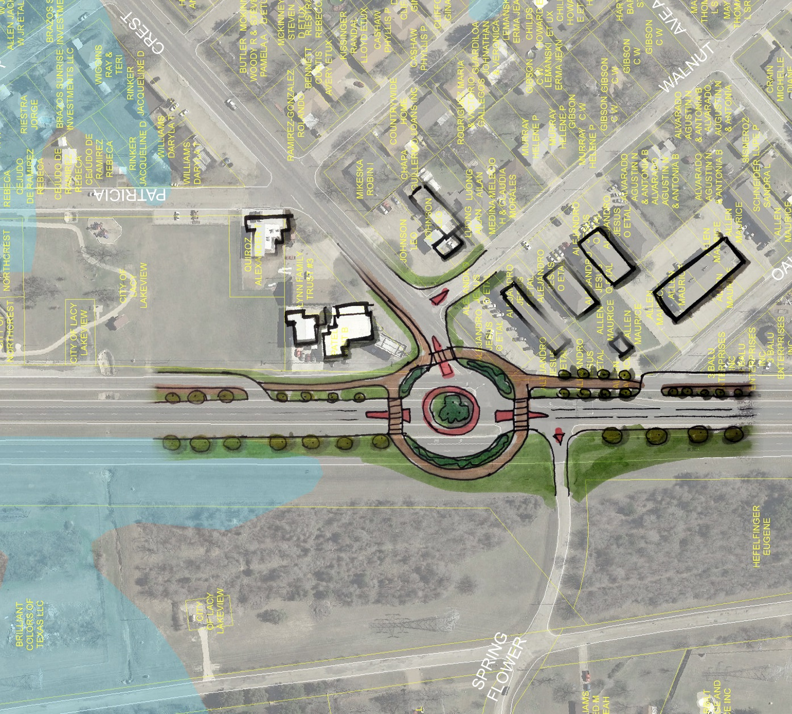
Crest Drive (FM 2417)
CREST DRIVE
US BUS 77
CREST
Potential Realignment
N

Slide 41
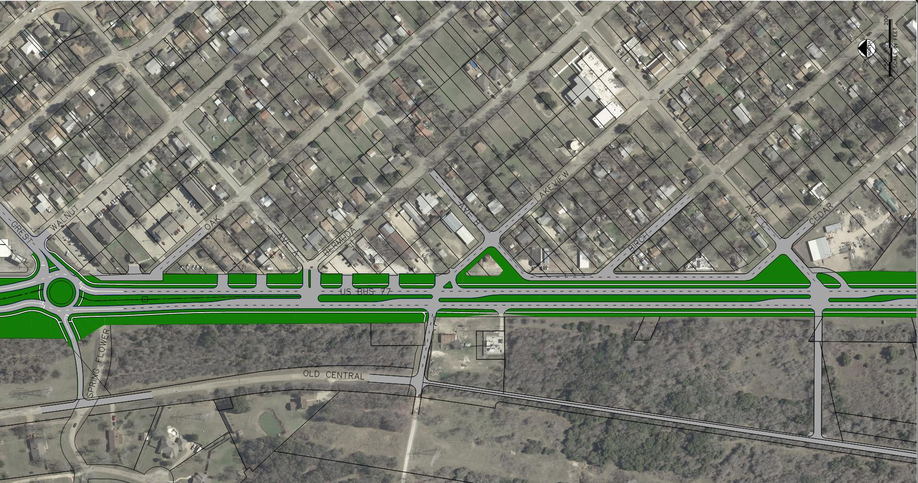
Illustrative Design of BUS 77, p3
Crest Drive
Parallel Road for local circulation
Sidewalk
N. Lacy Drive
Sidewalk
BUS 77
Spring
Flower Ln
Central Street
N

Slide 42
Craven Avenue
Closely spaced stops on Craven Avenue create driver confusion
CRAVEN
US BUS 77
N

Slide 43
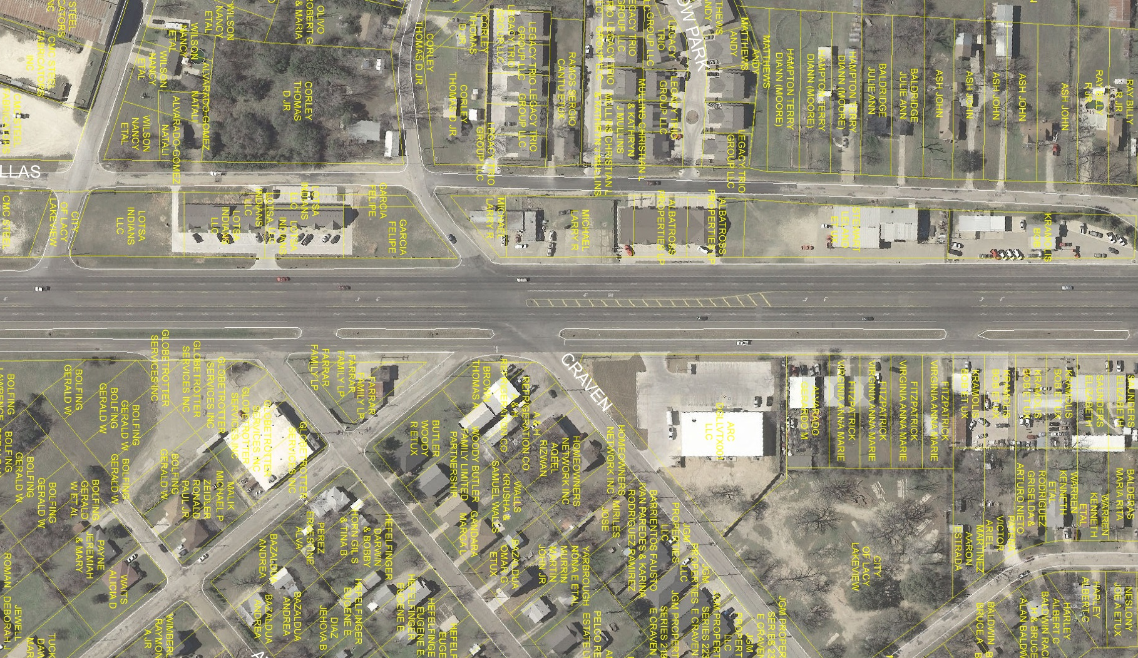
Craven Avenue
CRAVEN
US BUS 77
US BUS 77
N

Slide 44
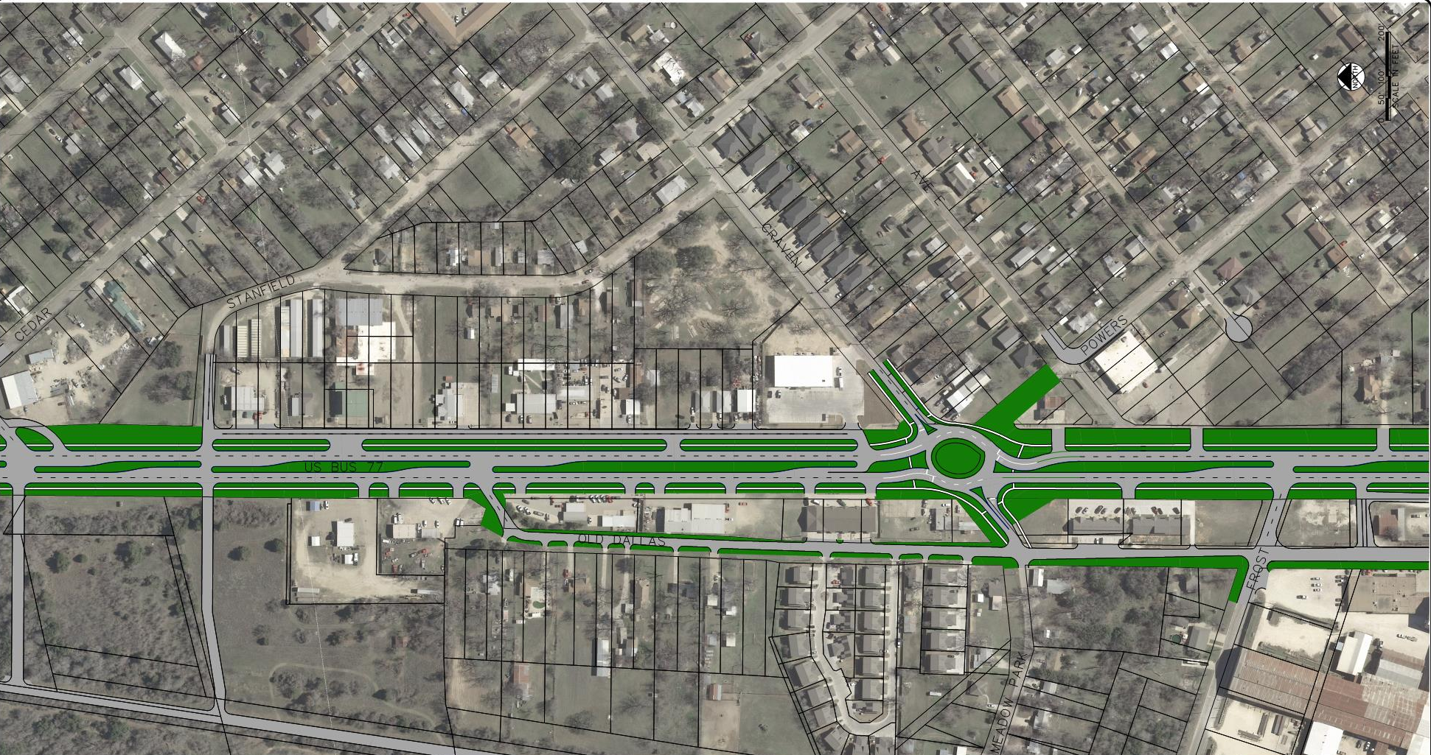
Illustrative Design of BUS 77, p4
Craven Drive
N. Lacy Drive
BUS 77
Old Dallas Road
N

Slide 45
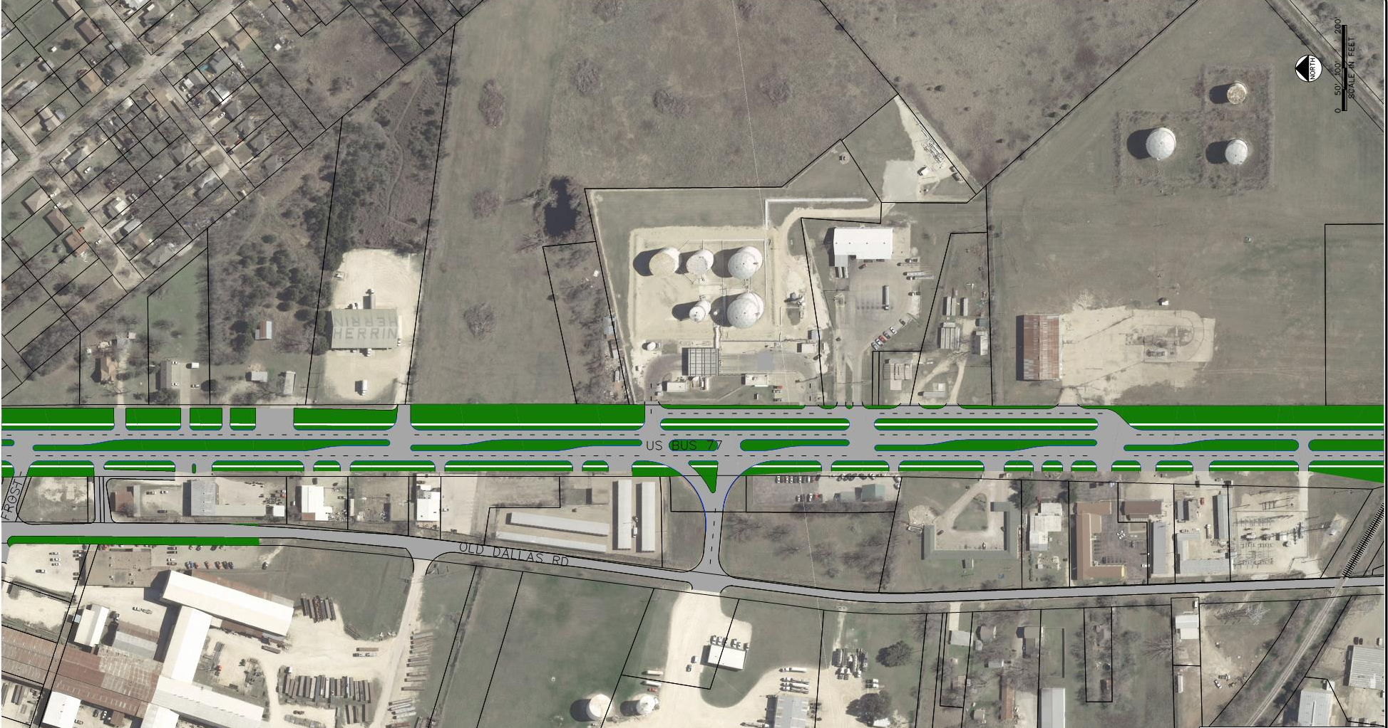
Illustrative Design of BUS 77, p5
N. Lacy Drive
BUS 77
Old Dallas Road
RR Service Track
N

Slide 46
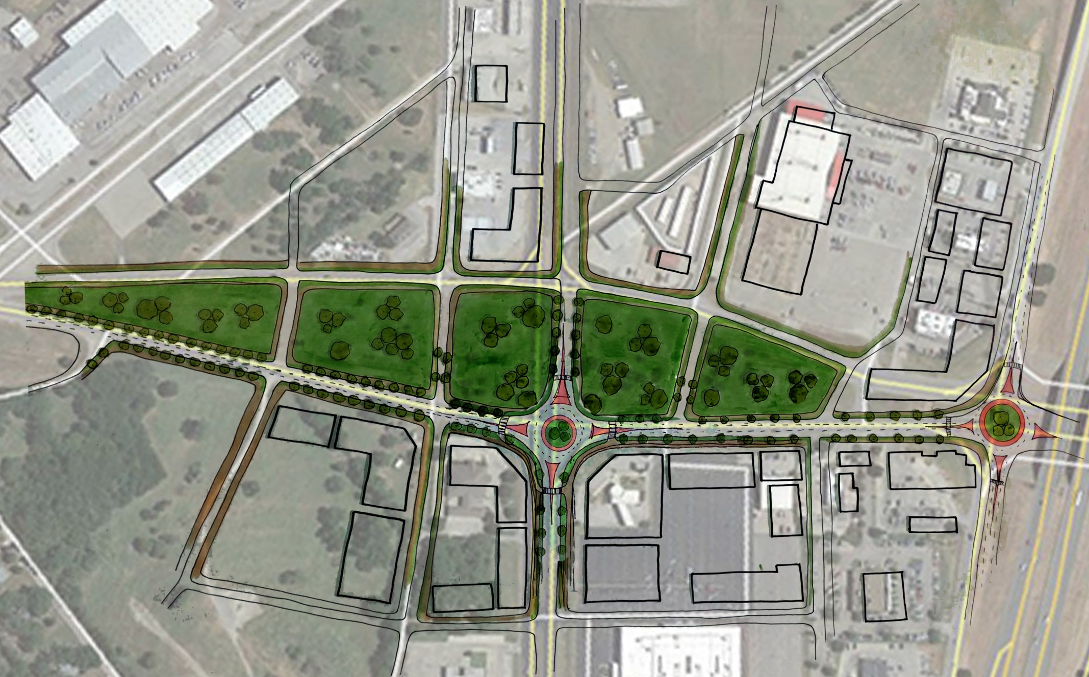
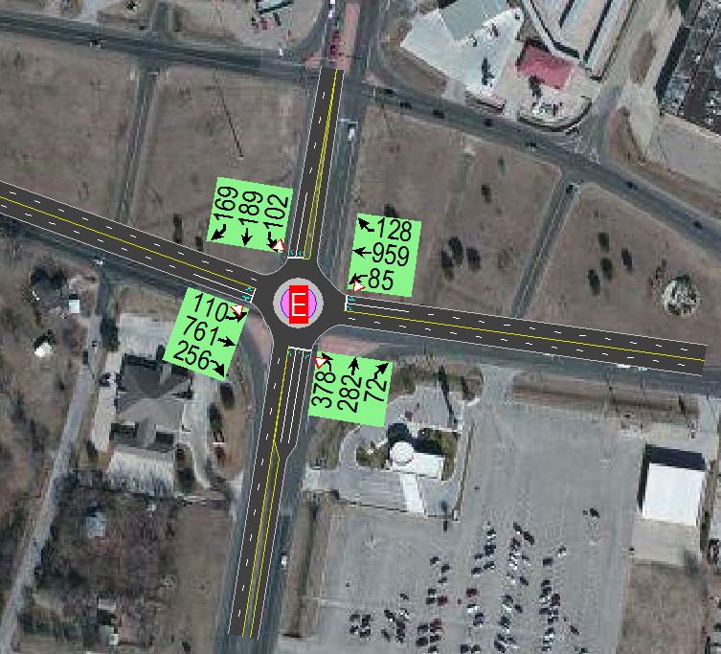
Lakeshore Gateway
Traffic Analysis: Signal works well
REVERE RD
PECAN LN
US BUS 77
OLD DALLAS RD
REMNANT RD
REMNANT RD
LOOP 340
LOOP 340
Traffic Analysis: Roundabout not good
N
N

Slide 47
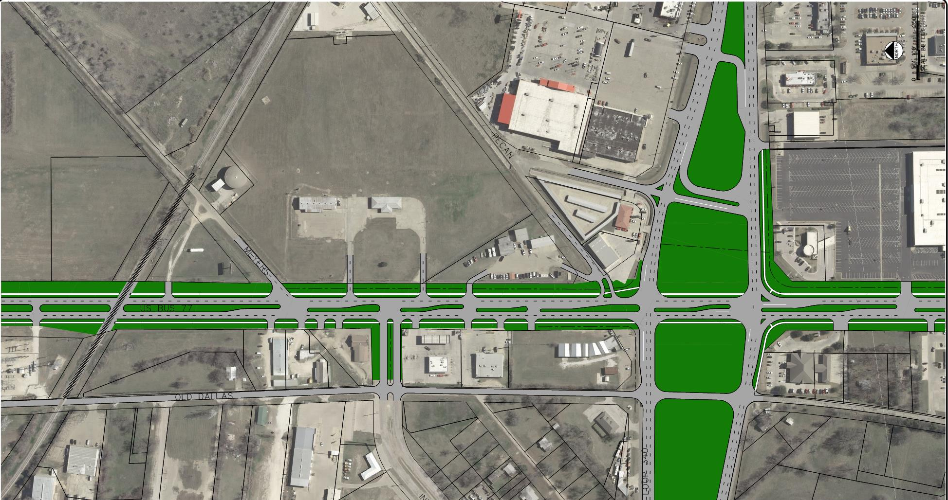
Illustrative Design of BUS 77, p6
Myers Lane
Cross-
Over
Lanes
BUS 77
Old Dallas Road
Loop 340
RR Service Track
N

Slide 48
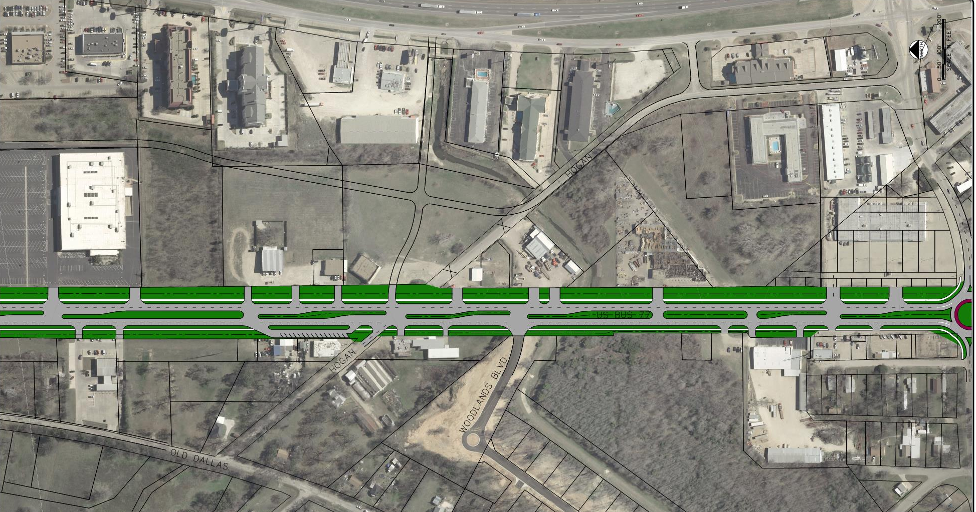
Illustrative Design of BUS 77, p7
I-35
Hogan Lane
Behrens Circle
Hogan Lane
BUS 77
Shared Parking
Old Dallas Road
Hogan Lane
N

Slide 49
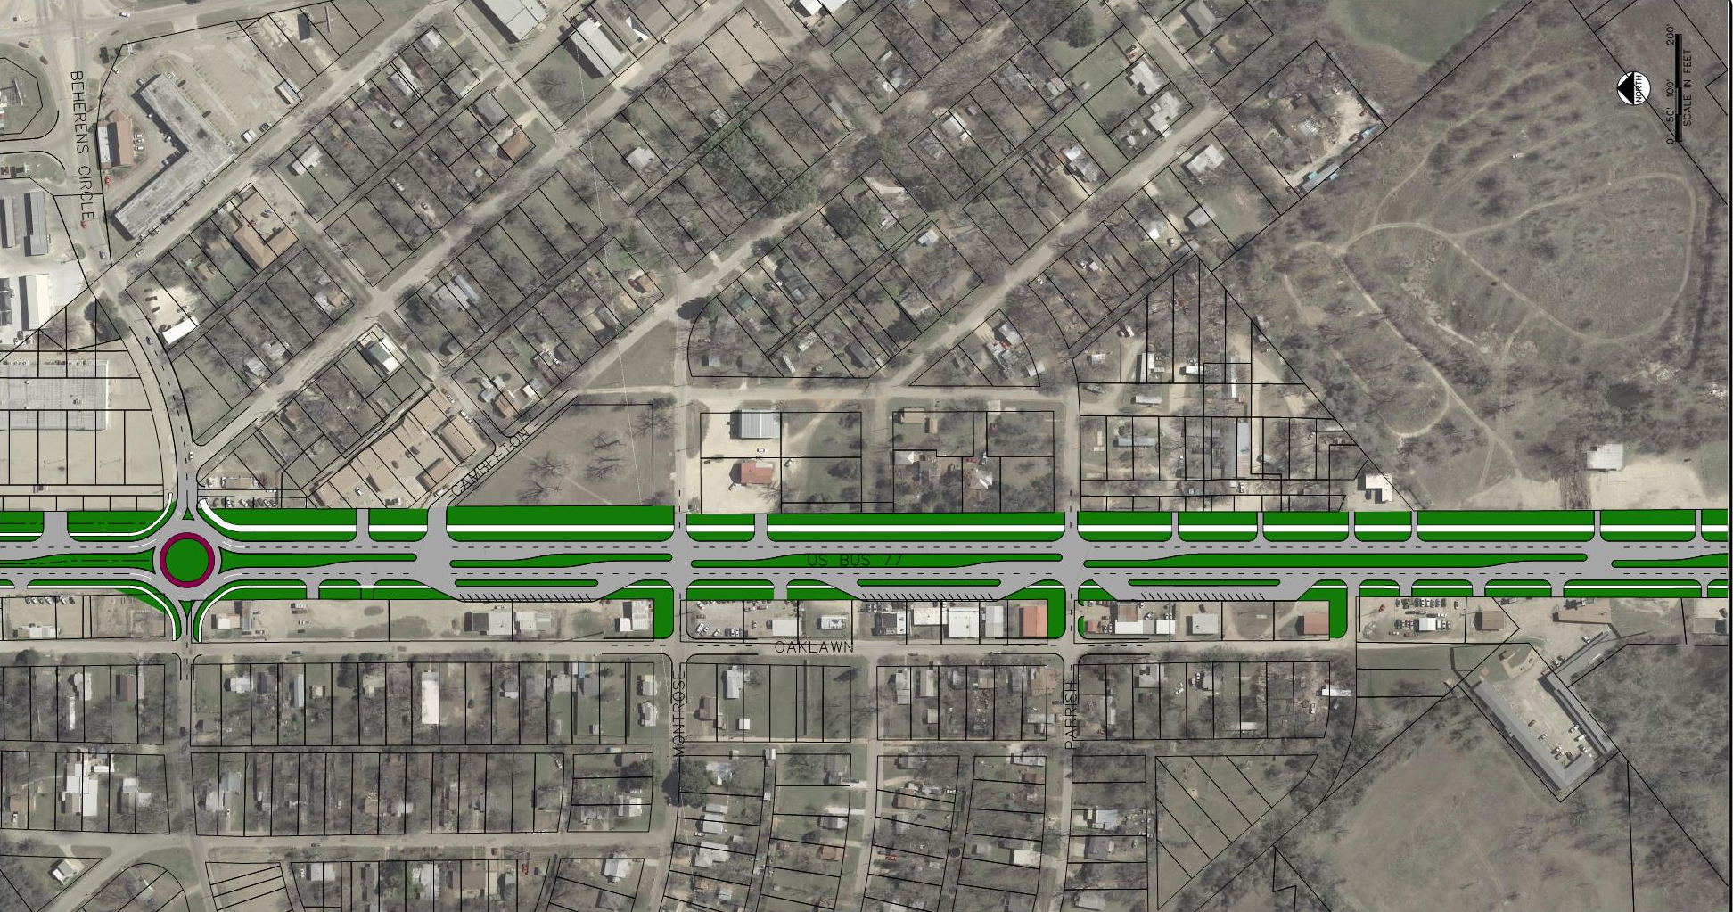
Illustrative Design of BUS 77, p8
Behrens Circle
BUS 77
Shared Parking
Shared Parking
Shared Parking
Oaklawn Street
Behrens Circle
N

Slide 50
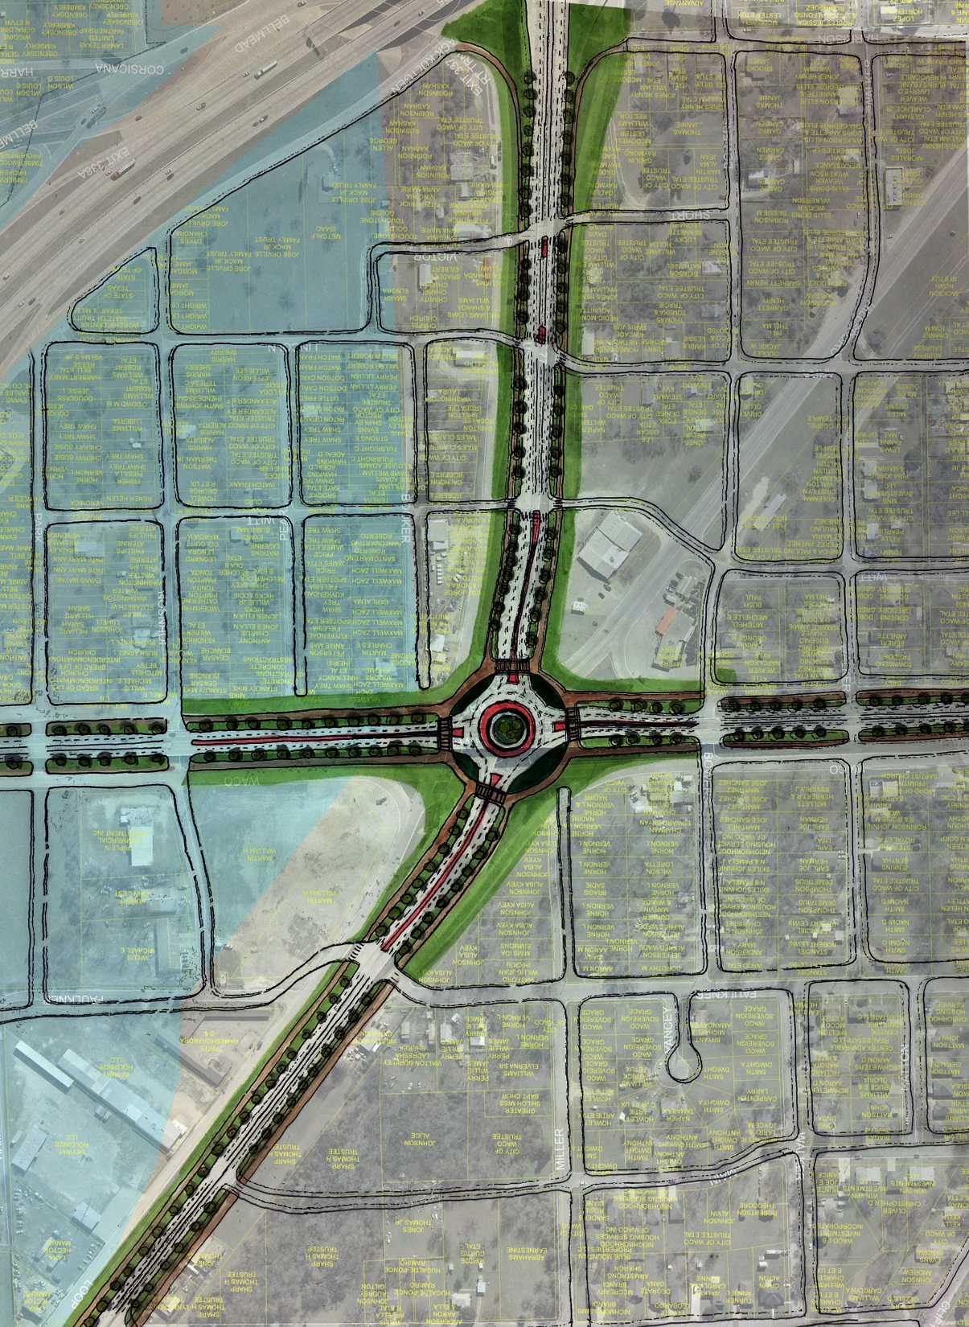
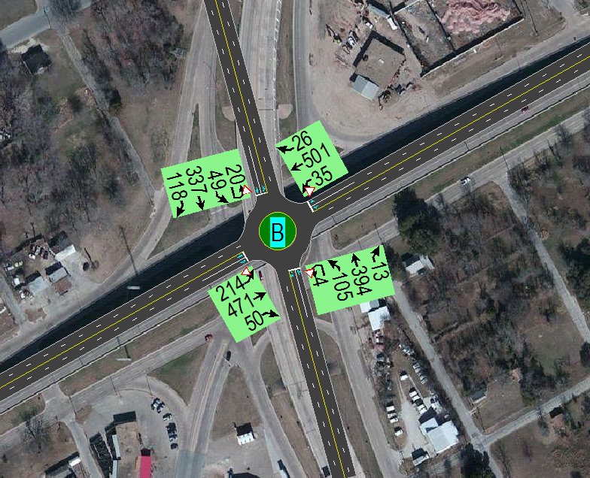
Potts Interchange
WACO DR
(US 84)
HILLSBORO RD
US BUS 77
US BUS 77
US BUS 77
N
Traffic Analysis: Roundabout works well

Slide 51
Potts Interchange Impact on Local Community Vitality
Historical Significance:
Provision of interchange is historic
Design of bridge structure is not
Possible to remove structure if:
Show not needed or negative
Show to be better without it
Show acceptable traffic without it
N

Slide 52
Illustrative Design of BUS 77, p9
US 84 (Waco Drive)
BUS 77 (N. La Salle Avenue)
Hillsboro Drive
N

Slide 53
Potts Interchange Impact on Local Community Vitality
N

Slide 54
Illustrative Design of BUS 77, p10
BUS 77 (N. La Salle Avenue)
I-35 (TxDOT Planned Configuration)
N

Slide 55
Marlin Hwy & Orchard Lane
Historical Significance:
Provision of interchange is historic
Design of bridge structure is not
Possible to remove structure if:
Show not needed or negative
Show to be better without it
Show acceptable traffic
ORCHARD
Marlin Highway
US BUS 77
<- TO I-35
US BUS 77
US BUS 77
UPRR
N

Slide 56
Marlin Hwy @ Orchard Lane & BUS 77
ORCHARD
US BUS 77
US BUS 77
Potential Extension
OLD US BUS 77 Local Industrial Road
N
Traffic Analysis: Roundabout works well
N

Slide 57
Illustrative Design of BUS 77, p11
Katy Lane
Kendall Lane
Orchard Lane
BUS 77 (N. La Salle Avenue)
Outside Lane ->
Buffered Bike Lane
Cotton Belt Street
N

Slide 58
Illustrative Design of BUS 77, p12
Industrial Boulevard
Landscape Buffer
Truck Staging
Excess
Land
BUS 77 (N. La Salle Avenue)
Cherry St.
E. 10th St.
N

Slide 59
Illustrative Design of BUS 77, p13
Marlin Highway Spur 484
Excess
Land
Industrial Boulevard
Landscape Buffer
Excess
Land
Proposed Multifamily
Martin Luther King Blvd Ext’n
BUS 77 (N. La Salle Avenue)
N

Slide 60
Illustrative Design of BUS 77, p14
Industrial Blvd
Proposed Multifamily
Marlin Highway Spur 484
BUS 77 (N. La Salle Avenue)
Martin Luther King Blvd Ext’n
Proposed Hotel
N

Slide 61
Implementation Priority Strategy
Safety
Functional Improvements
Economic Development

Slide 62
Priority Set 1: Safety Improvements
Crest Drive
BUS 77 @ Crest Drive
Eliminate service road crossing Crest Drive
Align Spring Flower Lane into intersection
Use Roundabout for traffic control
BUS 77
Spring Flower Ln
Central Street

Slide 63
Priority Set 1: Safety Improvements
BUS 77 @ Craven Avenue
Eliminate service road (South and North Lacy Drive) crossing Craven Avenue
Use Roundabout for traffic control to better incorporate East and West Craven Avenues at the intersection
Not bring Powers Street into roundabout
Craven Avenue
BUS 77

Slide 64
Priority Set 2: Functional/ED Improvements
BUS 77 @ Marlin Hwy/MLK Blvd
Eliminate 3-level interchange
Connect Marlin Hwy to MLK Blvd
Marlin Highway Spur 484
Industrial Boulevard
BUS 77 (N. La Salle Avenue)
Martin Luther King Blvd Ext’n
Create boulevard for industry
Industrial Blvd also serves as event bypass
Eliminates circuitous routes for industry

Slide 65
Priority Set 2: Functional/ED Improvements
BUS 77 @ Orchard Lane
Eliminate Orchard Lane overpass
Eliminate on-ramps/off-ramps
Orchard Lane
BUS 77 (N. La Salle Avenue)

Slide 66
Priority Set 2: Functional/ED Improvements
BUS 77 @ I-35 (as proposed)
BUS 77 @ US 84 (continuation)
US 84
BUS 77
I-35
BUS 77
Hillsboro Drive

Slide 67
Discussions with City Councils Waco * Bellmead * Lacy Lakeview
How do these concepts compare to reality for this area?
Would these improvements help businesses to grow?
How can the concepts be improved?
What other factors need to be considered?
What can/should be done sooner than later?

Slide 68
Project Development Stages
Corridor Study
Illustrative Design
Partnerships
Programs
Bonds
Environmental
MTP inclusion
Design
Schematics
Final Design
PS&E
Phased
Priority
TIP/STIP inclusion
ROW/utility relocation
Identify
Construction

