Slide 1
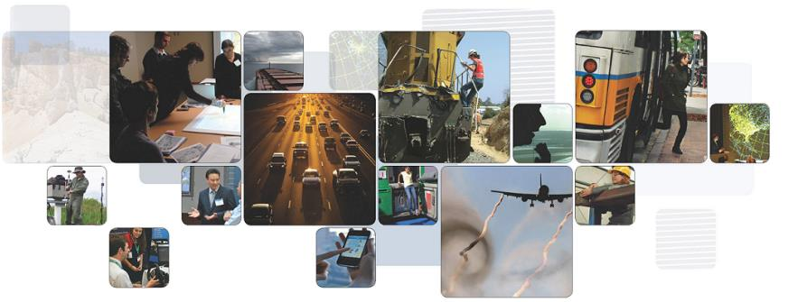
Introduction to Automated Vehicles
Scott Smith
October 2016
The National Transportation Systems Center
U.S. Department of Transportation
Office of the Secretary of Transportation
John A. Volpe National Transportation Systems Center
Advancing transportation innovation for the public good

Slide 2
Outline
What are automated vehicles (AVs)
Levels of automation
Early deployment opportunities
Policy development
Useful conferences and mailing lists

Slide 3
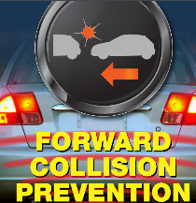
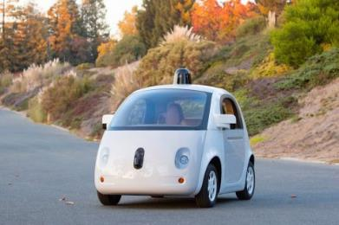
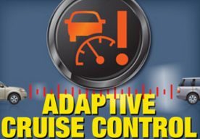
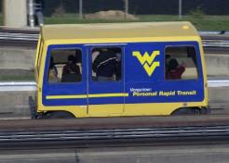
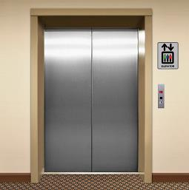
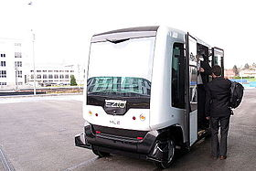
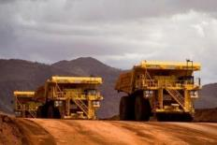
What is an Automated Vehicle?
Notes:
Based on news reports the first thing you likely think about is the google car but in actuality automated vehicles have been around in many forms for a while.
One of the first forms of automated transportation was the elevator - a simple form of transportation many of us take every day and never think about.
Expanding the definition to other modes and automation has been part of transportation in many places such as industrial applications, certain public transit application and of course military and aviation has been very active in the field.

Slide 4
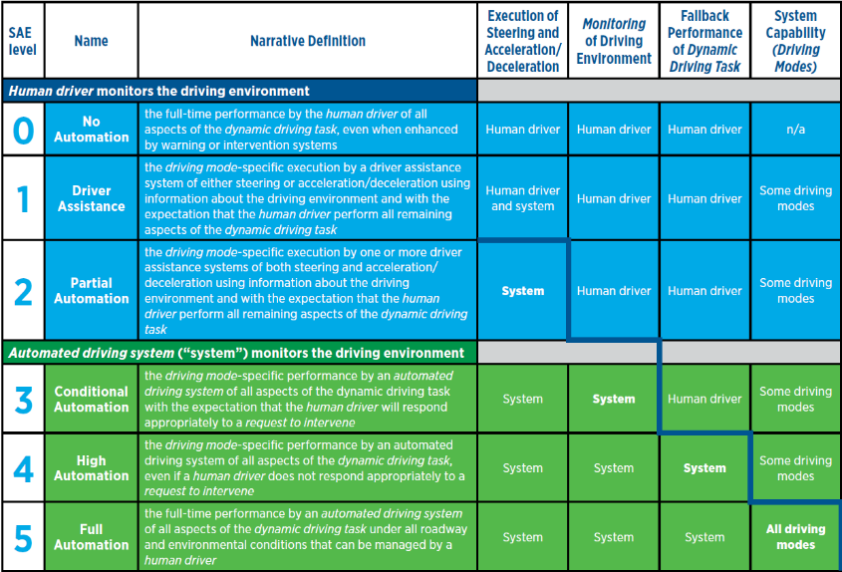
Levels of Automation (SAE J3016)
Notes:
What is happening now (L1, L2, L4), what may never happen (L3, L5)
L2 and L3 present a human-factors challenge: will the driver stay sufficiently engaged?
L5 presents a technical challenge, and may not be as imminent as some have suggested.
Standard originally published in 2014, with a revision in September 2016. This table comes from the original standard.

Slide 5
Example Systems at Each Automation Level
SAELevel | Example Systems | Driver Roles
1 | Adaptive Cruise Control OR Lane Keeping Assistance | Must drive other functions and monitor driving environment
2 | Adaptive Cruise Control AND Lane Keeping Assistance Traffic Jam Assist | Must monitor driving environment (system nags driver to try to ensure it)
3 | Traffic Jam Pilot Automated parking Highway Autopilot | May read a book, text, or web surf, but be prepared to intervene when needed
4 | Closed campus driverless shuttle Valet parking in garage ‘Fully automated’ in certain conditions | May sleep, and system can revert to minimum risk condition if needed
5 | Automated taxi Car-share repositioning system | No driver needed
Source: California PATH

Slide 6
Early Deployment Opportunities
Driver assistance functions
Low speed shuttles
Truck platooning
Notes:
Two projects underway
Auburn U/Peterbilt (2-truck platoons)
Caltrans/UC Berkeley/Volvo (3-truck platoons)

Slide 7
Smart City Challenge
78 applicants, 7 finalists
Winner: Columbus, Ohio
$40 million Federal funding plus private funding
Automated vehicles
First-mile / last mile deployment of several electric automated vehicles on public roadways
Heavy truck (tractor) platooning

Slide 8
Federal Automated Vehicles Policy
Focuses on Highly Automated Vehicles (SAE level 3 – 5)
“…sets out a proactive safety approach that will bring lifesaving technologies to the roads safely while providing innovators the space they need to develop new solutions. “
Consistent with NHTSA’s mission, it focuses on vehicles and drivers
Does not explicitly address role of MPOs, transit, land use, etc.
Four components
Vehicle Performance Guidance
Model State Policy
Current Regulatory Tools
Modern Regulatory Tools
www.transportation.gov/AV
Notes:
It recognizes
The need for balance: in this case, to protect safety while not impeding innovation
It is not the last word: in this rapidly changing field, policies will need to be revisited as more information becomes available

Slide 9
Conferences and Mailing Lists
Automated Vehicles Symposium
Annual conference sponsored by TRB and AUVSI
1200 attendees in July 2016
http://www.automatedvehiclessymposium.org
Examples of mailing lists
Smart Transportation Dispatch (Carnegie Mellon University)
Smart Driving Cars (Alain Kornhauser)

Slide 10
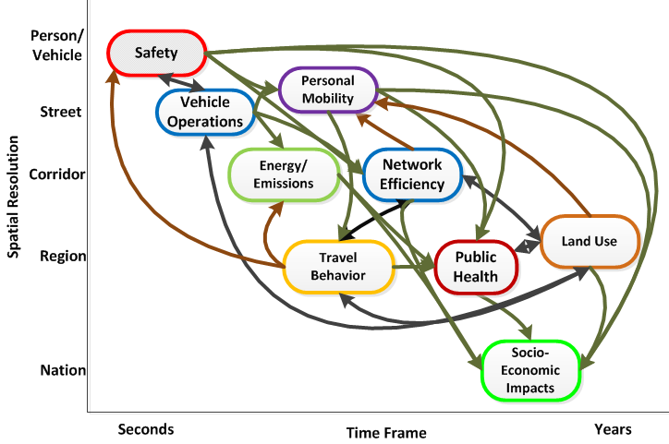
Impacts of AVs
Notes:
Objective is to develop a comprehensive framework for analyzing impacts (benefits and dis-benefits)
We need to work in multiple spatial and temporal resolutions. Spatial ranges from vehicle-vehicle interactions to national impacts. Temporal ranges from fractions of a second to years
Locations on this “graph” are approximate.
Safety - typically analyzed at a high level of detail (delta V in a crash), but benefits are rolled up to a larger area/timeframe (e.g., crashes in a nation per year)
Vehicle operations – also has detailed analysis (car following, gap acceptance, etc.), with benefits rolled up to a larger area/timeframe (network efficiency)
Personal Mobility – the ability of people to reach desired destinations. Becomes very important for non-motorists at the higher levels of automation (driverless cars)
Energy / environmental follows vehicle mobility
Network efficiency– looks at the performance of a region in terms of congestion
Travel behavior– looks at how people respond to changes in the transportation system (e.g., more people using a road that has become less congested)
Land use - reduced parking requirements, possibly more sprawl, etc.
Public health – access to medical care, active transportation
Economic analysis - many of these benefit areas lead to economic benefits: reduced crash, congestion, pollution and energy costs, increased ability for non-motorists to reach jobs
The colors of the ovals are arbitrary. The colors of the lines signify the following
Green lines – forward effects
Brown lines - feedback
Black lines go in both directions

Slide 11
Direct and Indirect Impacts
Cost
Infrastructure
Safety
Vehicle Operations
Energy / Emissions
Personal Mobility
Multi-tasking
Accessibility
Asset Management
Lanes and lane widths
V2I infrastructure
Size and weight
Network Efficiency
Travel Behavior
Public Health
Land Use
Socio-Economic
Notes:
Another way to look at this is via direct and indirect impacts:
Direct impacts: can be directly seen and measured in a field test. For example. Vehicle operations includes car following
Indirect impacts: derived from the direct impacts and other factors in the environment

Slide 12
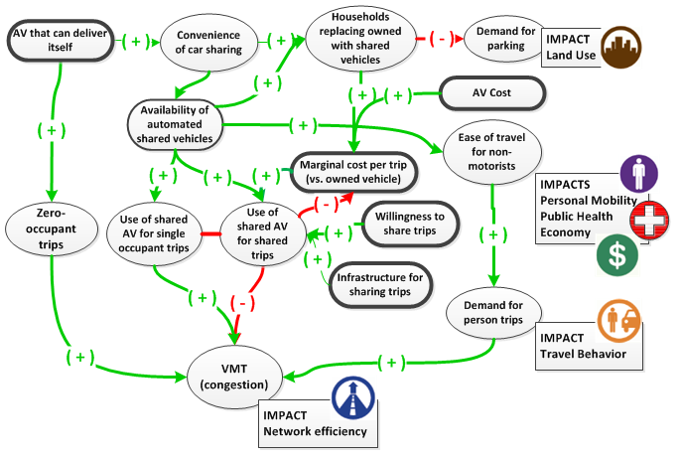
Going from Direct to Indirect Impacts, an example
Example of an AV that can deliver itself to a user
Notes:
Influence diagram
Green is positive influence (good or bad). Red is negative influence (good or bad)
What if you had an AV that can deliver itself?
Car sharing more convenient …. Land Use
Automated shared vehicles…ease of travel for non-motorists … Personal Mobility, etc.
Marginal cost / trip is usually higher for shared vehicles (consider typical car ownership, with high fixed cost vs. car sharing business models)
Marginal cost, willingness to share, infrastructure for sharing all affect use of AVs for shared trips
A number of factors influence VMT, mostly positive, one negative

Slide 13
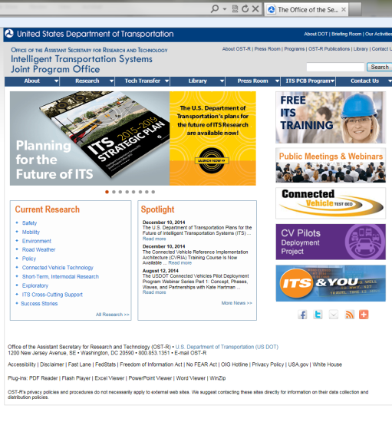
For More Information
www.its.dot.gov
Project Manager: Scott Smith
US DOT / Volpe Center
Scott.Smith@dot.gov
617-494-2588
Program Manager: Kevin Dopart
US DOT / ITS JPO
Kevin.Dopart@dot.gov
202-366-5004

