Slide 1
How Creative Placemaking Can Revolutionalize the Public Engagement Process
October 28, 2016 | AMPO
Ben Stone, Transportation for America/Smart Growth America
Rochelle Carpenter, Transportation for America/Nashville Area MPO
Duncan Hwang, APANO
Laura Zabel, Springboard for the Arts
Notes:
Great to be back in Boston, college, grad school, work. Quick intro: Director of Arts & Culture for T4A & SGA.

Slide 2
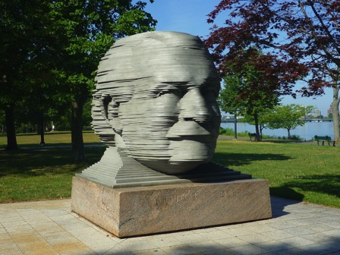
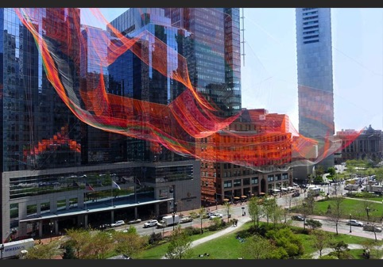
Art in Communities – Public Art
Notes:
This will be a talk on creative placemaking, but I’d like to start by talking about art in communities more generally so we can narrow in on what we’re actually talking about.
Public art – my background; here are two local examples. Great, but only a small part of creative placemaking and not really what we’re talking about.

Slide 3
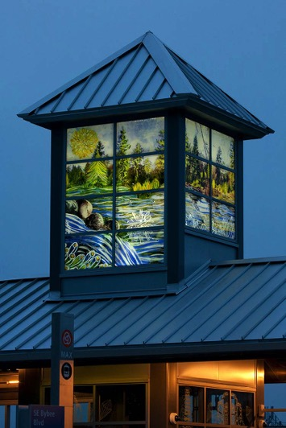
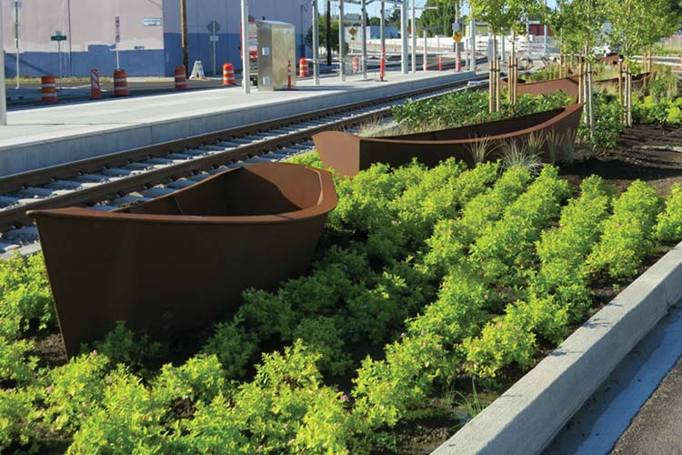
Art in Communities – Percent for Art
Notes:
art’s connection to transportation frequently comes through percent for art programs. Leads to station area improvements like these great examples in portland. Public art conference will talk about this later this week.

Slide 4
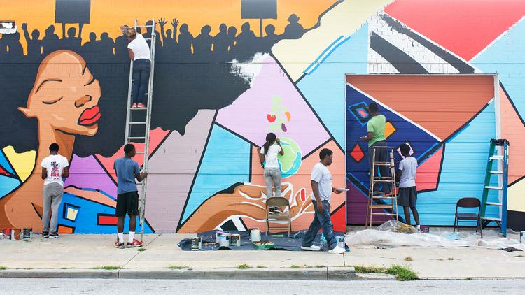
Art in Communities – Community Art
Notes:
Community art = democratizing the art making process; often used to mask blight, at its best it helps people unlock their creative potential.

Slide 5
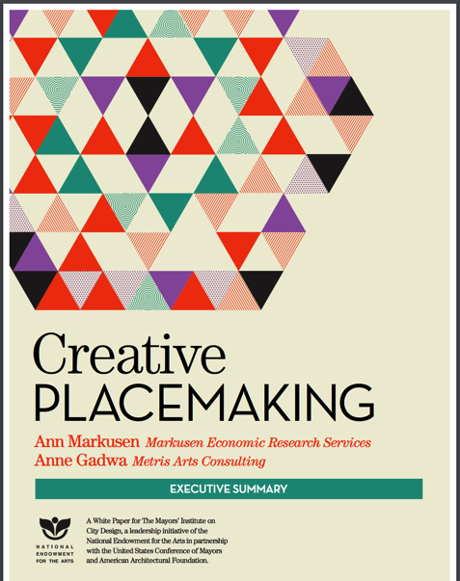
A Brief History of Creative Placemaking
In creative placemaking, partners from public, private, non-profit, and community sectors strategically shape the physical and social character of a neighborhood, town, city, or region around arts and cultural activities. Creative placemaking animates public and private spaces, rejuvenates structures and streetscapes, improves local business viability and public safety, and brings diverse people together to celebrate, inspire, and be inspired.
Notes:
So then what are we actually talking about? Creative Placemaking was only coined in 2010 by Ann and Anne working for the MICD and NEA.
Keys: partners, shaping the character, arts and culture. Still frankly not that clear…
This then led to the NEA adopting Creative Placemaking as a key funding area through their Our Town program.

Slide 6
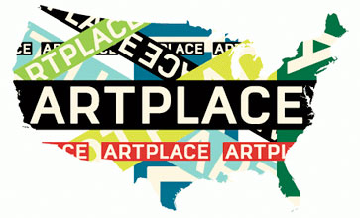
A Brief History of Creative Placemaking
ArtPlace is a ten year collaboration that funds projects, researches practice, and builds the field of creative placemaking.
The collaboration includes:
• 14 Foundations
• 8 Federal Agencies
• 6 Financial Institutions
Notes:
Larger grants, 10 year initiative.

Slide 7
A Brief History of Creative Placemaking
Projects in which art plays an intentional and integrated role in place-based community planning and development.
Notes:
Immediately after that, ArtPlace was born and simplified this definition. Art in placebased commnity planning and development. Get arts at the table as an equal to housing, transportation etc.

Slide 8
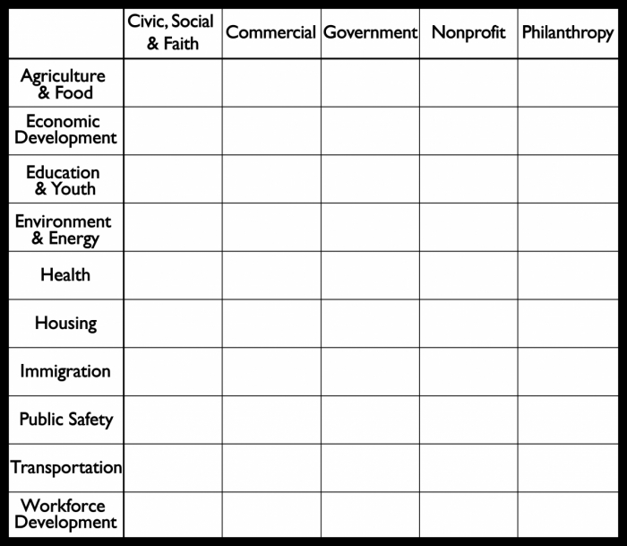
Notes:
Really interested in arts role in all of these intersections.

Slide 9
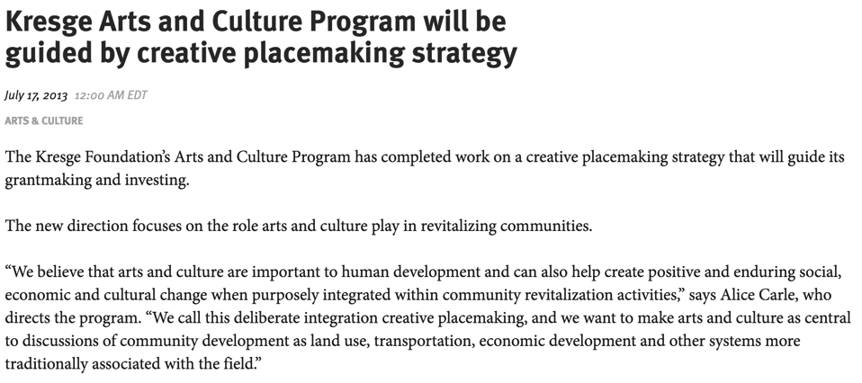
A Brief History of Creative Placemaking
Notes:
Creative Placemaking futher took over the philanthropic world when Kresge decided to shift their focus to this area for all arts funding.

Slide 10
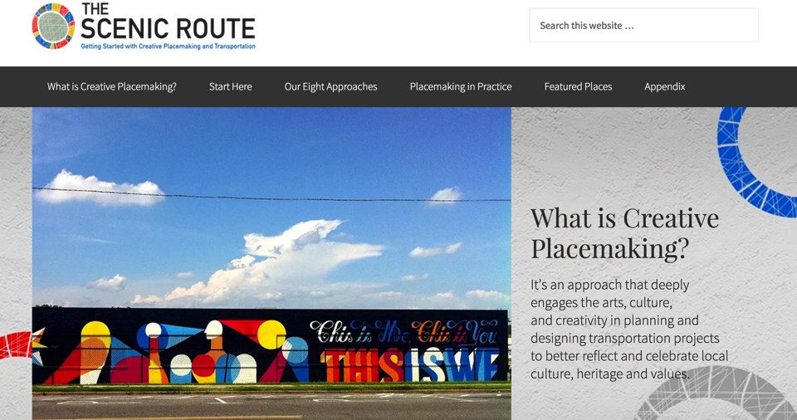
Transportation for America: The Scenic Route
Notes:
So what am I up to now? T4A put together this great creative placemaking guide for the transportation community. Even though I know this is the development community, I think there are plenty of helpful lessons here.

Slide 11
Transportation for America: The Scenic Route
In the transportation context, creative placemaking is an approach that deeply engages the arts, culture, and creativity, especially from underrepresented communities, in planning and designing projects so that the resulting communities better reflect and celebrate local culture, heritage and values.
Notes:
So we of course had to come up with our own applicable definition.

Slide 12
Scenic Route: 8 Approaches to Creative Placemaking
Notes:
Our guide highlights 8 approaches to creative placemaking, no time for all of them right now in detail…these apply to any number of projects beyond transportation projects.

Slide 13
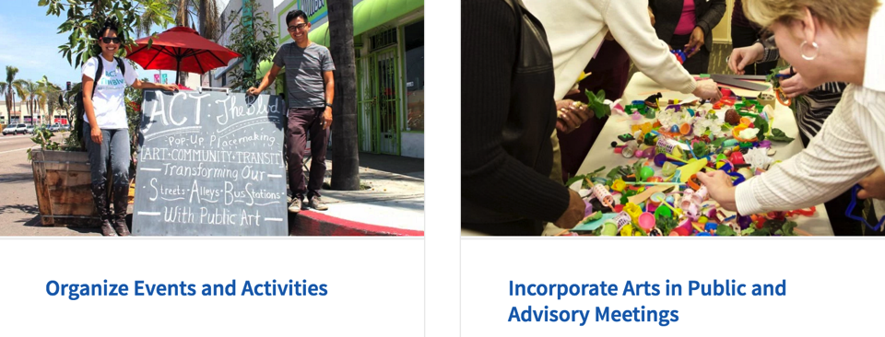
Scenic Route: 8 Approaches to Creative Placemaking

Slide 14
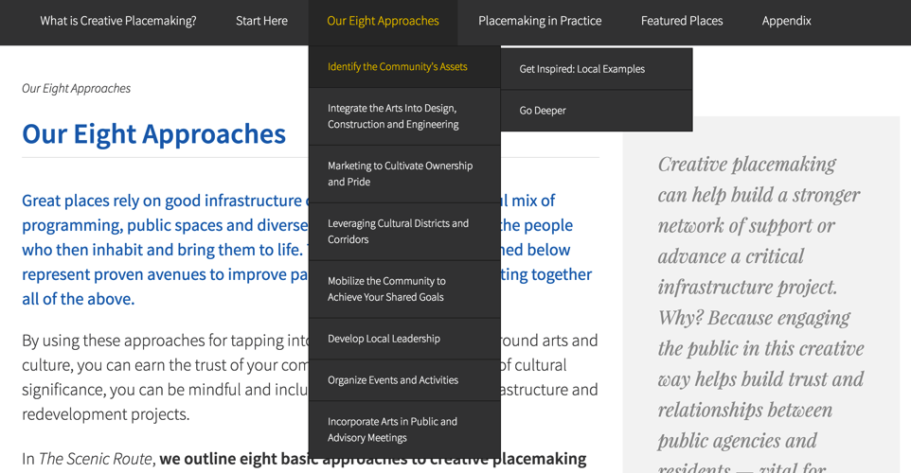
How to use the Scenic Route
Notes:
A vast amount of detail on each of these approaches

Slide 15
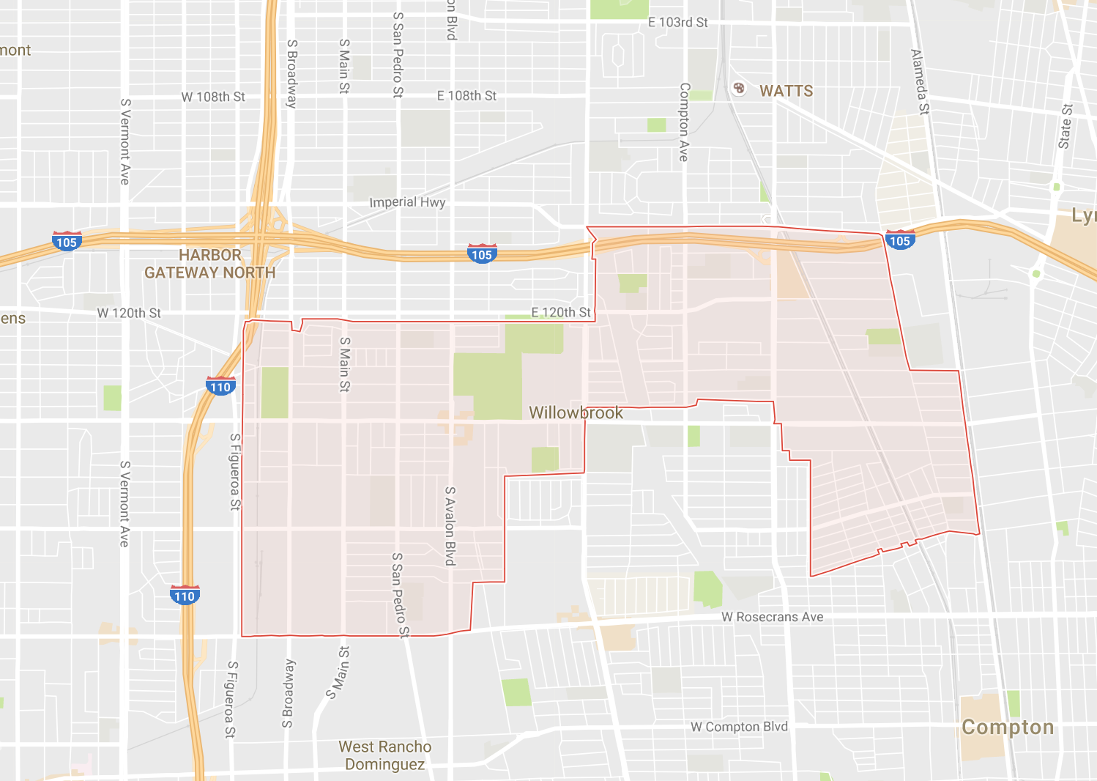
Willowbrook Is/Es: Identify the Community’s Assets
Notes:
Identify community’s assets: how do you engage local community and portray local culture in a “blank slate” community? Ask people to self identify as assets, publish catalog

Slide 16
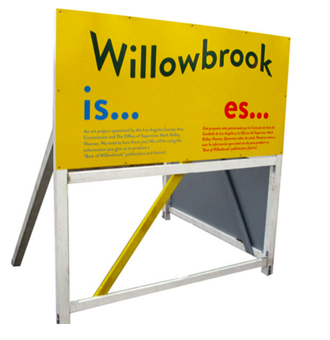
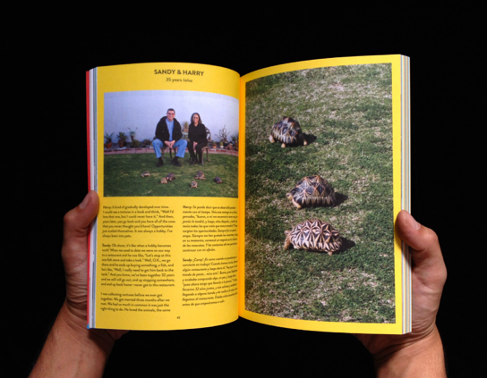
Willowbrook Is/Es: Identify the Community’s Assets
Notes:
Identify community’s assets: how do you engage local community and portray local culture in a “blank slate” community? Ask people to self identify as assets, publish catalog

Slide 17
Willowbrook Is/Es: Identify the Community’s Assets
“As often as not, visioning exercises are a kind of smokescreen. They fill some kind of mandated requirement to receive community input, but they exert just a tiny bit of influence on trajectories that were set long before any input was gathered, any experts were hired to gather that input. With all of that rigamarole, it’s easy to lose sight of the word itself. This book is a tool to help you see.
“Instead of trying to build a system for residents to project their hopes, it made more sense to build a “visioning tool” for the planners. A set of corrective images that those who might work in the area in the future could use to help focus their hopes and dreams. Too often, I feel, the future of the area is imagined by meditating on what it lacks, for its problems.
-Rosten Woo, Willbrook Is/Es
Notes:
Identify community’s assets: how do you engage local community and portray local culture in a “blank slate” community? Ask people to self identify as assets, publish catalog

Slide 18
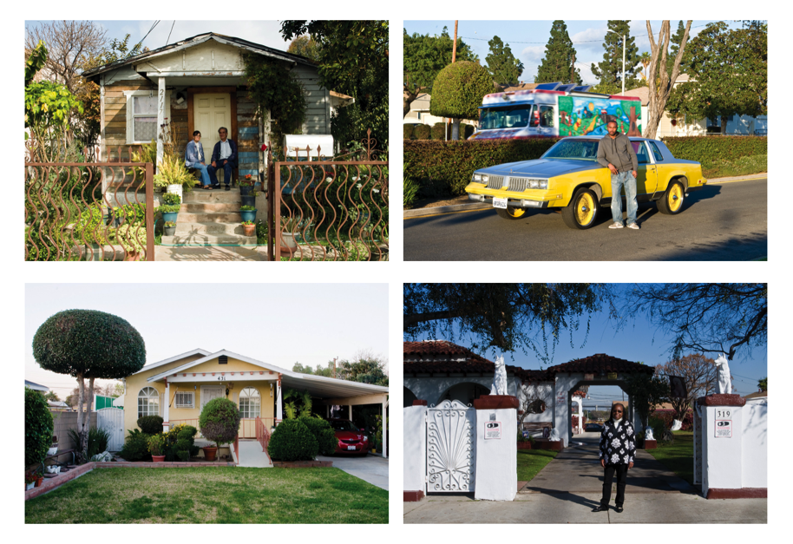
Willowbrook Is/Es: Identify the Community’s Assets
Notes:
Every community has assets, talented people, its really all about presentation.

Slide 19
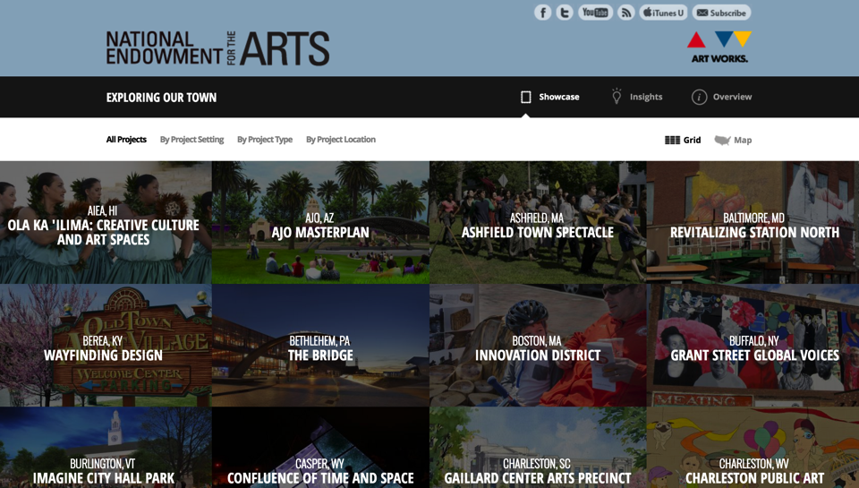
Resources: NEA’s Exploring Our Town www.arts.gov/exploring-our-town/showcase
Notes:
So where can you learn more? NEA!

Slide 20
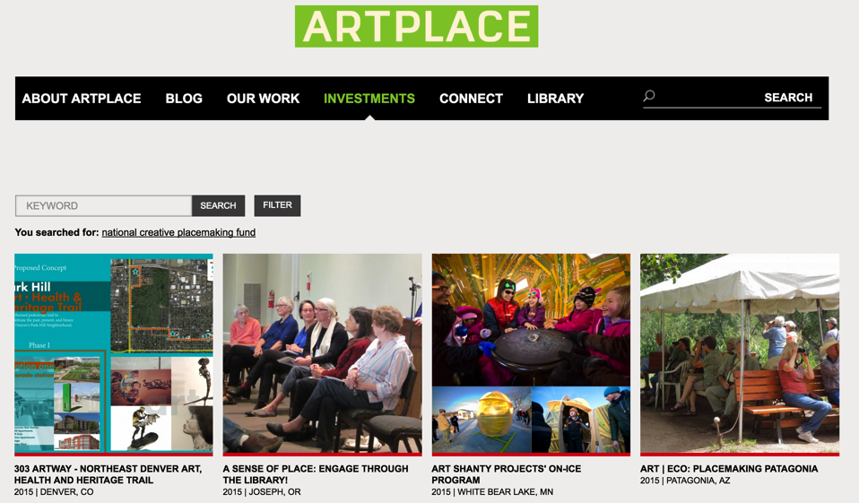
Resources: ArtPlace America www.artplaceamerica.org
Notes:
ArtPlace!

