Slide 1


2014 Transportation Bond
Prioritization and Education of a Successful Transportation Bond Initiative
AMPO National Conference
October 27, 2016

Slide 2
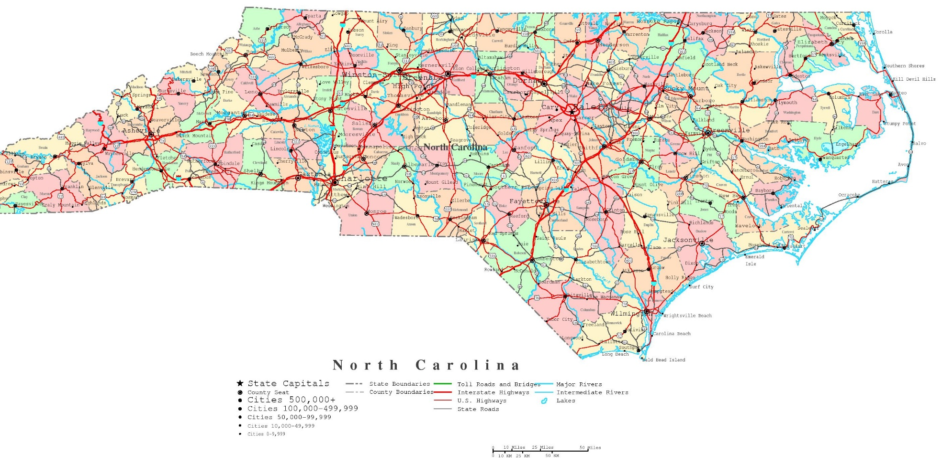


Slide 3
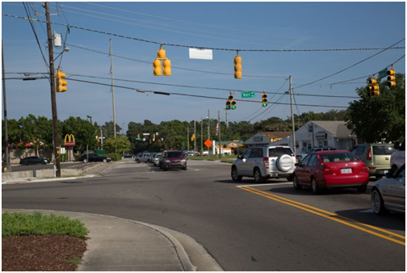

Why the request to pursue a transportation bond…
The City of Wilmington had identified transportation needs
Transportation high priority for City residents
Less $ for transportation projects
Growth: more people = more cars

Slide 4

City’s Comprehensive Plan:
Citizen Top priorities
Top priority: “More crosswalks, sidewalks, bike lanes, and bike paths”
Other transportation priorities:
  Natural areas, trails, trees, open spaces
  Neighborhood traffic calming
  Improved traffic flow
  Access to retail, entertainment
  Streetscape improvements
  Roadway and intersection improvements

Slide 5
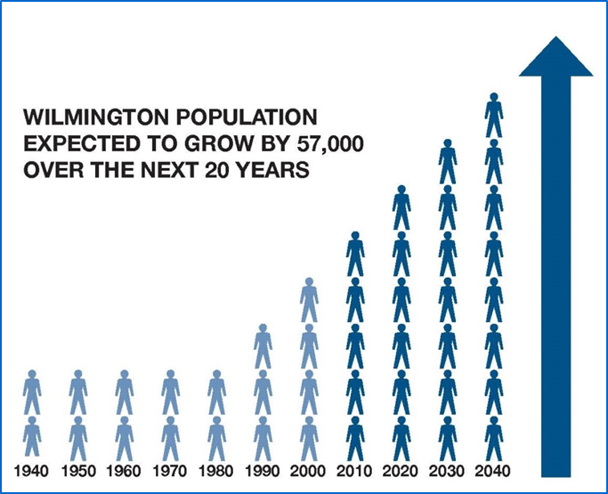

More people, less $
State, federal funds dwindling
Construction costs increasing
Wilmington’s population rising
Growth: more people = more cars

Slide 6
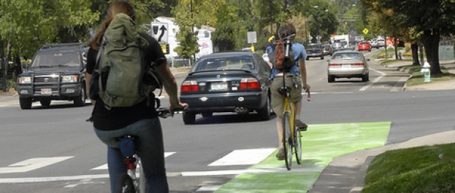
Bike-pedestrian safety:
New Hanover County ranked:
  # 1 in NC for bike accidents
  #2 for car crashes
  among top ranked for pedestrian accidents

Slide 7
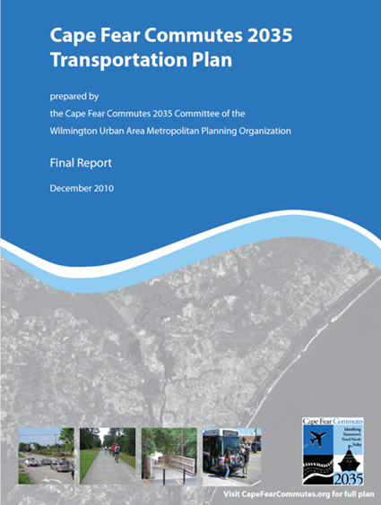
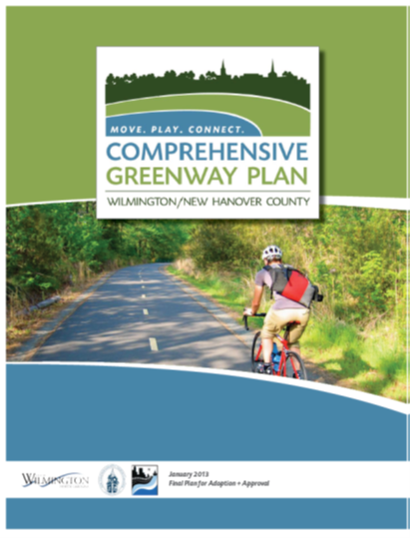
Guiding Documents

Slide 8

Evaluation Criteria
Roadways
Sidewalks
Intersections
Greenways
Other considerations

Slide 9

Roadway (CIP) Evaluation Criteria
Cost Benefit
Economic Development
Environmental Stewardship
Infrastructure
Legal Compliance
Project Coordination
Plans
Public Safety/Hazard
Public Support/Demand

Slide 10
Additional Roadway Evaluation Criteria
Project Completion (design, permitting, funding)
Access Management (reduce conflict points)
Mobility (throughput, congestion reduction)
Economic Investment Potential (ROI, population served, development potential)

Slide 11
Project Evaluation Criteria for Sidewalks and Intersections
Closing a Gap
Major Obstacle
Safety Concern
Utilize outside funding
Proximity of a school
Connection to Transit
Adopted in plan
Bicycle/Pedestrian Generators
Right-Of-Way/Easement Dedication
CITY parallel function class
Goat Path (for Sidewalks)

Slide 12
Project Evaluation Criteria for Greenways
Direct Access to/from:
Downtown Wilmington
Proposed Multi-Modal Center
Local Beach Community
College/University
Existing and/or Funded Trail
Elementary, Middle or High School
Major Transit Routes
Park or Recreation Center
Major shopping Centers
Higher Density Residential/Employment Areas

Slide 13
Project Evaluation Criteria for Greenways (cont.)
Fills Gaps
Majority of proposed trail serves areas outside the existing trails
Serves Lower income areas with Lower Car Ownership rate
Corridor contains high number of Bike/Ped Accidents
Proposed trail is recommended in a previously adopted plan

Slide 14
Project Evaluation Criteria for Greenways (cont.)
Relates to Top 10 recommended trail locations from Stakeholder Input
Less than 10% of proposed corridor lies within wetland area
Significant portion of proposed trail lies in existing public property or easements
Lower relative number of roadway crossings for the proposed trail corridor
Lower relative number of stream crossings for the proposed trail corridor

Slide 15

Other Considerations
Sidewalk Rehabilitation
Wilmington Multi-Modal Transportation Center
Buses, Bus Shelters and other public transportation facilities
Coordination with underground utilities
Coordination with CFPUA

Slide 16
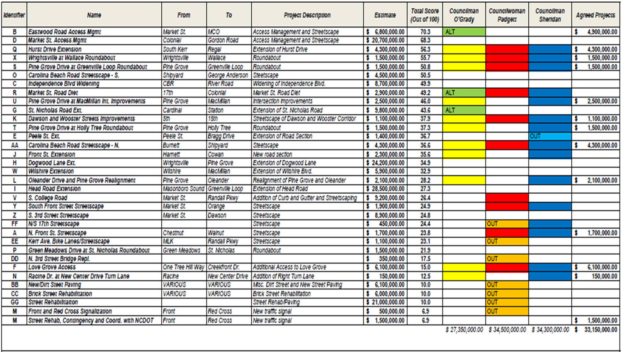
Tool for Evaluating Projects

Slide 17

Recommended Project Funding Breakdown - $55 million
Roadways – $35 Million
Bike/Pedestrian – $20 Million
$11 million from other funding (Public Transportation)
$44 million bond
2-cent tax increase

Slide 18
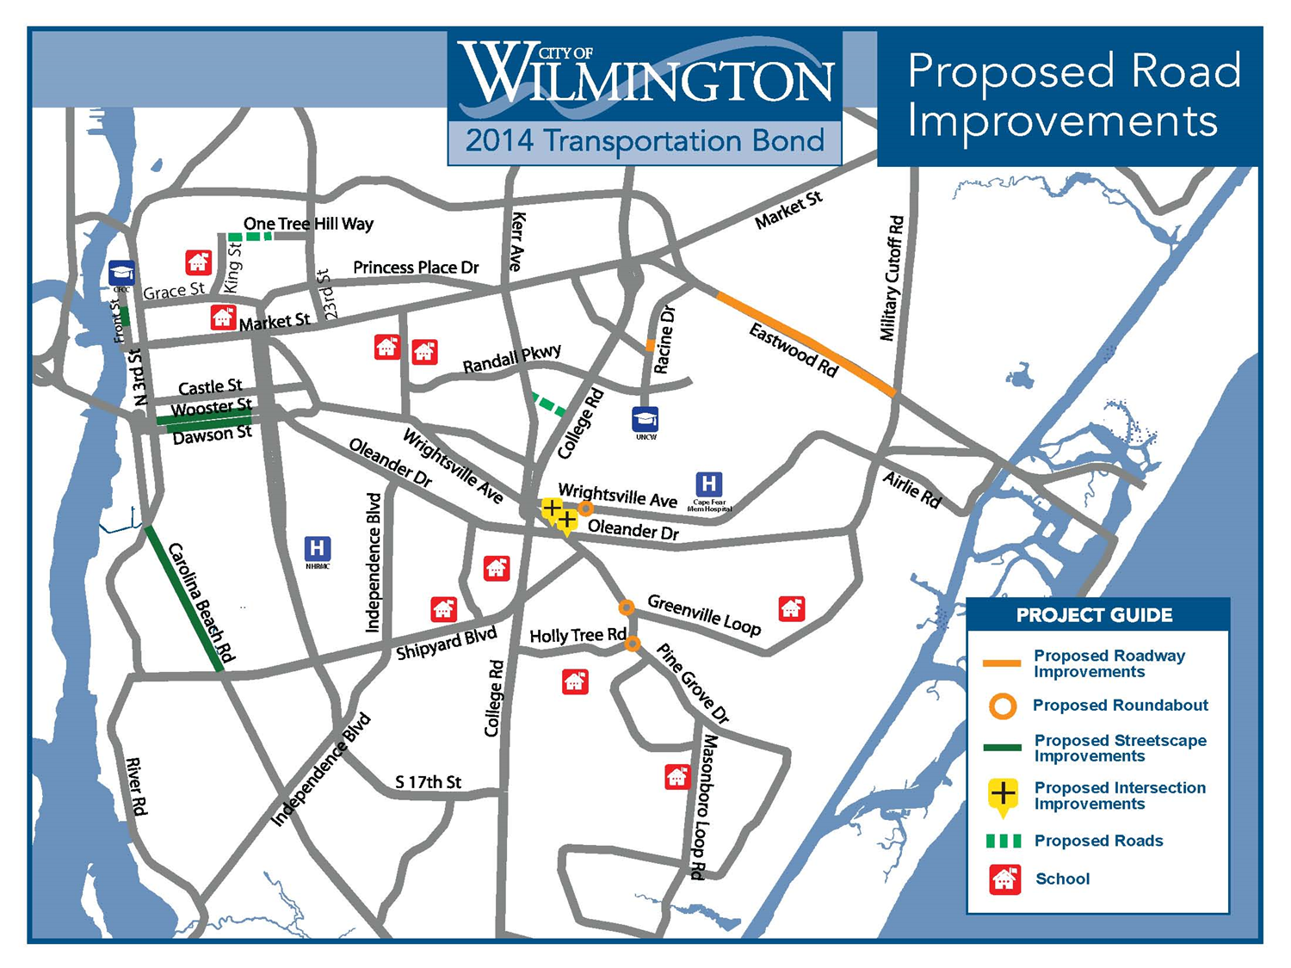

Slide 19
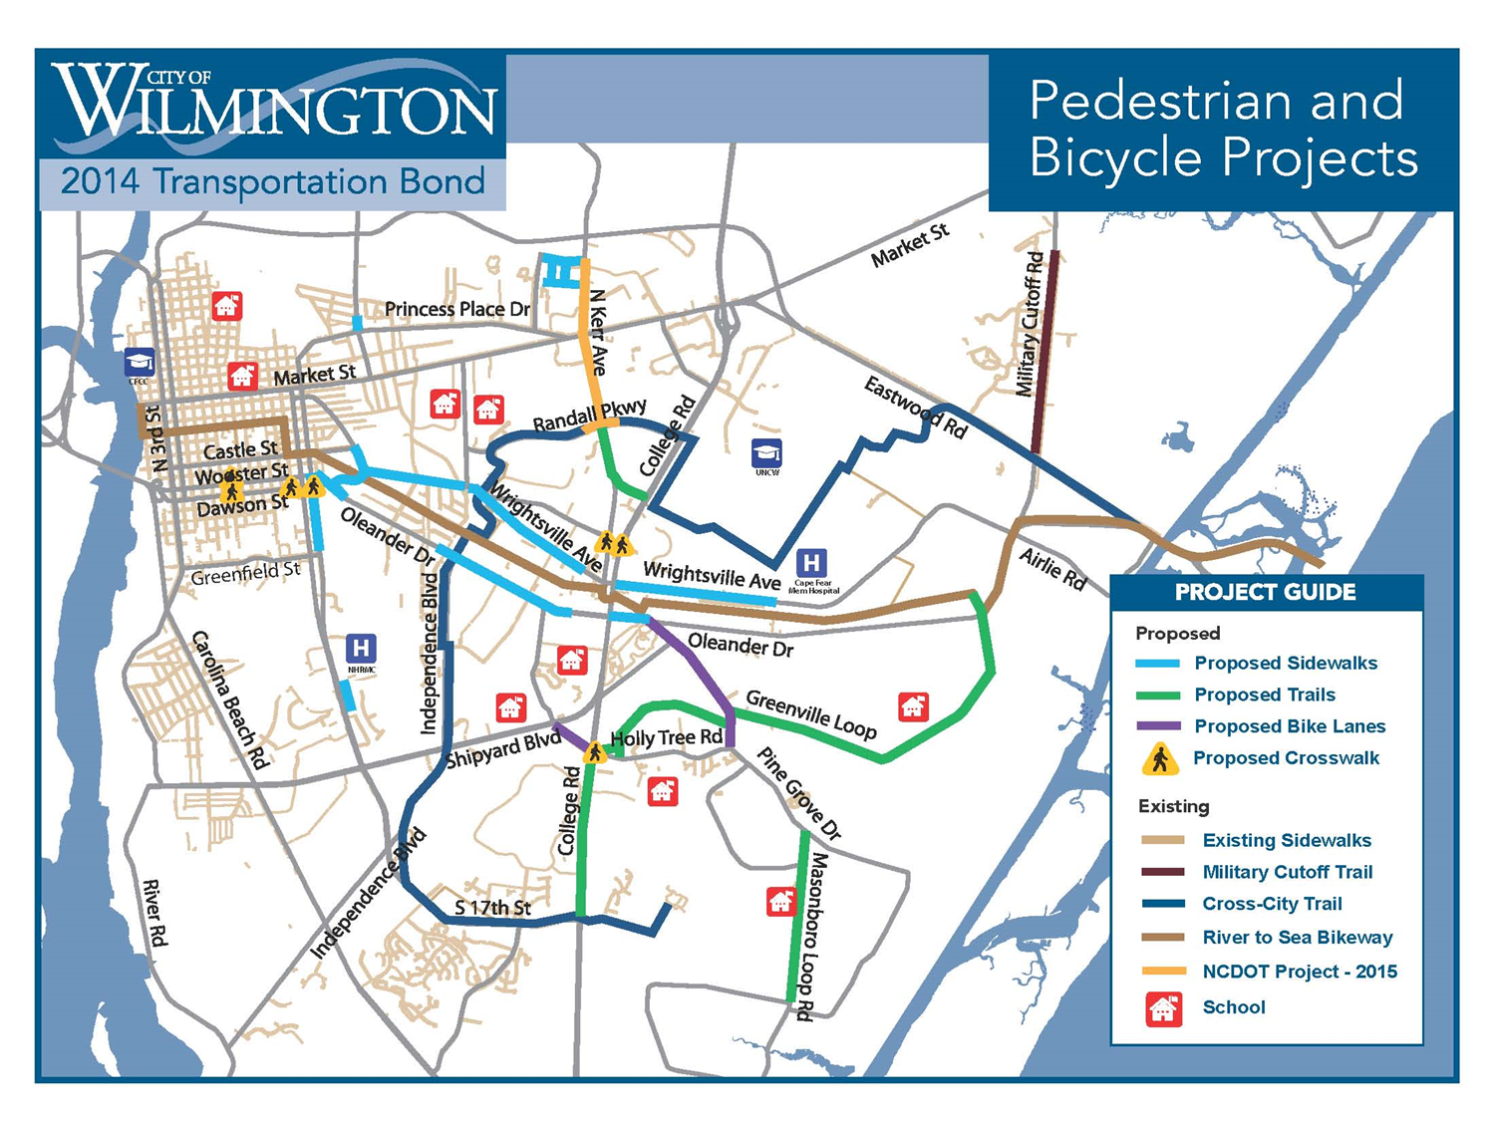

Slide 20

Public Engagement (Communication Plan)

Slide 21
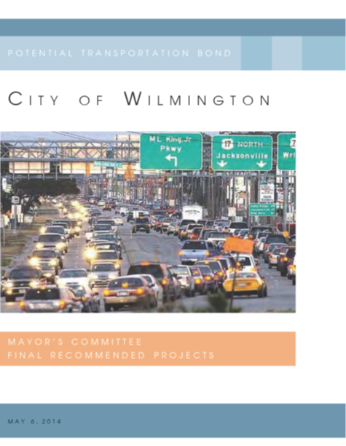
Transportation Bond Booklet
Created 5 months before the election
Includes a comprehensive list of projects
Provides a description and map for each project

Slide 22
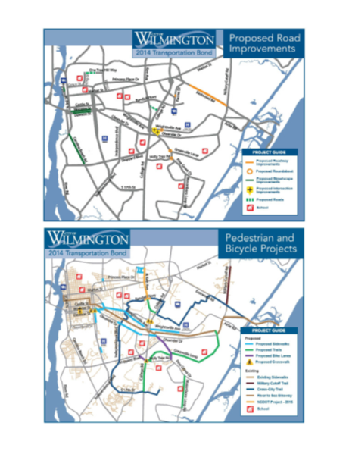
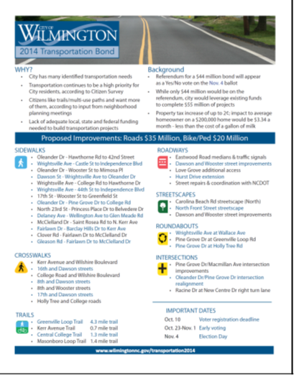
Handouts
Why?
Background
List of Proposed Projects
Maps of the Proposed Projects
Key Dates

Slide 23
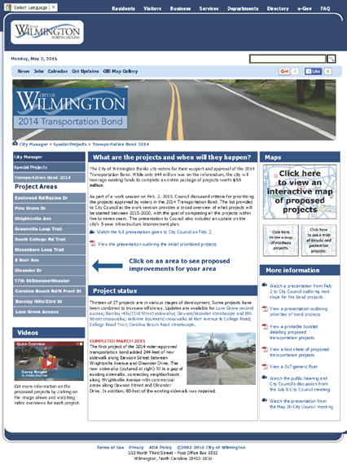
On-line Outreach
Website
Direct Messaging
    Facebook
    Twitter

Slide 24
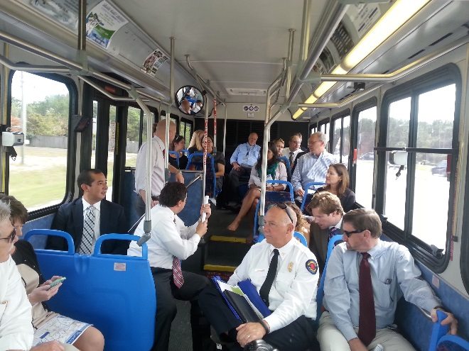
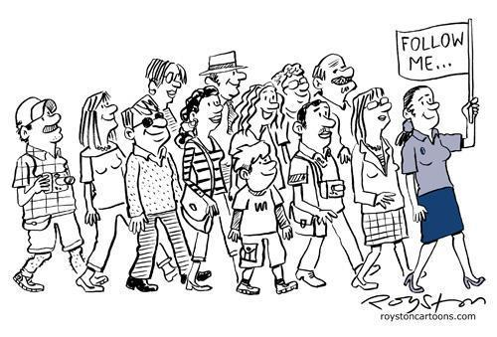
Project Tour
Tours were provided to the various project locations for media representatives and stakeholders, etc.

Slide 25
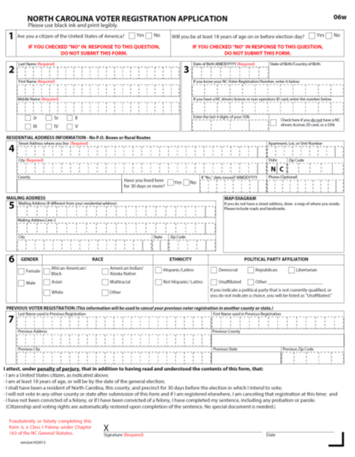

Voter Information
Obtained Voter Registration Cards for the public meetings
Only provided the cards but it was incumbent on individual to file with Board of Elections

Slide 26
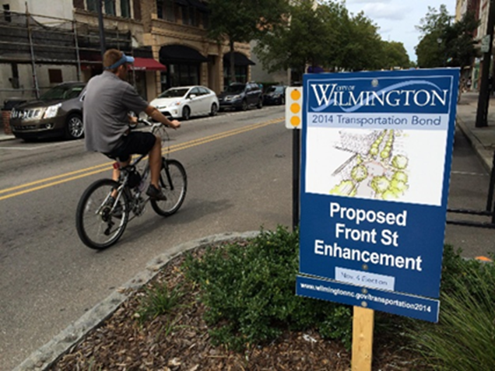
Project Boards and Billboards
Probably the most successful educational tools
Signs placed at the locations of the projects
Billboards educate across the City

Slide 27
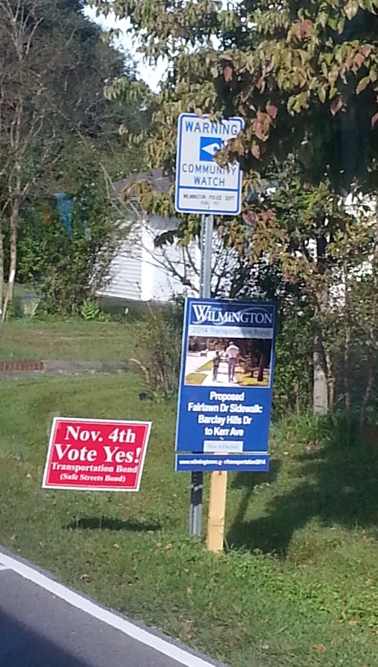
Citizen Education Committee
“Safe Streets Bond Referendum Committee”
  Ad-hoc Committee appointed by the Mayor
  Represent various interests
  Educate and Advocacy
  Distributed Bond Materials
  Displayed “Vote Yes” signs

Slide 28
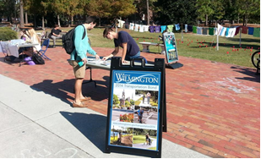
UNCW Participation
Partnered with UNCW through an Election Communication Course
“Run to the Polls” Event
Students informed their peer
  Social media
  Community Outreach
  Event Planning
  Opposition Research

Slide 29
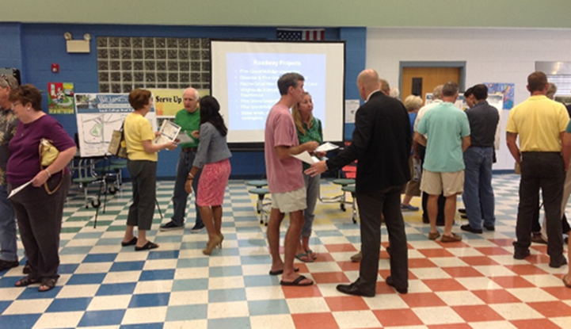
Public Meetings and Displays
Held 7 public meetings across the City to discuss the various projects
Notifications via public displays, direct mailings, radio, internet and television

Slide 30
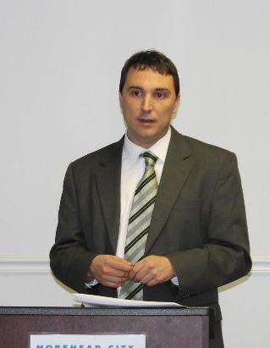
Presentations to Community Leaders
Presented to 25 organizations
  Examples include:
    Kiwanis Clubs
    Rotary Clubs
    Wilmington Realtors
    BASE
    Wilmington Downtown Inc.

Slide 31
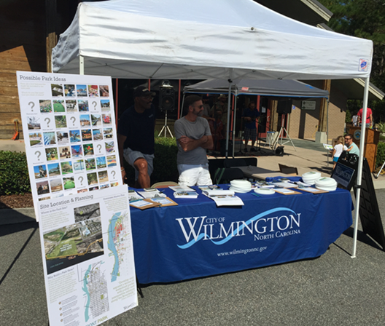
Community Events
Wilmington’s 275th Anniversary
Wilmington Riverfest
Fire in the Pines Festival
Wilmington Farmers Market
Area Races
CF Green Building Alliance Run or Stroll to the Polls”
UNCW “Run to the Polls”

Slide 32

Distribution of Materials
Distributed on page fact sheet to the community
    30 businesses
    20 residential apartment complexes

Slide 33
News Media
Interviews
  Local TV Stations
  Radio Stations
My turn: Transportation bond could bring several improvements
  Published: Tuesday, October 28th 2014, 1:53 pm EDT Updated: Wednesday, February 25th 2015, 12:45 pm EDT

Slide 34
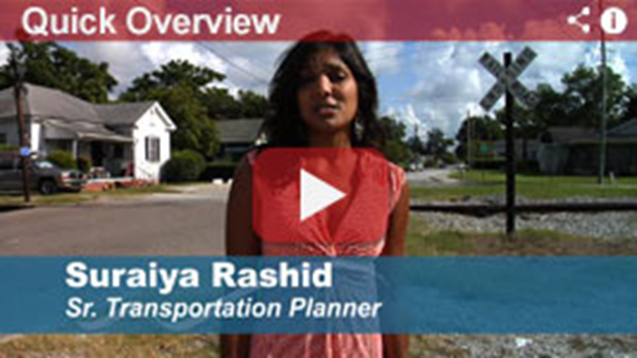
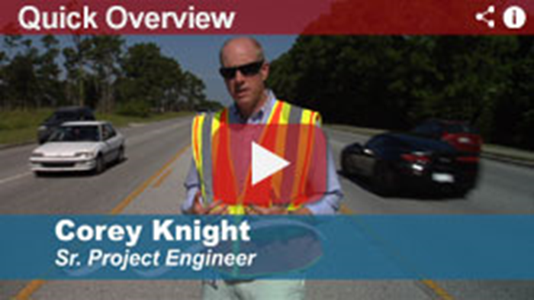
On-line Videos

Slide 35
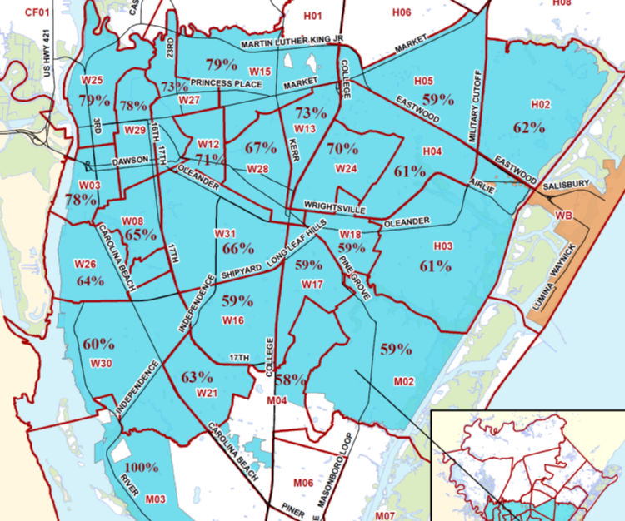
Results

Slide 36
Questions?
For more information:
www.wilmingtonnc.gov/transportation2014

