Slide 1
Benefit/Cost Analysis for Project and Plan Evaluation in SANDAG’s
“San Diego Forward”
AMPO Annual Conference, Project Evaluation Session
Jeff Frkonja, Joe Castiglione (RSG)
Jim Miller (SANDAG)
With Special Thanks to
Vince Bernardin, Bryce Lovell, and Mariela Tinarejo (RSG)
Toni Horst (AECOM)
Clint Daniels, Gregor Schroeder, and Ziying Ouyang (SANDAG)
October 23, 2014

Slide 2
Agenda
Evaluating Projects and Plan Alternatives the SANDAG Way
BCA Metrics and Supporting Assumptions
RSG-Developed BCA Analysis Using SANDAG’s Agent-Based Travel Demand Model (ABM)
Noteworthy Features of BCA based on ABM

Slide 3
The SANDAG Planning Process

Slide 4
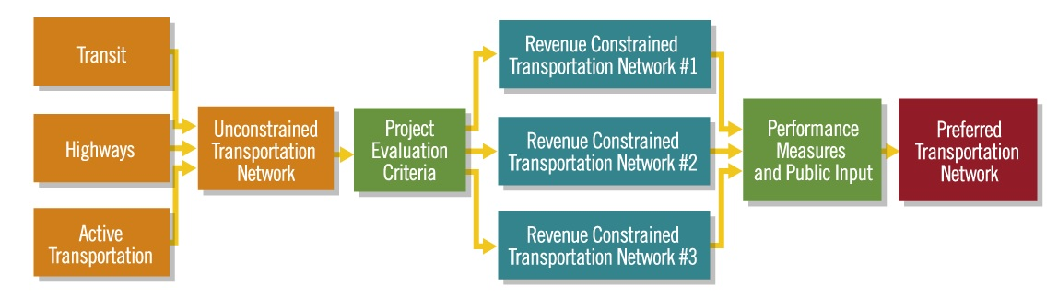
Transport Choices→Project Evaluation→Plan Alternative
Process Flow
  Develop Choices
  Categorize Proposed or Potential Projects
  Evaluate each Project *
  Combine Projects into Coherent “Networks” (Plan Alternatives)
  Evaluate “Networks” *
  Apply Evaluation Results to Choosing/Designing Final Alternative
* BCA Applied at these Steps
Source: SANDAG (see http://www.sdforward.com/mobility-planning/creating-transportation-choices)

Slide 5
BCA Metrics

Slide 6
Benefit-Cost Analysis Overview
Uses monetary value as the metric to support decision-making by making different characteristics comparable
Q: Does an investment (relative to no or different investment) produce more benefits than costs?
  To invest or not to invest
  To prioritize investments
  To better “design” a given investment
Q: Who benefits?
  Harder to answer this question with past tools
Notes:
Repeat for minority populations.
Can be broken out by benefit type if desired.

Slide 7
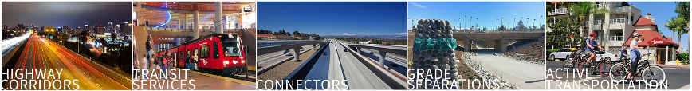
Benefit-Cost Analysis Principles
Analysis should…
  Be comprehensive across the population at hand
  Keep both costs and benefits mutually exclusive
  Explicitly treat difficult-to-monetize benefits and costs
  Be transparent
  Cover real choices

Slide 8
Benefit-Cost Analysis Metrics
Direct benefits
  Mobility cost savings
    Actual travel time savings
    Reliability benefits
  Out-of-pocket cost savings (e.g. fuel and tolls)
Indirect benefits
  Accident reduction benefits
  Emissions (and other environmental) cost savings
  Auto ownership cost savings
  Physical activity health benefits

Slide 9
BCA Supporting Assumptions

Slide 10
BCA Assumptions
Value of Travel Time Savings (VTTS or VOT)
Value of Reliability Benefits (VOR)
Value of Accidents Prevented (by type)
Value of Quantities of Emissions Reduced
Vehicle Operating Costs
Vehicle Ownership Costs
Value of Meeting Physical Activity Threshold
Economic
  Discount Rate
  Inflation Rate

Slide 11
SANDAG BCA Assumption Choices
2010 $
Source: SANDAG, RSG. Technical Memorandum “” San Diego Forward Cost Effectiveness Evaluation Criteria Assumptions. 3/6/2014.

Slide 12
SANDAG Assumption Choices
2010 $
Source: SANDAG, RSG. Technical Memorandum “” San Diego Forward Cost Effectiveness Evaluation Criteria Assumptions. 3/6/2014.
Notes:
Repeat for minority populations.
Can be broken out by benefit type if desired.

Slide 13

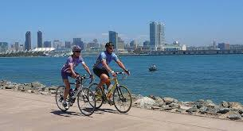
Value of Meeting Physical Activity Threshold
California Center for Public Health Advocacy. Chenoweth & Associates 2006, “The Economic Costs of Overweight, Obesity, and Physical Inactivity Among California Adults”
  Minimum exercise threshold: 22 min / weekday
  Average health cost of not meeting threshold: $1,100/year (year 2010 $)

Slide 14
BCA Results from SANDAG’s Agent-Based Travel Demand Model (ABM)

Slide 15
Actual (preliminary) SANDAG BCA Findings
First or One of the First BCA Applications in ABM framework
Source: RSG, SANDAG

Slide 16
Actual (preliminary) SANDAG BCA Findings
Who benefits?
  Benefits by individuals belong to a “Community of Concern” (similar to Environmental Justice)
Source: RSG, SANDAG
Notes:
“White alone, not Hispanic or Latino, percent, 2013” share was 47.2% - i.e.. San Diego is a majority minority county.
Most “core” investments serve minority areas

Slide 17
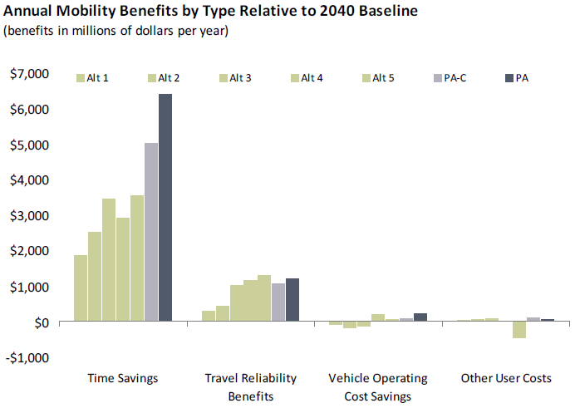
BCA for Plan Alternative Comparison (PSRC example)
Source: PSRC. Transportation 2040 FEIS--Appendix D Policy Analysis and
Evaluation Criteria Report

Slide 18
Noteworthy BCA Features in an Activity-Based Model Framework

Slide 19
Aggregate vs. Activity-Based Analysis
Aggregate potential level of detail:
  Zone
  Market Segment (e.g. Home-Based-Work-Low-Income)
Activity-based potential level of detail:
  Person, along any characteristic (e.g. HH income, age, etc.)
  Person-trips
Notes:
Repeat for minority populations.
Can be broken out by benefit type if desired.

Slide 20
Activity-Based Analysis
Environmental Justice (“Communities of Concern”): In aggregate modeling the zone becomes a proxy for the people
Typical: Green is an “EJ” zone because threshold percent of residents meet EJ criteria; assume global proportion of trips
Notes:
Repeat for minority populations.
Can be broken out by benefit type if desired.

Slide 21
Activity-Based Analysis
Environmental Justice (“Communities of Concern”): In ABM modeling we know exactly who the EJ individuals are (dark green arrows) because model simulates individual characteristics
ABM enables more-precise accounting by person and characteristic
Notes:
Repeat for minority populations.
Can be broken out by benefit type if desired.

Slide 22
Activity-Based Analysis
Physical Activity Threshold=22 min/day
  Aggregate model sees three trips below threshold
8 min
10 min
14 min
Notes:
Repeat for minority populations.
Can be broken out by benefit type if desired.

Slide 23
Activity-Based Analysis
Physical Activity Threshold=22 min/day
  ABM sees one daily activity that in total crosses threshold
8 min
10 min
14 min
Notes:
Repeat for minority populations.
Can be broken out by benefit type if desired.

Slide 24
Geographic Subarea Analysis
Possible with Aggregate approach
  ABM enables cross-tabulating user characteristics with geography (e.g. Blue-Green Trips by EJ folks)
Investment
Blue-Green Trips
Purple-Green Trips
Notes:
Repeat for minority populations.
Can be broken out by benefit type if desired.

Slide 25
Sources for Valuation and How-To
Travel Demand Forecasting Value-of-Time Definition
  Implied VOT: ratio of time and cost coefficients in the (primary) mode choice statistical model
USDOT Value-of-Time Definition
  USDOT. The Value of Travel Time Savings: Departmental Guidance for Conducting Economic Evaluations Revision 2. 2011.
AASHTO “Red Book” (project-level BCA)
  American Association of State Highway and Transportation Officials. User and Non-User Benefit Analysis for Highways. 2010

Slide 26

Thank You!
Jeff Frkonja
312.605.9213
jeff.frkonja@rsginc.com

Slide 27
Reserve Slides

Slide 28
Project Evaluation
Example Highway Corridor Criteria
  Congestion Relief *
  Safety
  Evacuation Route Access
  Non-SOV Mobility *
  Emissions Reduction *
  Serves Designated Growth Areas
  Promotes Physical Activity *
  Support Goods Movement/Freight System Bottleneck Relief *
  Cost-Effectiveness *
* BCA can inform these criteria
Source: SANDAG “Project Evaluation Criteria”(see http://www.sdforward.com/mobility-planning/evaluating-projects)

Slide 29
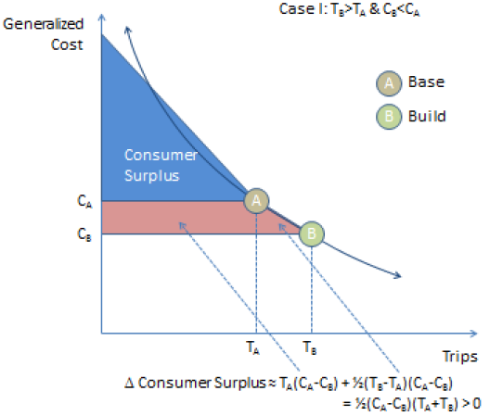
BCA Founded in Economic Theory
Consumer Surplus
“Good” = travel from O to D
$ Willing to Pay
$ Actually Paid
Willing minus Actual = Surplus
Build Alternative Changes the Surplus
Additional Surplus can be invested in some other good and thus has economic and personal value
Source: Ohio DOT : “Enhancement of Economic Analysis Capabilities: Initial Review and Recommendations”. 2011

Slide 30
In-Vehicle Travel Time (freight / trucks)
 | Heavy Trucks | Light Trucks
ATRI, 2010 | 89.23
Smalkowski & Levinson, 2005 | 58.10
Outwater & Kitchen, 2008 | 53.32 | 42.66
Miao et al., 2011 | 33.94 - 57.65
Almy et al., 2010 | 45.15
Mei et al., 2013 | 33.29 - 52.22 | 26.06 - 46.14
BLA, EDRG & RSG, 2013 | 36.05 | 22.26 - 27.24
Kawamura, 1999 | 32.25
Kawamura, 2003 | 21.96 - 34.94
Cal-BC | 28.70
USDOT* | 26.43
*Driver's time only, USDOT acknowledges there is value to commodities' time
Notes:
Repeat for minority populations.
Can be broken out by benefit type if desired.

Slide 31
In-Vehicle Travel Time (auto and transit)
Trips on work tours
  c(i) = -0.15/$ / [((income(i) / 30,000 ^0.6) * (occupancy(i) ^ 0.8))]
  b(i) = -0.030/min
Trips on non-work tours
  c(i) = -0.15/$ / [((income(i) / 30,000 ^0.5) * (occupancy(i) ^ 0.7))]
  b(i) = -0.015/min
Notes:
Repeat for minority populations.
Can be broken out by benefit type if desired.

Slide 32
Travel Time Reliability (auto & freight / truck)
Calculate “Total Equivalent Delay”
Link-level calculation
  Segmentation limited to assignment classes
  Trucks / auto
Set VOR equal to IVTT VOT
Source: SHRP2 L05
Notes:
Repeat for minority populations.
Can be broken out by benefit type if desired.

Slide 33
Collisions
Segmented by collision type
Link-level calculation
  Facility type segmentation only
  SANDAG staff updating VMT-based rates using SWITRS
Auto only
Source: USDOT Memo (2/28/2013) on the value of statistical life, Cal-B/C
Collision Type | Value
Fatality | $9,100,000
Injury | $427,700
Property damage only | $10,200
Notes:
Repeat for minority populations.
Can be broken out by benefit type if desired.

Slide 34
Emissions
Segmented by pollutant
Link-level calculation
Source: BAAQMD
Pollutant | Monetization
CO2 | $55.35 / ton
PM2.5 | to be imputed from MTC monetization factors and SANDAG weighted distribution of PM2.5 by type
NOx | $7,800 / ton
ROG | to be imputed from MTC monetization factors and SANDAG weighted distribution of ROG by type
SO2 | $40,500 / ton
Notes:
Repeat for minority populations.
Can be broken out by benefit type if desired.

Slide 35
Auto Ownership Costs
MTC = $6,290 / year
AAA = $6,000 / year
Household-level calculation
Source: MTC
Notes:
Repeat for minority populations.
Can be broken out by benefit type if desired.

