Slide 1
Examining Transportation Corridors with Environmental Data
Strategies for Conducting an Environmental Analysis using the CommunityViz Platform

Slide 2
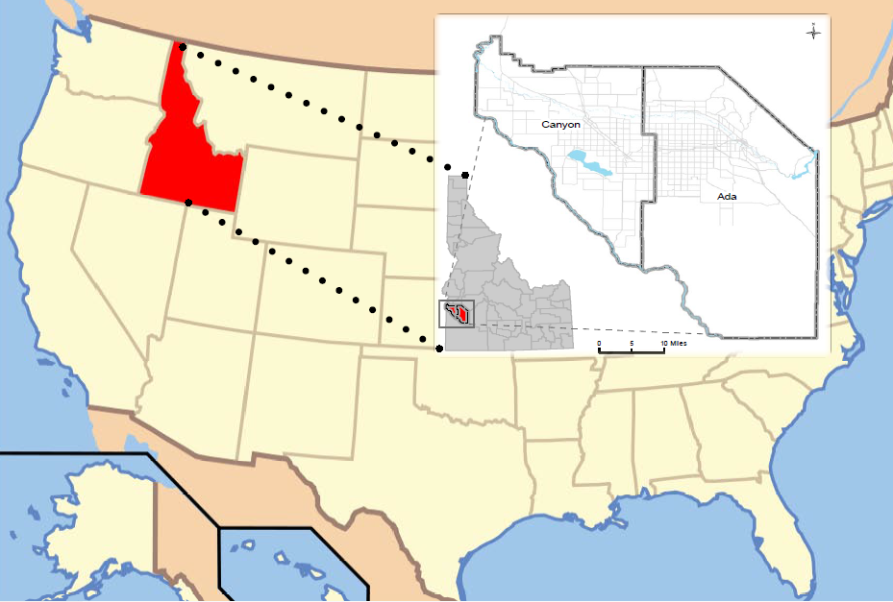

Slide 3
Environmental Suitability Analysis
Project Introduction
Purpose
Review current environmental and resource data
Identify areas that are more or less suitable for development (transportation projects)
Overview of the Utility of CommunityViz
Select data layers
Assign weights to signify relative importance
Identify conflict points and what features cause conflict

Slide 4
Environmental Suitability Analysis
Conducting an analysis using CommunityViz

Slide 5
Environmental Suitability Analysis
How the Environmental Data were Analysed

Slide 6
Environmental Suitability Analysis
How the Environmental Data were Analysed
Thousands of cells that are a quarter mile in length/width
Counts the number of point features within a cell and/or the percentage of the cell overlapped by polygon features
Weighted score calculated based on Assumption value x data count

Slide 7
Priorities
Environmental Groupings:
Comparison within Groups
Comparison across Groups

Slide 8
Sensitivity Thresholds
Weighted Score > 50

Slide 9
Sensitivity Thresholds
Weighted Score > 35

Slide 10
Sensitivity Thresholds
Weighted Score > 20

Slide 11
Sensitivity Thresholds
Weighted Score > 10

Slide 12
Sensitivity Thresholds

Slide 13
Integration and Future Steps
Distilled lots of environmental data into useable information
Lessons learned:
Data quality and availability (some data were not shared)
Difficult to distinguish importance among the environmental elements
Everything is important to everyone
Prioritized environmental elements
Provided an iterative process and evaluation in meeting
Included in CIM 2040 corridor write ups
Incorporate into performance-based planning (2016)
Could assist with the NEPA process
Documentation and public involvement are necessary

