Slide 1

Atlanta Roadside Emissions Exposure Study (AREES)
Linking Transportation Emissions and Planning Decisions
David D’Onofrio
Principal Planner – Air Quality & Climate Change
Atlanta Regional Commission
ddonofrio@atlantaregional.com
404.463.3268

Slide 2
Outline
Air Quality and Public Health
Regional Air Quality in Atlanta
Transportation Conformity – Regional Air Quality Analysis
Bridging the Gap – Bringing Air Quality to the Local Level
Developing a Framework to Link Transportation and Air Quality

Slide 3



Air Quality & Public Health
3.5 Million
People Killed per Year Globally
50 %
Percent of Deaths from Transportation Sources
$1.6 Trillion
Value of Premature Death in OECD nations
Source: OECD, 2014
Notes:
Associated with asthma, respiratory disease, heart disease, premature mortality, cancer, and low birth weight.
The Organization for Economic Co-operation and Development (OECD)
US had 3rd highest number of deaths at 110,000 accounting for about 1.7 million years of lost life and 1.9 million disability-adjusted years of life lost

Slide 4
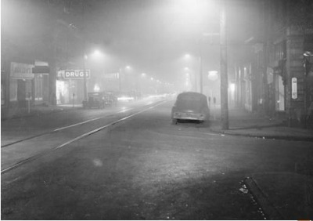
Clean Air Act
First Enacted by Congress and President Nixon in 1970
  Triggered by episodes like the Donora Smog of 1948
Preceded by several similar bills since 1963
Established National Ambient Air Quality Standards (NAAQS) for key Criteria Pollutants
Notes:
Donora Smog – 20 deaths 800 animals 8000 sick
London Smog – 6,000 – 12,000 deaths and 25,000 – 100,000 sick

Slide 5

Air Quality & Public Health –
Near Roadway
Notes:
Direct PM2.5 road sources ~45% / Nox ~ 60%
Estimated 45 million Americans live within 300’ of a highway
Research is building on the negative health impacts of proximity to major roadways/freeways – tied to:
Asthma exacerbation/initiation
Birth/childhood outcomes such as lung development issues, cognitive effects, risk for leukemia
Heart attack
Hightened immune response (allergic response) to near-road particles
Some States, like CA have laws that prevent the citing of sensitive land uses (like schools) within set distances of highways

Slide 6
Atlanta Nonattainment Areas

Slide 7
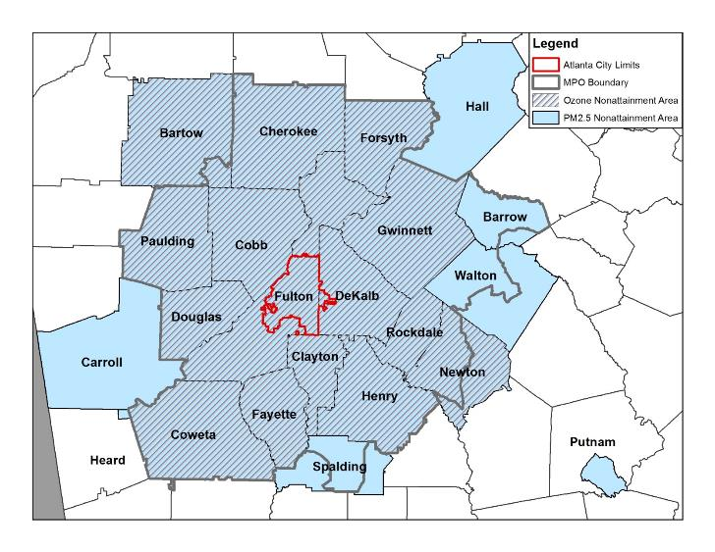
Atlanta Nonattainment Areas

Slide 8
Source: GA EPD

Slide 9
Source: GA EPD

Slide 10
Transportation Conformity - Regional
Regionally-focused
Accumulated emissions for the entire planning area
Impossible to break down to a neighborhood-level
Notes:
A 2005 study found that the risk of asthma increased 89% for each quarter-mile closer children lived to a major roadway
CA prohibits construction of schools within 500 ft of freeway or busy corridors
Elderly individuals may be more sensitive to pollutants due to the decreased ability of their bodies to remove chemicals
Linked to increased risk of lung cancer, breast cancer, heart disease
A MA study found a 5% increased risk of heart attack for each kilometer you live closer to a major roadway

Slide 11
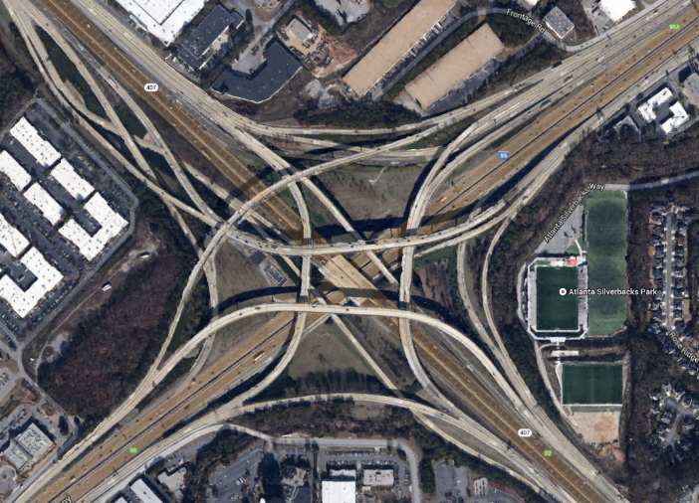
Regional-Local Disconnect
Notes:
Want to use this slide to just bring to point that we don’t really know how the regional value translates down to a human-scale exposure.
In addition, 68 elementary schools in the ten county area are within 500ft of a major road, 5< 500ft from expressway
21 out of 45 hospitals are within 500ft of an expressway/major roadway
38 parks are within 500ft of an expressway, 321 within 500ft of major roadway (out of 902 parks)

Slide 12
AREES Goals
Establish a method to assess local scale impacts of the transportation system on air quality
Identify “hot spots” of locally elevated air pollution levels. Use this information to assess community impacts and equity
Provide a guide for ARC and local communities to inform transportation project selection and sensitive land-use siting based on concern for public health
Notes:
Goal to produce a performance measure that can be tied into the transportation planning process for project selection in RTP/TIP.
Goal to provide information about transportation exposure for sensitive land use types (schools/hospitals/parks/etc)
Roadways, transportation facilities, freight
logistics, and industry can create “hot spots” of locally elevated air
pollution levels, which may impact homes and schools and may
inequitably impact some citizens more than others. These hot spots
are linked to increased rates of asthma attack, premature and low
birth weight babies, infant mortality, and other respiratory diseases.

Slide 13
Bridging the Gap
Exposure
Transportation
Emissions
Dispersion
Notes:
ARC interested in bridging the gap between regional and local scale exposure.
Some EPA tools exist for a project level analysis, but are data intensive and time consuming.
Interested in developing a methodology that could be applied at once to our entire modeling domain.

Slide 14
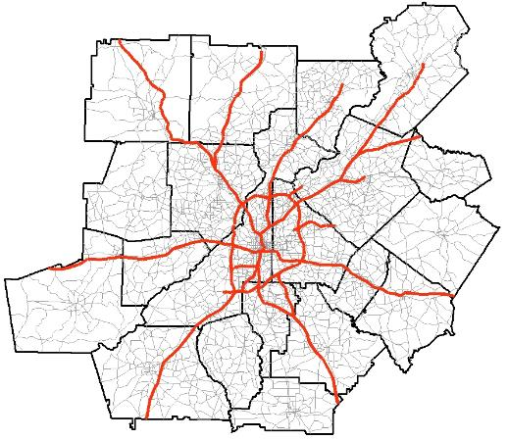
Bridging the Gap
ARC Transportation Model
Transportation Modeling
  ARC maintains a 20 county travel model
  The model is used to analyze changes to travel variables and feeds into regional emissions
Transportation
Emissions
Dispersion

Slide 15
Bridging the Gap
MOVES Emissions Model
Emissions Modeling
  Takes travel data, automobile design and emission factors into consideration
  Produces regional values of total pollutants emitted
Transportation
Emissions
Dispersion

Slide 16

Bridging the Gap
Dispersion Modeling
  Model how pollutants will spread after being emitted
Transportation
Emissions
Dispersion

Slide 17
Transportation
Model
Travel
Data
Vehicle
Data
Model
Input
Output
Emissions Model
Model Stream
Receptor Network
Link-level Emissions
Meteorology
Dispersion Model
Pollution Concentration
Maps & Data

Slide 18
Project Timeline
2012
2013
2014
Project Kick-off in Summer 2012
Research of Health Impacts & Regional Assessment
Stakeholder Engagement Meeting
Research into Dispersion Models & Methodologies
Beginning of Partnership with Georgia Environmental Protection Division

Slide 19
Project Timeline
2012
2013
2014
Proof of Concept Work
Input Testing & Development
Switch of Dispersion Model to RLINE
Testing Sample Transportation Projects

Slide 20
Project Timeline
2012
2013
2014
Model Scripting
Model Runs & Result Analysis
Full 20-county runs
Compare to regional monitors

Slide 21
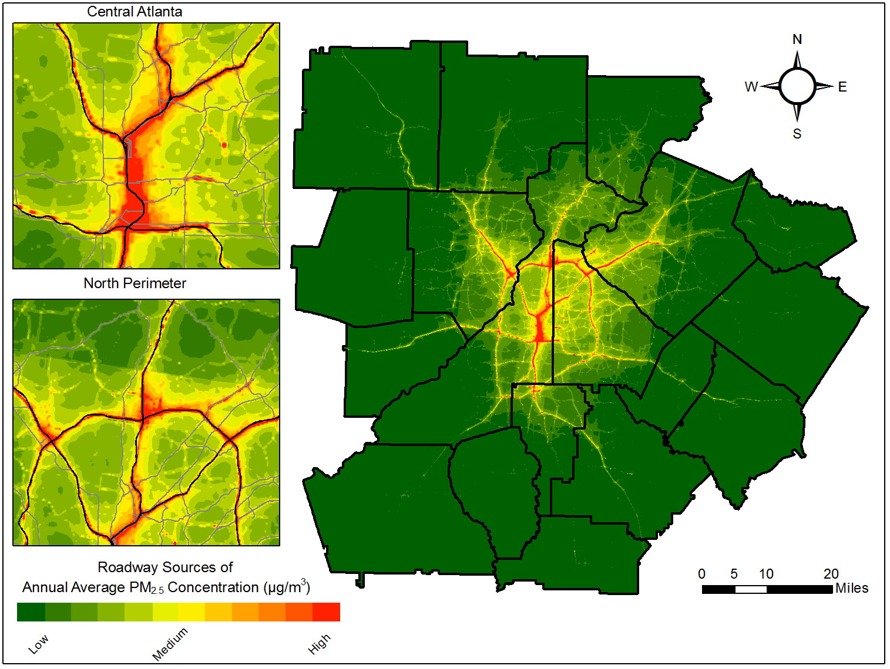
http://atlregional.github.io/dispersion/
Notes:
Broke the region into 12 sub-areas for model runs
Runtime for the 20-county model was around 243 hours (10 days)
Concentrations may be tending high really near the roadway, will be working on a downscaler in coming months to post-process emissions and help them to better match what we’re seeing from monitors and what we know about the ratio of PM from transportation v other sources

Slide 22
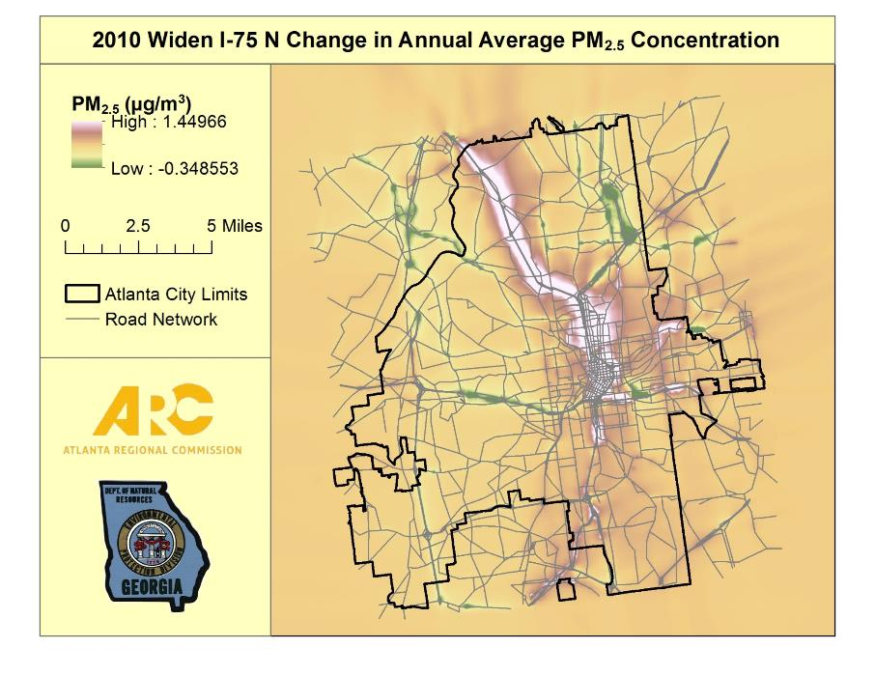
Notes:
150m buffer of I-75 N project: 10.2 µg/m³ in base to 10.4 µg/m³
500m buffer of I-75 N project: 7.3 µg/m³ in base to 7.4 µg/m³ in build
For entire domain: 2.749 µg/m³ in base to 2.751 µg/m³ in build

Slide 23
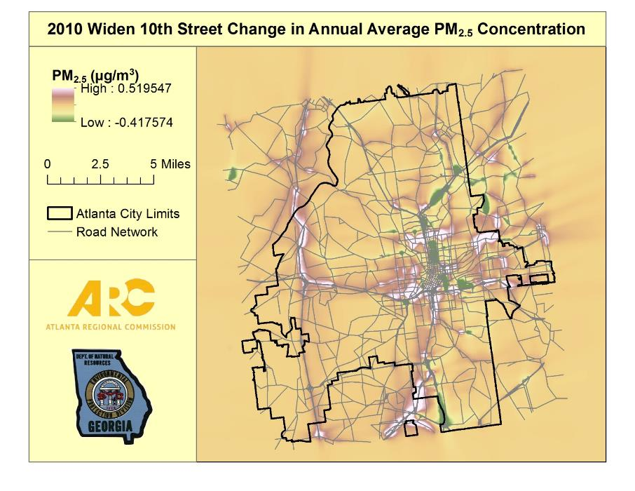

Slide 24
Framework – Linking Transportation and Air Quality
Notes:
Our goal was to develop a tool that turns this…. (regional numbers, no local context….)

Slide 25

Framework – Linking Transportation and Air Quality
Notes:
Our goal was to develop a tool that turns this…. (regional numbers, no local context….)

Slide 26
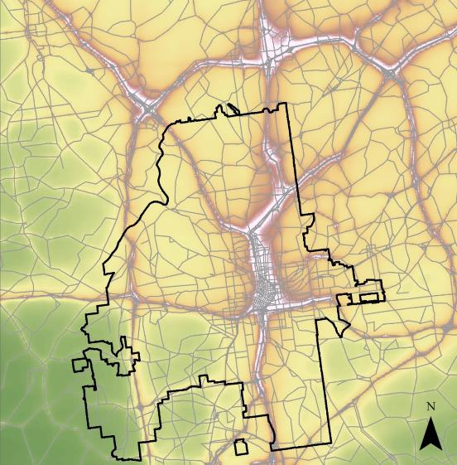
Framework – Linking Transportation and Air Quality
Perimeter – 16,000 people
Central Buckhead –
6,000 people
Downtown/Midtown – 54,000 people
Notes:
Into something like this….where we have accountability to project decisions and their impact on air quality.
We can look at a zoomed in snapshot of our region and determine that widening 10th street would have no major impact on the people that live here (9.6 µg/m³ to 9.7 µg/m³)

Slide 27
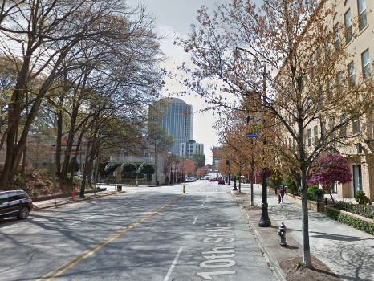
Framework – Linking Transportation and Air Quality
Notes:
Into something like this….where we have accountability to project decisions and their impact on air quality.
We can look at a zoomed in snapshot of our region and determine that widening 10th street would have no major impact on the people that live here (9.6 µg/m³ to 9.7 µg/m³)

Slide 28
Framework – Linking Transportation and Air Quality
Needs Assessment
Project Evaluation
Regional Performance
Congestion
Safety
Air Quality Hotspots
Accessibility
Congestion
Bike/Ped Demand
Change in Emissions
2016 Regional Transportation Plan Update
Notes:
AREES falls into all the above categories
Can use to assess a snapshot of the region in the needs assessment
Will develop performance measure to evaluate AQ impacts of projects evaulated in the RTP
Will run on a constrained network to see how the plan impact AQ
Then will run federally required conformity

Slide 29
Next Steps / Future Enhancements
Work on a downscaler to make emissions match observations
Develop performance measures for plan update that relate emissions to human-scale exposure
Prepare documentation & information for methodology dissemination
Notes:
PM should focus on human-exposure and consider EJ groups & sensitive land-use

Slide 30







Project Team
David D’Onofrio – ARC
Byeong-Uk Kim, PhD – GA Environmental Protection Division
Yunhee Kim, PhD – GA Environmental Protection Division
Kyung-Hwa Kim – ARC
Support / Advice

Slide 31

Contact Information
David D’Onofrio
ddonofrio@atlantaregional.com
(404) 463-3268

